Slide 1

Daily Prayer for 2nd April 2026 St Christopher’s Cathedral and Awali Church, Bahrain
The Diocese of Cyprus and the Gulf

Slide 2
Daily Prayer for 2nd April 2026 St Christopher’s Cathedral, Bahrain
“When Morning Gilds the Sky”
The Diocese of Cyprus and the Gulf

Slide 3
Welcome
Opening Acclamation: Grace, mercy and peace from God our Father and the Lord Jesus Christ be with you. And also with you.
We give thanks for this penitential journey to the cross.
Lord bless us and save us.
Amen
We have come together in the name of Christ
to offer our praise and thanksgiving,
to hear and receive God’s holy word,
to pray for the needs of the world,
and to seek the forgiveness of our sins,
that by the power of the Holy Spirit
we may give ourselves to the service of God.
Amen.

Slide 4
Prayer
Confession: Most merciful God, we confess that we have sinned against you in thought, word and deed, by what we have done and by what we have left undone. We have not loved you with our whole heart. We have not loved our neighbours as ourselves. In your mercy forgive what we have been, help us to amend what we are, and direct what we shall be; through Jesus Christ our Lord. Amen.
Almighty God have mercy upon you,
forgive you all your sins
through our Lord Jesus Christ,
strengthen you in all goodness,
and by the power of the Holy Spirit
Keep you in eternal life. Amen.

Slide 5
Prayer
Collect for Lent: Almighty and everlasting God,
you hate nothing that you have made
and forgive the sins of all those who are penitent:
create and make in us new and contrite hearts
that we, worthily lamenting our sins
and acknowledging our wretchedness,
may receive from you, the God of all mercy,
perfect remission and forgiveness;
through Jesus Christ your Son our Lord,
who is alive and reigns with you,
in the unity of the Holy Spirit,
one God, now and for ever.
Amen.

Slide 6
Prayer
Collect for Holy Week on 2nd April
Almighty and everlasting God,
who in your tender love towards the human race
sent your Son our Saviour Jesus Christ
to take upon him our flesh
and to suffer death upon the cross:
grant that we may follow the example of his patience and humility,
and also be made partakers of his resurrection;
through Jesus Christ your Son our Lord,
who is alive and reigns with you,
in the unity of the Holy Spirit,
one God, now and for ever.
Amen.

Slide 7
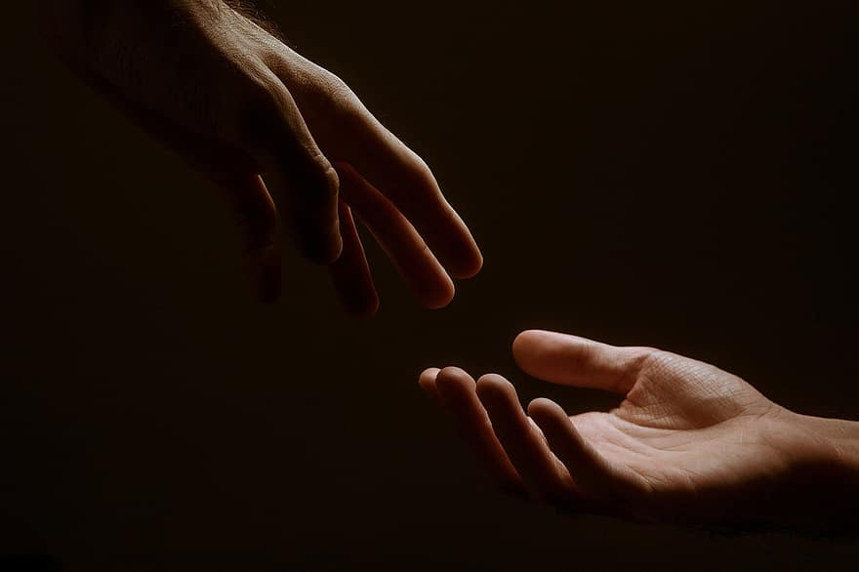
Prayer
Prayers
Let us pray for:
The world in which we live
The people who lead us
The people who need our prayers
The sick and the dying
Our families and loved ones
Lord, in your mercy
Hear our prayer.
Notes:
Prayers of the People

Slide 8
Nunc Dimitis
Now, Lord, you let your servant go in peace
your word has been fulfilled.
My own eyes have seen the salvation
which you have prepared in the sight of every people;
A light to reveal you to the nations
and the glory of your people Israel.
Glory to the Father and to the Son and to the Holy Spirit;
as it was in the beginning is now and shall be for ever. Amen.

Slide 9
Scripture
Psalm 39: I fell silent and did not open my mouth,
for surely it was your doing.
Take away your plague from me;
I am consumed by the blows of your hand.
With rebukes for sin you punish us; like a moth you consume our beauty;
truly, everyone is but a breath.
Hear my prayer, O Lord, and give ear to my cry;
hold not your peace at my tears.
For I am but a stranger with you,
a wayfarer, as all my forebears were.
Turn your gaze from me, that I may be glad again,
before I go my way and am no more.
Glory to the Father and to the Son and to the Holy Spirit;
as it was in the beginning is now and shall be for ever. Amen.

Slide 10
Scripture
Exodus 11: Moses said, ‘Thus says the Lord: About midnight I will go out through Egypt. Every firstborn in the land of Egypt shall die, from the firstborn of Pharaoh who sits on his throne to the firstborn of the female slave who is behind the handmill, and all the firstborn of the livestock. Then there will be a loud cry throughout the whole land of Egypt, such as has never been nor will ever be again. But not a dog shall growl at any of the Israelites—not at people, not at animals—so that you may know that the Lord makes a distinction between Egypt and Israel. Then all these officials of yours shall come down to me, and bow low to me, saying, “Leave us, you and all the people who follow you.” After that I will leave.’ And in hot anger he left Pharaoh. The Lord said to Moses, ‘Pharaoh will not listen to you, in order that my wonders may be multiplied in the land of Egypt.’ Moses and Aaron performed all these wonders before Pharaoh; but the Lord hardened Pharaoh’s heart, and he did not let the people of Israel go out of his land.
This is the word of the Lord.
Thanks be to God.

Slide 11
Collects
As our evening prayer rises before you, O God,
so may your mercy come down upon us
to cleanse our hearts
and set us free to sing your praise
now and for ever. Amen.
Lighten our darkness, Lord we pray
And in your great mercy,
defend us from all perils and dangers of this night,
For the sake of your Son, our Saviour, Jesus Christ, Amen.

Slide 12
Blessing
Lord’s Prayer: Our Father, who art in heaven, hallowed be thy name; thy kingdom come; thy will be done; on earth as it is in heaven. Give us this day our daily bread. And forgive us our trespasses, as we forgive those who trespass against us. And lead us not into temptation; but deliver us from evil. For thine is the kingdom, the power, and the glory, for ever and ever. Amen. Blessing: May the God of peace sanctify you wholly;
and may your spirit and soul and body be kept sound and blameless
at the coming of our Lord Jesus Christ;
and the blessing of God Almighty, the Father, the Son and the Holy Spirit
Rest upon you and keep you and all whom you love, safe and well, for evermore, Amen.
Closing Prayer:
Heavenly Father, as we are in Christ, may we also abide in your love, in the unity of the Holy Spirit. Amen.

Slide 13
Daily Prayer for 2nd April 2026 St Christopher’s Cathedral, Bahrain "In our Darkness"
The Diocese of Cyprus and the Gulf

Slide 14
Daily Prayer for 2nd April 2026 St Christopher’s Cathedral and Awali Church, Bahrain
The Diocese of Cyprus and the Gulf

