Slide 1

Daily Prayer for 9th April 2026 St Christopher’s Cathedral and Awali Church, Bahrain
The Diocese of Cyprus and the Gulf

Slide 2
Daily Prayer for 9th April 2026 St Christopher’s Cathedral and Awali Church, Bahrain
“Psalm 40”
The Diocese of Cyprus and the Gulf

Slide 3
Welcome
Opening Acclamation: Grace, mercy and peace from God our Father and the Lord Jesus Christ be with you. And also with you.
Today the Lord Jesus is Risen, Alleluia
He is Risen indeed! Alleluia!
We have come together in the name of Christ
to offer our praise and thanksgiving,
to hear and receive God’s holy word,
to pray for the needs of the world,
and to seek the forgiveness of our sins,
that by the power of the Holy Spirit
we may give ourselves to the service of God.
Amen.

Slide 4
Prayer
Confession: Most merciful God, we confess that we have sinned against you in thought, word and deed, by what we have done and by what we have left undone. We have not loved you with our whole heart. We have not loved our neighbours as ourselves. In your mercy forgive what we have been, help us to amend what we are, and direct what we shall be; through Jesus Christ our Lord. Amen.
Almighty God have mercy upon you,
forgive you all your sins
through our Lord Jesus Christ,
strengthen you in all goodness,
and by the power of the Holy Spirit
Keep you in eternal life. Amen.

Slide 5
Prayer
Collect for Easter Day: Lord of all life and power,
who through the mighty resurrection of your Son
overcame the old order of sin and death
to make all things new in him:
grant that we, being dead to sin
and alive to you in Jesus Christ,
may reign with him in glory;
to whom with you and the Holy Spirit
be praise and honour, glory and might,
now and in all eternity.
Amen.

Slide 6
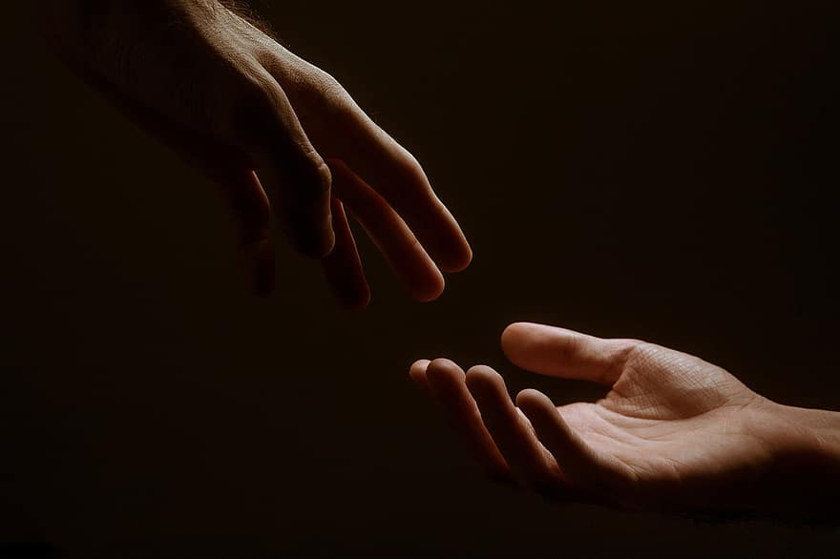
Prayer
Prayers
Let us pray for:
The world in which we live
The people who lead us
The people who need our prayers
The sick and the dying
Our families and loved ones
Lord, in your mercy
Hear our prayer.
Notes:
Prayers of the People

Slide 7
Song of Christ the Servant
Christ committed no sin, no guile was found on his lips.
Christ suffered for you, leaving you an example,
that you should follow in his steps.
He committed no sin, no guile was found on his lips,
when he was reviled, he did not revile in turn.
When he suffered, he did not threaten,
but he trusted himself to God who judges justly.
Christ himself bore our sins in his body on the tree,
that we might die to sin and live to righteousness.
By his wounds, you have been healed, for you were straying like sheep,
but have now returned to the shepherd and guardian of your souls.
Glory to the Father and to the Son and to the Holy Spirit;
as it was in the beginning is now and shall be for ever. Amen.
Christ committed no sin, no guile was found on his lips.

Slide 8
Scripture
Psalm 106: Give thanks to the Lord, for he is gracious,
for his faithfulness endures for ever.
Who can express the mighty acts of the Lord
or show forth all his praise?
Blessed are those who observe what is right
and always do what is just.
Remember me, O Lord, in the favour you bear for your people;
visit me in the day of your salvation;
That I may see the prosperity of your chosen and rejoice in the gladness of your people,
and exult with your inheritance.
We have sinned like our forebears;
we have done wrong and dealt wickedly.
In Egypt they did not consider your wonders, nor remember the abundance of your faithful love;
they rebelled against the Most High at the Red Sea.
But he saved them for his name’s sake,
that he might make his power to be known.
Glory to the Father and to the Son and to the Holy Spirit;
as it was in the beginning is now and shall be for ever. Amen.

Slide 9
Scripture
Luke 7: Soon afterwards he went to a town called Nain, and his disciples and a large crowd went with him. As he approached the gate of the town, a man who had died was being carried out. He was his mother’s only son, and she was a widow; and with her was a large crowd from the town. When the Lord saw her, he had compassion for her and said to her, ‘Do not weep.’ Then he came forward and touched the bier, and the bearers stood still. And he said, ‘Young man, I say to you, rise!’ The dead man sat up and began to speak, and Jesus gave him to his mother. Fear seized all of them; and they glorified God, saying, ‘A great prophet has risen among us!’ and ‘God has looked favourably on his people!’ This word about him spread throughout Judea and all the surrounding country.
This is the word of the Lord.
Thanks be to God.

Slide 10
Collects
As our evening prayer rises before you, O God,
so may your mercy come down upon us
to cleanse our hearts
and set us free to sing your praise
now and for ever. Amen.
Lighten our darkness, Lord we pray
And in your great mercy,
defend us from all perils and dangers of this night,
For the sake of your Son, our Saviour, Jesus Christ, Amen.

Slide 11
Blessing
Lord’s Prayer: Our Father, who art in heaven, hallowed be thy name; thy kingdom come; thy will be done; on earth as it is in heaven. Give us this day our daily bread. And forgive us our trespasses, as we forgive those who trespass against us. And lead us not into temptation; but deliver us from evil. For thine is the kingdom, the power, and the glory, for ever and ever. Amen. Blessing: May the God of peace sanctify you wholly;
and may your spirit and soul and body be kept sound and blameless
at the coming of our Lord Jesus Christ;
and the blessing of God Almighty, the Father, the Son and the Holy Spirit
Rest upon you and keep you and all whom you love, safe and well, for evermore, Amen.
Closing Prayer:
Blessed Jesus, King of Kings and Lord of Lords, may we follow you in the example of our lives as we celebrate your gift of new life; in the unity of the Holy Spirit. Amen.

Slide 12
Daily Prayer for 95th April 2026 St Christopher’s Cathedral and Awali Church, Bahrain
“Holy Forever”
The Diocese of Cyprus and the Gulf

Slide 13
Daily Prayer for 9th April 2026 St Christopher’s Cathedral and Awali Church, Bahrain
The Diocese of Cyprus and the Gulf

