Slide 1

Holy Communion
7th March 2026
Awali Church, Bahrain
The Diocese of Cyprus and the Gulf

Slide 2
Holy Communion
7th March 2026
Awali Church, Bahrain
"I the Lord of Sea and Sky"
The Diocese of Cyprus and the Gulf

Slide 3
Welcome
Opening Acclamation:
Grace, mercy and peace from God our Father and the Lord Jesus Christ be with you.
And also with you.
We give thanks for this penitential journey to the cross.
Lord bless us and save us.
Amen
Almighty God,
to whom all hearts are open,
all desires known,
and from whom no secrets are hidden:
cleanse the thoughts of our hearts
by the inspiration of your Holy Spirit,
that we may perfectly love you,
and worthily magnify your holy name;
through Christ our Lord.
Amen.

Slide 4
Prayer
Confession:
Let us confess our sins to Almighty God:
Most merciful God, we confess that we have sinned against you in thought, word and deed, by what we have done and by what we have left undone. We have not loved you with our whole heart. We have not loved our neighbours as ourselves. In your mercy forgive what we have been, help us to amend what we are, and direct what we shall be; through Jesus Christ our Lord. Amen.
Almighty God have mercy upon you,
forgive you all your sins
through our Lord Jesus Christ,
strengthen you in all goodness,
and by the power of the Holy Spirit
Keep you in eternal life. Amen.

Slide 5
Prayer
Collect for the 3rd Sunday of Lent:
Almighty God,
whose most dear Son went not up to joy but first he suffered pain,
and entered not into glory before he was crucified:
mercifully grant that we, walking in the way of the cross,
may find it none other than the way of life and peace;
through Jesus Christ our Lord
who is alive and reigns with you
in the unity of the Holy Spirit,
one God, now and forever,
Amen.

Slide 6
Apostles Creed
I believe in God, the Father almighty,
creator of heaven and earth.
I believe in Jesus Christ, his only Son, our Lord,
who was conceived by the Holy Spirit,
born of the Virgin Mary,
suffered under Pontius Pilate,
was crucified, died, and was buried;
he descended to the dead.
On the third day he rose again;
he ascended into heaven,
he is seated at the right hand of the Father,
and he will come to judge the living and the dead.
I believe in the Holy Spirit,
the holy catholic Church,
the communion of saints,
the forgiveness of sins,
the resurrection of the body,
and the life everlasting.
Amen.

Slide 7
Scripture
Psalm 95:
O come, let us sing to the LORD;
let us make a joyful noise to the rock of our salvation!
Let us come into his presence with thanksgiving;
let us make a joyful noise to him with songs of praise!
For the LORD is a great God
and a great King above all gods.
In his hand are the depths of the earth;
the heights of the mountains are his also.
The sea is his, for he made it,
and the dry land, which his hands have formed.
O come, let us worship and bow down;
let us kneel before the LORD, our Maker!
For he is our God, and we are the people of his pasture and the sheep of his hand.
O that today you would listen to his voice!
This is he word of the Lord
Thanks be to God

Slide 8
Scripture
Exodus 17:1-7
From the wilderness of Sin the whole congregation of the Israelites journeyed by stages, as the LORD commanded. They camped at Rephidim, but there was no water for the people to drink. The people quarreled with Moses and said, "Give us water to drink." Moses said to them, "Why do you quarrel with me? Why do you test the LORD?" But the people thirsted there for water, and the people complained against Moses and said, "Why did you bring us out of Egypt, to kill us and our children and livestock with thirst?" So Moses cried out to the LORD, "What shall I do for this people? They are almost ready to stone me." The LORD said to Moses, "Go on ahead of the people and take some of the elders of Israel with you; take in your hand the staff with which you struck the Nile and go. I will be standing there in front of you on the rock at Horeb. Strike the rock, and water will come out of it, so that the people may drink." Moses did so, in the sight of the elders of Israel. He called the place Massah and Meribah, because the Israelites quarreled and tested the LORD, saying, "Is the LORD among us or not?"
This is the word of the Lord.
Thanks be to God.

Slide 9
Scripture
Romans 5:1-11:
Therefore, since we are justified by faith, we have peace with God through our Lord Jesus Christ, through whom we have obtained access to this grace in which we stand, and we boast in our hope of sharing the glory of God. And not only that, but we also boast in our afflictions, knowing that affliction produces endurance, and endurance produces character, and character produces hope, and hope does not put us to shame, because God's love has been poured into our hearts through the Holy Spirit that has been given to us. For while we were still weak, at the right time Christ died for the ungodly. Indeed, rarely will anyone die for a righteous person--though perhaps for a good person someone might actually dare to die. But God proves his love for us in that while we still were sinners Christ died for us. Much more surely, therefore, since we have now been justified by his blood, will we be saved through him from the wrath of God. For if while we were enemies we were reconciled to God through the death of his Son, much more surely, having been reconciled, will we be saved by his life. But more than that, we even boast in God through our Lord Jesus Christ, through whom we have now received reconciliation.
This is the word of the Lord.
Thanks be to God.

Slide 10
Holy Communion
7th March 2026
Awali Church, Bahrain
"My Jesus,My Saviour"
The Diocese of Cyprus and the Gulf

Slide 11
Scripture
Hear the Gospel of our Lord Jesus Christ according to John.
Glory to you, O Lord.
John 4:5-42:
So he came to a Samaritan city called Sychar, near the plot of ground that Jacob had given to his son Joseph. Jacob's well was there, and Jesus, tired out by his journey, was sitting by the well. It was about noon. A Samaritan woman came to draw water, and Jesus said to her, "Give me a drink." (His disciples had gone to the city to buy food.) The Samaritan woman said to him, "How is it that you, a Jew, ask a drink of me, a woman of Samaria?" (Jews do not share things in common with Samaritans.) Jesus answered her, "If you knew the gift of God and who it is that is saying to you, 'Give me a drink,' you would have asked him, and he would have given you living water." The woman said to him, "Sir, you have no bucket, and the well is deep. Where do you get that living water? Are you greater than our ancestor Jacob, who gave us the well,and with his sons and his flocks drank from it?" Jesus said to her, "Everyone who drinks of this water will be thirsty again, but those who drink of the water that I will give them will never be thirsty. The water that I will give will become in them a spring of water gushing up to eternal life." The woman said to him, "Sir, give me this water, so that I may never be thirsty or have to keep coming here to draw water." Jesus said to her, "Go, call your husband, and come back."

Slide 12
Scripture
The woman answered him, "I have no husband." Jesus said to her, "You are right in saying, 'I have no husband,' for you have had five husbands, and the one you have now is not your husband. What you have said is true!" The woman said to him, "Sir, I see that you are a prophet. Our ancestors worshiped on this mountain, but you say that the place where people must worship is in Jerusalem." Jesus said to her, "Woman, believe me, the hour is coming when you will worship the Father neither on this mountain nor in Jerusalem. You worship what you do not know; we worship what we know, for salvation is from the Jews. But the hour is coming and is now here when the true worshipers will worship the Father in spirit and truth, for the Father seeks such as these to worship him. God is spirit, and those who worship him must worship in spirit and truth."
The woman said to him, "I know that Messiah is coming" (who is called Christ). "When he comes, he will proclaim all things to us." Jesus said to her, "I am he, the one who is speaking to you." Just then his disciples came. They were astonished that he was speaking with a woman, but no one said, "What do you want?" or, "Why are you speaking with her?" Then the woman left her water jar and went back to the city. She said to the people, "Come and see a man who told me everything I have ever done! He cannot be the Messiah, can he?"

Slide 13
Scripture
They left the city and were on their way to him. Meanwhile the disciples were urging him, "Rabbi, eat something." But he said to them, "I have food to eat that you do not know about." So the disciples said to one another, "Surely no one has brought him something to eat?" Jesus said to them, "My food is to do the will of him who sent me and to complete his work. Do you not say, 'Four months more, then comes the harvest'? But I tell you, look around you, and see how the fields are ripe for harvesting. The reaper is already receiving wages and is gathering fruit for eternal life, so that sower and reaper may rejoice together. For here the saying holds true, 'One sows and another reaps.' I sent you to reap that for which you did not labor. Others have labored, and you have entered into their labor." Many Samaritans from that city believed in him because of the woman's testimony, "He told me everything I have ever done." So when the Samaritans came to him, they asked him to stay with them, and he stayed there two days. And many more believed because of his word. They said to the woman, "It is no longer because of what you said that we believe, for we have heard for ourselves, and we know that this is truly the Savior of the world."
This is the Gospel of the Lord.
Praise to you, O Christ.

Slide 14

Sermon
Rob
Notes:
Prayers of the People

Slide 15
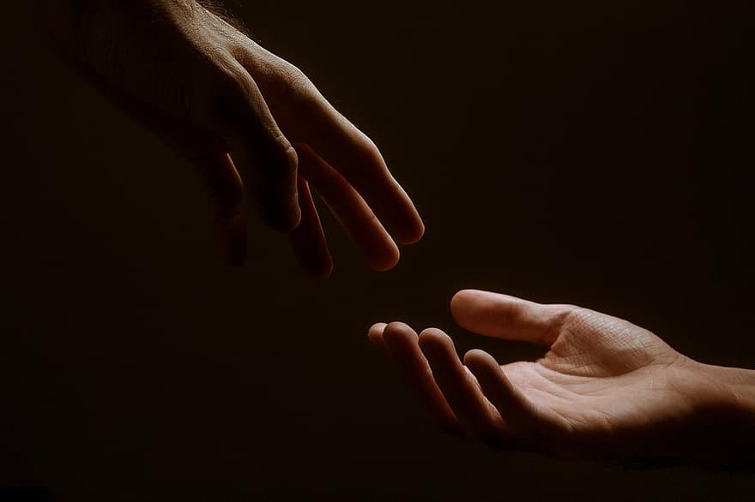
Prayer
Prayers
Let us pray for:
The world in which we live
The people who lead us
The people who need our prayers
The sick and the dying
Our families and loved ones
Lord, in your mercy
Hear our prayer.
Notes:
Prayers of the People

Slide 16
Peace
Jesus Christ is our Peace, he has reconciled us to God in one body by the Cross.
We meet in his name and share his Peace.
The peace of the Lord be always with you - “Shalom”
And also with you - “Shalom”

Slide 17
Holy Communion
7th March 2026
Awali Church, Bahrain
"Agnes Dei"
The Diocese of Cyprus and the Gulf

Slide 18
Eucharist
The Lord is here
His Spirit is with us.
Lift up your hearts.
We lift them to the Lord.
Let us give thanks to the Lord our God.
It is right to give thanks and praise.
It is indeed right to give you thanks,
God our Creator,
loving and faithful,
holy and strong.
You made us
and the whole universe,
and filled your world with life.
You sent your Son to live among us,
Jesus our Saviour, Mary’s child.
He suffered on the cross;
he died to save us from our sins;
he rose in glory from the dead.
You send your Spirit
to bring new life to the world,
and clothe us with power from on high.
And so we join angels and archangels
And all the company of heaven
to celebrate and praise your holy name saying:
Holy, Holy, Holy Lord
God of Power and Might.
Heaven and Earth are full of your Glory
Hosannah in the highest.
Blessed is the one who comes in the name of the Lord.

Slide 19
Eucharist
Father, on the night before he died,
Jesus shared a meal with his friends.
He took the bread, and thanked you.
He broke it, and gave it to them, saying:
Take and eat; this is my body, given for you.
Do this to remember me.
After the meal, Jesus took the cup of wine.
He thanked you, and gave it to them, saying:
Drink this, all of you.
This is my blood,
the new promise of God’s unfailing love.
Do this to remember me.
Great is the mystery of faith:
Christ has died.
Christ is risen.
Christ will come again.
Father, as we bring this bread and wine,
and remember his death and resurrection,
send your Holy Spirit,
that we who share these gifts
may be fed by Christ’s body and his blood.
Pour your Spirit on us
that we may love one another,
work for the healing of the earth,
and share the good news of Jesus,
as we wait for his coming in glory.
For honour and praise belong to you, Father,
with Jesus your Son, and the Holy Spirit:
one God, for ever and ever.
Amen

Slide 20
Eucharist
Our Father,
who art in heaven,
hallowed be thy name;
thy kingdom come;
thy will be done;
on earth as it is in heaven.
Give us this day our daily bread.
And forgive us our trespasses,
as we forgive those who trespass against us.
And lead us not into temptation;
but deliver us from evil.
For thine is the kingdom,
the power, and the glory,
for ever and ever. Amen.
Glory to God in the highest,
and peace to his people on earth.
Lord God, heavenly King,
almighty God and Father,
we worship you, we give you thanks,
we praise you for your glory.
Lord Jesus Christ, only Son of the Father,
Lord God, Lamb of God,
you take away the sin of the world:
have mercy on us;
you are seated at the right hand of the Father:
receive our prayer.
For you alone are the Holy One,
you alone are the Lord,
you alone are the Most High, Jesus Christ,
with the Holy Spirit,
in the glory of God the Father.
Brothers and sisters, let us share these gifts of God,
Amen

Slide 21
Holy Communion
7th March 2026
Awali Church, Bahrain
"Love Divine"
The Diocese of Cyprus and the Gulf

Slide 22
Blessing
Prayer:
Lord and heavenly Father,
we offer you through your dear Son Jesus Christ this our sacrifice of praise and thanksgiving.
Grant that by his merits and death, and through faith in his blood, we and all your Church may receive forgiveness of our sins and all other benefits of his passion. And here we offer and present to you, O Lord, ourselves, our souls and our bodies, to be a reasonable, holy and living sacrifice; fill us all who share in this holy communion with your grace and heavenly blessing. Amen.
Blessing:
May the God of peace sanctify you wholly;
that your spirit and soul and body be kept sound and blameless
at the coming of our Lord Jesus Christ;
and the blessing of God Almighty, the Father, the Son and the Holy Spirit
Rest upon you and keep you and all whom you love, safe and well, for evermore, Amen.
Closing Prayer:
God our Redeemer show us compassion and love. Lead us, guide us, fill us with your Spirit. Show us the way from darkness to light that we may be the light of the world; so go in the light of Jesus.
In the name of Christ, Amen.

Slide 23
Holy Communion
7th March 2026
Awali Church, Bahrain
The Diocese of Cyprus and the Gulf

