Slide 1

Daily Prayer for 11th March 2026
St Christopher’s Cathedral and Awali Church, Bahrain
The Diocese of Cyprus and the Gulf

Slide 2
Daily Prayer for 11th March 2026
St Christopher’s Cathedral, Bahrain
“Walk in the Light”
The Diocese of Cyprus and the Gulf

Slide 3
Welcome
Opening Acclamation:
Grace, mercy and peace from God our Father and the Lord Jesus Christ be with you.
And also with you.
We give thanks for this penitential journey to the cross.
Lord bless us and save us.
Amen
Blessed are you, Lord God of our salvation,
to you be glory and praise for ever.
In the darkness of our sin you have shone in our hearts
to give the light of the knowledge of the glory of God
in the face of Jesus Christ.
Open our eyes to acknowledge your presence,
that freed from the misery of sin and shame
we may grow into your likeness from glory to glory.
Blessed be God, Father, Son and Holy Spirit.
Amen.

Slide 4
Prayer
Confession:
Most merciful God, we confess that we have sinned against you in thought, word and deed, by what we have done and by what we have left undone. We have not loved you with our whole heart. We have not loved our neighbours as ourselves. In your mercy forgive what we have been, help us to amend what we are, and direct what we shall be; through Jesus Christ our Lord. Amen.
Almighty God have mercy upon you,
forgive you all your sins
through our Lord Jesus Christ,
strengthen you in all goodness,
and by the power of the Holy Spirit
Keep you in eternal life. Amen.

Slide 5
Prayer
Collect for Lent:
Almighty and everlasting God,
you hate nothing that you have made
and forgive the sins of all those who are penitent:
create and make in us new and contrite hearts
that we, worthily lamenting our sins
and acknowledging our wretchedness,
may receive from you, the God of all mercy,
perfect remission and forgiveness;
through Jesus Christ your Son our Lord,
who is alive and reigns with you,
in the unity of the Holy Spirit,
one God, now and for ever.
Amen.

Slide 6
Prayer
Collect for St Sophronias of Jerusalem on 11th March
So let us hasten all together to meet Our God.
The True Light has come,
the light that enlightens every man who is born into this world.
Let all of us, my brethren, be enlightened and made radiant by this light.
Let all of us share in its splendour,
and be so filled with it that no one remains in the darkness,
through Jesus Christ your Son our Lord,
who is alive and reigns with you,
in the unity of the Holy Spirit,
one God, now and for ever.
Amen.

Slide 7
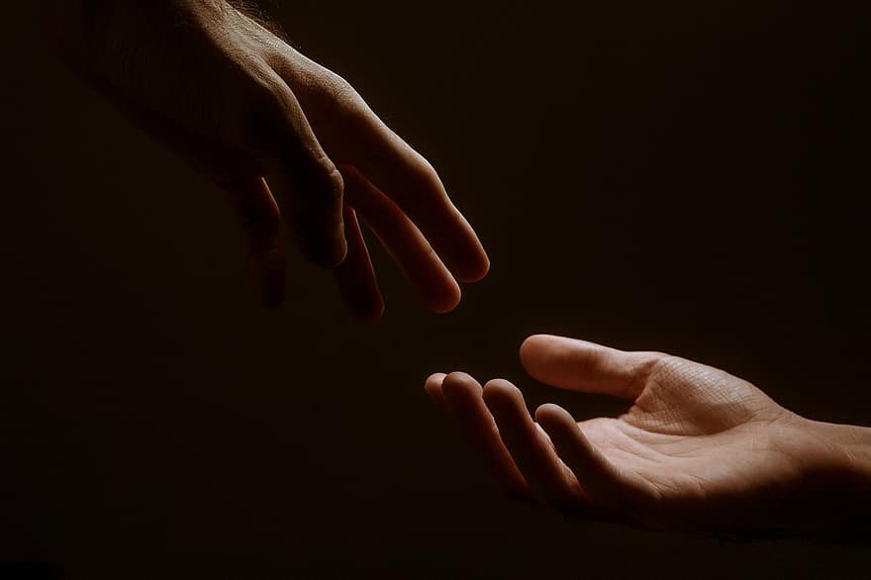
Prayer
Prayers
Let us pray for:
The world in which we live
The people who lead us
The people who need our prayers
The sick and the dying
Our families and loved ones
Lord, in your mercy
Hear our prayer.
Notes:
Prayers of the People

Slide 8
Magnificat
My soul proclaims the greatness of the Lord, my spirit rejoices in God my Saviour;
he has looked with favour on his lowly servant.
From this day all generations will call me blessed;
the Almighty has done great things for me and holy is his name.
He has mercy on those who fear him,
from generation to generation.
He has shown strength with his arm
and has scattered the proud in their conceit,
Casting down the mighty from their thrones
and lifting up the lowly.
He has filled the hungry with good things
and sent the rich away empty.
He has come to the aid of his servant Israel,
to remember his promise of mercy,
The promise made to our ancestors,
to Abraham and his children for ever.
Glory to the Father and to the Son and to the Holy Spirit;
as it was in the beginning is now and shall be for ever. Amen.

Slide 9
Scripture
Psalm 39:
‘And now, what is my hope?
Truly my hope is even in you.
‘Deliver me from all my transgressions
and do not make me the taunt of the fool.’
I fell silent and did not open my mouth,
for surely it was your doing.
Take away your plague from me;
I am consumed by the blows of your hand.
With rebukes for sin you punish us;
like a moth you consume our beauty; truly, everyone is but a breath.
Hear my prayer, O Lord, and give ear to my cry;
hold not your peace at my tears.
For I am but a stranger with you,
a wayfarer, as all my forebears were.
Turn your gaze from me, that I may be glad again,
before I go my way and am no more.
Glory to the Father and to the Son and to the Holy Spirit;
as it was in the beginning is now and shall be for ever. Amen.

Slide 10
Scripture
John 8:12-20:
Again Jesus spoke to them, saying, ‘I am the light of the world. Whoever follows me will never walk in darkness but will have the light of life.’ Then the Pharisees said to him, ‘You are testifying on your own behalf; your testimony is not valid.’ Jesus answered, ‘Even if I testify on my own behalf, my testimony is valid because I know where I have come from and where I am going, but you do not know where I come from or where I am going. You judge by human standards; I judge no one. Yet even if I do judge, my judgement is valid; for it is not I alone who judge, but I and the Father who sent me. In your law it is written that the testimony of two witnesses is valid. I testify on my own behalf, and the Father who sent me testifies on my behalf.’ Then they said to him, ‘Where is your Father?’ Jesus answered, ‘You know neither me nor my Father. If you knew me, you would know my Father also.’ He spoke these words while he was teaching in the treasury of the temple, but no one arrested him, because his hour had not yet come.
This is the word of the Lord.
Thanks be to God.

Slide 11
Collects
As our evening prayer rises before you, O God,
so may your mercy come down upon us
to cleanse our hearts
and set us free to sing your praise
now and for ever. Amen.
Lighten our darkness, Lord we pray
And in your great mercy,
defend us from all perils and dangers of this night,
For the sake of your Son, our Saviour, Jesus Christ, Amen.

Slide 12
Blessing
Lord’s Prayer:
Our Father, who art in heaven, hallowed be thy name; thy kingdom come; thy will be done; on earth as it is in heaven. Give us this day our daily bread. And forgive us our trespasses, as we forgive those who trespass against us. And lead us not into temptation; but deliver us from evil. For thine is the kingdom, the power, and the glory, for ever and ever. Amen.
Blessing:
May the God of peace sanctify you wholly;
and may your spirit and soul and body be kept sound and blameless
at the coming of our Lord Jesus Christ;
and the blessing of God Almighty, the Father, the Son and the Holy Spirit
Rest upon you and keep you and all whom you love, safe and well, for evermore, Amen.
Closing Prayer:
God our Redeemer, you are the light of the world. Shine, Jesus, Shine, that despite this present darkness we may see the light of salvation shining brightly in the world. Amen.

Slide 13
Daily Prayer for 11th March 2026
St Christopher’s Cathedral, Bahrain
"The Lord is my Light"
The Diocese of Cyprus and the Gulf

Slide 14
Daily Prayer for 11th March 2026
St Christopher’s Cathedral and Awali Church, Bahrain
The Diocese of Cyprus and the Gulf

