Slide 1


Daily Prayer for 14th April 2026
St Christopher’s Cathedral and Awali Church, Bahrain
The Diocese of Cyprus and the Gulf

Slide 2
Daily Prayer for 14th April 2026
St Christopher’s Cathedral, Bahrain
“Bless the Lord my Soul”
The Diocese of Cyprus and the Gulf

Slide 3
Welcome
Opening Acclamation:
O Lord, open our lips
And our mouth shall proclaim your praise. Amen.
Rejoice in the Lord always: again I say rejoice.
Be known to everyone: for your consideration of others,
The Lord is near: do not be anxious.
But in everything make your requests known to God: in prayer and petition with thanksgiving.
Then the peace of God, which passes all understanding: will keep your hearts and minds through Jesus Christ our Lord.
Glory to the Father, and to the Son, and to the Holy Spirit;
as it was in the beginning is now and shall be forever. Amen.

Slide 4
Opening Prayer
That this evening may be holy, good, and peaceful; let us pray with one heart and mind.
silence is kept
As our evening prayer rises before you, O God,
so may your mercy come down upon us
to cleanse our hearts
and set us free to sing your praise
now and forever.
Amen.

Slide 5
The Psalm – Psalm 104
Bless the Lord, O my soul.
O Lord my God, how excellent is your greatness!
You are clothed with majesty and honour,
wrapped in light as in a garment.
You spread out the heavens like a curtain
and lay the beams of your dwelling place in the waters above.
You make the clouds your chariot
and ride on the wings of the wind.
You make the winds your messengers
and flames of fire your servants.
You laid the foundations of the earth,
that it never should move at any time.
You covered it with the deep like a garment;
the waters stood high above the hills.
At your rebuke they fled;
at the voice of your thunder they hastened away.
They rose up to the hills and flowed down to the valleys beneath,
to the place which you had appointed for them.
You have set them their bounds that they should not pass, •
nor turn again to cover the earth.
You send the springs into the brooks,
which run among the hills.

Slide 6
The Psalm – Psalm 104
They give drink to every beast of the field,
and the wild asses quench their thirst.
Beside them the birds of the air make their nests
and sing among the branches.
You water the hills from your dwelling on high;
the earth is filled with the fruit of your works.
You make grass to grow for the cattle
and plants to meet our needs,
Bringing forth food from the earth
and wine to gladden our hearts,
Oil to give us a cheerful countenance
and bread to strengthen our hearts.
The trees of the Lord are full of sap,
the cedars of Lebanon which he planted,
In which the birds build their nests,
while the fir trees are a dwelling for the stork.
The mountains are a refuge for the wild goats
and the stony cliffs for the conies.
You appointed the moon to mark the seasons,
and the sun knows the time for its setting.
You make darkness that it may be night,
in which all the beasts of the forest creep forth.

Slide 7
The Psalm – Psalm 104
The lions roar for their prey
and seek their food from God.
The sun rises and they are gone
to lay themselves down in their dens.
People go forth to their work
and to their labour until the evening.
O Lord, how manifold are your works!
In wisdom you have made them all; the earth is full of your creatures.
There is the sea, spread far and wide,
and there move creatures beyond number, both small and great.
There go the ships, and there is that Leviathan
which you have made to play in the deep.
All of these look to you
to give them their food in due season.
When you give it them, they gather it;
you open your hand and they are filled with good.
When you hide your face they are troubled;
when you take away their breath, they die and return again to the dust.
When you send forth your spirit, they are created,
and you renew the face of the earth.
May the glory of the Lord endure for ever;
may the Lord rejoice in his works;

Slide 8
The Psalm – Psalm 104
He looks on the earth and it trembles;
he touches the mountains and they smoke.
I will sing to the Lord as long as I live;
I will make music to my God while I have my being.
So shall my song please him
while I rejoice in the Lord.
Let sinners be consumed out of the earth and the wicked be no more.
Bless the Lord, O my soul. Alleluia.
Glory to the Father and to the Son and to the Holy Spirit;
as it was in the beginning is now and shall be for ever. Amen.

Slide 9
Magnificat
My soul proclaims the greatness of the Lord, my spirit rejoices in God my Saviour;
he has looked with favour on his lowly servant.
From this day all generations will call me blessed;
the Almighty has done great things for me and holy is his name.
He has mercy on those who fear him,
from generation to generation.
He has shown strength with his arm
and has scattered the proud in their conceit,
Casting down the mighty from their thrones
and lifting up the lowly.
He has filled the hungry with good things
and sent the rich away empty.
He has come to the aid of his servant Israel,
to remember his promise of mercy,
The promise made to our ancestors,
to Abraham and his children for ever.
Glory to the Father and to the Son and to the Holy Spirit;
as it was in the beginning is now and shall be for ever. Amen.

Slide 10
Scripture – 1 Corinthians 15:50-58
What I am saying, brothers and sisters, is this: flesh and blood cannot inherit the kingdom of God, nor does the perishable inherit the imperishable. Look, I will tell you a mystery! We will not all die, but we will all be changed, in a moment, in the twinkling of an eye, at the last trumpet. For the trumpet will sound, and the dead will be raised imperishable, and we will be changed. For this perishable body must put on imperishability, and this mortal body must put on immortality. When this perishable body puts on imperishability and this mortal body puts on immortality, then the saying that is written will be fulfilled:
“Death has been swallowed up in victory.”
“Where, O death, is your victory?
Where, O death, is your sting?”
The sting of death is sin, and the power of sin is the law. But thanks be to God, who gives us the victory through our Lord Jesus Christ. Therefore, my beloved brothers and sisters, be steadfast, immovable, always excelling in the work of the Lord because you know that in the Lord your labor is not in vain.
This is the word of the Lord.
Thanks be to God.

Slide 11

Homily
+Sean
Notes:
Prayers of the People

Slide 12
Nunc Dimitis
Now, Lord, you let your servant go in peace
your word has been fulfilled.
My own eyes have seen the salvation
which you have prepared in the sight of every people;
A light to reveal you to the nations
and the glory of your people Israel.
Glory to the Father and to the Son and to the Holy Spirit;
as it was in the beginning is now and shall be for ever. Amen.

Slide 13
Prayers
Lord, have mercy upon us
Christ, have mercy upon us
Lord, have mercy upon us
Show us your mercy, O Lord:
and grant us your salvation.
O Lord, be gracious to our lands:
and mercifully hear us when we call upon you.
Let your priests be clothed with righteousness:
and let your servants shout for joy.
O Lord, make your ways known upon the earth:
let all nations acknowledge your saving power.
Make our hearts clean, O God:
and renew a right spirit within us. Amen.

Slide 14
Prayers
Eternal God, from whom all holy desires, all good counsels, and all just works proceed:
give your servants that peace which the world cannot give
that our hearts may be set to obey your commandments
and that, free from the fear of our enemies,
we may pass our time in rest and quietness;
through the merits of Jesus Christ our Saviour. Amen.
Lighten our darkness, Lord we pray
And in your great mercy,
defend us from all perils and dangers of this night,
For the sake of your Son, our Saviour, Jesus Christ, Amen.

Slide 15
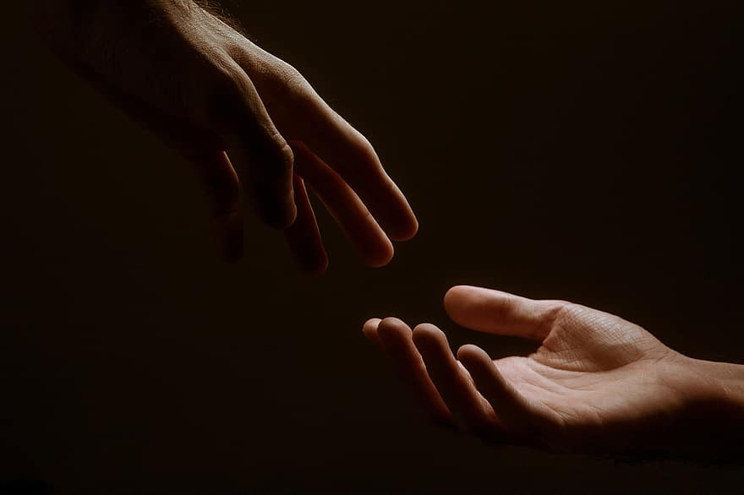
Prayer
Prayers
Let us pray for:
The world in which we live
The people who lead us
The people who need our prayers
The sick and the dying
Our families and loved ones
Lord, in your mercy
Hear our prayer.
Notes:
Prayers of the People

Slide 16
Collect
Risen Christ,
for whom no door is locked, no entrance barred:
open the doors of our hearts,
that we may seek the good of others
and walk the joyful road of sacrifice and peace,
to the praise of God the Father.
Amen.

Slide 17
Blessing
Lord’s Prayer:
Our Father,
who art in heaven,
hallowed be thy name;
thy kingdom come;
thy will be done;
on earth as it is in heaven.
Give us this day our daily bread.
And forgive us our trespasses,
as we forgive those who trespass against us.
And lead us not into temptation;
but deliver us from evil.
For thine is the kingdom, the power, and the glory,
for ever and ever. Amen.
The Grace:
The grace of our Lord Jesus Christ, and the love of God, and the fellowship of the Holy Spirit, be with us all for ever more. Amen.

Slide 18
Daily Prayer for 14th April 2026
St Christopher’s Cathedral and Awali Church, Bahrain
“As the Deer Pants for the Water
The Diocese of Cyprus and the Gulf

Slide 19
Daily Prayer for 14th April 2026
St Christopher’s Cathedral and Awali Church, Bahrain
The Diocese of Cyprus and the Gulf

