Slide 1
Easter day
5th April 2026
St Christopher’s Cathedral and Awali Church, Bahrain

Slide 2
Thine be the Glory

Slide 3
Welcome
Opening Acclamation:
Alleluia! Christ is risen.
He is risen indeed. Alleluia!
Today we celebrate the glorious resurrection of our Lord Jesus Christ.
From the darkness of death, God has brought forth life;
from despair, hope; from sorrow, joy. On this day the stone is rolled away, the tomb stands empty, and Christ is alive for evermore. As we gather, we rejoice that nothing can separate us from the love of God.
We come to worship with glad hearts, to proclaim the victory of life over death, and to share in the new life Christ gives.
Alleluia! Christ is risen.
He is risen indeed. Alleluia!

Slide 4
Welcome
Almighty God,
to whom all hearts are open,
all desires known,
and from whom no secrets are hidden:
cleanse the thoughts of our hearts
by the inspiration of your Holy Spirit,
that we may perfectly love you,
and worthily magnify your holy name;
through Christ our Lord.
Amen.

Slide 5
Prayer
Confession:
God shows his love for us
in that, while we were still sinners, Christ died for us.
Let us then show our love for him
by confessing our sins in penitence and faith.
Most merciful God, we confess that we have sinned against you in thought, word and deed, by what we have done and by what we have left undone. We have not loved you with our whole heart. We have not loved our neighbours as ourselves. In your mercy forgive what we have been, help us to amend what we are, and direct what we shall be; through Jesus Christ our Lord. Amen.

Slide 6
Prayer
Absolution:
Almighty God have mercy upon you,
forgive you all your sins
through our Lord Jesus Christ,
strengthen you in all goodness,
and by the power of the Holy Spirit
Keep you in eternal life.
Amen.

Slide 7
Gloria
Glory to God in the highest,
and peace to his people on earth.
Lord God, heavenly King,
almighty God and Father,
we worship you, we give you thanks,
we praise you for your glory.
Lord Jesus Christ, only Son of the Father,
Lord God, Lamb of God,
you take away the sin of the world:
have mercy on us;
you are seated at the right hand of the Father:
receive our prayer.
For you alone are the Holy One,
you alone are the Lord,
you alone are the Most High, Jesus Christ,
with the Holy Spirit,
in the glory of God the Father.
Amen.

Slide 8
Prayer
Collect for Easter Day:
Lord of all life and power,
who through the mighty resurrection of your Son
overcame the old order of sin and death
to make all things new in him:
grant that we, being dead to sin
and alive to you in Jesus Christ,
may reign with him in glory;
to whom with you and the Holy Spirit
be praise and honour, glory and might,
now and in all eternity.
Amen.

Slide 9
Scripture – Psalm 118
O give thanks to the LORD, for he is good; his steadfast love endures forever!
Let Israel say, "His steadfast love endures forever."
Open to me the gates of righteousness,
that I may enter through them and give thanks to the LORD.
This is the gate of the LORD; the righteous shall enter through it.
I thank you that you have answered me and have become my salvation.
The stone that the builders rejected has become the chief cornerstone.
This is the Lord's doing; it is marvelous in our eyes.
This is the day that the LORD has made; let us rejoice and be glad in it.
Save us, we beseech you, O LORD! O LORD, we beseech you, give us success!
Blessed is the one who comes in the name of the LORD.
We bless you from the house of the LORD.
The LORD is God, and he has given us light.
Bind the festal procession with branches, up to the horns of the altar.
You are my God, and I will give thanks to you; you are my God; I will extol you.
O give thanks to the LORD, for he is good, for his steadfast love endures forever
This is the word of the Lord
Thanks be to God

Slide 10
Scripture – Jeremiah 31:1-6
At that time, says the LORD, I will be the God of all the families of Israel, and they shall be my people. Thus says the LORD: The people who survived the sword found grace in the wilderness; when Israel sought for rest, the LORD appeared to him from far away. I have loved you with an everlasting love; therefore I have continued my faithfulness to you. Again I will build you, and you shall be built, O virgin Israel! Again you shall adorn yourself with your tambourines and go forth in the dance of the merrymakers. Again you shall plant vineyards on the mountains of Samaria; the planters shall plant and shall enjoy the fruit. For there shall be a day when sentinels will call in the hill country of Ephraim: "Come, let us go up to Zion, to the LORD our God."
This is the word of the Lord
Thanks be to God

Slide 11
Scripture – Colossians 3:1-4
So if you have been raised with Christ, seek the things that are above, where Christ is, seated at the right hand of God. Set your minds on the things that are above, not on the things that are on earth, for you have died, and your life is hidden with Christ in God. When Christ who is your life is revealed, then you also will be revealed with him in glory.
This is the word of the Lord
Thanks be to God

Slide 12

Jesus Christ is Risen Today
The Diocese of Cyprus and the Gulf

Slide 13
Gospel Acclamation
Praise to you, O Christ, King of eternal glory.
Christ humbled himself and became obedient unto death,
even death on a cross.
Therefore God has highly exalted him
and given him the name that is above every name.
Praise to you, O Christ, King of eternal glory.

Slide 14
Gospel
Hear the Gospel of our Lord Jesus Christ according to John.
Glory to you, O Lord.
Early on the first day of the week, while it was still dark, Mary Magdalene came to the tomb and saw that the stone had been removed from the tomb. So she ran and went to Simon Peter and the other disciple, the one whom Jesus loved, and said to them, "They have taken the Lord out of the tomb, and we do not know where they have laid him." Then Peter and the other disciple set out and went toward the tomb. The two were running together, but the other disciple outran Peter and reached the tomb first.
He bent down to look in and saw the linen wrappings lying there, but he did not go in.
Then Simon Peter came, following him, and went into the tomb. He saw the linen wrappings lying there, and the cloth that had been on Jesus's head, not lying with the linen wrappings but rolled up in a place by itself. Then the other disciple, who reached the tomb first, also went in, and he saw and believed, for as yet they did not understand the scripture, that he must rise from the dead. Then the disciples returned to their homes. But Mary stood weeping outside the tomb. As she wept, she bent over to look into the tomb, and she saw two angels in white sitting where the body of Jesus had been lying, one at the head and the other at the feet.
20:13
They said to her, "Woman, why are you weeping?" She said to them, "They have taken away my Lord, and I do not know where they have laid him."
20:14
When she had said this, she turned around and saw Jesus standing there, but she did not know that it was Jesus.
20:15
Jesus said to her, "Woman, why are you weeping? Whom are you looking for?" Supposing him to be the gardener, she said to him, "Sir, if you have carried him away, tell me where you have laid him, and I will take him away."
20:16
Jesus said to her, "Mary!" She turned and said to him in Hebrew, "Rabbouni!" (which means Teacher).
20:17
Jesus said to her, "Do not touch me, because I have not yet ascended to the Father. But go to my brothers and say to them, 'I am ascending to my Father and your Father, to my God and your God.'"
20:18
Mary Magdalene went and announced to the disciples, "I have seen the Lord," and she told them that he had said these things to her.
Praise to you, O Christ.

Slide 15
Gospel
They said to her, "Woman, why are you weeping?" She said to them, "They have taken away my Lord, and I do not know where they have laid him." When she had said this, she turned around and saw Jesus standing there, but she did not know that it was Jesus. Jesus said to her, "Woman, why are you weeping? Whom are you looking for?" Supposing him to be the gardener, she said to him, "Sir, if you have carried him away, tell me where you have laid him, and I will take him away." Jesus said to her, "Mary!" She turned and said to him in Hebrew, "Rabbouni!" (which means Teacher). Jesus said to her, "Do not touch me, because I have not yet ascended to the Father. But go to my brothers and say to them, 'I am ascending to my Father and your Father, to my God and your God.'" Mary Magdalene went and announced to the disciples, "I have seen the Lord," and she told them that he had said these things to her.
This is the Gospel of the Lord.
Praise to you, O Christ.

Slide 16
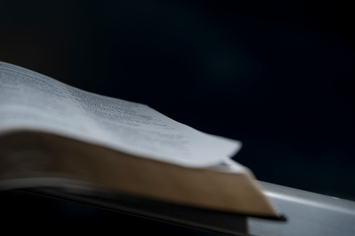
Sermon
Martin
Notes:
Prayers of the People

Slide 17
Nicene Creed
We believe in one God,
the Father, the Almighty,
maker of heaven and earth,
of all that is,
seen and unseen.
We believe in one Lord, Jesus Christ,
the only Son of God,
eternally begotten of the Father,
God from God, Light from Light,
true God from true God,
begotten, not made,
of one Being with the Father;
through him all things were made.
For us and for our salvation he came down from heaven,
was incarnate from the Holy Spirit and the Virgin Mary
and was made man.

Slide 18
Nicene Creed
For our sake he was crucified under Pontius Pilate;
he suffered death and was buried.
On the third day he rose again
in accordance with the Scriptures;
he ascended into heaven
and is seated at the right hand of the Father.
He will come again in glory to judge the living and the dead,
and his kingdom will have no end.
We believe in the Holy Spirit,
the Lord, the giver of life,
who proceeds from the Father and the Son,
who with the Father and the Son is worshipped and glorified,
who has spoken through the prophets.
We believe in one holy catholic and apostolic Church.
We acknowledge one baptism for the forgiveness of sins.
We look for the resurrection of the dead,
and the life of the world to come. Amen.

Slide 19
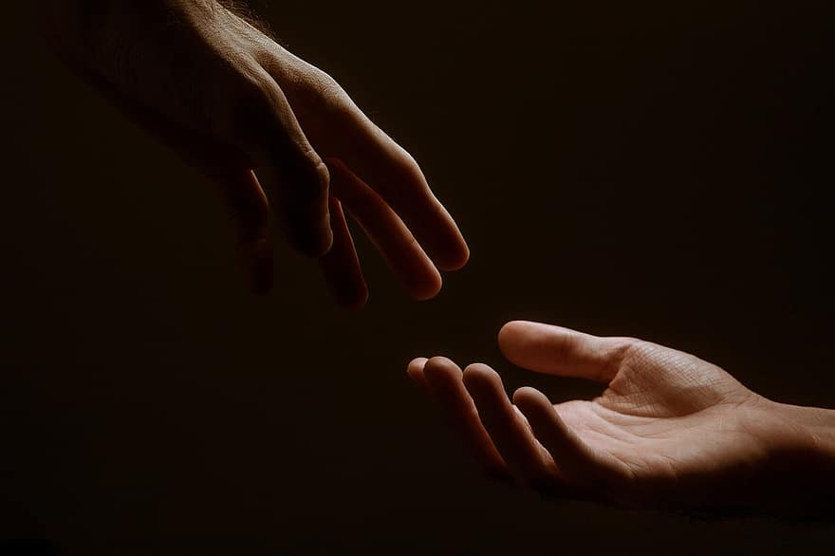
Prayer
Prayers
Let us pray for:
The world in which we live
The people who lead us
The people who need our prayers
The sick and the dying
Our families and loved ones
Lord, in your mercy
Hear our prayer.
Notes:
Prayers of the People

Slide 20
Peace
Jesus Christ is our Peace,
he has reconciled us to God in one body by the Cross.
We meet in his name and share his Peace.
The peace of the Lord be always with you - “Shalom”
And also with you - “Shalom”

Slide 21
Alleluia Alleluia
The Diocese of Cyprus and the Gulf

Slide 22
Eucharist
Jesus, true vine and bread of life,
ever giving yourself that the world might live,
let us share your death and passion:
make us perfect in your love.
Amen.
The Lord is here
His Spirit is with us.
Lift up your hearts.
We lift them to the Lord.
Let us give thanks to the Lord our God.
It is right to give thanks and praise.

Slide 23
Eucharist
It is indeed right and just,
our duty and our salvation,
always and everywhere to give you thanks,
holy Father, almighty and eternal God,
through Jesus Christ our Lord.
But chiefly are we bound to praise you
because you raised him
gloriously from the dead.
For he is the true paschal lamb
who was offered for us
and has taken away the sin of the world.
By his death he has destroyed death
and by his rising to life again
he has restored to us everlasting life.
Therefore with angels and archangels,
and with all the company of heaven,
we proclaim your great and glorious name,
for ever praising you and saying:
Holy, Holy, Holy Lord
God of Power and Might.
Heaven and Earth
are full of your Glory
Hosannah in the highest.
Blessed is the one
who comes in the name of the Lord.
Hosannah in the highest.

Slide 24
Eucharist
Accept our praises, heavenly Father,
through your Son our Saviour Jesus Christ,
and as we follow his example and obey his command, grant that by the power of your Holy Spirit these gifts of bread and wine
may be to us his body and his blood;
who, in the same night that he was betrayed,
took bread and gave you thanks;
he broke it and gave it to his disciples, saying:
Take, eat; this is my body which is given for you; do this in remembrance of me.
In the same way, after supper he took the cup and gave you thanks; he gave it to them, saying:
Drink this, all of you; this is my blood of the new covenant, which is shed for you and for many for the forgiveness of sins.
Do this, as often as you drink it,
in remembrance of me.
Great is the mystery of faith:
Christ has died.
Christ is risen.
Christ will come again.

Slide 25
Eucharist
Accept through him, our great high priest,
this our sacrifice of thanks and praise,
and as we eat and drink these holy gifts
in the presence of your divine majesty,
renew us by your Spirit,
inspire us with your love
and unite us in the body of your Son,
Jesus Christ our Lord.
Through him, and with him, and in him,
in the unity of the Holy Spirit,
with all who stand before you
in earth and heaven,
we worship you, Father almighty,
in songs of everlasting praise:
Blessing and honour and glory and power
be yours for ever and ever.
Amen.

Slide 26
Eucharist
Our Father,
who art in heaven,
hallowed be thy name;
thy kingdom come;
thy will be done;
on earth as it is in heaven.
Give us this day our daily bread.
And forgive us our trespasses,
as we forgive those
who trespass against us.
And lead us not into temptation;
but deliver us from evil.
For thine is the kingdom,
the power, and the glory,
for ever and ever.
Amen.
Every time we eat this bread
and drink this cup,
we proclaim the Lord’s death
until he comes.
Jesus, Lamb of God, have mercy on us.
Jesus, bearer of our sins,
have mercy on us.
Jesus, redeemer of the world,
grant us your peace.
Draw near with faith.
Receive the body of our Lord Jesus Christ
which he gave for you,
and his blood which he shed for you.
Eat and drink
in remembrance that he died for you,
and feed on him in your hearts
by faith with thanksgiving.

Slide 27
Eucharist
Prayer:
God of Life,
who for our redemption gave your only-begotten Son
to the death of the cross,
and by his glorious resurrection
have delivered us from the power of our enemy:
grant us so to die daily to sin,
that we may evermore live with him in the joy of his risen life;
through Jesus Christ our Lord.
Amen.

Slide 28
Praise my Soul the King of Heaven
The Diocese of Cyprus and the Gulf

Slide 29
Blessing and Dismissal
The God of peace,
who brought again from the dead
our Lord Jesus,
that great shepherd of the sheep,
through the blood
of the eternal covenant,
make you perfect
in every good work to do his will,
working in you that which is
well-pleasing in his sight;
and the blessing of God almighty,
the Father, the Son,
and the Holy Spirit,
be among you
and remain with you always.
Amen.
With the power that raised Jesus from the dead at work within you,
go in peace to love and serve the Lord. Alleluia, alleluia.
In the name of Christ. Alleluia, alleluia.

Slide 30
Easter Day
5th April 2026
St Christopher’s Cathedral and Awali Church, Bahrain

