Slide 1

Holy Communion
20th March 2026
St Christopher’s Cathedral and Awali Church, Bahrain
Riyadh Fellowship, Saudi Arabia
The Diocese of Cyprus and the Gulf

Slide 2
10000 Reasons
The Diocese of Cyprus and the Gulf

Slide 3
Welcome
Opening Acclamation:
Grace, mercy and peace from God our Father and the Lord Jesus Christ be with you.
And also with you.
We give thanks for this penitential journey to the cross.
Lord bless us and save us.
Amen
Almighty God,
to whom all hearts are open,
all desires known,
and from whom no secrets are hidden:
cleanse the thoughts of our hearts
by the inspiration of your Holy Spirit,
that we may perfectly love you,
and worthily magnify your holy name;
through Christ our Lord.
Amen.

Slide 4
Prayer
Confession:
Let us confess our sins to Almighty God:
Most merciful God, we confess that we have sinned against you in thought, word and deed, by what we have done and by what we have left undone. We have not loved you with our whole heart. We have not loved our neighbours as ourselves. In your mercy forgive what we have been, help us to amend what we are, and direct what we shall be; through Jesus Christ our Lord. Amen.
Almighty God have mercy upon you,
forgive you all your sins
through our Lord Jesus Christ,
strengthen you in all goodness,
and by the power of the Holy Spirit
Keep you in eternal life. Amen.

Slide 5
Prayer
Collect for the 5th Sunday of Lent:
Most merciful God,
who by the death and resurrection of your Son Jesus Christ
delivered and saved the world:
grant that by faith in him who suffered on the cross
we may triumph in the power of his victory;
through Jesus Christ your Son our Lord,
who is alive and reigns with you,
in the unity of the Holy Spirit,
one God, now and for ever.
Amen.

Slide 6
Apostles Creed
I believe in God, the Father almighty,
creator of heaven and earth.
I believe in Jesus Christ, his only Son, our Lord,
who was conceived by the Holy Spirit,
born of the Virgin Mary,
suffered under Pontius Pilate,
was crucified, died, and was buried;
he descended to the dead.
On the third day he rose again;
he ascended into heaven,
he is seated at the right hand of the Father,
and he will come to judge the living and the dead.
I believe in the Holy Spirit,
the holy catholic Church,
the communion of saints,
the forgiveness of sins,
the resurrection of the body,
and the life everlasting.
Amen.

Slide 7
Scripture
Psalm 130:
Out of the depths I cry to you, O LORD.
Lord, hear my voice! Let your ears be attentive to the voice of my supplications!
If you, O LORD, should mark iniquities, Lord, who could stand?
But there is forgiveness with you, so that you may be revered.
I wait for the LORD; my soul waits, and in his word I hope;
my soul waits for the Lord more than those who watch for the morning,
more than those who watch for the morning.
O Israel, hope in the LORD!
For with the LORD there is steadfast love, and with him is great power to redeem.
It is he who will redeem Israel from all its iniquities.
This is he word of the Lord
Thanks be to God

Slide 8
Scripture
Ezekiel 37:1-14
The hand of the LORD came upon me, and he brought me out by the spirit of the LORD and set me down in the middle of a valley; it was full of bones. He led me all around them; there were very many lying in the valley, and they were very dry. He said to me, "Mortal, can these bones live?" I answered, "O Lord GOD, you know." Then he said to me, "Prophesy to these bones and say to them: O dry bones, hear the word of the LORD. Thus says the Lord GOD to these bones: I will cause breath to enter you, and you shall live. I will lay sinews on you and will cause flesh to come upon you and cover you with skin and put breath in you, and you shall live, and you shall know that I am the LORD." So I prophesied as I had been commanded, and as I prophesied, suddenly there was a noise, a rattling, and the bones came together, bone to its bone. I looked, and there were sinews on them, and flesh had come upon them, and skin had covered them, but there was no breath in them. Then he said to me, "Prophesy to the breath, prophesy, mortal, and say to the breath: Thus says the Lord GOD: Come from the four winds, O breath, and breathe upon these slain, that they may live." I prophesied as he commanded me, and the breath came into them, and they lived and stood on their feet, a vast multitude.
...continued

Slide 9
Scripture
Ezekiel 37:1-14
Then he said to me, "Mortal, these bones are the whole house of Israel. They say, 'Our bones are dried up, and our hope is lost; we are cut off completely.' Therefore prophesy and say to them: Thus says the Lord GOD: I am going to open your graves and bring you up from your graves, O my people, and I will bring you back to the land of Israel. And you shall know that I am the LORD when I open your graves and bring you up from your graves, O my people. I will put my spirit within you, and you shall live, and I will place you on your own soil; then you shall know that I, the LORD, have spoken and will act," says the LORD.
This is the word of the Lord.
Thanks be to God.

Slide 10
Scripture
Romans 8:6-11
To set the mind on the flesh is death, but to set the mind on the Spirit is life and peace. For this reason the mind that is set on the flesh is hostile to God; it does not submit to God's law-- indeed, it cannot, and those who are in the flesh cannot please God. But you are not in the flesh; you are in the Spirit, since the Spirit of God dwells in you. Anyone who does not have the Spirit of Christ does not belong to him. But if Christ is in you, then the body is dead because of sin, the Spirit is life because of righteousness. If the Spirit of him who raised Jesus from the dead dwells in you, he who raised Christ Jesus from the dead will give life to your mortal bodies also through his Spirit that dwells in you.
This is the word of the Lord.
Thanks be to God.

Slide 11
Jesus, all for Jesus
The Diocese of Cyprus and the Gulf

Slide 12
Scripture
Hear the Gospel of our Lord Jesus Christ according to John.
Glory to you, O Lord.
Now a certain man was ill, Lazarus of Bethany, the village of Mary and her sister Martha. Mary was the one who anointed the Lord with perfume and wiped his feet with her hair; her brother Lazarus was ill. So the sisters sent a message to Jesus, "Lord, he whom you love is ill."
But when Jesus heard it, he said, "This illness does not lead to death; rather, it is for God's glory, so that the Son of God may be glorified through it." Accordingly, though Jesus loved Martha and her sister and Lazarus, after having heard that Lazarus was ill, he stayed two days longer in the place where he was. Then after this he said to the disciples, "Let us go to Judea again." The disciples said to him, "Rabbi, the Jews were just now trying to stone you, and are you going there again?" Jesus answered, "Are there not twelve hours of daylight? Those who walk during the day do not stumble because they see the light of this world. But those who walk at night stumble because the light is not in them." After saying this, he told them, "Our friend Lazarus has fallen asleep, but I am going there to awaken him."The disciples said to him, "Lord, if he has fallen asleep, he will be all right." Jesus, however, had been speaking about his death, but they thought that he was referring merely to sleep.

Slide 13
Scripture
Then Jesus told them plainly, "Lazarus is dead. For your sake I am glad I was not there, so that you may believe. But let us go to him." Thomas, who was called the Twin, said to his fellow disciples, "Let us also go, that we may die with him." When Jesus arrived, he found that Lazarus had already been in the tomb four days. Now Bethany was near Jerusalem, some two miles away, and many of the Jews had come to Martha and Mary to console them about their brother. When Martha heard that Jesus was coming, she went and met him, while Mary stayed at home. Martha said to Jesus, "Lord, if you had been here, my brother would not have died. But even now I know that God will give you whatever you ask of him." Jesus said to her, "Your brother will rise again." Martha said to him, "I know that he will rise again in the resurrection on the last day." Jesus said to her, "I am the resurrection and the life. Those who believe in me, even though they die, will live, and everyone who lives and believes in me will never die. Do you believe this?" She said to him, "Yes, Lord, I believe that you are the Messiah, the Son of God, the one coming into the world." When she had said this, she went back and called her sister Mary and told her privately, "The Teacher is here and is calling for you."

Slide 14
Scripture
And when she heard it, she got up quickly and went to him. Now Jesus had not yet come to the village but was still at the place where Martha had met him. The Jews who were with her in the house consoling her saw Mary get up quickly and go out. They followed her because they thought that she was going to the tomb to weep there. When Mary came where Jesus was and saw him, she knelt at his feet and said to him, "Lord, if you had been here, my brother would not have died." When Jesus saw her weeping and the Jews who came with her also weeping, he was greatly disturbed in spirit and deeply moved. He said, "Where have you laid him?" They said to him, "Lord, come and see." Jesus began to weep. So the Jews said, "See how he loved him!" But some of them said, "Could not he who opened the eyes of the blind man have kept this man from dying?" Then Jesus, again greatly disturbed, came to the tomb. It was a cave, and a stone was lying against it. Jesus said, "Take away the stone." Martha, the sister of the dead man, said to him, "Lord, already there is a stench because he has been dead four days." Jesus said to her, "Did I not tell you that if you believed you would see the glory of God?" So they took away the stone. And Jesus looked upward and said, "Father, I thank you for having heard me.

Slide 15
Scripture
I knew that you always hear me, but I have said this for the sake of the crowd standing here, so that they may believe that you sent me." When he had said this, he cried with a loud voice, "Lazarus, come out!" The dead man came out, his hands and feet bound with strips of cloth and his face wrapped in a cloth. Jesus said to them, "Unbind him, and let him go." Many of the Jews therefore, who had come with Mary and had seen what Jesus did believed in him.
This is the Gospel of Christ
Praise to you, Lord Jesus.

Slide 16

Sermon
Martin
Notes:
Prayers of the People

Slide 17
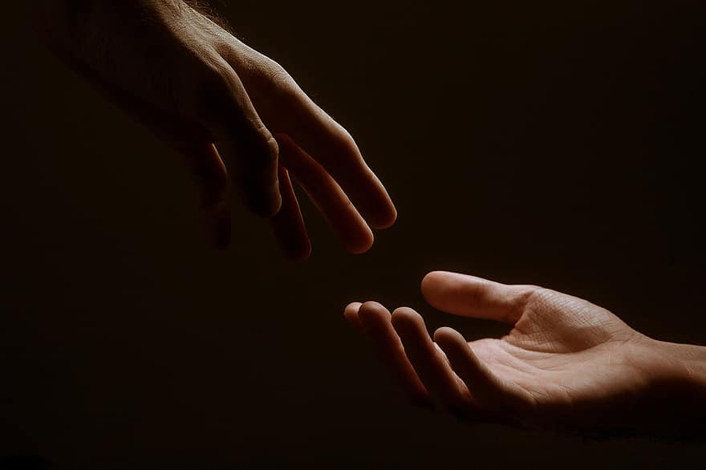
Prayer
Prayers
Let us pray for:
The world in which we live
The people who lead us
The people who need our prayers
The sick and the dying
Our families and loved ones
Lord, in your mercy
Hear our prayer.
Notes:
Prayers of the People

Slide 18
Peace
Jesus Christ is our Peace, he has reconciled us to God in one body by the Cross.
We meet in his name and share his Peace.
The peace of the Lord be always with you - “Shalom”
And also with you - “Shalom”

Slide 19
Praise my Soul
The Diocese of Cyprus and the Gulf

Slide 20
Eucharist
The Lord is here
His Spirit is with us.
Lift up your hearts.
We lift them to the Lord.
Let us give thanks to the Lord our God.
It is right to give thanks and praise.
It is indeed right to give you thanks,
God our Creator,
loving and faithful,
holy and strong.
You made us
and the whole universe,
and filled your world with life.
You sent your Son to live among us,
Jesus our Saviour, Mary’s child.
He suffered on the cross;
he died to save us from our sins;
he rose in glory from the dead.
You send your Spirit
to bring new life to the world,
and clothe us with power from on high.
And so we join angels and archangels
And all the company of heaven
to celebrate and praise your holy name saying:
Holy, Holy, Holy Lord
God of Power and Might.
Heaven and Earth are full of your Glory
Hosannah in the highest.
Blessed is the one who comes in the name of the Lord.

Slide 21
Eucharist
Father, as we bring this bread and wine,
and remember his death and resurrection,
send your Holy Spirit,
that we who share these gifts
may be fed by Christ’s body and his blood.
Pour your Spirit on us
that we may love one another,
work for the healing of the earth,
and share the good news of Jesus,
as we wait for his coming in glory.
For honour and praise belong to you, Father,
with Jesus your Son, and the Holy Spirit:
one God, for ever and ever.
Amen
Father, on the night before he died,
Jesus shared a meal with his friends.
He took the bread, and thanked you.
He broke it, and gave it to them, saying:
Take and eat; this is my body, given for you.
Do this to remember me.
After the meal, Jesus took the cup of wine.
He thanked you, and gave it to them, saying:
Drink this, all of you.
This is my blood,
the new promise of God’s unfailing love.
Do this to remember me.
Great is the mystery of faith:
Christ has died.
Christ is risen.
Christ will come again.

Slide 22
Eucharist
Our Father,
who art in heaven,
hallowed be thy name;
thy kingdom come;
thy will be done;
on earth as it is in heaven.
Give us this day our daily bread.
And forgive us our trespasses,
as we forgive those who trespass against us.
And lead us not into temptation;
but deliver us from evil.
For thine is the kingdom,
the power, and the glory,
for ever and ever. Amen.
Draw near with faith
Eat and drink of the body and blood
Of our Lord Jesus Christ
And feed upon him by Faith with thanksgiving
Glory to God in the highest,
and peace to his people on earth.
Lord God, heavenly King,
almighty God and Father,
we worship you, we give you thanks,
we praise you for your glory.
Lord Jesus Christ, only Son of the Father,
Lord God, Lamb of God,
you take away the sin of the world:
have mercy on us;
you are seated at the right hand of the Father:
receive our prayer.
For you alone are the Holy One,
you alone are the Lord,
you alone are the Most High, Jesus Christ,
with the Holy Spirit,
in the glory of God the Father.
Brothers and sisters, let us share these gifts of God,
Amen

Slide 23
Amazing Grace
The Diocese of Cyprus and the Gulf

Slide 24
Prayer
Prayer:
Lord and heavenly Father,
we offer you through your dear Son Jesus Christ
this our sacrifice of praise and thanksgiving.
Grant that by his merits and death,
and through faith in his blood,
we and all your Church may receive forgiveness of our sins
and all other benefits of his passion.
And here we offer and present to you,
O Lord, ourselves, our souls and our bodies,
to be a reasonable, holy and living sacrifice;
fill us all who share in this holy communion
with your grace and heavenly blessing. Amen.

Slide 25
Blessing
Blessing:
May the God of peace sanctify you wholly;
that your spirit and soul and body be kept sound and blameless
at the coming of our Lord Jesus Christ;
and the blessing of God Almighty, the Father, the Son and the Holy Spirit
Rest upon you and keep you and all whom you love, safe and well, for evermore, Amen.
Closing Prayer:
God our Redeemer show us compassion and love. Lead us, guide us, fill us with your Spirit. Show us the way from darkness to light that we may be the light of the world; so go in the light of Jesus.
In the name of Christ, Amen.

Slide 26
Holy Communion
20th March 2026
St Christopher’s Cathedral and Awali Church, Bahrain
Riyadh Fellowship, Saudi Arabia
The Diocese of Cyprus and the Gulf

