Slide 1
Daily Prayer for 6th April 2026 St Christopher’s Cathedral and Awali Church, Bahrain

Slide 2
Daily Prayer for 6th April 2026 St Christopher’s Cathedral, Bahrain
“Be not Afraid”

Slide 3
Welcome
Opening Acclamation: Grace, mercy and peace from God our Father and the Lord Jesus Christ be with you. And also with you.
Jesus Christ is risen from the dead; alleluia!
He is risen indeed; alleluia!
Amen
Blessed are you, Lord God of our salvation,
to you be glory and praise for ever.
In the darkness of our sin you have shone in our hearts
to give the light of the knowledge of the glory of God
in the face of Jesus Christ.
Open our eyes to acknowledge your presence,
that freed from the misery of sin and shame
we may grow into your likeness from glory to glory.
Blessed be God, Father, Son and Holy Spirit.
Amen.

Slide 4
Prayer
Confession: Most merciful God, we confess that we have sinned against you in thought, word and deed, by what we have done and by what we have left undone. We have not loved you with our whole heart. We have not loved our neighbours as ourselves. In your mercy forgive what we have been, help us to amend what we are, and direct what we shall be; through Jesus Christ our Lord. Amen.
Almighty God have mercy upon you,
forgive you all your sins
through our Lord Jesus Christ,
strengthen you in all goodness,
and by the power of the Holy Spirit
Keep you in eternal life. Amen.

Slide 5
Prayer
Collect for St Juliana on 6th April: Dear Lord, we thank You for giving us St. Juliana Falconieri
as an example of holiness.
Help us to imitate the love of You she showed
from the time she was a young girl
being raised by her mother and uncle
and may we show the same mercy
to the chronically sick
that she demonstrated
throughout her life;
through Jesus Christ your Son our Lord,
who is alive and reigns with you,
in the unity of the Holy Spirit,
one God, now and for ever.
Amen.

Slide 6
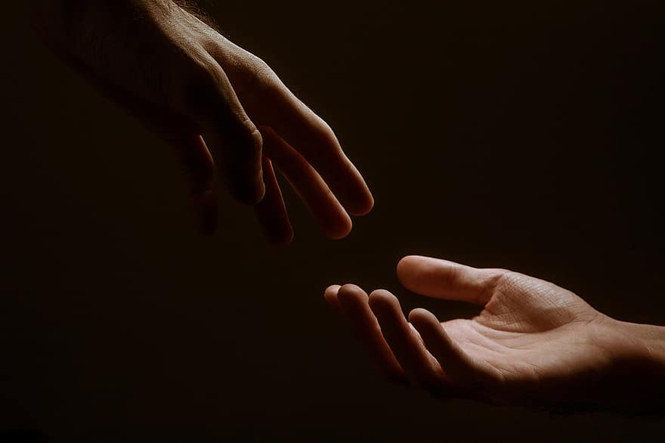
Prayer
Prayers
Let us pray for:
The world in which we live
The people who lead us
The people who need our prayers
The sick and the dying
Our families and loved ones
Lord, in your mercy
Hear our prayer.
Notes:
Prayers of the People

Slide 7
Magnificat
My soul proclaims the greatness of the Lord, my spirit rejoices in God my Saviour;
he has looked with favour on his lowly servant.
From this day all generations will call me blessed;
the Almighty has done great things for me and holy is his name.
He has mercy on those who fear him,
from generation to generation.
He has shown strength with his arm
and has scattered the proud in their conceit,
Casting down the mighty from their thrones
and lifting up the lowly.
He has filled the hungry with good things
and sent the rich away empty.
He has come to the aid of his servant Israel,
to remember his promise of mercy,
The promise made to our ancestors,
to Abraham and his children for ever.
Glory to the Father and to the Son and to the Holy Spirit;
as it was in the beginning is now and shall be for ever. Amen.

Slide 8
Scripture
Psalm 135: The idols of the nations are but silver and gold,
the work of human hands.
They have mouths, but cannot speak;
eyes have they, but cannot see;
They have ears, but cannot hear;
neither is there any breath in their mouths.
Those who make them shall become like them,
and so will all who put their trust in them. R
Bless the Lord, O house of Israel;
O house of Aaron, bless the Lord.
Bless the Lord, O house of Levi;
you who fear the Lord, bless the Lord.
Blessed be the Lord from Zion,
who dwells in Jerusalem. Alleluia.
Glory to the Father and to the Son and to the Holy Spirit;
as it was in the beginning is now and shall be for ever. Amen.

Slide 9
Scripture
Mark 16: When the sabbath was over, Mary Magdalene, and Mary the mother of James, and Salome bought spices, so that they might go and anoint him. And very early on the first day of the week, when the sun had risen, they went to the tomb. They had been saying to one another, ‘Who will roll away the stone for us from the entrance to the tomb?’ When they looked up, they saw that the stone, which was very large, had already been rolled back. As they entered the tomb, they saw a young man, dressed in a white robe, sitting on the right side; and they were alarmed. But he said to them, ‘Do not be alarmed; you are looking for Jesus of Nazareth, who was crucified. He has been raised; he is not here. Look, there is the place they laid him. But go, tell his disciples and Peter that he is going ahead of you to Galilee; there you will see him, just as he told you.’ So they went out and fled from the tomb, for terror and amazement had seized them; and they said nothing to anyone, for they were afraid.
This is the word of the Lord.
Thanks be to God.

Slide 10
Collects
As our evening prayer rises before you, O God,
so may your mercy come down upon us
to cleanse our hearts
and set us free to sing your praise
now and for ever. Amen.
Lighten our darkness, Lord we pray
And in your great mercy,
defend us from all perils and dangers of this night,
For the sake of your Son, our Saviour, Jesus Christ, Amen.

Slide 11
Blessing
Lord’s Prayer: Our Father, who art in heaven, hallowed be thy name; thy kingdom come; thy will be done; on earth as it is in heaven. Give us this day our daily bread. And forgive us our trespasses, as we forgive those who trespass against us. And lead us not into temptation; but deliver us from evil. For thine is the kingdom, the power, and the glory, for ever and ever. Amen. Blessing: May the God of peace sanctify you wholly;
and may your spirit and soul and body be kept sound and blameless
at the coming of our Lord Jesus Christ;
and the blessing of God Almighty, the Father, the Son and the Holy Spirit
Rest upon you and keep you and all whom you love, safe and well, for evermore, Amen.
Closing Prayer:
God our Hope, hear the prayer of our heart and the cries of our mouth. Show us the meaning of hope amidst darkness and desolation that we may see the light of Christ. Amen

Slide 12
Daily Prayer for 6th April 2026 St Christopher’s Cathedral, Bahrain "Give me a sight O Savious"

Slide 13
Daily Prayer for 6th April 2026 St Christopher’s Cathedral and Awali Church, Bahrain

