Slide 1


Prayer Service 11.00am 23rd March 2026 This is Bahrain
The Diocese of Cyprus and the Gulf
with This is Bahrain

Slide 2
Holy Holy Holy
The Diocese of Cyprus and the Gulf

Slide 3
Welcome
Opening Acclamation: Grace, mercy and peace from God our Father and the Lord Jesus Christ be with you. And also with you.
We give thanks for this penitential journey to the cross.
Lord bless us and save us.
Amen
Blessed are you, Lord God of our salvation,
to you be glory and praise for ever.
In the darkness of our sin you have shone in our hearts
to give the light of the knowledge of the glory of God
in the face of Jesus Christ.
Open our eyes to acknowledge your presence,
that freed from the misery of sin and shame
we may grow into your likeness from glory to glory.
Blessed be God, Father, Son and Holy Spirit.
Amen.

Slide 4
Prayer
Collect for Lent: Almighty and everlasting God,
you hate nothing that you have made
and forgive the sins of all those who are penitent:
create and make in us new and contrite hearts
that we, worthily lamenting our sins
and acknowledging our wretchedness,
may receive from you, the God of all mercy,
perfect remission and forgiveness;
through Jesus Christ your Son our Lord,
who is alive and reigns with you,
in the unity of the Holy Spirit,
one God, now and for ever.
Amen.

Slide 5
Prayer
Prayer for Bahrain and the Gulf At this time of conflict, war and global strife,
O God, from whom all holy desires,
all good counsels, and all just works do proceed;
Shine you light into the darkness of men and women’s hearts.
Give to your servants in Bahrain and the gulf
that peace which the world cannot give;
that our hearts may be set to obey your commandments,
and also that we, being defended from the fear of our enemies,
may pass our time in rest and quietness;
through the merits of Jesus Christ our Saviour.
Amen.

Slide 6
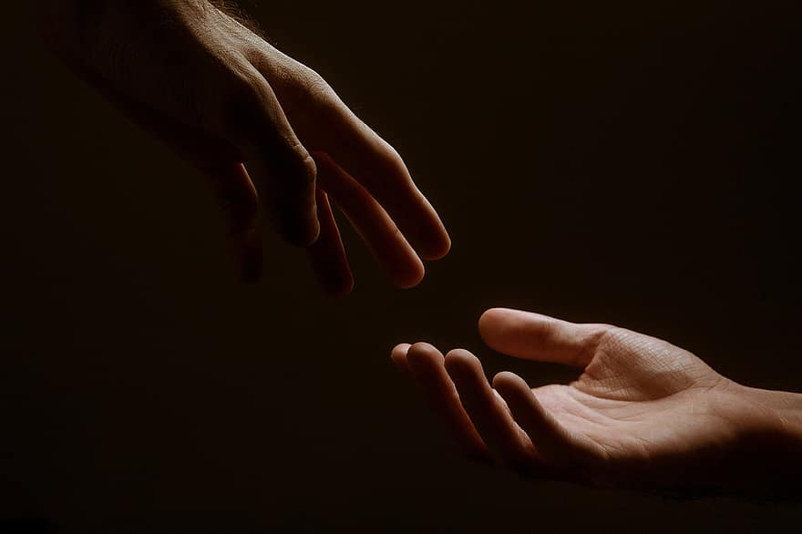
Prayer – Bishop of Cyprus and the Gulf
Notes:
Prayers of the People

Slide 7
Prayer – Global President of the Mother’s Union
Notes:
Prayers of the People

Slide 8
Prayer
Prayers
Let us pray for:
The world in which we live
The people who lead us
The people who need our prayers
The sick and the dying
Our families and loved ones
Lord, in your mercy
Hear our prayer.
Notes:
Prayers of the People

Slide 9
In Our Darkness
The Diocese of Cyprus and the Gulf

Slide 10
Blessing
Lord’s Prayer: Our Father, who art in heaven, hallowed be thy name; thy kingdom come; thy will be done; on earth as it is in heaven. Give us this day our daily bread. And forgive us our trespasses, as we forgive those who trespass against us. And lead us not into temptation; but deliver us from evil. For thine is the kingdom, the power, and the glory, for ever and ever. Amen. Blessing: May the God of peace sanctify you wholly;
and may your spirit and soul and body be kept sound and blameless
at the coming of our Lord Jesus Christ;
and the blessing of God Almighty, the Father, the Son and the Holy Spirit
Rest upon you and keep you and all whom you love, safe and well, for evermore, Amen.
Closing Prayer:
God our Hope, hear the prayer of our heart and the cries of our mouth. Show us the meaning of hope amidst darkness and desolation that we may see the light of Christ; through our Lord, Jesus Christ. Amen

Slide 11
Prayer Service Thank you and may God Bless You
The Diocese of Cyprus and the Gulf
with This is Bahrain

