Slide 1
Easter day 10th April 2026 St Christopher’s Cathedral and Awali Church, Bahrain

Slide 2
Tell Out My Soul

Slide 3
Tell Out My Soul
Tell out, my soul, the greatness of the Lord!
Unnumbered blessings give my spirit voice;
tender to me the promise of his word –
in God my Saviour shall my heart rejoice.
Tell out, my soul, the greatness of his name!
Make known his might, the deeds his arm has done;
his mercy sure, from age to age the same –
his holy name: the Lord, the Mighty One.

Slide 4
Tell Out My Soul
Tell out, my soul, the greatness of his might!
Powers and dominions lay their glory by;
proud hearts and stubborn wills are put to flight,
the hungry fed, the humble lifted high.
Tell out, my soul, the glories of his word!
Firm is his promise, and his mercy sure:
tell out, my soul, the greatness of the Lord
to children’s children and for evermore!

Slide 5
Welcome
Opening Acclamation: Alleluia! Christ is risen.
He is risen indeed. Alleluia!
Today we celebrate the glorious resurrection of our Lord Jesus Christ.
From the darkness of death, God has brought forth life;
from despair, hope; from sorrow, joy. On this day the stone is rolled away, the tomb stands empty, and Christ is alive for evermore. As we gather, we rejoice that nothing can separate us from the love of God.
We come to worship with glad hearts, to proclaim the victory of life over death, and to share in the new life Christ gives.
Alleluia! Christ is risen.
He is risen indeed. Alleluia!

Slide 6
Welcome
Almighty God,
to whom all hearts are open,
all desires known,
and from whom no secrets are hidden:
cleanse the thoughts of our hearts
by the inspiration of your Holy Spirit,
that we may perfectly love you,
and worthily magnify your holy name;
through Christ our Lord.
Amen.

Slide 7
Prayer
Confession: God shows his love for us
in that, while we were still sinners, Christ died for us.
Let us then show our love for him
by confessing our sins in penitence and faith.
Most merciful God, we confess that we have sinned against you in thought, word and deed, by what we have done and by what we have left undone. We have not loved you with our whole heart. We have not loved our neighbours as ourselves. In your mercy forgive what we have been, help us to amend what we are, and direct what we shall be; through Jesus Christ our Lord. Amen.

Slide 8
Prayer
Absolution: Almighty God have mercy upon you,
forgive you all your sins
through our Lord Jesus Christ,
strengthen you in all goodness,
and by the power of the Holy Spirit
Keep you in eternal life.
Amen.

Slide 9
Gloria
Glory to God in the highest,
and peace to his people on earth.
Lord God, heavenly King,
almighty God and Father,
we worship you, we give you thanks,
we praise you for your glory.
Lord Jesus Christ, only Son of the Father,
Lord God, Lamb of God,
you take away the sin of the world:
have mercy on us;
you are seated at the right hand of the Father:
receive our prayer.
For you alone are the Holy One,
you alone are the Lord,
you alone are the Most High, Jesus Christ,
with the Holy Spirit,
in the glory of God the Father.
Amen.

Slide 10
Prayer
Collect: Almighty Father,
you have given your only Son to die for our sins
and to rise again for our justification:
grant us so to put away the leaven of malice and wickedness
that we may always serve you
in pureness of living and truth;
through the merits of your Son Jesus Christ our Lord,
who is alive and reigns with you,
in the unity of the Holy Spirit,
one God, now and for ever.
Amen.

Slide 11
Scripture – Psalm 118
Protect me, O God, for in you I take refuge.
I say to the LORD, "You are my Lord; I have no good apart from you."
As for the holy ones in the land,
they are the noble ones in whom is all my delight.
Those who choose another god multiply their sorrows;
their drink offerings of blood I will not pour out or take their names upon my lips.
The LORD is my chosen portion and my cup; you hold my lot.
The boundary lines have fallen for me in pleasant places; I have a goodly heritage.
I bless the LORD, who gives me counsel;
in the night also my heart instructs me.
I keep the LORD always before me;
because he is at my right hand, I shall not be moved.
Therefore my heart is glad, and my soul rejoices; my body also rests secure.
For you do not give me up to Sheol or let your faithful one see the Pit.
You show me the path of life. In your presence there is fullness of joy;
in your right hand are pleasures forevermore.
This is the word of the Lord
Thanks be to God

Slide 12
Scripture – Acts 2:14, 22-32
But Peter, standing with the eleven, raised his voice and addressed them, "Fellow Israelites, listen to what I have to say: Jesus of Nazareth, a man attested to you by God with deeds of power, wonders, and signs that God did through him among you, as you yourselves know this man, handed over to you according to the definite plan and foreknowledge of God, you crucified and killed by the hands of those outside the law. But God raised him up, having released him from the agony of death, because it was impossible for him to be held in its power. For David says concerning him, 'I saw the Lord always before me, for he is at my right hand so that I will not be shaken; therefore my heart was glad, and my tongue rejoiced; moreover, my flesh will live in hope. For you will not abandon my soul to Hades or let your Holy One experience corruption. You have made known to me the ways of life; you will make me full of gladness with your presence.’ "Fellow Israelites, I may say to you confidently of our ancestor David that he both died and was buried, and his tomb is with us to this day. Since he was a prophet, he knew that God had sworn with an oath to him that he would put one of his descendants on his throne. Foreseeing this, David spoke of the resurrection of the Messiah, saying, 'He was not abandoned to Hades, nor did his flesh experience corruption.’ "This Jesus God raised up, and of that all of us are witnesses
This is the word of the Lord
Thanks be to God

Slide 13
Scripture – 1 Peter 1:3-9
Blessed be the God and Father of our Lord Jesus Christ! By his great mercy he has given us a new birth into a living hope through the resurrection of Jesus Christ from the dead and into an inheritance that is imperishable, undefiled, and unfading, kept in heaven for you, who are being protected by the power of God through faith for a salvation ready to be revealed in the last time. In this you rejoice, even if now for a little while you have had to suffer various trials, so that the genuineness of your faith--being more precious than gold that, though perishable, is tested by fire--may be found to result in praise and glory and honor when Jesus Christ is revealed. Although you have not seen him, you love him, and even though you do not see him now, you believe in him and rejoice with an indescribable and glorious joy, for you are receiving the outcome of your faith, the salvation of your souls.
This is the word of the Lord
Thanks be to God

Slide 14
My Jesus My Saviour

Slide 15
My Jesus My Saviour
My Jesus, my Savior
Lord there is none like you
All of my days
I want to praise
The wonders of
your mighty love
My comfort, my shelter
Tower of refuge and strength
Let every breath, all that I am
Never cease to worship You
Shout to the Lord,
all the earth let us sing
Power and majesty,
praise to the King
Mountains bow down
and the seas will roar
At the sound of Your name
I sing for joy at the
work of your hands
Forever I'll love you,
forever I'll stand
Nothing compares to the promise
I have in you

Slide 16
Gospel Acclamation
Praise to you, O Christ, King of eternal glory.
Christ humbled himself and became obedient unto death,
even death on a cross.
Therefore God has highly exalted him
and given him the name that is above every name.
Praise to you, O Christ, King of eternal glory.

Slide 17
Gospel
Hear the Gospel of our Lord Jesus Christ according to John.
Glory to you, O Lord.
When it was evening on that day, the first day of the week, and the doors were locked where the disciples were, for fear of the Jews, Jesus came and stood among them and said, "Peace be with you.“ After he said this, he showed them his hands and his side. Then the disciples rejoiced when they saw the Lord. Jesus said to them again, "Peace be with you. As the Father has sent me, so I send you.“ When he had said this, he breathed on them and said to them, "Receive the Holy Spirit. If you forgive the sins of any, they are forgiven them; if you retain the sins of any, they are retained.“ But Thomas (who was called the Twin), one of the twelve, was not with them when Jesus came. So the other disciples told him, "We have seen the Lord."

Slide 18
Gospel
But he said to them, "Unless I see the mark of the nails in his hands and put my finger in the mark of the nails and my hand in his side, I will not believe.“ A week later his disciples were again in the house, and Thomas was with them. Although the doors were shut, Jesus came and stood among them and said, "Peace be with you.“ Then he said to Thomas, "Put your finger here and see my hands. Reach out your hand and put it in my side. Do not doubt but believe.“ Thomas answered him, "My Lord and my God!“ Jesus said to him, "Have you believed because you have seen me? Blessed are those who have not seen and yet have come to believe.“ Now Jesus did many other signs in the presence of his disciples that are not written in this book. But these are written so that you may continue to believe that Jesus is the Messiah, the Son of God, and that through believing you may have life in his name.
This is the Gospel of the Lord.
Praise to you, O Christ.

Slide 19
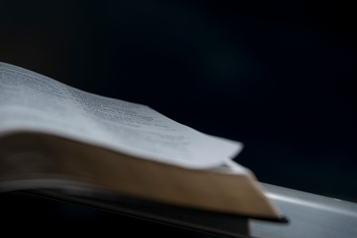
Sermon
Martin
Notes:
Prayers of the People

Slide 20
Nicene Creed
We believe in one God,
the Father, the Almighty,
maker of heaven and earth,
of all that is,
seen and unseen.
We believe in one Lord, Jesus Christ,
the only Son of God,
eternally begotten of the Father,
God from God, Light from Light,
true God from true God,
begotten, not made,
of one Being with the Father;
through him all things were made.
For us and for our salvation he came down from heaven,
was incarnate from the Holy Spirit and the Virgin Mary
and was made man.

Slide 21
Nicene Creed
For our sake he was crucified under Pontius Pilate;
he suffered death and was buried.
On the third day he rose again
in accordance with the Scriptures;
he ascended into heaven
and is seated at the right hand of the Father.
He will come again in glory to judge the living and the dead,
and his kingdom will have no end.
We believe in the Holy Spirit,
the Lord, the giver of life,
who proceeds from the Father and the Son,
who with the Father and the Son is worshipped and glorified,
who has spoken through the prophets.
We believe in one holy catholic and apostolic Church.
We acknowledge one baptism for the forgiveness of sins.
We look for the resurrection of the dead,
and the life of the world to come. Amen.

Slide 22
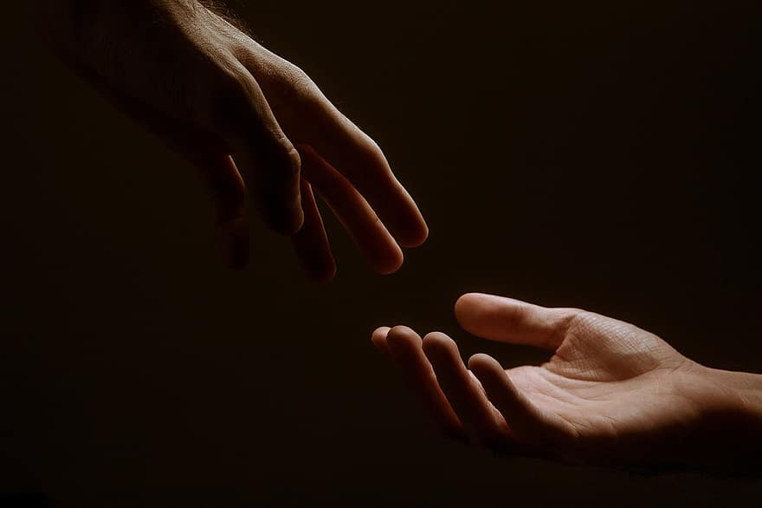
Prayer
Prayers
Let us pray for:
The world in which we live
The people who lead us
The people who need our prayers
The sick and the dying
Our families and loved ones
Lord, in your mercy
Hear our prayer.
Notes:
Prayers of the People

Slide 23
Peace
Jesus Christ is our Peace,
he has reconciled us to God in one body by the Cross.
We meet in his name and share his Peace.
The peace of the Lord be always with you - “Shalom”
And also with you - “Shalom”

Slide 24
These are the Days of Elijah

Slide 25
These are the Days of Elijah
These are the days of Elijah
Declaring the Word of the Lord
And these are the days
of Your servant Moses
Righteousness being restored
And though these are days of great trials
Of famine and darkness and sword
Still we are the voice
in the desert crying
Prepare ye the way of the Lord!
Behold He comes,
riding on the clouds
Shining like the sun,
at the trumpet call
Lift your voice,
it’s the year of Jubilee
And out of Zion’s hill
salvation comes

Slide 26
These are the Days of Elijah
And these are the days of Ezekiel
The dry bones becoming as flesh
And these are the days
of Your servant David
Rebuilding a temple of praise
And these are the days of the harvest
The fields are as white in the world
And we are the laborers in Your vineyard
Declaring the Word of the Lord
Behold He comes,
riding on the clouds
Shining like the sun,
at the trumpet call
Lift your voice,
it’s the year of Jubilee
And out of Zion’s hill
salvation comes

Slide 27
Eucharist
Jesus, true vine and bread of life,
ever giving yourself that the world might live,
let us share your death and passion:
make us perfect in your love.
Amen.
The Lord is here
His Spirit is with us.
Lift up your hearts.
We lift them to the Lord.
Let us give thanks to the Lord our God.
It is right to give thanks and praise.

Slide 28
Eucharist
It is indeed right and just,
our duty and our salvation,
always and everywhere to give you thanks,
holy Father, almighty and eternal God,
through Jesus Christ our Lord.
But chiefly are we bound to praise you
because you raised him
gloriously from the dead.
For he is the true paschal lamb
who was offered for us
and has taken away the sin of the world.
By his death he has destroyed death
and by his rising to life again
he has restored to us everlasting life.
Therefore with angels and archangels,
and with all the company of heaven,
we proclaim your great and glorious name,
for ever praising you and saying:
Holy, Holy, Holy Lord
God of Power and Might.
Heaven and Earth
are full of your Glory
Hosannah in the highest.
Blessed is the one
who comes in the name of the Lord.
Hosannah in the highest.

Slide 29
Eucharist
Accept our praises, heavenly Father,
through your Son our Saviour Jesus Christ,
and as we follow his example and obey his command, grant that by the power of your Holy Spirit these gifts of bread and wine
may be to us his body and his blood;
who, in the same night that he was betrayed,
took bread and gave you thanks;
he broke it and gave it to his disciples, saying:
Take, eat; this is my body which is given for you; do this in remembrance of me.
In the same way, after supper he took the cup and gave you thanks; he gave it to them, saying:
Drink this, all of you; this is my blood of the new covenant, which is shed for you and for many for the forgiveness of sins.
Do this, as often as you drink it,
in remembrance of me.
Great is the mystery of faith:
Christ has died.
Christ is risen.
Christ will come again.

Slide 30
Eucharist
Accept through him, our great high priest,
this our sacrifice of thanks and praise,
and as we eat and drink these holy gifts
in the presence of your divine majesty,
renew us by your Spirit,
inspire us with your love
and unite us in the body of your Son,
Jesus Christ our Lord.
Through him, and with him, and in him,
in the unity of the Holy Spirit,
with all who stand before you
in earth and heaven,
we worship you, Father almighty,
in songs of everlasting praise:
Blessing and honour and glory and power
be yours for ever and ever.
Amen.

Slide 31
Eucharist
Our Father,
who art in heaven,
hallowed be thy name;
thy kingdom come;
thy will be done;
on earth as it is in heaven.
Give us this day our daily bread.
And forgive us our trespasses,
as we forgive those
who trespass against us.
And lead us not into temptation;
but deliver us from evil.
For thine is the kingdom,
the power, and the glory,
for ever and ever.
Amen.
Every time we eat this bread
and drink this cup,
we proclaim the Lord’s death
until he comes.
Jesus, Lamb of God, have mercy on us.
Jesus, bearer of our sins,
have mercy on us.
Jesus, redeemer of the world,
grant us your peace.
Draw near with faith.
Receive the body of our Lord Jesus Christ
which he gave for you,
and his blood which he shed for you.
Eat and drink
in remembrance that he died for you,
and feed on him in your hearts
by faith with thanksgiving.

Slide 32
Eucharist
Prayer: God of Life,
who for our redemption gave your only-begotten Son
to the death of the cross,
and by his glorious resurrection
have delivered us from the power of our enemy:
grant us so to die daily to sin,
that we may evermore live with him in the joy of his risen life;
through Jesus Christ our Lord.
Amen.

Slide 33
Praise to the Lord, the Almighty

Slide 34
Praise to the Lord, the Almighty
Praise to the Lord, the Almighty, the King of creation!
O my soul, praise him, for he is your health and salvation!
Come, all who hear; now to his temple draw near,
join me in glad adoration.
Praise to the Lord, above all things so wondrously reigning;
sheltering you under his wings, and so gently sustaining!
Have you not seen all that is needful has been
sent by his gracious ordaining?

Slide 35
Praise to the Lord, the Almighty
Praise to the Lord,
who will prosper your work and defend you;
surely his goodness and mercy shall daily attend you.
Ponder anew what the Almighty can do,
if with his love he befriends you.
Praise to the Lord! O let all that is in me adore him!
All that has life and breath,
come now with praises before him.
Let the Amen sound from his people again;
gladly forever adore him.

Slide 36
Blessing and Dismissal
The God of peace,
who brought again from the dead
our Lord Jesus,
that great shepherd of the sheep,
through the blood
of the eternal covenant,
make you perfect
in every good work to do his will,
working in you that which is
well-pleasing in his sight;
and the blessing of God almighty,
the Father, the Son,
and the Holy Spirit,
be among you
and remain with you always.
Amen.
With the power that raised Jesus from the dead at work within you,
go in peace to love and serve the Lord. Alleluia, alleluia.
In the name of Christ. Alleluia, alleluia.

Slide 37
10th April 2026 St Christopher’s Cathedral and Awali Church, Bahrain

