Slide 1

Daily Prayer for 26th March 2026 St Christopher’s Cathedral and Awali Church, Bahrain
The Diocese of Cyprus and the Gulf

Slide 2
Daily Prayer for 26th March 2026 St Christopher’s Cathedral, Bahrain
“The Lord Hears the Cry of the Poor”
The Diocese of Cyprus and the Gulf

Slide 3
Welcome
Opening Acclamation: Grace, mercy and peace from God our Father and the Lord Jesus Christ be with you. And also with you.
We give thanks for this penitential journey to the cross.
Lord bless us and save us.
Amen
Blessed are you, Lord God of our salvation,
to you be glory and praise for ever.
In the darkness of our sin you have shone in our hearts
to give the light of the knowledge of the glory of God
in the face of Jesus Christ.
Open our eyes to acknowledge your presence,
that freed from the misery of sin and shame
we may grow into your likeness from glory to glory.
Blessed be God, Father, Son and Holy Spirit.
Amen.

Slide 4
Prayer
Confession: Most merciful God, we confess that we have sinned against you in thought, word and deed, by what we have done and by what we have left undone. We have not loved you with our whole heart. We have not loved our neighbours as ourselves. In your mercy forgive what we have been, help us to amend what we are, and direct what we shall be; through Jesus Christ our Lord. Amen.
Almighty God have mercy upon you,
forgive you all your sins
through our Lord Jesus Christ,
strengthen you in all goodness,
and by the power of the Holy Spirit
Keep you in eternal life. Amen.

Slide 5
Prayer
Collect for Lent: Almighty and everlasting God,
you hate nothing that you have made
and forgive the sins of all those who are penitent:
create and make in us new and contrite hearts
that we, worthily lamenting our sins
and acknowledging our wretchedness,
may receive from you, the God of all mercy,
perfect remission and forgiveness;
through Jesus Christ your Son our Lord,
who is alive and reigns with you,
in the unity of the Holy Spirit,
one God, now and for ever.
Amen.

Slide 6
Prayer
Collect for St Margaret on 26th March Merciful God,
you gave Saint Margaret of Scotland great love for the poor.
Help us to live by her example
so that your goodness and mercy
are visible in today's world.
May we always be ready to share with the poor,
in our own country and in other,
more needy parts of the world.
Through Jesus Christ, your Son,
who lives and reigns with you
in the unity of the Holy Spirit,
one God, for ever and ever.
Amen.

Slide 7
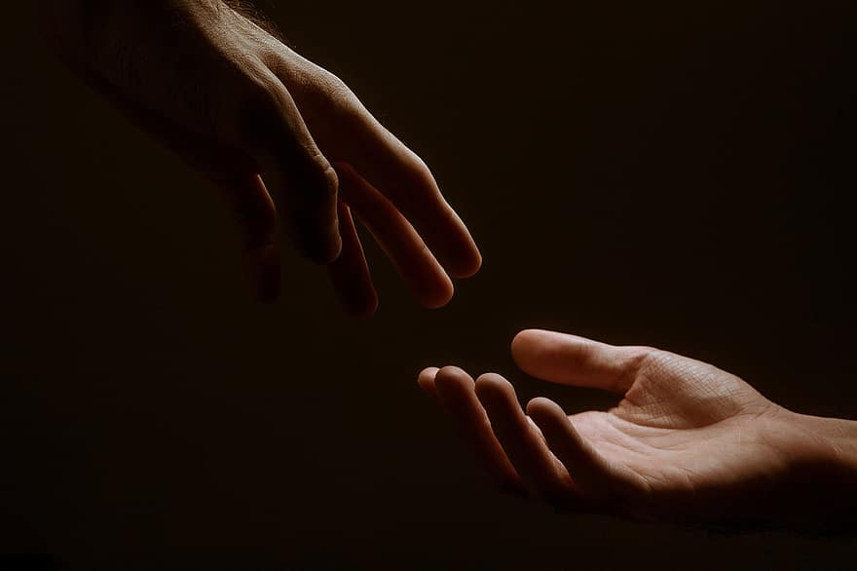
Prayer
Prayers
Let us pray for:
The world in which we live
The people who lead us
The people who need our prayers
The sick and the dying
Our families and loved ones
Lord, in your mercy
Hear our prayer.
Notes:
Prayers of the People

Slide 8
Magnificat
My soul proclaims the greatness of the Lord, my spirit rejoices in God my Saviour;
he has looked with favour on his lowly servant.
From this day all generations will call me blessed;
the Almighty has done great things for me and holy is his name.
He has mercy on those who fear him,
from generation to generation.
He has shown strength with his arm
and has scattered the proud in their conceit,
Casting down the mighty from their thrones
and lifting up the lowly.
He has filled the hungry with good things
and sent the rich away empty.
He has come to the aid of his servant Israel,
to remember his promise of mercy,
The promise made to our ancestors,
to Abraham and his children for ever.
Glory to the Father and to the Son and to the Holy Spirit;
as it was in the beginning is now and shall be for ever. Amen.

Slide 9
Scripture
Psalm 42: As the deer longs for the water brooks,
so longs my soul for you, O God.
My soul is athirst for God, even for the living God;
when shall I come before the presence of God?
My tears have been my bread day and night,
while all day long they say to me, ‘Where is now your God?’
Now when I think on these things, I pour out my soul:
how I went with the multitude and led the procession to the house of God,
With the voice of praise and thanksgiving,
among those who kept holy day.
Why are you so full of heaviness, O my soul,
and why are you so disquieted within me?
O put your trust in God;
for I will yet give him thanks, who is the help of my countenance, and my God.
Glory to the Father and to the Son and to the Holy Spirit;
as it was in the beginning is now and shall be for ever. Amen.

Slide 10
Scripture
Jeremiah 23: Am I a God near by, says the Lord, and not a God far off? Who can hide in secret places so that I cannot see them? says the Lord. Do I not fill heaven and earth? says the Lord. I have heard what the prophets have said who prophesy lies in my name, saying, ‘I have dreamed, I have dreamed!’ How long? Will the hearts of the prophets ever turn back—those who prophesy lies, and who prophesy the deceit of their own heart? They plan to make my people forget my name by their dreams that they tell one another, just as their ancestors forgot my name for Baal. Let the prophet who has a dream tell the dream, but let the one who has my word speak my word faithfully.
This is the word of the Lord.
Thanks be to God.

Slide 11
Collects
As our evening prayer rises before you, O God,
so may your mercy come down upon us
to cleanse our hearts
and set us free to sing your praise
now and for ever. Amen.
Lighten our darkness, Lord we pray
And in your great mercy,
defend us from all perils and dangers of this night,
For the sake of your Son, our Saviour, Jesus Christ, Amen.

Slide 12
Blessing
Lord’s Prayer: Our Father, who art in heaven, hallowed be thy name; thy kingdom come; thy will be done; on earth as it is in heaven. Give us this day our daily bread. And forgive us our trespasses, as we forgive those who trespass against us. And lead us not into temptation; but deliver us from evil. For thine is the kingdom, the power, and the glory, for ever and ever. Amen. Blessing: May the God of peace sanctify you wholly;
and may your spirit and soul and body be kept sound and blameless
at the coming of our Lord Jesus Christ;
and the blessing of God Almighty, the Father, the Son and the Holy Spirit
Rest upon you and keep you and all whom you love, safe and well, for evermore, Amen.
Closing Prayer:
God our Hope, hear the prayer of our heart and the cries of our mouth. Show us the meaning of hope amidst darkness and desolation that we may see the light of Christ. Amen

Slide 13
Daily Prayer for 26th March 2026 St Christopher’s Cathedral, Bahrain "As the Deer pants for the Water"
The Diocese of Cyprus and the Gulf

Slide 14
Daily Prayer for 26th March 2026 St Christopher’s Cathedral and Awali Church, Bahrain
The Diocese of Cyprus and the Gulf

