Slide 1

Daily Prayer for 9th March 2026
St Christopher’s Cathedral and Awali Church, Bahrain
The Diocese of Cyprus and the Gulf

Slide 2
Daily Prayer for 9th March 2026
St Christopher’s Cathedral, Bahrain
“May Jesus Christ be Praised”
The Diocese of Cyprus and the Gulf

Slide 3
Welcome
Opening Acclamation:
Grace, mercy and peace from God our Father and the Lord Jesus Christ be with you.
And also with you.
We give thanks for this penitential journey to the cross.
Lord bless us and save us.
Amen
Blessed are you, Lord God of our salvation,
to you be glory and praise for ever.
In the darkness of our sin you have shone in our hearts
to give the light of the knowledge of the glory of God
in the face of Jesus Christ.
Open our eyes to acknowledge your presence,
that freed from the misery of sin and shame
we may grow into your likeness from glory to glory.
Blessed be God, Father, Son and Holy Spirit.
Amen.

Slide 4
Prayer
Confession:
Most merciful God, we confess that we have sinned against you in thought, word and deed, by what we have done and by what we have left undone. We have not loved you with our whole heart. We have not loved our neighbours as ourselves. In your mercy forgive what we have been, help us to amend what we are, and direct what we shall be; through Jesus Christ our Lord. Amen.
Almighty God have mercy upon you,
forgive you all your sins
through our Lord Jesus Christ,
strengthen you in all goodness,
and by the power of the Holy Spirit
Keep you in eternal life. Amen.

Slide 5
Prayer
Collect for Lent:
Almighty and everlasting God,
you hate nothing that you have made
and forgive the sins of all those who are penitent:
create and make in us new and contrite hearts
that we, worthily lamenting our sins
and acknowledging our wretchedness,
may receive from you, the God of all mercy,
perfect remission and forgiveness;
through Jesus Christ your Son our Lord,
who is alive and reigns with you,
in the unity of the Holy Spirit,
one God, now and for ever.
Amen.

Slide 6
Prayer
Collect for 9th March
Almighty God,
whose most dear Son went not up to joy but first he suffered pain,
and entered not into glory before he was crucified:
mercifully grant that we, walking in the way of the cross,
may find it none other than the way of life and peace;
through Jesus Christ your Son our Lord,
who is alive and reigns with you,
in the unity of the Holy Spirit,
one God, now and for ever.
Amen.

Slide 7
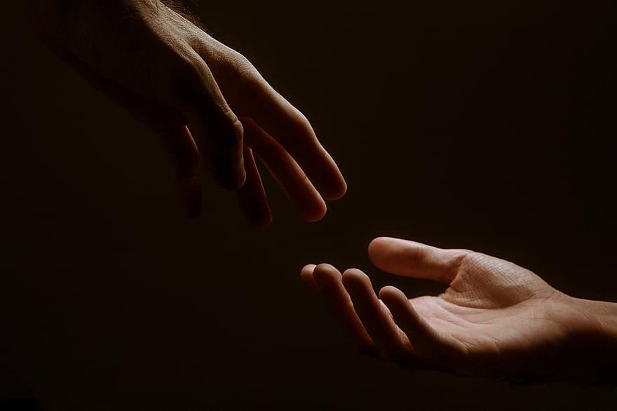
Prayer
Prayers
Let us pray for:
The world in which we live
The people who lead us
The people who need our prayers
The sick and the dying
Our families and loved ones
Lord, in your mercy
Hear our prayer.
Notes:
Prayers of the People

Slide 8
Benedictus
Blessed be the Lord the God of Israel,
who has come to his people and set them free.
He has raised up for us a mighty Saviour,
born of the house of his servant David.
Through his holy prophets God promised of old
to save us from our enemies, from the hands of all that hate us,
To show mercy to our ancestors,
and to remember his holy covenant.
This was the oath God swore to our father Abraham:
to set us free from the hands of our enemies,
Free to worship him without fear,
holy and righteous in his sight all the days of our life.
And you, child, shall be called the prophet of the Most High,
for you will go before the Lord to prepare his way,
To give his people knowledge of salvation
by the forgiveness of all their sins.
In the tender compassion of our God
the dawn from on high shall break upon us,
To shine on those who dwell in darkness and the shadow of death,
and to guide our feet into the way of peace.
Glory to the Father and to the Son and to the Holy Spirit;
as it was in the beginning is now and shall be for ever. Amen.

Slide 9
Scripture
Psalm 7:
O Lord my God, in you I take refuge;
save me from all who pursue me, and deliver me,
Lest they rend me like a lion and tear me in pieces
while there is no one to help me.
O Lord my God, if I have done these things:
if there is any wickedness in my hands,
If I have repaid my friend with evil,
or plundered my enemy without a cause,
Then let my enemy pursue me and overtake me,
trample my life to the ground, and lay my honour in the dust.
Rise up, O Lord, in your wrath; lift yourself up against the fury of my enemies.
Awaken, my God, the judgement that you have commanded.
Let the assembly of the peoples gather round you;
be seated high above them: O Lord, judge the nations.
Glory to the Father and to the Son and to the Holy Spirit;
as it was in the beginning is now and shall be for ever. Amen.

Slide 10
Scripture
Hebrews 5:1-10:
So also Christ did not glorify himself in becoming a high priest, but was appointed by the one who said to him, ‘You are my Son, today I have begotten you’; as he says also in another place, ‘You are a priest for ever, according to the order of Melchizedek.’
In the days of his flesh, Jesus offered up prayers and supplications, with loud cries and tears, to the one who was able to save him from death, and he was heard because of his reverent submission. Although he was a Son, he learned obedience through what he suffered; and having been made perfect, he became the source of eternal salvation for all who obey him, having been designated by God a high priest according to the order of Melchizedek.
This is the word of the Lord.
Thanks be to God.

Slide 11
Collects
As our evening prayer rises before you, O God,
so may your mercy come down upon us
to cleanse our hearts
and set us free to sing your praise
now and for ever. Amen.
Lighten our darkness, Lord we pray
And in your great mercy,
defend us from all perils and dangers of this night,
For the sake of your Son, our Saviour, Jesus Christ, Amen.

Slide 12
Blessing
Lord’s Prayer:
Our Father, who art in heaven, hallowed be thy name; thy kingdom come; thy will be done; on earth as it is in heaven. Give us this day our daily bread. And forgive us our trespasses, as we forgive those who trespass against us. And lead us not into temptation; but deliver us from evil. For thine is the kingdom, the power, and the glory, for ever and ever. Amen.
Blessing:
May the God of peace sanctify you wholly;
and may your spirit and soul and body be kept sound and blameless
at the coming of our Lord Jesus Christ;
and the blessing of God Almighty, the Father, the Son and the Holy Spirit
Rest upon you and keep you and all whom you love, safe and well, for evermore, Amen.
Closing Prayer:
God our Redeemer, hear the prayer of our heart and the cries of our mouth. Send your Holy Spirit upon us and satisfy us with the water of eternal life; through our Lord, Jesus Christ. Amen.

Slide 13
Daily Prayer for 9th March 2026
St Christopher’s Cathedral, Bahrain
"Lord Jesus, think on me"
The Diocese of Cyprus and the Gulf

Slide 14
Daily Prayer for 9th March 2026
St Christopher’s Cathedral and Awali Church, Bahrain
The Diocese of Cyprus and the Gulf

