Slide 1

Daily Prayer for 1st March 2026
St Christopher’s Cathedral, Bahrain
The Diocese of Cyprus and the Gulf

Slide 2
Daily Prayer for 1st March 2026
St Christopher’s Cathedral, Bahrain
"I lift my eyes up to the Mountains; where does my help come from?"
The Diocese of Cyprus and the Gulf

Slide 3
Welcome
Opening Acclamation:
Grace, mercy and peace from God our Father and the Lord Jesus Christ be with you.
And also with you.
We give thanks for this penitential journey to the cross.
Lord bless us and save us.
Amen
Almighty God,
to whom all hearts are open,
all desires known,
and from whom no secrets are hidden:
cleanse the thoughts of our hearts
by the inspiration of your Holy Spirit,
that we may perfectly love you,
and worthily magnify your holy name;
through Christ our Lord.
Amen.
<number>
Lent 2026
1st March 2026

Slide 4
Prayer
Confession:
Most merciful God, we confess that we have sinned against you in thought, word and deed, by what we have done and by what we have left undone. We have not loved you with our whole heart. We have not loved our neighbours as ourselves. In your mercy forgive what we have been, help us to amend what we are, and direct what we shall be; through Jesus Christ our Lord. Amen.
Almighty God have mercy on you,
forgive you all your sins
through our Lord Jesus Christ,
strengthen you in all goodness,
and by the power of the Holy Spirit
Keep you in eternal life. Amen.
<number>
Lent 2026
1st March 2026

Slide 5
Prayer
Collect for Lent:
Almighty and everlasting God,
you hate nothing that you have made
and forgive the sins of all those who are penitent:
create and make in us new and contrite hearts
that we, worthily lamenting our sins
and acknowledging our wretchedness,
may receive from you, the God of all mercy,
perfect remission and forgiveness;
through Jesus Christ your Son our Lord,
who is alive and reigns with you,
in the unity of the Holy Spirit,
one God, now and for ever.
Amen.
<number>
Lent 2026
1st March 2026

Slide 6
Prayer
Diocesan Prayer for Cyprus and the Gulf:
God of infinite compassion and gentleness,
you call us to be your people
in every place to which you lead us.
In this our earthly pilgrimage
walk alongside us as our guide,
sustain us by your Word and holy sacraments.
Raise our eyes to see your glory
in all you have made
and to be your new creation,
through Jesus Christ our ascended Lord.
Amen.
<number>
Lent 2026
1st March 2026

Slide 7
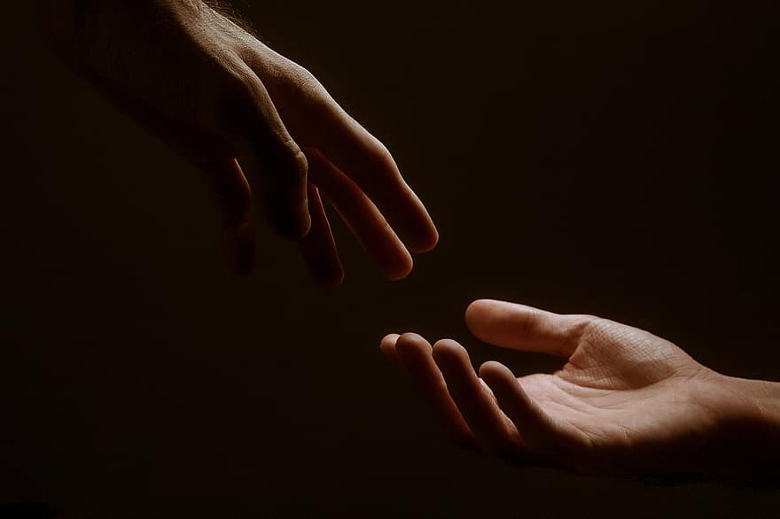
Prayer
Prayers
Let us pray for:
The world in which we live
The people who lead us
The people who need our prayers
The sick and the dying
Our families and loved ones
Lord, in your mercy
Hear our prayer.
<number>
Lent 2026
1st March 2026
Notes:
Prayers of the People

Slide 8
Song of Christ the Servant
Christ committed no sin, no guile was found on his lips.
Christ suffered for you, leaving you an example,
that you should follow in his steps.
He committed no sin, no guile was found on his lips,
when he was reviled, he did not revile in turn.
When he suffered, he did not threaten,
but he trusted himself to God who judges justly.
Christ himself bore our sins in his body on the tree,
that we might die to sin and live to righteousness.
By his wounds, you have been healed, for you were straying like sheep,
but have now returned to the shepherd and guardian of your souls.
Glory to the Father and to the Son and to the Holy Spirit;
as it was in the beginning is now and shall be for ever. Amen.
Christ committed no sin, no guile was found on his lips.
<number>
Lent 2026
1st March 2026

Slide 9
Nunc Dimitis
Now, Lord, you let your servant go in peace
your word has been fulfilled.
My own eyes have seen the salvation
which you have prepared in the sight of every people;
A light to reveal you to the nations
and the glory of your people Israel.
Glory to the Father and to the Son and to the Holy Spirit;
as it was in the beginning is now and shall be for ever. Amen.
<number>
Lent 2026
1st March 2026

Slide 10
Scripture
Psalm 121:
I lift up my eyes to the hills
from where will my help come?
My help comes from the Lord,
who made heaven and earth.
He will not let your foot be moved;
he who keeps you will not slumber.
He who keeps Israel
will neither slumber nor sleep.
The Lord is your keeper;
the Lord is your shade at your right hand.
The sun shall not strike you by day,
nor the moon by night.
The Lord will keep you from all evil;
he will keep your life.
The Lord will keep your going out and your coming in,
from this time on and for evermore.
Glory to the Father and to the Son and to the Holy Spirit;
as it was in the beginning is now and shall be for ever. Amen.
<number>
Lent 2026
1st March 2026

Slide 11
Scripture
Luke 14.27-33:
Whoever does not carry the cross and follow me cannot be my disciple. For which of you, intending to build a tower, does not first sit down and estimate the cost, to see whether he has enough to complete it? Otherwise, when he has laid a foundation and is not able to finish, all who see it will begin to ridicule him, saying, “This fellow began to build and was not able to finish.” Or what king, going out to wage war against another king, will not sit down first and consider whether he is able with ten thousand to oppose the one who comes against him with twenty thousand? If he cannot, then, while the other is still far away, he sends a delegation and asks for the terms of peace. So therefore, none of you can become my disciple if you do not give up all your possessions.
The word of the Lord.
Thanks be to God.
<number>
Lent 2026
1st March 2026

Slide 12
Collects
As our evening prayer rises before you, O God,
so may your mercy come down upon us
to cleanse our hearts
and set us free to sing your praise
now and for ever. Amen.
Lighten our darkness, Lord we pray
And in your great mercy,
defend us from all perils and dangers of this night,
For the sake of your Son, our Saviour, Jesus Christ, Amen.
<number>
Lent 2026
1st March 2026

Slide 13
Blessing
Lord’s Prayer:
Our Father, who art in heaven, hallowed be thy name; thy kingdom come; thy will be done; on earth as it is in heaven. Give us this day our daily bread. And forgive us our trespasses, as we forgive those who trespass against us. And lead us not into temptation; but deliver us from evil. For thine is the kingdom, the power, and the glory, for ever and ever. Amen.
Blessing:
May the God of peace sanctify you wholly;
and may your spirit and soul and body be kept sound and blameless
at the coming of our Lord Jesus Christ;
and the blessing of God Almighty, the Father, the Son and the Holy Spirit
Rest upon you and keep you and all whom you love, safe and well, for evermore, Amen.
Closing Prayer:
Lord Jesus Christ, may we see the world at peace and your light restored in this present darkness.
Establish your Church in righteousness and grace. Strengthen us in faith and make us faithful witnesses to your truth. In love, faith and hope we pray. Amen.
<number>
Lent 2026
1st March 2026

Slide 14
Daily Prayer for 1st March 2026
St Christopher’s Cathedral, Bahrain
"Come Holy Spirit"
The Diocese of Cyprus and the Gulf

