Slide 1

Daily Prayer for 12th March 2026
St Christopher’s Cathedral and Awali Church, Bahrain
The Diocese of Cyprus and the Gulf

Slide 2
Daily Prayer for 12th March 2026
St Christopher’s Cathedral and Awali Church, Bahrain
"I Surrender"
The Diocese of Cyprus and the Gulf

Slide 3
Welcome
Opening Acclamation:
Grace, mercy and peace from God our Father and the Lord Jesus Christ be with you.
And also with you.
We give thanks for this penitential journey to the cross.
Lord bless us and save us.
Amen
Almighty God,
to whom all hearts are open,
all desires known,
and from whom no secrets are hidden:
cleanse the thoughts of our hearts
by the inspiration of your Holy Spirit,
that we may perfectly love you,
and worthily magnify your holy name;
through Christ our Lord.
Amen.

Slide 4
Prayer
Confession:
Most merciful God, we confess that we have sinned against you in thought, word and deed, by what we have done and by what we have left undone. We have not loved you with our whole heart. We have not loved our neighbours as ourselves. In your mercy forgive what we have been, help us to amend what we are, and direct what we shall be; through Jesus Christ our Lord. Amen.
Almighty God have mercy upon you,
forgive you all your sins
through our Lord Jesus Christ,
strengthen you in all goodness,
and by the power of the Holy Spirit
Keep you in eternal life. Amen.

Slide 5
Prayer
Collect for Lent:
Almighty and everlasting God,
you hate nothing that you have made
and forgive the sins of all those who are penitent:
create and make in us new and contrite hearts
that we, worthily lamenting our sins
and acknowledging our wretchedness,
may receive from you, the God of all mercy,
perfect remission and forgiveness;
through Jesus Christ your Son our Lord,
who is alive and reigns with you,
in the unity of the Holy Spirit,
one God, now and for ever.
Amen.

Slide 6
Prayer
Collect for Saint Maximilian on 12th March 2026
Grant, O Lord Jesus, that we too may give ourselves
entirely without reserve
to the love and service of our Heavenly Father
in order to better love and serve your people
in imitation of your humble servant, Maximilian.
Through our Lord Jesus Christ, Your Son,
who lives and reigns with You
in the unity of the Holy Spirit,
one God for ever and ever.
Amen.

Slide 7
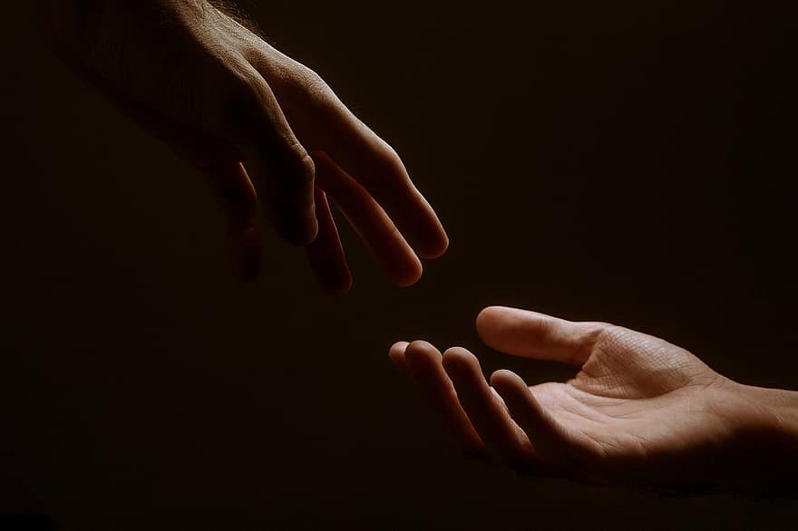
Prayer
Prayers
Let us pray for:
The world in which we live
The people who lead us
The people who need our prayers
The sick and the dying
Our families and loved ones
Lord, in your mercy
Hear our prayer.
Notes:
Prayers of the People

Slide 8
Benedictus
Blessed be the Lord the God of Israel,
who has come to his people and set them free.
He has raised up for us a mighty Saviour,
born of the house of his servant David.
Through his holy prophets God promised of old
to save us from our enemies, from the hands of all that hate us,
To show mercy to our ancestors,
and to remember his holy covenant.
This was the oath God swore to our father Abraham:
to set us free from the hands of our enemies,
Free to worship him without fear,
holy and righteous in his sight all the days of our life.
And you, child, shall be called the prophet of the Most High,
for you will go before the Lord to prepare his way,
To give his people knowledge of salvation
by the forgiveness of all their sins.
In the tender compassion of our God
the dawn from on high shall break upon us,
To shine on those who dwell in darkness and the shadow of death,
and to guide our feet into the way of peace.
Glory to the Father and to the Son and to the Holy Spirit;
as it was in the beginning is now and shall be for ever. Amen.

Slide 9
Scripture
Psalm 60:
O God, you have cast us off and broken us;
you have been angry; restore us to yourself again.
You have shaken the earth and torn it apart;
heal its wounds, for it trembles.
You have made your people drink bitter things;
we reel from the deadly wine you have given us.
You have made those who fear you to flee,
to escape from the range of the bow.
That your beloved may be delivered,
save us by your right hand and answer us.
God has spoken in his holiness:
‘I will triumph and divide Shechem, and share out the valley of Succoth.
Gilead is mine and Manasseh is mine;
Ephraim is my helmet and Judah my sceptre.
This is he word of the Lord
Thanks be to God

Slide 10
Scripture
John 8:39-47
They answered him, ‘Abraham is our father.’ Jesus said to them, ‘If you were Abraham’s children, you would be doing what Abraham did, but now you are trying to kill me, a man who has told you the truth that I heard from God. This is not what Abraham did. You are indeed doing what your father does.’ They said to him, ‘We are not illegitimate children; we have one father, God himself.’ Jesus said to them, ‘If God were your Father, you would love me, for I came from God and now I am here. I did not come on my own, but he sent me. Why do you not understand what I say? It is because you cannot accept my word. You are from your father the devil, and you choose to do your father’s desires. He was a murderer from the beginning and does not stand in the truth, because there is no truth in him. When he lies, he speaks according to his own nature, for he is a liar and the father of lies. But because I tell the truth, you do not believe me. Which of you convicts me of sin? If I tell the truth, why do you not believe me? Whoever is from God hears the words of God. The reason you do not hear them is that you are not from God.’
This is the word of the Lord.
Thanks be to God.

Slide 11
Collects
As our evening prayer rises before you, O God,
so may your mercy come down upon us
to cleanse our hearts
and set us free to sing your praise
now and for ever. Amen.
Lighten our darkness, Lord we pray
And in your great mercy,
defend us from all perils and dangers of this night,
For the sake of your Son, our Saviour, Jesus Christ, Amen.

Slide 12
Blessing
Lord’s Prayer:
Our Father, who art in heaven, hallowed be thy name; thy kingdom come; thy will be done; on earth as it is in heaven. Give us this day our daily bread. And forgive us our trespasses, as we forgive those who trespass against us. And lead us not into temptation; but deliver us from evil. For thine is the kingdom, the power, and the glory, for ever and ever. Amen.
Blessing:
May the God of peace sanctify you wholly;
and may your spirit and soul and body be kept sound and blameless
at the coming of our Lord Jesus Christ;
and the blessing of God Almighty, the Father, the Son and the Holy Spirit
Rest upon you and keep you and all whom you love, safe and well, for evermore, Amen.
Closing Prayer:
God our Redeemer show us compassion and love. Lead us, guide us, fill us with your Spirit. Show us the way from fear to courage that we may be your voice in the world. Amen.

Slide 13
Daily Prayer for 12th March 2026
St Christopher’s Cathedral and Awali Church, Bahrain
"Do not be afraid"
The Diocese of Cyprus and the Gulf

Slide 14
Daily Prayer for 12th March 2026
St Christopher’s Cathedral and Awali Church, Bahrain
The Diocese of Cyprus and the Gulf

