Slide 1

Daily Prayer for 13th March 2026
St Christopher’s Cathedral and Awali Church, Bahrain
The Diocese of Cyprus and the Gulf

Slide 2
Daily Prayer for 13th March 2026
St Christopher’s Cathedral, Bahrain
“Brother, Sister, Let me Serve you”
The Diocese of Cyprus and the Gulf

Slide 3
Welcome
Opening Acclamation:
Grace, mercy and peace from God our Father and the Lord Jesus Christ be with you.
And also with you.
We give thanks for this penitential journey to the cross.
Lord bless us and save us.
Amen
Blessed are you, Lord God of our salvation,
to you be glory and praise for ever.
In the darkness of our sin you have shone in our hearts
to give the light of the knowledge of the glory of God
in the face of Jesus Christ.
Open our eyes to acknowledge your presence,
that freed from the misery of sin and shame
we may grow into your likeness from glory to glory.
Blessed be God, Father, Son and Holy Spirit.
Amen.

Slide 4
Prayer
Confession:
Most merciful God, we confess that we have sinned against you in thought, word and deed, by what we have done and by what we have left undone. We have not loved you with our whole heart. We have not loved our neighbours as ourselves. In your mercy forgive what we have been, help us to amend what we are, and direct what we shall be; through Jesus Christ our Lord. Amen.
Almighty God have mercy upon you,
forgive you all your sins
through our Lord Jesus Christ,
strengthen you in all goodness,
and by the power of the Holy Spirit
Keep you in eternal life. Amen.

Slide 5
Prayer
Collect for Lent:
Almighty and everlasting God,
you hate nothing that you have made
and forgive the sins of all those who are penitent:
create and make in us new and contrite hearts
that we, worthily lamenting our sins
and acknowledging our wretchedness,
may receive from you, the God of all mercy,
perfect remission and forgiveness;
through Jesus Christ your Son our Lord,
who is alive and reigns with you,
in the unity of the Holy Spirit,
one God, now and for ever.
Amen.

Slide 6
Prayer
Collect for St Monica on 13th March
Saint Monica, troubled wife and mother,
many sorrows pierced your heart during your lifetime.
Yet, you never despaired or lost faith.
With confidence, persistence, and profound faith,
you prayed daily for the conversion of your husband and your son, Augustine.
Intercede for me, that I may be given your same fortitude,
patience, and trust in the Lord.
Please take my requests to God, and help me to bring my family closer to Him,
through Jesus Christ your Son our Lord,
who is alive and reigns with you,
in the unity of the Holy Spirit,
one God, now and for ever.
Amen.

Slide 7
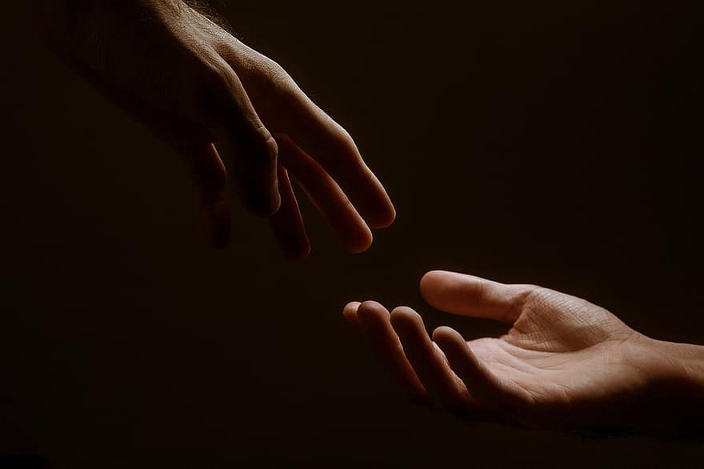
Prayer
Prayers
Let us pray for:
The world in which we live
The people who lead us
The people who need our prayers
The sick and the dying
Our families and loved ones
Lord, in your mercy
Hear our prayer.
Notes:
Prayers of the People

Slide 8
Nunc Dimitis
Now, Lord, you let your servant go in peace
your word has been fulfilled.
My own eyes have seen the salvation
which you have prepared in the sight of every people;
A light to reveal you to the nations
and the glory of your people Israel.
Glory to the Father and to the Son and to the Holy Spirit;
as it was in the beginning is now and shall be for ever. Amen.

Slide 9
Scripture
Psalm 91:
You who live in the shelter of the Most High,
who abide in the shadow of the Almighty,
will say to the LORD, ‘My refuge and my fortress;
my God, in whom I trust.’
For he will deliver you from the snare of the fowler
and from the deadly pestilence;
he will cover you with his pinions, and under his wings you will find refuge;
his faithfulness is a shield and buckler.
You will not fear the terror of the night,
or the arrow that flies by day,
or the pestilence that stalks in darkness,
or the destruction that wastes at noonday.
A thousand may fall at your side,
ten thousand at your right hand,
but it will not come near you.
Glory to the Father and to the Son and to the Holy Spirit;
as it was in the beginning is now and shall be for ever. Amen.

Slide 10
Scripture
1 John 4:7-16:
Beloved, let us love one another, because love is from God; everyone who loves is born of God and knows God. Whoever does not love does not know God, for God is love. God's love was revealed among us in this way: God sent his only Son into the world so that we might live through him. In this is love, not that we loved God but that he loved us and sent his Son to be the atoning sacrifice for our sins. Beloved, since God loved us so much, we also ought to love one another. No one has ever seen God; if we love one another, God lives in us, and his love is perfected in us. By this we know that we abide in him and he in us, because he has given us of his Spirit. And we have seen and do testify that the Father has sent his Son as the Saviour of the world. God abides in those who confess that Jesus is the Son of God, and they abide in God. So we have known and believe the love that God has for us. God is love, and those who abide in love abide in God, and God abides in them.
This is the word of the Lord.
Thanks be to God.

Slide 11
Collects
As our evening prayer rises before you, O God,
so may your mercy come down upon us
to cleanse our hearts
and set us free to sing your praise
now and for ever. Amen.
Lighten our darkness, Lord we pray
And in your great mercy,
defend us from all perils and dangers of this night,
For the sake of your Son, our Saviour, Jesus Christ, Amen.

Slide 12
Blessing
Lord’s Prayer:
Our Father, who art in heaven, hallowed be thy name; thy kingdom come; thy will be done; on earth as it is in heaven. Give us this day our daily bread. And forgive us our trespasses, as we forgive those who trespass against us. And lead us not into temptation; but deliver us from evil. For thine is the kingdom, the power, and the glory, for ever and ever. Amen.
Blessing:
May the God of peace sanctify you wholly;
and may your spirit and soul and body be kept sound and blameless
at the coming of our Lord Jesus Christ;
and the blessing of God Almighty, the Father, the Son and the Holy Spirit
Rest upon you and keep you and all whom you love, safe and well, for evermore, Amen.
Closing Prayer:
God our Redeemer shall wipe away our tears. All that Jesus has done for your children will not go unrewarded. There is hope for the future and salvation for the lost. Amen.

Slide 13
Daily Prayer for 13th March 2026
St Christopher’s Cathedral, Bahrain
"Mama"
The Diocese of Cyprus and the Gulf

Slide 14
Daily Prayer for 13th March 2026
St Christopher’s Cathedral and Awali Church, Bahrain
The Diocese of Cyprus and the Gulf

