Slide 1

Daily Prayer for 2nd March 2026
St Christopher’s Cathedral, Bahrain
The Diocese of Cyprus and the Gulf

Slide 2
Daily Prayer for 2nd March 2026
St Christopher’s Cathedral, Bahrain
"The Lord is Gracious and Compassionate"
The Diocese of Cyprus and the Gulf

Slide 3
Welcome
Opening Acclamation:
Grace, mercy and peace from God our Father and the Lord Jesus Christ be with you.
And also with you.
We give thanks for this penitential journey to the cross.
Lord bless us and save us.
Amen
Almighty God,
to whom all hearts are open,
all desires known,
and from whom no secrets are hidden:
cleanse the thoughts of our hearts
by the inspiration of your Holy Spirit,
that we may perfectly love you,
and worthily magnify your holy name;
through Christ our Lord.
Amen.
<number>
Lent 2026
1st March 2026

Slide 4
Prayer
Confession:
Most merciful God, we confess that we have sinned against you in thought, word and deed, by what we have done and by what we have left undone. We have not loved you with our whole heart. We have not loved our neighbours as ourselves. In your mercy forgive what we have been, help us to amend what we are, and direct what we shall be; through Jesus Christ our Lord. Amen.
Almighty God have mercy on you,
forgive you all your sins
through our Lord Jesus Christ,
strengthen you in all goodness,
and by the power of the Holy Spirit
Keep you in eternal life. Amen.
<number>
Lent 2026
1st March 2026

Slide 5
Prayer
Collect for Lent:
Almighty and everlasting God,
you hate nothing that you have made
and forgive the sins of all those who are penitent:
create and make in us new and contrite hearts
that we, worthily lamenting our sins
and acknowledging our wretchedness,
may receive from you, the God of all mercy,
perfect remission and forgiveness;
through Jesus Christ your Son our Lord,
who is alive and reigns with you,
in the unity of the Holy Spirit,
one God, now and for ever.
Amen.
<number>
Lent 2026
1st March 2026

Slide 6
Prayer
Collect for 2nd March 2026
Almighty God,
from the first fruits of the English nation who turned to Christ,
you called your servant Chad
to be an evangelist and bishop of his own people:
give us grace so to follow his peaceable nature,
humble spirit and prayerful life,
that we may truly commend to others
the faith which we ourselves profess;
through Jesus Christ your Son our Lord,
who is alive and reigns with you,
in the unity of the Holy Spirit,
one God, now and for ever. Amen.
<number>
Lent 2026
1st March 2026

Slide 7
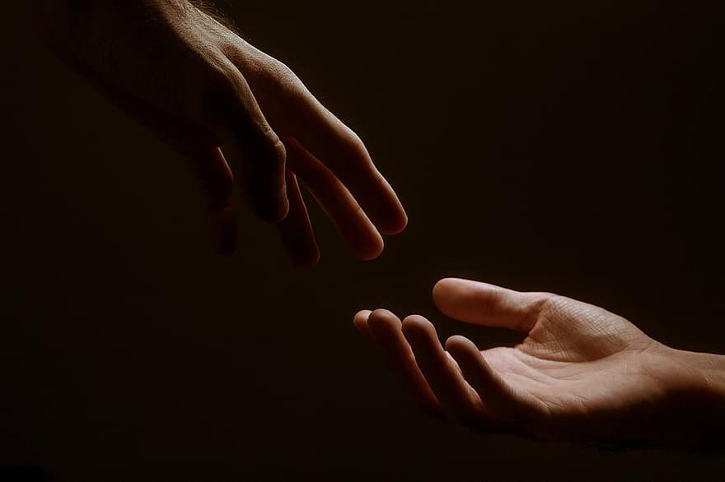
Prayer
Prayers
Let us pray for:
The world in which we live
The people who lead us
The people who need our prayers
The sick and the dying
Our families and loved ones
Lord, in your mercy
Hear our prayer.
<number>
Lent 2026
1st March 2026
Notes:
Prayers of the People

Slide 8
Canticle
Tell the good news of Jesus the Christ to all who are searching for redemption.
This is the message we have heard from Christ and proclaim to you:
that God is light, in whom there is no darkness at all.
If we say that we have fellowship with God while we walk in darkness,
we lie and do not do what is true.
But if we walk in the light as God is in the light,
we have fellowship with one another.
And the blood of Jesus, the Son of God,
cleanses us from all our sins.
If we say that we have no sin,
we deceive ourselvesand the truth is not in us.
If we confess our sins,
the One who is faithful and just will forgive us and cleanse us from all unrighteousness.
Glory to the Father and to the Son and to the Holy Spirit;
as it was in the beginning is now and shall be for ever. Amen.
Tell the good news of Jesus the Christ to all who are searching for redemption.
<number>
Lent 2026
1st March 2026

Slide 9
Magnificat
My soul proclaims the greatness of the Lord, my spirit rejoices in God my Saviour;
he has looked with favour on his lowly servant.
From this day all generations will call me blessed;
the Almighty has done great things for me and holy is his name.
He has mercy on those who fear him,
from generation to generation.
He has shown strength with his arm
and has scattered the proud in their conceit,
Casting down the mighty from their thrones
and lifting up the lowly.
He has filled the hungry with good things
and sent the rich away empty.
He has come to the aid of his servant Israel,
to remember his promise of mercy,
The promise made to our ancestors,
to Abraham and his children for ever.
Glory to the Father and to the Son and to the Holy Spirit;
as it was in the beginning is now and shall be for ever. Amen.
<number>
Lent 2026
1st March 2026

Slide 10
Scripture
Psalm 145:
I will extol you, my God and King,
and bless your name forever and ever.
2 Every day I will bless you
and praise your name forever and ever.
3 Great is the Lord and greatly to be praised;
his greatness is unsearchable.
4 One generation shall extol your works to another
and shall declare your mighty acts.
5 They will recount the glorious[a] splendor of your majesty,
and on your wondrous works I will meditate.
6 They will proclaim the might of your awesome deeds,
and I will declare your greatness.
7 They shall celebrate the fame of your abundant goodness
and shall sing aloud of your righteousness.
8 The Lord is gracious and merciful,
slow to anger and abounding in steadfast love.
9 The Lord is good to all,
and his compassion is over all that he has made.
Glory to the Father and to the Son and to the Holy Spirit;
as it was in the beginning is now and shall be for ever. Amen.
<number>
Lent 2026
1st March 2026

Slide 11
Scripture
Ephesians 3:7-13:
Of this gospel I have become a servant according to the gift of God's grace that was given to me by the working of his power. Although I am the very least of all the saints, this grace was given to me to bring to the Gentiles the news of the boundless riches of Christ, and to make everyone see what is the plan of the mystery hidden for ages in God who created all things; so that through the church the wisdom of God in its rich variety might now be made known to the rulers and authorities in the heavenly places. This was in accordance with the eternal purpose that he has carried out in Christ Jesus our Lord, in whom we have access to God in boldness and confidence through faith in him. I pray therefore that you may not lose heart over my sufferings for you; they are your glory.
The word of the Lord.
Thanks be to God.
<number>
Lent 2026
1st March 2026

Slide 12
Collects
As our evening prayer rises before you, O God,
so may your mercy come down upon us
to cleanse our hearts
and set us free to sing your praise
now and for ever. Amen.
Lighten our darkness, Lord we pray
And in your great mercy,
defend us from all perils and dangers of this night,
For the sake of your Son, our Saviour, Jesus Christ, Amen.
<number>
Lent 2026
1st March 2026

Slide 13
Blessing
Lord’s Prayer:
Our Father, who art in heaven, hallowed be thy name; thy kingdom come; thy will be done; on earth as it is in heaven. Give us this day our daily bread. And forgive us our trespasses, as we forgive those who trespass against us. And lead us not into temptation; but deliver us from evil. For thine is the kingdom, the power, and the glory, for ever and ever. Amen.
Blessing:
May the God of peace sanctify you wholly;
and may your spirit and soul and body be kept sound and blameless
at the coming of our Lord Jesus Christ;
and the blessing of God Almighty, the Father, the Son and the Holy Spirit
Rest upon you and keep you and all whom you love, safe and well, for evermore, Amen.
Closing Prayer:
Lord Jesus Christ, we bring before you the troubles of this world, knowing that you know our pain you know our suffering and you know our concerns. Because you suffered on the cross, died, was buried and rose to new and everlasting life, In love, faith and hope we pray. Amen.
<number>
Lent 2026
1st March 2026

Slide 14
Daily Prayer for 2nd March 2026
St Christopher’s Cathedral, Bahrain
"Be Thou My Vision"
The Diocese of Cyprus and the Gulf

