Slide 1

Daily Prayer for 3rd March 2026
St Christopher’s Cathedral, Bahrain
The Diocese of Cyprus and the Gulf

Slide 2
Daily Prayer for 3rd March 2026
St Christopher’s Cathedral, Bahrain
"Abide with Me"
The Diocese of Cyprus and the Gulf

Slide 3
Welcome
Opening Acclamation:
Grace, mercy and peace from God our Father and the Lord Jesus Christ be with you.
And also with you.
We give thanks for this penitential journey to the cross.
Lord bless us and save us.
Amen
Blessed are you, Lord God of our salvation,
to you be glory and praise for ever.
In the darkness of our sin you have shone in our hearts
to give the light of the knowledge of the glory of God
in the face of Jesus Christ.
Open our eyes to acknowledge your presence,
that freed from the misery of sin and shame
we may grow into your likeness from glory to glory.
Blessed be God, Father, Son and Holy Spirit.
Amen.

Slide 4
Prayer
Confession:
Most merciful God, we confess that we have sinned against you in thought, word and deed, by what we have done and by what we have left undone. We have not loved you with our whole heart. We have not loved our neighbours as ourselves. In your mercy forgive what we have been, help us to amend what we are, and direct what we shall be; through Jesus Christ our Lord. Amen.
May almighty God have mercy upon you,
forgive you all your sins
through our Lord Jesus Christ,
strengthen you in all goodness,
and by the power of the Holy Spirit
Keep you in eternal life. Amen.

Slide 5
Prayer
Collect for Lent:
Almighty and everlasting God,
you hate nothing that you have made
and forgive the sins of all those who are penitent:
create and make in us new and contrite hearts
that we, worthily lamenting our sins
and acknowledging our wretchedness,
may receive from you, the God of all mercy,
perfect remission and forgiveness;
through Jesus Christ your Son our Lord,
who is alive and reigns with you,
in the unity of the Holy Spirit,
one God, now and for ever.
Amen.

Slide 6
Prayer
Collect for 3rd March 2026
Almighty God,
you show to those who are in error
the light of your truth,
that they may return to the way of righteousness:
grant that they may reject those things
that are contrary to your perfect law,
and follow the example of Christ.
Through our Lord Jesus Christ,
who is alive and reigns with you,
in the unity of the Holy Spirit,
one God, now and for ever. Amen.

Slide 7
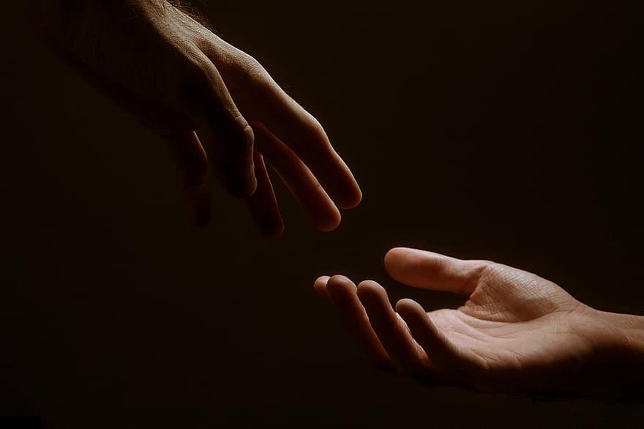
Prayer
Prayers
Let us pray for:
The world in which we live
The people who lead us
The people who need our prayers
The sick and the dying
Our families and loved ones
Lord, in your mercy
Hear our prayer.
Notes:
Prayers of the People

Slide 8
Nunc Dimitis
Now, Lord, you let your servant go in peace
your word has been fulfilled.
My own eyes have seen the salvation
which you have prepared in the sight of every people;
A light to reveal you to the nations
and the glory of your people Israel.
Glory to the Father and to the Son and to the Holy Spirit;
as it was in the beginning is now and shall be for ever. Amen.
<number>
Lent 2026
1st March 2026

Slide 9
Scripture
Psalm 54:
Save me, O God, by your name
and vindicate me by your power.
Hear my prayer, O God;
give heed to the words of my mouth.
For strangers have risen up against me, and the ruthless seek after my life;
they have not set God before them.
Behold, God is my helper;
it is the Lord who upholds my life.
May evil rebound on those who lie in wait for me;
destroy them in your faithfulness.
An offering of a free heart will I give you
and praise your name, O Lord, for it is gracious.
For he has delivered me out of all my trouble,
and my eye has seen the downfall of my enemies.
Glory to the Father and to the Son and to the Holy Spirit;
as it was in the beginning is now and shall be for ever. Amen.

Slide 10
Scripture
1 Peter 2:4-9:
Come to him, a living stone, though rejected by mortals yet chosen and precious in God’s sight, and like living stones let yourselves be built into a spiritual house, to be a holy priesthood, to offer spiritual sacrifices acceptable to God through Jesus Christ. For it stands in scripture:
“See, I am laying in Zion a stone, a cornerstone chosen and precious, and whoever believes in him will not be put to shame.” This honor, then, is for you who believe, but for those who do not believe,
“The stone that the builders rejected has become the very head of the corner,” and
“A stone that makes them stumble and a rock that makes them fall.”
They stumble because they disobey the word, as they were destined to do. But you are a chosen people, a royal priesthood, a holy nation, God’s own people, in order that you may proclaim the excellence of him who called you out of darkness into his marvelous light.
This is the word of the Lord.
Thanks be to God.

Slide 11
Collects
As our evening prayer rises before you, O God,
so may your mercy come down upon us
to cleanse our hearts
and set us free to sing your praise
now and for ever. Amen.
Lighten our darkness, Lord we pray
And in your great mercy,
defend us from all perils and dangers of this night,
For the sake of your Son, our Saviour, Jesus Christ, Amen.

Slide 12
Blessing
Lord’s Prayer:
Our Father, who art in heaven, hallowed be thy name; thy kingdom come; thy will be done; on earth as it is in heaven. Give us this day our daily bread. And forgive us our trespasses, as we forgive those who trespass against us. And lead us not into temptation; but deliver us from evil. For thine is the kingdom, the power, and the glory, for ever and ever. Amen.
Blessing:
May the God of peace sanctify you wholly;
and may your spirit and soul and body be kept sound and blameless
at the coming of our Lord Jesus Christ;
and the blessing of God Almighty, the Father, the Son and the Holy Spirit
Rest upon you and keep you and all whom you love, safe and well, for evermore, Amen.
Closing Prayer:
May God our Redeemer show us compassion and love. May he protect us from our enemies that we shall find refuge beneath his wings; his faithfulness shall be our shield and our rampart. Amen.

Slide 13
Daily Prayer for 3rd March 2026
St Christopher’s Cathedral, Bahrain
"Bless the Lord, My Soul"
The Diocese of Cyprus and the Gulf

Slide 14
Daily Prayer for 3rd March 2026
St Christopher’s Cathedral, Bahrain
The Diocese of Cyprus and the Gulf

