Slide 1

Daily Prayer for 4th March 2026
St Christopher’s Cathedral, Bahrain
The Diocese of Cyprus and the Gulf

Slide 2
Daily Prayer for 4th March 2026
St Christopher’s Cathedral, Bahrain
"Guide me oh, thy great Redeemer"
The Diocese of Cyprus and the Gulf

Slide 3
Welcome
Opening Acclamation:
Grace, mercy and peace from God our Father and the Lord Jesus Christ be with you.
And also with you.
We give thanks for this penitential journey to the cross.
Lord bless us and save us.
Amen
Almighty God,
to whom all hearts are open,
all desires known,
and from whom no secrets are hidden:
cleanse the thoughts of our hearts
by the inspiration of your Holy Spirit,
that we may perfectly love you,
and worthily magnify your holy name;
through Christ our Lord.
Amen.

Slide 4
Prayer
Confession:
Most merciful God, we confess that we have sinned against you in thought, word and deed, by what we have done and by what we have left undone. We have not loved you with our whole heart. We have not loved our neighbours as ourselves. In your mercy forgive what we have been, help us to amend what we are, and direct what we shall be; through Jesus Christ our Lord. Amen.
Almighty God have mercy upon you,
forgive you all your sins
through our Lord Jesus Christ,
strengthen you in all goodness,
and by the power of the Holy Spirit
Keep you in eternal life. Amen.

Slide 5
Prayer
Collect for Lent:
Almighty and everlasting God,
you hate nothing that you have made
and forgive the sins of all those who are penitent:
create and make in us new and contrite hearts
that we, worthily lamenting our sins
and acknowledging our wretchedness,
may receive from you, the God of all mercy,
perfect remission and forgiveness;
through Jesus Christ your Son our Lord,
who is alive and reigns with you,
in the unity of the Holy Spirit,
one God, now and for ever.
Amen.

Slide 6
Prayer
Collect for St Casimir - 4th March 2026
O God, who preserved Your servant Casimir
constant and faithful in Your service
amidst the delights of the court,
and the attractive allurements of the world,
grant, we ask You, that by his example
Your people may despise the transitory things of the world
and eagerly pursue things which are eternal:
through Jesus Christ our Lord.
Amen.

Slide 7
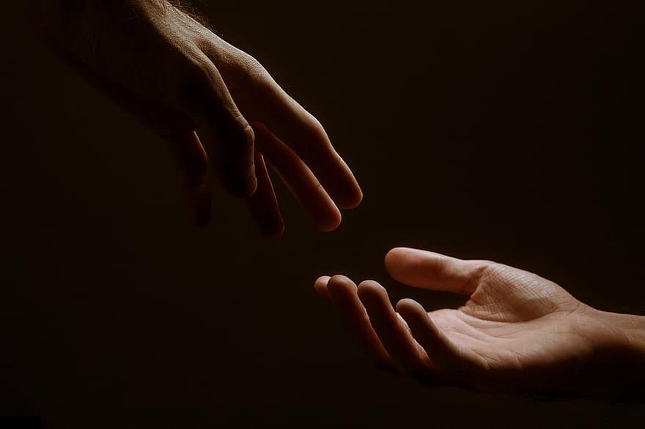
Prayer
Prayers
Let us pray for:
The world in which we live
The people who lead us
The people who need our prayers
The sick and the dying
Our families and loved ones
Lord, in your mercy
Hear our prayer.
Notes:
Prayers of the People

Slide 8
Magnificat
My soul proclaims the greatness of the Lord, my spirit rejoices in God my Saviour;
he has looked with favour on his lowly servant.
From this day all generations will call me blessed;
the Almighty has done great things for me and holy is his name.
He has mercy on those who fear him,
from generation to generation.
He has shown strength with his arm
and has scattered the proud in their conceit,
Casting down the mighty from their thrones
and lifting up the lowly.
He has filled the hungry with good things
and sent the rich away empty.
He has come to the aid of his servant Israel,
to remember his promise of mercy,
The promise made to our ancestors,
to Abraham and his children for ever.
Glory to the Father and to the Son and to the Holy Spirit;
as it was in the beginning is now and shall be for ever. Amen.

Slide 9
Scripture
Psalm 23:
The LORD is my shepherd, I shall not want.
He makes me lie down in green pastures;
he leads me beside still waters;
he restores my soul.
He leads me in right paths
for his name's sake.
Even though I walk through the darkest valley,
I fear no evil;
for you are with me;
your rod and your staff they comfort me.
You prepare a table before me
in the presence of my enemies;
you anoint my head with oil;
my cup overflows.
Surely goodness and mercy shall follow me all the days of my life,
and I shall dwell in the house of the LORD my whole life long.
Glory to the Father and to the Son and to the Holy Spirit;
as it was in the beginning is now and shall be for ever. Amen.

Slide 10
Scripture
John 10:11-14:
“I am the good shepherd. The good shepherd lays down his life for the sheep. The hired hand, who is not the shepherd and does not own the sheep, sees the wolf coming and leaves the sheep and runs away, and the wolf snatches them and scatters them. The hired hand runs away because a hired hand does not care for the sheep. I am the good shepherd. I know my own, and my own know me.
This is the word of the Lord.
Thanks be to God.

Slide 11
Collects
As our evening prayer rises before you, O God,
so may your mercy come down upon us
to cleanse our hearts
and set us free to sing your praise
now and for ever. Amen.
Lighten our darkness, Lord we pray
And in your great mercy,
defend us from all perils and dangers of this night,
For the sake of your Son, our Saviour, Jesus Christ, Amen.

Slide 12
Blessing
Lord’s Prayer:
Our Father, who art in heaven, hallowed be thy name; thy kingdom come; thy will be done; on earth as it is in heaven. Give us this day our daily bread. And forgive us our trespasses, as we forgive those who trespass against us. And lead us not into temptation; but deliver us from evil. For thine is the kingdom, the power, and the glory, for ever and ever. Amen.
Blessing:
May the God of peace sanctify you wholly;
and may your spirit and soul and body be kept sound and blameless
at the coming of our Lord Jesus Christ;
and the blessing of God Almighty, the Father, the Son and the Holy Spirit
Rest upon you and keep you and all whom you love, safe and well, for evermore, Amen.
Closing Prayer:
May God our great shepherd, show us the path of righteousness, lead us to the promised land and send his Holy Spirit to lighten our way. May he protect us from our enemies that He shall lead us to the safe places and we shall follow; his rod and his staff shall be our comfort. Amen.

Slide 13
Daily Prayer for 4th March 2026
St Christopher’s Cathedral, Bahrain
"Psalm 23"
The Diocese of Cyprus and the Gulf

Slide 14
Daily Prayer for 4th March 2026
St Christopher’s Cathedral, Bahrain
The Diocese of Cyprus and the Gulf

