Slide 1

Daily Prayer for 20th March 2026
St Christopher’s Cathedral and Awali Church, Bahrain
The Diocese of Cyprus and the Gulf

Slide 2
Daily Prayer for 20th March 2026
St Christopher’s Cathedral, Bahrain
“By the Waters of Babylon”
The Diocese of Cyprus and the Gulf

Slide 3
Welcome
Opening Acclamation:
Grace, mercy and peace from God our Father and the Lord Jesus Christ be with you.
And also with you.
We give thanks for this penitential journey to the cross.
Lord bless us and save us.
Amen
Blessed are you, Lord God of our salvation,
to you be glory and praise for ever.
In the darkness of our sin you have shone in our hearts
to give the light of the knowledge of the glory of God
in the face of Jesus Christ.
Open our eyes to acknowledge your presence,
that freed from the misery of sin and shame
we may grow into your likeness from glory to glory.
Blessed be God, Father, Son and Holy Spirit.
Amen.

Slide 4
Prayer
Confession:
Most merciful God, we confess that we have sinned against you in thought, word and deed, by what we have done and by what we have left undone. We have not loved you with our whole heart. We have not loved our neighbours as ourselves. In your mercy forgive what we have been, help us to amend what we are, and direct what we shall be; through Jesus Christ our Lord. Amen.
Almighty God have mercy upon you,
forgive you all your sins
through our Lord Jesus Christ,
strengthen you in all goodness,
and by the power of the Holy Spirit
Keep you in eternal life. Amen.

Slide 5
Prayer
Collect for Lent:
Almighty and everlasting God,
you hate nothing that you have made
and forgive the sins of all those who are penitent:
create and make in us new and contrite hearts
that we, worthily lamenting our sins
and acknowledging our wretchedness,
may receive from you, the God of all mercy,
perfect remission and forgiveness;
through Jesus Christ your Son our Lord,
who is alive and reigns with you,
in the unity of the Holy Spirit,
one God, now and for ever.
Amen.

Slide 6
Prayer
Collect for St John of Parma on 20th March
As St John of Parma sought the face of Christ
in the silence of the hermitage and the leadership of your brothers,
guide us toward a life of true Gospel simplicity.
​Help us to detach our hearts from the distractions of this world
so that we may be filled with the light of the Holy Spirit.
through Jesus Christ our Lord,
who lives and reigns with you and the Holy Spirit,
one God, now and for ever.
Amen.

Slide 7
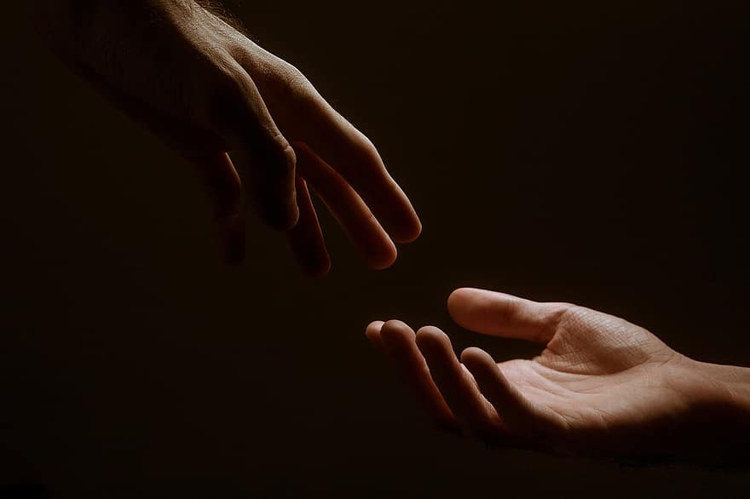
Prayer
Prayers
Let us pray for:
The world in which we live
The people who lead us
The people who need our prayers
The sick and the dying
Our families and loved ones
Lord, in your mercy
Hear our prayer.
Notes:
Prayers of the People

Slide 8
Benedictus
Blessed be the Lord the God of Israel,
who has come to his people and set them free.
He has raised up for us a mighty Saviour,
born of the house of his servant David.
Through his holy prophets God promised of old
to save us from our enemies, from the hands of all that hate us,
To show mercy to our ancestors,
and to remember his holy covenant.
This was the oath God swore to our father Abraham:
to set us free from the hands of our enemies,
Free to worship him without fear,
holy and righteous in his sight all the days of our life.
And you, child, shall be called the prophet of the Most High,
for you will go before the Lord to prepare his way,
To give his people knowledge of salvation
by the forgiveness of all their sins.
In the tender compassion of our God
the dawn from on high shall break upon us,
To shine on those who dwell in darkness and the shadow of death,
and to guide our feet into the way of peace.
Glory to the Father and to the Son and to the Holy Spirit;
as it was in the beginning is now and shall be for ever. Amen.

Slide 9
Scripture
Psalm 13:
How long will you forget me, O Lord; for ever?
How long will you hide your face from me?
How long shall I have anguish in my soul and grief in my heart, day after day?
How long shall my enemy triumph over me?
Look upon me and answer, O Lord my God;
lighten my eyes, lest I sleep in death;
Lest my enemy say, ‘I have prevailed against him,’
and my foes rejoice that I have fallen.
But I put my trust in your steadfast love;
my heart will rejoice in your salvation.
I will sing to the Lord,
for he has dealt so bountifully with me.
Glory to the Father and to the Son and to the Holy Spirit;
as it was in the beginning is now and shall be for ever. Amen.

Slide 10
Scripture
Jeremiah 19:14-20:6:
When Jeremiah came from Topheth, where the Lord had sent him to prophesy, he stood in the court of the Lord’s house and said to all the people: Thus says the Lord of hosts, the God of Israel: I am now bringing upon this city and upon all its towns all the disaster that I have pronounced against it, because they have stiffened their necks, refusing to hear my words.Now the priest Pashhur son of Immer, who was chief officer in the house of the Lord, heard Jeremiah prophesying these things. Then Pashhur struck the prophet Jeremiah, and put him in the stocks that were in the upper Benjamin Gate of the house of the Lord. The next morning when Pashhur released Jeremiah from the stocks, Jeremiah said to him, The Lord has named you not Pashhur but ‘Terror-all-around.’ For thus says the Lord: I am making you a terror to yourself and to all your friends; and they shall fall by the sword of their enemies while you look on. And I will give all Judah into the hand of the king of Babylon; he shall carry them captive to Babylon, and shall kill them with the sword. I will give all the wealth of this city, all its gains, all its prized belongings, and all the treasures of the kings of Judah into the hand of their enemies, who shall plunder them, and seize them, and carry them to Babylon. And you, Pashhur, and all who live in your house, shall go into captivity, and to Babylon you shall go; there you shall die, and there you shall be buried, you and all your friends, to whom you have prophesied falsely.
This is the word of the Lord.
Thanks be to God.

Slide 11
Collects
As our evening prayer rises before you, O God,
so may your mercy come down upon us
to cleanse our hearts
and set us free to sing your praise
now and for ever. Amen.
Lighten our darkness, Lord we pray
And in your great mercy,
defend us from all perils and dangers of this night,
For the sake of your Son, our Saviour, Jesus Christ, Amen.

Slide 12
Blessing
Lord’s Prayer:
Our Father, who art in heaven, hallowed be thy name; thy kingdom come; thy will be done; on earth as it is in heaven. Give us this day our daily bread. And forgive us our trespasses, as we forgive those who trespass against us. And lead us not into temptation; but deliver us from evil. For thine is the kingdom, the power, and the glory, for ever and ever. Amen.
Blessing:
May the God of peace sanctify you wholly;
and may your spirit and soul and body be kept sound and blameless
at the coming of our Lord Jesus Christ;
and the blessing of God Almighty, the Father, the Son and the Holy Spirit
Rest upon you and keep you and all whom you love, safe and well, for evermore, Amen.
Closing Prayer:
God our Salvation, hear the prayer of our heart and the cries of our mouth. Lead us in the way of life and guide our footsteps to follow you and no other; through our Lord, Jesus Christ. Amen

Slide 13
Daily Prayer for 20th March 2026
St Christopher’s Cathedral, Bahrain
"O Love that will not let me go"
The Diocese of Cyprus and the Gulf

Slide 14
Daily Prayer for 20th March 2026
St Christopher’s Cathedral and Awali Church, Bahrain
The Diocese of Cyprus and the Gulf

