Slide 1
Arnold Garcon is a native Haitian who was educated in the United States, at Lipscomb University in Nashville, and who presently ministers among the Haitian people and the North Haiti Mission. Among the work Arnold is involved in is planting new churches, a school in Petite Anse, Preachers’Training Seminars and a radio broadcast in French, English and Spanish that reaches Haiti, the Dominican Republic and the Bahamas. There are an estimated two hundred Churches of Christ in Haiti with an estimated membership of 15,000. There are also Haitian Churches of Christ in Florida, in the United States, but at present there are no statistics available regarding these congregations.

Slide 2
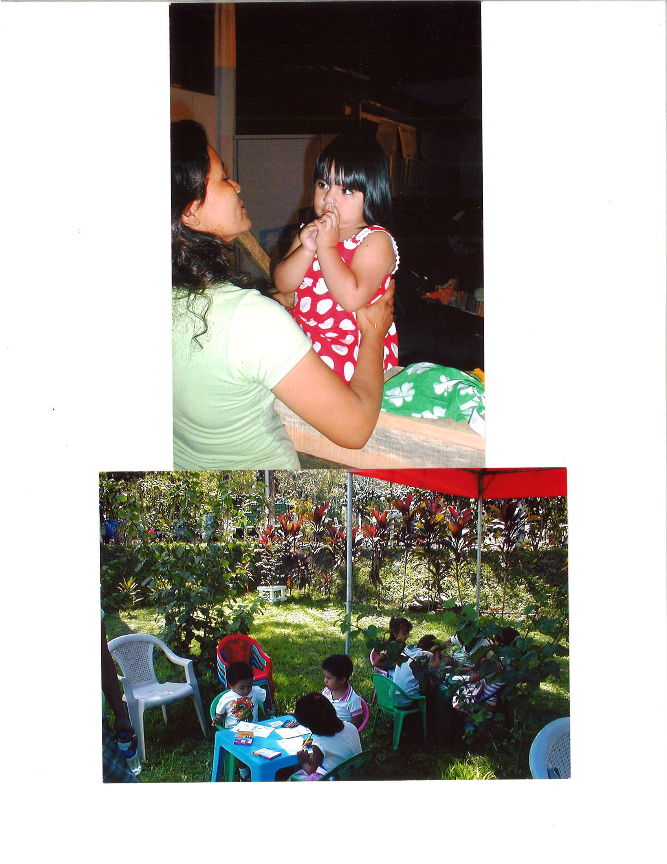

Slide 4
El Savador Girls with Dresses

Slide 5
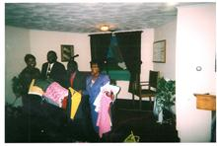
Brother Garcon picking up Dresses to take to Haiti

Slide 6
www.thedorcasproject.com

Slide 7
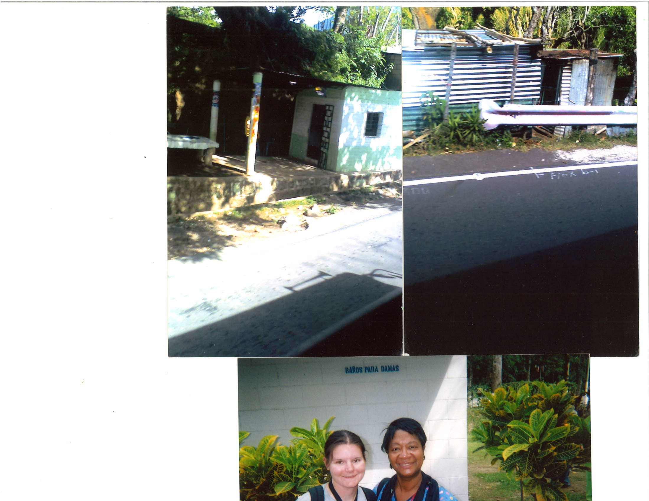

Slide 8
Me and my translater

Slide 9
Ms. Nell sewing for my Dorcas Project

Slide 10
Ms. Nell Jordan’s dresses she sewed

Slide 11
Dresses sent to Haiti by Missionary Dale Byrum

