Slide 1
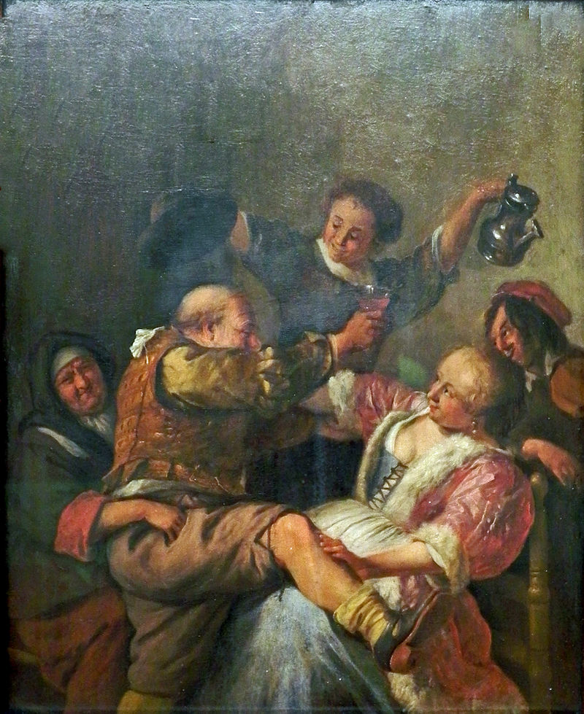
Jan Steen (1626 – 1679)

Slide 2
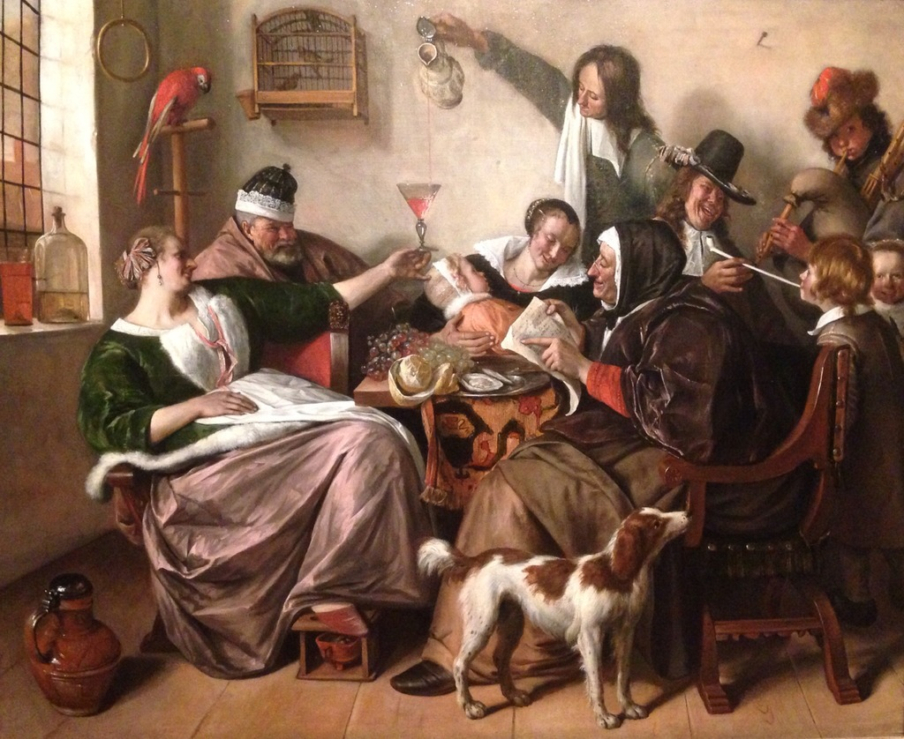

Slide 3
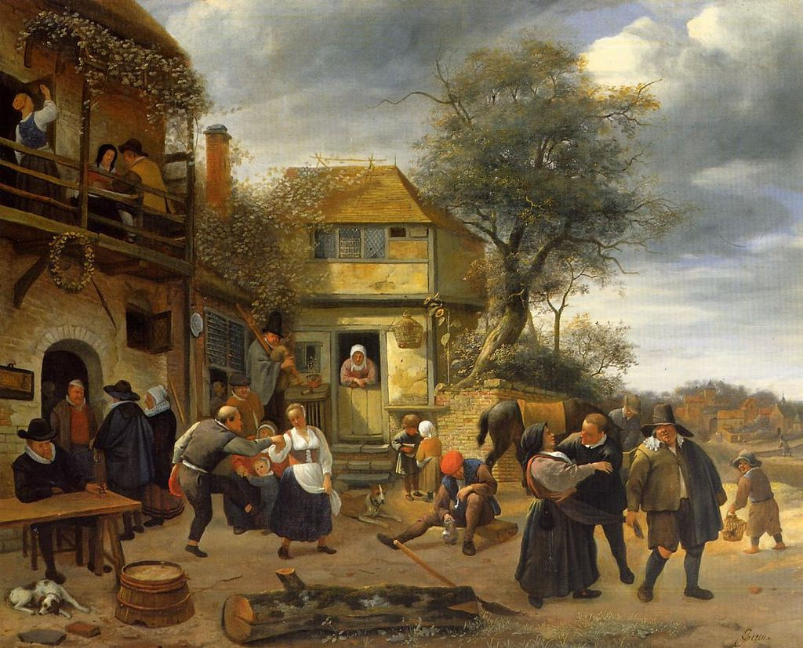
Jan Stehen: Peasants before an Inn

Slide 4
