Slide 1
TRINITY
三位一体

Slide 2
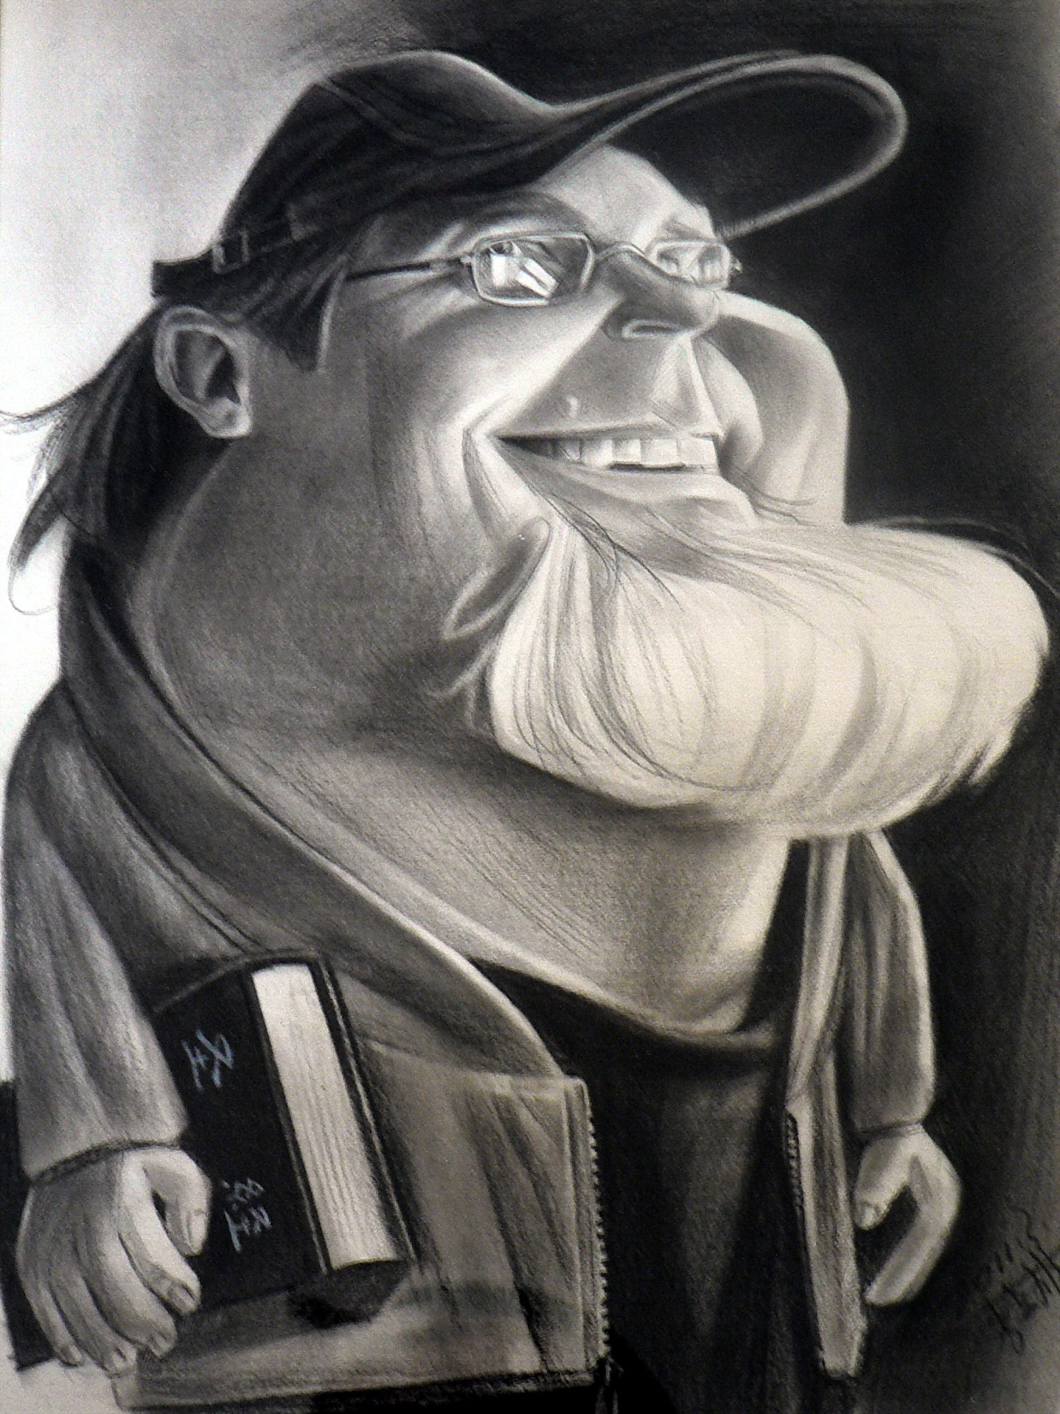
Taught by:
Dr. Barleon & Suran

Slide 3
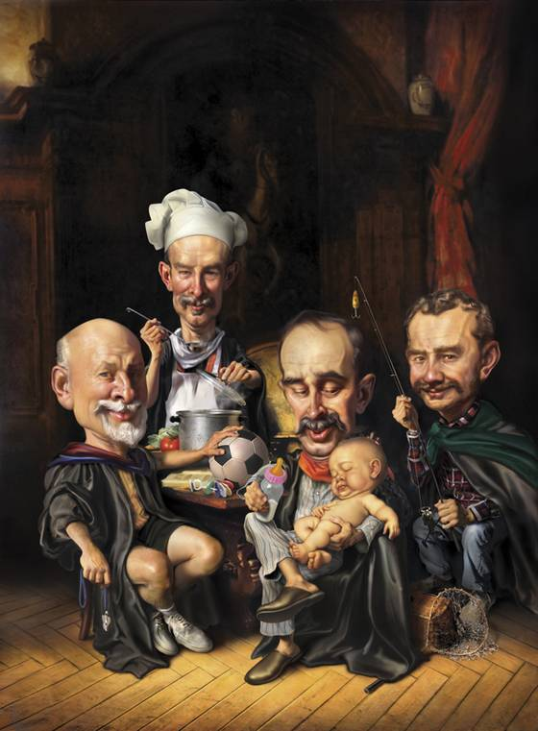
关于三一真神的二十个问题
20 Questions on… The TRINITY

Slide 4
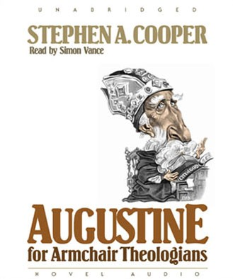
“If you deny the trinity, you lose your soul.
Try to explain it, you lose your mind”
–St. Augustine
“如果你否认
三位一体,
你会失去灵魂； 若试图解释之, 你会失去理智.”
——圣奥古斯丁

Slide 5
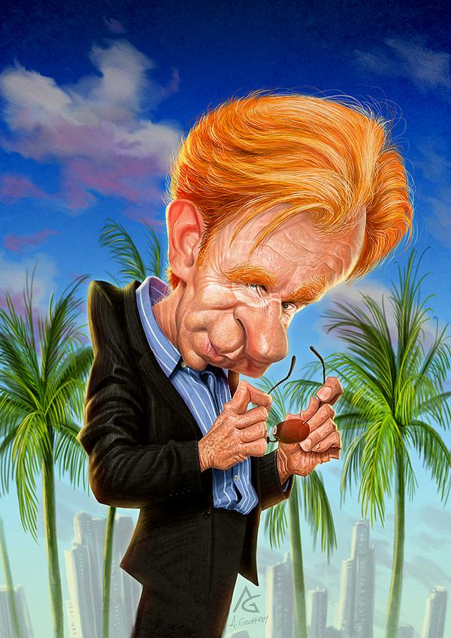
为何我要学习三位一体的教义？
Why should I study the doctrine of the Trinity?
1

Slide 6
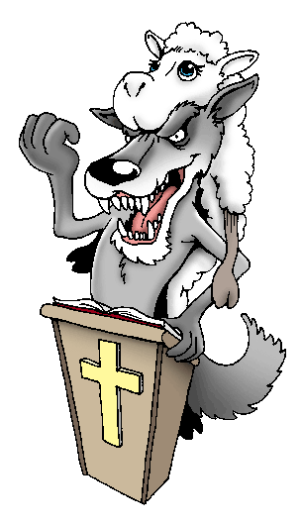
“…好嘱咐那几个人不可传异教.”
提前1:3
1 Timothy 1:3
“…command certain people not to teach false doctrines any longer.”

Slide 7

提前4:16 “你要谨慎自己和自己的教训,要在这些事上恒心. 因为这样行,又能救自己,又能救听你的人.”
1 Timothy 4:16 “Watch your life and doctrine closely. Persevere in them, because if you do, you will save both yourself and your hearers.”

Slide 8
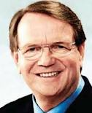
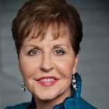
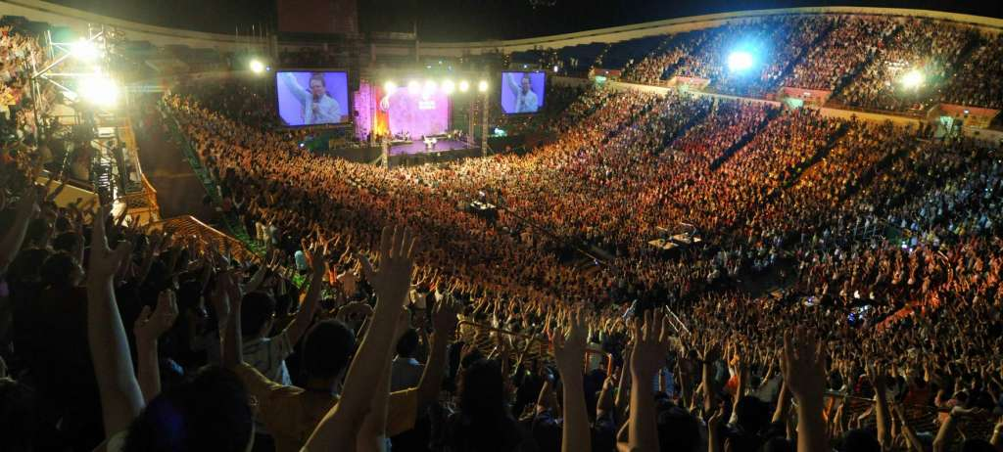
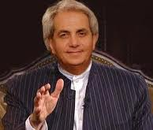
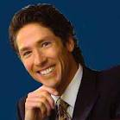
提后4:3 “因为时候要到,人必厌烦纯正的道理,耳朵发痒,就随从自己的情欲,增添好些师傅;”
2 Timothy 4:3 “For the time will come when people will not put up with sound doctrine. Instead, to suit their own desires, they will gather around them a great number of teachers to say what their itching ears want to hear.”

Slide 9
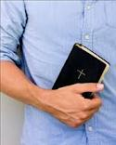
“坚守所教真实的道理,就能将纯正的教训劝化人,又能把争辩的人驳倒了.”
多1:9
Titus 1:9 “He must hold firmly to the trustworthy message as it has been taught, so that he can encourage others by sound doctrine and refute those who oppose it.”

Slide 10
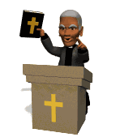
“但你所讲的,总要合乎那纯正的道理.”
多2:1
Titus 2:1
“You, however, must teach what is appropriate to sound doctrine.”

Slide 11
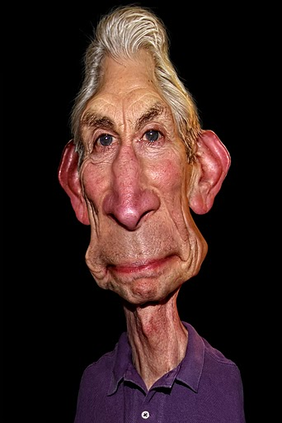
“三位一体”
这词出现在《圣经》 了吗？
Is the word ‘TRINITY’ in the Bible?
3
2

Slide 12
“三位一体”这词虽未出现, 但概念和教导出现了。
提阿非罗,安提阿教会的第六任主教, 第一次在他的书中使用了 “三位一体”.
特土良, 早期教父, 将这个词普遍化了（公元150-220年）.
The word TRINITY does not appear in the Bible but the concept and teachings do.
Theophilus, 6th Bishop of Antioch, first used the word ‘trinity’ in his book, ‘Refutation of Autolucus’ (168 AD) to explain the doctrine succinctly.
Tertullian, the early church father, popularized the word Trinity (150-220 AD)
Notes:
Word

Slide 13
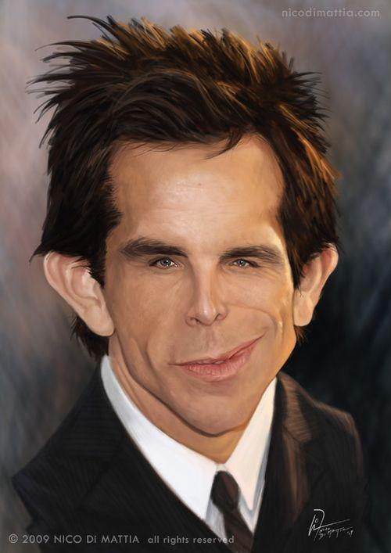
“三位一体”
这个词是什么意思？
What does the word
‘TRINITY’ mean?
3

Slide 14
神是父、子和圣灵。
一位神，三个位格。
God is Father, Son and Holy Spirit. One God. Three Persons.
威斯敏斯特信条(1647):
“上帝是三位一体的：圣父、圣子、圣灵，三位有同一的实质，同一的权能，同一的无时限.”
Westminster Confession of Faith (1647):
“In the unity of the Godhead there be three persons – one of substance, power and eternity; God the Father, God the Son, and God the Holy Ghost.”

Slide 15
“三位一体是一位神, 三个位格永恒地存在着—圣父,圣子和圣灵. 他们既完整又平等,在永恒中互为关联.”
“The Trinity is One God who eternally exists as three persons – Father, Son, and Spirit – who are fully and equally God in eternal relation with each other.”

Slide 16
圣父
Father
圣子Son
不是 (IS NOT)
是 (IS)
是 (IS)
神
GOD
不是 (IS NOT)
不是 (IS NOT)
是(IS)
圣灵
Spirit

Slide 17

《圣经》教导只有一位神吗?
Does the Bible teach that there is only ONE GOD?
4

Slide 18
申4:35 “惟有耶和华他是神，除他以外,再无别神.”
Deut. 4:35 “…the LORD is God; besides him there is no other.”
“你们如今要知道: 我,惟有我是神,在我以外并无别神.” 申32:39
Deut. 32:39 “See now that I myself am He! There is no God besides Me.”

Slide 19
诗86:10 “因你为大,且行奇妙的事,惟独你是神.”
Ps. 86:10 “For you are great and do marvelous deeds; you alone are God”
赛43:10耶和华说: “你们是我的见证,我所拣选的仆人. 既是这样,便可以知道,且信服我,又明白我就是耶和华. 在我以前没有真神,在我以后也必没有.”
Is. 43:10 “You are My witnesses,” declares the LORD, “and My servant whom I have chosen, so that you may know and believe Me and understand that I AM HE. Before Me no god was formed, nor will there be one after Me.”

Slide 20
“我是耶和华;在我以外并没有别神.
除了我以外再没有神.”赛45:5
Is. 45:5 “I am the LORD, and there is no other; apart from Me there is no God.”
提前1:17 “但愿尊贵,荣耀归与那不能朽坏,不能看见,永世的君王,独一的神,直到永永远远. 阿们!”
1 Tim. 1:17 “Now to the King eternal, immortal, invisible, the only God, be honor and glory for ever and ever. Amen.”
“因为只有一位神…”
提前2:5
还有很多
经文！
many more verses!
1 Tim. 2:5 “For there is one God…”

Slide 21

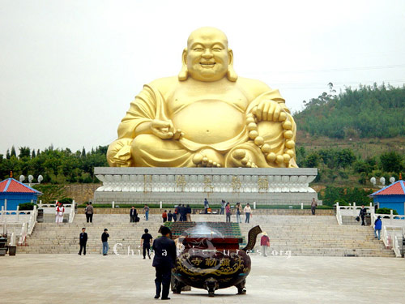
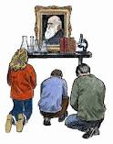
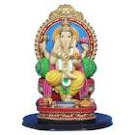
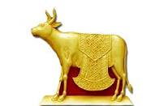
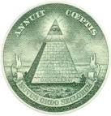
每个国家都有很多假神
  There are many false gods in every country

Slide 22
这些 “诸神”都是些鬼魔并有超自然力量.
  These ‘gods’ are demons and have supernatural powers
“所祭祀的鬼魔并非真神。” 申32:17
  “They sacrificed to false gods, which are not God” Deut. 32:17
“外邦人所献的祭是祭鬼,不是祭神, 我不愿意你们与鬼相交.” 林前10:20
  “No, but the sacrifices of pagans are offered to demons, not to God, and I do not want you to be participants with demons. “ 1 Cor. 10:20
那些以为自己是在敬拜真神, 只是名字不同 (比如阿拉)其实是在给鬼魔献祭。
  Those who think they are calling the True God by another name (ie: Allah) are actually sacrificing to demons.

Slide 23
鬼魔也能伪造神迹并伪装成基督教领袖。
  Demons can do counterfeit miracles & disguise as Christian leaders
林后11:13-15: “那等人是假使徒,行事诡诈,装作基督使徒的模样. 这也不足为怪,因为连撒但也装作光明的天使. 所以,他的差役若装作仁义的差役,也不算希奇…”
  2 Cor. 11:13-15 “For such are false apostles, deceitful workers, transforming themselves into the apostles of Christ. And no marvel; for Satan himself is transformed into an angel of light. Therefore it is no great thing if his ministers also be transformed as the ministers of righteousness…

Slide 24
太7:21-23 “凡称呼我‘主啊,主啊’的人,不能都进天国;惟独遵行我天父旨意的人,才能进去. 当那日,必有许多人对我说: ‘主啊,主啊,我们不是奉你的名传道,奉你的名赶鬼,奉你的名行许多异能吗?’ 我就明明地告诉他们说: ‘我从来不认识你们,你们这些作恶的人,离开我去吧!’”
  Matt. 7:21-23 ““Not everyone who says to me, ‘Lord, Lord,’ will enter the kingdom of heaven, but only the one who does the will of my Father who is in heaven. Many will say to me on that day, ‘Lord, Lord, did we not prophesy in your name and in your name drive out demons and in your name perform many miracles?’ Then I will tell them plainly, ‘I never knew you. Away from me, you evildoers!’

Slide 25
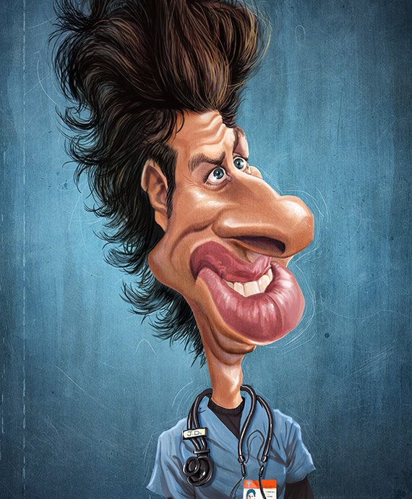
《圣经》有无教导圣父是神?
Does the Bible teach that the Father is God?
5

Slide 26
约6:27 “因为人子是父神所印证的.”
人人似乎都认同这一点
EVERYONE SEEMS TO AGREE ON THIS POINT
John 6:27 “For on Him (Jesus) God the Father has placed his seal of approval.”
林前8:6 然而我们只有一位神，就是父,万物都本于他,我们也归于他;并有一位主,就是耶稣基督,万物都是藉著他有的,我们也是藉著他有的。
1 Cor. 8:6 “Yet for us there is but one God, the Father, from whom all things came and for whom we live; and there is but one Lord, Jesus Christ, through whom all things came and through whom we live.”

Slide 27
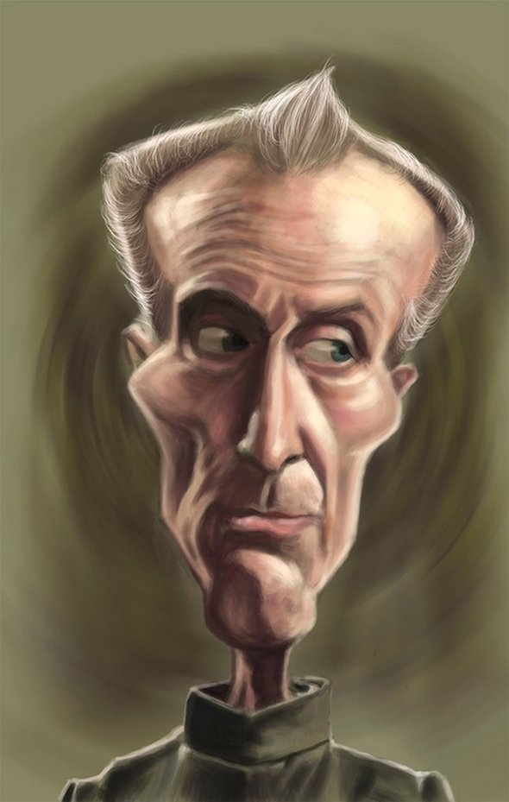
《圣经》 有无教导说耶稣是神？
Does the Bible teach that
JESUS IS GOD?
6

Slide 28
太初有道，道与神同在，道就是神。 这道太初与神同在。 万物是藉著他造的；凡被造的，没有一样不是藉著他造的。道成了肉身，住在我们中间，充充满满地有恩典，有真理。我们也见过他的荣光，正是父独生子的荣光。 约1:1-3,14
“In the beginning was the Word, and the Word was with God, and the Word was God. He was with God in the beginning. Through Him all things were made; without Him nothing was made that has been made...The Word became flesh and made His dwelling among us. We have seen His glory, the glory of the one and only Son, who came from the Father, full of grace and truth.”
John 1:1-3, 14

Slide 29
“我实实在在地告诉你们: 还没有亚伯拉罕就有了我.” 约8:58 耶稣说:
John 8:58 “Very truly I tell you,” Jesus answered, “before Abraham was born, I AM!”
“犹太人又拿起石头来要打他。 耶稣对他们说:“我从父显出许多善事给你们看，你们是为哪一件拿石头打我呢?” 犹太人回答说: “我们不是为善事拿石头打你,是为你说僭妄的话;又为你是个人,反将自己当作神.” 约10:31-33
^{John 10:31-33} “Again his Jewish opponents picked up stones to stone Him, but Jesus said to them, “I have shown you many good works from
the Father. For which of these do you stone me?” “We are not stoning you for any good work,” they replied, “but for blasphemy, because
you, a mere man, claim to be God.”

Slide 30
“过了八日,门徒又在屋里,多马也和他们同在. 门都关了. 耶稣来站在当中说:“愿你们平安!” 就对多马说: “伸过你的指头来,摸我的手;伸出你的手来,探入我的肋旁. 不要疑惑,总要信!” 多马说; ”我的主,我的神!” 耶稣对他说: “你因看见了我才信,那没有看见就信的有福了!” 约20:26-29
“A week later his disciples were in the house again, and Thomas was with them. Though the doors were locked, Jesus came and stood among them and said, “Peace be with you!” Then he said to Thomas, “Put your finger here; see my hands. Reach out your hand and put it into my side. Stop doubting and believe.” Thomas said to him, “My Lord and my God!” Then Jesus told him, “Because you have seen me, you have believed; blessed are those who have not seen and yet have believed.” John 20:26-29

Slide 31
“列祖就是他们的祖宗, 按肉体说, 基督也是从他们出来的,他是在万有之上,永远可称颂的神。阿们！ ”罗5:9:
Rom. 9:5“Theirs are the patriarchs, and from them is traced the human ancestry of the Messiah, who is God over all, forever praised! Amen.”
多2:13 “等候所盼望的福，并等候至大的神和我们救主耶稣基督的荣耀显现。”
Titus 2:13 “while we wait for the blessed hope—the appearing of the glory of our great God and Savior, Jesus Christ”

Slide 32
“我们也知道神的儿子已经来到,且将智慧赐给我们,使我们认识那位真实的,我们也在那位真实的里面,就是在他儿子耶稣基督里面。这是真神,也是永生. ”约一5:20
1 John 5:20 “We know also that the Son of God has come and has given us understanding, so that we may know him who is true. And we are in him who is true by being in his Son Jesus Christ. He is the true God and eternal life.”
有太多的经文来印证这点了！
There are far too many to show them all!

Slide 33
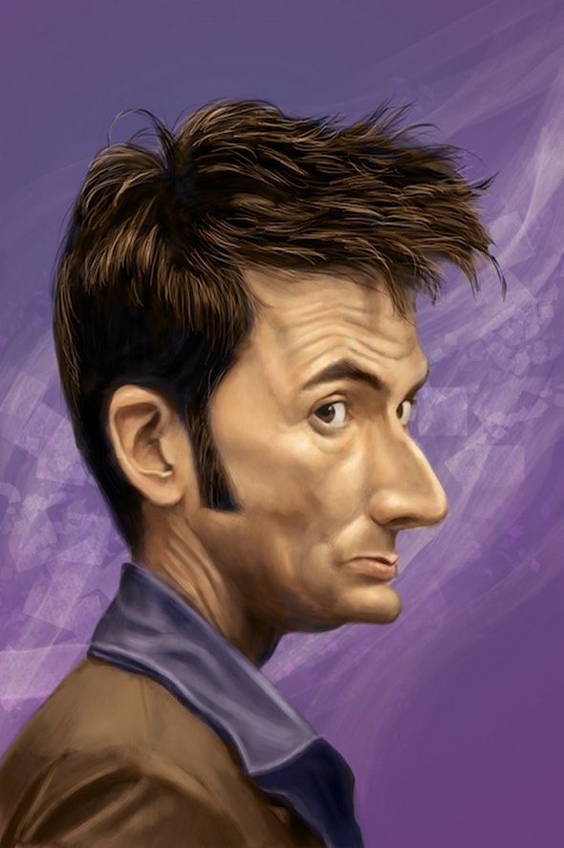
《圣经》有无 教导圣灵是神?
Does the Bible teach that the HOLY SPIRIT IS GOD?
7

Slide 34
* 首先, 非常重要的是圣灵是一个位格,不是一股能量. 当你跟圣灵说话时,应称呼 “祂”,而非 “它”.
* 一个位格要求有情感,智力和意志, 但并不一定有身体.
* 圣灵有这三样。我们在后面学习圣灵的时候会重点谈到。
1st, it is important to remember that the Holy Spirit is a person, not a force.
When you speak of the Holy Spirit, you should say HE, not IT.
A person requires EMOTIONS, INTELLECT and WILL, not necessarily a body.
He has all 3. We will focus more on this when we study the Holy Spirit soon.

Slide 35
“主(神)就是那灵,主的灵在哪里,那里就得以自由.我们众人既然敞著脸得以看见主的荣光,好像从镜子里返照,就变成主的形状,荣上加荣,如同从主的灵变成的.”林后3:17-18
2 Cor. 3:17-18 “Now the Lord (God) is the Spirit, and where the Spirit of the Lord is, there is freedom. And we all, who with unveiled faces contemplate the Lord’s glory, are being transformed into his image with ever-increasing glory, which comes from the Lord, who is the Spirit.”

Slide 36
“有一个人,名叫亚拿尼亚，同他的妻子撒非喇卖了田产,把价银私自留下几分,他的妻子也知道,其余的几分拿来放在使徒脚前. 彼得说: “亚拿尼亚,为甚么撒但充满了你的心,叫你欺哄圣灵,把田地的价银私自留下几分呢? 田地还没有卖,不是你自己的吗? 既卖了,价银不是你作主吗? 你怎么心里起这意念呢? 你不是欺哄人,是欺哄神了!”
徒5:1-4
Acts 5:1-4 “Now a man named Ananias, together with his wife Sapphira, also sold a piece of property. With his wife’s full knowledge he kept back part of the money for himself, but brought the rest and put it at the apostles’ feet. Then Peter said, “Ananias, how is it that Satan has so filled your heart that you have lied to the Holy Spirit and have kept for yourself some of the money you received for the land? Didn’t it belong to you before it was sold? And after it was sold, wasn’t the money at your disposal? What made you think of doing such a thing? You have not lied just to human beings but to God.”

Slide 37
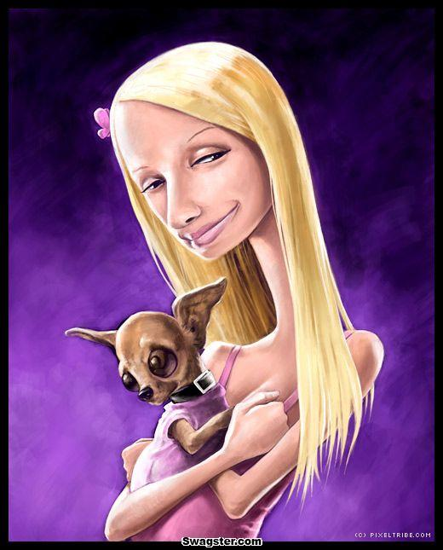
“三个分别不同的位格”是什么意思?
What do we mean when we say
3 SEPARATE PERSONS?
8

Slide 38
位格PERSON
智力INTELLECT
情感EMOTIONS
意志WILL

Slide 39
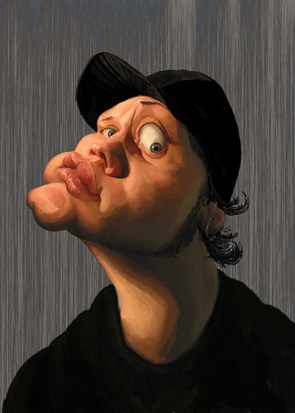
三个位格是否声称他们有所分别?
Do the 3 persons claim to be separate people?
9

Slide 40
“但我要从父那里差保惠师来,就是从父出来真理的圣灵,他来了,就要为我作见证. ”约15:26
John 15:26 “When the Advocate comes, whom I will send to you from the Father, the Spirit of truth who goes out from the Father, He will testify about me.”
“…因为圣灵照著神(圣父)的旨意替圣徒祈求.” 罗8:27
Rom. 8:27 “…the Spirit intercedes for God’s people in
accordance with the will of God (the Father). “

Slide 41
林后1:3 “愿颂赞归与我们的主耶稣基督的父神,就是发慈悲的父, 赐各样安慰的神.”
2 Cor. 1:3 “Praise be to the God and Father of our Lord Jesus Christ”
“作使徒的保罗(不是由于人,也不是藉著人,乃是藉著耶稣基督,与叫他从死里复活的父神)和一切与我同在的众弟兄,写信给加拉太的各教会.”加1:1-2
Gal. 1:1 “Paul, an apostle—sent not from men nor by a man, but by
Jesus Christ and God the Father, who raised him from the dead—
and all the brothers and sisters with me”

