Slide 1
TRINITY
三位一体

Slide 2
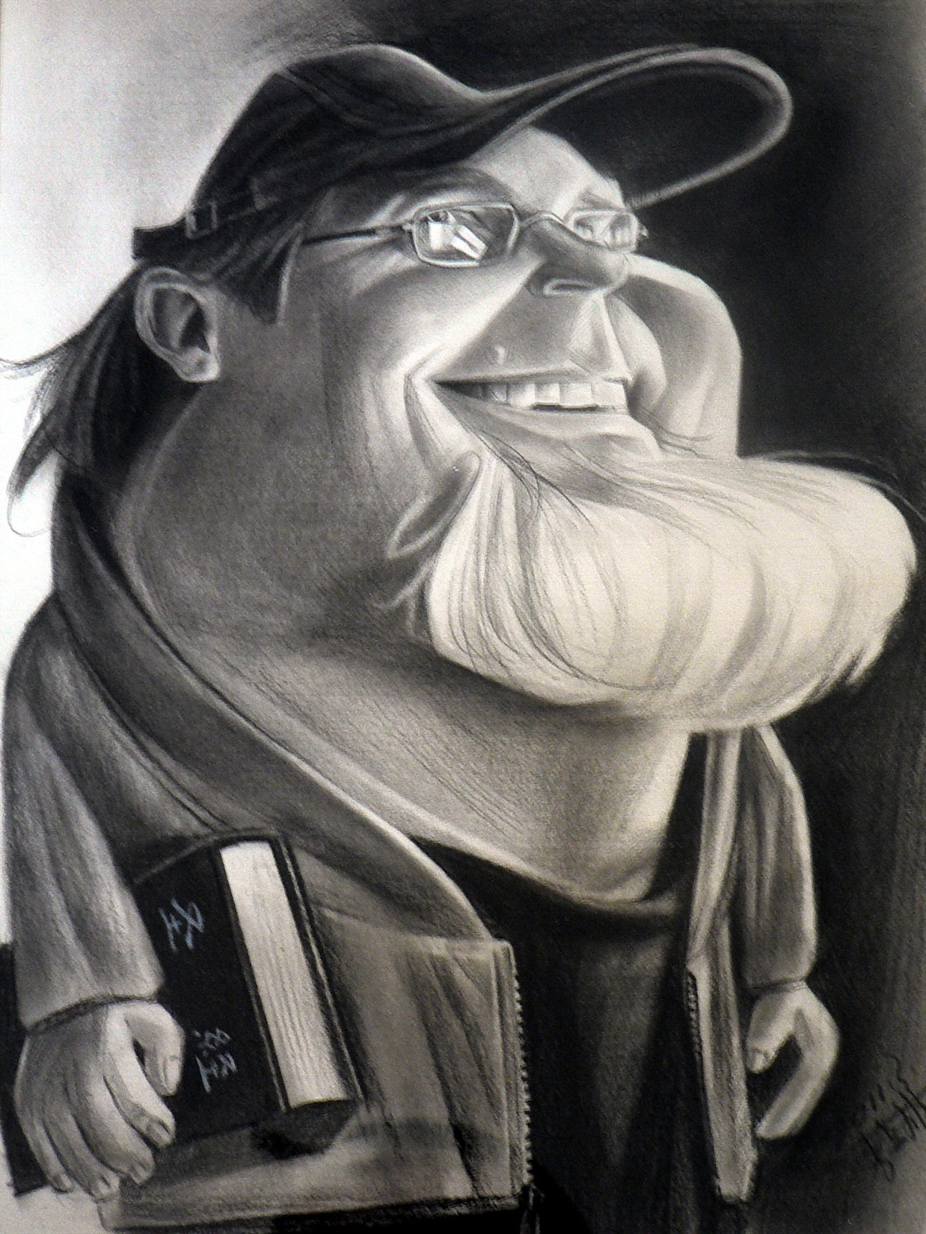
Taught by:
Dr. Barleon & Suran

Slide 3
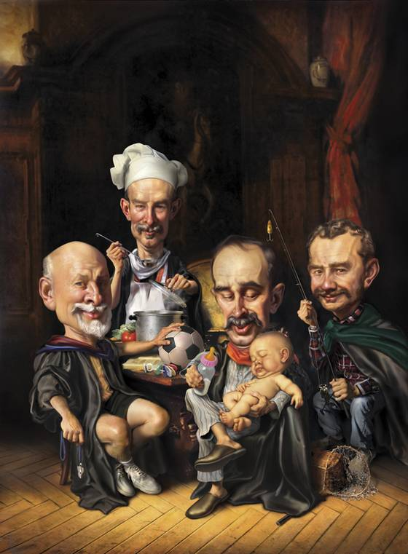
关于三一真神的二十个问题
20 Questions on… The TRINITY

Slide 4
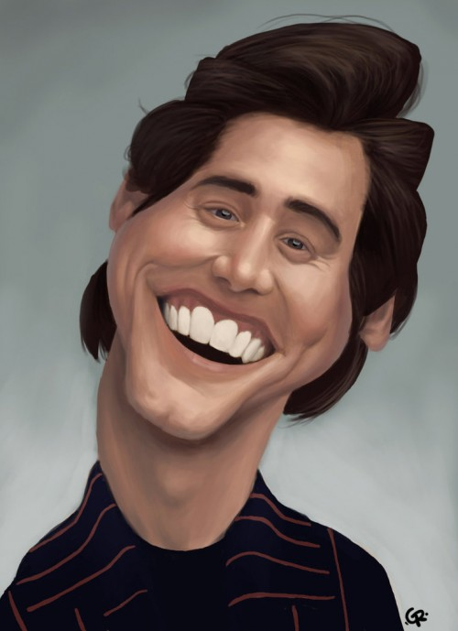
三位一体的神看上去是什么样子?
What is this Trinitarian God like?
10

Slide 5
仁爱:没有爱心的,就不认识神,因为神就是爱. 神是这样向我们显明爱的:神差他独生子到世间来,使我们藉著他得生,神爱我们的心在此就显明了.不是我们爱神,乃是神爱我们,差他的儿子,为我们的罪作了挽回祭,这就是爱了. 约一4:8-11
LOVING: “Whoever does not love does not know God, because God is love. This is how God showed His love among us: He sent His one and only Son into the world that we might live through Him. This is love: not that we loved God, but that He loved us and sent His Son as an atoning sacrifice for our sins.” 1 John 4:8

Slide 6
“耶和华,耶和华,是有怜悯,有恩典的神,不轻易发怒,并有丰盛的慈爱和诚实.为千万人存留慈爱,赦免罪孽,过犯和罪恶,万不以有罪的为无罪.” 出34:6b-7a
“The LORD, the LORD, the compassionate and gracious God, slow to anger, abounding in love and faithfulness, maintaining love to thousands, and forgiving wickedness, rebellion and sin. Yet he does not leave the guilty unpunished; ” Ex. 34:6b-7a

Slide 7
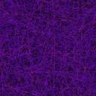
领主和主人Lord & Master
主权的Sovereign God
恩典的Gracious
忍耐的Patient
慈爱的Loving
信实的Faithful
饶恕的Forgiving
公义的 Just
审判的Judge

Slide 8
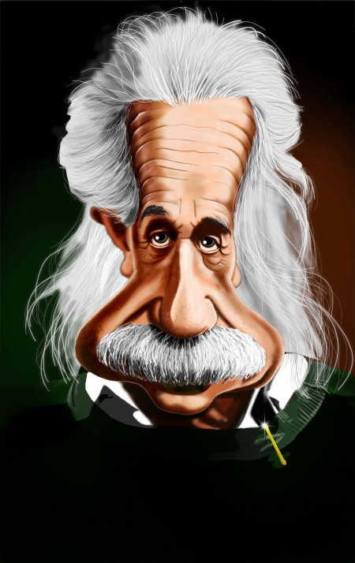
古犹太拉比教导三位一体吗?
Did ancient Jewish Rabbis teach the Trinity?
11

Slide 9

“起初神(圣父)创造天地。 地是空虚混沌,渊面黑暗; 神的灵运行在水面上”创1:1-2
Gen. 1:1-2 “In the beginning God (the Father) created the heavens and the earth. Now the earth was formless and empty, darkness was over the surface of the deep, and the Spirit of God was hovering over the waters.”
神=Elohim (单数/ 复数) 照字面解 就是 “一个神们”
留意这个词: 起初
God = Elohim (singular / plural) Literally “ONE GODS”
Notice the words: “IN THE BEGINNING”

Slide 10
当古犹太拉比以人们的日常语言(又叫塔古姆)写旧约时, 他们留意到“起初”(希伯来语是 re’shit )这个词与 旧约中出现了四次的“头生” （希伯来语: bekor）这个词是同义。
  When the ancient Rabbis wrote the Old Testament into the common language of the people (this is called a TARGUM), they noticed the word BEGINNING (Hebrew re’shit) was synonymous with the word FIRSTBORN (Hebrew: bekor) 4 times in the O.T.
他们希伯来《塔古姆》里将这段话翻成 “在头生子里，神创造了…”
  They translated the passage, “In the Firstborn, God created…” in the Targum Neofiti
耶稣在《西1:15-16》和《约1:3》里被保罗 和约翰称为“头生子”。
  Jesus is called the Firstborn by Paul (Col. 1:15-16) and John (John 1:3)

Slide 11
在创世纪第一章的往后几节, 神提到自己时都是用的复数形式。
  A few verses later in Genesis 1, God refers to Himself in the plural tense…
“我们要照著我们的形像, 按著我们的样式造人.”
“Let US make man in OUR image after OUR likeness”
因此, 第一节若这么翻译可能更容易理解: “在头生子里,神(圣父)创造天地…神的灵运行在水面上.”
Thus, verse 1 makes more sense if translated “IN THE FIRSTBORN, GOD (THE FATHER) CREATED THE HEAVEN AND THE EARTH…. AND THE SPIRIT OF GOD WAS HOVERING OVER THE WATERS.”

Slide 12
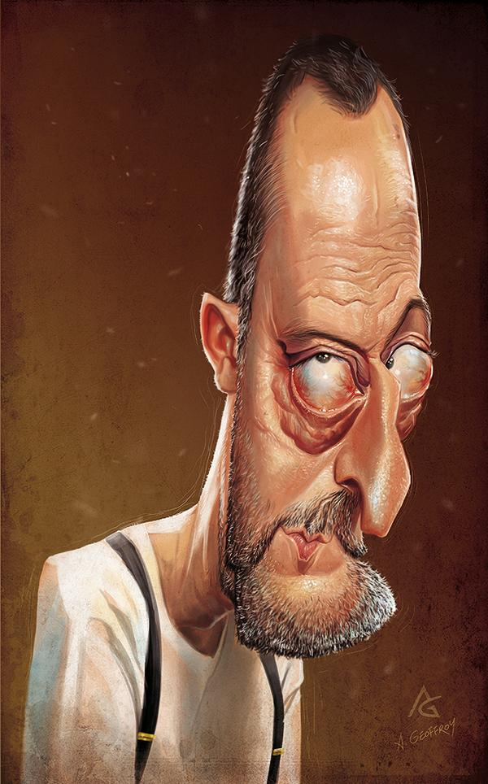
旧约中能不能找到三位一体?
Is the Trinity found in the
OLD TESTMENT?
12

Slide 13
“主耶和华的灵在我身上.因为耶和华(圣父)用膏膏我(弥赛亚),叫我传好信息给谦卑的人,差遣我医好伤心的人,报告被掳的得释放,被囚的出监牢;”
FATHER
圣父
SON
圣子
HOLY SPIRIT
圣灵
“The Spirit of the Sovereign LORD is on Me (the Messiah)” Isaiah 61:1

Slide 14
他们在一切苦难中,他也同受苦难,并且他面前的使者(称呼道成肉身前的耶稣)拯救他们。他以慈爱和怜悯救赎他们,在古时的日子常保抱他们,怀搋他们. 他们竟悖逆,使主的圣灵担忧;他就转作他们的仇敌,亲自攻击他们. 赛63:9-10
FATHER
圣父
SON
圣子
HOLY SPIRIT
圣灵
“In all their distress He too was distressed, and the angel of His presence (a term used for the pre-incarnate Jesus) saved them. In His love and mercy He redeemed them; He lifted them up and carried them all the days of old. Yet they rebelled and grieved His Holy Spirit.“ Isaiah 63:9-10

Slide 15
赛11: 1-3 “从耶西的本必发一条,从他根生的枝子必结果实. 耶和华的灵必住在他身上,就是使他有智慧和聪明的灵,谋略和能力的灵,知识和敬畏耶和华的灵. 他必以敬畏耶和华为乐,行审判不凭眼见,断是非也不凭耳闻;”
FATHER
圣父
SON
圣子
HOLY SPIRIT
圣灵
Isaiah 11:1-3 “A shoot will come up from the stump of Jesse; from His roots a Branch will bear fruit. The Spirit of the LORD will rest on Him— the Spirit of wisdom and of understanding, the Spirit of counsel and of might, the Spirit of the knowledge and fear of the LORD— and He will delight in the fear of the LORD.”

Slide 16
赛42:1 “看哪！我的仆人,我所扶持,所拣选,心里所喜悦的. 我已将我的灵赐给他,他必将公理传给外邦. ”
FATHER
圣父
SON
圣子
HOLY SPIRIT
圣灵
Isaiah 42:1 “ Here is My servant, whom I uphold, My chosen one in whom I delight; I will put My Spirit on Him, and He will bring justice to the nations.

Slide 17
赛48:16 “…现在主耶和华差遣我和他的灵来”
FATHER
圣父
SON
圣子
HOLY SPIRIT
圣灵
Is. 48:16 “… the Lord GOD has sent Me, and His Spirit."
赛61:1 “…主耶和华的灵在我身上”
Is. 61:1 “… The Spirit of the Lord GOD is upon Me."

Slide 18
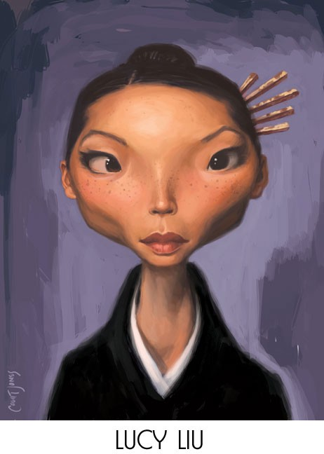
新约中能找到三位一体吗？
Is the Trinity found in the
NEW TESTAMENT?
13

Slide 19
路1:35 “天使回答说: ‘圣灵要临到你身上,至高者的能力要荫庇你,因此所要生的圣者必称为神的儿子.’ ”
FATHER
圣父
SON
圣子
HOLY SPIRIT
圣灵
耶稣的受孕 (IN JESUS CONCEPTION )
Luke 1:35 “The angel answered, “The Holy Spirit will come on you,
and the power of the Most High will overshadow you.
So the Holy One to be born will be called the Son of God.”

Slide 20
太3:16-17 耶稣受了洗,随即从水里上来。天忽然为他开了,他就看见神的灵彷佛鸽子降下 ,落在他身上. 从天上有声音说: “这是我的爱子,我所喜悦的.”
FATHER
圣父
SON
圣子
HOLY SPIRIT
圣灵
耶稣的受洗 (IN JESUS BAPTISM )
Matt. 3:16-17 “As soon as Jesus was baptized, He went up out of the water.
At that moment heaven was opened, and He saw the Spirit of God
descending like a dove and alighting on Him. And a voice from heaven said, “This is My Son, whom I love; with Him I am well pleased.”

Slide 21
太28:19 “所以,你们要去,使万民作我的门徒,奉父,子,圣灵的名给他们施洗.”
FATHER
圣父
SON
圣子
HOLY SPIRIT
圣灵
在大使命中 (IN THE GREAT COMMISSION)
Matt. 28:19 “Therefore go and make disciples of all nations, baptizing them in the name of the Father and of the Son and of the Holy Spirit,”

Slide 22
徒1:7-8 耶稣对他们说:“父凭著自己的权柄所定的时候,日期,不是你们可以知道的. 但圣灵降临在你们身上,你们就必得著能力;”
FATHER
圣父
SON
圣子
HOLY SPIRIT
圣灵
在使徒行传中 (IN ACTS )
Acts 1:7-8 “He said to them: “It is not for you to know the times or
dates the Father has set by His own authority. But you will receive
power when the Holy Spirit comes on you”

Slide 23
仔细看他们的分工…
圣父:祝福我们,选择我们, 预定我们, 爱我们.
圣子: 救赎我们, 饶恕我们.
圣灵: 盖上得救的印记, 保证我们得救到底.
FATHER
圣父
SON
圣子
HOLY SPIRIT
圣灵
在救恩中 (IN YOUR SALVATION:弗Eph. 1:3-14)
WATCH FOR THESE THINGS…
FATHER: Blessed us, Chose us, predestined us, loves us
JESUS: Redeems us, forgives us,
SPIRIT: : Seals us, guarantees our salvation

Slide 24
愿颂赞归与我们主耶稣基督的父神！他在基督里曾赐给我们天上各样属灵的福气.就如神从创立世界以前,在基督里拣选了我们,使我们在他面前成为圣洁,无有瑕疵;又因爱我们,就按著自己意旨所喜悦的,预定我们藉著耶稣基督得儿子的名分,使他荣耀的恩典得著称赞。这恩典是他在爱子里所赐给我们的. 我们藉这爱子的血得蒙救赎,过犯得以赦免,乃是照他丰富的恩典. 这恩典是神用诸般智慧聪明,充充足足赏给我们的,都是照他自己所预定的美意,叫我们知道他旨意的奥秘,要照所安排的,在日期满足的时候,使天上地上一切所有的,都在基督里面同归于一. 我们也在他里面得了基业,这原是那位随己意行做万事的,照著他旨意所预定的,叫他的荣耀,从我们这首先在基督里有盼望的人,可以得著称赞. 你们既听见真理的道,就是那叫你们得救的福音,也信了基督,既然信他,就受了所应许的圣灵为印记. 这圣灵是我们得基业的凭据,直等到神之民被赎，使他的荣耀得著称赞。弗1:3-14 (Eph 1:3-14)

Slide 25
“耶稣基督的使徒彼得,写信给那分散在本都,加拉太,加帕多家,亚西亚,庇推尼寄居的,就是照父神的先见被拣选,藉著圣灵得成圣洁,以致顺服耶稣基督,又蒙他血所洒的人;愿恩惠,平安多多地加给你们!”
FATHER
圣父
SON
圣子
HOLY SPIRIT
圣灵
在预定中 (IN PREDESTINATION)
“Peter, an apostle of Jesus Christ, To God’s elect, exiles scattered throughout the provinces of Pontus, Galatia, Cappadocia, Asia and Bithynia, who have been chosen according to the foreknowledge of God the Father, through the sanctifying work of the Spirit, to be obedient to Jesus Christ and sprinkled with His blood: Grace and peace be yours in abundance.” 1 Peter 1:1-2

Slide 26
提多书3:4-6: “但到了神我们救主的恩慈和他向人所施的慈爱显明的时候,他便救了我们,并不是因我们自己所行的义,乃是照他的怜悯,藉著重生的洗和圣灵的更新. 圣灵就是神藉著耶稣基督我们救主厚厚浇灌在我们身上的。”
FATHER
圣父
SON
圣子
HOLY SPIRIT
圣灵
在救恩中 (IN SALVATION)
Titus 3:4-6 “But when the kindness and love of God our Savior appeared, He saved us, not because of righteous things we had done, but because of His mercy. He saved us through the washing of rebirth and renewal by the Holy Spirit, whom He poured out on us generously through Jesus Christ our Savior”

Slide 27
“恩赐原有分别,圣灵却是一位. 职事也有分别,主却是一位. 功用也有分别,神却是一位, 在众人里面运行一切的事.”
FATHER
圣父
SON
圣子
HOLY SPIRIT
圣灵
在恩赐中 (IN GIVING GIFTS)
“There are different kinds of gifts, but the same Spirit
distributes them. There are different kinds of service, but the same Lord. There are different kinds of working, but in all of them and in everyone
it is the same God at work.” 1 Cor. 12:4-6

Slide 28
林后13:14 “愿主耶稣基督的恩惠、神的慈爱、 圣灵的感动，常与你们众人同在！ ”
FATHER
圣父
SON
圣子
HOLY SPIRIT
圣灵
2 Cor. 13:14 “May the grace of the Lord Jesus Christ, and the love of God, and the fellowship of the Holy Spirit be with you all”
“亲爱的弟兄啊,你们却要在至圣的真道上造就自己,在圣灵里祷告,保守自己常在神的爱中,仰望我们主耶稣基督的怜悯,直到永生.”
犹大书20-21
在圣经的公式里 (IN BIBLICAL FORMULAS)
Jude 20-21 “But you, dear friends, by building yourselves up in your most holy faith and praying in the Holy Spirit, keep yourselves in God’s love as you wait for the mercy of our Lord Jesus Christ to bring you to eternal life. ”

Slide 29
“我要求父,父就另外赐给你们一位保惠师, 叫他永远与 你们同在,就是真理的圣灵.”
约翰福音14:16-17a
FATHER
圣父
SON
圣子
HOLY SPIRIT
圣灵
在耶稣的话里 (IN JESUS’ WORDS)
John 14:16-17a “And I will ask the Father, and He will give you another Advocate to help you and be with you forever— the Spirit of Truth.”

Slide 30
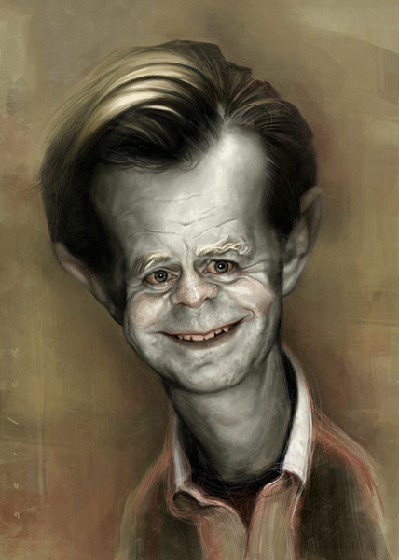
早期教会教导三位一体的教义吗？
Did the early church teach the doctrine of the trinity?
14

Slide 31
尼西亚大会（公元325年）
COUNCIL OF NICAEA (325 AD)
康斯坦堡大会（公元381年）
COUNCIL OF CONSTANTINOPLE (381 AD)
使徒们（30-90AD）
APOSTLES (30-90 AD)
迦克敦大会（公元451年）
COUNCIL OF CHALCEDON (451 AD)
伊格那丢：安提阿主教（公元90）
Ignatious: Bishop of Antioch (90 AD)
克莱门特：罗马第三任主教（公元96年）
Clement the 3rd Bishop of Rome (96 AD)
殉道士犹士丁：作家（公元155年）
Justin Martyr: Writer (155 AD)
提阿非罗：安提阿第六任主教（公元168年）
Theophilus: 6th Bishop of Antioch (168 AD)
雅典那哥拉: 神学家（公元177年）
Athenagoras: theologian (177 AD)
爱任纽：里昂主教（公元180年）
Irenaeus: Bishop of Lyons (180 AD)
特土良：早期教会（公元197年）
Tertullian (Early church Father (197 AD)
贵格利：教会领袖（公元264年）
Gregory Thaumaturgus: Church Leader (264 AD)
圣·奥古斯丁（公元400-419年只研究三位一体）
St. Augustine (400-419 studied ONLY the trinity)

Slide 32

St. Augustine (400-419 studied ONLY the trinity for 19 years)
Wrote: Treaties on the Trinity
圣奥古斯丁
著述:
三位一
体论著
(于公元400-419年间花了19年时间只研究三位一体)

Slide 33
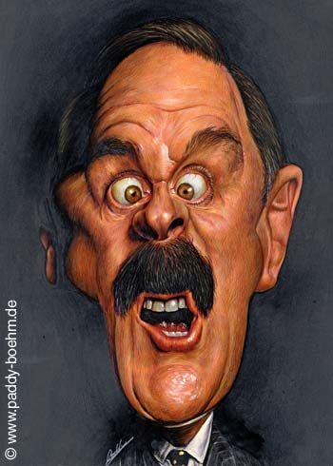
哪些有关三位一体的教导被认为是异端言论？
What teachings would be considered heresy in regards to the Trinity?
15

Slide 34
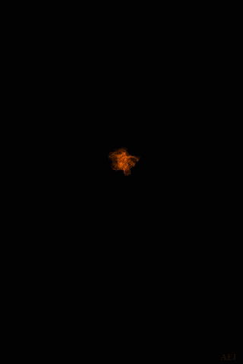
三位神(三神论)
“父,子和圣灵是三个独立,自治和神圣的存在.”
  “Father, Son and Spirit are Three independent, autonomous, divine beings”
摩门教教导: 父是人升高后变成神;耶稣和圣灵是父的两个孩子. 有很多星球和世界, 很多神,我们也能变成神。
  Mormons teach: The Father is an exalted man who became God; Jesus and the Spirit are spirit babies of the Father. There are many worlds, many gods, we too can become god.
1
1
1
3
1
THREE GODS (Tri-theism)

Slide 35

耶稣不是神 (阿里乌斯主义)
“耶稣也是被造的,不是神.”
  “Jesus was a created being, not God”
“圣灵只是一股能量.”
  “The Holy Spirit is just a force”
耶和华见证人教导: “耶稣只是天使长米迦勒, 是路西弗的兄弟.”
  Jehovah’s Witnesses teach “Jesus is Michael the Archangel and the brother of Lucifer”
JESUS WAS NOT GOD (Arianism)

Slide 36

同一神三个名字 (形态论)
圣父: “神在旧约中启示自己为律法制定者.”
  FATHER: “God revealed Himself as the Law Giver in the Old Testament”
圣子: “神在福音书中启示自己为救赎者.”
  SON: “God revealed Himself as the Redeemer in the Gospels”
圣灵: “神在新约和今天启示自己为维持者.”
  SPIRIT: “God reveals Himself as the Sustainer in the N.T. and today.”
联合国际五旬教会（UPCI）
  United Pentecostal Church International (UPCI)
3 NAMES FOR THE SAME GOD (Modalism)

Slide 37
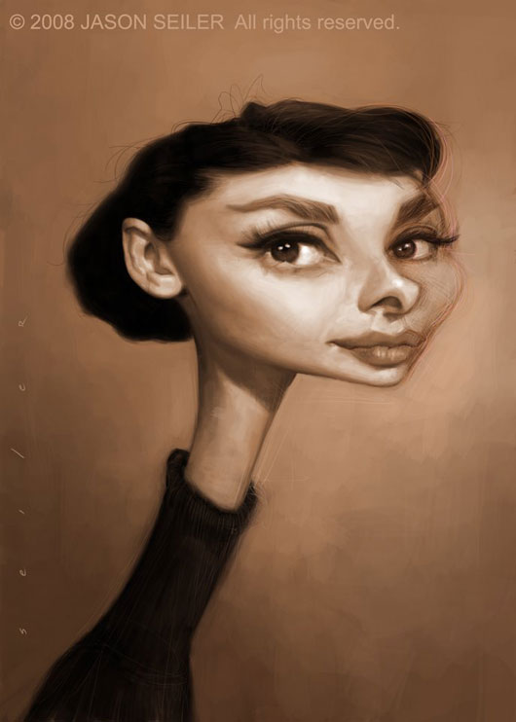
有无什么方法可以教导孩子明白三位一体？
Are there ways to teach the doctrine of the Trinity to my children?
16

Slide 38

使用《圣经》
USE THE BIBLE
1) 通过圣经故事告诉他们圣父、圣子和圣灵。
  Tell them about the Father, the Son and the Spirit through Bible stories
2) 让他们背诵《十诫》（尤其是第一诫）
  Have them memorize the 10 Commandments (especially the first one)
3) 首先解释三个位格都是神，而非不同的神。
  Begin by explaining that all 3 are God, but not different gods
4) 使用差强人意的例证时要说明它并没有表达完全。
  Use insufficient illustrations to show what you DONOT MEAN
5) 使用一个简单的盒子实例。
  Use a simple illustration of a box

Slide 39
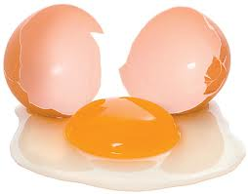


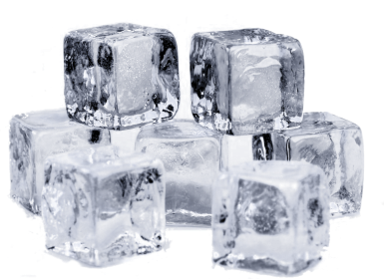
可使用的实例向孩子说明三位一体这概念
鸡蛋(壳,黄,白)
但三个可以分开
  EGGS (Shell, Yolk, White):
  but the 3 can be separated
水(液态,冰,蒸汽)
但它们只能一次以一 种形态出现.
  WATER (Liquid, Ice, Steam):
  but they can only be one at a time
INSUFFICIENT WAYS TO ILLUSTRATE THE TRINITY TO KIDS

Slide 40

盒子
长 (length)
三边相异, 同一盒子
  3 Different sides but only ONE BOX
抽走一条边, 其余均消失.
  Remove one side, they all disappear
  里面相同.打开看看
  Same inside. Open to discover.
宽 (width)
高 (height)
THE BOX

Slide 41
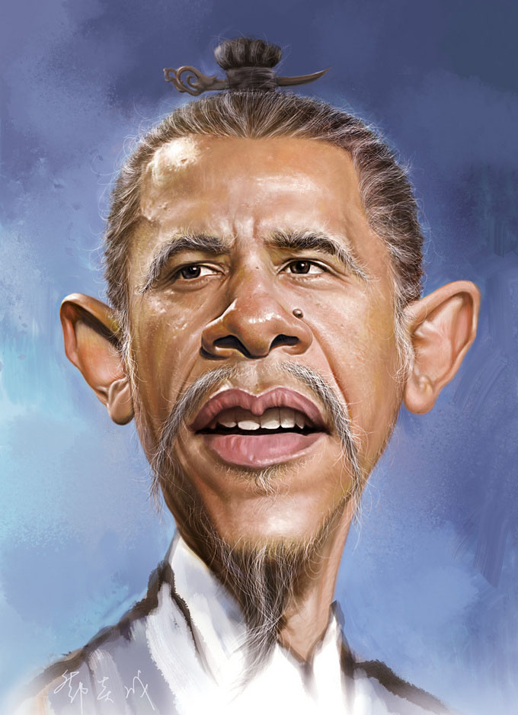
若我的教 会不相信 这教义,我 该怎么办?
What should I do if my church does not believe this doctrine?
17

Slide 42

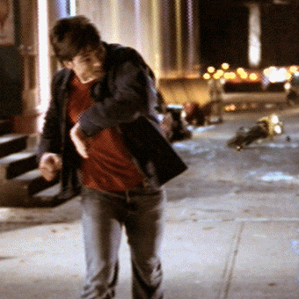


Slide 43
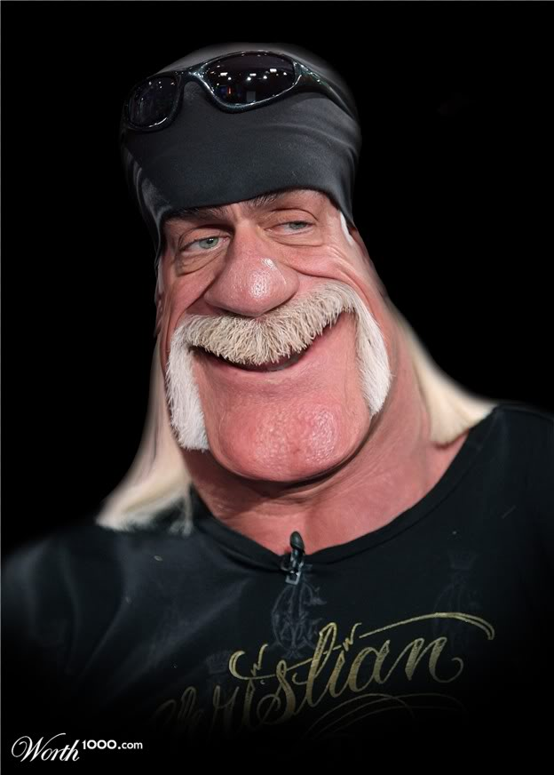
三位一体的教义会如何影响我的生活?
How should the doctrine of the TRINITY affect my life?
18

Slide 44
父,子,圣灵可以一起敬拜,也可分别敬拜.
  Worship Father, Son and Holy Spirit together and separately
逐个感谢他们在你救恩中的不同角色。
  Thank them each for their role in your salvation
认识到你被三个位格的神一起爱着。
  Realize how loved you are by all three
在圣灵的大能里分享耶稣, 将结果交给父神。
  Share Jesus in the power of the Spirit and leave the results to God

Slide 45
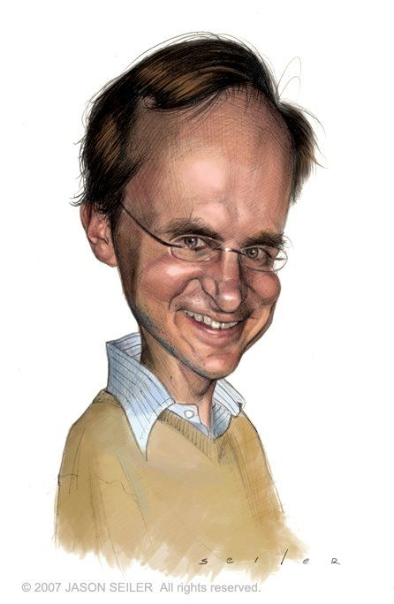
我应向 谁祷告?
Which One do I pray to?
19

Slide 46
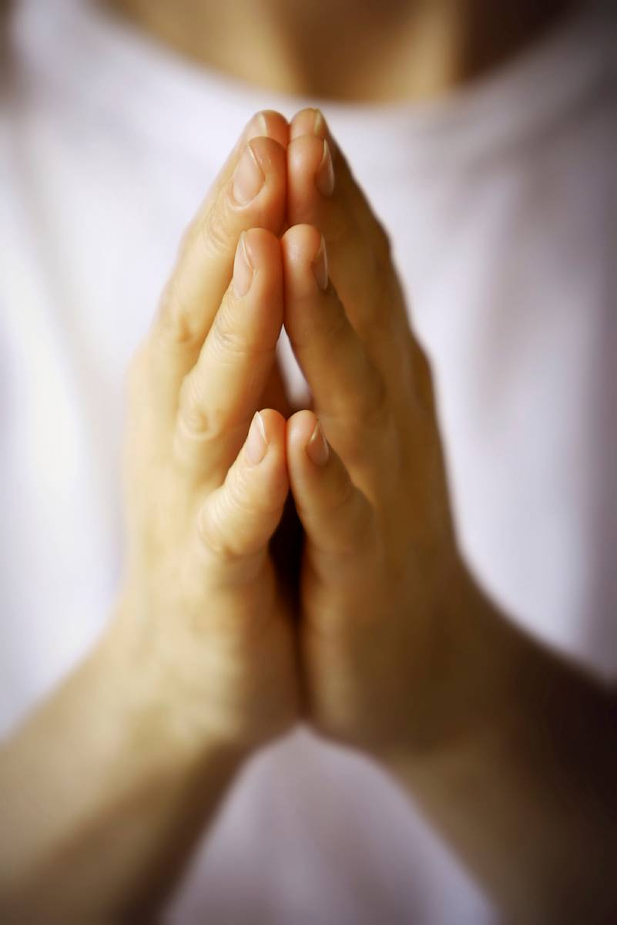
依靠圣灵, 通过耶稣向父神祷告.
  Pray to the Father, through the Son, by the Holy Spirit
对三位一起说话或分别说话都可以。
  Talk to all three together or each One individually

Slide 47
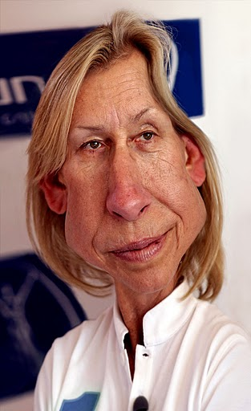
基督徒在这个问题上的认识难道不可以不一致吗?
Isn’t this an issue that Christians can disagree on?
20

Slide 48
不可. 否认三位一体就是否认整个基督信仰.
  No. To deny the trinity is to deny the core of Christianity.
神只有一位.
    THERE IS ONLY ONE GOD
父是神.
    THE FATHER IS GOD
子是神.
    JESUS IS GOD
圣灵是神.
    THE HOLY SPIRIT IS GOD

Slide 49

Next week: WHO IS THE HOLY SPIRIT?

