Slide 1
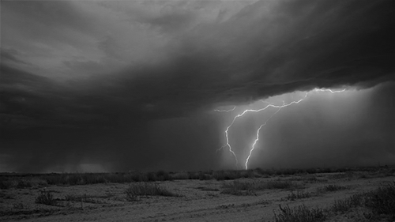
《神学》介绍
Introduction to THEOLOGY

Slide 2
圣经主题课程
INTENSIVE BIBLE TRAINING PROGRAM

Slide 3
第一部分
《神学》介绍 Introduction to THEOLOGY
纯正教义的重要性 The Importance of Sound Doctrine
为什么基督徒相信的教义都有所不同？ Why Christians believe different doctrines
第二部分（正统与异端的区分标准）
基督信仰的基要信条 Essential Beliefs of the Christian Faith

Slide 4
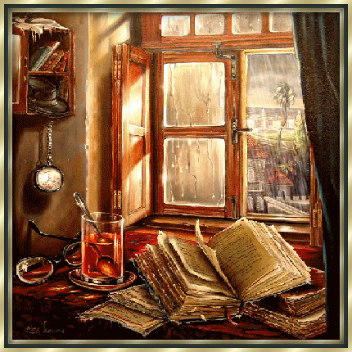
什么是神学?
What is THEOLOGY?

Slide 5
“关于上帝的理性讨论.”- 奥古斯丁
“Rational discussion respecting the deity.” –Augustine
“关于神的科学以及神与宇宙万物的关系。-史特朗
“The Science of God and the relations between God and the universe.”–A. H. Strong
“对神的思考以及表达这些思考的某些方式.” -查尔斯·雷历
“Thinking about God and expressing those thoughts in some way.” –Charles Ryrie
Definitions by some theologians…

Slide 6
什么是神学?
“神学”一词是从两个希腊词结合起来的,意思是 “神的研究”. 基督教系统神学简单地说就是通过《圣经》已启示的内容来理解神和祂的作为。
The word “theology” comes from two Greek words that combined mean
“the study of God.” Christian Systematic theology is simply an attempt to understand God and His works as revealed in the Bible.
What is THEOLOGY?

Slide 7
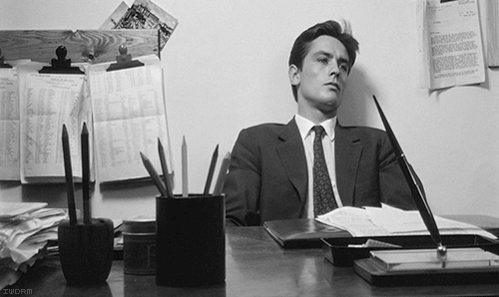
为何要学习《神学》?
Why study THEOLOGY?

Slide 8
为何要学习《神学》?
学习神学是为了更好地认识神，以便我们能透过爱和顺服来荣耀神。劣质神学及对神肤浅和不正确的理解会通过教导和行为制造异端并冒犯神。若无神学，我们会浪费生命，失去灵魂。但通过学习神学, 我们能深化对神的爱。
We study theology to get to know God in order that we may glorify Him through our love and obedience. Poor theology and a superficial, inaccurate understanding of God will only create heresies and displease God by our teachings and actions. Without theology, we waste our lives and lose our souls. As we study theology, we deepen our love for God.
Why study THEOLOGY?

Slide 9
谁应该学习《神学》?
Who should study THEOLOGY?

Slide 10
谁应该学习《神学》?
所有的基督徒都应该透彻地学习神学—— 个人对神强化式的研究，以便更好地认识、热爱和顺服那位我们将要一起度永生的神。
问题的实质不是 “我是否想成为神学家？”而是 “我是一个好神学家还是坏神学家?”
All Christians should be consumed with theology—the intense, personal study of God—in order to know, love, and obey the One with whom we will joyfully spend eternity.
The real question is NOT “Do I want to be a theologian?”, but we should really be asking “Will I be a good theologian or a bad theologian?”
Who should study THEOLOGY?

Slide 11
大部分人是如何形成他们的神学的?
How do most people develop their theology?

Slide 12
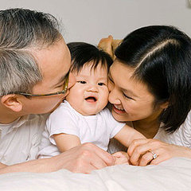
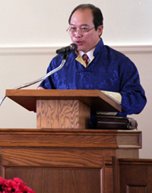
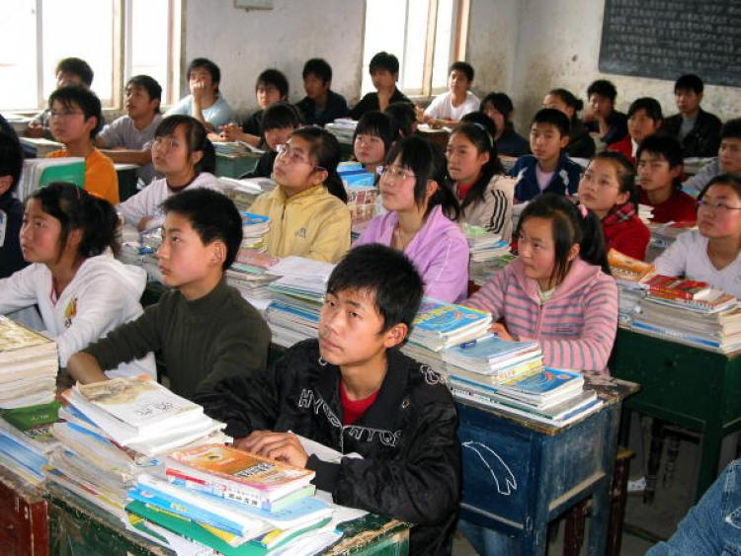
大部分人是如何形成他们的神学的?
How do most people develop their theology?

Slide 13
小报神学(走访天堂和地狱; 对天使和鬼魔作不符圣经的描述; 与死去的亲属对话; 所有的信仰均平等；等等)
Tabloid Theology (Visiting Heaven or Hell; unscriptural description of angels & demons; talking to dead relatives; all faiths are equal; etc.)
流行神学(医治聚会; 成功神学; 易信主义;等等)
Big Church Theology (Healing services; Health, Wealth & Prosperity gospel; Easy-Believism; etc.)
情绪化神学(建立在我们认为神应是谁以及我们认为他或不是什么之上的神学.)
Emotional Theology (Theology based on who WE think God should be and what WE think He should and should not do)
人文神学(试图将圣经与当今观点混合起来).
Humanistic Theology (Trying to blend the Bible with current opinion)
Modern Theology

Slide 14
我们该如何形成自己的神学?
How should we develop our theology?

Slide 15
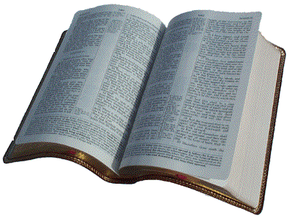
如何形成我们自己的神学?
隐秘的事是属耶和华我们神的；惟有明显的事是永远属我们和我们子孙的，好叫我们遵行这律法上的一切话。”(申29:29)
“The secret things belong to the Lord our God, but the things revealed belong to us and to our sons forever, that we may observe all the words of this law” (Deut. 29:29).
How should we develop our theology?

Slide 16
WHY SHOULD EVERYONE STUDY SOUND DOCTRINE?
为何人人都应学习纯正的教义?

Slide 17
因为神命令我们这么做！ 提前4:16 “你要谨慎自己和自己的教训,要在这些事上恒心. 因为这样行,又能救自己,又能救听你的人.”
BECAUSE WE ARE COMMANDED TO!
1 Timothy 4:16 “Watch your life and doctrine closely. Persevere in them, because if you do, you will save both yourself and your hearers.”

Slide 18
为预防流行的假教师. 提后4:3 “因为时候要到,人必厌烦纯正的道理,耳朵发痒,就随从自己的情欲,增添好些师傅;”
TO AVOID POPULAR FALSE TEACHERS
2 Timothy 4:3 “For the time will come when people will not put up with sound doctrine. Instead, to suit their own desires, they will gather around them a great number of teachers to say what their itching ears want to hear.”

Slide 19
可责备假教师 “我往马其顿去的时候,曾劝你仍住在以弗所,好嘱咐那几个人不可传异教,” 提前1:3
TO REBUKE FALSE TEACHERS
1 Timothy 1:3
“…command certain people not to teach false doctrines any longer.”

Slide 20
可鼓励其他基督徒 “坚守所教真实的道理,就能将纯正的教训劝化人,又能把争辩的人驳倒了.” 提多书1:9
TO ENCOURAGE OTHER CHRISTIANS
Titus 1:9 “He must hold firmly to the trustworthy message as it has been taught, so that he can encourage others by sound doctrine and refute those who oppose it.”

Slide 21
为要教导真理 “但你所讲的,总要合乎那纯正的道理.” 提多书2:1
TO TEACH TRUTH
Titus 2:1 “You, however, must teach what is appropriate to sound doctrine.”

Slide 22
为什么我问的每个圣经问题都会得到多种不同的答案？ 既然圣经是容易明白的,为什么他们观点不一致呢?
Why do I get such a variety of different answers to each Bible question I ask? Why don’t they all agree if the Bible is so easy to understand?

Slide 23
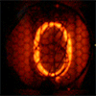
十大 得到错误答案 的原因
Top 10 Reasons We Get Wrong Answers

Slide 24
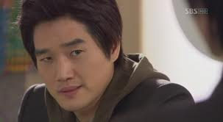
PRIDE
1. 骄傲
有时候我们甚至不愿意承认我们可能错了.
(Sometimes we are unwilling to even consider that WE MIGHT BE WRONG.)

Slide 25
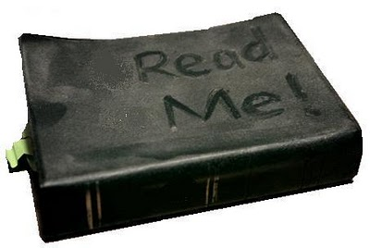
LAZINESS
1.骄傲
有时我们不愿深入学习,常采取一种“且信且行”的态度。
(Sometimes we are unwilling to devote ourselves to deep study. We adopt a
“just believe and move on” attitude.)
2. 懒惰

Slide 26
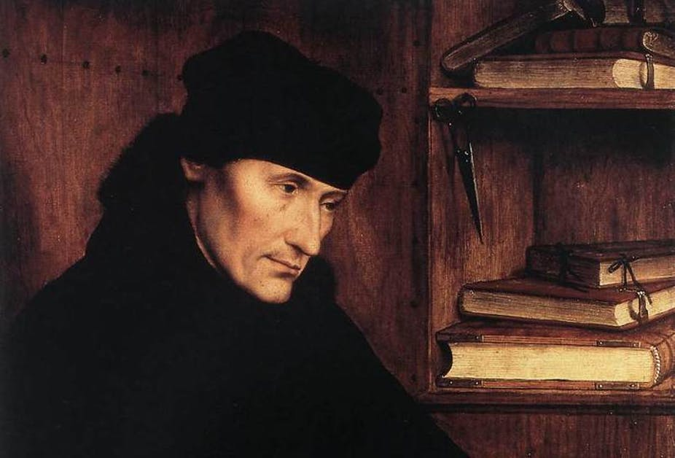
FALSE LOYALTY
1.骄傲
有时我们忠于自己的宗派或导师多过忠于神。
(Sometimes we put our devotion to our denomination or mentors before our devotion to God.)
2. 懒惰
3. 愚忠

Slide 27
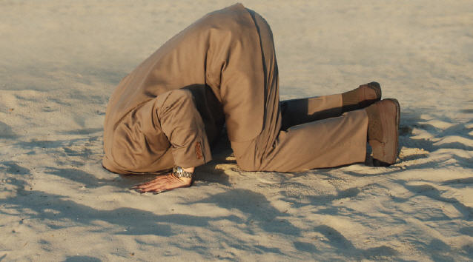
EMOTIONALISM
1.骄傲
有时只接受那些我们感觉良好的答案.不愿接受那些触犯我们世界观的教义。
(Sometimes we will only accept answers we FEEL good about. We won’t accept doctrines that offend our worldview.)
2. 懒惰
3. 愚忠
4. 情感倾向
4. X
4. X
4. X
4. X
4. X
4. X

Slide 28
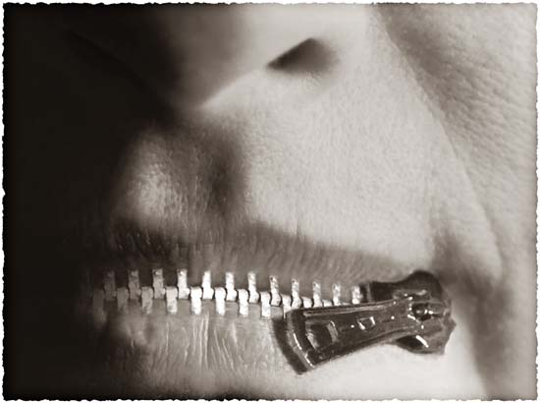
OPINIONATED
1.骄傲
对于神自己都沉默的问题,有时我们谈论起来却满带权威。
(Sometimes we speak authoritatively when even God is silent on the subject.)
2. 懒惰
3. 愚忠
4. 情感倾向
5. 固执己见
4. X
4. X
4. X
4. X
4. X

Slide 29
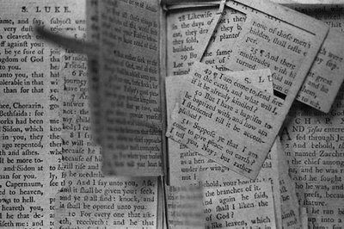
DECONTEXTUALIZING
1.骄傲
有时我们从上下文中抽出经文证明自己的观点。我们假设每节经文都适用于我们当下的情况。
(Sometimes we take verses out of context to prove our points. We assume that every verse applies to our given situation.)
2. 懒惰
3. 愚忠
4. 情感倾向
5. 固执己见
6. 断章取意
4. X
4. X
4. X
4. X

Slide 30
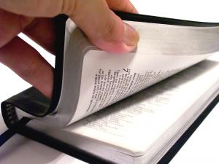
BAD HERMENEUTICS
1.骄傲
有时我们忽略了基本的圣经学习原则。往往在尚无正确释经的前提下就开始应用这节信息。
(Sometimes we ignore the most basic principles of Bible Study. We try to apply a passage before we interpret it’s meaning.)
2. 懒惰
3. 愚忠
4. 情感倾向
5. 固执己见
6. 断章取意
7. 不良释经
4. X
4. X
4. X

Slide 31
CULTURAL BLINDERS
1.骄傲
有时我们以自己的文化,语言和情景来解释经文,而不是将之还原到最初的语言和意思.
(Sometimes we interpret Scripture in light of our culture, language and situation instead of the original meaning and language.)
2. 懒惰
3. 愚忠
4. 情感倾向
5. 固执己见
6. 断章取意
7. 不良释经
8. 文化盲区
4. X
4. X

Slide 32
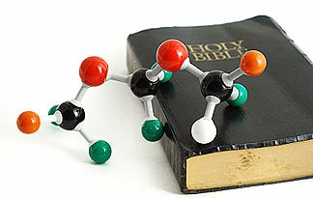
FEAR and DOUBT
1.骄傲
有时我们认为表面上的矛盾就是真矛盾。害怕科学上的新发现，不愿接受它们。
(Sometimes we assume that apparent contradictions are real contradictions.
We fear scientific breakthroughs rather
than embrace them.)
2. 懒惰
3. 愚忠
4. 情感倾向
5. 固执己见
6. 断章取意
7. 不良释经
8. 文化盲区
9. 畏惧和怀疑
4. X

Slide 33
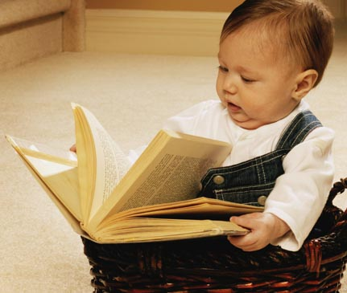
LIMITED GROWTH
1.骄傲
有时我们想明白的教义超过了我们目前的成熟度。
(Sometimes we want to understand doctrines beyond our maturity level.)
2. 懒惰
3. 愚忠
4. 情感倾向
5. 固执己见
6. 断章取意
7. 不良释经
8. 文化盲区
9. 畏惧和怀疑
10. 成长局限

Slide 34
10 Reasons We Get Wrong Answers
那我如何获得 正确的答案呢?
(So how do I get the RIGHT ANSWER?)
1.骄傲
2. 懒惰
3. 愚忠
4. 情感倾向
5. 固执己见
6. 断章取意
7. 不良释经
8. 文化盲区
9. 畏惧和怀疑
10. 成长局限

Slide 35
十大 获得正确答案 的方法
Top 10 Reasons We Get RIGHT Answers

Slide 36
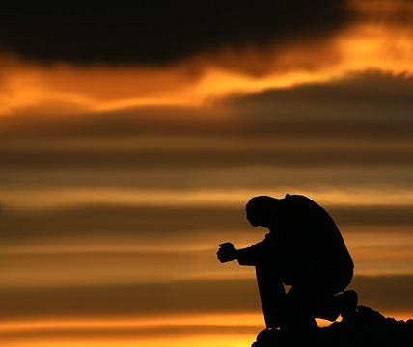
HUMILITY
1. 谦卑
要认识到你的认知可能不完整。祈求神挪去骄傲和罪。
(Realize that your knowledge may be incomplete. Ask God to remove pride
& sin as you study)

Slide 37
STUDY THE WORD
1. 谦卑
“竭力钻研, 得蒙神的认可,做无愧的工人,按着正义分解神的道.”
“Study to show yourself approved to God;
a workman who doesn’t need to be ashamed; rightly dividing the Word of Truth.”
2. 钻研神的道

Slide 38
DEVOTION TO TRUTH
1. 谦卑
将你的忠诚聚焦在圣经已启示的真理上, 而不是你的宗派或导师如何相信。
(Focus your devotion on TRUTH as revealed in the Bible; NOT on what your denomination or mentors believe. )
2. 钻研神的道
3. 忠于真理

Slide 39
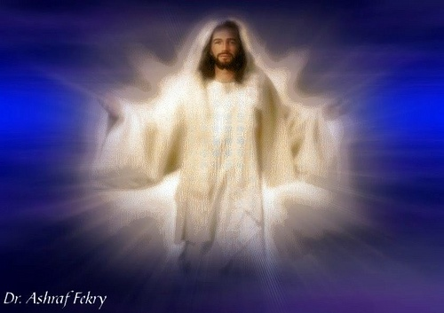
LET GOD BE GOD
1. 谦卑
接受圣经里神启示的祂自己，而不是你感觉祂该怎样或你认为祂该如何。
(Accept God for who He is as revealed
in Scripture; NOT as you feel He should be or how you think He should act. )
2. 钻研神的道
3. 忠于真理
4. 让神做神
4. X
4. X
4. X
4. X
4. X
4. X

Slide 40
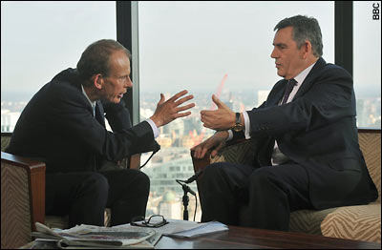
“MY OPINION IS…”
1. 谦卑
确保将观点与事实分开. 有自己的观点是可以的,但要意识并承认你可能错了。
(Make sure you separate opinions from fact. It is okay to have an opinion but realize and admit that you may be wrong.)
2. 钻研神的道
3. 忠于真理
4. 让神做神
5. “我的观点是…”
4. X
4. X
4. X
4. X
4. X

Slide 41
KEEP IT IN CONTEXT
1. 谦卑
所有的经文都有上下文。问谁写的？写给谁？何时？为什么？哪里？正确答案总能在上下文里找到。
(All verses have a context. Ask who wrote it? To whom? When? Why? Where? The truth is always found in context.)
2. 钻研神的道
3. 忠于真理
4. 让神做神
5. “我的观点是…”
6. 保持上下文
4. X
4. X
4. X
4. X

Slide 42
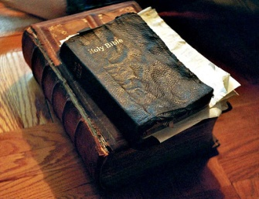
INTERPRET FIRST
1. 谦卑
只有正确的释经才能带来正确的应用。决不在没有释经的情况下就应用某节经文。
(Only a true interpretation can lead to a true application. Never apply a verse without first interpreting it.)
2. 钻研神的道
3. 忠于真理
4. 让神做神
5. “我的观点是…”
6. 保持上下文
7. 首先释经
4. X
4. X
4. X

Slide 43
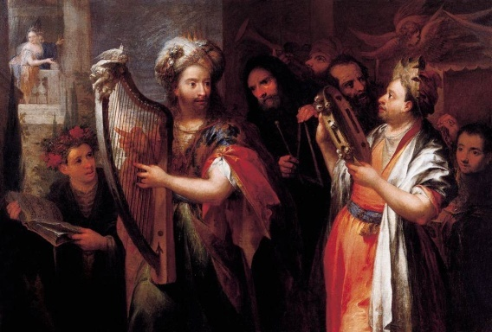
LOOK FOR THE ORIGINAL SETTING
1. 谦卑
总是根据原始的文化,语言和情形,而非你的国情和文化背景去释经。
(Always interpret Scripture in light of the original culture, language and situation instead of your national background.)
2. 钻研神的道
3. 忠于真理
4. 让神做神
5. “我的观点是…”
6. 保持上下文
7. 首先释经
8. 原始背景
4. X
4. X

Slide 44
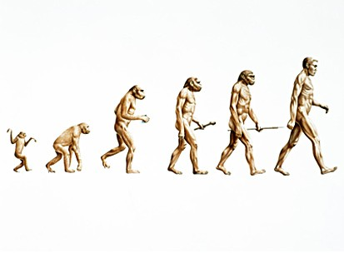
TRUTH IS TRUTH
1. 谦卑
真正的科学总是最后支持圣经里的真理。不存在矛盾，勇敢地寻求答案吧。
True science will always eventually support the truths found in Scripture. There are NO contradictions; just look for the answer.
2. 钻研神的道
3. 忠于真理
4. 让神做神
5. “我的观点是…”
6. 保持上下文
7. 首先释经
8. 原始背景
9. 真理就是真理
4. X

Slide 45
ENJOY GROWING
1. 谦卑
不要指望一下就明白所有的答案。按照神给你的速度，享受学习之旅每一步的乐趣。
(Don’t expect to know all answers at once. Enjoy the learning journey at God’s pace.)
2. 钻研神的道
3. 忠于真理
4. 让神做神
5. “我的观点是…”
6. 保持上下文
7. 首先释经
8. 原始背景
9. 真理就是真理
10. 享受成长

Slide 46
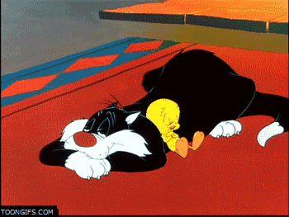
休息
BREAK

