Slide 1
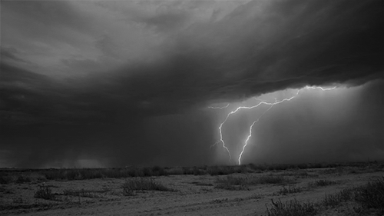
《神学》介绍二
Introduction to THEOLOGY

Slide 2
第一部分
《神学》介绍 Introduction to THEOLOGY
纯正教义的重要性 The Importance of Sound Doctrine
为什么基督徒相信的教义都有所不同？ Why Christians believe different doctrines
第二部分（正统与异端的区分标准）
基督信仰的基要信条 Essential Beliefs of the Christian Faith

Slide 3
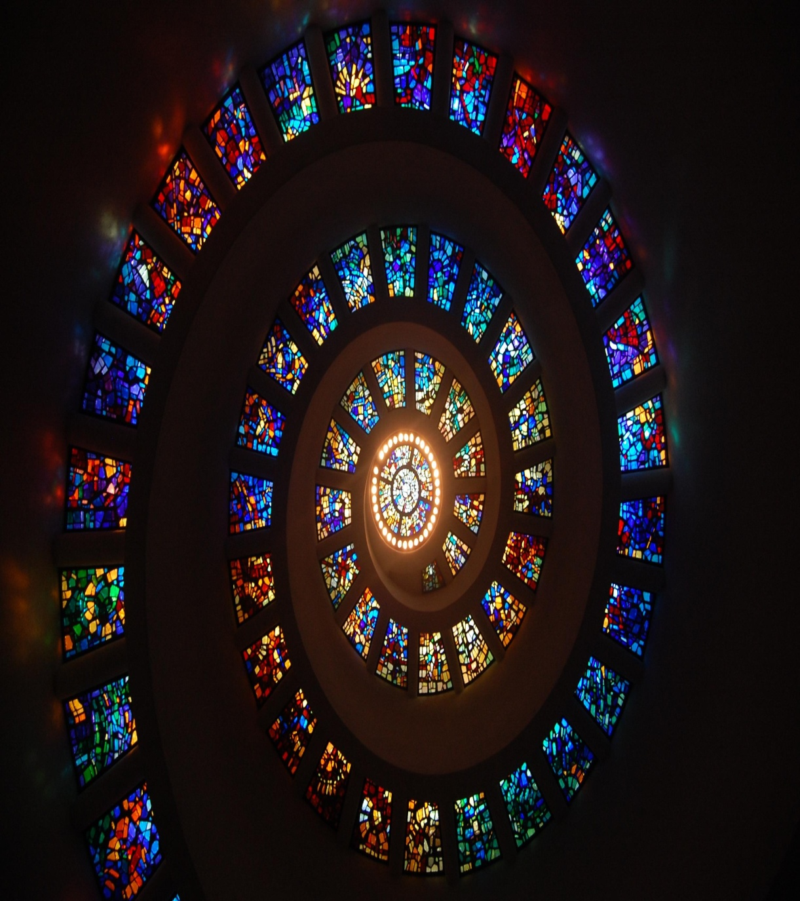
《神学》第二部分
基督信仰的基要信条 Essential Beliefs of the Christian Faith

Slide 4
基要vs.非基要教义
ESSENTIAL vs. NON-ESSENTIAL DOCTRINES

Slide 5
基督徒要明白： 哪些是握紧的教义 哪些是松手的教义
Essential and Non-Essential Beliefs

Slide 6
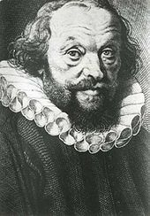
基要vs.非基要教义
“在基要里合一，在非基要里宽容, 在一切事上以爱相待.”
—梅登斯
“In essentials unity, in non-essentials liberty, in all things charity.”
–Rupertus Meldenius
ESSENTIAL vs. NON-ESSENTIAL DOCTRINES

Slide 7
基要vs.非基要教义
不要在非基要的教义上分裂,即使你确信它们的真相。
Don’t divide over non-essentials even if convicted about their truth.
不管后果如何，决不妥协基要教义。
Never compromise the essentials no matter what the consequence.
不要因为自己在某些问题上不够确定而感到羞愧。圣经并非在所有启示上都同样清晰。
There is no shame in being less certain about some things than others. The Bible does not teach all things with the same clarity.
在这个后现代世界, 你在一些困难的议题上坦承自己的不确定，反而让你的见证更真实有力。
Showing honest uncertainty about difficult issues makes your witness more authentic and powerful to a postmodern world.
ESSENTIAL vs. NON-ESSENTIAL DOCTRINES

Slide 8
教义清晰性问题
所有经文均同等为神所默示， 但并非所有经文都同等清晰。
ALL SCRIPTURE IS EQUALLY INSPIRED,
BUT NOT ALL SCRIPTURE IS EQUALLY CLEAR.
要用清晰的经文来解释不清晰的经文.
INTERPRET THE UNCLEAR VERSES IN LIGHT OF THE MANY CLEAR VERSES
邪教往往从稀少的非清晰经文里构思教义
CULTS MAKE DOCTRINES OF THE RARE UNCLEAR VERSES
举例: 为死人施洗
Example: Baptism for the Dead
DOCTRINE OF PERSPICUITY

Slide 9
松手教义 VS 握紧教义
CLOSE HANDED BELIEFS vs. OPEN HANDED BELIEFS

Slide 10
松手教义 VS 握紧教义
异端和纯正教义的判断标准是《圣经》，早期教会因为圣经的拥有不普及，大公教会使用“信经”来厘清信仰，判断正误。
今天我们要来学习十六项基要教义。只有与这些基要教义相左的教导才能被定为“异端”，因此，每个基督徒都应该明白这些“握紧的教义”是什么。
CLOSE HANDED BELIEFS vs. OPEN HANDED BELIEFS

Slide 11
救恩的基要教义
ESSENTIAL FOR SALVATION
正统性的基要教义
ESSENTIAL FOR ORTHODOXY
重要但并非基要
IMPORTANT but NOT ESSENTIAL
观点
OPINIONS
假教导
FALSE TEACHING
异端
HERESY

Slide 12
在今天的时间里, 我们将分析十六项每个基督徒必须相信的基要教义
IN OUR TIME TODAY, TODAY WE WILL LOOK AT 16 FOUNDATIONAL DOCTRINES EVERY CHRISTIAN MUST BELIEVE

Slide 13
只有一位神
1
只有一位神,唯一,永恒, 全能, 全知, 全在的创造者。
There is One, and only One, eternal, almighty, all knowing, ever present Creator God.
约翰福音17:3 “认识你独一的真神，并且认识你所差来的耶稣基督，这就是永生。”
John 17:3 “Now this is eternal life: that they know you, the only true God, and Jesus Christ, whom you have sent.”
THERE IS ONE GOD

Slide 14
经文
申6:4 “以色列啊,你要听! 耶和华我们神是独一的主.”
Deut. 6:4 “Hear, O Israel: The LORD our God, the LORD is one”
出20:2-3 “我是耶和华你的神,…除了我以外,你不可有别的神.”
Ex. 20:2-3 “I am the LORD your God…You shall have no other gods before me”
赛43:10b-11 “在我以前没有真神,在我以后也必没有.惟有我是耶和华,除我以外没有救主.”
Is. 43:10b-11 “before Me there was no God formed, neither shall there be after Me. I, even I, am the LORD; and beside Me there is no Savior.”
Scripture

Slide 15
三位一体
2
独一真神以三个位格的形式永恒地存在: 父、子和圣灵.
The One True God exists eternally in three persons; Father, Son and Holy Spirit
父是神（帖后1:2）
The Father is God (2 Thess. 1:2)
子是神 （约1:1-5）
The Son is God (John 1:1-5)
圣灵是神（徒5:3-4）
The Spirit is God (Acts 5:3-4)
THE TRINITY

Slide 16
经文
太28:19 “所以,你们要去,使万民作我的门徒，奉父,子,圣灵的名给他们施洗.”
Matt. 28:19 “Therefore go and make disciples of all nations, baptizing them in the name of the Father and of the Son and of the Holy Spirit”
太3:16-17 “耶稣受了洗,随即从水里上来。天忽然为他开了,他就看见神的灵彷佛鸽子降下,落在他身上.从天上有声音说:“这是我的爱子,我(圣父)所喜悦的.”
Matt. 3:16-17 “As soon as Jesus was baptized, He went up out of the water. At that moment heaven was opened, and He saw the Spirit of God descending like a dove and alighting on him. And a voice from heaven said, “This is My (the Father’s) Son, whom I love; with Him I am well pleased.”
Scripture

Slide 17
人的堕落
3
所有人生下来就因着罪在属灵里与神隔绝。
All men are born spiritually separated from God by sin.
人不能靠着善行拯救自己。
Man is incapable of saving himself by good works.
若不重生, 无人能进天堂看见神。
Without a new birth, no one can enter heaven and see God.
MAN’S DEPRAVITY

Slide 18
经文
约3:3 “耶稣回答说:“我实实在在地告诉你:人若不重生,就不能见神的国。”
John 3:3 “Jesus replied, “Very truly I tell you, no one can see the kingdom of God unless they are born again”
罗3:10-12 就如经上所记: “没有义人,连一个也没有! 没有明白的,没有寻求神的; 都是偏离正路,一同变为无用. 没有行善的,连一个也没有!”
Rom. 3:10-12 “There is no one righteous, not even one; there is no one who understands; there is no one who seeks God. All have turned away, they have together become worthless; there is no one who does good, not even one.”
罗3:23 “因为世人都犯了罪,亏缺了神的荣耀”
Rom. 3:23 “for all have sinned and fall short of the glory of God”
Scripture

Slide 19
耶稣由童贞女而生
4
耶稣是在童女马利亚与约瑟未同房之前所生。
Jesus was born of the virgin Mary before she had any relationships with Joseph.
马利亚是由圣灵受孕而生了耶稣。
The Holy Spirit conceived in Mary to bear Jesus
这一点应验了以赛亚的预言(7:14)。
This fulfilled Isaiah’s prophecy (7:14)
耶稣不是从亚当而出, 因此不具有人的罪性。
Jesus was not from Adam, therefore had no sin nature.
VIRGIN BIRTH OF JESUS

Slide 20
经文
太1:18-23 “…耶稣基督降生的事记在下面:他母亲马利亚已经许配了约瑟,还没有迎娶,马利亚就从圣灵怀了孕. 她丈夫约瑟是个义人,不愿意明明地羞辱她,想要暗暗地把她休了. 正思念这事的时候,有主的使者向他梦中显现,说: ‘大卫的子孙约瑟,不要怕,只管娶过你的妻子马利亚来,因她所怀的孕是从圣灵来的. 她将要生一个儿子,你要给他起名叫耶稣,因他要将自己的百姓从罪恶里救出来.”这一切的事成就,是要应验主藉先知所说的话,说: “必有童女怀孕生子,人要称他的名为以马内利.”(以马内利翻出来就是“神与我们同在”.)
Matt. 1:18-23” …Mary was pledged to be married to Joseph, but before they came together, she was found to be pregnant through the Holy Spirit. Because Joseph her husband was faithful to the law, and yet did not want to expose her to public disgrace, he had in mind to divorce her quietly. But after he had considered this, an angel of the Lord appeared to him in a dream and said, “Joseph son of David, do not be afraid to take Mary home as your wife, because what is conceived in her is from the Holy Spirit. She will give birth to a son, and you are to give Him the name Jesus, because He will save His people from their sins.” All this took place to fulfill what the Lord had said through the prophet: “The virgin will conceive and give birth to a son, and they will call Him Immanuel” (which means “God with us”)“
Scripture

Slide 21
基督的无罪性
5
耶稣一生毫无罪恶过犯。
Jesus lived His life without sin
作为一个无罪的人, 耶稣能完美地代表我们(取代我们的位置) 站立在父神面前。
As a sinless man, Jesus can perfectly represent us (stand in our place) before the Father
耶稣完美无缺。
Jesus was perfect
CHRIST’S SINLESSNESS

Slide 22
经文
林后5:21 “神使那无罪的,替我们成为罪,好叫我们在他里面成为神的义.”
2 Cor. 5:21 “God made Him who had no sin to be sin for us, so that in Him we might become the righteousness of God.”
来4:15 “因我们的大祭司并非不能体恤我们的软弱，他也曾凡事受过试探,与我们一样;只是他没有犯罪.”
Heb. 4:15 “For we do not have a high priest who is unable to empathize with our weaknesses, but we have One who has been tempted in every way, just as we are—yet He did not sin.”
彼前2:22 “他并没有犯罪,口里也没有诡诈.”
1 Peter 2:22 “He committed no sin, and no deceit was found in his mouth.”
Scripture

Slide 23
基督的神性
6
耶稣是神, 三位一体中第二位格。
Jesus is God, 2nd person of the Trinity
作为神-人,耶稣在神和人之间的鸿沟上架一座桥梁.
As the God-Man, Jesus could bridge the gap between God and man
耶稣从未终止祂的神性.
Jesus never ceased being God
CHRIST’S DIETY

Slide 24
经文
约1:1 “太初有道,道与神同在,道就是神.”
John 1:1 “In the beginning was the Word, and the Word was with God, and the Word was God.”
西2:9 “因为神本性一切的丰盛,都有形有体地居住在基督里面.”
Col. 2:9 “For in Christ all the fullness of the Deity lives in bodily form”
来1:8 “论到子却说:“神啊,你的宝座是永永远远的,你的国权是正直的.”
Heb. 1:8 “But about the Son he says, “Your throne, O God, will last for ever and ever; a scepter of justice will be the scepter of Your kingdom.”
Scripture

Slide 25
基督的人性
7
耶稣也是百分之百的人。
Jesus was fully human.
耶稣会饥渴，需睡觉，要呼吸如同每个世人。
Jesus hungered, thirsted, slept, and breathed just like every other man.
基督同时是百分百神也是百分百的人。
Fully God and fully man simultaneously
CHRIST’S HUMANITY

Slide 26
经文
约1:14a “道成了肉身,住在我们中间,充充满满地有恩典,有真理。”
John 1:14a “The Word became flesh and made His dwelling among us.”
腓2:7-8 “反倒虚己,取了奴仆的形像,成为人的样式。既有人的样子,就自己卑微,存心顺服，以至于死,且死在十字架上。 ”
Phil. 2:7-8 “rather, He made Himself nothing by taking the very nature of a servant, being made in human likeness. And being found in appearance as a man, He humbled Himself by becoming obedient to death— even death on a cross!”
来2:14 “儿女既同有血肉之体,他也照样亲自成了血肉之体,特要藉著死,败坏那掌死权的,就是魔鬼。”
Heb. 2:14 “Since the children have flesh and blood, He too shared in their humanity so that by his death he might break the power of him who holds the power of death—that is, the devil—”
Scripture

Slide 27
神恩典的必要性
8
罪恶的人不能拯救自己。
Sinful men are unable to save themselves.
靠着恩典,不配的罪人罪得饶恕并逃离未来的审判.
By grace, undeserving men are forgiven of sin and saved from future judgment.
恩典是不能挣得的,是神的礼物,不是靠行为, 完全建立在神的愿望和仁爱的基础上。
Grace is an unearned gift of God, not works, based solely on God’s desires and love.
离开恩典，没有救恩。
There is no salvation apart from grace.
NECCESSITY OF GOD’S GRACE

Slide 28
经文
弗2:8-9 “你们得救是本乎恩，也因著信。这并不是出于自己，乃是神所赐的；也不是出于行为，免得有人自夸。”
Eph. 2:8-9 “For it is by grace you have been saved, through faith—and this is not from yourselves, it is the gift of God— not by works, so that no one can boast.”
提多书3:5-7 “他便救了我们，并不是因我们自己所行的义，乃是照他的怜悯，藉著重生的洗和圣灵的更新。圣灵就是 神藉著耶稣基督我们救主厚厚浇灌在我们身上的，好叫我们因他的恩得称为义，可以凭著永生的盼望成为后嗣。 ”
Titus 3:5-7 “He saved us, not because of righteous things we had done, but because of His mercy. He saved us through the washing of rebirth and renewal by the Holy Spirit, whom He poured out on us generously through Jesus Christ our Savior, so that, having been justified by His grace, we might become heirs having the hope of eternal life.”
罗9:16 “据此看来，这不在乎那定意的，也不在乎那奔跑的，只在乎发怜悯的神。”
Rom. 9:16 “It does not, therefore, depend on human desire or effort, but on God’s mercy.”
Scripture

Slide 29
信心的必要性
9
信心是相信神愿意并能够拯救我们。
Faith is trusting that God will and can save us.
善行并不能偿还我们欠神的债。
Good works cannot repay the debt we owe God.
信心是相信神会行祂所说的: 饶恕我们,改变我们,拯救我们,收养我们并给我们盖上印记。
Faith is believing that God will do what He says; forgive us, change us, save us, adopt us & seal us.
信心的强度取决于你相信什么。
Faith can only be as strong as what you put faith in
NECCESSITY OF FAITH

Slide 30
经文
来11:1,6 “信就是所望之事的实底,是未见之事的确据. 人非有信,就不能得神的喜悦;因为到神面前来的人,必须信有神,且信他赏赐那寻求他的人.”
Heb. 11:1, 6 “Now faith is confidence in what we hope for and assurance about what we do not see… And without faith it is impossible to please God, because anyone who comes to Him must believe that He exists and that He rewards those who earnestly seek Him”
罗4:5 “惟有不做工的,只信称罪人为义的神,他的信就算为义. ”
Rom. 4:5 “However, to the one who does not work but trusts God who justifies the ungodly, their faith is credited as righteousness.”
Scripture

Slide 31
基督的赎罪之死
10
罪的刑罚就是死亡—与神永远隔绝.
The penalty for our sin is death-eternal separation from God.
基督通过他的十架之死已经偿付我们的罪价。
Christ paid our penalty through His death on the cross.
任何人认罪悔改相信基督，他们的罪价已经偿付并从神那里接受永生。
Anyone who repents of sin and puts their faith in Christ will have their sins paid for and will receive eternal life in God’s presence.
CHRIST’S ATONING DEATH

Slide 32
经文
可10:45 “因为人子来，并不是要受人的服事， 乃是要服事人，并且要舍命作多人的赎价。”
Mark 10:45 “For even the Son of Man did not come to be served, but to serve, and to give His life as a ransom for many.”
彼前2:24 “他被挂在木头上，亲身担当了我们的罪，使我们既然在罪上死，就得以在义上活。因他受的鞭伤，你们便得了医治。 ”
1 Peter 2:24 “He himself bore our sins in His body on the cross, so that we might die to sins and live for righteousness; “by His wounds you have been healed.”
彼前3:18 “因基督也曾一次为罪受苦，就是义的代替不义的，为要引我们到神面前。按著肉体说，他被治死；按著灵性说，他复活了。”
1 Peter 3:18 “For Christ also suffered once for sins, the Righteous for the unrighteous, to bring you to God. He was put to death in the body but made alive in the Spirit.”
Scripture

Slide 33
基督肉体的复活
11
耶稣埋葬三天后从死里复活从而战胜了死亡。
Jesus defeated death by rising from the dead three days after He was buried.
任何人声称基督徒但否认这个教义便没有得救。
Anyone who says he is a Christian and yet denies this doctrine is not yet saved.
复活后的耶稣显现给了五百人看。
Jesus appeared to more than 500 people
CHRIST’S BODILY RESURRECTION

Slide 34
经文
罗4:25 “耶稣被交给人,是为我们的过犯:复活,是为叫我们称义.”
Rom. 4:25 “He was delivered over to death for our sins and was raised to life for our justification. “
罗10:9 “你若口里认耶稣为主,心里信神叫他从死里复活,就必得救.”
Rom. 10:9 “If you declare with your mouth, “Jesus is Lord,” and believe in your heart that God raised him from the dead, you will be saved.”
路24:39 “你们看我的手,我的脚,就知道实在是我了.摸我看看! 魂无骨无肉,你们看,我是有的.”
Luke 24:39 “Look at my hands and my feet. It is I myself! Touch me and see; a ghost does not have flesh and bones, as you see I have.”
Scripture

Slide 35
基督身体升天
12
复活后四十天, 耶稣升天如今坐在父神的右手边。
40 days after the resurrection, Jesus ascended into Heaven where He sits at the right hand of God the Father
耶稣差派圣灵与我们同住。
Jesus sent the Holy Spirit to live in us
耶稣在为我们预备地方。
Jesus is preparing a place for us
CHRIST’S BODILY ASCENSION

Slide 36
经文
约16:7 “然而我将真情告诉你们,我去是与你们有益的. 我若不去,保惠师就不到你们这里来:我若去，就差他来.”
John 16:7 “But very truly I tell you, it is for your good that I am going away. Unless I go away, the Advocate will not come to you; but if I go, I will send Him to you.”
路24:50-51 “耶稣领他们到伯大尼的对面，就举手给他们祝福. 正祝福的时候,他就离开他们,被带到天上去了.”
Luke 24:50-51 “When He had led them out to the vicinity of Bethany, He lifted up His hands and blessed them. While He was blessing them, He left them and was taken up into heaven.”
徒1:9 “说了这话,他们正看的时候,他就被取上升,有一朵云彩把他接去,便看不见他了.”
Acts 1:9 “After He said this, He was taken up before their very eyes, and a cloud hid Him from their sight.”
Scripture

Slide 37
基督的代求
13
耶稣是神和人之间的中保。
Jesus is the Mediator between God and man
他是我们的大祭司和父神面前的辩护人。
He is our High Priest and Advocate before God the Father
耶稣代表我们向父祷告。
Jesus prays to the Father on our behalf
我们并不需要其他祭司或中保。
We do not need other priests or mediators
CHRIST’S INTERCESSION

Slide 38
经文
来4:15 “因我们的大祭司并非不能体恤我们的软弱,他也曾凡事受过试探,与我们一样;只是他没有犯罪.”
Heb. 4:15 “For we do not have a high priest who is unable to empathize with our weaknesses, but we have one who has been tempted in every way, just as we are—yet He did not sin.”
来7:25 “凡靠著他进到神面前的人,他都能拯救到底,因为他是长远活著,替他们祈求.”
Heb. 7:25 “Therefore He is able to save completely those who come to God through Him, because He always lives to intercede for them. “
约一2:1b “若有人犯罪,在父那里我们有一位中保,就是那义者耶稣基督.”
1 John 2:1b “But if anybody does sin, we have an advocate with the Father— Jesus Christ, the Righteous One.”
提前2:5 “因为只有一位神,在神和人中间,只有一位中保,乃是降世为人的基督耶稣.”
1Tim. 2:5 “For there is one God, and one Mediator between God and man; the man Christ Jesus”
Scripture

Slide 39
基督将来的审判
14
耶稣承诺要再来。
Jesus promised to return to earth
祂要来审判活人和死人。
He will come to judge the living and the dead
关于这事将如何发生有诸多不同观点。
There are many opinions at to how this will all happen
做好准备。
Be ready
CHRIST’S COMING JUDGMENT

Slide 40
经文
太24:30 “那时,人子的兆头要显在天上,地上的万族都要哀哭. 他们要看见人子有能力,有大荣耀,驾著天上的云降临.”
Matt. 24:30 “Then will appear the sign of the Son of Man in heaven. And then all the peoples of the earth will mourn when they see the Son of Man coming on the clouds of heaven, with power and great glory”
启22:12 “看哪,我必快来！赏罚在我,要照各人所行的报应他.”
Rev. 22:12 “Look, I am coming soon! My reward is with me, and I will give to each person according to what they have done.”
路12:40 “你们也要预备,因为你们想不到的时候, 人子就来了.”
Luke 12:40 “You also must be ready, because the Son of Man will come at an hour when you do not expect Him.”
Scripture

Slide 41
永恒的后果
15
每个人都会在某处度过永恒。
Everyone will live forever somewhere
那些将信心放在基督里的人将与祂度永生。
Those who have put their faith in Christ will live forever with Him
其余所有人将与神隔离并永远受折磨。
All others will suffer eternal torment apart from God
没有第二次机会(炼狱, 再投胎, 为死人施洗,等。)
There are no second chances (purgatory, reincarnation, baptism for the dead, etc.)
ETERNAL CONSEQUENCE

Slide 42
天堂
启21:4 “神要擦去他们一切的眼泪.不再有死亡,也不再有悲哀,哭号,疼痛,因为以前的事都过去了.”
Rev 21:4 ‘He will wipe every tear from their eyes. There will be no more death’ or mourning or crying or pain, for the old order of things has passed away.”
约14:1-3 “在我父的家里有许多住处;若是没有,我就早已告诉你们了;我去原是为你们预备地方去.我若去为你们预备了地方,就必再来接你们到我那里去;我在哪里，叫你们也在那里.”
John 14:1-3 “…My Father’s house has many rooms; if that were not so, would I have told you that I am going there to prepare a place for you? And if I go and prepare a place for you, I will come back and take you to be with me that you also may be where I am.”
HEAVEN

Slide 43
地狱
帖后1:7-9 “…那时，主耶稣同他有能力的天使从天上在火焰中显现,要报应那不认识神和那不听从我主耶稣福音的人. 他们要受刑罚,就是永远沉沦,离开主的面和他权能的荣光.”
2 Thess. 1:7-9 “…He will punish those who do not know God and do not obey the gospel of our Lord Jesus. They will be punished with everlasting destruction and shut out from the presence of the Lord and from the glory of His might”
启20:15 “若有人名字没记在生命册上,他就被扔在火湖里.”
Rev. 20:15 “Anyone whose name was not found written in the book of life was thrown into the lake of fire.”
Hell

Slide 44
神话语的完备性
16
圣经的每一个词语都是神的默示。
Every Word of the Bible is God breathed
圣经是关于神, 人, 罪和救恩等真理和启示的源泉。
The Bible is the source of truth and revelation about God man, sin and salvation
圣经是教义的唯一权威。
The Bible is the sole authority for doctrine
圣经是我们信心和实践的准则。
The Bible is our guideline for faith and practice
SUFFICIENCY OF GOD’S WORD

Slide 45
经文
约17:17 “求你用真理使他们成圣, 你的道就是真理.”
John 17:17 “Sanctify them by the truth; Your word is truth.”
提后3:16 “圣经都是神所默示的(注:或作 “凡神所默示的圣经”), 于教训,督责,使人归正,教导人学义都是有益的,叫属神的人得以完全,预备行各样的善事.”
2 Tim. 3:16 “All Scripture is God-breathed and is useful for teaching, rebuking, correcting and training in righteousness, so that the servant of God may be thoroughly equipped for every good work.”
Scripture

Slide 46
救恩的基要教义
让我们看一些例子
Let’s look at some examples of each
ESSENTIAL FOR SALVATION
正统性的基要教义
ESSENTIAL FOR ORTHODOXY
重要但并非基要
IMPORTANT but NOT ESSENTIAL
观点
OPINIONS
假教导
FALSE TEACHING
异端
HERESY

Slide 47
救恩的基要教义…
一位神ONE GOD
三位一体TRINITY
人的堕落DEPRAVITY
生于童女VIRGIN BIRTH
基督的无罪性SINLESS CHRIST
基督是神CHRIST IS GOD
基督是人CHRIST IS MAN
恩典 GRACE
信心 FAITH
赎罪ATONEMENT
复活RESURRECTION
升天ASCENSION
代求INTERCESSION
审判JUDGMENT
永恒 ETERNITY
圣经SCRIPTURE
Essential to Salvation……

Slide 48
正统性的基要教义
无误 Inerrancy
恩典的教义Grace Doctrines
男女的互补性Complementarionism
浸水礼Immersion
永恒保障Eternal Security
支持生命Pro-Life
婚姻观点Marriage Views
很多其它
MANY MORE
Essential for Orthodoxy

Slide 49
重要但并不基要
表记恩赐 Sign Gifts
末世 End Times
政治观点Political Views
离婚观点Divorce Views
教会治理风格Style of Church Government
宣教方法Method of Evangelism
战争观点 Views on War
很多其它
MANY MORE
Important, but not Essential

Slide 50
观点
圣经版本 Bible Version
音乐风格Music styles
抽烟/酒精Smoking/Alcohol
教会着装Church Attire
计划生育Birth Control
素食主义Vegetarianism
十一奉献10% Tithe
军队服役Military Service
教会使用乐器
Instruments in Church
纹身 Tattoos
主日、安息日Sunday Sabbath
很多其它 MANY MORE
OPINIONS

Slide 51
假教导
健康财富Health & Wealth
无罪完美Sinless Perfection
神必须回应祷告
God must answer prayer
炼狱 Purgatory
需要祭司 Priests Needed
必需说方言Tongues Needed
牧师的绝对权柄Absolute Pastoral Authority
灵魂灭绝论Annihilationism
还有很多Many more
FALSE TEACHING

Slide 52
异端
耶稣不是神
Jesus not God
我们都是神
We are gods
赎罪券
Indulgences
靠善行得救
Works Salvation
泛基督教主义
Ecumenicalism
同性恋基督徒
Gay Christians
只用新约
N.T. Only
普救论
Universalism
三位神等等
Many more
HERESY

Slide 53
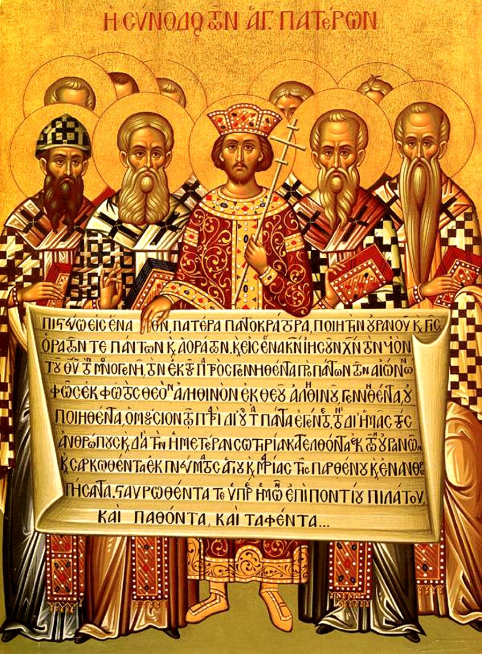
参照“三大信经”
历代教会公认及接受的信经共有三条：
使徒信经（The Apostles' Creed）、尼西亚信经（The Nicene Creed）及亚他拿修信经（The Athanasian Creed）。
在早期教会中具有绝对的至高权威，所以成为分辨异端、解决教义问题、及教导信徒的总原则。
今天基督徒依然可以使用这些古老信经来判断真理和异端。
ESSENTIAL vs. NON-ESSENTIAL DOCTRINES

Slide 54
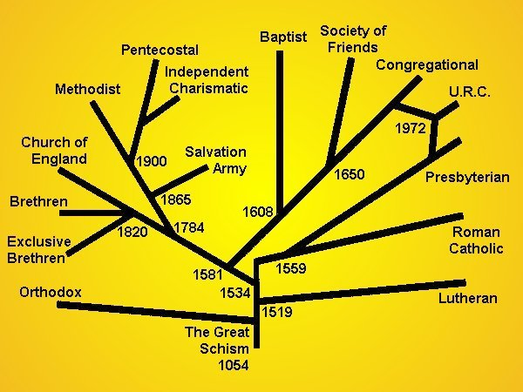
在基要真理里合一
“兄弟可以穿不同的衣服但還是兄弟；
仇敵可能會穿相同的衣服但仍是仇敵。”
——唐崇荣牧师
ESSENTIAL vs. NON-ESSENTIAL DOCTRINES

Slide 55
记住…
“在基要里合一，在非基要里宽容, 在一切事上以爱相待.”
—梅登斯
“In essentials unity, in non-essentials liberty, in all things charity.”
–Rupertus Meldenius
REMEMBER…

