Slide 1

养育成功的孩子
Raising Successful Children
Dr. Jay BarLeon
& Suran
（介巴梁&苏然）

Slide 2
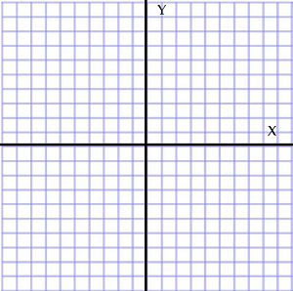

温暖型/控制型 象限
THE WARMTH / CONTROL QUADRANT
成功育儿的劝告 TIPS FOR SUCCESSFUL PARENTING

Slide 3
神至高无上
GOD IS SOVEREIGN.
祂比你更爱你的孩子
HE LOVES YOUR CHILDREN MORE THAN YOU DO.
作为父母,我们犯了很多错误
AS PARENTS, WE MAKE MANY MISTAKES.
神的话语给了我们很多教养的忠告
GOD’S WORD GIVES US A LOT OF PARENTING ADVICE
求神帮助你成为祂孩子更好的父母
ASK GOD TO HELP YOU BECOME A BETTER PARENT TO HIS CHILDREN

Slide 4
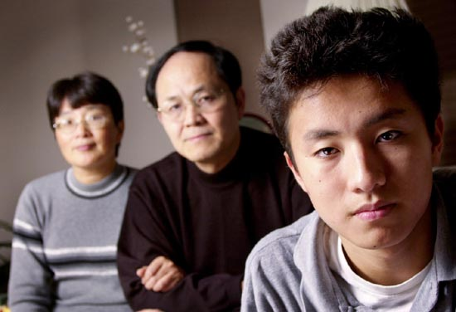
以弗所书六章四节:“你们作父亲的，不要惹儿女的气,只要照着主的教训和警戒养育他们.”
Ephesians 6:4 “Fathers, do not exasperate your children; instead,
bring them up in the training and instruction of the Lord. “

Slide 5
“These commandments that I give you today are to be upon your hearts. Impress them on your children. Talk about them when you sit at home and when you walk along the road, when you lie down and when you get up. Tie them as symbols on your hands and bind them on your foreheads. Write them on the doorframes of your houses and on your gates.”
Deuteronomy 6:6-9
How can you do that if you are not with them at those times?
“我今日所吩咐你的话都要记在心上,也要殷勤教训你的儿女.无论你坐在家里,行在路上,躺下,起来,都要谈论.也要系在手上为记号,戴在额上为经文:又要写在你房屋的门框上,并你的城门上.”-申命记6:6-9

Slide 6
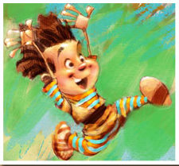
你说你爱他们,你以爱待他们了吗？
YOU SAY YOU LOVE THEM…DO YOU TREAT THEMWITH LOVE?
40
看看林前13章
LOOK AT 1 COR 13
爱不是一种感觉
LOVE IS NOT A FEELING
爱是你如何对待某人
LOVE IS HOW YOU TREAT SOMEONE

Slide 7
爱是什么？（林前13章）
耐烦
Patient
恩慈
Kind
自信
Confident
满足
Satisfied
谦卑
Humble
敬重
Honor
不自私
Unselfish
平静
Calm
饶恕
Forgiving
纯洁
Pure
诚实
Honest
安全
Safe
信任
Trusting
满有盼望
Hopeful
持久
Enduring
永恒
Eternal
What love IS (1 Cor. 13)

Slide 8
爱不是什么？(林前13)
不耐烦
Impatient
粗鲁
Rude
疑心重重
Suspicious
嫉妒
Envious
骄傲
Prideful
不尊重
Disrespectful
自私
Selfish
愤怒
Angry
不饶恕
Unforgiving
不贞
Impure
不诚实
Dishonest
粗暴
Violent
不信任
Untrusting
悲观
Pessimistic
放弃
Quitting
短暂
Temporary
What love IS NOT (1 Cor. 13)

Slide 9
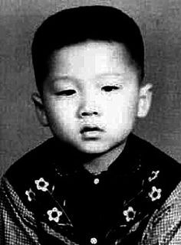


这个孩子长大后是谁？
(Who did this child grow up to be?)

Slide 10
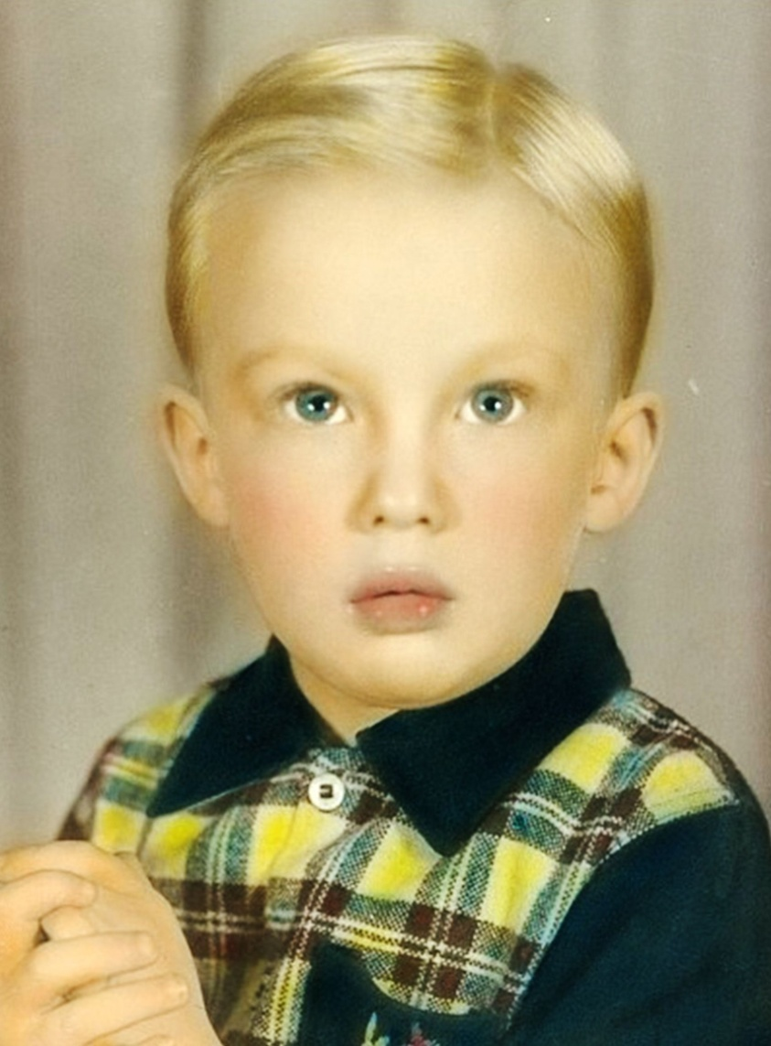

这个孩子长大后是谁？
(Who did this child grow up to be?)

Slide 11
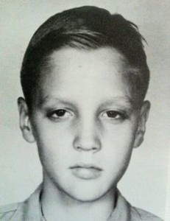
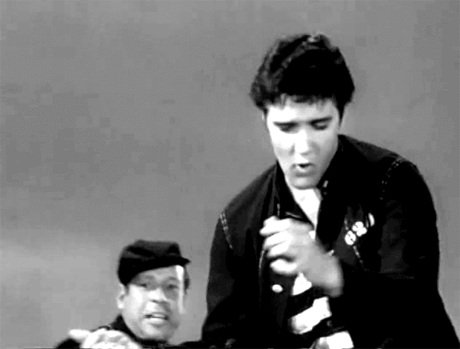
这个孩子长大后是谁？
(Who did this child grow up to be?)

Slide 12
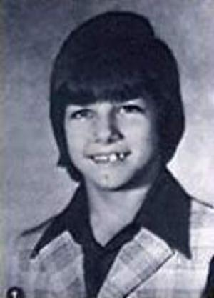
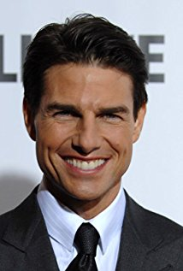
这个孩子长大后是谁？
(Who did this child grow up to be?)

Slide 13
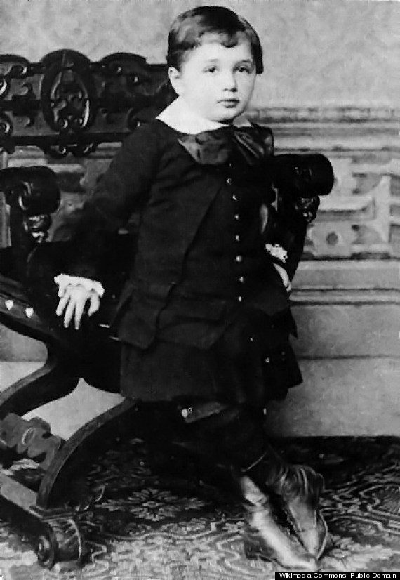
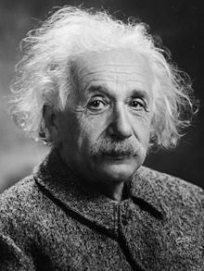
这个孩子长大后是谁？
(Who did this child grow up to be?)

Slide 14
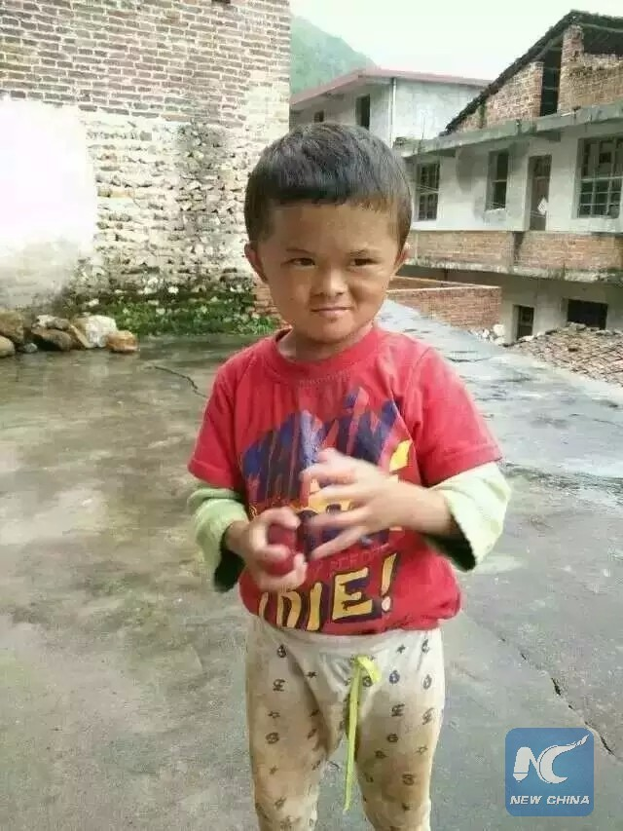
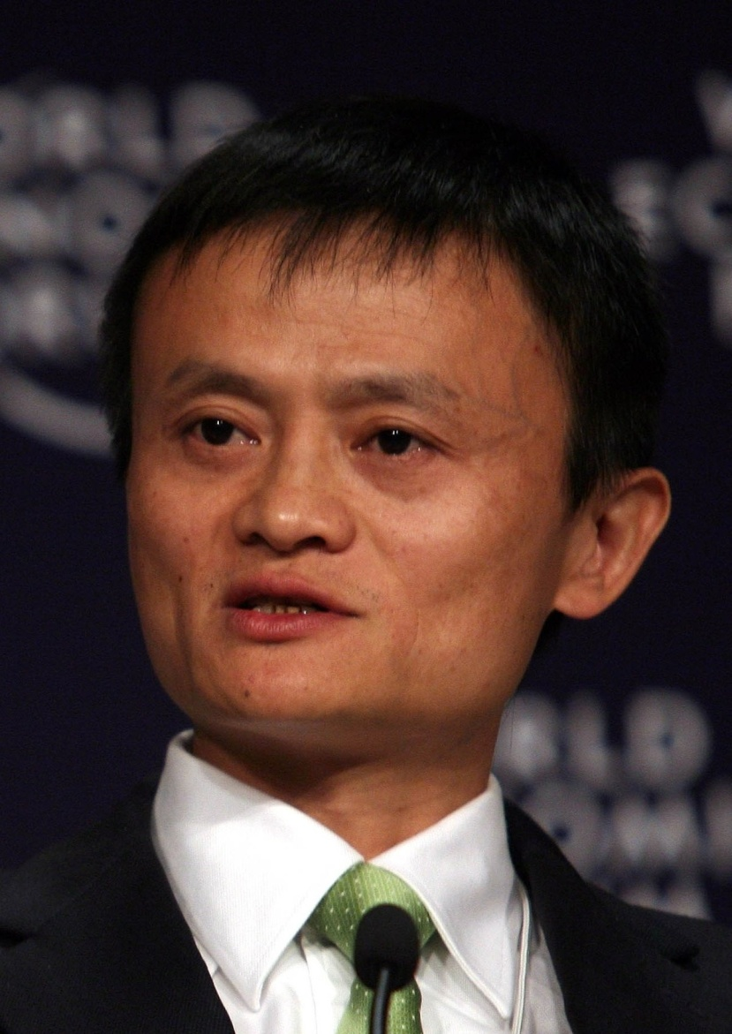
这个孩子长大后是谁？
(Who did this child grow up to be?)

Slide 15
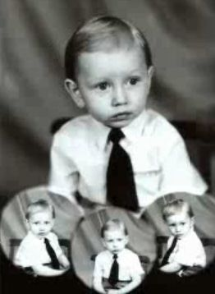
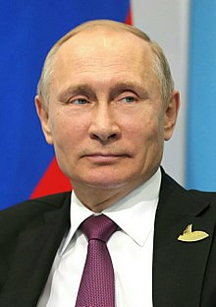
这个孩子长大后是谁？
(Who did this child grow up to be?)

Slide 16
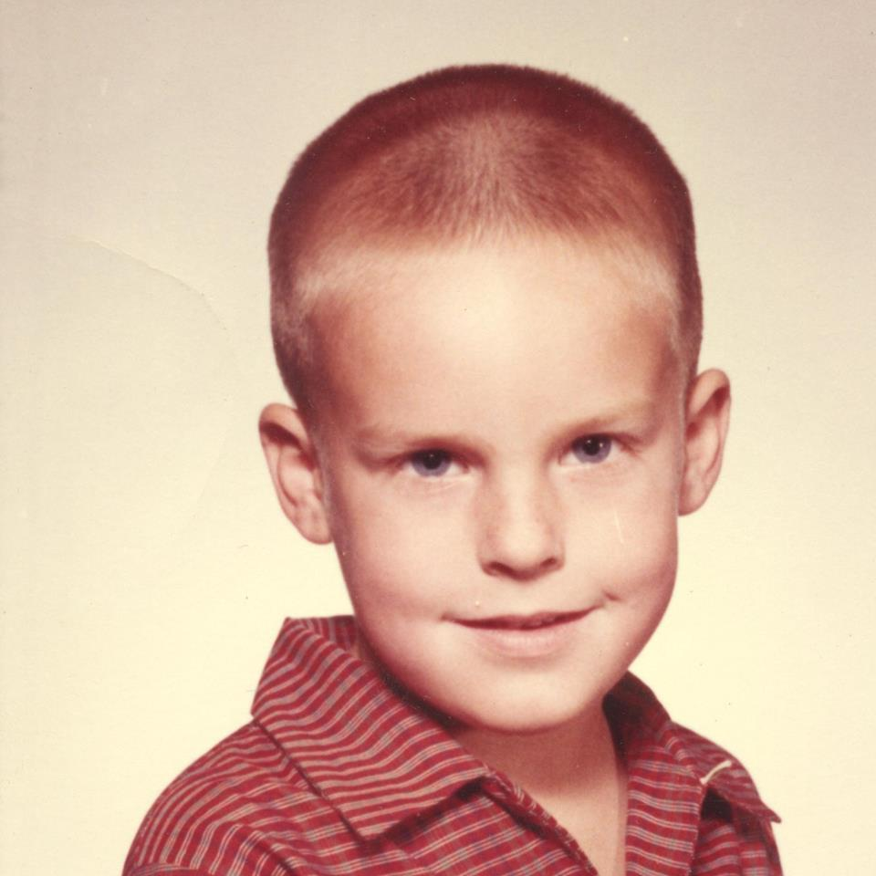
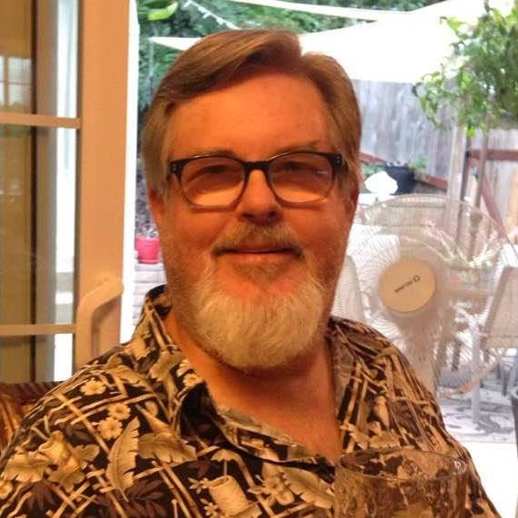
这个孩子长大后是谁？
(Who did this child grow up to be?)

Slide 17
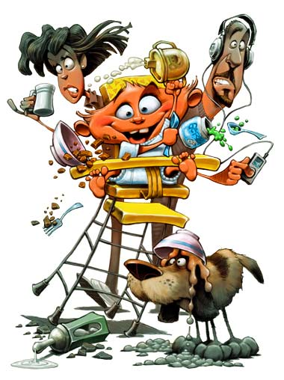

介绍
INTRODUCTION

Slide 18

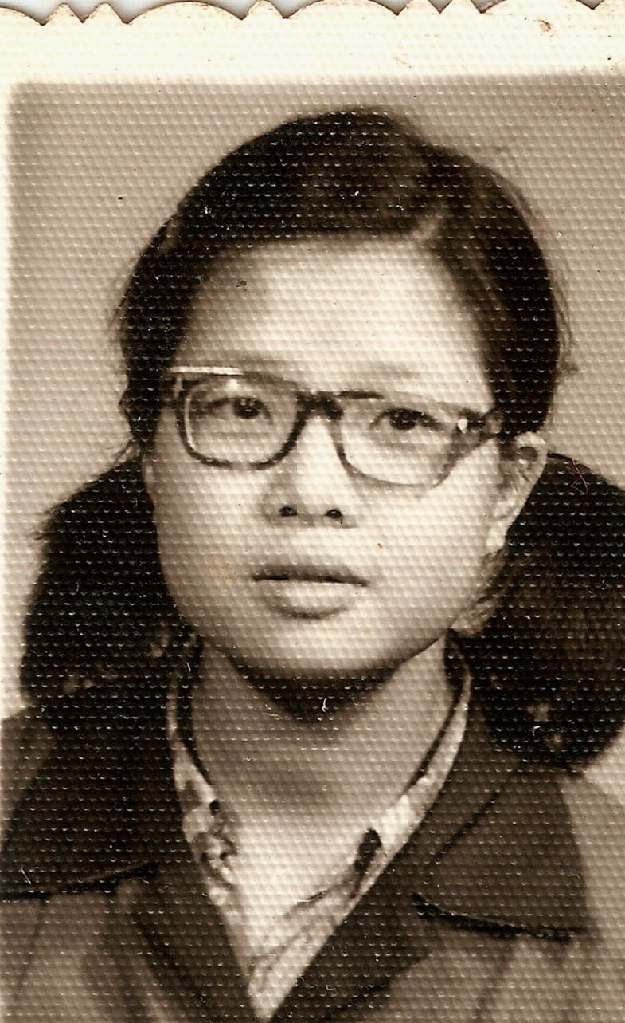

Slide 19

1) 一个全新的世界
1) A WHOLE NEW WORLD

Slide 20
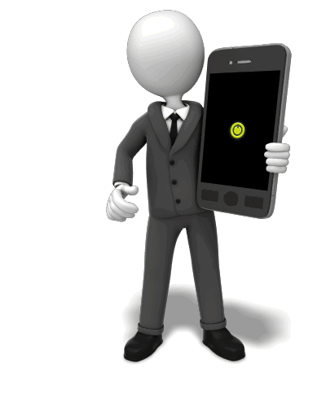

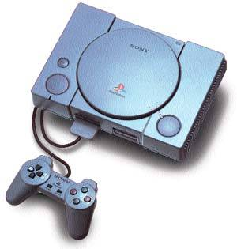
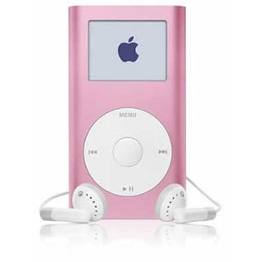
新科技带来更多优势
时也导致新的压力
TECHNOLOGY WILL ALLOW NEW ADVANTAGES AND CAUSE NEW PRESSURES

Slide 21


他们有哪些优势和压力是我们那时没有的？
What advantages and pressures will they have that we didn’t?

Slide 22

更多试探:
MORE TEMPTATION.

Slide 23

今日的儿童和少年遇到更多什么诱惑？
What temptations are now more available to kids and teens?

Slide 24
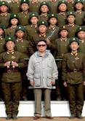
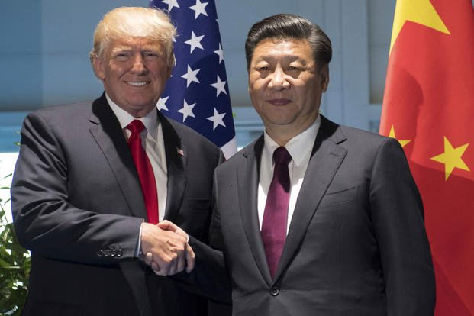

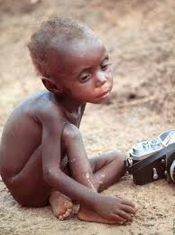
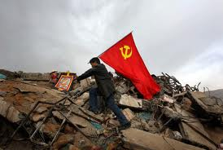
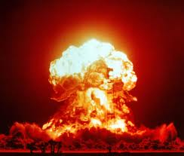
更容易留意到世界大事
MORE AWARENESS OF WORLD EVENTS

Slide 25

这会如何影响到我们的孩子？
What affect might this have on our kids?

Slide 26
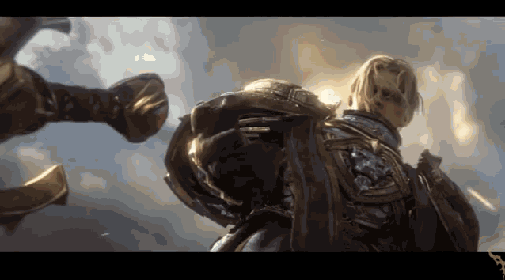
一个前所未有的新的
虚拟世界存在着
A NEW VIRTUAL WORLD EXISTS THAT NEVER HAS BEFORE

Slide 27

这个世界会如何影响我们的孩子和社会？
  How does this world affect our kids and society?

Slide 28

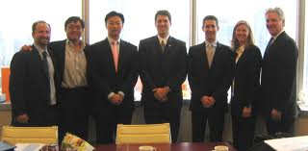
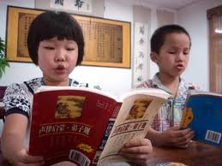
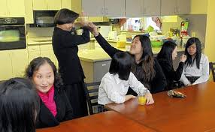
有更多教育和商业个人机会
MORE PRIVATE OPPORTUNITIES FOR SCHOOL & BUSINESS

Slide 29
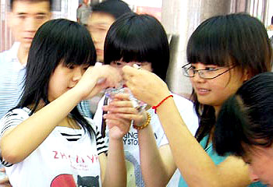


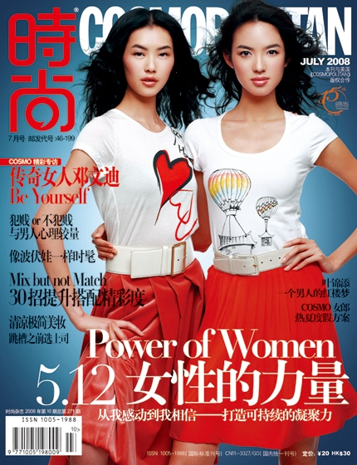
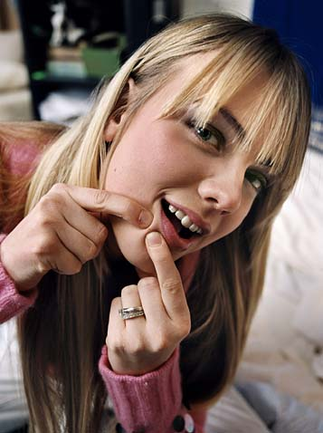

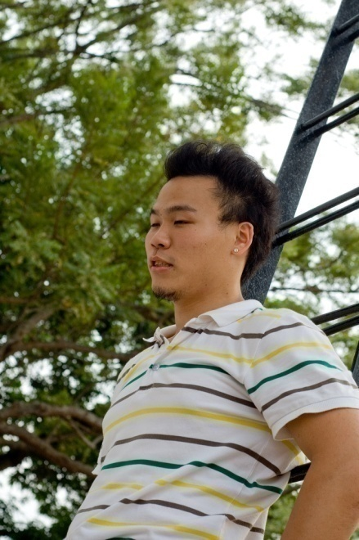
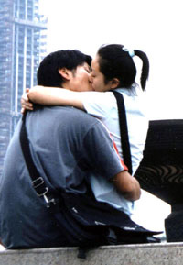
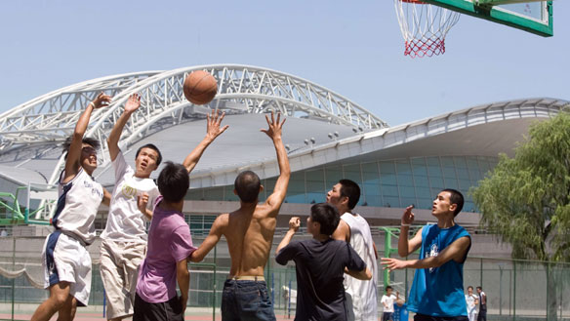
同辈和社会压力加大
8
INCREASING PEER PRESSURE AND SOCIAL PRESSURE

Slide 30

这会如何影响我们的孩子和家庭？
How does this one affect kids and families?

Slide 31

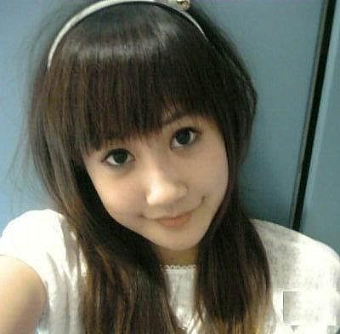
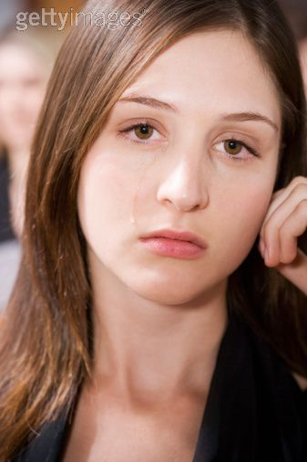

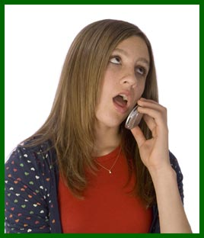

他们将会有更多家庭朋友之外的朋友
1
THEY WILL HAVE MORE FRIENDS OUTSIDE OF FAMILY FRIENDS

Slide 32
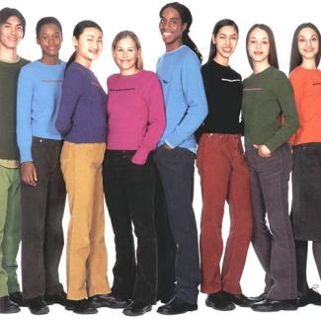
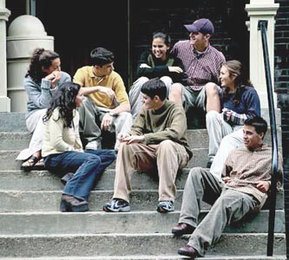
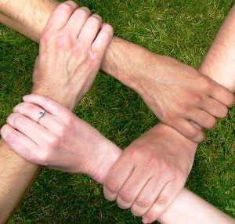
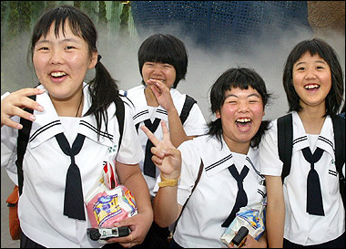

你不会喜欢他们所有的朋友
YOU WON’T ALWAYS LIKE THEIR FRIENDS
关于朋友的几个建议
对他们朋友的负面反应会让孩子隐蔽友谊
NEGATIVE RESPONSES TO FRIENDS ENCOURAGE THE KIDS TO HIDE FRIENDSHIPS
试着了解他们的朋友.你的家应成为安全之所
GET TO KNOW THEIR FRIENDS. YOUR HOUSE SHOULD BE THE SAFE PLACE.
将你的孩子与朋友隔离是非常有害的
ISOLATING YOUR CHILD FROM FRIENDS IS DETRIMENTAL
孩子越年轻,你对他们的朋友越有影响力
THE YOUNGER THE CHILD, THE GREATER YOUR INFLUENCE ON THEIR FRIENDS
A FEW TIPS REGARDING FRIENDS

Slide 33
耶稣也同样需要经历这些
JESUS HAD TO GO THROUGH THIS ALSO
智力
Mental
身体
Physical
灵性
Spiritual
社交
Social
耶稣的智慧和身量, (身量或作年纪)
并神和人喜爱他的心, 都一齐增长. 路2:52
“And Jesus kept increasing in wisdom and stature, and in favor with God and men.” Lk 2:52

Slide 34

2) 温暖型/控制型象限
2) THE WARMTH / CONTROL QUADRANT

Slide 35




光有规则没有关系导致叛逆
Rules without relationship lead to rebellion

Slide 36
温暖型象限/控制型象限
温暖= 父母有能力在口头上和身体上
以合宜的方式向孩子示范爱和情感。 WARMTH = the parent’s ability to demonstrate love and affection to their child(ren) in both verbally and physically appropriate ways.
控制=父母有能力为孩子建立和保持
合宜的界限和规矩。
  CONTROL = the parent’s ability to establish and maintain proper boundaries and rules for the child(ren).
THE WARMTH / CONTROL QUADRANT

Slide 37
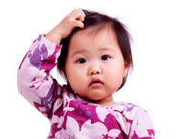
受尊敬型父母
健康的孩子
Respected Parent
Healthy Child
高
high
严格型父母
破碎的孩子
Strict Parent
Broken Child
控制 (control)
温暖 (warmth)
温暖 (warmth)
高
high
低
low
控制 (control)
纵容型父母
悖逆的孩子
Permissive Parent Rebellious Child
忽略型父母
冷漠的孩子
Uninvolved Parent
Indifferent Child
低 low

Slide 38

QUESTIONS? (Until 3:30 pm)

