Slide 1
养育成功的孩子
Raising Successful Children
Dr. Jay BarLeon
& Suran
（介巴梁&苏然）

Slide 2
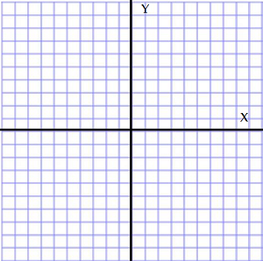
温暖型/控制型 象限
THE WARMTH / CONTROL QUADRANT
成功育儿的劝告 TIPS FOR SUCCESSFUL PARENTING

Slide 3
神至高无上 GOD IS SOVEREIGN.
祂比你更爱你的孩子 HE LOVES YOUR CHILDREN MORE THAN YOU DO.
作为父母,我们犯了很多错误 AS PARENTS, WE MAKE MANY MISTAKES.
神的话语给了我们很多教养的忠告 GOD’S WORD GIVES US A LOT OF PARENTING ADVICE
求神帮助你成为祂孩子更好的父母 ASK GOD TO HELP YOU BECOME A BETTER PARENT TO HIS CHILDREN

Slide 4
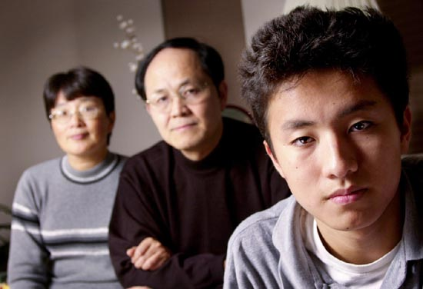
以弗所书六章四节:“你们作父亲的，不要惹儿女的气,只要照着主的教训和警戒养育他们.”
Ephesians 6:4 “Fathers, do not exasperate your children; instead,
bring them up in the training and instruction of the Lord. “

Slide 5
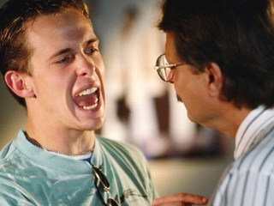
光有规则没有关系导致叛逆
Rules without relationship lead to rebellion

Slide 6
温暖型象限/控制型象限
温暖= 父母有能力在口头上和身体上
以合宜的方式向孩子示范爱和情感。 WARMTH = the parent’s ability to demonstrate love and affection to their child(ren) in both verbally and physically appropriate ways.
控制=父母有能力为孩子建立和保持
合宜的界限和规矩。
CONTROL = the parent’s ability to establish and maintain proper boundaries and rules for the child(ren).
THE WARMTH / CONTROL QUADRANT

Slide 7
受尊敬型父母
健康的孩子
Respected Parent
Healthy Child
高
high
严格型父母
破碎的孩子
Strict Parent
Broken Child
控制 (control)
温暖 (warmth)
温暖 (warmth)
高
high
低
low
控制 (control)
纵容型父母
悖逆的孩子
Permissive Parent Rebellious Child
忽略型父母
冷漠的孩子
Uninvolved Parent
Indifferent Child
低 low

Slide 8
育儿
建议
PARENTING TIPS

Slide 9
我们的住家女儿
30 MINUTE BREAK

Slide 10
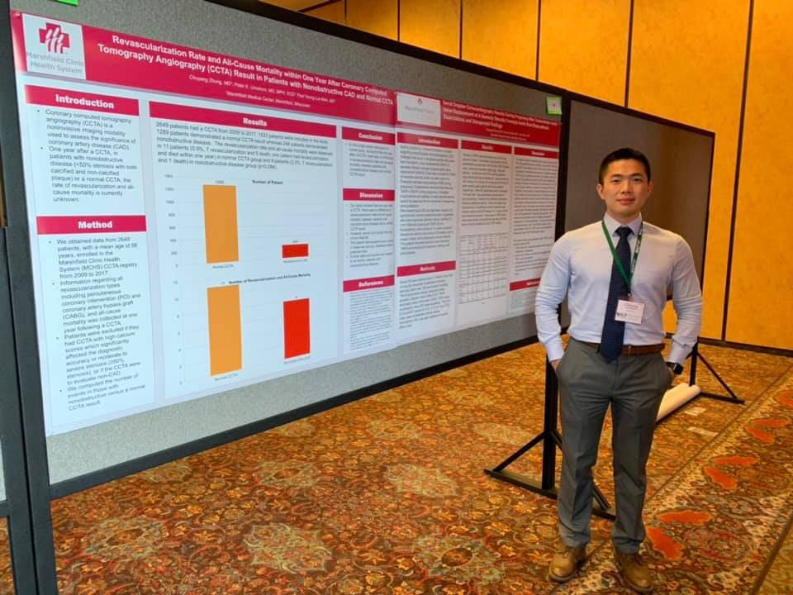
我们家儿子

Slide 11
上帝没有孙子.你的孩子必须建立他们自己的信仰 God has no grandchildren. Your children must develop their own faith.
当他们质问信仰时不要惊慌或愤怒 DON’T PANIC OR GET ANGRY WHEN THEY QUESTION YOUR FAITH
当孩子质问信仰时,慈爱地回答不要惊慌 When your child questions the faith, answer the questions lovingly without panicking.
疑问
沉默
怀疑
疑问
回答
信心
QUESTIONS + SILENCE = DOUBT QUESTIONS + ANSWERS = FAITH

Slide 12
鼓励他们进入教会青少年事工 ENCOURAGE CHURCH & YOUTH MINISTRIES IF AVAILABLE

Slide 13
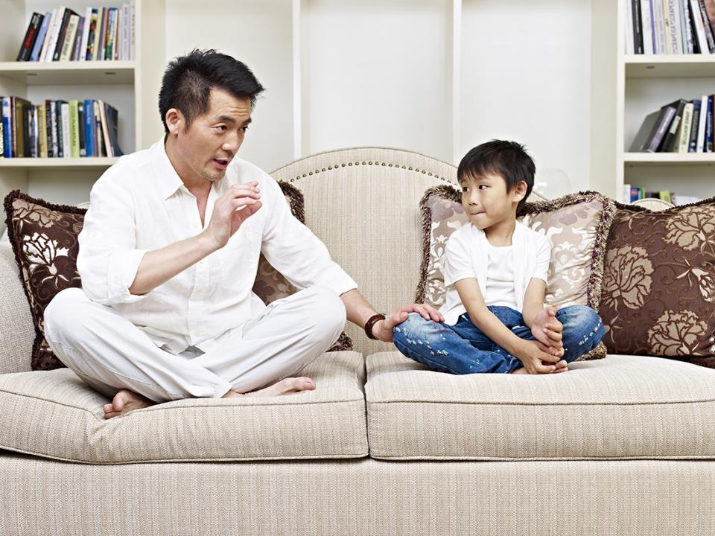
不要争吵…而是讨论 DO NOT ARGUE…DISCUSS

Slide 14
十大常见父母-青少年争吵事项 Top ten parent teen arguments
他们选择什么朋友 (Who they are hanging out with)
他们穿什么衣服 ( What they are wearing)
他们的身体姿态 ( Their body gestures)
他们的说话语调 ( Their tone of voice)
他们的学习成绩 ( Their grades)
没有完成要做的事 ( Not doing what they are told)
不敬的言语 ( Disrespectful words)
不同意父母的观点 ( Not agreeing with point of view)
他们如何度过课余时间 ( How they spend their free time)
他们对书籍、电视节目、音乐的选择等。
( Their choices in books, tv, movies, music, etc.)

Slide 15
箴15:1 “回答柔和，使怒消退；言语暴戾，触动怒气。 ”
Prov. 15:1 “A soft answer turns away wrath, but harsh words just stir up anger.”
歌罗西书3:21 “ 你们作父亲的，不要惹儿女的气，恐怕他们失了志气。”
Colossians 3:21 Fathers, do not embitter your children, or they will become discouraged.
箴言14:17 “轻易发怒的，行事愚妄；”
Proverbs 14:17 “A quick-tempered man does foolish things..”

Slide 16
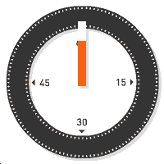
你最经常为什么跟你的孩子争执？
WHAT DO YOU ARGUE MOST ABOUT WITH YOUR CHILDREN?

Slide 17
为做对的事多鼓励他们 Encourage them for the good things they do

Slide 18
“污秽的言语一句不可出口，只要随事说造就人的好话，叫听见的人得益处。”弗4：29
“Don't use foul or abusive language. Let everything you say be good and helpful,
so that your words will be an encouragement to those who hear them.” Eph 4:29

Slide 19
激励
安慰
敦促
ENCOURAGE
COMFORT
URGE
不
打击
嘲笑
喊叫
NOT
DISCOURAGE
RIDICULE & YELL

Slide 20
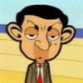
青少年对他们的缺点已经非常在意。他们不需要父母不断提醒他们的弱点, 失败和缺陷。唠叨和批评毫无帮助。
Teens are already aware of their shortcomings. They don’t need parents to remind them constantly of their weaknesses, failures and flaws. Nagging and criticizing doesn’t help.

Slide 21
他们一定会跌倒! 我们都这样! 要有这个期待并允许发生 THEY WILL FAIL SOMETIMES! We all do! Expect it and allow for it.
青少年必须自己做出越来越多决定 Teens MUST make more and more decisions on their own.
训练他们,信任他们,奖赏他们 Train them, Trust them, and reward them.
教他们挣钱,省钱和购买 Teach them to earn, save and make purchases
母亲: 切断脐带 MOTHERS: CUT THE UMBILICAL CORD
父亲: 正面而非负面的强化力量 FATHERS: POSITIVE, NOT NEGITIVE REINFORCEMENT

Slide 22
1 Thessalonians 2:11-12 “For you know that we dealt with each of you as a father deals with his own children, encouraging, comforting and urging you to live lives worthy of God, who calls you into his kingdom and glory.”
帖前2:11-12 “你们也晓得我们怎样劝勉你们，安慰你们,嘱咐你们各人,好像父亲待自己的儿女一样,要叫你们行事对得起那召你们进他国,得他荣耀的神.”

Slide 23
你可以从哪些方面鼓励你的孩子？
What are some ways you can encourage your children?

Slide 24
交谈要求你聆听，
而非光是你在说 CONVERSATIONS REQUIRE YOU TO LISTEN, NOT JUST TALK

Slide 25
让生活太容易会伤害孩子 Don’t hurt them by making life too easy

Slide 26
孩子多大时我们可教他们做下面这些事
自己吃饭
Feed themselves
睡自己的房间
Sleep in their own room
自己系鞋带
Tie their own shoes
自己穿衣服
Dress themselves
自己上厕所
Use the bathroom alone
自己刷牙
Brush their teeth
At what age can we teach our children to…

Slide 27
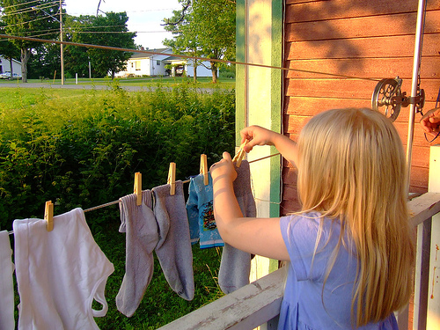
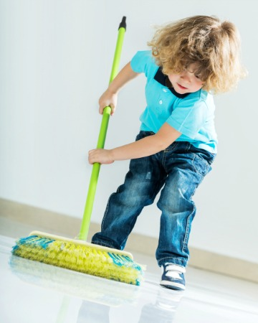
家务是训练的重要部分 CHORES ARE AN IMPORTANT PART OF TRAINING

Slide 28
为什么训练孩子做家务如此重要？
Why is it so important to teach kids to do chores?

Slide 29
2018年哈佛大学的研究认为从小做家务的孩子，成年后更容易成功和快乐。
2018 Study from Harvard University says that children who grow up doing chores around the house are more likely to be successful and happy as adults.
“热爱和工作伦理是成功的两个最重要因素.”
“Love and work ethic are the 2 most important ingredients for success”
斯坦福大学的研究也同意这个观点。
Stanford University Researchers agree with this study
越年幼开始，越好。
The sooner you start, the better.

Slide 30
“她的家务我全包了,
因为她没时间.”
“I do all of the work for her because she doesn’t have any time”

Slide 31
通过做家务孩子能学会什么功课？
What lessons do kids learn by doing chores?

Slide 32
在他们离家之前你 希望他们学会什么？ WHAT DO YOU WANT THEM TO KNOW BY THE TIME THEY LEAVE HOME?
不要同时教他们每一项家务 DON’T TEACH THEM EVERY CHORE AT THE SAME TIME
你做- 他们看
YOU DO -
THEY WATCH
你们一起做
YOU DO
TOGETHER
他们做-你看
THEY DO -
YOU WATCH
他们做
THEY DO

Slide 33
孩子多大我们该教他们做这些事：
清洁房间
Clean their own room
洗碗
Help with the dishes
洗衣服
Do laundry when needed
做家务
Do housework
做饭
Cook a meal
其它？
Any other?
At what age should we teach our kids to…

Slide 34
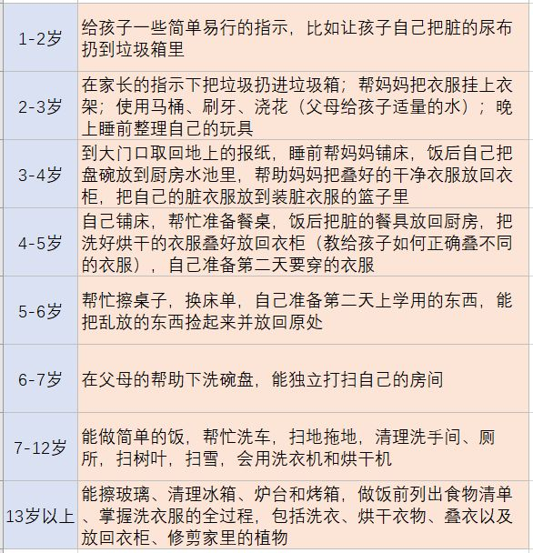
孩子多大我们该教他们做这些事
At what age should we teach our kids to…

Slide 35
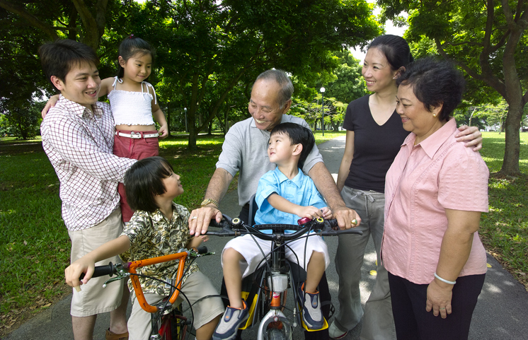
足够的优质时间双方都需要 Quantity time and quality time are both needed .

Slide 36
“These commandments that I give you today are to be upon your hearts. Impress them on your children. Talk about them when you sit at home and when you walk along the road, when you lie down and when you get up. Tie them as symbols on your hands and bind them on your foreheads. Write them on the doorframes of your houses and on your gates.” Deuteronomy 6:6-9 How can you do that if you are not with them at those times?
“我今日所吩咐你的话都要记在心上,也要殷勤教训你的儿女.无论你坐在家里,行在路上,躺下,起来,都要谈论.也要系在手上为记号,戴在额上为经文:又要写在你房屋的门框上,并你的城门上.”-申命记6:6-9

Slide 37
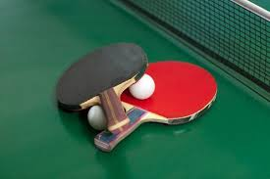
一起玩
PLAY TOGETHER

Slide 38
你跟一个3岁孩子能玩什么?
10？13？17呢？
What can you play with a 3 year old? 10? 13? 17?

Slide 39
请谨记:他们生而独特,并非小型的你 Remember they are UNIQUE; not a miniature YOU

Slide 40
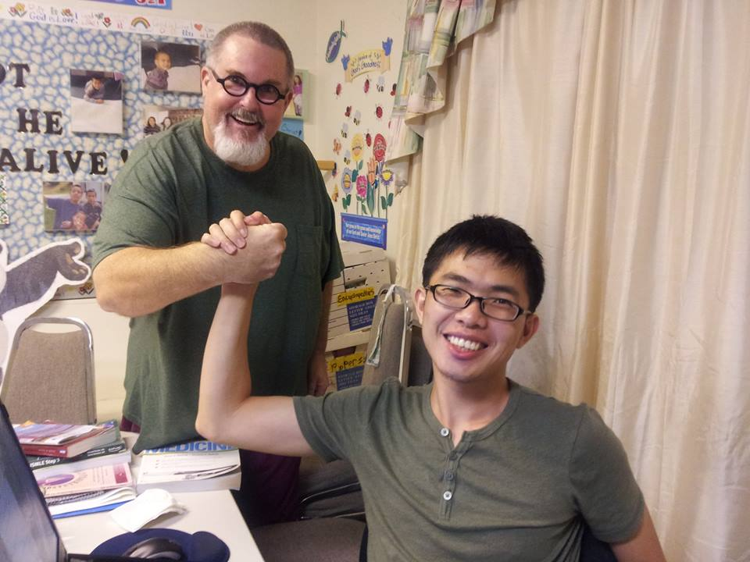
审查你的动机 EXAMINE YOUR MOTIVES
孩子不是：
CHILDREN ARE NOT…
不只是传宗接代. Just to carry on the family name 你的个人财产或仆人 Your possession or servant
需要完工的项目. A project to complete
小型的你. Mini-YOUs
地位符号或战利品. Status Symbols or Trophies

Slide 41
记住: 你的孩子是神的赏赐！ REMEMBER…your kids are a gift from God!
创33:5: “这些孩子是神施恩给你仆人的. ”
Gen. 33:5 “These are the children God has graciously given your servant.”
撒上1:27 “我祈求为要得这孩子，耶和华已将我所求的赐给我了。”
1 Sam 1:27 “I prayed for this child, and the LORD has granted me what I asked of him.”
诗127:3 “儿女是耶和华所赐的产业，所怀的胎是他所给的赏赐。 ”
Ps 127:3 “Children are a heritage from the LORD, offspring a reward from him.”

Slide 42
你在教养孩子上将向神交账 YOU ARE ACCOUNTABLE TO GOD FOR PARENTING
“凡使这信我的一个小子跌倒的，倒不如把大磨石拴在这人的颈项上，扔在海里。”
“Whoever causes one of these little ones who believe in me to sin, it would be better for him if a great millstone were hung around his neck and he were thrown into the sea.” Mark 9:42

Slide 43
箴言22:6 “教养孩童,使他走当行的道，就是到老他也不偏离.”
Proverbs 22:6 “Train a child in the way he should go,
and when he is old he will not turn from it.”

Slide 44
孩童: 从出生到离家 A CHILD: From birth to leaving home
教养：致力于推向某个特定方向 TRAIN UP: Dedicated to pushing in a certain direction
使他走当行的路: 在他被神塑造后;神对他们独特的设计 IN THE WAY HE SHOULD GO: After his own bend; God’s unique design for them
就是到老: ‘下巴长了胡子’ WHEN HE IS OLD: ‘Has hair on his chin’;
他也不偏离: 他将不会轻易放弃 HE WILL NOT DEPART FROM IT: He will not give it up easily
《箴言》是一个普遍规律,并非应许. A PROVERB is a general rule, NOT A PROMISE

Slide 45
管教和惩罚之间有什么区别？
What is the difference between discipline and punishment?

Slide 46
管教而不是惩罚 Discipline instead of punish

Slide 47
管教和惩罚的不同
“惩罚”
“PUNISH”
报复某人做了
某事.
to get back at someone for something they have done.
“管教”
“DISCIPLINE”
与 “门徒”这个词是同一个词根。意思是教导和训练那些知道自己做错了并愿意改正以避免重蹈覆辙的人,让他们更规律地遵守。
comes from the same root word as ‘disciple.’
It means to teach or train someone in such a way that they are aware of their wrong-doing and desire to correct it in order to avoid the same results in the future and obey more regularly.
The Difference between PUNISH and DISCIPLINE

Slide 48
箴13:24: “不忍用杖打儿子的，是恨恶他；疼爱儿子的，随时管教。”
Proverbs 13:24 “He who spares the rod hates his son, but he who loves him is careful to discipline him. “
箴3:11-12 “我儿,你不可轻看耶和华的管教（或译：惩治),也不可厌烦他的责备;因为耶和华所爱的,他必责备,正如父亲责备所喜爱的儿子.” Proverbs 3:11-12 “My son, do not despise the Lord's discipline and do not resent his rebuke, because the Lord disciplines those he loves, as a father the son he delights in.”

Slide 49
不要虚张声势。
DO NOT BLUFF

Slide 50
太5:37: “你们的话语应该如此:是,就说是; 不是,就说不是. 再多说,就是出于那恶者”
(Proverbs 6:23 “For these commands are a lamp, this teaching is a light,
and the corrections of discipline are the way to life.”

Slide 51
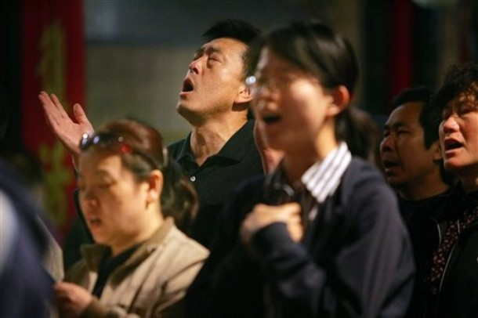
不要只作星期天基督徒 Don’t be a Sunday Christian only

Slide 52
“Only be careful, and watch yourselves closely so that you do not forget the things your eyes have seen or let them slip from your heart as long as you live. Teach them to your children and to their children after them. Remember the day you stood before the Lord your God… when he said to me, “Assemble the people before me to hear my words so that they may learn to revere me as long as they live in the land and may teach them to their children.” Deuteronomy 4:9-10
“你只要谨慎，殷勤保守你的心灵，免得忘记你亲眼所看见的事，又免得你一生这事离开你的心；总要传给你的子子孙孙。你在何烈山站在耶和华─你神面前的那日，耶和华对我说：你为我招聚百姓，我要叫他们听见我的话，使他们存活在世的日子，可以学习敬畏我，又可以教训儿女这样行。”申4:9-10

Slide 53
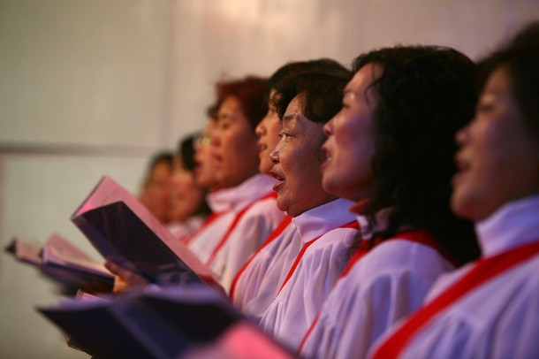
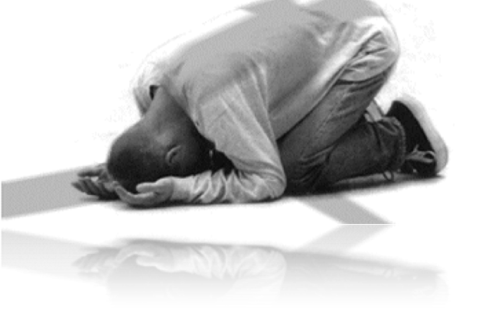
有多少这些行为你孩子只看见你星期天行？ HOW MANY OF THESE DO YOUR KIDS SEE YOU DO ONLY ON SUNDAY?

Slide 54
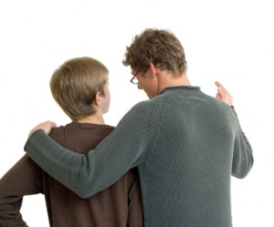
如果你错了请求原谅—
树立谦卑的榜样 ASK FORGIVENESS WHEN YOU ARE WRONG…Model Humility

Slide 55
不要替他们做家庭作业而是帮助他们 DON’T DO THEIR HOMEWORK FOR THEM…HELP THEM WITH IT

Slide 56
不要鼓励易上瘾的行为
DON’T ENCOURAGE ADDICTIVE BEHAVIORS

Slide 57
在哪些领域容易给孩子造成上瘾？
In what areas is it easy to create addicts of our children?

Slide 58
清晰沟通 COMMUNICATE CLEARLY
确保他们明白你说的话
Make sure they understand what you say
若他们从未告知过，不要假设他们明白某事是错的。
Don’t assume they know something is wrong if they have never been told
不要因他们不知道是错的事而管教他们。
Don’t discipline for actions they didn’t know were wrong

Slide 59
不要让他们难堪 DON’T EMBARRASS THEM

Slide 60
在哪些方面我容易让孩子感到难堪？
What are some ways we embarrass our kids and teens?

Slide 61
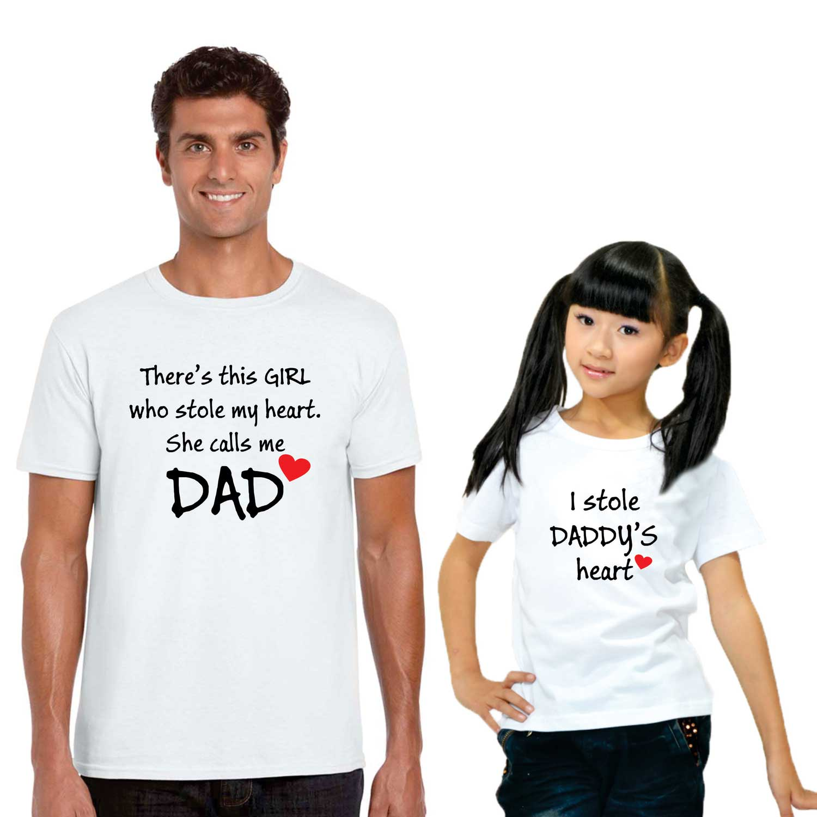
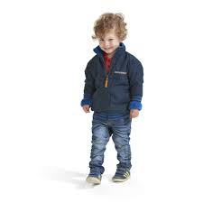
你若有不止一个孩子,
不要偏爱某一个 IF YOU HAVE MORE THAN ONE CHILD, DON’T SHOW PREFERENTIAL TREATMENT

Slide 62
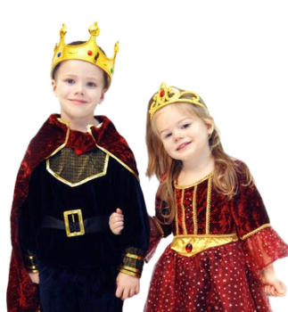
谁最容易引起父母的关注？
Who usually gets the most attention from parents?

Slide 63
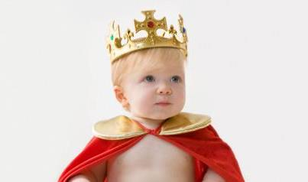
如果你只有一个孩子，不要让他们以为自己是宇宙的中心 IF YOU HAVE ONLY ONE CHILD,
DON’T MAKE THEM THINK THEY ARE THE CENTER OF THE UNIVERSE

Slide 64
不要让孩子控制家庭 DON’T LET THE CHILD CONTROL THE FAMILY
你的孩子需要学习服从而非为所欲为.
YOUNG CHILDREN NEED TO LEARN TO OBEY WITHOUT GETTING THEIR WAY
你做决定.他们服从你的决定.
YOU MAKE DECISIONS..THEY OBEY YOUR DECISIONS
吃什么, 何时上床睡觉, 看什么节目…等。
What to eat… When to go to bed… what to watch… etc.
允许年长点的孩子做更多决定但绝不允许无礼.
Allow Older children more decisions but never permission to disrespect

Slide 65
尽量减少家里的压力 REDUCE THE AMOUNT OF STRESS AT HOME

Slide 66
我们常做哪些事让孩子感到压力重重？
What are some things we do that stress our children?

Slide 67
公开表达你对配偶的爱和情感 OPENLY SHOW LOVE AND AFFECTION TO YOUR SPOUSE

Slide 68
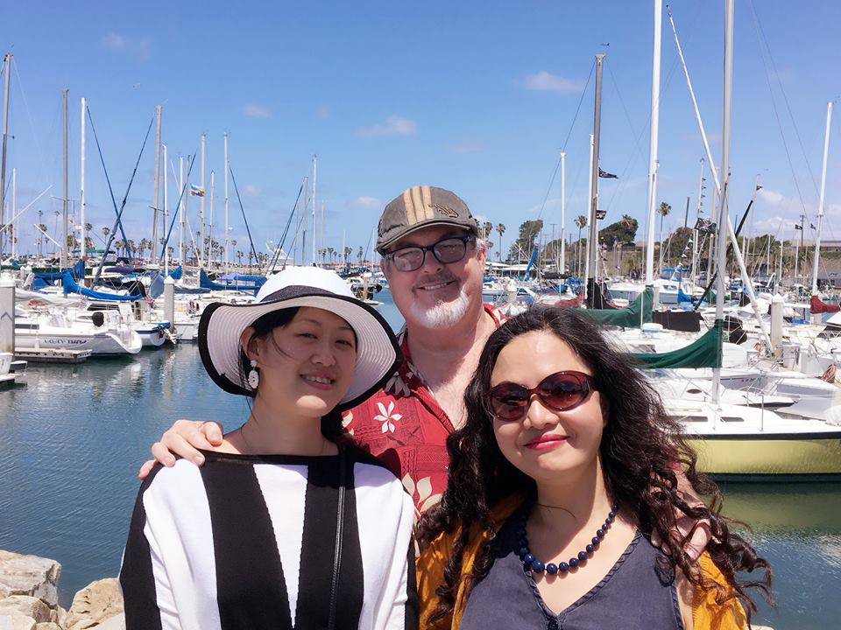
若能,常去旅行…并让旅行有趣 TRAVEL IF YOU CAN…KEEP IT FUN

Slide 69
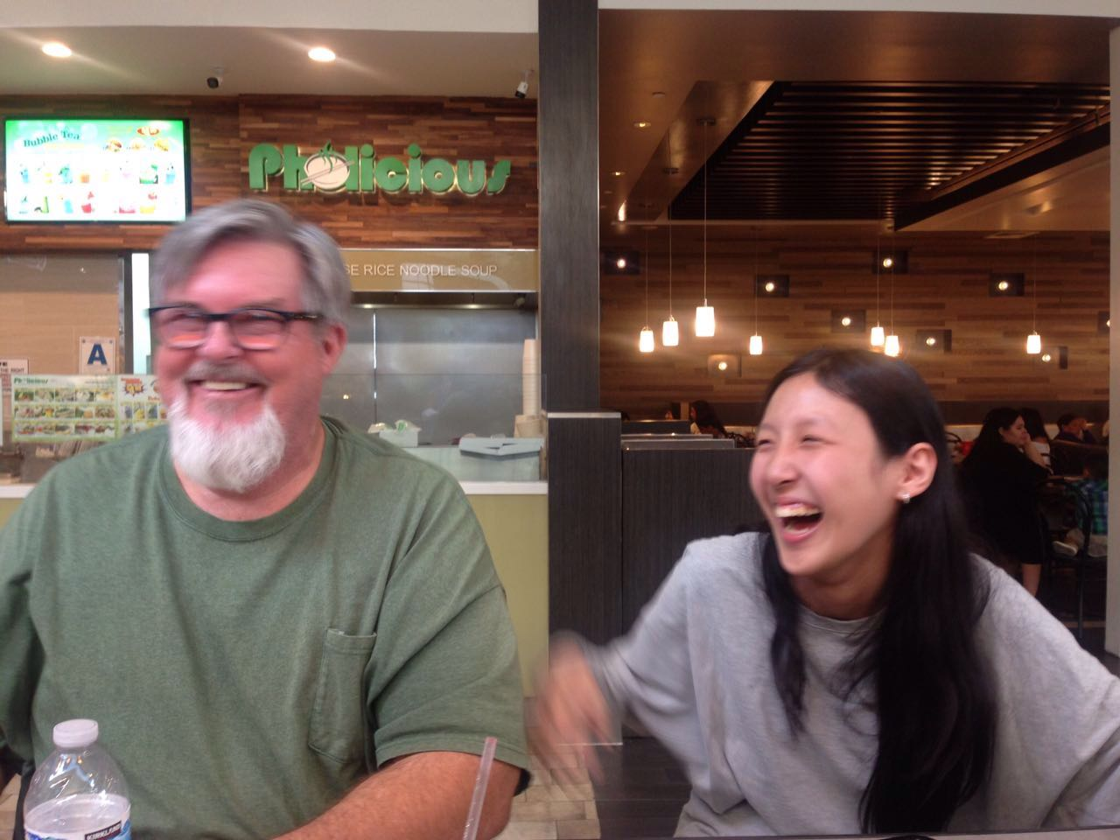
让家里充满笑声
LAUGH

Slide 70
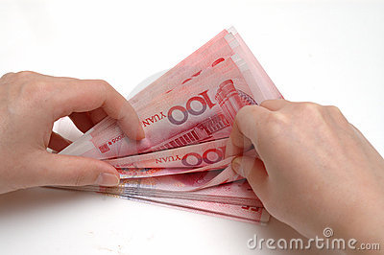
不要关注家庭物质财产 DONT FOCUS ON WHAT YOUR FAMILY OWNS
珍视爱,时间和信仰
Put value on love, time and faith
生活中最重要的东西依然是免费的
The best things in life are still free

Slide 71
你的影响力有限 YOUR INFLUENCE IS LIMITED
父母不能：A PARENT CANNOT…
属灵上转变, 重生或拯救一个孩子.
spiritually convert, regenerate, or save a child.
圣化一个孩子, 让他变得圣洁或公义.
sanctify a child; make them holy or righteous
指示, 决定或发展一个孩子的个性.
dictate, determine or develop the personality of a child
父母能：A PARENT CAN…
影响他们, 带领他们, 将耶稣示范给他们.
Influence them… lead them… model Jesus for them

Slide 72
神造了你的孩子并按其本来面目爱他们 GOD MADE AND LOVES YOUR CHILDREN AS THEY ARE
诗139:13-16: “我的肺腑是你所造的。我在母腹中，你已覆庇我。 我要称谢你，因我受造奇妙可畏。你的作为奇妙，这是我心深知道的。 我在暗中受造，在地的深处被联络，那时，我的形体并不向你隐藏。 我未成形的体质，你的眼早已看见了。你所定的日子，我尚未度一日，你都写在你的册上了。”
Ps 139:13-16 “For you formed my inward parts; you knitted me together in my mother’s womb. I praise you, for I am fearfully and wonderfully made. Wonderful are your works; my soul knows it very well. My frame was not hidden from you, when I was being made in secret, intricately woven in the depths of the earth. Your eyes saw my unformed substance; in your book were written, every one of them, the days that were formed for me, when as yet there was none of them.” GOD CHOOSES WHO WILL BE BLIND, DEAF, DUMB, ETC.

Slide 73
让你的孩子眼观耳听你赞美神 LET YOUR CHILDREN SEE AND HEAR YOU GIVE PRAISE TO GOD
赛38:19 “只有活人，活人必称谢你，像我今日称谢你一样。为父的，必使儿女知道你的诚实。”
Isaiah 38:19 “The living, the living— they praise you, as I am doing today; parents tell their children about your faithfulness.”

Slide 74
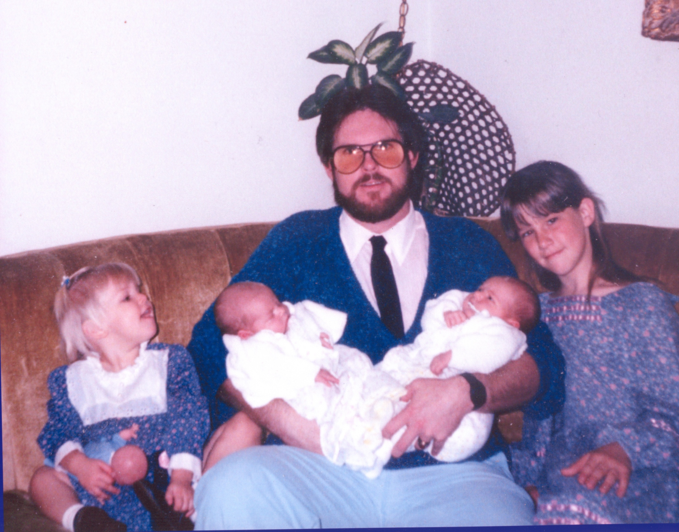
CONCLUSION: LOVE YOUR FAMILY UNCONDITIONALLY
结论:无条件地爱你的家人

