Slide 1
REV

Slide 2
启示录
REVELATION

Slide 3
启示录
根据《圣经》接下来会发生什么？
What will happen next according to the Bible?
末世的四种主要观点是怎样的？
What are the 4 main views of the END TIMES?
在耶稣再临之前还有什么事情必须发生？
Is there anything that must still happen before Jesus can return?
我能做什么来预备耶稣的再临？
What can I do to get ready for the RETURN OF JESUS?
REVELATION

Slide 4
要记住的重要事项
Important things to Remember
准备开始 深奥的神学 学习了吗？ Are you ready to study some deep theology?
关键术语
Key Terms
本书释经的不同方法
Different Methods of Interpretation
《启示录》的大纲
Outline of the Book of Revelation
关于千禧年的四种观点
4 Main Views of the Millennium
末世图表
End Times Chart

Slide 5
注意事项
IMPORTANT THINGS TO REMEMBER

Slide 6
这本书不是叫“未来的启示”，而是叫“耶稣基督的启示 (1节)”。耶稣基督的许多属性在这卷书中都得到了阐述。(祂的爱, 王权、忿怒、激情、知识、主权，等等)。
The book is not called the Revelation of the Future, but the Revelation of Jesus Christ (v.1). Many of Jesus’ attributes are expounded on in the book. (His love, Kingship, wrath, passion, knowledge, sovereignty, so much more).

Slide 7
2. 不要在你的释经方法上过于教条。旧约的先知们留下了数以百计的关于弥赛亚首次来临的预言，然而，耶稣年代所有的旧约专家都搞错了。
Do not get too dogmatic on your approach. The Old Testament prophets left hundreds of prophecies regarding the first coming of the Messiah and all the Bible teachers still got it wrong.

Slide 8
3. 不要因为觉得难以理解而避开《启示录》，这是一种试探。第一章告诉我们，阅读这卷书的人会得到祝福，并吩咐我们要遵守书中的教导。
Do not give in to the temptation to avoid Revelation just because it is difficult to understand. Chapter 1 tells us there is a blessing that goes with reading it and that we are required to obey the teachings therein.

Slide 9
4. 在历史上，敬虔的学者们对《启示录》的解释一直存在分歧。随着你对末世论(末世的研究)了解的增多，当心别让骄傲潜入你心。
Godly scholars throughout history have disagreed on the interpretation of Revelation. As you learn more about eschatology (the study of the end times), beware not to let pride seep into your heart.

Slide 10
5. 没有人能完全理解《启示录》，所以请放松，享受更多地认识耶稣，而不仅仅是聚焦于未来要发生的事件。
NO ONE completely understands the book of Revelation. So relax and enjoy getting to know more about Jesus, not just the future events.

Slide 11
6. 这是一场信徒之间的“内部”辩论。末世论是次要的问题，不是基本的教义要求。
This is an “in-house” debate among believers. This is a secondary issue, not a primary doctrinal requirement.

Slide 12
7. 不要把你的《启示录》观点与一个人的救恩或属灵的成熟度联系在一起。敬虔的属灵领袖和学者在这个问题上存在分歧。
Do not attach your view of Revelation to the salvation or spiritual maturity of others. Godly people and scholars can disagree on this topic.

Slide 13
8. 在《启示录》中，我们学到了很多关于永恒未来的知识。这一知识赐给我们终极的盼望，并帮助我们在千难万险时依然坚持不懈。
We learn a lot about our eternal future in Revelation. This knowledge gives us hope and helps us persevere under difficult times.

Slide 14
9. 不要因为你《启示录》的观点不同而影响你对另一信徒的爱。世界需要看到的是我们的爱和合一，而不是我们在次要问题上的分歧。
Do not let your different view of Revelation affect your love for another believer. The world needs to see our love and unity, not our division over secondary issues.

Slide 15
随着历史进程的推进，以及更多信息的被发现，我们对预言的理解也会更容易。
例证: 在近2000年(公元70年至1946年)的漫长岁月里，以色列这个国家不复存在。因此，许多人将有关以色列的预言替换为有关教会的预言。现在以色列再次成为一个国家，对这些预言的看法必须重新评估。
We can begin to understand prophecies a little better as history progresses, and more information comes to light.
Example: There was no nation Israel for nearly 2,000 years (70 AD-1946 AD). As a result, many people interpreted prophecies regarding Israel as pertaining to the Church instead. Now that Israel is a nation again, views of those prophecies must e reevaluated.

Slide 16
11. 不是所有的预言都呈线性发展，中间存在着大的时间间隔。——“山峦式预言”
Not all events in prophecy are linear. Large time gaps can exist.
Mountaintop Prophecies

Slide 17
12. 旧约的预言（但以理的七十周等）有助于我们解释《启示录》。
Old Testament prophecies (Daniel’s 70 weeks, etc.) help us interpret Revelation.

Slide 18
13. 关键：为基督再来做好准备。在祂突然惊现之前，我们要忠心到底。
KEY: Get ready for Christ to return. Be faithful until his surprise appearing.

Slide 19
14. 本次的学习只是一个概述，而非对这卷书进行深入地，逐字逐句地解释。
This study is an overview, not an in-depth, verse-by-verse exegesis of the book.

Slide 20
15. “我们不是基督再临的策划委员会成员，而是基督再临欢迎委员会成员。”
“I am not on the Planning Committee. I am on the Welcoming Committee.”

Slide 21
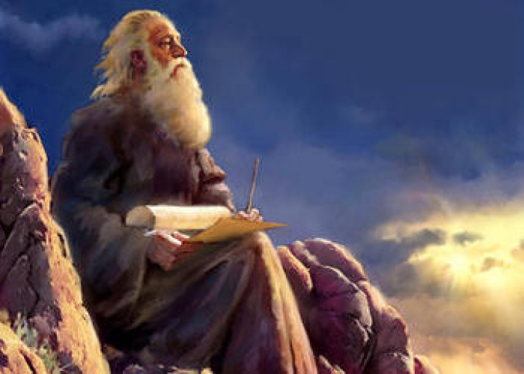
使徒约翰
AUTHOR

Slide 22
约翰: 可能是十二使徒里最年轻的一位。
JOHN: Possible the youngest of the 12 apostles.
使徒雅各的兄弟, 被称为“雷子”。
Brother of James the apostle. Called “sons of thunder”.
著述了约翰福音，约翰一、二、三书以及启示录。
Wrote John’s Gospel, 1,2,3 John & Revelation
启示录是他被流放在希腊拔摩岛时写的。
Wrote Revelation while exiled to the island of Patmos
最后一位活着的使徒。写于公元90-95年。
Last living apostle. Wrote around 90-95 AD
他称自己为 “耶稣所爱的那位” (约13:23)
He refers to himself as “the one whom Jesus loved” (John 13:23)
他曾经在以弗所牧养教会。
At one time, he pastored the church at Ephesus.

Slide 23
拔摩岛

Slide 24
关键 术语
KEY TERMS

Slide 25
关键术语
启示录: 披露一些之前不被人知道的事
Revelation: “the disclosure or revelation of things previously unknown”
末世论 :对末世的研究
Eschatology: the theological study of the end times
千禧年: 基督在地上作王一千年
Millennium : The 1,000 year reign of Christ on Earth.
教会时代:从耶稣升天之后到耶稣再来之前的时期
Church Age: The period of time between Christ’s ascension and His return

Slide 26
关键术语
基督的第二次来临:耶稣以肉体形式重回地球并亲自作王统治全地
Second Coming: The bodily return of Jesus to earth to reign as King
灾难：指在基督再来之前，世上七年里不断恶化的事件。 “灾难”指的是整整七年的时间， “大灾难”指的是后三年半里的苦难。
Tribulation: A 7 year period of worsening events on earth prior to the Second Coming of Christ. The “Tribulation” refers to the full seven-year period while the “Great Tribulation” refers to the second half of the Tribulation.
被提: 指基督再来之前, 会先提走世上的信徒(活的和死的), 然后他们会与祂同来。
Rapture: The idea that Christ will come to take believers (both living and dead) out of the world before His return with them at the second coming.

Slide 27
关键术语
敌基督: 在大灾难期间统治世界的领袖
Antichrist: The world leader during the time of Tribulation.
假先知: 在大灾难期间的世界宗教领袖。
False Prophet: Leader of the world church during the Tribulation period.
六六六:兽的印记 (敌基督)
666 : The mark of the Beast (Antichrist)

Slide 28
解释《启示录》的不同方法
DIFFERENT METHODS OF INTERPRETATION

Slide 29
象征派观点: ：“一切都是象征和寓言”
问题是：你是在使用经文支持你的观点，而非以经解经。每一代人根据他们当下的情况，对经文作出不同的解释。
The Idealist View: “It’s ALL symbolism and allegory”
Problem: You make Scripture support your view rather than interpret Scripture in light of other Scriptures. Each generation interprets it differently in light of their current situation.

Slide 30
实现派观点: “大多数，也许所有的圣经预言都已经发生了”
全部实现派认为《启示录》中的所有事件都随着公元70年耶路撒冷的毁灭而实现了。
部分实现派认为，除了耶稣要再来建立祂的国度之外，大多数事件都已经发生了。
问题是：耶路撒冷是在公元70年陷落的，而这些预言直到公元90年代才出现。书中说这些事件“尚待发生”。
The Preterist View: “Most, maybe all Bible prophecy has already happened.”
Full Preterist view believes all of the events in Revelation were fulfilled with the destruction of Jerusalem in 70 AD.
Partial Preterist view says most events have happened except the return of Jesus to set up His kingdom.
Problem: Jerusalem fell in 70 AD. The prophecies weren’t written until the 90s AD. The book states that these events are “still to come”.

Slide 31
历史派观点：“《启示录》并非预言，而是教会历史的概述。”
问题是：《启示录》中提到的许多事情不适合放在历史上的任何时期。
The Historicist View: “Revelation is not prophecy, but an overview of church history.”
Problem: Many things mentioned in Revelation don’t fit anywhere in history.

Slide 32
未来派的观点："《启示录》中的细节应该照字面来理解。”
象征和寓言应该根据圣经，而非根据文化观念或时事动态来解释。
这是我们在理解《启示录》时所持的观点。
释经学的第一定律: 如果普通意义是常识，那就不要寻求其它意义。
The Futurist (Literal) view: “The details in Revelation should be taken literally.”
Symbols and allegory should be interpreted in light of Scripture, not cultural ideas or current events.
This is the view we will use to approach the book of Revelation.
1st Law of Hermeneutics: If the plain sense makes common sense, seek no other sense.”

Slide 33
比喻
Figurative
象征派观点
字面
Literal
未来派观点
实现派观点
历史派观点
The Idealist View:
The Preterist View:
The Historicist View:
The Futurist View:

Slide 34
谢谢
奉献支持
1. 请在祷告中记念我们
我们相信上帝会回应祂孩子们的祈祷，但我们祷告不是要神照我们的旨意行，乃是我们要照祂的旨意行。请继续以感恩的心祈求神满足我们在智慧、方向、安全和财务上的需要。
2. 请考虑给予事工财政支援
提供给中国基督徒的任何培训我们都不收费。所有的费用，包括课程开发，旅途费用都仰赖于忠心慷慨的支持者帮助支付。
如果您希望奉献支持事工，
请扫上面的二维码，
在微信上进行。
THANK YOU

