Slide 1
REV

Slide 2
启示录
REVELATION

Slide 3
简单地了解一下四种不同的末世观点
We will look briefly at the 4 Main Views on the End Times.

Slide 4
切记！这只是个快速综览, 不是一个详细的研究.
REMEMBER! This is a quick overview, NOT a detailed study.

Slide 5
对比一下千禧年的不同观点
Comparing Views of the MILLENNIUM

Slide 6
两千多年来人们一直想知道耶稣何时会回来.人们不断问的问题是：
For 2,000 years people have wondered when Jesus will return.
Some of the questions that people continually ask are…
1. 耶稣会不会以肉体形式在地上统治一千年？
Will Jesus physically reign on earth for 1,000 years? 2. 基督徒会不会经历七年大灾难？
Will Christians go through a 7 year Tribulation Period? 3. 教会被提和基督再来发生是不是一回事？
Are the rapture and the 2nd Coming the same event? 4. 是否基督徒被提走, 其他人则留下来？
Will Christians be taken and others left behind?
5. 教会是否就是现代的以色列？
Are Christians the modern day Israel?

Slide 7
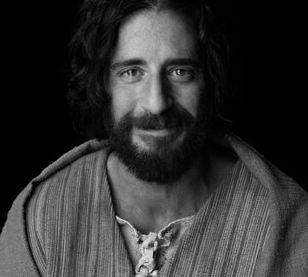
尽管关于末世有不同的观点,
但他们在一些要点上却意见一致：
There are different Points of View on the End Times, but they all share some KEY POINTS:
1. 耶稣是一切爱他和服事他之人的救主和主。
JESUS IS THE SAVIOR AND LORD OF ALL WHO LOVE AND SERVE HIM
2. 耶稣会为爱他的人再来。
JESUS WILL COME AGAIN FOR THOSE WHO LOVE HIM
3. 耶稣要求他的跟随者要预备好他再来。
JESUS CALLS HISFOLLOWERS TOBE READY FOR HIS RETURN
4. 没有人知道具体哪一天哪一时他会再来。
NO ONE KNOWS THE DAY OR HOUR OF HIS RETURN
5. 我们服事同一位主并呼召爱其他的信徒,甚至 那些与我们在末世上有不同观点的弟兄姊妹。
WE SERVE THE SAME LORD AND ARE CALLED TO LOVE OTHER BELIEVERS, EVEN THOSE WHOMAY DISAGREE WITH OUR END TIMES VIEWS.

Slide 8
末世观点的差异性可以通过对千禧年的不同看法得到解释
1,000
The differences in END TIME views can best be explained through views of the MILLENIUM.

Slide 9
你
YOU

Slide 10
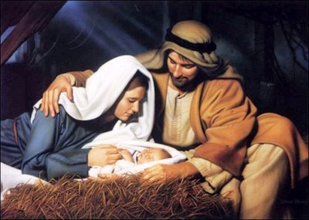
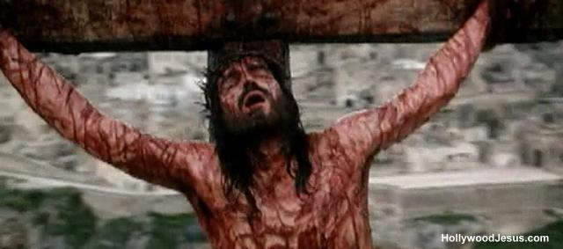

Slide 11
旧约
O.T.
新约
N.T.

Slide 12
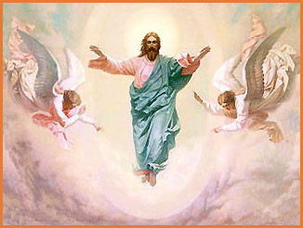
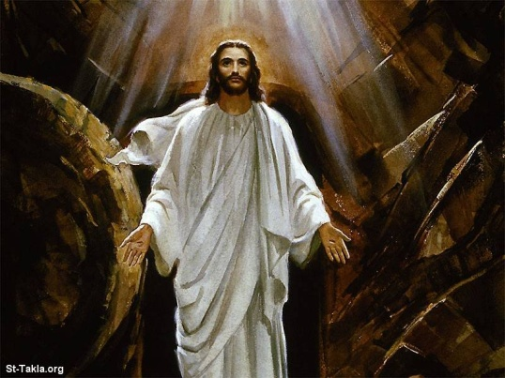

Slide 13
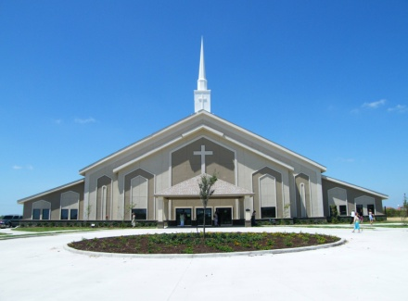
教会时代
CHURCH AGE

Slide 14
1,000

Slide 15
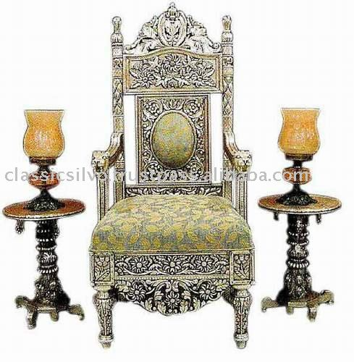
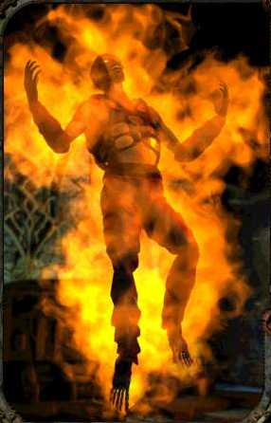
1,000

Slide 16
末世的四种不同看法:
无千禧年派
AMILLENIANISM
后千禧年派
POSTMILLENIANISM
历史性 前千禧年派
HISTORIC PREMILLENIANISM
时代论 前千禧年派
DISPENSATIONAL PREMILLENIANISM
The 4 Main Views are…

Slide 17
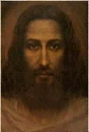
1. 无千禧年派 AMILLENNIALISM
教会时代 (CHURCH AGE)
千禧年 (MILLENNIUM)
大灾难 (TRIBULATION)
“A” 是否定. A-Millennium = 无-千禧年
“A” is a negative. A-Millennium = NO- Millennium
千禧年不是照字面说的1000年。
Millennium is not a literal 1000 years
教会就是现代的以色列。
The Church is the Modern Israel
启示录是象征的, 不是字面的。
Revelations is symbolic, not literal
首先由圣奥古斯丁发展起来的(公元五世纪)
1st developed by St. Augustine (5th Cent)
大部分改革宗教会从公元450年到1800年持此观点:
约翰·加尔文; 马丁路德
Most Reformed churches from 450 A.D. to the 1800s; John Calvin; Martin Luther
基督的第一次来临
1st COMING of CHRIST
基督的第二次来临
2nd COMING of CHRIST

Slide 18
1. 无千禧年派 AMILLENNIALISM
基督的第一次来临
1st COMING of CHRIST
基督的第二次来临
2nd COMING of CHRIST

Slide 19
无千禧年派强调的是什么？
(What AMILLENIALISTS emphasize)
1. 《启示录》由七部分组成. 这七部分是看待教会时代的七种方式，而非七个事件。
The Book of Revelation consists of 7 sections. Instead of literal events, these sections represents 7 ways to view the Church Age 2. “早期教会怎么认为？” 很重要。
“What did the early church believe?” is important 3. 耶稣会再来, 击败罪恶的权势, 让得救的和未得救的复活, 审判他们, 然后将他们送往天堂或地狱。
Jesus will return, defeat the powers of evil, resurrect the saved and the unsaved, judge them, and deliver them to Heaven or Hell forever. 4. 大部分对以色列的提及都是指教会。
Most references to Israel refer to the church
5. 数字都是代表某物(1000年指很长一段时间)。
Numbers all represent something (1,000 years just means a long time)

Slide 20
2. 后千禧年派 POSTMILLENNIALISM
讲道 PREACHING 和平 PEACE
教会时代 (CHURCH AGE)
神的国 (KINGDOM OF GOD)
“后” 就是 “以后”。
“POST” means “AFTER”.
后—千禧年= 耶稣在千禧年之后再来
POST-Millennium = Jesus returns AFTER the Millennium
千禧年不是实际的一千年; 只是很长一段时间。
Millennium is not a literal 1000 years; just a long time
神的国现通过讲道扩张了, 传福音和使命。
The Kingdom of God is extended in Preaching, Evangelism & Missions
(公元1135年直到现在) 很多改革宗; 长老会; 爱德华兹; 司布真持此观点.
(A.D. 1135 – Present) Many Reformed; Presbyterians; Edwards; Spurgeon
基督的第一次来临
1st COMING of CHRIST
基督的第二次来临
2nd COMING of CHRIST

Slide 21
1. 后千禧年派 AMILLENNIALISM
基督的第一次来临
1st COMING of CHRIST
基督的第二次来临
2nd COMING of CHRIST

Slide 22
后千禧年派强调的是什么？
(What POSTMILLENIALISTS emphasize)
1. 世界会 “基督化” , 紧接着就是一段和平繁荣时期, 然后基督就再来审判了。
The world will be “Christianized” followed by a time of peace & prosperity then Christ will return to Judge
2. 教会是指现代的以色列。
The Church is the Modern Israel 3. 《启示录》是象征的, 并非实指。
Revelations is symbolic, not literal.
4. 世界的大部分人将会得救。
Most of the world will be saved;
5. 重点放在传福音上以催促基督的再来。
Focus is on spreading the Gospel to hurry Jesus’ Coming
6. 耶稣在地上是以圣灵统治而非以肉体形式呈现。
Jesus will reign through the Holy Spirit, not be physically present on earth.

Slide 23
3. 历史性前千禧年派 HISTORICAL PREMILLENNIALISM
教会时代
CHURCH AGE
大灾难
TRIBULATION
千禧年
MILLENIUM
基督第二次来临
2nd Coming of Christ
基督的第一次来临
1st COMING of CHRIST
千禧年不是实际的一千年.
Millennium is not a literal 1000 years
基督将会再临地上统治.
Christ will return to reign on earth
被提和第二次再来是同一事件.
Rapture & 2nd Coming are the same event
教会早期三百年; 早期教父; 爱任纽; 特土良
First 300 years of early church; Early Church Fathers; Irenaeus; Tertullian

Slide 24
3.历史性前千禧年派 AMILLENNIALISM
基督的第一次来临
1st COMING of CHRIST
基督的第二次来临
2nd COMING of CHRIST

Slide 25
历史性 前千禧年派强调的是什么？
(What HISTORICAL PREMILLENIALISTS emphasize)
1. 基督徒会经历大灾难. 大灾难会炼净教会, 将真假信徒分开.
Christians go through the tribulation. This tribulation will purify the church by separating false Christians from true Christians.
2. 敌基督者会在耶稣回来之前被揭露.
The Antichrist will be revealed before Jesus returns
3. 世界将会变得越来越邪恶.
The earth will grow increasingly evil
4. 神与以色列立的约因以色列的悖逆将会被教会取代.
God’s covenant with Israel was given to the Church due to Israel’s disobedience.
5. 此观点试图平衡《启示录》中的象征和实指性语言.
This view attempts to balance symbolic and literal language in Revelations.

Slide 26
为何如此多神学家这么多年认为教会就是新以色列？ Why did so many theologians believe the CHURCH was the NEW ISRAEL for so many years?

Slide 27
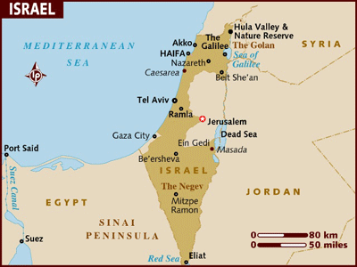
关键原因: (The Key Reason…)
以色列和耶路撒冷早在公元七十年就完全被摧毁了。
Israel & Jerusalem
were completely destroyed in 70 A.D.
超过 一千八百年,以色列不存在!
For over 1800 years, there was
NO NATION ISRAEL!

Slide 28
在十九世纪,神学家开始凭着信心教导: 根据圣经预言, 以色列将会再次立国, 并重新获得对耶路撒冷的控制.
一年八百多年过去后以色列才再次立国.
大部分人拒绝相信以色列会再次立国并重获耶路撒冷.
In the 1800s, theologians began to teach in faith that Israel would become a nation
again someday and regain control of Jerusalem according to Biblical prophecy.
It had been over 1800 years since Israel existed.
Most refused to accept that Israel could ever become a nation again or get Jerusalem.

Slide 29
多年来很多人想彻底铲除犹太人.
Many people have tried to destroy the Jews through the years
1948: 经历了1878年后, 以色列再次成为一个国家.
1948: Israel became a nation after 1878 years.
1967: 以色列重新得回耶路撒冷.
1967: Israel regained control of Jerusalem

Slide 30
4. 时代论前千禧年派 DISPENSATIONAL PREMILLENNIALISM
教会
时代
CHURCH
AGE
大灾难
TRIBULATION
千禧年
MILLENIUM
基督第二次来临
2nd Coming of Christ
被提
RAPTURE
基督的第一次来临
1st COMING of CHRIST
实际的一千个禧年是在实际的七年大灾难之后.
Literal 1000 year Millennium follows a literal 7 year Tribulation
教会和以色列是两个不同的实体.
The Church and Israel are separate entities
“ 被提”和 “第二次来临”是两个事件。
Rapture and 2nd Coming are separate events
(公元1800至今) 大部分新教徒; 浸信会,蒂姆·莱希;雷历
(A.D. 1800 –Present) Most Protestants; Baptists, Tim LaHaye; Walvoord; Ryrie

Slide 31
4. 时代论前千禧年派 AMILLENNIALISM
基督的第一次来临
1st COMING of CHRIST
基督的第二次来临
2nd COMING of CHRIST

Slide 32
时代论前千禧年派强调什么?
(What DISPENSATIONALISM PREMILLENIALISTS emphasize)
1. 尽量照字面原意去解释《启示录》这卷书.
Interprets the Book of Revelation literally as much as possible
2. 耶稣将很快提走所有基督徒并在七年后为一场大战再来.
Jesus will rapture all Christians soon and return 7 years later for a battle
3. 在七年大灾难期间世界将遭受极可怕的灾难.
During a literal 7 year Tribulation period the world will suffer terrible disasters
4. 在这期间成为基督徒的人将受极端的逼迫.
Those who become Christians during this time will suffer extreme persecution.
5. 在大灾难期间大多数犹太人会转向耶稣.
During the Great Tribulation most Jews will turn to Jesus
6. 千禧年间, 犹太人将获得所有神曾应许的土地.
During the Millennium, the Jews will receive all land they were promised by God

Slide 33
谢谢
奉献支持
1. 请在祷告中记念我们
我们相信上帝会回应祂孩子们的祈祷。我们祷告不是要神照我们的旨意行，乃是我们要照祂的旨意行。请继续以感恩的心祈求神满足我们在智慧、方向、安全和财务上的需要。
2. 请考虑给予事工财政支援
提供给中国基督徒的任何培训我们都不收费。所有的费用，包括课程开发，旅途费用都仰赖于忠心慷慨的支持者帮助支付。
如果您希望奉献支持事工，
请扫上面的二维码，
在微信上进行。
THANK YOU

