Slide 2
圣经强化课程
INTENSIVE BIBLE TRAINING PROGRAM

Slide 3
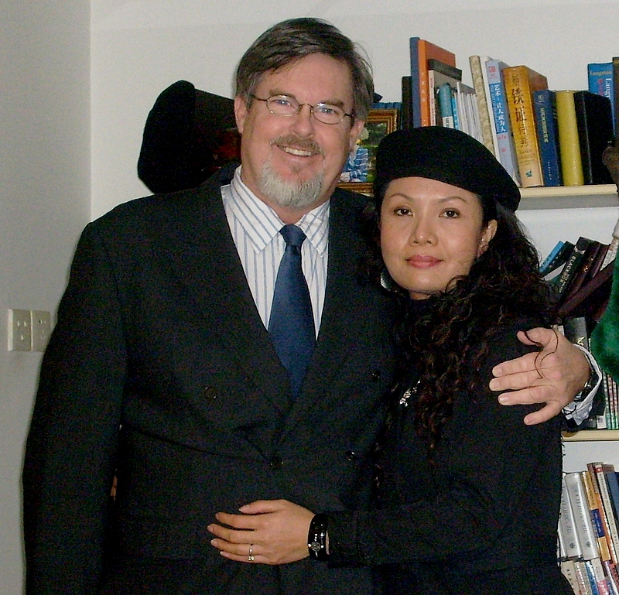
Teachers:
Dr. Jay Barleon
&Suran

Slide 4
圣灵是谁？ WHO IS THE HOLY SPIRIT?

Slide 5
1. 圣灵的位格
THE PERSONALITY OF THE SPIRIT
2. 圣灵的名字
THE NAMES OF THE SPIRIT
3. 圣灵的神性
THE DEITY OF THE SPIRIT
4. 圣灵的标志
THE SYMBOLS OF THE SPIRIT
5. 圣灵的作为
THE ACTIONS OF THE SPIRIT
6. 圣灵的果子
THE FRUIT OF THE SPIRIT
7. 受圣灵洗和被圣灵充满
THE BAPTISM & FILLING OF THE SPIRIT
8. 亵渎圣灵
THE BLASPHEMY OF THE SPIRIT
9. 属灵的恩赐
THE GIFTS OF THE SPIRIT
10. 圣灵的同在
THE PRESENCE OF THE SPIRIT

Slide 6
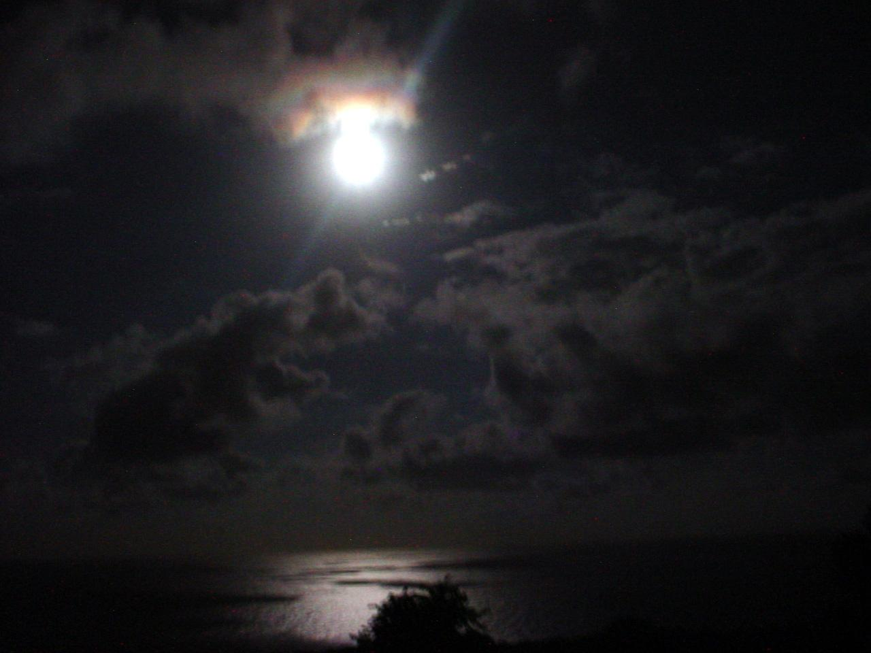
圣灵的位格
The PERSONALITY of the Spirit

Slide 7
“谁”—不是“什么” “WHO” - - NOT “WHAT” 祂是一个位格, 不是一样东西! He is a PERSON, not a THING! 并不需要身体才能成为一个位格! You don’t need a BODY to be a person.

Slide 8
圣灵的个性 (The Personality of the Holy Spirit)
智能 (Intellect)
情感(Emotions)
意志 (Will)

Slide 9
智能 (Intellect)
祂教导：
林前2:13 (He TEACHES: 1 Cor. 2:13)
祂有头脑 ：
罗马8:27 (He has a MIND: Rom. 8:27)
祂明白并寻求神的事物
林前2:10-11 (He KNOWS & SEARCHES the things of God: 1 Cor. 2:10-11)

Slide 10
情感 (Emotions)
祂会忧伤
以弗所书 4:30
(He can be GRIEVED: Eph. 4:30)
祂爱
罗马书15:30
(He Loves: Rom. 15:30)

Slide 11
意志 (WILL)
祂带领并指引人们
徒 16:6-11
(he leads and directs people: Acts 16:6-11)
祂决定给他们什么恩赐
林前12:11
(He decides which gifts to give and gives them: 1 Cor. 12:11)

Slide 12
圣灵的名字
The NAMES of the Spirit

Slide 13
全能者的气
Breath of the Almighty
伯Job 33:4
保惠师
Counselor Comforter
约John14:16,26; 15:26
谋略的灵
Spirit of Counsel
赛Isaiah11:2
永恒的灵
Eternal Spirit
来Hebrews 9:14

Slide 14
乐意的灵
Free Spirit
Psalm51:12
神
God
徒Acts5:3-4
良善的灵
Good Spirit
尼Nehemiah 9:20
诗Psalm143:10
圣灵
Holy Spirit
诗Psa. 51:11
路Lu. 11:13

Slide 15
主
Lord
林后2 Cor.3:16-17
至高者的灵
Power of the Highest
路Luke 1:35
能力的灵
Spirit of Might
赛Isaiah11:2
收养的灵
Spirit of Adoption
罗Rom.8:15

Slide 16
焚烧的灵
Spirit of Burning
赛Isaiah4:4
审判者的灵
Spirit of Judgment
赛Isaiah 4:4;28:6
基督的灵
Spirit of Christ
罗Romans8:0
彼前1Peter1:11
荣耀的灵
Spirit of Glory
彼前1Peter 4:14

Slide 17
神的灵
Spirit of God
创Genesis1:2; 1 ；
林前1Cor.2:11
耶和华的灵
Spirit of Yahweh
赛Isa.11:2; 61:1
施恩的灵
Spirit of Grace
亚Zech.12:10; 来Heb.10:29
知识的灵
Spirit of Knowledge
赛Isaiah11:2

Slide 18
真理的灵
Spirit of Truth
约John 14:17;15:26
聪明的灵
Spirit of Understanding
赛Isaiah11:2
智慧的灵
Spirit of Wisdom
赛Isa.11:2弗Eph.1:17
生命的灵
Spirit of Life
罗Romans8:2

Slide 19
永生神的灵
Spirit of the Living God
林后2 Cor.3:3
预言的灵
Spirit of Prophecy
启Rev.19:10
启示的灵
Spirit of Revelation
Eph.1:17
父的灵
Spirit of the Father
太Matt.10:20

Slide 20
敬畏耶和 华的灵
Spirit of the Fear of the Lord
赛Isa.11:2
主的灵
Spirit of the Lord
徒Acts5:9
儿子的灵
Spirit of the Son
加 Gal.4:6
灵
Spirit
太Matt.4:1; 约Jon.3:6

Slide 21
圣灵的神性
The DEITY of the Spirit

Slide 22
圣灵是神 (The Holy Spirit is GOD)
祂被称为: HE IS CALLED…
神的灵 (创1:2) Spirit of God, Gen. 1:2
耶和华的灵 (士3:30) Spirit of Yahweh, Judges 3:10
圣灵 (赛63:10) Holy Spirit, Isa. 63:10
基督的灵 (罗8:9) Spirit of Christ, Rom. 8:9
神的圣灵 (弗4:30) Holy Spirit of God, Eph. 4:30.

Slide 23
圣灵是神 (The Holy Spirit is GOD)
对圣灵撒谎就对神撒谎:
To lie to the Holy Spirit is to lie to God…
(使徒行传5:3-4) 彼得说:“亚拿尼亚! 为什么撒旦充满你的心,叫你欺哄圣灵,把田地的价银私自留下几分呢？既卖了,价银不是你作主吗? 你怎么心里起这个意念呢? 你不是欺哄人,是欺哄神了.”
(Acts 5:3-4) “But Peter said, “Ananias, why has the Satan filled your heart to lie to the Holy Spirit and keep back part of the price of the land for yourself? While it remained was it not your own? And after it was sold, was it not in your own control? Why have you conceived this thing in your heart? You have not lied to men but to God.”

Slide 24
圣灵是神 (The Holy Spirit is GOD)
祂具有神所有的属性:
He has all of the attributes of God…
祂全宇宙无处不在 (诗139:7-10)
He is everywhere present in the universe (Psalm 139:7-10)
祂具有所有神的能力 (路1:35)
He has all power (Luke 1:35)
祂拥有所有的知识,祂参透万事 (林前2:10-11)
He has all knowledge (I Corinthians 2:10-11)
祂是永恒的(来9:14)
He is eternal (Hebrews 9:14)

Slide 25
圣灵的标志
The SYMBOLS of the Spirit

Slide 26
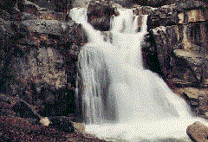
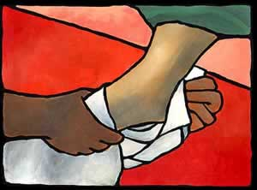
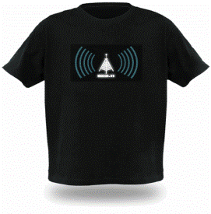
圣灵的标志 (Symbols of the Holy Spirit)
气息，油、鸽子、火、印章、仆人、衣服、水、风。
Breath, Oil, Doves, Fire, Seal, Servant, Clothing, Water, Wind

Slide 27
圣灵的作为
The ACTIONS of the Spirit

Slide 28
* 祂给我们每人特殊的能力侍奉神: 林前2:11 He gives us special abilities to serve God: I Cor. 2:11
* 祂在我们的生命中替我们做很多 的决定:林前15:28 He makes decisions re our lives: Acts 15:28
* 祂写成的《圣经》:彼后1:21 He wrote the Bible: 2 Peter 1:21
祂引导我们理解圣经的真理：
约16:13 He guides us in the truth of the Bible: John 16:13

Slide 29
祂呼召特定的人做特定的事:
徒13:2 He calls certain people to do certain things: Acts 13:2
* 祂教导我们耶稣曾教导的真理： 约14:26 He teaches us everything Jesus taught: John 14:26
* 祂代表我们向天父说话: 罗8:27 He speaks to the Father on our behalf: Rom. 8:27
* 祂使我们相信耶稣就是他声称的那一位:约15:26 He convinces us that Jesus is who He says: John 15:26

Slide 30
* 祂起初也参与了创造: 创1:2 He played a part in Creation, Gen 1:2
* 祂给相信的人一个新的生命:约6:63 He gives a new life to believers: John 6:63
* 祂使我们成为圣洁:彼前1:2 He makes us holy: I Peter 1:2
* 祂给我们盖上印记,等候得赎的日 子:弗1:13;4:30 He puts a seal on us to preserve us: Eph. 1:13; 4:30

Slide 31
* 祂使我们在基督里合一:林前12:13 He unifies Christians in Christ: I Cor. 12:13
* 祂使我们成为神的孩子:罗8:15 He adopt us as children of God: Rom. 8:15
* 祂叫耶稣从死里复活 :罗8:11 He raised Jesus from the dead: Rom. 8:11
* 祂给我们信心的保证 :罗8:16 He gives us assurance of our faith: Rom. 8:16

Slide 32
* 祂洁净我们并宣告我们“无罪”: 林前6:11 He washes us and declares us “not guilty”: I Cor. 6:11
* 祂让我们远离自己的罪,悔改得生 命:徒11:15,18 He puts in our hearts to turn from sin: Acts 11:1- 18
* 祂赐给我们强大的信心:林前 2:9,12;12:3 He gives us greater faith: I Cor. 2:9, 12; 12:3
* 祂赐给我们新的态度: 加5:22-23 He gives us new responses: Gal. 5:22-23

Slide 33
* 祂引导我们每天的生活:罗8:14 He leads us in our everyday life: Rom. 8:14
* 祂行神迹：徒8:39 He performs miracles: Acts 8:39
* 祂使童女马利亚怀上耶稣:路1 He conceived in Mary to bear Jesus: Luke 1
* 祂使得我们认识自己的罪: 约16:9 He convicts us of our sin: John 16:9

Slide 34
圣灵的果子
The FRUIT of the Spirit

Slide 35
圣灵的果实? (加:22-23) Fruit of the Spirit? (Galatians 5:22-23)
和平 (PEACE)
忍耐 (PATIENCE)
恩慈 (KINDNESS)
良善 (GOODNESS)
信实 (FAITHFULNESS)
温柔 (GENTLENESS)
喜乐 (JOY)
节制 (SELF-CONTROL)
爱 (LOVE)

