Slide 1
SACRAMENTS 圣礼2

Slide 2
定义
圣礼(天主教): “一个凭借行为而获得恩典的动作.”
SACRAMENT (Catholic): “An act whereby grace is attributed to a person for their action”
圣礼(新教)“一个神恩典的象征.”
SACRAMENT (Protestant): “A symbol of God’s grace”
在新教的定义之下，洗礼和圣餐是圣礼。
Under the Protestant definition, baptism and communion ARE sacraments
法令的定义: “一个由基督颁布给教会实践的命令.”
ORDINANCE: “a command of Christ to be practiced by the church.”
有人称洗礼和圣餐为圣礼，其余则管这些为法令。
Some call baptism and communion sacraments, others call them ordinances
DEFINITIONS

Slide 3
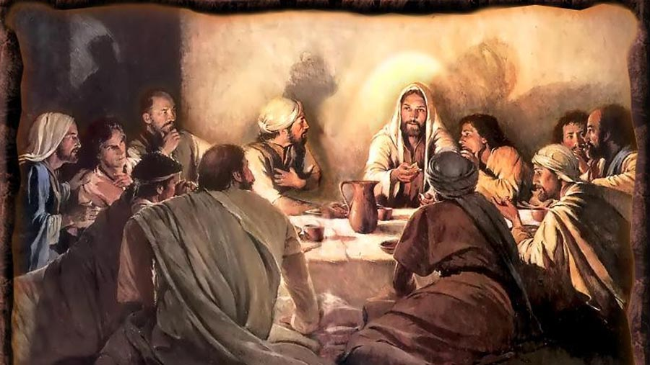
圣餐
COMMUNION

Slide 4
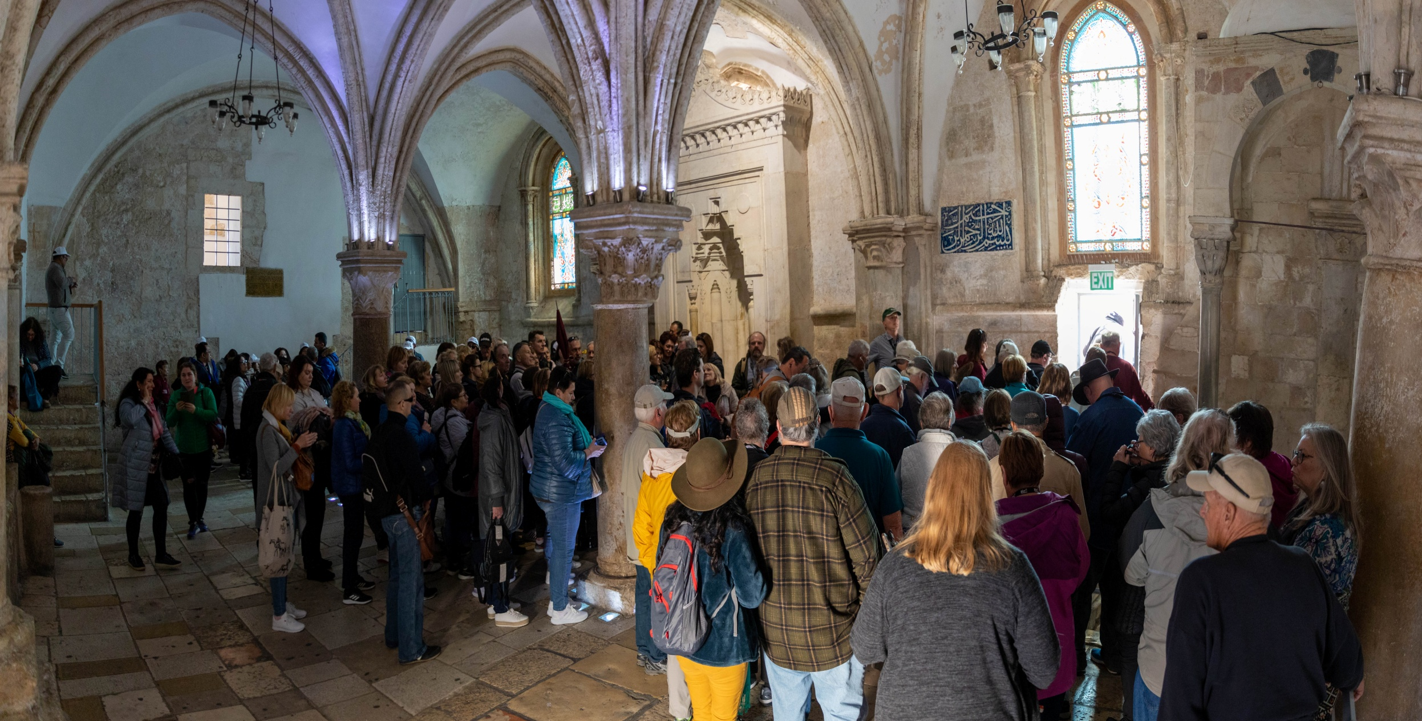
马可楼
我们旅行团参观耶路撒冷的马可楼

Slide 5
圣餐
圣餐的定义: 基督的圣礼/条例之一, 重现主的晚餐并纪念耶稣的身体和鲜血.
Definition: COMMUNION is a Christian sacrament / ordinance reenacting the Last Supper and commemorating the body and blood of Jesus.
也叫主的晚餐 a.k.a. The Eucharist or the Lord's Supper
关门圣餐 是一种只限于特定教会和会众参与的圣餐
Closed communion is the practice of restricting the communion to members of a particular church or congregation
开门圣餐 是一种允许其它教会成员参与, 被绝大多数新教教会遵行的圣餐方式。
Open communion is the practice of allowing members of other churches to share communion, followed by most Protestant Christian churches
COMMUNION

Slide 6
圣餐的起源
旧约 (OLD TESTAMENT)
(出24:9-11)西奈山; 摩西与耶稣一起又吃又喝。
(Ex. 24:9-11) Mt. Sinai; Moses et al had dinner with Jesus
(出)逾越节晚餐
(Ex. ) Passover Meal
新约 (NEW TESTAMENT)
最后的晚餐(太25:26-29)由耶稣设立
The Last Supper (Matt 23:26-29) Instituted by Jesus
(林前11) 保罗给出了领圣餐的指导方针.
(1 Cor. 11) Paul’s Guidelines for partaking
ORIGINS of COMMUNION

Slide 7
领圣餐的先决条件
圣经上的 (BIBLICAL)
得救 (salvation)
自我省察 (self-examination)
悔改 (repentance)
圣经之外的 (EXTRA-BIBLICAL)
必须是教会成员 (church membership)
受洗之后 (baptized)
关门圣餐 (closed communion)
必须是长老才能领 (elder participation required)
只能在教会领 (at church only)
PREREQUISITES of COMMUNION

Slide 8
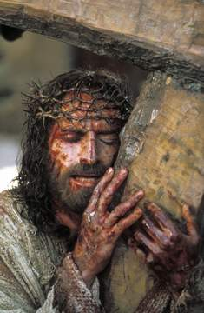
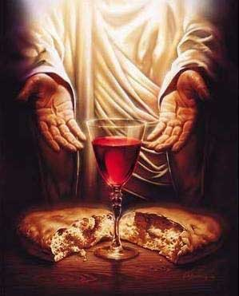
圣餐的要素
ELEMENTS of COMMUNION

Slide 9
有关圣餐的四种观点
这是我的身体
为你们舍的.
This
is my body which
is broken
for you
这是我的血
为你们流的
This
is my blood which
is shed
for you
FOUR VIEWS of COMMUNION

Slide 10
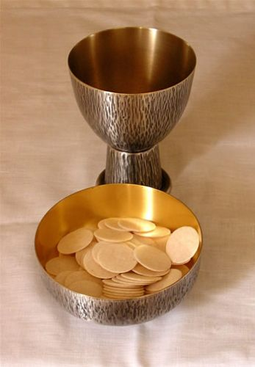
圣餐变体论
认为在圣餐仪式中当神父主持弥撒的时候饼实际上变成了耶稣基督的身体,“葡萄酒” 变成了耶稣基督的血。
罗马天主教
Transubstantiation
The belief that the bread becomes the actual body of Jesus Christ and the ‘wine’ becomes the actual blood of Jesus Christ during communion (when the priest performs mass)
Roman Catholic

Slide 11
圣体共在论
认为圣餐仪式中饼和酒并非真正变成了基督的身体和血，但是耶稣与饼和酒同在。
路德会
Consubstantiation
The belief that the bread and wine do not change into the literal body and blood of Jesus, but Jesus is "with, in, and under" the bread and the wine
Lutheran

Slide 12
属灵同在论
当我们按照耶稣对所有信徒的命令领受圣餐时,圣灵奇妙地印证蒙拣选者的信心.
改革宗
Spiritual Presence
The Holy Spirit mysteriously confirms the faith of the elect as we partake in a sacrament commanded by Jesus for all believers to practice.
Reformed

Slide 13
纪念之说
认为饼和酒并不真正变成耶稣的身体和血, 只代表他的身体和血。我们领圣餐是为了纪念他.
浸信会
尽管许多敬虔的学者和早期教父们的观点都可归入以上四种
我个人却持这第四种
Although there are godly scholars and early church fathers that fall into all
4 of these categories,
I personally hold this view.
MEMORIALISM
The belief that the bread and wine do not change into the literal body and blood of Jesus, but represent His body and blood. We partake in the communion in remembrance.
Baptist

Slide 14
混乱圣餐的危险 (林前:11)
忽视教会分裂
IGNORING CHURCH DIVISION
“我现今吩咐你们的话,不是称赞你们, 因为你们聚会不是受益,乃是招损.第一,我听说你们聚会的时候,彼此分门别类，我也稍微地信这话。”
“ In the following directives I have no praise for you, for your meetings do more harm than good. In the first place, I hear that when you come together as a church, there are divisions among you, and to some extent I believe it. “
Dangers of Communion (1 Cor: 11)

Slide 15
混乱圣餐的危险(林前:11)
视之为普通餐饮，而非圣礼
TREATING IT LIKE A MEAL, NOT A SACRAMENT
你们聚会的时候,算不得吃主的晚餐;因为吃的时候,各人先吃自己的饭,甚至这个饥饿,那个酒醉.你们要吃喝,难道没有家吗？还是藐视神的教会,叫那没有的羞愧呢？
“So then, when you come together, it is not the Lord’s Supper you eat, for when you are eating, some of you go ahead with your own private suppers. As a result, one person remains hungry and another gets drunk. ²² Don’t you have homes to eat and drink in? Or do you despise the church of God by humiliating those who have nothing?”
Dangers of Communion (1 Cor: 11)

Slide 16
混乱圣餐的危险(林前:11)
当存着感恩而行
Should be done with Thanksgiving
我当日传给你们的,原是从主领受的,就是主耶稣被卖的那一夜,拿起饼来,祝谢了,就擘开,说:“这是我的身体,为你们舍的. 你们应当如此行,为的是记念我.” 饭后,也照样拿起杯来,说：“这杯是用我的血所立的新约. 你们每逢喝的时候,要如此行,为的是记念我.” 你们每逢吃这饼,喝这杯,是表明主的死,直等到他来。
“For I received from the Lord what I also passed on to you: The Lord Jesus, on the night he was betrayed, took bread, and when he had given thanks, he broke it and said, “This is my body, which is for you; do this in remembrance of me.” In the same way, after supper he took the cup, saying, “This cup is the new covenant in my blood; do this, whenever you drink it, in remembrance of me.” For whenever you eat this bread and drink this cup, you proclaim the Lord’s death until he comes.”
Dangers of Communion (1 Cor: 11)

Slide 17
混乱圣餐的危险(林前:11)
不自我省察和悔改而领圣餐会导致疾病或死亡
Communion without self-examination and repentance can lead to sickness/death
所以,无论何人不按理吃主的饼,喝主的杯,就是干犯主的身,主的血了. 人应当自己省察,然后吃这饼,喝这杯. 因为人吃喝,若不分辨是主的身体,就是吃喝自己的罪了. 因此，在你们中间有好些软弱的与患病的,死的也不少.我们若是先分辨自己,就不至于受审。
“So then, whoever eats the bread or drinks the cup of the Lord in an unworthy manner will be guilty of sinning against the body and blood of the Lord. Everyone ought to examine themselves before they eat of the bread and drink from the cup. For those who eat and drink without discerning the body of Christ eat and drink judgment on themselves. That is why many among you are weak and sick, and a number of you have fallen asleep. But if we were more discerning with regard to ourselves, we would not come under such judgment”
Dangers of Communion (1 Cor: 11)

Slide 18
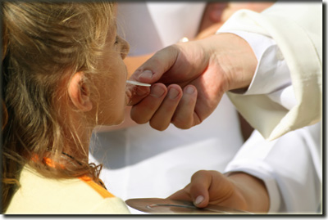
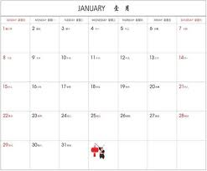
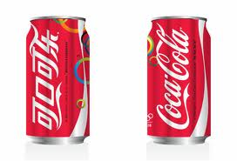
有关圣餐的问题
孩子何时才能领圣餐？
When should a child take their first communion?
孩子信主并明白圣餐的意义
我们要多久领一次圣餐？
How often should we take communion?
每季度，每月、每周
我们能否用别的东西
代替圣餐中的元素？
Can we substitute the elements of communion?
不能(圣经用的是葡萄酒(汁)，以及无酵饼)
QUESTIONS re: COMMUNION

