Slide 1
HONEST ANSWERS to TOUGH QUESTIONS Part 1

Slide 2
疑难问题的诚实答案
1

Slide 3
为什么我问的每个圣经问题都会得到多种不同的答案？ 既然圣经是容易明白的，为什么他们观点不一致呢？
Why do I get such a variety of different answers to each Bible question I ask? Why don’t they all agree if the Bible is so easy to understand?

Slide 4
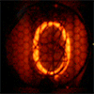
十大 得到错误答案 的原因
Top 10 Reasons We Get Wrong Answers

Slide 5
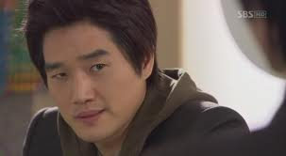
PRIDE
1. 骄傲
有时候我们甚至不愿意承认我们可能错了。
(Sometimes we are unwilling to even consider that WE MIGHT BE WRONG.)

Slide 6
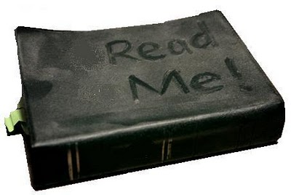
LAZINESS
1.骄傲
有时我们不愿深入学习，常采取一种“且信且行”的态度。
(Sometimes we are unwilling to devote ourselves to deep study. We adopt a
“just believe and move on” attitude.)
2. 懒惰

Slide 7
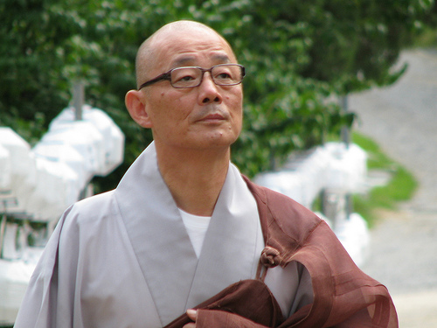
FALSE LOYALTY
1.骄傲
有时我们忠于自己的宗派或导师多过忠于神。
(Sometimes we put our devotion to our denomination or mentors before our devotion to God.)
2. 懒惰
3. 愚忠

Slide 8
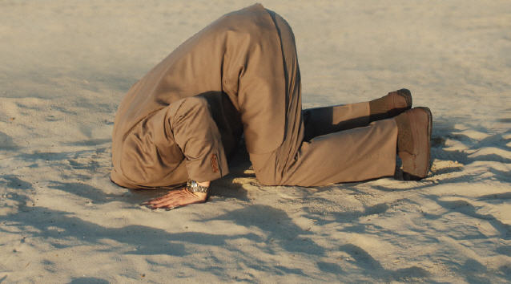
EMOTIONALISM
1.骄傲
有时只接受那些我们感觉良好的答案。不愿接受那些触犯我们世界观的教义。
(Sometimes we will only accept answers we FEEL good about. We won’t accept doctrines that offend our worldview.)
2. 懒惰
3. 愚忠
4. 情感倾向
4. X
4. X
4. X
4. X
4. X
4. X

Slide 9
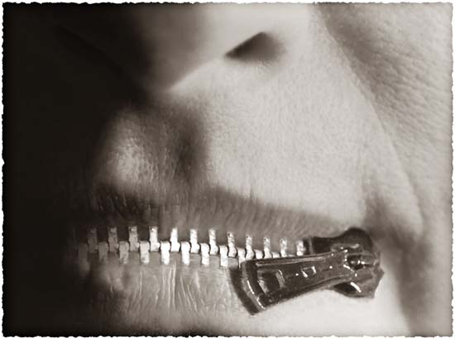
OPINIONATED
1.骄傲
对于神自己都沉默的问题，有时我们谈论起来却满带权威。
(Sometimes we speak authoritatively when even God is silent on the subject.)
2. 懒惰
3. 愚忠
4. 情感倾向
5. 固执己见
4. X
4. X
4. X
4. X
4. X

Slide 10
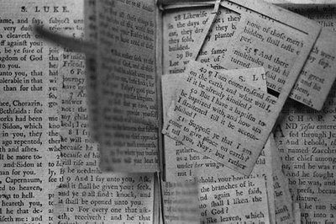
DECONTEXTUALIZING
1.骄傲
有时我们从上下文中抽出经文证明自己的观点。我们假设每节经文都适用于我们当下的情况。
(Sometimes we take verses out of context to prove our points. We assume that every verse applies to our given situation.)
2. 懒惰
3. 愚忠
4. 情感倾向
5. 固执己见
6. 断章取意
4. X
4. X
4. X
4. X

Slide 11
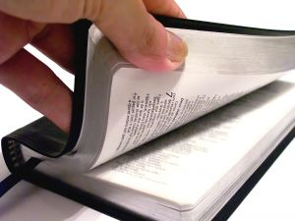
BAD HERMENEUTICS
1.骄傲
有时我们忽略了基本的圣经学习原则。往往在尚无正确释经的前提下就开始应用这节信息。
(Sometimes we ignore the most basic principles of Bible Study. We try to apply a passage before we interpret it’s meaning.)
2. 懒惰
3. 愚忠
4. 情感倾向
5. 固执己见
6. 断章取意
7. 不良释经
4. X
4. X
4. X

Slide 12
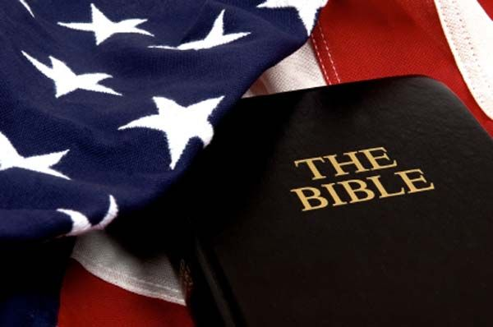
CULTURAL BLINDERS
1.骄傲
有时我们以自己的文化，语言和情景来解释经文，而不是将之还原到最初的语言和意思。
(Sometimes we interpret Scripture in light of our culture, language and situation instead of the original meaning and language.)
2. 懒惰
3. 愚忠
4. 情感倾向
5. 固执己见
6. 断章取意
7. 不良释经
8. 文化盲区
4. X
4. X

Slide 13
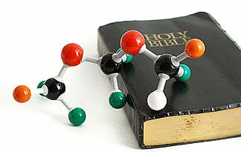
FEAR and DOUBT
1.骄傲
有时我们认为表面上的矛盾就是真矛盾。害怕科学上的新发现，不愿接受它们。
(Sometimes we assume that apparent contradictions are real contradictions.
We fear scientific breakthroughs rather
than embrace them.)
2. 懒惰
3. 愚忠
4. 情感倾向
5. 固执己见
6. 断章取意
7. 不良释经
8. 文化盲区
9. 畏惧和怀疑
4. X

Slide 14
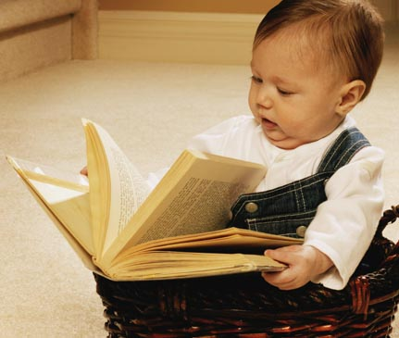
LIMITED GROWTH
1.骄傲
有时我们想明白的教义超过了我们目前的成熟度。
(Sometimes we want to understand doctrines beyond our maturity level.)
2. 懒惰
3. 愚忠
4. 情感倾向
5. 固执己见
6. 断章取意
7. 不良释经
8. 文化盲区
9. 畏惧和怀疑
10. 成长局限

Slide 15
10 Reasons We Get Wrong Answers
那我如何获得正确的答案呢？
(So how do I get the RIGHT ANSWER?)
1.骄傲
2. 懒惰
3. 愚忠
4. 情感倾向
5. 固执己见
6. 断章取意
7. 不良释经
8. 文化盲区
9. 畏惧和怀疑
10. 成长局限

Slide 16
十大 获得正确答案 的原因
Top 10 Reasons We Get RIGHT Answers

Slide 17
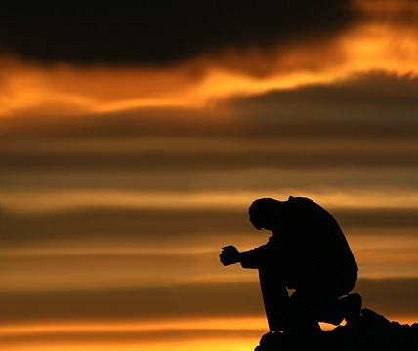
HUMILITY
1. 谦卑
要认识到你的认知可能不完整。祈求神挪去骄傲和罪。
(Realize that your knowledge may be incomplete. Ask God to remove pride
& sin as you study)

Slide 18
STUDY THE WORD
1. 谦卑
“竭力钻研，
得蒙神的认可，做无愧的工人，按着正义分解神的道。”
“Study to show yourself approved to God;
a workman who doesn’t need to be ashamed; rightly dividing the Word of Truth.”
2. 钻研神的道

Slide 19
DEVOTION TO TRUTH
1. 谦卑
将你的忠诚聚焦在圣经已启示的真理上, 而不是你的宗派或导师如何相信。
(Focus your devotion on TRUTH as revealed in the Bible; NOT on what your denomination or mentors believe. )
2. 钻研神的道
3. 忠于真理

Slide 20
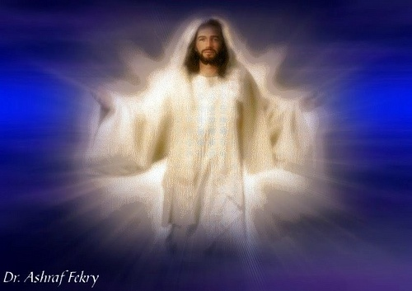
LET GOD BE GOD
1. 谦卑
接受圣经里神启示的祂自己，而不是你感觉祂该怎样或你认为他该如何。
(Accept God for who He is as revealed
in Scripture; NOT as you feel He should be or how you think He should act. )
2. 钻研神的道
3. 忠于真理
4. 让神做神
4. X
4. X
4. X
4. X
4. X
4. X

Slide 21
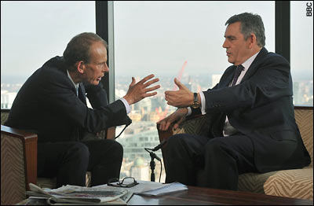
“MY OPINION IS…”
1. 谦卑
确保将观点与事实分开。有自己的观点是可以的，但要意识并承认你可能错了。
(Make sure you separate opinions from fact. It is okay to have an opinion but realize and admit that you may be wrong.)
2. 钻研神的道
3. 忠于真理
4. 让神做神
5. “我的观点是…”
4. X
4. X
4. X
4. X
4. X

Slide 22
KEEP IT IN CONTEXT
1. 谦卑
所有的经文都有上下文。问谁写的？写给谁？何时？为什么？哪里？正确答案总能在上下文里找到。
(All verses have a context. Ask who wrote it? To whom? When? Why? Where? The truth is always found in context.)
2. 钻研神的道
3. 忠于真理
4. 让神做神
5. “我的观点是…”
6. 保持上下文
4. X
4. X
4. X
4. X

Slide 23
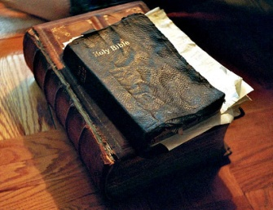
INTERPRET FIRST
1. 谦卑
只有正确的释经才能带来正确的应用。决不在没有释经的情况下就应用某节经文。
(Only a true interpretation can lead to a true application. Never apply a verse without first interpreting it.)
2. 钻研神的道
3. 忠于真理
4. 让神做神
5. “我的观点是…”
6. 保持上下文
7. 首先释经
4. X
4. X
4. X

Slide 24
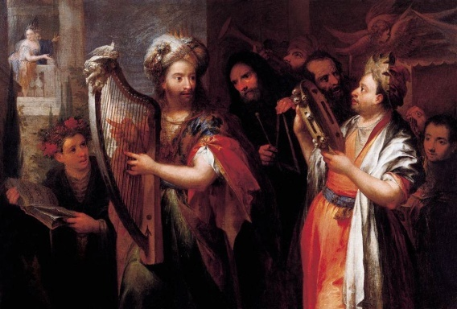
LOOK FOR THE ORIGINAL SETTING
1. 谦卑
总是根据原始的文化，语言和情形，而非你的国情和文化背景去释经。
(Always interpret Scripture in light of the original culture, language and situation instead of your national background.)
2. 钻研神的道
3. 忠于真理
4. 让神做神
5. “我的观点是…”
6. 保持上下文
7. 首先释经
8. 原始背景
4. X
4. X

Slide 25
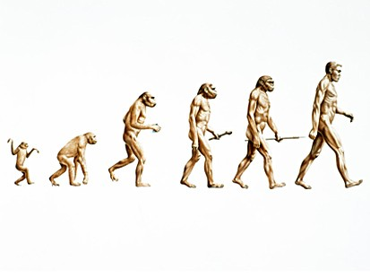
TRUTH IS TRUTH
1. 谦卑
真正的科学总是最后支持圣经里的真理。不存在矛盾，勇敢地寻求答案吧。
True science will always eventually support the truths found in Scripture. There are NO contradictions; just look for the answer.
2. 钻研神的道
3. 忠于真理
4. 让神做神
5. “我的观点是…”
6. 保持上下文
7. 首先释经
8. 原始背景
9. 真理就是真理
4. X

Slide 26
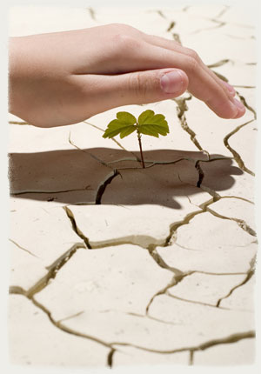
ENJOY GROWING
1. 谦卑
不要指望一下就明白所有的答案。按照神给你的速度，享受学习之旅每一步的乐趣。
(Don’t expect to know all answers at once. Enjoy the learning journey at God’s pace.)
2. 钻研神的道
3. 忠于真理
4. 让神做神
5. “我的观点是…”
6. 保持上下文
7. 首先释经
8. 原始背景
9. 真理就是真理
10. 享受成长

Slide 27
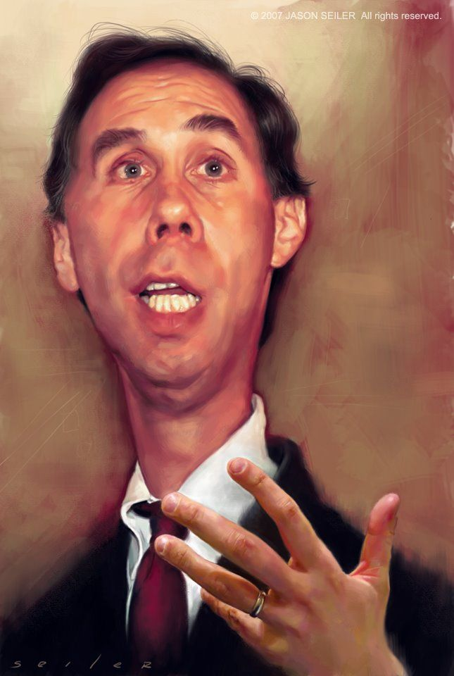
通常，难题不是缺少答案，而是很多答案听上去都有道理。然而每节经文只有一个正确的解释。——杰巴梁
“Often, the problem is not a lack of answers, but a lot of answers that all sound correct.
But there is only one correct interpretation for each passage.”
–Dr. Jay BarLeon

Slide 28
“准备好开始
《刁钻问题的诚实答案》了吗?”
“Are you ready for some HONEST ANSWERS to some
TOUGH QUESTIONS?”

Slide 29
第一个问题… First question…

Slide 30
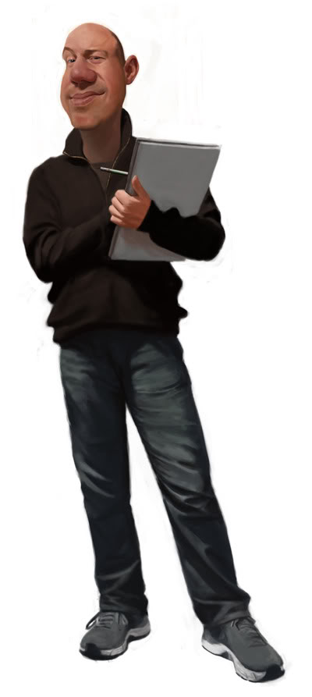
“为什么路加在《使徒行传》
9:7节说， “同行的人站在那里，说不出话来，听见声音，却看不见人。但是在徒22:9节保罗说：“与我同行的人看见那光，却没有听明那位对我说话的声音。”？
“Why did Luke say in Acts 9:7, “The men who were traveling with Saul had stopped,
not saying a word; they HEARD the voice but COULD NOT SEE ANYONE”,
but in Acts 22:9 quoted Paul as saying, “The men with me SAW the light,
but DID NOT HEAR the voice of the one speaking to me”?

Slide 31
使徒行传 9:7,
“The men who were traveling with
Saul had stopped, not saying a word; they HEARD the voice
but COULD NOT SEE ANYONE”,
使徒行传 22:9
“The men with me SAW the light,
but DID NOT HEAR the voice
of the one speaking to me”?
The Greek word:
ἀκούω (akouō)
Can mean…
TO HEAR A NOISE AUDIBLY
Or it can mean…
TO UNDERSTAND WHAT IS BEING SAID
depending on the context of the situation.
只听到一个说话声音
明白那个声音说了什么

Slide 32
一个稍难的问题
a deeper question

Slide 33
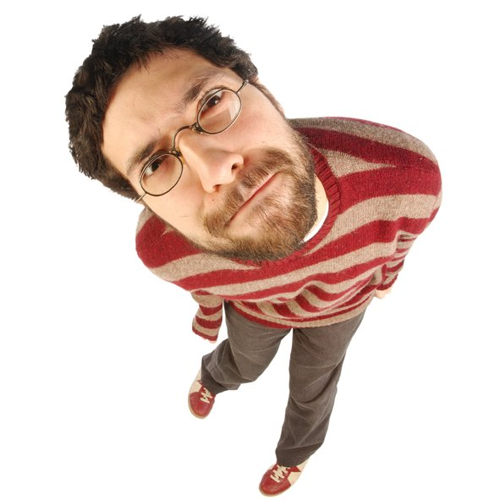
为什么约翰福音6:44节说“若不是差我来的父吸引人，就没有人到我这里来…”?
这句话的意思是不是神“召唤”或“追求”我们到祂跟前来？
What does John 6:44 mean when it says, “No man can come to me, except the Father which hath sent me draw him…”? Does this simply mean God ‘calls’ us or ‘woos’ us to come to Him?

Slide 34
John 6:44 “No man can come to me, except the Father which hath sent me draw him…”
James 2:6 when the rich “drag” the poor into court.
John 18:10 when Peter “drew” his sword out of it’s sheath.
John 21:11 when Peter “pulled” or “drew” the net into the boat.
Acts 16:19 Paul and Silas were grabbed and “dragged” into the marketplace, against their will.
Acts 21:30, where Paul’s friends rescued him by ‘dragging’ him inside and closing the door.
The Greek word for “draw” is (ἕλκω) helkō.
It means “to drag off”.
The Greeks used this term to “draw” or “pull” water from a well. We don’t coax the water. We pull it out.
Derived from the word airō which means: 1) to take for oneself,
to prefer, choose, and 2) to choose by vote, elect to office.
The One drawing does so because He wants to and chooses to.

Slide 35
约 6:44 “若不是差我来的父吸引人，… ”
雅2:6 有钱人将穷人“拽”到法庭去。
约 18:10 彼得从剑鞘里“拔”出刀。
约21:11 彼得将渔网“拖进”船里。
徒16:9 保罗和西拉被暴民揪住，并“拉到”市场上去见官。
徒 21:30, 这里圣殿的百姓，拿住保罗，将他“拉出”圣殿，准备杀他。.
吸引:救恩就是神不断追求吸引我们，直到我们最终俯首称臣吗？
希腊词语的“吸引”是 (ἕλκω) helkō.
意思是“拽出”
希腊人用这个词“吸引”来指从井里打水上来。我们不会去吸引水，我们将水从井里拽出来。
x
这个词是从词根 airō 而来，意思为：1) 拿给自己,
更喜欢,选择。 2) 通过投票选择，当选某个职位。
天父将我们“拉出来”是因为祂愿意或者选择这么做，祂在救恩上有绝对的主权。

Slide 37
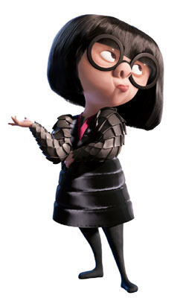
为何太5:48告诉我们“要完全就像我们的天父完全一样.”？
是否意味着我只有完全了才能进天堂？
Why does Matthew 5:48 tell us to “be perfect as our Father in heaven is perfect”?
Do I have to be perfect to get to heaven?

Slide 38
“你们要完全，像你们的天父完全一样。”太5:48 “Be perfect, therefore, as your heavenly Father is perfect.” Matthew 5:48
希腊词是 Teleio，意思是…The Greek word is: Teleios which means…
1) 使之达到终端，完成 (brought to its end, finished)
2) 不缺少达到完整必需的任何东西(lacking nothing necessary to completeness)
3) 完全成长,成年, 足龄, 成熟。 (full grown, adult, of full age, mature)
上下文是… …The CONTEXT is…
登山宝训=我们的爱必需超过法利赛人的爱
Sermon on the Mount = Our love must surpass that of the Pharisees
林前13:10: 等那完全的来到，这有限的必归于无有了。 TeLeios指的是圣经的整全性。
1 Cor. 13:10: teleios refers to the completion of Scripture
雅各书3:2: 完全人能控制他的舌头
James 3:2: the PERFECT man controls his tongue

Slide 39
几个简短的问题… A few short questions…

Slide 40
什么是“肉体的情欲，眼目的情欲和今生的骄傲”？
What is the ‘lust of the flesh, lust of the eyes and the pride of life’?
“凡世界上的事，就像肉体的情欲，眼目的情欲，并今生的骄傲都不是从父来的，乃是从世界来的。”
约一2:16
“For all that is in the world, the lust of the flesh, and the lust of the eyes, and the pride of life, is not of the Father, but is of the world.” 1 John 2:16

Slide 41
“凡世界上的事…..”
搞明白“世界”
这“世界” Kosmos在新约圣经中的三层意思：
物质的全地或宇宙。“世界也是籍着祂造的”。
居住在世上的人。“神爱世人”。
世界这一由撒旦管辖的价值观和思想体系，制度和秩序，包括受幽暗权势左右和操纵的各种物质、利益、财富、色情、宴乐、道德、知识、宗教等。“全世界都卧在那恶者的手下”，“这世界的王”。
耶稣基督说我们“不属于世界”。我们虽然生活于世界，但是我们不属于这世界。前者是指这个物质的全地和宇宙，后者指这个世界的思想和价值秩序。

Slide 42
肉体的情欲Lust of the FLESH (Epithymia sarx)
Body craving, longing, desire for what is forbidden, animalistic lust of our body;
眼目的情欲 LUST OF THE EYES (Epithymia ophthalmos)
视觉上渴求禁止的；肉眼和心眼都同时渴望。
今生的骄傲 PRIDE OF LIFE (alazoneia bios)
自信；信靠地上的事物，比如财富、权利、 知识、 力量和寿命。
肉体渴求，贪恋，渴慕圣经禁止的，肉体上动物性的欲望。
Visually desiring the forbidden; what we crave with our eyes AND our mind’s eye.
self-assurance; trust in earthly things like our own wealth, power, strength, length of life.

Slide 43
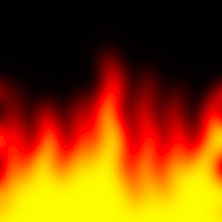
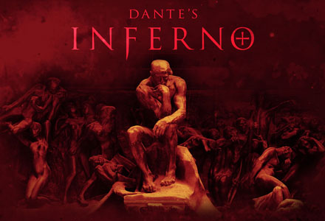
地狱分层次吗？
Are there levels of Hell?
地狱分层次的看法来自…
但丁的《神曲》
The idea of levels in Hell comes from…

Slide 44
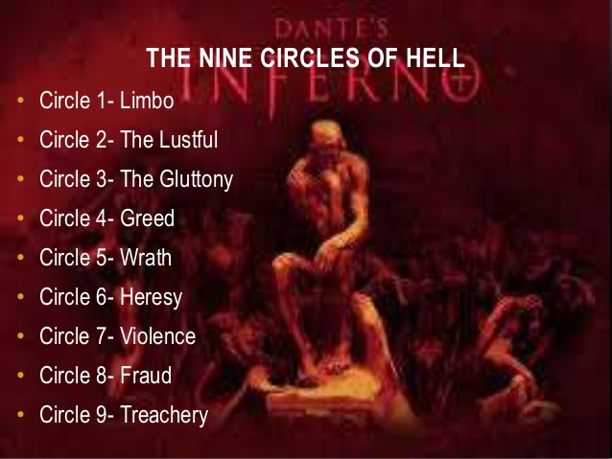
《神曲》地狱篇描写的九层地狱
第一层：边界
第二层：色欲
第三层：饕餮
第四层：贪婪
第五层：愤怒
第六层：异端
第七层：强暴
第八层：欺诈
第九层：背叛
The idea of levels in Hell comes from…

Slide 45
认为地狱的审判分层次的看法最初来自意大利诗人但丁1321年的著作《神曲》。在此书里，罗马诗人维吉尔带领但丁寻找他那被撒旦掳去的，失落的爱人。他们穿越九层地狱，根据邪恶程度不断加深，直到撒旦被捆绑的地球中心。在这里，每个罪人因着他所犯的主要罪孽而永受折磨。根据但丁的描写，地狱层次从第一层开始，这里住着一些未受洗却德行高尚的异教徒，直到地狱的中心，专为那些犯了致命大罪——背叛离弃神的人而存留。 The idea of levels of punishment in hell derives primarily from the Divine Comedy written by Dante Alighieri in 1321. In it, the Roman poet Virgil guides Dante to find his lost love, kidnapped by Satan, through the 9 circles of hell which increase in wickedness, and culminate at the center of the earth, where Satan is bound. Each sinner is afflicted for all of eternity by the chief sin he committed. According to Dante, the circles range from the first circle, where dwell the unbaptized yet virtuous pagans, to the very center of hell reserved for those who have committed the ultimate sin—treachery against God.

Slide 46
圣经没有明确提到地狱有层次， 但可能在以下地方暗示了审判的层次… But Scripture might possibly also allude to degrees of punishment in…
启20:12-13,我又看见死了的人，无论大小，都站在宝座前。案卷
展开了，并且另有一卷展开，就是生命册。死了的人都凭着这些
案卷所记载的，照他们所行的受审判。于是海交出其中的死人；
死亡和阴间也交出其中的死人；他们都照各人所行的受审判。
Rev. 20:12-13, “And I saw the dead, great and small, standing before the throne, and books were opened. Another book was opened, which is the book of life. The dead were judged according to what they had done as recorded in the books. The sea gave up the dead that were in it, and death and Hades gave up the dead that were in them, and each person was judged according to what he had done. “
太11:24, “但我告诉你们，当审判的日子，所多玛所受的，比你 还容易受呢！”
Matthew 11:24, “But I tell you that it will be more bearable for Sodom on the day of judgment than for you."
太23: 14, “你们这假冒为善的文士和法利赛人有祸了！因为你们侵吞寡妇的家产，假意作很长的祷告，所以要受更重的刑罚。”
Matthew 23:14, "Woe unto you, scribes and Pharisees, hypocrites! for ye devour widows' houses, and for a pretence make long prayer: therefore ye shall receive the greater damnation,"

Slide 47
疑难问题的诚实答案

Slide 48
谢谢
奉献支持
1. 请在祷告中记念我们
我们相信上帝会回应祂孩子们的祈祷。我们祷告不是要神照我们的旨意行，乃是我们要照祂的旨意行。请继续以感恩的心祈求神满足我们在智慧、方向、安全和财务上的需要。
2. 请考虑给予事工财政支援
提供给中国基督徒的任何培训我们都不收费。所有的费用，包括课程开发，旅途费用都仰赖于忠心慷慨的支持者帮助支付。
如果您希望奉献，请扫上面的二维码。
愿主恩待您！
THANK YOU

