Slide 1
HONEST ANSWERS to
TOUGH QUESTIONS
Part 3

Slide 2

疑难问题的诚实答案
3

Slide 3

下一个问题
Next question…

Slide 4
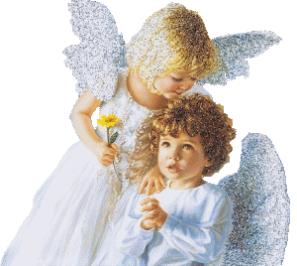
关于天使有哪些误区?
What are some common misconceptions about ANGELS?

Slide 5
“天使是肥嘟嘟的小孩子”(总是成人) “Angels are chubby children” (always adult)
“天使有男有女”（总是男性）“Angels are both male and female” (always male)
“天使无性别”(总是被指为 ‘他’) “Angels are sexless” (always referred to as ‘he’)

Slide 6
“天使是得救的存在体” (对救恩好奇)
“Angels are saved beings” (curious about salvation)
“天使都是懦弱无用的人”(勇士) “Angels are effeminate wimps” (warriors)
“天使有翅膀”（只有基路伯和萨拉弗才有翅膀） “Angels have wings” (only Cherubim & Seraphim)

Slide 7
“人死后就变成天使”(非同族类)
“Dead people become angels when they die” (separate race)
“天使向牧羊人唱歌” (高喊)
“Angels sang to the shepherds” (shouted)
“天使同时遍在” (一次只在一处)
“Angels are omnipresent” (one place at a time)

Slide 8

下一个问题
Next question…

Slide 9
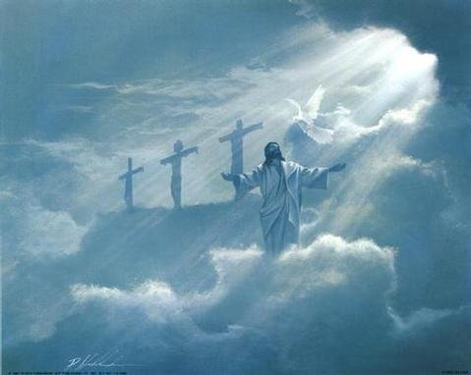
歌罗西书1:15称耶稣为 “首生的”,是否意味着耶稣也是受造的呢？
Colossians 1:15 calls Jesus the “firstborn of all creation”.
Does this mean He was created?
“首生”这个词希腊文是prototokos
The word "firstborn" in the Greek is the word prototokos

Slide 10
“首生”这个词希腊文是 prototokos
The word "firstborn" in the Greek is the word prototokos
不是按时间顺序第一的意思。
it doesn't mean first in chronology
在卓越中的首位(首要的，至高的)
it means first in preeminence (the primary one, the supreme one)
这么翻译可能更合适 “他是那不能看见之神的像,是至高无上的，在一切被造的以先。”
Probably a better way to translate it would be He is the image of the invisible God and the supreme one of all creation.
举例: “我在我们班以第一名毕业。”
Example: “I graduated FIRST in my class”

Slide 11

下一个问题

Slide 12

圣经中对UFO怎么说的？
外星人呢？其它星球生命呢？
What does the Bible say about UFOs? Aliens? Life on other planets?

Slide 13
没有！
: NOTHING!

Slide 14
我的观点是什么？
What’s my opinion?

Slide 15
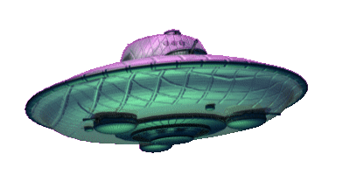
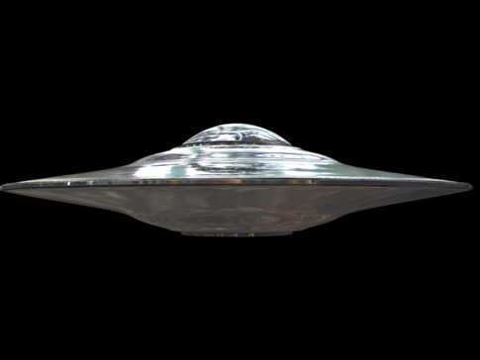
UFO的意思就是身份未明的飞行物。
如果我能分辨它们，那就不是身份未明的
飞行物了。你说呢？
UFO simply means UNIDENTIFIED flying object. If I could identify it, it wouldn’t be an unidentified flying object anymore, now would it?

Slide 16

在我们地球上，空中无数鬼魔所行之事远超我们能意识到的。 这或许也是他们的诡计，为要迷惑和误导人们…
There are countless demonic forces doing far more than we will ever realize during our time here on earth. Perhaps this is part of their plan to confuse and misdirect people…

Slide 17
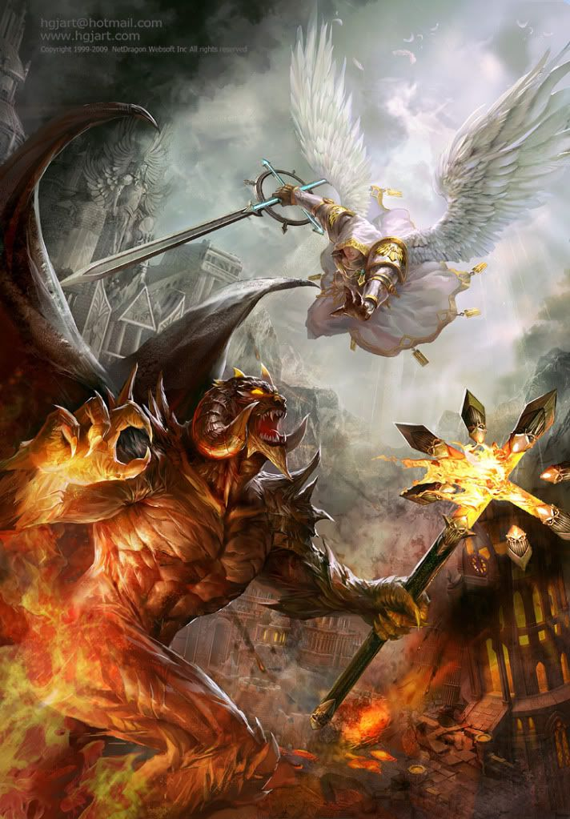
因我们并不是与属血气的争战，乃是与那些执政的、掌权的、管辖这幽暗世界的，以及天空属灵气的恶魔争战。
以弗所书6:12
There are countless demonic forces doing far more than we will ever realize during our time here on earth. Perhaps this is part of their plan to confuse and misdirect people…

Slide 18

下一个问题
Next question…

Slide 19
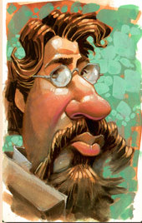
为何希伯来书12:14说 “非圣洁没有人能见主”？那么我必须多圣洁才能去天堂呢？
Why does Heb. 12:14 say that “without holiness, no man shall see the Lord”? So how holy do I have to be to get to heaven?

Slide 20

大部分人说 “当父神透过耶稣看我们时，我们完全圣洁！”
Most say, “We are completely HOLY when
God the Father sees us through Jesus!”
尽管这个说法是对的，但是在此却与上下文不合…
Although the statement is true, it doesn’t fit
the context of the passage…

Slide 21
The author of Hebrews, speaking at this point to the Christian Jews, was encouraging them to do several things to show publically they were different.
* Run a good race without loosing heart…
* Fix your eyes on Jesus who endured the cross…
* You still haven’t suffered to the point of death yet…
* Accept God’s discipline as from a loving Father…
* Strengthen yourselves; make level paths for your feet…
希伯来书的作者在这里是对犹太基督徒说话，鼓励他们在好几方面公开显示自己的与众不同。
  在完成赛程时不要丧气…
  定睛于忍受十架苦难的耶稣
  你们还没有受苦到死的程度…
  接受神慈父般的管教…
  坚固你自己；为自己的脚，把道路修直.

Slide 22
* “你们要追求与众人和睦， 并要追求圣洁，若非圣洁， 没有人（那些在观察你的人）能见主（透过你的行为看到主）。
*恐怕有人失了神的恩…”
MAKE EVERY EFFORT TO LIVE AT PEACE WITH ALL MEN AND
BE HOLY, FOR WITHOUT HOLINESS, NO MAN (those who are watching you) WILL SEE THE LORD (in your actions).
SEE THAT NO ONE MISSES THE GRACE OF GOD…”

Slide 23

下一个问题

Slide 24
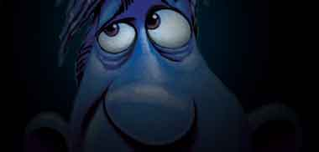
有人祷告求神“捆绑撒旦”
是什么意思？
What do people mean when they ask God to ‘bind Satan’?

Slide 25
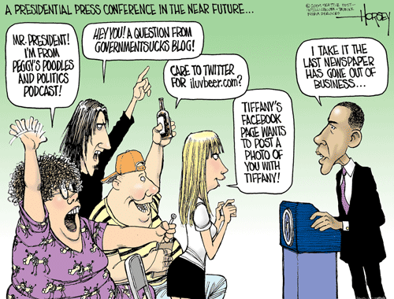
How long does Satan stay bound for?
Do you take turns binding him to keep him bound longer?
撒旦能被捆绑多久？你们是轮流捆绑他，这样他被俘的时间就长点吗？
How could he attack you anyway if someone else had him bound?
若其他人已经把他捆绑了， 他如何还能攻击你呢？
我奉耶稣的名捆绑你的提问！
I bind your questions in the Name of Jesus!
若撒旦不是无所不在的，他如何听到你要捆绑他呢？
How does Satan hear you bind him if he’s not omnipresent?
Wouldn’t he come back mad once he got free?
他被释放后会不会发怒呀？

Slide 26
撒旦唯一被捆绑会发生在千禧年间。 并且需要一个大能的天使才能捆绑他。
  The only time Satan will be bound is during the 1,000 Millennium.
  It will take a strong angel to do that.
“他捉住那龙，就是古蛇，又叫魔鬼，也叫撒旦，把它捆绑一千年，扔在无底坑里，将无底坑关闭，用印封上，使它不得再迷惑列国。等到哪一千年完了，以后必须暂时释放它。” （启示录20:2-3）
  "He seized the dragon, that ancient serpent, who is the devil, or Satan, and bound him for a thousand years. He threw him into the Abyss, and locked and sealed it over him, to keep him from deceiving the nations anymore until the thousand years were ended. After that, he must be set free for a short time." [Revelation 20:2-3]

Slide 27
犹大在他的书信里警告，末世时，假教师会出现并声称他们（和我们）有胜过魔鬼的能力…
  Jude warned in his epistle that in the end times, false teachers would come, teaching that they (and we) have power over demonic forces…
  “这些作梦的人也像他们污秽身体，轻慢主治的，毁谤在尊位的。天使长米迦勒为摩西的尸首与魔鬼争辩的时候，尚且不敢用毁谤的话罪责他，只说: ‘主责备你吧!’ 但这些人毁谤他们所不知道的。他们本性所知道的事与那没有灵性的畜类一样，在这事上竟败坏了自己。他们有祸了！”（犹8-10）
  “ In the very same way, these dreamers pollute their own bodies, reject authority and slander celestial beings. But even the archangel Michael, when he was disputing with the devil about the body of Moses, did not dare to bring a slanderous accusation against him, but said, "The Lord rebuke you!" Yet these men speak abusively against whatever they do not understand; and what things they do understand by instinct, like unreasoning animals —these are the very things that destroy them. WOE TO THEM!“ (Jude 8-10)

Slide 28

下一个问题

Slide 29
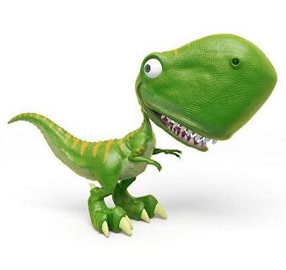
圣经关于恐龙是怎么说的？圣经中提到了恐龙吗？
What does the Bible say about dinosaurs? Are there dinosaurs in the Bible?

Slide 30
有三种恐龙在圣经中被提到
There are 3 dinosaurs mentioned in Scripture
海中怪兽: Leviathan
约伯记41章描述了这蛇颈龙/ 龙般的怪兽
最强大的猛兽 (只有神能驯服)
Job 41 describes a Plesiosaur type / dragon
The greatest monster (only tamed by God)

Slide 31
约伯记41章中的海中怪兽(龙)
Leviathan (the Dragon) in Job 41
不能被抓，被射，被刺。
不能抓来当宠物。
不能被买卖。
看见它就令人丧胆。
无人够凶猛敢惹它。
它体力巨大又形状优美。
不能被人剥皮。
不能被控制。
它有可怕的牙齿。
它的鳞甲紧密闭合。
它喷火；甚至在水下也能。
它的颈和胸如石头般坚硬。
最勇敢的人都害怕它。
它卷起金属如烂木。
它毫无惧怕。
Cannot be caught, shot, or pierced.
Cannot be made into a pet.
Cannot be bought or sold.
The sight of him is overpowering.
No one is fierce enough to wake him.
He has strength and graceful form.
He cannot be skinned.
He cannot be bridled.
He has frightening teeth.
His scaled are tightly knit.
He breathes fire; even under water.
His neck and chest are hard like rock.
The bravest men are terrified of him.
He bends metal like rotten wood.
He is afraid of nothing.

Slide 32
有三种恐龙在圣经中被提到
There are 3 dinosaurs mentioned in Scripture
巨兽: Behemoth
约伯记40:15描述的腕龙
与河马或大象差异甚大
Job 40 :15 describes a Brachiosaurus
Much different than a hippo or elephant

Slide 33

约伯记41中的巨兽（恐龙）
Behemoth (the Dinosaur) in Job 41
像牛那样吃草。
强壮的肚腹和腰。
尾巴如同香柏树。
大腿强壮。
骨头和四肢如同金属般坚固。
只有神能驯服它。
其它动物在它周围玩耍而不恐惧。
生活在水或沼泽里。
湍急的河流也不能撼动它。
无人能捕获它。
Eats grass like an ox
Strong stomach and loins
A tail like a cedar tree
Powerful thighs
Bones and limbs like metal
Only God can tame him
Animals play near him without fear
Dwells in the water /marshes
Raging rivers cannot move him
No one can capture him

Slide 34
有三种恐龙在圣经中被提到
There are 3 dinosaurs mentioned in Scripture
巨龙: Tanniyn
海/陆怪兽; “古蛇”; “龙”
提到了30次
“Sea/land monster”; “Serpent”; “DRAGON”
Mentioned almost 30 times

Slide 35
几乎地球上每种文化里都可找到恐龙的绘画,岩画,手工制品,小雕像,石刻以及恐龙的传说(腕龙,翼龙, 暴龙)。这些东西远在第一个恐龙化石被发现之前就有了。马可波罗还声称看见过它们。
Nearly every culture on earth has drawings, petroglyphics, artifacts, figurines, rock carvings and legends of dinosaurs (Brachiosaurus, Pterodactyls, Tyrannosaurus) from long before the first fossil was discovered. Marco Polo spoke of seeing them.
很多诗歌, 罗马马赛克, 巴比伦城墙上都描绘了人与恐龙(甚至有人骑恐龙)共存的事实。中国人的一些绘画和传说中则有皇帝乘坐由恐龙拉动战车的内容。
Mayan pottery, Roman mosaics, and Babylonian city walls depict coexistence between man and dinosaur (even men riding dinosaurs) while the Chinese have drawing and legends of emperors having their chariots / carts drawn by dragons.

Slide 36
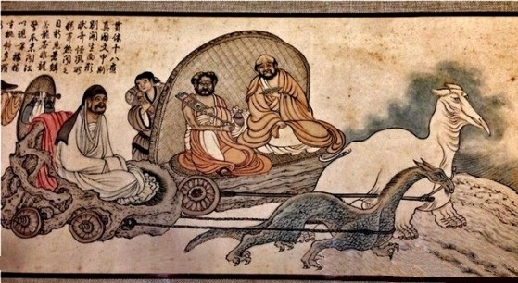

Slide 37
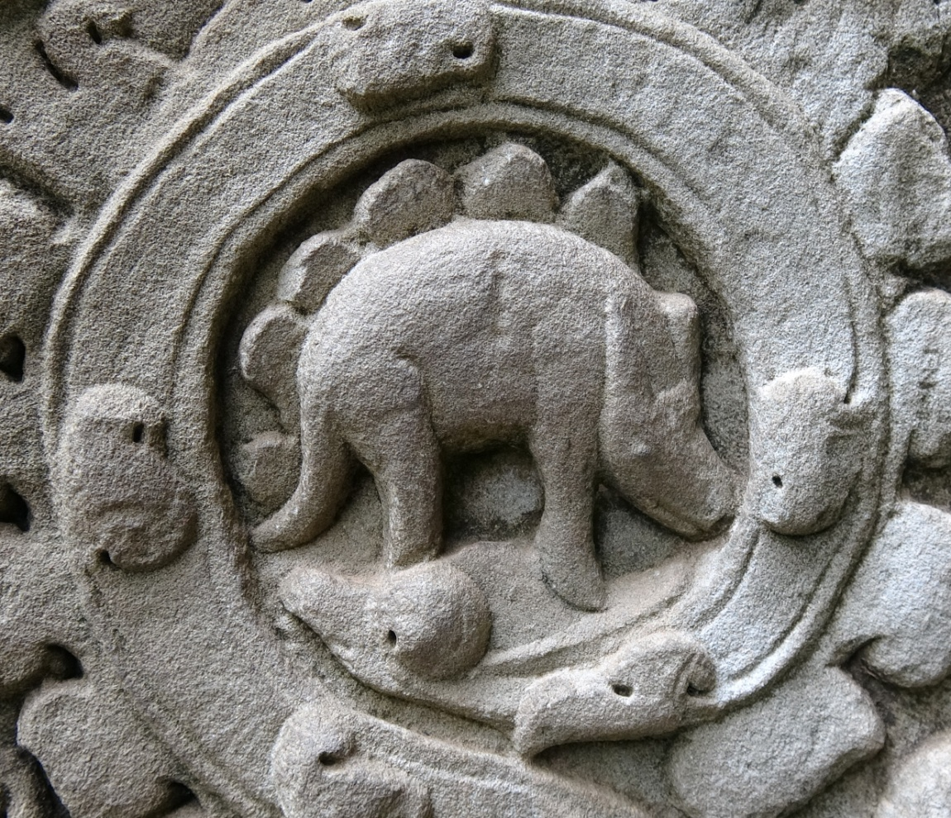
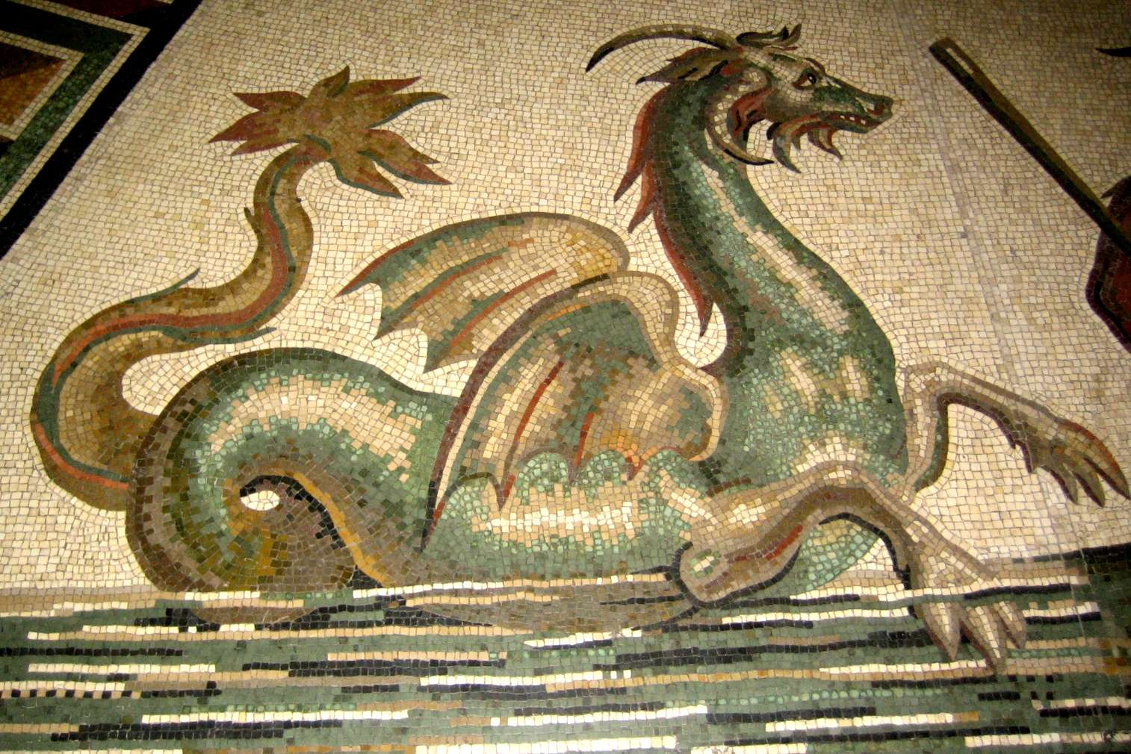

Slide 38
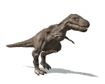
在美国德州和中西亚地区找到的恐龙化石上有人和恐龙一起行走的脚印。
Fossilized footprints of man and dinosaur walking together have been found in Texas, and West-Central Asia.
创造论的研究者显示如果每种恐龙的幼龙与地球上其它陆地动物都放在诺亚方舟里，方舟还会有三分之一的空间放粮草。
Creation researchers have shown that if babies of every dinosaur were
placed on the ark alongside every other land animal, there would
still be 1/3 of the ark left empty for provisions.

Slide 39
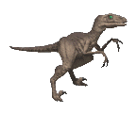

它们现在哪里去了？: So where are they now?
我认为绝大多数死于大洪水. 还有一些在着陆于亚拉腊山后，很快被冻死了。那些生存下来的则往南进入约旦河和地中海流域(在这里约伯记提到的). 这只是我个人观点。
I THINK…most died in the flood. Many died immediately following in the frozen
tops of the Ararat Mountains. Those who survived headed south into the Jordon /
Mediterranean Valley (where they are mentioned by Job). But that’s only my opinion.
据报道四十年前还有人看到腕龙的存在(甚至很多人死于吃恐龙肉中毒.) 很多湖泊里出现了符合蛇颈龙描述的动物（尼斯湖怪）.
People have reported seeing the Brachiosaurus as recently as
40 years ago (when many died from eating it.) Many lakes have
creatures that fit the description of Plesiosaur (Nessie in Loch Ness)

Slide 40
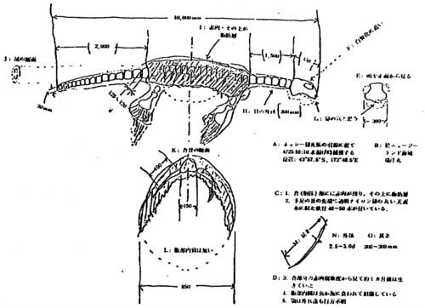
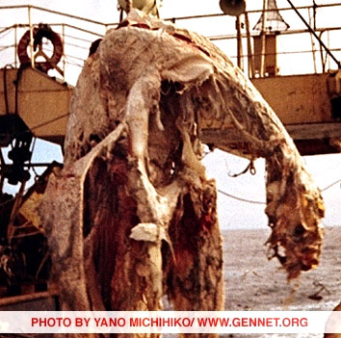
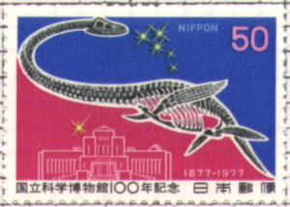
1977年, 一艘日本渔船捕到了一具很多人相信是恐龙的骨骼. 日本人还专门发行邮票纪念这一发现。
In 1977, a Japanese fishing boat pulled in the carcass of what many think was a Plesiosaur. A Japanese stamp commemorates the find.
photographs taken by Michihiko Yano aboard the Zuiyo-maru on April 25, 1977.

Slide 41
疑难问题的诚实答案

Slide 42

谢谢
奉献支持
1. 请在祷告中记念我们
我们相信上帝会回应祂孩子们的祈祷。我们祷告不是要神照我们的旨意行，乃是我们要照祂的旨意行。请继续以感恩的心祈求神满足我们在智慧、方向、安全和财务上的需要。
2. 请考虑给予事工财政支援
提供给中国基督徒的任何培训我们都不收费。所有的费用，包括课程开发，旅途费用都仰赖于忠心慷慨的支持者帮助支付。
如果您希望奉献，请扫上面的二维码。
愿主恩待您！
THANK YOU

