Slide 1
HONEST ANSWERS to TOUGH QUESTIONS Part 2

Slide 2
疑难问题的诚实答案
2

Slide 3
下一个问题… Next question…

Slide 4
圣经如何看待不同人种和不同信仰的通婚？
What does the Bible say about interracial or interfaith marriages?
旧约中的犹太人不准与非犹人种通婚，以避免引入异教。(申7:3-4 )
Old Testament Jews were not to intermarry with non-Jews in order to avoid being led into false religions (Deuteronomy 7:3–4 (NIV) Do not intermarry with them. Do not give your daughters to their sons or take their daughters for your sons, for they will turn your sons away from following me to serve other gods, and the Lord’s anger will burn against you and will quickly destroy you.”)
2) 基督徒 决不嫁娶非基督徒。(林后6:14)
Christians are NEVER to marry non-Christians (2 Cor. 6:14 (NIV) Do not be yoked together with unbelievers. For what do righteousness and wickedness have in common? Or what fellowship can light have with darkness? ”)

Slide 5
下一个问题… Next question…

Slide 6
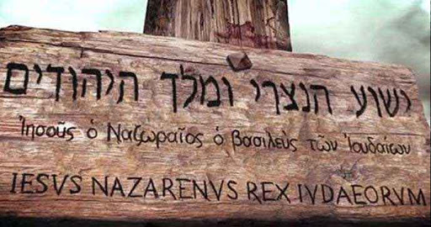
为何福音书的作者记录耶稣头上木牌的内容有所不同？
Why do the Gospel authors differ on what the sign above Jesus said?

Slide 7
为何福音书的作者记录耶稣头上木牌的内容有所不同？
Why do the Gospel authors differ on what the sign above Jesus said?
约19:19 Jn 19:19
犹太人的王， 拿撒勒人耶稣。
JESUS OF NAZARETH,THE KING OF THE JEWS
作为他的历史叙述的一部分，约翰给出了完整的描述。
John gives the complete rendering as part of his historical account.
Jesus Nazarenus Rex Judaeorum
I N R I

Slide 8
为何福音书的作者记录耶稣头上木牌的内容有所不同？
Why do the Gospel authors differ on what the sign above Jesus said?
太27:37 Matt 27:37
这是犹太人的王耶稣。
‘THIS IS JESUS, THE KING OF THE JEWS.’”
马太福音是写给犹太人的，因此强调耶稣是他们的王。他避免提及拿撒勒，以免冒犯一些人。
Matthew’s Gospel is written to the Jews. He reminds them that Jesus is their King. Mentioning Nazareth would hae been offensive to some.
Jesus Nazarenus Rex Judaeorum
I N R I

Slide 9
为何福音书的作者记录耶稣头上木牌的内容有所不同？
Why do the Gospel authors differ on what the sign above Jesus said?
路23:38 Lk 23:38
这是犹太人的王.
‘THIS IS THE KING OF THE JEWS.’”
作为历史学家，路加指出了耶稣被指控的具体罪行。
Luke, the historian, was addressing the specific crime Jesus was charged with.
Jesus Nazarenus Rex Judaeorum
I N R I

Slide 10
下一个问题… Next question…

Slide 11
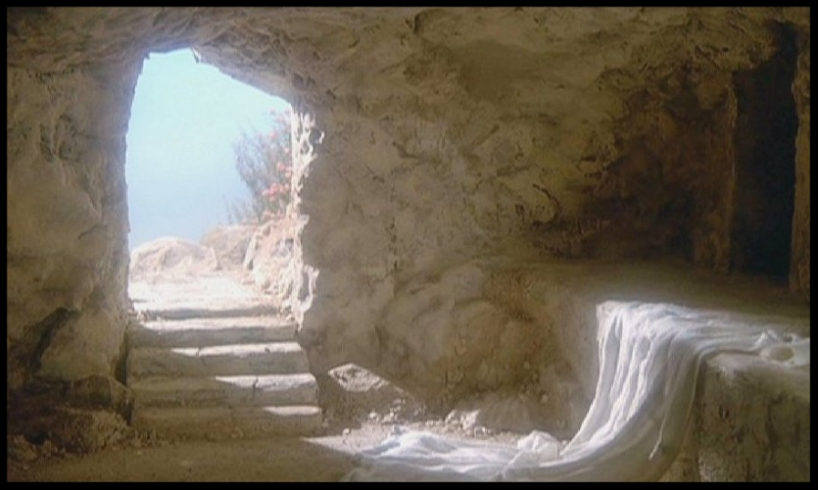
“若耶稣是在
周五晚上下葬，
周日早上复活的，
那为何耶稣说他在坟墓里呆了
三天三夜”呢？
“If Jesus was laid in the grave on Friday night and rose on Sunday morning, then
why does Jesus say He would be in the grave three days and three nights?”

Slide 12
答案一：希腊文如同英语，使用24小时中的任何一部分为‘一天一夜’。“我工作了一整天，”不意味着你真的工作了二十四小时。
ANSWER 1: The Greek language, much like English, used any part of a 24 hour day as ‘a day and night’.
“I’ve been at work ‘all day’, doesn’t mean you were there for a 24 hour day.
星期五
Friday
星期六
Saturday
星期天
Sunday
“约拿三日三夜在大鱼肚腹中，人子也要这样三日三夜在地里头。（太12:40）
For as Jonas was three days and three night in the whale's belly; so shall the Son of man be three days and three nights in the heart of the earth" (Matthew 12:40).

Slide 13
周五下午六点
6pm Friday
周六
Saturday
周日早上五点
5am Sunday
三天岛屿巡游！
3 DAY cruise to an island!

Slide 14
答案二：耶稣可能是在周四下葬的。
马可福音15说那是‘安息日的前一日（逾越节安息日，而非每周的安息日）’，
而年度逾越节安息日可能落到一周的任何一天。
根据利23:7, 这天是第一个月的十五号，
不管这是一周的哪天。在我们主被钉十架的那年, 逾越节安息日(尼散月15日)是在星期五, 所以每周安息日便是在隔天的星期六.
周四
Thursday
周六
Saturday
周日
Sunday
周五
Friday

Slide 15
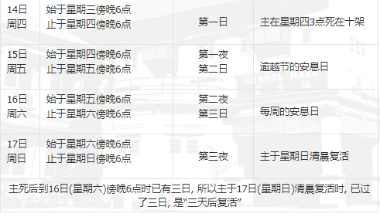
周四
Thursday
周六
Saturday
周日
Sunday
周五
Friday

Slide 16
下一个问题 Next question…

Slide 17
我如何知道自己有什么属灵恩赐？
How can I tell which spiritual gift I have?
属灵恩赐和天赋有什么区别？
What’s the difference between a spiritual gift and a God-given talent?

Slide 18
恩赐GIFT
你喜欢为主做什么？
What do you enjoy doing for the Lord?
你擅长为主做什么？
What are you good at doing for the Lord?
你曾经成功地为主做过什么？
What have you has success at doing for the Lord?
其他人建议你为主做什么？
What do other suggest you
do for the Lord?

Slide 19
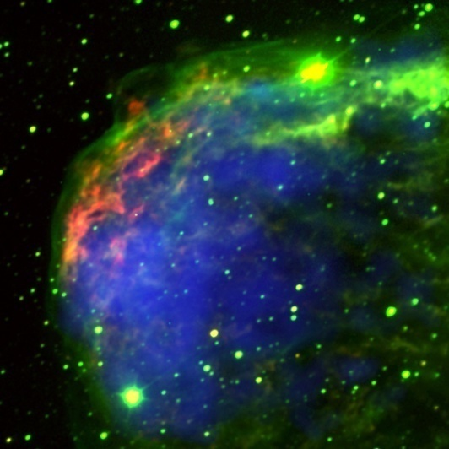
属灵恩赐
Spiritual Gift
天赋
God Given Talent
神给你在教会服事祂的能力
God given ability for serving Him in the church.
神给你在世界服事祂的能力
God given ability for serving Him in this world.

Slide 20
下一个问题

Slide 21
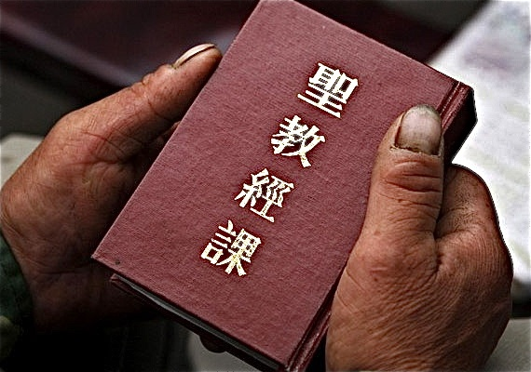
偷运圣经可以吗? 违反法律藏匿基督徒可以吗？
Is it OK to smuggle Bibles, or hide Christians from the government if you have to break laws to do it?

Slide 22
“因此, 你们要去使万民做我的门徒, 奉父、子、圣灵的名给他们施洗. 凡我所 吩咐你们的，都教训他们遵守，我就常与你们同在，直到世界的末了。”太28:19
“Therefore go and make disciples of ALL nations, baptizing them in the name of the Father and of the Son and of the Holy Spirit, and teaching them to obey everything I have commanded you. And surely I am with you always, to the very end of the age.“ Matt. 28:19
彼得和众使徒回答说: “顺从神，不顺从人，是应当的。” 徒5:29
Peter and the other apostles replied: "We must obey God rather than men!” Acts 5:29
遵守一切法律除非它与神更高的法律相冲突。神的法永远超越人间的法。
Obey every law unless it contradicts the higher laws of the Sovereign God whose laws always supersede the laws of mere mortal man.

Slide 23
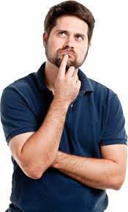
下一个问题 Next question…

Slide 24
自杀的人能去天堂吗？
Can someone who commits suicide go to heaven?
根据耶稣的话, 只有 “亵渎圣灵”
的罪不可饶恕. (可3:29)
According to Jesus the only unforgivable sin is
blasphemy against the Holy Spirit (Mark 3:29)
在马可福音三章的上下文中: “亵渎圣灵”就是 “弃绝耶稣的信息,将耶稣基督的神迹和话语归因于撒旦的作为.”
in context of Mark 3: The ‘blasphemy of the Holy Spirit’ is “the rejection of Jesus’ message by the attributing to Satan the miraculous works and words of Jesus Christ.”

Slide 25
自杀的人能去天堂吗？
Can someone who commits suicide go to heaven?
抑郁症在世界范围内处于历史最高水平。自杀是13-24岁美国人的第二大死因。去年有近五万美国人自杀。
Depression is at an all time high worldwide. Suicide is the #2 cause of death among Americans age 13-24. Nearly 50,000 Americans committed suicide last year.
“我们的国家是世界上自杀率最高的国家之一。”北京卫生局发言人毛羽说。
"Our nation has one of the highest rates of suicide in the world," -Beijing Health Bureau spokesman Mao Yu
在中国每年有二十八万人自杀身亡，一半以上是忧郁症患者。
About 287,000 people kill themselves in China every year.

Slide 26
自杀的人能去天堂吗？
Can someone who commits suicide go to heaven?
根据圣经，无论发生什么，基督徒都拥有永生，这一点毫无疑问 (约一5:13)
任何事都不能把基督徒和神的爱隔离！当然自杀也不能将他们与神的爱隔绝。耶稣为我们的罪而死……如果一个真正的基督徒因受到精神打击导致懦弱而自杀, 耶稣的死也偿还了这个罪。(罗马书8：38-39)

Slide 27
基督徒也不能幸免于抑郁、化学失衡、双相情感障碍或精神健康问题(所有这些都是每年造成自杀的原因)。
Christians are not immune to depression, chemical imbalance, bipolar disorder or mental health problems (all of which account for many suicides yearly).
在过去的两年里，美国有许多著名的牧师或他们的家庭成员自杀。
In the last 2 years, numerous famous pastors or their family members have committed suicide in the U.S.
我们所有的罪都被耶稣的血遮盖了，而不仅仅只是那些我们死前有时间请求宽恕的罪。
ALL of our sins have been covered by the blood of Jesus, not just those we have time to ask forgiveness for before we die.
这不等于说自杀不是违背神的一种严重的罪。
基督徒的生命乃为神而活——什么时候死只有上帝能决定。

Slide 28
疑难问题的诚实答案

Slide 29
谢谢
奉献支持
1. 请在祷告中记念我们
我们相信上帝会回应祂孩子们的祈祷。我们祷告不是要神照我们的旨意行，乃是我们要照祂的旨意行。请继续以感恩的心祈求神满足我们在智慧、方向、安全和财务上的需要。
2. 请考虑给予事工财政支援
提供给中国基督徒的任何培训我们都不收费。所有的费用，包括课程开发，旅途费用都仰赖于忠心慷慨的支持者帮助支付。
如果您希望奉献，请扫上面的二维码。
愿主恩待您！
THANK YOU

