Slide 1
HONEST ANSWERS to TOUGH QUESTIONS Part 5

Slide 2
疑难问题的诚实答案
5

Slide 4
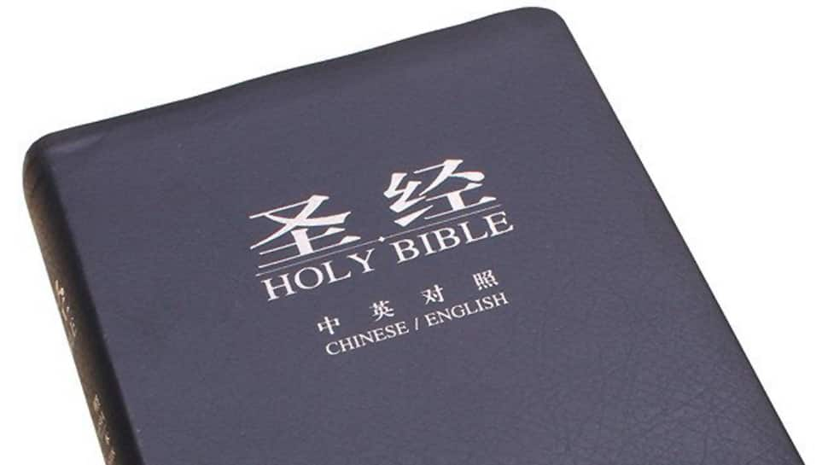
基督徒会失去救恩吗？
Is it possible for Christians to lose their salvation?
不会
NO

Slide 5
基督徒是否会失去救恩吗？
=基督会失去基督徒吗？
Is it possible for Christ to lose Christians?

Slide 6
约5:24
John 5:24
我们已经出死入生了。
罗:8
Rom. 8
没有人能使我们与神的爱隔绝。
犹大书24
Jude 24
神通过恩典保守我们无暇无疵。
We have passed from death unto life
Nothing can separate us from God’s love
God makes us blameless through grace

Slide 7
约一2:19
1 John 2:19
那离开的从未得救。
诗篇51
Psalm 51
生命中的罪能偷走我们的确据。
弗1:14
Eph. 1:14
圣灵给我们盖上印记直到被赎的日子。
Those who leave were never saved
Sin in our life can steal our assurance
The Spirit seals us until the day of redemption

Slide 8
弗1:4
Eph. 1:4
创世之前我们就已蒙拣选。
弗2:8-9
Eph. 2:8-9
就是我们的信心也是神的礼物。
约3:16
John 3:16
永生就是“永生”。
We were chosen before Creation
Even our faith is a gift from God
Eternal life means ETERNAL life

Slide 10
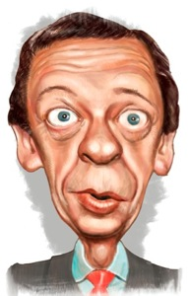
基督徒会被鬼附吗？
Can a Christian
be demon possessed?

Slide 11
圣经并没有明确说明基督徒是否会被鬼附。
The Bible does not explicitly state whether a Christian can be possessed by a demon.

Slide 12
有人说既然基督徒有圣灵内住，
似乎不可能圣灵会允许邪灵附身
在他内住的这人身上。然而，
圣灵无处不在，
所以凡邪灵居住的地方，
圣灵也在。
Some would say that since a Christian is indwelt by the Holy Spirit it would seem unlikely that the Holy Spirit would allow a demon to possess the same person He is indwelling. BUT…The Holy Spirit is EVERYWHERE and therefore indwells
EVERYWHERE demons dwell.

Slide 13
注意到在新约所有关于属灵争战的经文里，从未告诉我们要给信徒赶鬼。信徒被告知要抵抗魔鬼但没有告知要赶鬼出来。
Notice that in all the N.T. passages dealing with spiritual warfare,
we are never told to cast a demon out of a believer. Believers are
told to resist the devil never instructed to cast him out.

Slide 14
有人相信基督徒可能被鬼压迫，但不会被附身。区别是….
Some believe Christians can be oppressed, but not possessed. The difference is…
邪灵附身包括鬼魔对某人的思想/行为有直接的控制. (路4:33-35;8:27-33;太17:14-18)
Demon possession involves a demon having direct control over the thoughts and/or actions of a person(Luke 4:33-35; 8:27-33; Matt. 17:14-18).
邪灵压迫或影响包括一个或多个鬼魔在属灵上攻击一个人，怂恿他或她做出罪恶的行为。(彼前5:8-9;雅4:7)
Demon oppression or influence involves a demon or demons attacking a person spiritually and/or encouraging him/her into sinful behavior(1 Pe 5:8-9; Ja 4:7).

Slide 15
现在问题变成:一个基督徒是否可能让自己的意念和行为被鬼控制呢？
The question becomes: Is it possible for a Christian to yield control of
his thoughts or actions to a demon?

Slide 17
为什么基督徒受吩咐要
“试验自己是否得救”？
Why are Christians told to “test themselves to see if they are saved”?

Slide 18
经文的上下文: CONTEXT of the VERSE
“你们总要自己省察有信心没有，也要自己试验.岂不知你们若不是可弃绝的，就有耶稣基督在你们心里吗？”
“Examine yourselves to see whether you are in the faith; test yourselves. Don’t you realize that Christ Jesus is in you— unless, of course, you fail the test?” (2 Cor. 13:5)

Slide 19
哥林多人要求保罗证明他是使徒。他勉为其难地为自己辩护，免得哥林多人与他所传的真理被割断。但在这段话里，他反唇相讥，挑战他们去察验自己。哥林多人不应傲慢愚蠢地挑战保罗与主关系的真实性，而应检视自己得救的真实性。熟悉的新约术语peirazo(测试)和dokimazo(检查)在这里作为同义词使用。它们传达了测试某物以确定其真实性的想法。测试的目的是看哥林多人是否有信心。Pistis(信仰)在这里指的不是信仰的主观因素，而是基督教真理的客观主体——基督教信仰
The Corinthians had demanded proof of Paul’s apostleship. He reluctantly defended himself so the Corinthians would not be cut off from the truth he preached to them. But in this passage, he turned the tables on his accusers and challenged them to test and examine themselves. Instead of arrogantly and foolishly challenging the genuineness of Paul’s relationship to the Lord, the Corinthians needed to examine the genuineness of their own salvation. The familiar New Testament terms peirazo (test) and dokimazo (examine) are used here as synonyms. They convey the idea of putting something to the test to determine its genuineness. The test was to see if the Corinthians were in the faith. Pistis (faith) refers here not to the subjective element of belief but to the objective body of Christian truth —the Christian faith.
.

Slide 20
保罗呼召我们自我察验不是一个新概念。
Paul’s call for self-examination was not a new concept.
约伯向神呼喊: “我的罪孽和罪过有多少呢？
求你叫我知道我的过犯与罪愆.”(伯13:23;cf.31:4-6)
Job cried out to God, “How many are my iniquities and sins?
Make known to me my rebellion and my sin” (Job 13:23; cf. 31:4–6).
在诗篇17:3中大卫: “你已经试验我的心，
你在夜间监察我。你熬炼我，却找不着什么.”
In Psalm 17:3 David declared, “You have tried my heart.…
You have tested me and You find nothing.”
“耶和华啊, 求你察看我，试验我，
熬炼我的肺腑.”诗篇26:2
“Examine me, O Lord, and try me; Test my mind and my heart.” Ps 26:2

Slide 21
“神啊，求你监察我，知道我的心思；试炼我，
知道我的意念。看在我里面有什么恶行没有，
引导我走永生的道路。”(诗篇139:23-24)
“Search me, O God, and know my heart; try me and know myanxious thoughts; and
see if there be any hurtful way in me, and lead me in the everlasting way” (Ps. 139:23–24).
在《耶律米哀歌》3:40中，耶律米劝勉他的以色列同胞: “我们当深深考察自己的行为，再归向耶和华。”
In Lamentations 3:40 Jeremiah exhorted his fellow Israelites,
“Let us examine and probe our ways, and let us return to the Lord,”
描写了自我省察是领主的圣餐的前提。
保罗写道: “人应当自己省察，然后吃这饼，
喝这杯。”(林前11:28)
Describing the self-examination that is a prerequisite for participating in the Lord’s Supper, Paul wrote, “A man must examine himself, and in so doing he is to eat of the bread and drink of the cup (1 Cor. 11:28).

Slide 23
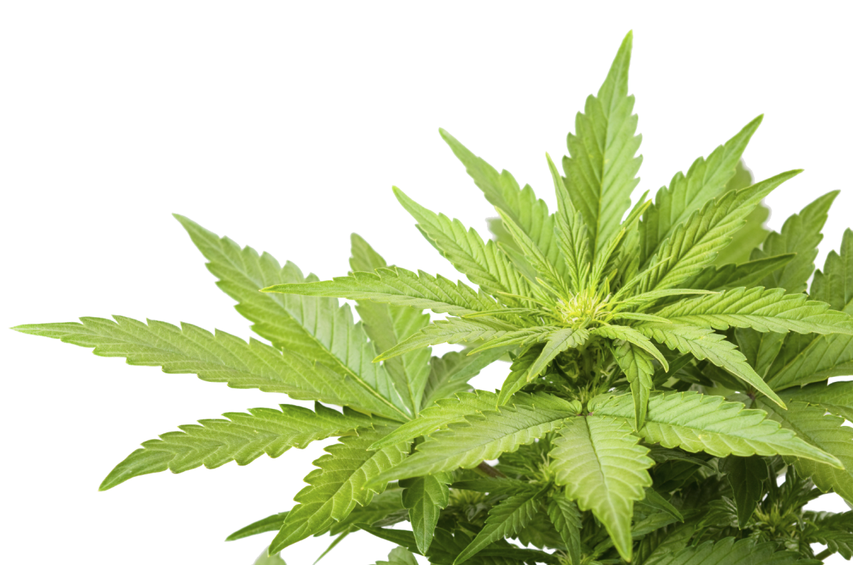
既然所有的植物都是给我们的,只要合适就可以使用,那抽大麻有什么错呢？
How can it be wrong to smoke pot, since God gave us every seed producing
plant to do with as we see fit?

Slide 24
上帝供万物给我们使用，但不是滥用。
God gives us all things to USE, not ABUSE.
举例: 葡萄酒可用来提神，也可以让人喝醉。
Example: Grapes can be used for refreshing drink or to get a person drunk.
加5:20使用了“邪术”或“巫术”这个词。这个词来自希腊文PHARMAKEIA，也就是药剂学一词的来源。这个词与滥用药物有关，通常被巫师使用。下一节说，滥用“药物”的人，必不能承受神的国。
Gal. 5:20 the word "witchcraft" or "sorcery" is used. This is from the Greek work PHARMAKEIA, from which we get our word pharmacy. The word has to do with the abuse of drugs, which was often used by sorcerers.The next verse says that those who abuse pharmakeia will not inherit the kingdom of God.
圣经命令我们遵守人的律法，除非它们直接与神的律法相抵触。
The Bible commands us to obey the laws of man unless they directly contradict a law of God.

Slide 26
忧郁症的核心总归是邪灵在发动吗？ Is depression always demonic at its core?

Slide 27
忧郁症有四种
可能的来源
Depression has 4 possible origins
属灵的
Spiritual
情绪的
Emotional
社交的
Social
身体的
Physical

Slide 28
忧郁症有四种
可能的来源
Depression has 4 possible origins
属灵：对鬼魔影响或 上帝考验的反应
Spiritual: reaction to the influence of demons or the testing of God.
情感：对生活中发生的悲伤或灾难的自然反应。
Emotional: Natural reaction to sad or difficult events that happen in life.
社交：对周围人群影响的自然反应。
Social: Natural reaction to the influence of those around you.
身体：维持情感生活平衡的化学物质失去平衡。
Physical: Imbalance of body chemicals that sustain a balanced emotional life.

Slide 30
彼得前书 3:15-16“只要心里尊主基督为圣。有人问你们心中盼望的缘由，就要常做准备，以温柔、敬畏的心回答各人， 存着无亏的良心，叫你们在何事上被毁谤，就在何事上可以叫那诬赖你们在基督里有好品行的人自觉羞愧。” “But in your hearts set apart Christ as Lord. Always be prepared to give an answer to everyone who asks you to give the reason for the hope that you have. But do this with gentleness and respect, keeping a clear conscience, so that those who speak maliciously against your good behavior in Christ may be ashamed of their slander.” -1st Peter 3:15-16
为什么知道答案那么重要呢？
知识不是会让我们自高自大吗？
Why is it important to even know the answers?
Doesn’t knowledge just make us prideful?

Slide 31
有人认为“只爱耶稣”而不学神学是一种美德。有好几个原因可以解释为什么学习神学（如何回答有关上帝的问题）是信仰生活的重要部分。
Some people act like it is a virtue to “just love Jesus” but not study theology. There are several reasons why study of theology (knowing answers about God) is an essential part of the believer’s life.
圣经吩咐我们要学习神的道。你不可能“爱耶稣”但却忽视祂的教导。
The Bible tells us to study the Word. You cannot “love Jesus” while ignoring His teachings.
我们如果爱一个人，就会愿意去更多认识这人。
When we love someone, we want to know more about them.
作为信徒，我们不希望曲解上帝和祂的道。
As believers, we do not want to misrepresent God or His Word.
我们的意见是无关紧要的，除非它与上帝的意见一致。
Our opinion is irrelevant unless it coincides with God’s opinion.
我们越认识上帝和祂的道，我们就越欣赏祂。
The more we know about God and His Word, the more we can appreciate Him.

Slide 32
提摩太后书 2:14-18 告诉我们通过学习神的话语，我们可以提醒和警告别人有关神的教导，驳倒异端，揭发假师傅等等。但我们这么做是基于真理，而非争论各自意见。
2 Tim. 2:14-18 tells us by studying the Word, we canremind and warn others of God’s teachings, refute heresies, expose false teachers, etc. But we should do so without arguing over opinions.
“¹⁴ 你要向众人提醒这些事，在上帝面前嘱咐他们不可在言词上争辩；这是没有益处的，只能伤害听的人。你当竭力在上帝面前作一个经得起考验、无愧的工人，按着正意讲解真理的话。 要远避世俗的空谈，因为这等空谈会使人进到更不敬虔的地步。 17他们的话如同毒疮越烂越大；其中有许米乃和腓理徒，他们偏离了真理，说复活的事已过去，败坏了好些人的信心。
2 Tim. 2 :14-18 “Keep reminding God’s people of these things. Warn them before God against quarreling about words; it is of no value, and only ruins those who listen. 15 Do your best to present yourself to God as one approved, a worker who does not need to be ashamed and who correctly handles the word of truth. 16 Avoid godless chatter, because those who indulge in it will become more and more ungodly. 17 Their teaching will spread like gangrene. Among them are Hymenaeus and Philetus, 18 who have departed from the truth. They say that the resurrection has already taken place, and they destroy the faith of some.

Slide 34
《圣经》对死刑是怎么说的？不是说 “不能杀人”吗？
What does the Bible say about the death penalty?
What about ‘Thou shalt not kill”?
“不许杀人”？
“Thou shalt not kill”?
希伯来语是 “RATSACH’”意思是:
预谋性杀人，复仇性杀戮.
The Hebrew word is ‘RATSACH’ which means…
premeditated murder… to slay in vengeance…

Slide 35
这不是指：
This does NOT refer to…
死刑: The DEATH PENALTY…
战斗和战争: COMBAT & WAR…
吃肉: EATING ANIMALS…

Slide 36
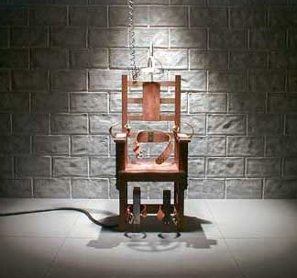
死刑
神命令杀人要
偿命(创9:6)
并在多种犯罪中表明可以使用
死刑
(出21,22; 利20)
The DEATH PENALTY…
God commands that MEN take the life of those who murder (Gen. 9:6)
And gives the death penalty for various crimes (Ex 21, 22; Lev 20)

Slide 37
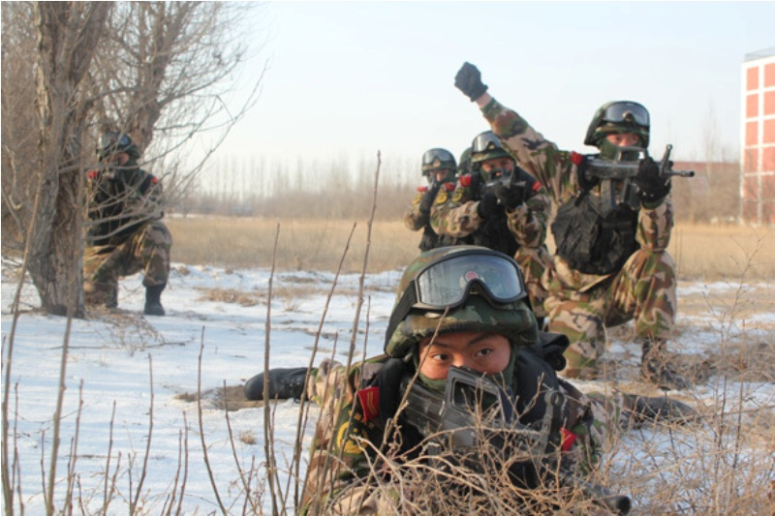
战斗和战争
神预备他的子民打仗并命令他的军队消灭敌人(出13;撒上15:3;书4:13;等等)
基督再来时将会有一场很血腥的战争(启19)
COMBAT & WAR…
God prepared His people for war and commanded His armies to obliterate the enemies (Ex 13; 1 Sam 15:3; Josh 4:13; many more)The Coming of Christ is going to be very bloody (Rev 19)

Slide 38
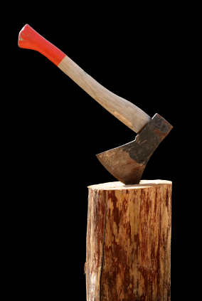
吃肉
神说所有肉都可以带着感恩吃用(帖前5:18) ;
耶稣吃鱼和羊肉(路22-24); 神命令彼得吃各种肉(徒10); 大洪水之后，神告诉挪亚我们可以吃肉了(创9)。
EATING ANIMALS… God said that ALL meat can be eaten with thanksgiving (1 Th 5:18);Jesus ate fish and lamb (Luke 22-24); God commanded Peter to eat all forms of meat (Acts 10); God told Noah we may eat meat (Gen 9)

Slide 39
疑难问题的诚实答案

Slide 40
谢谢
奉献支持
1. 请在祷告中记念我们
我们相信上帝会回应祂孩子们的祈祷。我们祷告不是要神照我们的旨意行，乃是我们要照祂的旨意行。请继续以感恩的心祈求神满足我们在智慧、方向、安全和财务上的需要。
2. 请考虑给予事工财政支援
提供给中国基督徒的任何培训我们都不收费。所有的费用，包括课程开发，旅途费用都仰赖于忠心慷慨的支持者帮助支付。
如果您希望奉献，请扫上面的二维码。
愿主恩待您！
THANK YOU

