Slide 1
HONEST ANSWERS to TOUGH QUESTIONS Part 4

Slide 2
疑难问题的诚实答案
4

Slide 3
徒2章是否证明福音简单到可以
三分钟之内分享完毕。
Does Acts 2 prove the Gospel is so simple it can be shared in 3 minutes?
在他的讲道之前: 听众都是来自世界各地的虔诚的犹太人.
他们熟悉律法。他们也知道神。
他们在等待弥赛亚来应验那些耳熟能详的预言
Prior to his sermon: the listeners were DEVOUT JEWS from all over the world. They already knew the law. They already knew God. They were already awaiting a Messiah to fulfill the prophecies they were familiar with.
彼得在徒2:15-36中的讲道三分钟就可以读完，
却有三千人得救了.
Peter preached a sermon in Acts 2:15-36 which can be read aloud
in 3 minutes and 3,000 were saved.

Slide 4
上下文:
CONTEXT
紧接着他呼召他们悔改, 40节说,
“还用许多话做见证, 劝勉他们说:
‘你们当救你们自己脱离这弯曲的世代.’”
使用大量词汇重复悔改的呼召。
Immediately following his call for them to REPENT, v. 40 says, “and with many other words did he
testify and exhort them saying ‘Save yourselves from this wicked generation.”
Many words and repeated calls to repent.

Slide 6
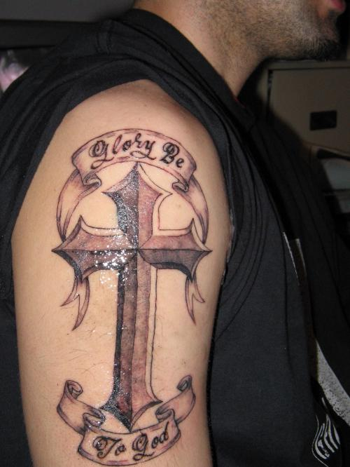
圣经关于纹身是怎么说的…
纹身？
What does the Bible say about…
Tattoos?

Slide 7
纹身: tattoos
“不可为死人用刀划身,也不可在身上刺花纹, 我是耶和华.” (利19:28)
“Do not cut your bodies for the dead or put tattoo marks
on yourselves. I am the LORD” (Lev. 19:28)
今天的基督徒不在旧约律法约束之下.
(罗10:4;加3:23-25;弗2:15)
Believers today are not under the Old Testament law
(Romans 10:4; Galatians 3:23-25; Ephesians 2:15)
2. 关键词是: “所以, 你们或吃或喝, 无论做什么， 都要为荣耀神而行。”（林前10:31）
is Key: “So whether you eat or drink or whatever you do, do it all for the glory of God” (1 Corinthians 10:31).

Slide 8
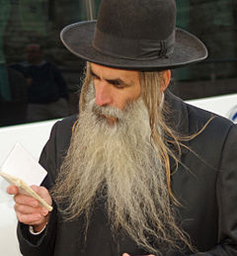
3. 你如果将19:28节应用到基督徒身上， 你必须把其余的经文也用到信徒身上。 那意味着我们都必须…
不能修剪胡子，不能穿混合织物的衣服， 不能混合耕种，不能让牛杂交，不能驱逐 非法外国人，不能在周六工作.
If you apply Lev.19:28 to Christians,
you must apply the rest of the passage to
believers too. This would mean we all must…
Never trim our beard
Avoid clothes with blended materials
Never blend seeds in our garden
Not cross cow breeds
Never eject an illegal alien
Never work on Saturday

Slide 10
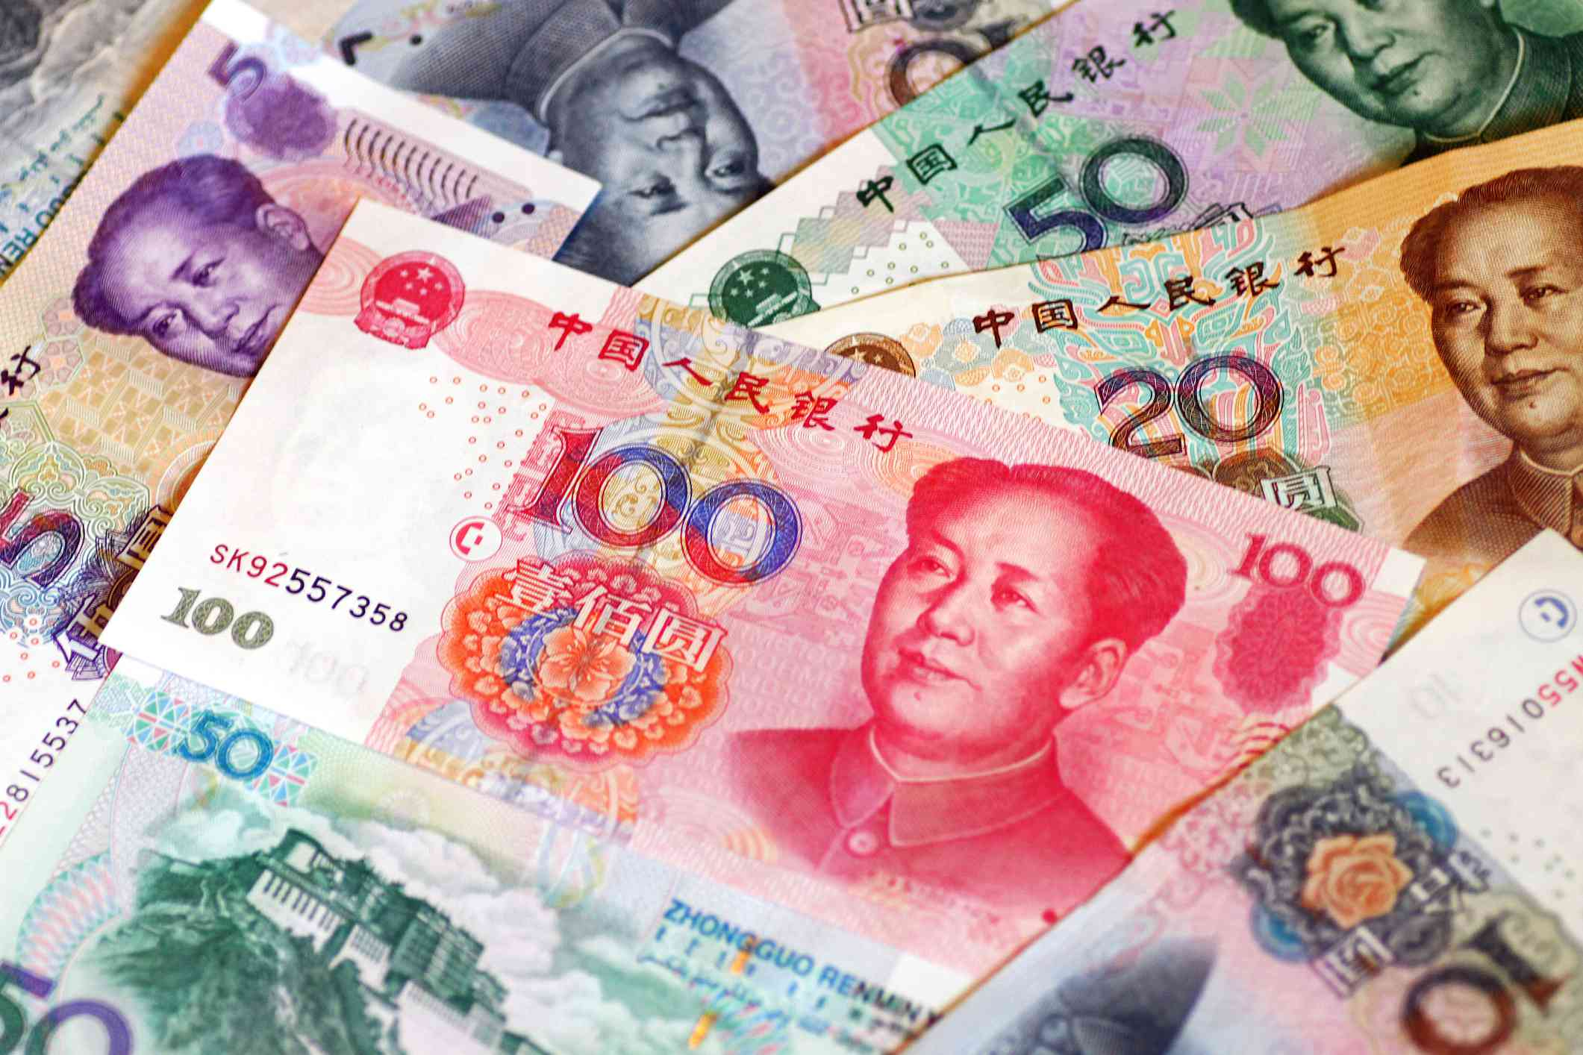
牧师该拿工资吗？
SHOULD PASTORS BE PAID?

Slide 11
他们的价值高于你所付工资。
提前5:17-18: 那善于管理教会的长老，当以为配受 加倍地敬奉。那劳苦传道教导人的，更当如此。
因为经上说，牛在场上踹谷的时候，不可笼住 它的嘴。又说，工人得工价是应当的。
They are worthy of more than you pay them
1 Tim. 5:17-18 ”Let the elders that rule well be counted worthy of double honor (honerarium: financial pay), especially they who labor in the word and doctrine. For the scripture saith, thou shalt not muzzle the ox that treads out the corn. And, The laborer is worthy of his reward.”

Slide 12
讲道人该由那些受教和听道的人支付工价.
林前9:14: 主也是这样命定，叫传福音的靠着福音养生。
Preachers are to be paid by those who listen and learn
1 Corinthians 9:14 “In the same way, the Lord ordered that those who preach the Good News should be supported by those who benefit from it.”

Slide 13
他的妻子不必工作, 能与她丈夫一起服事。林前9:5: 难道我们没有权柄娶信主的姊妹为妻，带着一同往来，仿佛其余的使徒， 和主的弟兄， 并矶法一样吗？
His wife should not have to work, but be able to minister along with her husband
(1 Cor. 9) ^{5”}Have we not power to lead about a sister, a wife, as well as other apostles, and as the brethren of the Lord, and Cephas?”
牧师不必打另一份工养家。
林前9:6 独有我与巴拿巴没有权柄不作工吗？
The pastor should not have to work another job to earn his living
(1 Cor. 9) ^{6”}Or I only and Barnabas, have not we power to forbear working?”

Slide 14
其它行业的都是做工得工价。
林前9:7 有谁当兵，自备粮饷呢？ 有谁栽葡萄园, 不吃园里的果子呢？有谁牧养牛羊，不吃牛羊的奶呢？
Every other professional gets paid to do his job
(1 Cor 9) 7”Who goes to warfare any time at his own charges? who plants a vineyard, and eats not of the fruit thereof? or who feeds a flock, and eats not of the milk of the flock? “

Slide 15
旧约也教导了这个原则。保罗提醒教会… 林前9: 我说这话，岂是照人的意见。律法不 也是这样说吗？ 9 就如摩西的律法记着说， 牛在场上踹谷的时候，不可笼住它的嘴。 难道神所挂念的是牛吗？ 10 不全是为我们说 的吗？分明是为我们说的。因为耕种的当存 着指望去耕种。打场的也当存得粮的指望去打场。
The Old Testament also taught this principle. Paul reminds the church…
(1 Cor. 9) ^{8”}Say I these things as a man? or saith not the law the same also? ⁹For it is written in the law of Moses, thou shalt not muzzle the mouth of the ox that treads out the corn. Doth God take care for oxen? ¹⁰Or saith he it altogether for our sakes? For our sakes, no doubt, this is written: that he that plows should plow in hope; and that he that threshes in hope should be partaker of his hope.”

Slide 16
这个原则也是神自己设立的。 林前9:13-14：你们岂不知为圣事劳碌的，就吃殿中的物吗？伺候祭坛的，就分领坛上的物吗？主也是这样命定，叫传福音的 靠着福音养生。
This is a principle set down by God Himself
(1 Cor. 9) 13 “ye not know that they which minister about holy things live of the things of the temple? and they which wait at the altar are partakers with the altar? ¹⁴Even so hath the Lord ordained that they which preach the gospel should live of the gospel.

Slide 17
我们受命要与教导神的话语的人分享一切好东西.
加6:6 :在道理上受教的，当把一切需用的供给施教的人。
* We are told to share all good things with the ones who teach us the Word of God
(Gal. 6:6) “Nevertheless, the one who receives instruction in the word should share all good things with their instructor. “
认为牧师服事神就必须忍受财政缺乏是令神厌恶的想法, 也与圣经不符。
To think that just because a pastor is serving God then he must have financial struggles is abhorrent to God and contrary to Scripture.

Slide 19
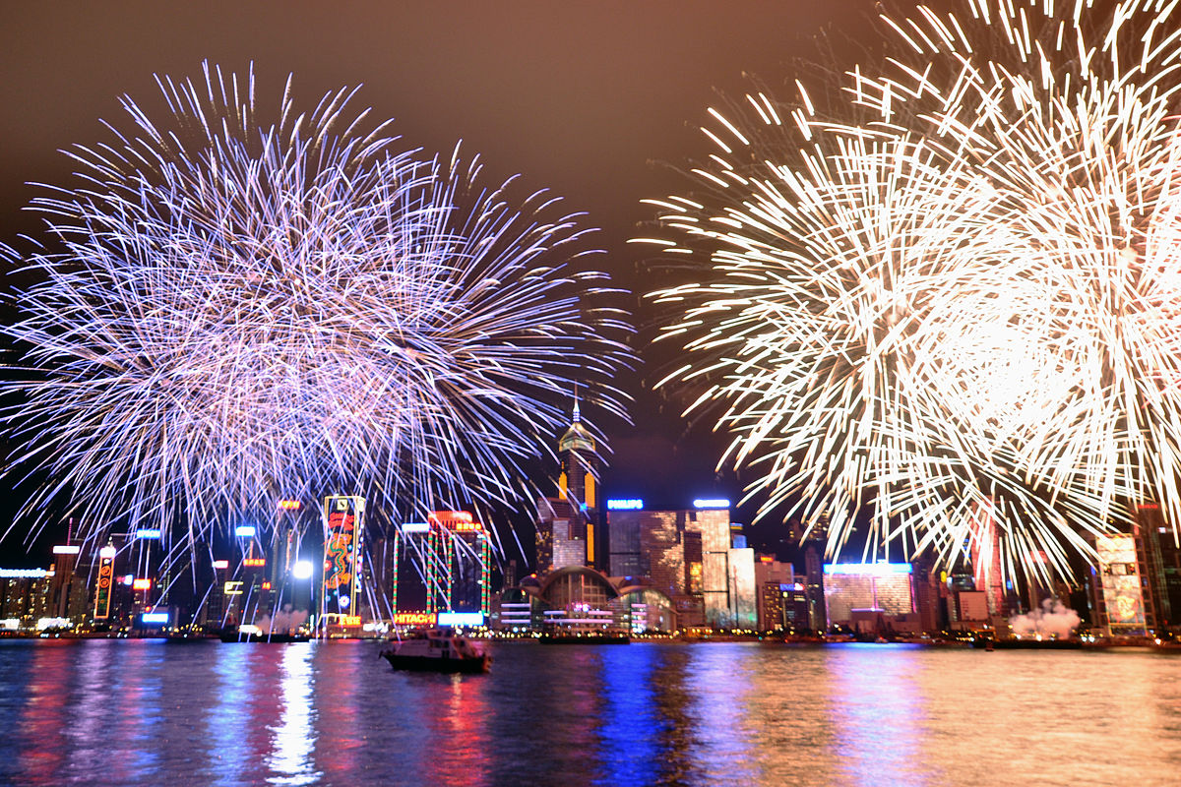
基督徒应该庆祝圣诞节吗？
Should Christians celebrate Holidays?

Slide 20
反对者的理由：
第一，12月25日不可能是主耶稣的生日。圣经虽未记载主耶稣的生日是哪一天，但描述耶稣诞生时“在伯利恒之野地里，有牧羊的人夜间按着更次看守羊群。”（路2:8）伯利恒地12月底天气寒冷，牧人不可能在野地牧羊，据此推测，主耶稣不可能生于12月25日。
第二，12月25日是古罗马农神节和冬至神祗的节日。据说，早期天主教会信仰混乱，圣诞节与偶像崇拜有关。
基督徒应该庆祝圣诞节吗？
Should Christians celebrate Holidays?

Slide 21
支持者的理由：
将12月25日定为圣诞节，大约是在主后336年左右，基督教刚变成罗马国教后不久。当时的罗马人在每年12月底庆祝异教农神节(Saturnalia)和冬至(Winter Solstice)。教会选择在这个季节庆祝主耶稣基督的诞辰，不是为了迎合异教的风俗，乃是要与世俗社会针锋相对，将这个节日赎出来，进行有智慧的“文化置换”。通过在同一个日子举行圣诞庆祝活动，对当时的异教文化进行和平、渐进式的改造。 事实证明，早期教会的这一做法颇有远见和智慧，异教的庆祝在主后第四世纪末就基本销声匿迹了，相反，主耶稣的名藉着圣诞庆祝而传开了，圣诞节如今成了全球性的节日。
基督徒应该庆祝圣诞节吗？
Should Christians celebrate Holidays?

Slide 22
支持者的理由：
与后期腐败的罗马天主教不同，公元四世纪时初代大公教会（天主教）的信仰纯正，许多早期教父，如爱任纽、革利勉、俄利根、奥古斯丁等，就服事于那个世代。正是他们将这个膜拜异教神祗的罗马节日赎了出来，庆祝耶稣基督的诞生。毕竟，在岁暮天寒，万物凋零的严冬，人们期盼的是一位赐生命的主，因此在此时庆祝圣诞再合适不过。
这是基督徒传福音的难得良机，把圣诞节的真正意义告诉那些尚未得救的人，邀请他们来教会听耶稣的故事，让他们有机会跟我们一样得到主耶稣的救赎，一起享受福音的好处。
基督徒应该庆祝圣诞节吗？
Should Christians celebrate Holidays?

Slide 23
神喜爱节日并亲自在旧约设立节日，并称为圣日（Holiday）。
God likes holidays and established many of them in the O.T.
第一个圣诞节是天使, 牧羊人, 马利亚和约瑟等人 一起庆祝的。
The first Christmas was celebrated by angels, shepherds, Mary & Joseph, etc.
罗马书14:5-6说个人要自己决定哪天为神而设。
Rom 14:5-6 says each man should decide for himself which days to set apart for God.
有些节日是与非信徒分享耶稣的故事的好机会，也可以与信徒一起敬拜神。
Some holidays are a great opportunity to share the story of Jesus with unbelievers and worship together with believers.

Slide 25
上帝能改变他的想法吗？
Can God change
His mind?

Slide 26
玛拉基书 3:6 ”因 我 ─ 耶 和 华 是 不 改 变 的 ， 所 以 你 们 雅 各 之 子 没 有 灭 亡 。”
“I the LORD do not change.” Malachi 3:6
雅 各 书 1:17 “各 样 美 善 的 恩 赐 和 各 样 全 备 的 赏 赐 都 是 从 上 头 来 的 ， 从 众 光 之 父 那 里 降 下 来 的 ； 在 他 并 没 有 改 变 ， 也 没 有 转 动 的 影 儿 。”
“Every good and perfect gift is from above, coming down from the Father of the heavenly lights, who does not change like shifting shadows.” James 1:17
民 数记 23:19 “神 非 人 ， 必 不 致 说 谎 ， 也 非 人 子 ， 必 不 致 后悔 。 他 说 话 岂 不 照 着 行 呢 ？ 他 发 言 岂 不 要 成 就 呢 ？”
“God is not a man, that He should lie, nor a son of man, that He should change His mind. Does He speak and then not act? Does He promise and not fulfill?” Numbers 23:19

Slide 27
那这些经文呢… Then what about……
创世记 6:6 “耶和华就后悔造人在地上，心中 忧伤。”
“And it repented the LORD that he had made man on the earth, and it grieved him at his heart.” Genesis 6:6
约拿书 3:10 “于是神察看他们的行为，见他 们离开恶道，他就后悔，不把所说的灾祸降 与他们了 。”
“When God saw what they did and how they turned from their evil ways, He had compassion and did not bring upon them the destruction He had threatened.” Jonah 3:10
出埃及记32:14 “於是耶和华后悔，不把所说 的祸降与他的百姓。”
“Then the LORD relented and did not bring on His people the disaster He had threatened.” Exodus 32:14

Slide 28
每次当圣经出现“耶和华后悔了”这个词时，不是指上帝要改变主意，而是指上帝要改变行动
要么由慈爱转公义，
降下灾祸和审判。
要么由公义转慈爱，
撤回灾祸和审判。

Slide 29
由慈爱转公义，降下灾祸和审判
创世记 6:6 “耶和华就后悔造人在地上，心中 忧伤。”
“我何时论到一邦或一国说，要建立、栽植；他们若行我眼中看为恶的事，不听从我的话，我就必后悔（转意），不将我所说的福气赐给他们”（耶18：9-10）
“我立扫罗为王，我后悔（改行动）了；因为他转去不跟从我，不遵守我的命令”（撒上15：11）

Slide 30
上帝由公义转怜悯，撤回灾祸和审判
出埃及记32:14 於是耶和华后悔，不把所说 的祸降与他的百姓。
士师在世的一切日子，耶和华拯救他们脱离仇敌的手。他们因受欺压扰害，就哀声叹气，所以耶和华后悔（施怜悯）了。（士2:18）
天使向耶路撒冷伸手要灭城的时候，耶和华后悔（转意），就不降这灾了，吩咐灭民的天使说：够了！住手吧！那时耶和华的使者在耶布斯人亚劳拿的禾场那里。（撒下24:16）

Slide 31
上帝的意志: God’s Will
神的定旨：神一说，事发生了。他说有，世界就有了。
GOD’S DECREED WILL: God speaks and it happens. He spoke and the world WAS.
神的许旨：神许可你做他宁愿你不做的事。神允许。 他选择不制止你。从长远看，这会成就他的旨意。
GOD’S PERMISSIVE WILL: God permits that which He does not prefer. God allows it. He chooses not to stop it. In the long term, it will result in His purpose being done.
神的令旨：神命令我们去做，并告诉我们反应的正面和负面后果。但祂预知了我们的反应。
GOD’S PERSCRIPTICE WILL: That which God commands us to do. He attaches positive and negative consequences to our responses. He foreknows our response.
中立：神既没命令也没禁止的事；中立（如网球）
ADIAPHORA: Those things God neither commands or forbids; neutral. (ie: tennis)

Slide 32
上帝与人的关系和互动常被形容为丈夫与妻子，父母与孩子间的关系和互动，包含丰富的情感和行动。这不表示上帝一直在变。上帝的属性是不变的──祂的慈愛信实和公义公正；上帝的旨意也不变──救赎罪人，引入永生。但是，当上帝在人类在互动时会同时彰显祂的公义与慈爱，特别是在祂向子民颁布了“令旨”后，祂会根据子民的表现而“调整”的行动。

Slide 33
约拿书3:10和以西结书32:14… 毁灭的威胁是有条件的，取决于他们是选择犯罪还是悔改。依着本性，神愿意怜悯而不是毁灭. 人们若悔改，神就会网开一面。
Jonah 3:10 & Ezekiel 32:14… The threat of destruction was conditional, based on their choice to sin or repent. By nature, God desires mercy over destruction and allows a way to escape judgment if people will repent.

Slide 34
创世记6:6…这节经文甚至继续说: “他心中忧伤”这节经文声明神后悔造了人。然而，他显然没有推翻他的决定. 相反，通过挪亚，他允许人类继续存在。我今天依然活着的事实证明神并没有改变他造人的决定。
GENESIS 6:6…This verse even goes on to say “His heart was filled with pain.” This verse declares that God had regret for creating man. However, obviously He did not reverse His decision. Instead, through Noah, He allowed man to continue to exist. The fact that we are alive today is proof that God did not change His mind about creating man.

Slide 35
神按他的旨意而行让人类实践他的完美计划
“我从起初指明末后的事，从古时言明未成的事，说，我的筹算必立定，凡我所喜悦的，我必成就。 11 我召鸷鸟从东方来，召那成就我筹算的人从远方来。我已说出，也必成就，我已谋定，也必作成。”(赛46:10-11)
God does what He needs to do to cause humanity to fulfill His perfect plan.
“…declaring the end from the beginning, and from the past things which were not done, saying, My purpose shall stand, and I will do all My pleasure … What I have said, that will I bring about; what I have planned, that will I do” (Isaiah 46:10-11)

Slide 36
疑难问题的诚实答案

Slide 37
谢谢
奉献支持
1. 请在祷告中记念我们
我们相信上帝会回应祂孩子们的祈祷。我们祷告不是要神照我们的旨意行，乃是我们要照祂的旨意行。请继续以感恩的心祈求神满足我们在智慧、方向、安全和财务上的需要。
2. 请考虑给予事工财政支援
提供给中国基督徒的任何培训我们都不收费。所有的费用，包括课程开发，旅途费用都仰赖于忠心慷慨的支持者帮助支付。
如果您希望奉献，请扫上面的二维码。
愿主恩待您！
THANK YOU

