Slide 1
ROMANCE 婚姻里的浪漫

Slide 2
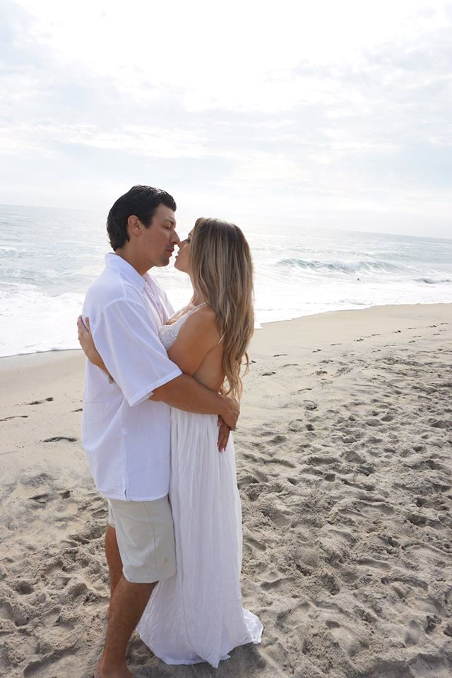
婚姻里的浪漫 ROMANCE IN MARRIAGE

Slide 3
浪漫的定义
词典解释: 与爱情相关的兴奋和神秘之感。
Dictionary: “A feeling of excitement and mystery associated with love.”
“创造相互之间的兴奋和期许，以此展示你对配偶的深爱和委身。”
“Creating a mutual sense of excitement and anticipation to demonstrate your affection and commitment to your spouse.”
DEFINITION OF ROMANCE

Slide 4
引述
“伟大的丈夫就是能够一生一世满足一个女人，
并一生一世以一个女人为满足的人。”
“A great lover is a man who can satisfy one woman over a lifetime and can himself be satisfied with one woman for a lifetime."
QUOTES

Slide 5
引述
“成为他/她的初恋固然好, 成为他/她的最终挚爱更好.”
“It is nice to be their first love;
it is better to be their last love”
QUOTES

Slide 6
引述
我希望成为你低头查看你的手机，微笑…然后撞到旁边电线杆的原因。
“I want to be the reason you look down at your phone and smile… and then walk into a pole.”
QUOTES

Slide 7
引述
人的大脑真是很奇妙。
原本一年365天，
一天24小时运作得好好的。
突然，当你坠入爱河时，
它停止运作了。
“The brain is amazing. It works 24 hours a day, 365 days a year. Until you fall in love; then it stops working.”
QUOTES

Slide 8
引述
“嫁娶那个以你为荣，为了得到你，甘愿不惜一战的人吧。
“Marry someone who is proud to have you and
will fight any battle to keep you.”
QUOTES

Slide 9
为何爱情会变冷
WHY DOES ROMANCE GET COLD?

Slide 10
为何浪漫会止息？
一般的婚姻周期
Common Marriage Cycle
文化原因
Cultural Reasons
WHY DOES ROMANCE STOP?

Slide 11
爱 (LOVE)
媒体已经扭曲了爱的本意。
Media has distorted the true meaning of LOVE
爱常常错误地等同于性欲、情感、 刺激、喜爱、需要，等等。
Love is usually misidentified lust, emotions, excitement, like, need, etc
.
爱是行动的选择,而非情感。
Love is a choice of action, not an emotion
社会的爱
SOCIETAL LOVE
真爱的定义
TRUE LOVE

Slide 12
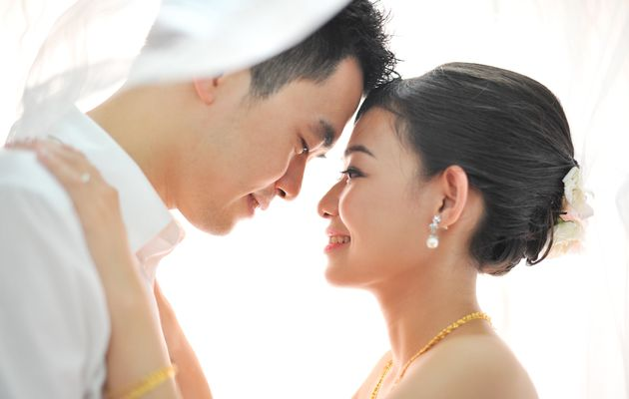
为何婚姻中的浪漫甚为重要？
WHY IS ROMANCE IN MARRIAGE IMPORTANT?

Slide 13
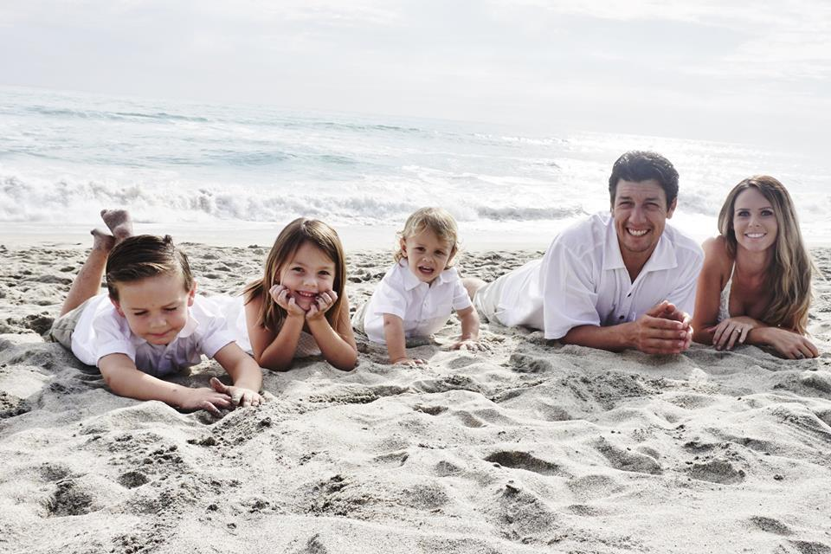
浪漫的姿态
ROMANTIC GESTURES

Slide 14
定义: 刻意,用心地向你的爱人展示你的忠诚和热爱。 Definition: Intentional, thoughtful demonstrations of your love or devotion to your spouse.

Slide 15
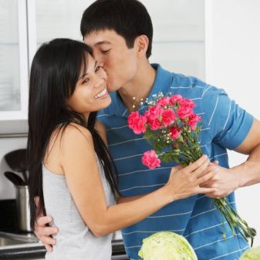
每天都用不同的方式说: “我爱你.” Say “I LOVE YOU” in a different way EVERY DAY

Slide 16
从哪里开始？
1. 设法满足你爱人, 而非只是你的浪漫需求。
SEEK TO MEET YOUR SPOUSE'S ROMANTIC NEEDS, NOT JUST YOURS
WHERE DO I BEGIN?

Slide 17
讨论:
Discussion:
过去你喜欢得到对方哪些浪漫举动？
What are some romantic gestures you have liked getting in the past?
过去你的爱人喜欢你的哪些浪漫举动？
What are some romantic gestures your spouse liked in the past?
哪些地方于你们具有特殊意义？为什么？
What places that have special meaning to you and your spouse? Why?

Slide 18
从哪里开始？
2. 将你的家(尤其是卧室) 设置为浪漫之所
MAKE YOUR HOME (ESPECIALLY YOUR BEDROOM) A SETTING FOR ROMANCE.
讨论: Discussion:
有哪些方式可以让你的家和卧室更容易产生浪漫气氛？
What are some ways you can make your house and bedroom more conducive to romance?
WHERE DO I BEGIN?

Slide 19
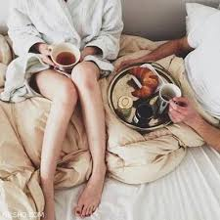
从哪里开始？
3. 寻找创意和点子向对 方展示爱和忠诚.
LOOK FOR CREATIVE WAYS TO SHOW LOVE AND COMMITMENT TO THEM
尽量去发现和使用对方爱的语言。
Try to discover and use THEIR love language
WHERE DO I BEGIN?

Slide 20
爱的五种语言
The 5 LOVE LANGUAGES

Slide 21
肯定言语 WORDS OF AFFIRMATION
服务行动 ACTS OF SERVICE
身体接触 PHYSICAL TOUCH
优质时间 QUALITY TIME
接受礼物 RECEIVING GIFTS

Slide 22
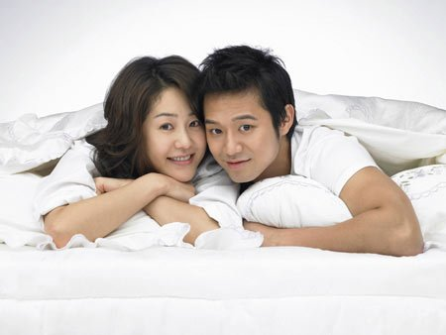
FUN TIPS for MARRIED COUPLES
给夫妻的有趣建议

Slide 23
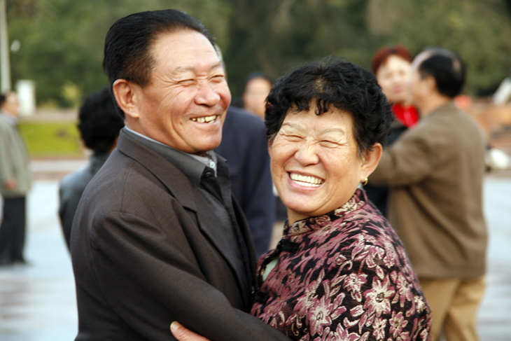
让浪漫成为你们关系中的重中之重
MAKE ROMANCE A PRIORITY IN YOUR RELATIONSHIP.
发挥你的创造性
BE CREATIVE

Slide 24
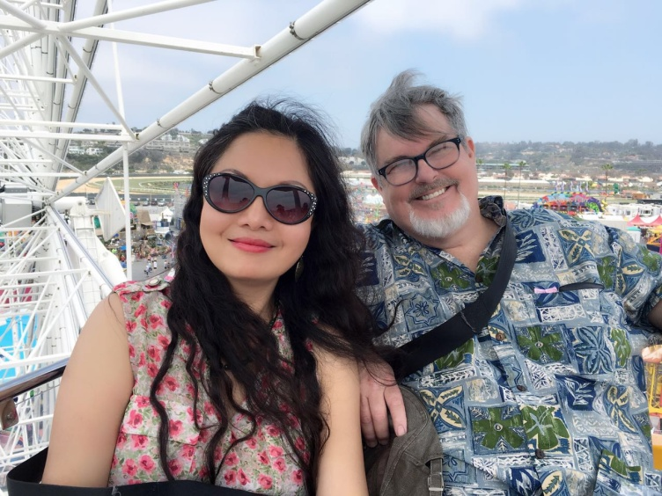
重要:
二人独处无可转让。
TIME ALONE IS A NON-NEGOTIABLE.
我们都需要被“充电”。
WE ALL NEED TO GET “RECHARGED”.
衰竭可导致压力,争吵,抑郁,甚至更糟的事发生.
EXHAUSTION CAN CAUSE STRESS, FIGHTS, DEPRESSION & WORSE
IMPORTANT:

Slide 25
重要:
找一个你信任的临时保姆
FIND A BABYSITTER YOU TRUST
操练交替看顾孩子。
PRACTICE CHILD SWAPPING
IMPORTANT:

Slide 26
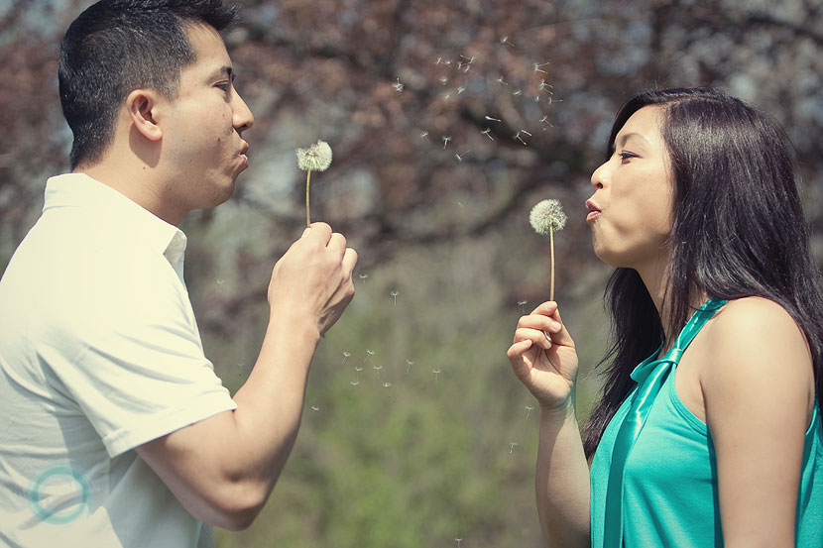
几个建议
A FEW SUGGESTIONS

Slide 27
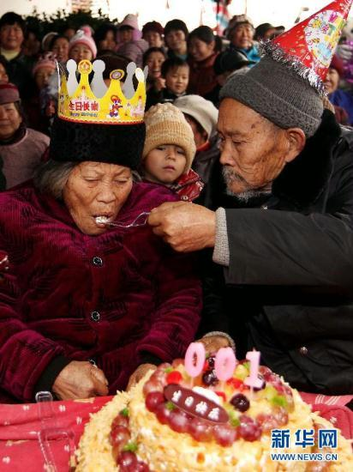
找机会一起庆祝(生日, 结婚纪念日,特殊日子, 节假日等.) Find events to celebrate. (birthdays, anniversaries, special days, holidays, etc.)

Slide 28
去钓鱼 或 只一起 说说话 go fishing & just talk

Slide 29
给某个朋友看孩子 babysit together for a friend

Slide 30
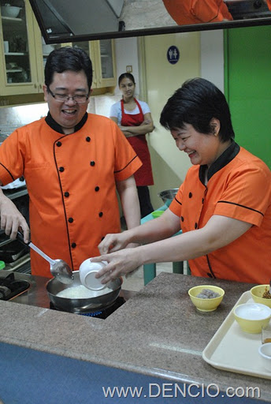
一起学 点什么 新东西 Take a fun class together

Slide 31
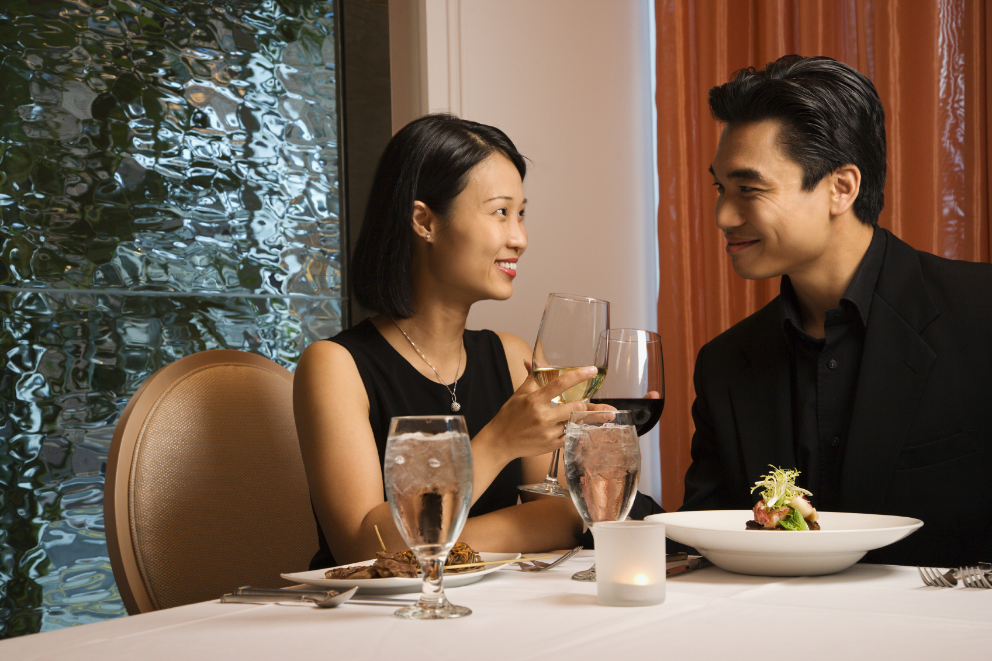
每周 单独 约会 一次 Have a DATE NIGHT once a week

Slide 32
不带孩子和家人外出 度几天假 Get away for a few days without kids or family.

Slide 33
存一笔旅游基金,有一天一起去一个你们俩都梦想的地方 Start a savings account for a trip you both want to take someday

Slide 34
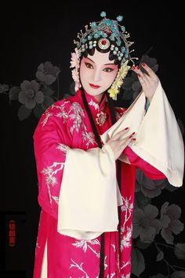
文化之夜 去参观博物馆，看音乐会，歌剧或芭蕾。 CULTURE NIGHT Go to an art museum, concert, opera or ballet.

Slide 35
跳舞 月夜河边翩翩起舞 DANCE (by the river in the moonlight?)

Slide 36
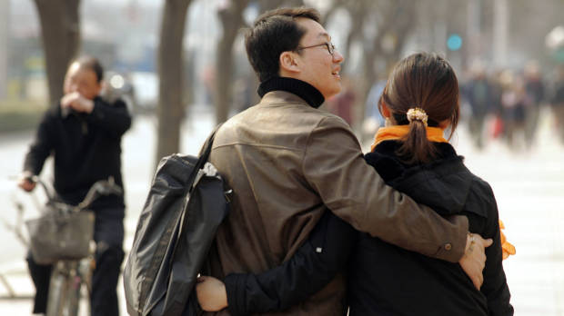
到一新的地方散步 TAKE A WALK SOMEWHERE NEW

Slide 37
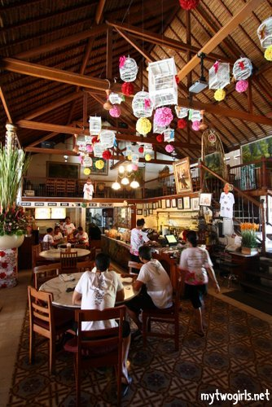
外出去 一个从未去过餐厅 用餐 DINE OUT at a place you have never tried

Slide 38
给彼此做做按摩 GIVE EACH OTHER A MASSAGE

Slide 39
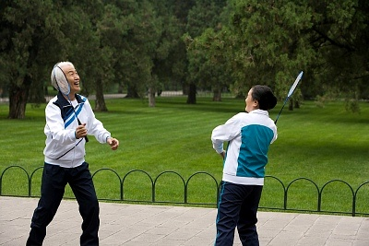
一起玩网球、乒乓球、 羽毛球和高尔夫球比赛 Play a game of tennis, ping-pong, badminton or golf.

Slide 40
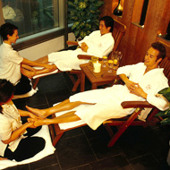
在水疗馆里度过一天 ENJOY a day at the SPA

Slide 41
一起去看一个很久不见的老朋友 Visit old friends together you haven’t seen in a while

Slide 42
一起玩一个你们孩子玩过的游戏 Try playing one of your kid’s video games together

Slide 43
订一个 “梦想清单” (在你一生里希望一起做 的事情) Make a “bucket list” (Things you want to do together before you die)

Slide 44
在一起看一遍儿时最喜欢的电影 Watch your favorite childhood movies again together

Slide 45
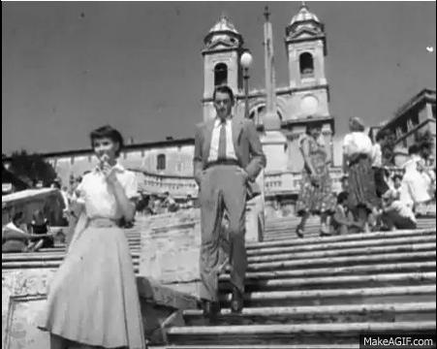
一起观看一部经典电影 Watch an old classic movie together

Slide 46
给床换边 Change sides in the bed

Slide 47
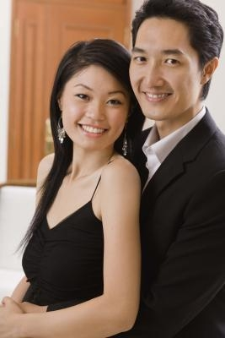
拍一些新的照片 HAVE SOME NEW PICTURES TAKEN

Slide 48
询问对方哪些方面你可 以改变让对方更幸福 Ask them what you can change to make them happier.

Slide 49
一起翻阅你们的老相册 Look through all of your old photo albums

Slide 50
谈谈你们的童年(朋友,宠物,学校,苦难,假期等) Discuss your childhoods (Friends, pets, schools, hardships, vacations, etc.)

Slide 51
依偎着一起看电影 Cuddle while watching a movie

Slide 52
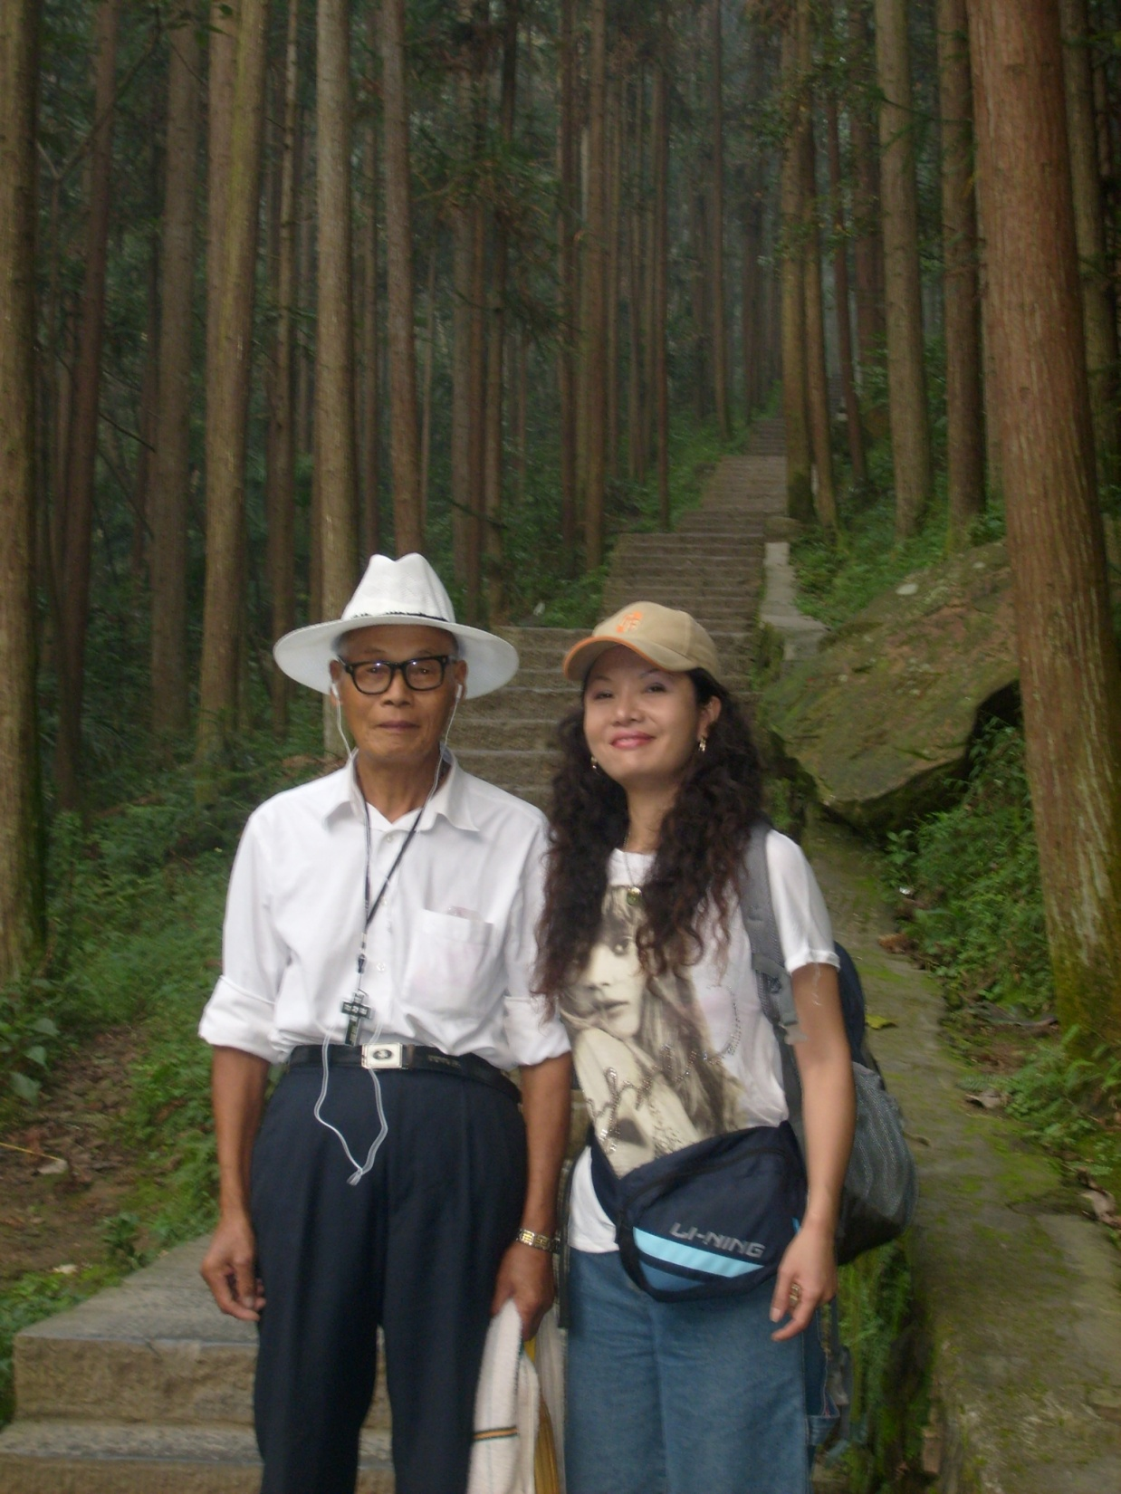
带你们的父母去一个他们想去的地方 Bring your parents somewhere they always wanted to go

Slide 53
一起参加一个赈灾项目 Do a Service Relief Project Together

Slide 54
去让人画一幅肖像漫画 Have Caricatures made

Slide 55
结论
投资浪漫绝对物超所值。
ROMANCE IS WORTH EVERYTHING YOU INVEST
要有创意，始终如一， 专情忘我。
BE CREATIVE, CONSISTENT, & UNSELFISH
决不放弃！
DON’T GIVE UP!
制定计划
MAKE A PLAN
CONCLUSION

Slide 56
推荐电影: 消防员
Recommended Movie: FIREPROOF

Slide 57
小组活动
策划一个约会
Plan a date
你们去哪里？ (Where will you go?)
你们要做什么？ (What will you do?)
你们要穿什么 (What will you each wear?)
你准备增加什么绝妙点子？ (What special touches will you add?)
等等 (Etc.)
GROUP ACTIVITY

