Slide 1
基督徒的
金钱奉献观
Today: MONEY & Offering

Slide 2
圣经主题强化课程
INTENSIVE BIBLE TRAINING PROGRAM

Slide 3
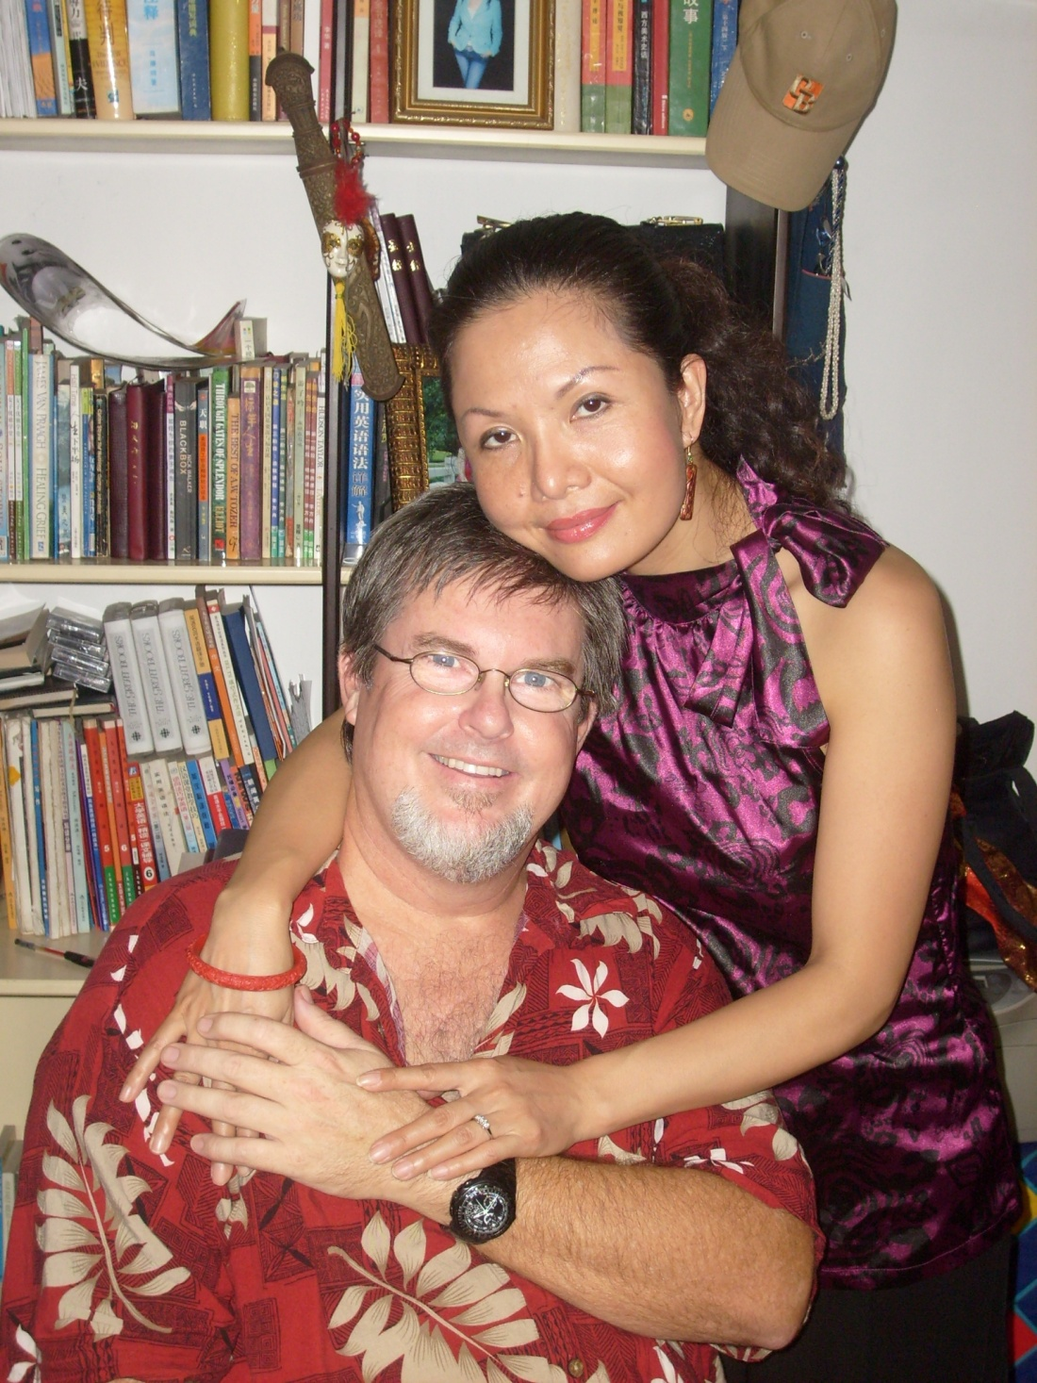
Teachers:
Dr. Jay
Barleon
&
Suran

Slide 4
十一奉献和捐献
TITHES & OFFERINGS

Slide 5
十一奉献是什么?
“十一奉献”是旧约中原则：要求犹太人必须拿出年收入的十分之一给祭司，以便让国家正常运转，以色列国民的需求得到满足。
TITHING is an Old Testament principle whereby the Jews would give 10% of their yearly income to the priests as part of their required giving in order to run the nation effectively and care for the needs of all of the citizens of Israel.
“十一奉献”在新约中从未作为对教会的要求。
TITHING is never given in the N.T. as a requirement for the church.
WHAT IS TITHING?

Slide 6
为何有人教导“十一奉献”？
他们说: “ 神要求人人拿出百分之十给神.”
THEY SAY: “God requires everyone to give 10% to God”
实情是: 圣经中没有要求一个人仅给百分之十。
TRUTH: No one in all of Scripture was required to give only 10%.
WHY DO SOME TEACHING TITHING?

Slide 7
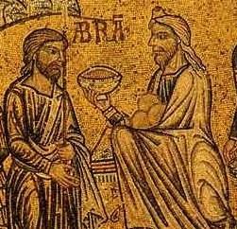
为何有人教导“十一奉献”？
他们说: “亚伯拉罕给了撒冷王麦基洗德十分之一.”
THEY SAY: “Abraham gave a TITHE to Melchizedek, King of Salem”
- 实情是：在创14，亚伯拉罕给麦基洗德十分之一只是一次性地，自愿地作为赢得战斗后， 对神感恩的标志。
- 并不是他所有财产的百分之十， 仅是他在战斗中虏获财物(来7:2) 的十分之一. 我们未见他再做十一奉献。
TRUTH: In Gen 14, when Abraham tithed to Melchizedek, it was a one-time, voluntary gift of 10% as a sign of thankfulness to God for winning a battle.
It was not 10% of everything he owned, but only of the items and people he had captured during a battle (Hebrews 7:2). We never see him tithe again.
WHY SOME TEACHING TITHING

Slide 8
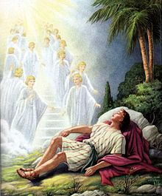
为何有人教导“十一奉献”？
他们说: “雅各给了神所有的十分之一”
THEY SAY: “JACOB gave God a TITHE of all he had”
实情是：雅各的十一奉献是有条件的。
TRUTH: Jacob’s Tithe was conditional
In Genesis 28, Jacob promised God 10% of his future income to God, but only under certain circumstances. Jacob had just been caught by God in terrible acts of lies, deception and robbery. God came to Jacob in a dream and renewed the vow He had made to Jacob’s father and grandfather. God had promised that a great nation would come from this family. Jacob tried to make a deal with God. He told God that “IF” God would go on his journey with him, and “IF” God would protect him, and “IF” God would give him food and clothing, and “IF” God would bring him back safe,” THEN” he would make God his God and give back a tenth of what had been given to him. ****** In other words, if God were to bless him with much, he would return 10%. He was trying to buy God’s blessing as many still do today. How often I hear people say, “If God will let me win the lottery, I will give Him a big part of it”.
WHY SOME TEACHING TITHING

Slide 9
为何有人教导“十一奉献”？
他们说: “犹太人被命令向神做十一奉献。”
THEY SAY: “The JEWS are commanded to give a TITHE to God”
实情是:犹太人要求奉献的 远远不止百分之十。
TRUTH: The Jews were required to give MUCH MORE than 10%
犹太人要奉献多少？
HOW MUCH DID THE JEWS GIVE?
WHY SOME TEACHING TITHING

Slide 10
祭司十一税 （利27:30-3）
PRIESTS TITHE 10% (Lev. 27:30-32)
In 1st Chronicles 29:9,
King David announced that he wanted to collect money to build a temple to God.
The people gave voluntarily, joyously and abundantly. Voluntary giving was always just as important to the Jew as the tithe.
节日十一税 （申12:16-17）
FESTIVAL TITHE 10% (Deut. 12:16-17)
贫穷十一税 （申14:28-2）
POOR TITHE 10% (Deut. 14:28-29)
圣殿税
TEMPLE TAX
遗留些庄稼
LEAVE SOME CROPS
自愿礼物和奉献（民18）
FREEWILL GIFTS & OFFERINGS (Num 18)
所罗门王的榜样
* King Solomon’s example
摩西的榜样
* Moses’ Example
大卫的榜样
* David’s Example

Slide 11
总的来说,一个普通以色列人每年要奉献的收入比例在23%到33%之间
这类似于他们国家的纳税方式
Keep the nation running, develop a welfare system and support the priestly tribe
Today, we are to pay our taxes, not to the church, but to the government because we are no longer living under a theocracy. The New Testament writers did, however, command us to pay our taxes to the government regardless of how godless or evil that government becomes (Romans 13:1-7). At the time Paul wrote this, the evil Nero was killing Christians by the thousands. If we do not pay our taxes, we are not only disobeying men, but God.
耶路撒冷在公义七十年被毁后，这个十一奉献的制度也就终结了。
新约圣经并未要求教会或基督徒“十一奉献”，但的确要求所有基督徒慷慨地奉献，从而有充分的资金支付牧师的工资，维持和发展教会和事工。

Slide 12
教导“十一奉献”的局限
律法主义 将犹太律法应用在基督徒身上会产生一系列问题。我们不得不问: “我们该在哪里划界限呢？为什么我们光接受这一条而拒绝其它的律法呢？”
可能导致教会的奉献不足：在2000年,美国有基督徒机构做了一个跨越宗派的调查,显示：教导十一奉献的教会收到会众的奉献只有其收入的2.6%, 而那些允许会众甘心奉献而不是内疚奉献的教会收到的奉献款要多得多。
虚假的所有权: 强调十一奉献的最大的危险是给基督徒一个错误的想法:认为只要给了教会十分之一，其余的就全归自己了。根据《圣经》，这种想法是不正确的。

Slide 13
百分百所有权的原则
神百分之百拥有一切. 我们
只是照管祂的资源的管家。
你的奉献属于上帝，不是
你给上帝的。
HOW MUCH SHOULD I GIVE?

Slide 14
百分百所有权原则
我们所拥有的一切都属于父神（哈2:8；诗24:1）。
我们每一样东西都是从神而来的赏赐（历上4:7）。
甚至我们挣钱养家的能力也从神而来（申8:18）。
神教导我们要成为他财富的好管家，而不要以为我们拥有一切（林前4:2）。
我们要为自己财务方面所作的各种决定向神交账（路12:35-48），就如同我们要求雇员为使用公司的钱财负责一样。我们应该不断寻求神的心意，明白神要我们在哪里使用他的资源，以便在地上成就他在我们身上的旨意。
4. DANGERS OF TEACHING N.T. TITHING

Slide 15
初熟之果的原则
最初和最好的属于上帝
利 23:9-14 出13:1-13/ 书 6:18-19 & 7:1-12/ 民18:26
原因:上帝是我们所有的祝福之源。
雅1:16-17/ 太5:45
这条原则适用于谁？
所有声称敬拜上帝的人。
箴言3:9-10/ 腓立比书4:15-19
HOW MUCH SHOULD I GIVE?

Slide 16
初熟之果的原则
问你自己两个尖锐问题：
1.上帝得到的是我的初熟之果,还是我的残羹剩汤？撒下24:21-25/ 玛1:6-9
2.是谁在我的口袋里打了个洞？
该1:2-11, 2:15-19 & 玛3:8-12
HOW MUCH SHOULD I GIVE?

Slide 17
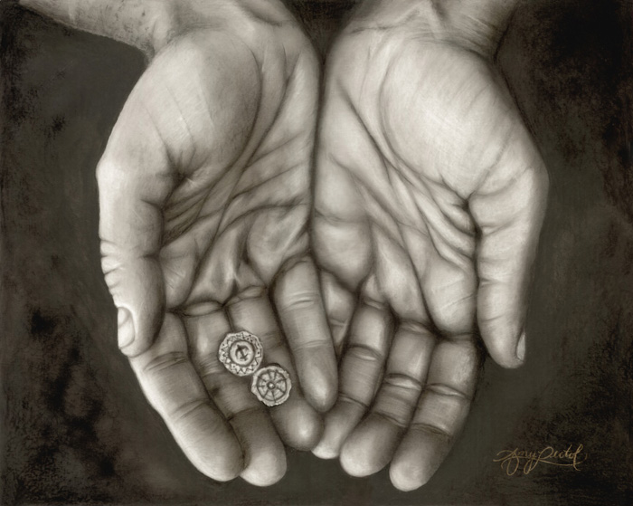
奉献的十大心态
10 PRINCIPLES OF GIVING

Slide 18
奉献的错误心态
钓鱼和投资的心态：
只要我做十一奉献，神就会加倍在财政上加倍祝福我。他们依据的经文是路加福音6:38.
有些教会称这些奉献给神的钱为种子钱，意思是神会让它长出百倍的果实来回报你。
神没有保证会加倍回报你，神只说要先求神的国和神的义，你的所需会得到满足。
路6:38讲的是饶恕，而非金钱。
10 PRINCIPLES OF GIVING

Slide 19
新约教导奉献的十大心态
《新约》没有命令和要求基督徒给教会奉献十分之一的收入。每次看到基督徒在金钱上的奉献都是心甘乐意的，但这并不意味着我们不需要为自己给多少负责。保罗的书信和耶稣基督的教导中都给出了好几个这方面的说明。在奉献多少，奉献到哪里及何时奉献等方面给了我们清晰的指引。《圣经》中关于这个方面的经文不下百条，然而，我在这里整理出“奉献的十大原则”供大家参考，在美国，很多牧师使用这些心态作为教导基督徒奉献的指南。
There are no commands or instructions for a Christian to give 10% of his income to the church. In the New Testament, every time we see Christians instructed to give financially, it is a freewill offering. But this does not mean that we are not accountable for what we give. There are several instructions in Paul’s letters and in the teachings of Jesus that give us clear guidance on how much, where and when we are to give. Although there are hundreds of verses in the Bible dealing with the subject, I have listed “10 Principle for Giving” used by many pastors as the guidelines for their teaching on Christian giving.
10 PRINCIPLES OF NEW TESTAMENT GIVING

Slide 20
1. 要给(从一个数目开始)
第一条原则就是要给。
听上去很简单，但却最难遵守。调查显示在常去教会的人群中，半数以上对神的事工一个子儿都不曾给过。
观察： 如果我们现在不开
始给，将来中彩票了 也不
会给。林前16:1-2
1. GIVE

Slide 21
2.牺牲式地奉献
在《撒下》二十四章二十四节中，大卫回答说：“我不肯用白得之物做燔祭，献给耶和华我的神。”
信靠神在你奉献了答应给神的资财后,会供应你的所需(林后9:6-11)
耶稣表扬那投入几个小钱的寡妇,因为那是她养生的所有钱。
保罗称赞贫穷的腓立比教会热心肠的，牺牲式的奉献（腓4:18）。
最重要的是，牺牲式的奉献讨我们圣洁之神的喜悦（来13:16）。
).
2. GIVE SACRIFICIALLY

Slide 22
3.理性地奉献
对于要作的奉献需给与认真的思考, 而不是依据情感做出反应. 神希望我们对自己的财政情况有清醒的认识(箴27:23-24),要肩负自己的各项财政责任. 包括:
We need to give serious thought to what we give, not just base our decision on an emotional response. God expects us to be aware of our financial situation (Prov. 27:23-24) and take care of our financial responsibilities. These include…
- 供应我们的家庭（提前5:8），
providing for our families (1 Timothy 5:8),
- 还清债务（罗13:8；诗37:21），
paying our debts (Rom. 13:8; Ps. 37:21),
- 帮助贫穷者（约一3:17，徒2,5&11）
helping the needy (1 John 3:17; Acts 2, 5 & 11),
-支付雇员工价等（雅5:4），
paying our employees everything they are owed (James 5:4),
3. GIVE RATIONALLY

Slide 23
4.忠心地奉献
通过我们在财政事务上的忠心来决定对我们在属灵事务上信任多少（路16:10-12）。
God uses our faithfulness in financial matters to determine how much He will trust us with in spiritual matters (Luke 16:10-12).
4. GIVE FAITHFULLY

Slide 24
5.私下里奉献
我们将自己决定给神奉献多少（林后9:7）。
We are to determine how much God wants us to give (2 Cor. 9:7)
有些人有能力捐得比其他人多得多，因为神让他们在资财上兴旺发达（林前16:2）
Some are able to give much more than others because God has prospered them more (1 Cor. 16:2).
另一些人，在成为基督徒后，从圣灵领受了特别的恩赐，给了他们奉献的资源和心志，愿意大量奉献钱财推动耶稣在地上的事工（林前）。
Others, upon becoming Christians, receive a special gift from the Holy Spirit that gives them both the resources and the desire to give large amounts to further the ministry of Jesus on earth (1 Cor.).
5. GIVE PERSONALLY

Slide 25
6.慷慨地奉献
你给上帝的是小费还是奉献？
马其顿教会虽相对贫穷，却极为甘捐乐输，甚至超出了他们的能力（林后8:1-7）。他们再三央求保罗允准他们在供给其它地方饥饿的圣徒的恩情上有份。
当神有某位儿女愿意慷慨地给与，祂会给他们提供更多的资源，让他们可以更多地奉献，更多地行善（林后9:6; 路6:38）。
6. GIVE GENEROUSLY

Slide 26
7.乐意地奉献
《圣经》教导我们要“乐意地奉献”（林后9:7;8:8-9）不要勉强，不要出于愧疚或律法的职责感。
The Bible tells us to “Give Cheerfully” (2 Cor. 9:7; 8:8-9) and not grudgingly, out of guilt, or out of a legalistic sense of duty.
希腊语“Hilaros”事实上用来形容一个人喜洋洋，兴冲冲地立马去做神要求的事的神态。
The Greek word ‘hilaros’ actually describes a person who’s heart is joyful, happy and quick to do whatever God asks.
7. GIVE CHEERFULLY

Slide 27
8.现在就奉献
我听到很多人说要等到负担得起的时候再给，或者要等到能负担得起10%的时候再给，或要付完所有的生活费后再给。神配得我们最好的初熟的果子，而不是月末那很可能根本就不会出现的残羹剩汤。
I have heard many people say that they will begin to give once they can afford it, once they can give 10%, or once they have paid off all of their bills. God deserves the best and first fruits, not the leftovers that will likely never even appear.
8. GIVE NOW

Slide 28
9.财政上奉献
将时间、服务、祷告、思想和生活中的其它领域奉献给神是好的，但神同样期待我们金钱上的奉献。耶稣说通过我们的花钱习惯就知道我们的心在哪里（太6:21）。
While it is good to give God our time, service, prayers, thoughts, and every other area of our lives, He also expects us to give financially. Jesus taught that we can tell where our heart is simply by following our spending habits (Matt. 6:21).
9. GIVE FINANCIALLY

Slide 29
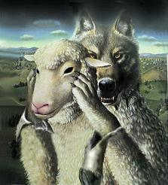
10.智慧地奉献
到处有很多假教师和假事工向你要钱，充实的却是他们自己的荷包，要留心这样的人和机构。这个世界充满了各样合情合理的需求，那么我们应该把钱给哪里？
There are many ministries and false teachers asking for money in order to fill their own pockets. There are also many legitimate needs in the world. So where do I give my money?
10. GIVE WISELY

Slide 30
《圣经》说我们该奉献给哪里？
WHERE DOES THE BIBLE SAY I SHOULD GIVE?

Slide 31
《圣经》说我们该奉献给哪里？
1. 第一优先权是教会和牧师(提前5:17-18;加6:6; 路10:17).
THOSE IN CHRISTIAN SERVICE (CHURCH, PASTORS) (1TIM 5:17-18; GAL 6:6; LUKE 10:17).
* 在道理上受教的,当把一切需用的供给施教的人. 加6;6)
“share all good things with the ones who teach you the Word of God” (Gal. 6:6);
* 那善于管理教会的长老，当以为配受加倍的敬奉。那劳苦传道教导人的，更当如此。(提前5:17-18)
the pastor deserves to be paid well; even double (1 Tim. 5:17-18);
* 他的妻子有权不必工作（林前9:3-7）
His wife should not have to work (1 Cor. 9:3-7);
* 应该让牧师能全心全意地花时间研究和传讲神的话语上（林前9章全部）
a pastor should be able to devote his full time to the study and preaching of the Word (1 Cor. 9: all).
* 认为牧师服事神就该有财务上的困难的想法是不合《圣经》，并令神厌恶的。
To think that just because a pastor is serving God then he must have financial struggles is abhorrent to God and contrary to Scripture. ,
WHERE DOES THE BIBLE SAY I SHOULD GIVE?

Slide 32
《圣经》说我们该奉献给哪里？
2. 有需要的家人: 再说一遍，父母等（提前5:8）
THOSE IN OUR FAMILIES WHO ARE IN NEED
(Aging parents, etc.).(1 timothy 5:8)
3. 宣教士
另一个优先权是帮助那些放弃家庭，朋友，舒适生活和稳定收入，离乡背井，跨文化将福音带给其它民族的宣教士。每当看到宣教士因为生存不下去而不得不离开宣教禾场，而那些声称对失丧的灵魂有负担的信徒却过着奢华放纵的生活，我就难过不已。
MISSIONARIES
Another priority is to help those who have given up their homes, families, friends, and income security to bring the Gospel to other nations, our missionaries. It breaks my heart to see missionaries leave the field because they cannot afford to survive, while others who claim to care about the lost live lavish lifestyles of self-indulgence.
WHERE DOES THE BIBLE SAY I SHOULD GIVE?

Slide 33
《圣经》说我们该奉献给哪里？
4. 教会里的特定事工(林后8-9)
捐输给一些基督徒团体,组织及直接帮助和感化你与主同行的某些个人。包括基督徒电台、杂志、作家、弟兄或姊妹团契、基督徒商人组织或任何其它教导你如何过荣耀神的生活的机构。
CERTAIN MINISTRIES OF YOUR CHURCH (2 CORINTHIANS 8-9)
A fourth priority of giving is to those groups, organizations and individuals that directly influence your walk with the Lord. This may be a radio station, magazine, author, Men’s or Women’s Fellowship group, Christian Businessman’s Organization, or any other avenue that teaches you how to live in a way that glorifies God.
WHERE DOES THE BIBLE SAY I SHOULD GIVE?

Slide 34
《圣经》说我们该奉献给哪里？
5. 那些无力生存的穷人（加2:10;雅2:15-16;路13:11;太25:35-36）
THE POOR WHO CANNOT SURVIVE ON THEIR OWN.
.(Gal. 2:10; James 2:15-16; Lk 13:11; Matt. 25:35-36)
6. 教会里无依无靠的寡妇(提前5:3-16)
CHURCH WIDOWS WHO HAVE NO MEANS OF SUPPORT (1Timothy 5:3-16)
7. 其他有需要的基督徒(林前16:1-2; 罗12:13)
OTHER CHRISTIANS WHO ARE CURRENTLY IN NEED (1 Corinthians 16:1-2; Romans 12:13)
WHERE DOES THE BIBLE SAY I SHOULD GIVE?

Slide 35
我该给多少？
HOW MUCH SHOULD I GIVE?

Slide 36
我该给多少？
从一毛不拔到开始奉献
从开始奉献到系统奉献
从系统奉献到十一奉献
从十一奉献到额外奉献
HOW MUCH SHOULD I GIVE?

Slide 37
这个决定是你跟主做出的
这里仅提供几条建议：
如果你现在奉献的比例是10%,那就从这开始吧.尽管这不是一个要求,我个人发现这是一个很好的起点,在这基础上相应地调整比例
作为信任神的标志，在支付所有的生活开支前就奉献一些出去。
考虑一下一次过从你的额外收入中拿出一笔钱奉献给一个值得的 项目或个人。
尽可能奉献特殊礼物给那些影响你属灵生命的人。
祈求圣灵带领你奉献的数量和位置。
捐得开心。
以一种欣喜若狂的方式奉献.神喜爱的是”乐意”的奉献者(林后9:7)

Slide 38
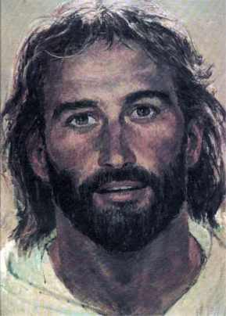
太6:24-34 “一个人不能事奉两个主。不是恶这个爱那个，就是重这个轻那个。你们不能又事奉神，又事奉玛门.”
Matthew 6:24-34 “No one can serve two masters. For you will hate one and love the other; you will be devoted to one and despise the other. You cannot serve both God and money.
选择你爱谁,服事谁,委身于谁. 你不能两者都选。
Choose which one you will LOVE, SERVE, and BE DEVOTED TO. You cannot choose BOTH.

