Slide 1
MARRIAGE 基督徒的婚姻

Slide 2
圣经主题课程
INTENSIVE BIBLE TRAINING PROGRAM

Slide 3
圣经是如何说到婚姻的？
What the Bible says about MARRIAGE

Slide 4
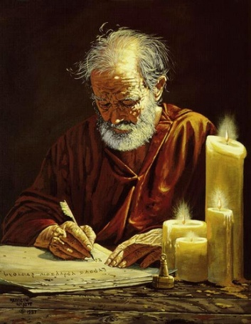
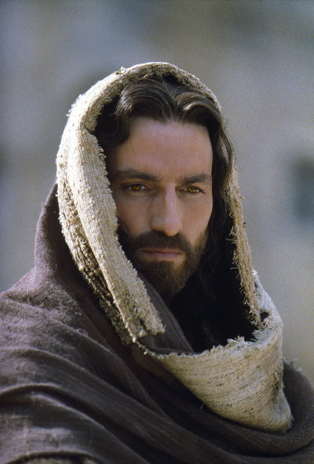
夏娃是从亚当而造. “为这个缘故，人要离开父母，与妻子连合，二人成为一体。 ” 创2:24
Eve was created from Adam. “For this reason, a man shall leave his mother and father and cleave to his wife; and the two shall become one flesh.” Gen. 2:24
耶稣说: “但从起初创造的时候,神造人是造男造女. 因此,人要离开父母,与妻子连合,二人成为一体.既然如此,夫妻不再是两 个人,乃是一体的了. 所以神配合的,人不可分开.”可10:6-9
JESUS SAID… “But at the beginning of creation God ‘made them male and female.’ ‘For this reason a man will leave his father and mother and be united to his wife, and the two will become one flesh.’ So they are no longer two, but one flesh. Therefore what God has joined together, let no one separate.” Mark 10:6-9

Slide 5
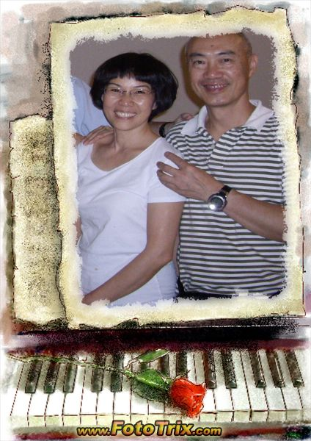
内容概要
夫妻的角色
The Role of the COUPLE
丈夫的角色
The Role of the HUSBAND
妻子的角色
The Role of the WIFE
TODAY’S OUTLINE

Slide 6
最早最重要的人际关系
上帝设立的最早的制度和人际关系——
婚姻。
远早于政府和国家的设立。
THE ROLE OF THE COUPLE

Slide 7
首个婚礼由上帝亲自主持
人类的第一首爱情诗
人类的首个婚礼：在伊甸园里，由上帝自己亲自主持。(创2:24)
你可想过：上帝既是你的天父，同时也是你的岳父或家公？
THE ROLE OF THE COUPLE

Slide 8
婚姻的终极宗旨
展示基督对教会的爱。
“这是极大的奥秘，但我是指着基督和教会说的。”弗5:32
《创世记》2章24节所说的婚姻关系是对基督与教会关系的喻表或象征。
THE ROLE OF THE COUPLE

Slide 9
夫妻的角色
示范神的爱…
EXAMPLE GOD’S LOVE…
向教会
to the CHURCH
向孩子
to their CHILDREN
向世界
to the WORLD
THE ROLE OF THE COUPLE

Slide 10
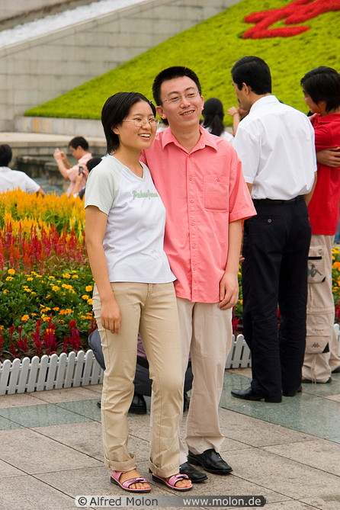
向教会示范神的爱
基督徒夫妇需要榜样, 而不只是讲道.
Christian couples need examples, not just sermons
你们夫妻如何对待对方会帮助其他人看到耶稣是如何爱他们的.
How you treat each other will help others see how much Jesus loves them
EXAMPLE GOD’S LOVE to the CHURCH

Slide 11
向孩子示范神的爱
人们通过观察他们的父母如何对待彼此,而选择如何对待自己的配偶, 或者选择不健康的另一极端.
People usually treat their spouse the way that they saw their parents treat each other, or they go to an unhealthy extreme the other way
如果一个孩子看到的是愤怒的,懒惰的,情绪化的, 争吵不休的父母, 当他听到耶稣爱教会如同丈夫爱自己的妻子时会怎么想？
If a child sees angry, unfaithful, lazy, moody, fighting parents, what will he think of when he hears that the love of Jesus for His church is like that of a man for his wife?
EXAMPLE GOD’S LOVE to their CHILDREN

Slide 12
向世界示范神的爱
一个非基督徒看到你的婚姻会说什么？
What would a non-Christian looking at your marriage say?
“如果基督能使我的婚姻变得像他们那样,我也希望拥有耶稣!”
“If Christ can make my marriage like theirs, I want Him in my life!”
或者 “他们说耶稣给了他们一颗新心, 可我并没有看见。”
OR “They say Jesus creates a new heart in them but I just don’t see it.”
EXAMPLE GOD’S LOVE to the WORLD

Slide 13
今天的内容概要
丈夫的角色
The Role of the HUSBAND
妻子的角色
The Role of the WIFE
夫妻的角色
The Role of the COUPLE
TODAY’S OUTLINE

Slide 14
符合圣经的婚姻角色
心
Heart
魂
Soul
智
Mind
体
Strength
BIBLICAL ROLES IN MARRIAGE

Slide 15
“丈夫当用合宜之分待妻子,妻子待丈夫也要如此. 妻子没有权柄主张自己的身子,乃在丈夫;丈夫也没有权柄主张自己的身子,乃在妻子. 夫妻不可彼此亏负,除非两相情愿,暂时分房,为要专心祷告方可;以后仍要同房,免得撒但趁著你们情不自禁引诱你们.” 林前7:3-5
“The husband should fulfill his marital duty to his wife, and likewise the wife to her husband. The wife does not have authority over her own body but yields it to her husband. In the same way, the husband does not have authority over his own body but yields it to his wife. Do not deprive each other except perhaps by mutual consent and for a time, so that you may devote yourselves to prayer. Then come together again so that Satan will not tempt you because of your lack of self-control.” 1 Cor. 7:3-5

Slide 16
妻子的角色
顺服你的丈夫如同顺服基督
SUBMIT TO YOUR HUSBAND AS UNTO JESUS
满足你丈夫的需求
MEET THE NEEDS OF YOUR HUSBAND
心: 情感需求
HEART: Emotional Needs
魂: 属灵需求
SOUL: Spiritual Needs
智: 心智需求
MIND: Mental Needs
体: 物质需求
STRENGTH: Physical Needs
THE ROLE OF THE WIFE

Slide 17
顺服丈夫如同顺服基督
“你们作妻子的,当顺服自己的丈夫,如同顺服主。 ”
“Wives, submit yourselves to your own husbands”
对于基督徒妻子这不是一个选择
NOT AN OPTION FOR CHRISTIAN WIVES
希腊词 “hypotasso”意思是 “将自己放在服从的位置上;遵从; 放弃控制; 屈服于另一人的意见和劝告.”
The Greek word “hypotasso” means “to put yourself under subjection to; to obey; to surrender control; to yield to another person’s advice or admonition”
该词是希腊文中的军事用语,意思是 “在军事上，军队服从长官的命令.” 在非军事用法上, 是 “自愿地服从, 合作, 担当责任, 肩负重担.”
This word was a Greek military term meaning "to arrange troops in a military fashion under the command of a leader". In non-military use, it was "a voluntary attitude of giving in, cooperating, assuming responsibility, and carrying a burden"
SUBMIT TO YOUR HUSBAND AS UNTO JESUS

Slide 18
顺服丈夫如同顺服基督
“你们作妻子的,当顺服自己的丈夫,”
“WIVES, SUBMIT YOURSELVES TO YOUR OWN HUSBANDS”
“如同顺服主. ”
“AS YOU DO TO THE LORD. ”
“hosper”…如同…同样的方式
“hosper”…JUST AS…IN THE SAME WAY
如果你顺服主耶稣与你顺服丈夫是同一个程度，耶稣会不会高兴？
If you submitted to the Lord Jesus only to the same level you submit to your husband, would Jesus be pleased or not?
SUBMIT TO YOUR HUSBAND AS UNTO JESUS

Slide 19
顺服丈夫如同顺服基督
因为丈夫是妻子的头，如同基督是教会的头，他又是教会全体的救主。
FOR THE HUSBAND IS THE HEAD OF THE WIFE AS CHRIST IS THE HEAD OF THE CHURCH, HIS BODY, OF WHICH HE IS THE SAVIOR
这里给出了理由。丈夫是妻子的头。
The REASON is given here. The husband is the head of the wife.
“如同基督是教会的头” 是什么意思？
What does “JUST AS CHRIST IS THE HEAD OF HIS CHURCH” mean?
SUBMIT TO YOUR HUSBAND AS UNTO JESUS

Slide 20
顺服丈夫如同顺服基督
“教会怎样顺服基督,妻子也要怎样凡事顺服丈夫. ”
”NOW AS THE CHURCH SUBMITS TO CHRIST, SO ALSO WIVES SHOULD SUBMIT TO THEIR HUSBANDS IN EVERYTHING”
教会应该怎样顺服基督？想顺服的时候才顺服吗？半心半意地？牢骚满腹的？还是仁爱敬重地顺服？
How is the church supposed to submit to Christ? Whenever they feel like it? Half-heartedly? Grumbling and complaining? Or lovingly out of respect?
是某些事上？大部分事上？或是凡事上？
In some things? In most things? Or in EVERYTHING?
SUBMIT TO YOUR HUSBAND AS UNTO JESUS

Slide 21
顺服丈夫如同顺服基督
“妻子也当敬重她的丈夫。”
“AND THE WIFE MUST RESPECT HER HUSBAND.”
留意到是“当”，而非“应该”。
Notice the word…”MUST”, not should
没有说“只有当他配得的时候”
It doesn’t say “only when he deserves it”
希腊文里敬重是 “phobio’, 在上下文里意思是出于尊敬而遵守。
The Greek word for respect is “phobio”, which in context means to to obey out of reverence.
这个词在别处译为 “畏惧或恐怖”, 因而有些男人使用这节经文来支持他们对妻子的虐待。
The word is translated elsewhere as “fear or terror” so some men have used this verse as permission to abuse their wives.
Reverend
SUBMIT TO YOUR HUSBAND AS UNTO JESUS

Slide 22
满足你丈夫的需求
心: 情感需求
HEART: Emotional Needs
魂: 属灵需求
SOUL: Spiritual Needs
意: 心智需求
MIND: Mental Needs
体: 物质需求
STRENGTH: Physical Needs
MEET THE NEEDS OF YOUR HUSBAND

Slide 23
心: 情感需求
尊重: 私下和公开场合均要如此
RESPECT: BOTH PRIVATELY AND PUBLICALLY
称赞: 私下和公开场合均要如此
PRAISE: BOTH PRIVATELY AND PUBLICALLY
确认: 因他辛勤劳动供应家人
VALIDATION: FOR THEIR HARD WORK IN PROVIDING
忠贞: 他必须能信任自己的妻子
FAITHFULNESS: HE MUST BE ABLE TO TRUST HIS WIFE
低压力的家: 保护他免受情感闯入者的侵扰
LOW STRESS HOME: PROTECT HIM FROM EMOTIONAL INTRUDERS
HEART: EMOTIONAL NEEDS

Slide 24
以积极和消极方式说同样的事
“为什么你今天不刮胡子？”
“你今天刮胡子吗？”
“我不喜欢你这件衬衣”
“我更喜欢另一件衬衣”
“你总是加班”
“你在家多休息一会儿吧”
“你从未告诉我你还爱我”
“我爱你”
避免使用“总是”,“从不”等夸张负面的词。
POSITIVE and NEGITIVE WAYS TO SAY THE SAME THING

Slide 25
让你的情感银行保持盈余
练习：每说一句负面的话，就要说两句正面的话补偿。
这样练习一段时间后，你的情感银行就能保持盈余，
否则就是负数。
多说称赞表扬的话，少说批评挑剔的话。
POSITIVE and NEGITIVE WAYS TO SAY THE SAME THING

Slide 26
魂: 属灵需求
爱神多于爱你的丈夫
LOVE GOD MORE THAN YOU LOVE YOUR HUSBAND
通过顺服神和你的丈夫表明你对神的爱
SHOW GOD YOU LOVE HIM BY SUBMITTING TO GOD AND YOUR HUSBAND
给他时间独立于你在属灵上成长
ALLOW HIM TIME TO GROW SPIRITUALLY INDEPENDANTLY OF YOU
不要期待即刻或最终的完美
DON’T EXPECT IMMEDIATE OR ULTIMATE PERFECTION
承认并感谢他属灵的成长
ACKNOWLEDGE ALL SPIRITUAL GROWTH IN HIS LIFE
SOUL: SPIRITUAL NEEDS

Slide 27
智: 心智需求
鼓励他(不要唠叨他)去阅读和学习新鲜事物
ENCOURAGE HIM (DON’T NAG HIM) TO READ OR LEARN NEW THINGS
提问题. 表达你对他生活的兴趣. 安静地聆听.
ASK QUESTIONS. SHOW INTEREST IN HIS LIFE. LISTEN QUIETLY
交流是双向的，让他也有机会发言。
COMMUNICATION IS A 2 WAY STREET. LET HIM GET A WORD IN, TOO.
让他不丢面子地成长. 不要说 “我早就告诉过你.”
LET HIM GROW WITHOUT LOOSING FACE. NOT “I TOLD YOU SO”
态度要积极而不要消极。
BE POSITIVE, NOT NEGATIVE
MIND: MENTAL NEEDS

Slide 28
体:物质需求
给丈夫提供三餐和整洁的家居环境
PROVIDE MEALS AND A CLEAN HOME ENVIRONMENT
帮助留意他的健康需求
HELP HIM KEEP AN EYE ON HIS HEALTH NEEDS
意识到他的性需求是正当的(即使他的需求多于你的), 尝试着去满足这些需求.
RECOGNIZE THAT HIS SEXUAL NEEDS ARE VALID (EVEN IF THEY ARE GREATER THAN YOURS) AND ATTEMPT TO MEET HIS NEEDS
提供一个没有唠叨抱怨的环境.
PROVIDE A NAGGING-FREE ENVIRONMENT
STRENGTH: PHYSICAL NEEDS

Slide 29
箴言里智愚两种妻的对照
“智慧之妻建造家室，
愚蠢之妻亲手拆毁.”
(14:1) “The wise woman builds her house but with her own hands the foolish one tears hers down”
“淑善之妻是丈夫头上的冠冕， 贻羞之妇，如同丈夫骨中的朽烂.”
(12:4) A wife of noble character is her husband’s crown, but a disgraceful wife is like decay in his bones.
CONTRASTING WISE & FOOLISH WIVES

Slide 30
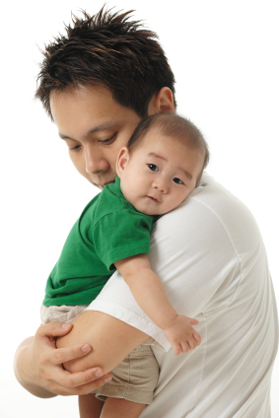
愚妻
蠢妻负面地影响她的家庭。
箴14:1：“愚妻亲手拆毁家室.”
蠢妻使她丈夫蒙羞。
箴12:4 : “贻羞之妇是丈夫骨中的朽烂.”
箴11:22:貌美而无见识的女人，恰如猪鼻子
带着金环。
蠢妻从不控制她的口舌。
箴9:13: “愚昧之妇喧嚣，庸愚，一无所知.”
箴17:1:“吃一块硬饼干而心安理得，
胜过满桌酒肉而相争相吵.”
FOOLISH WIVES

Slide 31
愚妻
蠢妻让丈夫不愿回家。
箴21:19: “可住在荒野，也不要跟爱唠叨、好埋怨的妻子同住.”
箴25:24: “宁愿住在屋顶的一角,也不要
跟爱唠叨的妻子同住宽敞的房屋.”
蠢妻总爱唠叨她丈夫。
箴19:13: “正如愚顽的儿子是父亲的灾祸，
争吵不休的妻子是丈夫的不幸.”
蠢妻爱在亲朋面前传丈夫的闲话。
箴26:20 “缺了柴，火就熄灭；无人传闲话、纷争便止息.”
箴17:9“宽恕别人过错的，得人喜爱；不忘旧恨的，破坏友谊.”
FOOLISH WIVES

Slide 32
智妻
贤妻因其淑善之德而受人尊敬。
(11:16) “温雅良善的女子会受尊荣.”
贤妻乃冠冕妻， 而非花瓶妻。
箴言31:10-31
WISE WIVES

Slide 33
冠冕妻 (箴31:10-31)
她的价值胜过男人一生所得财富。
她忠于自己的丈夫,并取得丈夫的高度信任。
她丈夫不会觉得需要用金钱才能取悦于她。
她一生她所作的对丈夫都有益无损。
她走出去觅选羊毛和麻，花好价钱购买。
她不闲散懒惰,总是亲手将该做的事做好。
她善待为她做工的人。
她善于持家,能做出明智的购买决定。
她努力为丈夫保持体态身材。
她不惧繁重工作。
WISE WIVES

Slide 34
冠冕妻 (箴31:10-31)
她张开手周济困苦人；伸出手帮补贫穷人。
她不因下雪而为家里的人担心，因为她全家都穿着温暖衣裳。
她穿戴得体，讨她丈夫喜悦。
她是个高尚体面的人。
她期待一个充满光明幸福的未来。
她开口就发智慧，她舌上显出仁慈。
她悉心照顾家人。
她的丈夫在人前对她赞赏有加。
她不依仗自己的美貌，知道美貌终将消退。
WISE WIVES

Slide 35
给妻子们的经文 BIBLE VERSES FOR WIVES

Slide 36
给妻子们的经文
“才德的妇人是丈夫的冠冕；贻羞的妇人如同朽烂在她丈夫的骨中.”（箴12:4）
“ A wife of noble character is her husband’s crown, but a disgraceful wife is like decay in his bones.” (Pr. 12:4)
“妇女美貌而无见识，如同金环带在猪鼻上。”(箴11:22)
“Like a gold ring in a pig’s snout is a beautiful woman who shows no discretion.” (Prov. 11:22)
BIBLE VERSES FOR WIVES

Slide 37
给妻子们的经文
“宁可住在房顶的角上,不在宽阔的房屋与争吵的妇人同住.” (箴21:9)
“Better to live on a corner of the roof than share a house with a quarrelsome wife.” (Pr. 21:9)
“妻子的争吵,如雨连连滴漏.”(箴19:13)
“a quarrelsome wife is like the constant dripping of a leaky roof.” (Pr. 19:13)
“艳丽是虚假的,美容是虚浮的,惟敬畏耶和华的妇女必得称赞! ”(箴31:30)
“Charm is deceptive, and beauty is fleeting; but a woman who fears the LORD is to be praised.” (Pr. 31:30)
BIBLE VERSES FOR WIVES

Slide 38
“你们作妻子的要顺服自己的丈夫。这样，若有不信从道理的丈夫，他们虽然不听道，也可以因妻子的品行被感化过来。这正是因看见你们有贞洁的品行和敬畏的心。你们不要以外面的辫头发、戴金饰、穿美衣为妆饰，只要以里面存著长久温柔、安静的心为妆饰，这在神面前是极宝贵的。因为古时仰赖神的圣洁妇人，正是以此为妆饰，顺服自己的丈夫，就如撒拉听从亚伯拉罕，称他为主。你们若行善，不因恐吓而害怕，便是撒拉的女儿了。 ”(彼前3:1-6)
“ Likewise, wives, be subject to your own husbands, so that even if some do not obey the word, they may be won without a word by the conduct of their wives, when they see your respectful and pure conduct. Do not let your adorning be external—the braiding of hair and the putting on of gold jewelry, or the clothing you wear— but let your adorning be the hidden person of the heart with the imperishable beauty of a gentle and quiet spirit, which in God's sight is very precious. For this is how the holy women who hoped in God used to adorn themselves, by submitting to their own husbands” (! Pet. 3:1-6)

Slide 39
给妻子们的经文
“又劝老年妇人，举止行动要恭敬，不说谗言，不给酒作奴仆，用善道教训人, 好指教少年妇人爱丈夫，爱儿女” (多2:3-4)
“ Likewise, teach the older women to be reverent in the way they live, not to be slanderers or addicted to much wine, but to teach what is good. Then they can urge the younger women to love their husbands and children” (Titus 2:3-4)
BIBLE VERSES FOR WIVES

Slide 40
推荐电影: 消防员
Recommended Movie: FIREPROOF

