Slide 1
基础 研经法

Slide 2
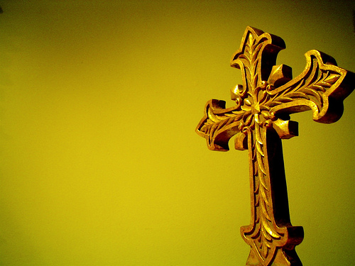
FAMOUS QUOTES
著名
引述

Slide 3
“God himself has condescended to teach me the way. He has written it down in a book. Oh, give me that book! At any price give me the book of God. Let me be a man of one book.”John Wesley
“上帝纡尊降贵地教导我祂的道路，并将之写在一本书里. 哦,快给我那本书! 不惜一切代价给我那本书. 让我成为《圣经》人.”
—约翰·卫斯理

Slide 4
“The Word of God well understood and religiously obeyed is the shortest route to spiritual perfection. And we must not select a few favorite passages to the exclusion of others. Nothing less than a whole Bible can make a whole Christian.” - AW. Tozer
“恰当地理解和遵守《圣经》是通向属灵完美的最短路径. 我们决不能挑选一些喜欢的经文而排除其余的经文.完整的圣经才能产生完整的基督徒.”
— 陶恕

Slide 5
“One of these days some simple soul will pick up the Book of God, read it, and believe it. Then the rest of us will be embarrassed.” -Leonard Ravenhill
“总有一天会有些单纯的灵魂拿起《圣经》阅读, 并相信《圣经》的话. 那我们其余的人将感到无地自容.”
—雷欧纳牧师

Slide 6
“I am much afraid that schools will prove to be the great gates of hell unless they diligently labor in explaining the Holy Scriptures, engraving them in the hearts of youth. I advise no one to place his child where the scriptures do not reign paramount.” -Martin Luther
“除非学校勤于解经，并将真理雕刻在年轻人的心上,否则恐怕学校将会被证明是通向地狱的巨大门户. 我建议你不要将孩子送往不高举《圣经》的学校.”
—马丁·路德

Slide 7
"I believe the Bible is the best gift God has ever given to man. All the good from The Savior of the world is communicated to us through this Book.“ Abraham Lincoln (1809-1865), 16th U.S. President
“我相信圣经是神给人类最好的礼物. 从救主而来的一切益处都是透过圣经向我们传达的.”
—亚伯拉罕·林肯（1809-1865）第十六界美国总统

Slide 8
“Ignorance of Scripture is ignorance of Christ.” Jerome, A.D. 340-420
“对圣经无知就是对基督无知.”
— 哲罗姆.
公元340-420年

Slide 9
“We fail in our duty to study God's Word not so much because it is difficult to understand, not because it is dull and boring, but because it is work. Our problem is not a lack of intelligence or a lack of passion. Our problem is that we are lazy.” — R.C. Sproul
“我们没有尽本分学习《圣经》并非因为其难于理解或枯燥无味，乃是因为这是一项工作.我们的问题也不是缺少智力和激情,而是懒惰.”
— R.C.斯普劳尔

Slide 10
“…the common people cry out for the scripture, to know it, and obey it, with great cost and peril to their lives” ---- Prologue to the Wyclif Bible, c. 1395.
“…平民大众迫切需要圣经，渴望了解之,遵行之,哪怕付出巨大代价,甚至冒生命危险也在所不惜.”
—《威克里夫圣经》的序言

Slide 11
基础研经法 BASIC BIBLE STUDY

Slide 12
介绍 Introduction

Slide 13
目标: Goals
激发研究神话语的强烈愿望
Create a desire to study God’s Word more
学习观察的基本法则
Learn basic rules of Observation
学习释经的基本法则
Learn basic rules of Interpretation
学习应用的基本法则
Learn basic rules of Application

Slide 14
研经时不该做的事 How NOT to study the Bible
将经文段落抽出语境（摸奖式）
Taking passages out of context (Lucky Dip)
寻找经文支持你的教义
Looking for verses to support your beliefs
未明白真理前就应用
Applying before Understanding the Truth
将每句话都属灵化
Spiritualizing every text

Slide 15
人们说他们不研经的原因… Why people say they DO NOT study the Bible…
“很乏味”
“It’s boring”
“我看不懂所读的经文”
“I don’t understand what I’m reading”
“我不知道如何研经”
“I don’t know how to study the Bible”
“没有时间”
“I don’t have time”
“跟我的生活没关系”
“It’s not relevant to my life”
我听到的最可笑的理由是…
The silliest excuse I HAVE EVER HEARD IS…
这些都
是借口…
不是充
分的原因!
THESE ARE EXCUSES…
NOT GOOD REASONS!

Slide 16
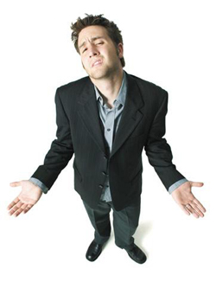
我已经读了《圣经》…我已经知道了.为什么还要不断地读它？
I have read the Bible.. I already know it.
Why should I keep reading it?

Slide 17
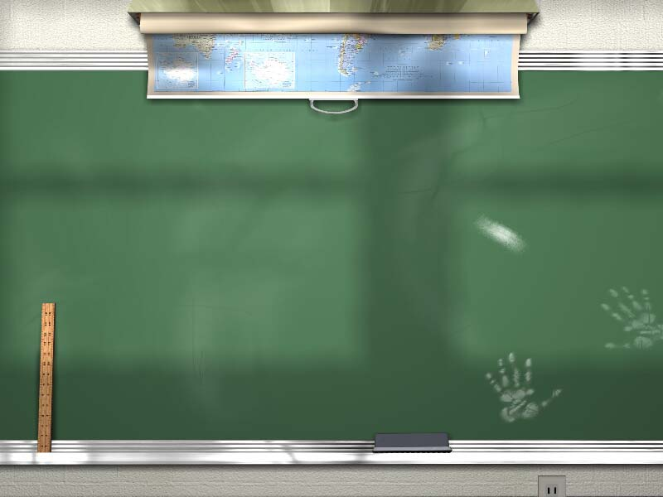
快速测试: 真和假 (Quick Test: True or False)

Slide 18
真: TRUE
假: FALSE
方舟里每种动物和鸟的数量是2.
There were 2 of every animal and bird on the ark.

Slide 19
创7:2-3 “凡洁净的畜类，你要带七公七母;不洁净的畜类,你要带一公一母;空中的飞鸟也要带七公七母,可以留种,活在全地上.”
Gen. 7:2-3 “Take with you seven of every kind of clean animal, a male and its mate, and two of every kind of unclean animal, a male and its mate, and also seven of every kind of bird, male and female, to keep their various kinds alive throughout the earth.”
假: FALSE
方舟里每种动物和鸟的数量是2.
There were 2 of every animal and bird on the ark.

Slide 20
真: TRUE
假: FALSE
以色列十二支派是按雅各十二儿子而命名的。
The 12 Tribes of Israel are named after the 12 sons of Jacob (Israel)

Slide 21
其中两个支派是按约瑟的儿子以法莲和玛拿西(雅各的孙子) 而命名的。
2 of the tribes are named after Joseph’s sons Ephraim and Manasseh (Jacob’s grandsons)
假: FALSE
以色列十二支派是按雅各十二儿子而命名的。
The 12 Tribes of Israel are named after the 12 sons of Jacob (Israel)

Slide 22
真: TRUE
假: FALSE
摩西的手杖在法老面前变成了蛇。
Moses’ staff turned into a snake in front of Pharoah

Slide 23
手杖属于摩西的兄长亚伦.
The staff belonged to Moses’ brother Aaron
假: FALSE
摩西的手杖在法老面前变成了蛇。
Moses’ staff turned into a snake in front of Pharaoh

Slide 24
真: TRUE
假: FALSE
约拿在鲸的肚子里呆了三天.
Jonah was in the belly of a whale for 3 days

Slide 25
他呆在鱼肚里. 鲸是哺乳动物.
He was in a FISH. A whale is a mammal.
假: FALSE
约拿呆在鲸肚子里三天.
Jonah was in the belly of a whale for 3 days

Slide 26
真: TRUE
假: FALSE
神在巴别塔变乱语言, 因为人试图建一个通天塔…
God changed the languages at Babel because the people
were trying to build a tower to reach heaven…

Slide 27
耶和华说: “看哪！他们成为一样的人民,都是一样的言语,如今既做起这事来,以后他们所要做的事就没有不成就的了.我们下去,在那里变乱他们的口音, 使他们的言语彼此不通.”
“The LORD said, "If as one people speaking the same language they have begun to do this, then nothing they plan to do will be impossible for them. Come, let us go down and confuse their language so they will not understand each other.“ Gen. 11:6-7
假: FALSE
神在巴别塔变乱语言, 因为人试图建一个通天塔…
God changed the languages at Babel because the people were trying to build a tower to reach heaven…

Slide 28
研经理由 (Reasons to Study the Bible)

Slide 29
理由一 (Reason #1) 神要你如此做！ God told you to!

Slide 30
“你当竭力在神面前得蒙喜悦,作无愧的工人, 按着正意分解真理的道.” （提后2:15）
“Study to show yourself approved unto God, a workman that does not need to be ashamed, rightly dividing the word of truth.” (2 Timothy 2:15)

Slide 31
理由二 (Reason #2) 这样你不会跟着骗子走！ So you won’t follow deceivers!

Slide 32
“不听犹太人荒渺的言语和离弃真道之人的诫命. 他们说是认识神,行事却和他相背;本是可憎恶的,是悖逆的,在各样善事上是可废弃的.” （提多1:14,16）
“Not giving heed to Jewish fables, and commandments of men, that turn from the truth. .... They profess that they know God; but in works they deny him, being abominable, and disobedient, and unto every good work reprobate.” (Titus 1:14 ,16)

Slide 33
理由三 (Reason #3) 知道救恩 的真理！ To know the TRUTH about SALVATION!

Slide 34
“并且知道你是从小明白圣经,这圣经能使你因信基督耶稣,有得救的智慧.” （提后3:15）
“…and how from infancy you have known the holy Scriptures, which are able to make you wise for salvation through faith in Christ Jesus.” (2 Timothy 3:15)

Slide 35
理由四 (Reason #4) 圣灵通过圣经学习带领我们！ The Spirit leads us through Bible Study!

Slide 36
“只等真理的圣灵来了,他要引导你们明白(原文作进入)一切的真理;因为他不是凭自己说的,乃是把他所听见的都说出来,并要把将来的事告诉你们.” （约16:13）
“But when He, the Spirit of truth, comes, He will guide you into all the truth; for He will not speak on His own initiative, but whatever He hears, He will speak…” (John 16:13)

Slide 37
理由五 (Reason #5) 认识真理！ To know Truth!

Slide 38
“你话的总纲是真实;你一切公义的典章是永远长存.” (诗119:160)
“The sum of Your Word is truth; and every one of Your righteous ordinances is everlasting.” (Psalm 119:160)

Slide 39
理由六 (Reason #6) 预备自己行神要我们做的事！ To prepare us for what God calls us to do!

Slide 40
“圣经都是神所默示的(或作:凡神所默示的圣经),于教训,督责,使人归正,教导人学义都是有益的,叫属神的人得以完全,预备行各样的善事.” （提后3:16-17）
“All Scripture is God-breathed and is useful for teaching, rebuking, correcting and training in righteousness, so that the man of God may be thoroughly equipped for every good work.” (2 Tim. 3:16-17)

Slide 41
理由七 (Reason #7) 明白教义！ To know sound doctrine!

Slide 42
“你若将这些事提醒弟兄们,便是基督耶稣的好执事,在真道的话语和你向来所服从的 善道上得了教育.” （提前4:6）
“In pointing out these things to the brethren, you will be a good servant of Christ Jesus, constantly nourished on the words of the faith and of the sound doctrine which you have been following.” (1 Timothy 4:6)

Slide 43
理由八 (Reason #8) 有得救的确信！ To have assurance of our salvation!

Slide 44
“我将这些话写给你们信奉神儿子之名的人,要叫你们知道自己有永生.” （约一5:13）
“I write this to you who believe in the Son of God, so that you may know you have eternal life.” (1 John 5:13)

Slide 45
研经的两种方式
TWO WAYS TO STUDY THE BIBLE

Slide 46
原意解经：归纳式 (Exegesis: Inductive)
观察
Observe
解释
Interpret
找到真理Find truth
私意解经：演绎式 (Eisegesis: Deductive)
我的 观点 My opinion
找到 支持 Find support
教导观点Teach opinion

Slide 47
阅读 (READ)
应用 (APPLICATION)
观察 (OBSERVATION)
解释 (INTERPRETATION)

Slide 48
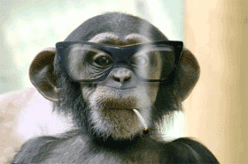
解释 (Interpretation)
发现段落中作者的原始意图。
应用 (Application)
根据圣经的教导作出生命的改变。
To make life changes based on the teachings of the Bible
Discovering the author’s original intent of the passage
Observe and list the facts of the passage
观察和列出段落的所有事实。
观察 (Observation)

