Slide 1
基础研经法 BASIC BIBLE STUDY

Slide 2
步骤2: Step 2 观察 Observation

Slide 3
研经的两种方式
TWO WAYS TO STUDY THE BIBLE

Slide 4
原意解经：归纳式 (Exegesis: Inductive)
观察
Observe
解释
Interpret
找到真理
Find truth
私意解经：演绎式 (Eisegesis: Deductive)
我的观点
My opinion
找到支持
Find support
教导观点
Teach opinion

Slide 5
阅读 (READ)
应用 (APPLICATION)
观察 (OBSERVATION)
解释 (INTERPRETATION)

Slide 6
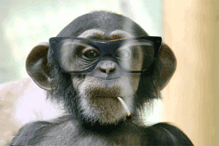
解释 (Interpretation)
发现文本中作者的原始意图。
应用 (Application)
根据圣经的教导作出生命的改变。
To make life changes based on the teachings of the Bible
Discovering the author’s original intent of the passage
Observe and list the facts of the passage
观察和列出段落的所有事实。
观察 (Observation)

Slide 7
观察 (Observation)观察
观察和列出段落的所有事实。
Observe and list the facts of the passage.

Slide 8
观察的规则: Review: Rules of Observation
1) 不要假设你最初的理解是正确的理解
Don’t assume your initial understanding is the true understanding 2) 提出你能想到的所有问题 Ask every question you can think of 3) 看看其他人怎样看待你的结论（历史和当代） See what others think of your conclusion (historical & Contemporary) 4) 必须先观察（提问），再释经（回答），
然后方能应用。 OBSERVATION (asking) must be followed by INTERPRETATION (answering) before we can do any APPLICATION.

Slide 9
你能数出多少四方盒子？ How many boxes can you make?

Slide 10
你能做出多少盒子？ How many boxes can you make?
+1=30
16
9
4

Slide 11
笔不离开纸，画四条连接线，一次性穿过每个点。在你尝试了两个不同方法后，考虑一下你给自己设立了什么限制。 Without lifting your pen from the paper, draw four straight, connected lines that go through each dot only once. After you have tried two different ways, consider what restrictions you may be putting on yourself.

Slide 12
笔不离开纸，画四条连接线，一次性穿过每个点。 在你尝试了两个不同方法后，考虑一下你给自己设立了什么限制。 Without lifting your pen from the paper, draw four straight, connected lines that go through each dot only once. After you have tried two different ways, consider what restrictions you may be putting on yourself.

Slide 13
福尔摩斯之谜 SHERLOCK HOLMES RIDDLES

Slide 14
福尔摩斯来到一个罪案现场。被害人是房子主人，他瘫坐在椅子上一动不动，头上有个弹孔。地板上有一把枪，桌子上放着一个卡式录音机。福尔摩斯按下按钮，他听到这样的信息：“我一生犯下了滔天大罪，现在我将灵魂交给上主。” 接着就是一声枪响。福尔摩斯微笑了一下，马上通知警察说这是一桩谋杀案。为什么他得出这个结论呢？
Sherlock breaks into a crime scene. The victim is the owner who is slumped dead on a chair and have a bullet hole in his head. A gun lies on the floor and a cassette recorder is found on the table. On pressing the play button, Sherlock hears the message 'I have committed sins in my life and now I offer my soul to the great Lord' and followed a gunshot Sherlock smiles and informed the police that's its a murder. Why did he think so?

Slide 15
一个死人在枪响之后如何能将录音带倒回到开头 ？
How can a dead person rewind back the tape himself after the gunshot?

Slide 16
这是一个大富家庭，他们住在一座圆形房子里。他们有一个女佣，一个管家，还有一个园丁。“你们今天都做了什么？”这个富人问到。管家说：“我洗了衣服.”女佣说:“我正在清扫房角.”, 园丁说:“我正在浇灌植物. ”谁在撒谎呢？
There was a very rich family, they lived in a big circular house. They had a maid,
a butler, and a gardener. “What did you do today?” asked the rich man. The butler said, “I washed the clothes”, the maid said, “I was dusting the corners”, and the gardener said, I was watering the plants.” Which one was lying?

Slide 17
女佣。她说她当时正在打扫房角。 这是一座圆屋，她如何打扫房角呢？
THE MAID. She said she was dusting the corners. Its a circular house, how can she be dusting the corners.

Slide 18
找出十二处差异
FIND 12 DIFFERENCES

Slide 19
找出十二处差异
FIND 12 DIFFERENCES

Slide 20
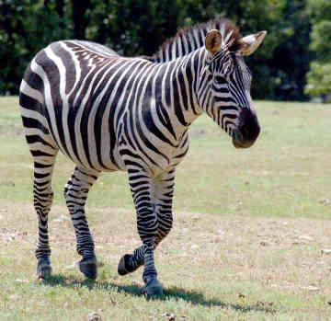
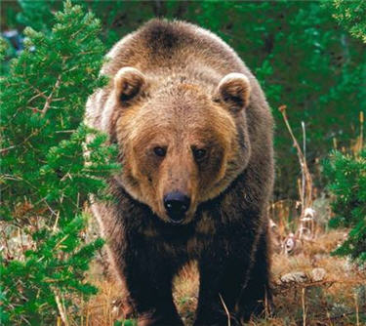
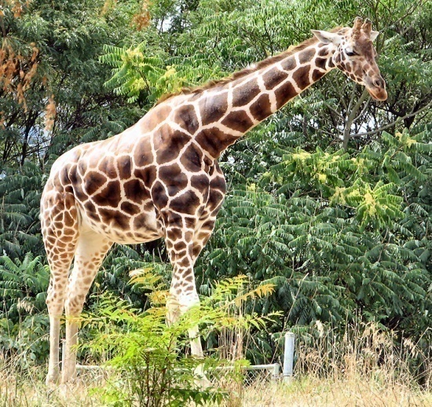
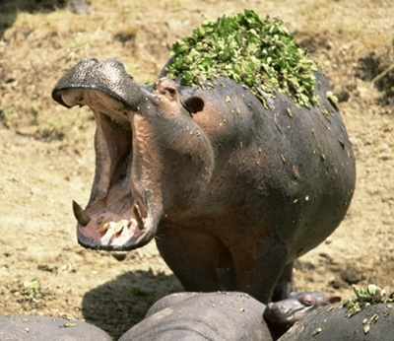
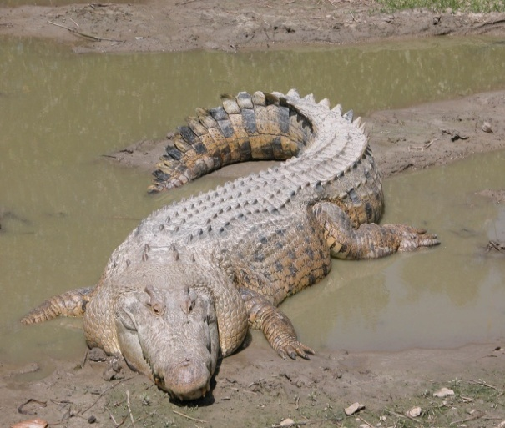
观察练习 (Observation Practice)
哪个不属于此类？ (Which one doesn’t fit?)

Slide 21
复习:观察的规则: Review: Rules of Observation
1) 不要假设你最初的理解是正确的理解
Don’t assume your initial understanding is the true understanding 2) 提出你能想到的所有问题 Ask every question you can think of 3) 看看其他人怎样看待你的结论（历史和当代） See what others think of your conclusion (historical & Contemporary) 4) 必须先观察（提问），再释经（回答），
然后方能应用。 OBSERVATION (asking) must be followed by INTERPRETATION (answering) before we can do any APPLICATION.
5) 通过下面的练习加强你的批判性思维技巧 Sharpen your critical thinking skills through puzzles and riddles.

Slide 22
正确提问 (Asking the Right Questions)
谁 (WHO)
什么 (WHAT)
何时 (WHEN)
哪里 (WHERE)
为何 (WHY)
如何 (HOW)

Slide 23
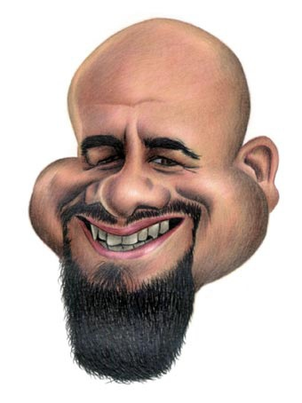
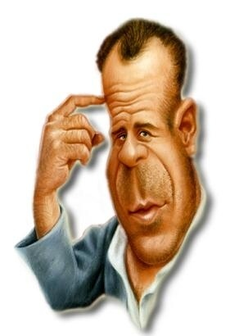
总是以提问开始 (always start by asking…)
为什么 (why?)
谁写的 (from who?)
写给谁 (to who?)

Slide 24
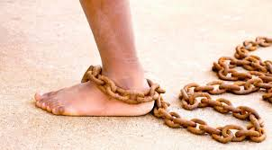
今日文本：腓利门书 (TODAY’S TEXT: PHILEMON)

Slide 25
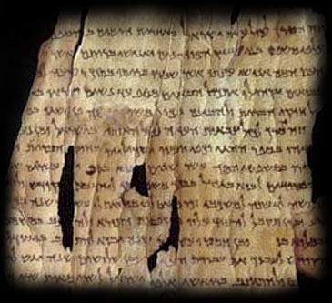
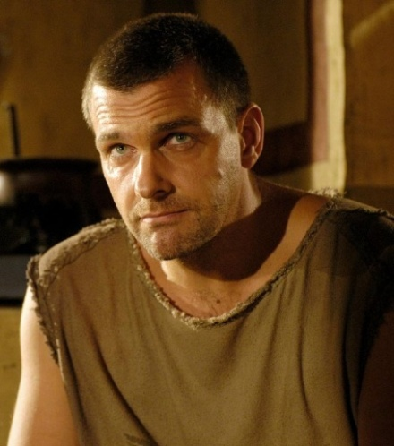
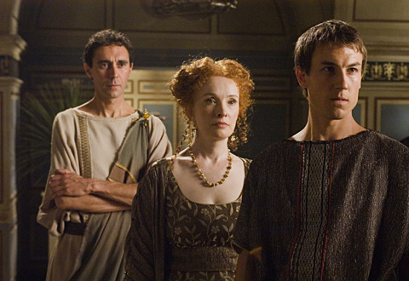
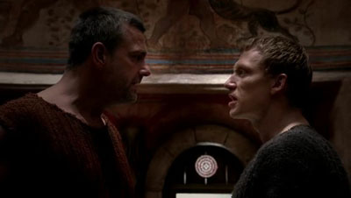
复述《腓利门书》 的故事 (Review the Story of Philemon)

Slide 26
谁? WHO?
谁是此信的作者（或作者们）？
Who was the author (or authors) of this letter?
谁是收信人（或收信人们）？
Who was the recipient (or recipients) of this letter?
谁是送信人？
Who was the deliverer of this letter?
这封信还涉及谁 ？
Who else is included in this letter?

Slide 27
《腓利门书》的样板问题： (Sample Questions from Philemon: WHO?)
谁
谁是此信的作者（或作者们）？
Who was the author (or authors) of this letter?
谁是收信人（或收信人们）？
Who was the recipient (or recipients) of this letter?
谁是送信人？
Who was the deliverer of this letter?
who
where
when
what
why
how
谁
哪里
何时
什么
为何
如何

Slide 28
什么 WHAT?
这封书信的背景是什么？
What is the background of this letter?
这封书信的用意是什么？
What is the purpose of this letter?

Slide 29
这封书信的背景是什么？
What is the background of this letter?
这封书信的用意是什么？
What is the purpose of this letter?
这封信是什么风格 ？
What is the style of this letter?
故事:可能是真实的或只是个例子
(Story: might be true or just an example)
寓言:用于教导一个教训
(Parable: Used to teach a lesson)
箴言:一般性规律，不是应许
(Proverb: a general rule, not a promise)
诗歌:通过歌曲和散文而教导
(Poetry: Teaching through song or prose)
比喻: 常见表达方式
(Figures of Speech: common expression)
预言: 告知未来事件
(Prophecy: Telling of a future event)

Slide 30
《腓利门书》的样板问题： (Sample Questions from Philemon: WHAT?)
什么
这封书信的背景是什么？
What is the background of this letter?
这封书信的用意是什么？
What is the purpose of this letter?
who
where
when
what
why
how
谁
哪里
何时
什么
为何
如何

Slide 31
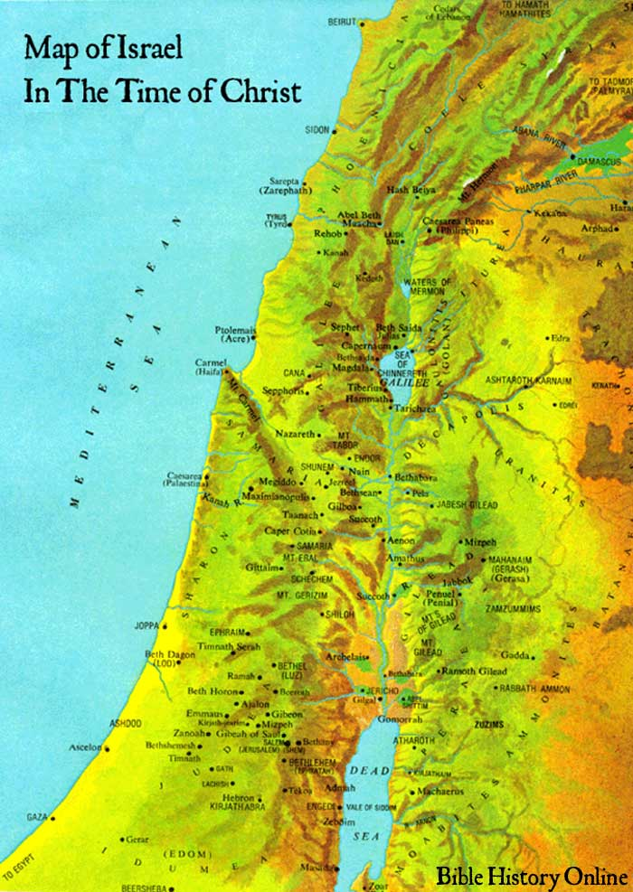
哪里？WHERE?
在地图上找出相关的地方。
Find on a MAP the Relevant Places
信在哪里写成？
Where was it written from?
如何影响信的上下文？
How does this influence the context?
信要寄往哪里？
Where was it written to?
这点如何影响我们理解此信？
How does this affect our understanding of the letter?

Slide 32
《腓利门书》的样板问题： (Sample Questions from Philemon: WHERE?)
哪里
在地图上找出相关的地方。
Find on a MAP the Relevant Places
信在哪里写成？信要寄往哪里？
Where was it written from? Written TO?
如何影响信的上下文？
How does this influence the context?
who
where
when
what
why
how
谁
哪里
何时
什么
为何
如何

Slide 33
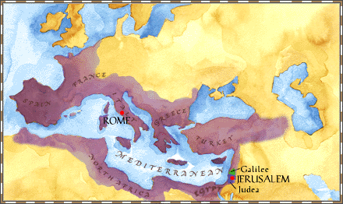
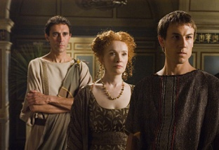

Slide 34
何时？WHEN?
历史概览 Historical overview
书信何时写成？ When was the letter written?
历史背景是什么？ What was the historical context of the letter?
社会结构背景是什么？What was the social structure context of the letter?
政治背景是什么？ What was the political context of the letter?
宗教背景是什么？ What was the religious context of the letter?
经济背景情况是什么？What was the economic context situation of the letter?
法律背景情况是什么？What was the legal context situation of the letter?
家庭背景情况是什么？What was the family context situation of the letter?
建筑背景情况是什么？What was the architectural context situation of the letter?
旅行背景情况是什么？What was the travel context situation of the letter?
农业背景情况是什么？What was the agricultural context situation of the letter?
地理背景情况是什么？ What was the geographical context situation of the letter?
饮食背景情况是什么？What was the dietary context situation of the letter?
军事背景情况是什么？What was the military context situation of the letter?

Slide 35
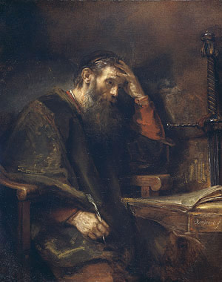
《腓利门书》的样板问题: (Sample Questions from Philemon: When?)
何时
书信何时写成？
历史背景是什么？
什么原因导致作者写这卷书 ？
还有哪些具体问题需要弄清楚 ？
who
where
when
what
why
how
谁
哪里
何时
什么
为何
如何

Slide 36
为何？ WHY?
为何神要将这信收入《圣经》？
Why did God include this in Scripture?
为何神要我读这卷书？
Why does He want ME to read it?
为何要写这信？
Why was this letter written?

Slide 37
《腓利门书》的样板问题： (Sample Questions from Philemon: WHY?)
为何
为何神要将这信收入《圣经》？
Why did God include this in Scripture?
为何神要我读这卷书？
Why does He want ME to read it?
为何要写这信？
Why was this letter written?
who
where
when
what
why
how
谁
哪里
何时
什么
为何
如何

Slide 38
如何? HOW?
收信人如何反应？
How did the recipient(s) respond?
我们应该如何反应？
How should we respond?

Slide 39
《腓利门书》的样板问题： (Sample Questions from Philemon: HOW?)
如何
收信人如何反应？
How did the recipient respond?
我们应该如何反应？
How should we respond?
who
where
when
what
why
how
谁
哪里
何时
什么
为何
如何

