Slide 1
基础研经法 BASIC BIBLE STUDY

Slide 2
步骤四: Step 4 应用 Application

Slide 3
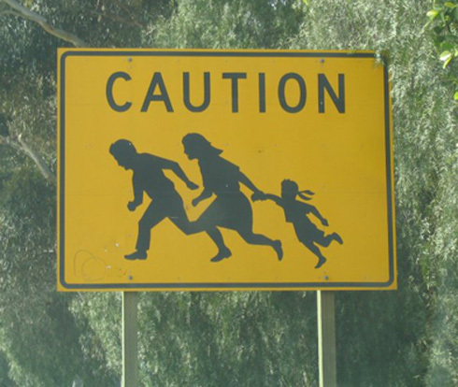
以下的加州路标是什么意思？ What do the following California signs mean?

Slide 4
以下的加州路标是什么意思？ What do the following California signs mean?
有些标志容易明白和应用 Some signs are easy to understand and apply
有些经文容易明白和应用 Some Bible verses are easy to understand and apply

Slide 5
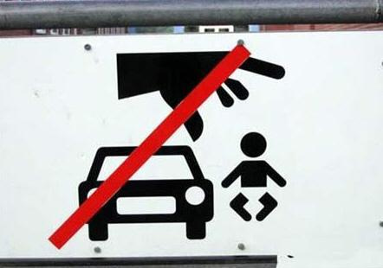
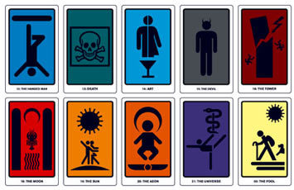
有些标志较难理解和应用 Some signs are harder to understand and apply
有些经文没有解释会较难理解和应用 Some Bible verses are harder to understand and apply without some explanation.
勿猜测；
找出答案 Don’t guess. Find out.

Slide 6
研究圣经的四 步骤 The 4 Steps of Bible Study
阅读 (READ)
应用 (APPLICATION)
观察 (OBSERVATION)
解释 (INTERPRETATION)

Slide 7
阅读: 多次练习多种文本
READ: Multiple times in various texts

Slide 8
观察:问对所有的问题
OBSERVE: Ask all the right questions

Slide 9
谁 (WHO)
什么 (WHAT)
何时 (WHEN)
哪里 (WHERE)
为何 (WHY)
如何 (HOW)

Slide 10
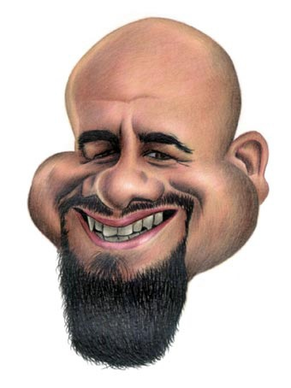
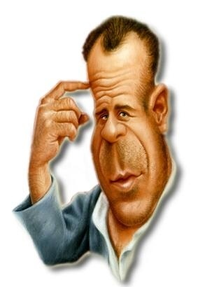
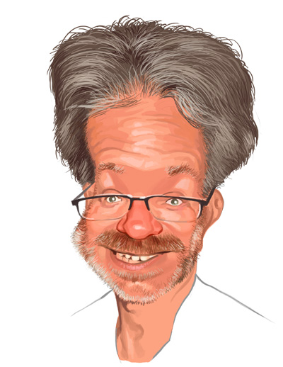
总是以提问开始 (always start by asking)
写给谁？(to who?)
谁写的？ (from who?)
为何写？ (why?)

Slide 11
解释: 获得正确的答案
INTERPRET: Get the right answers

Slide 12
“发现段落中作者的原始意图” “Discovering the author’s original intent of the passage”
字面解经 (Literal Interpretation)
经文对照 (Scripture Comparison)
教义一致 (Doctrinal Consistency)
上下文 (Context)
历史解释 (Historical Interpretation)
文学体裁 (Literary Form)

Slide 13
一旦你明白了经文的意思（释经），你的责任就是将之付诸实践。准确的释经和准确的应用取决于你准确的观察。因此，培养观察的技能必不可少，尽管一开始似乎有难度，且耗时耗力。（坚持不懈！）
Once you know what the passage means (interpretation), you are responsible to put it into practice in your own life. Accurate interpretation and correct application rest on the accuracy of your observations. Therefore, it is vital that you develop observation skills which might, at first, seem difficult, laborious, and time-consuming. (Persevere!)

Slide 14
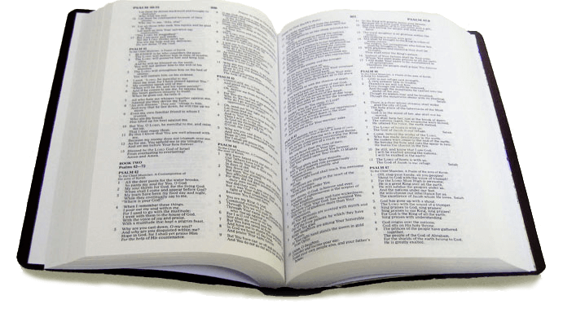
比较：圣经的一贯性
COMPARE: Scriptural Consistency

Slide 15
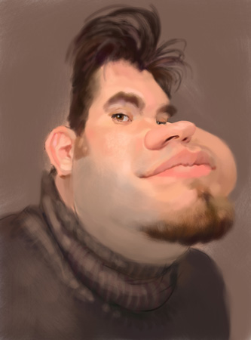
与其它经文对照 (COMPARE with other SCRIPTURE)
腓利门24 (Philemon 24)
歌罗西书4:14 (Colossians 4:14)
提后4:10 (2 Tim. 4:10)
底马
(Demas)

Slide 16
应用：我现在该做什么？
APPLY: WHAT DO I DO NOW?

Slide 17
定义:在研经中，应用是将你(通过观察和解释)发现的真理使用到生活中，以达到最终转变生命的目的。
DEFINITION: In Bible study, application is putting truth you've discovered (through observation and interpretation) to use in your life with the ultimate goal of transformation or life change.
研经目的并非只是增加信息而是转变生命。
Bible study is meant not merely to inform but to transform us.
应用是讲道中最重要的，但却是最被忽略的阶段。
Application is the most neglected yet the most needed stage in the process of preaching.

Slide 18
应用预测试
APPLICATION PRE-TEST

Slide 19
做一个应用预测试
只读一遍指定经文，不要阅读上下文。
Read the given passage ONE TIME without reading the context.
读完一遍后选择你认为最合适的答案。
Choose which answer looks the best after one reading.
你只有几分钟来回答这几个问题。
You have 15 minutes to finish 7 questions.
不要倒回去检查你的答案。
DO NOT go back and check your answers.
APPLICATION PRE-TEST

Slide 20
应用预测试
利未记19:28
基督徒不应该纹身
犹太人不应该纹身
旧约时期的犹太人不应该纹身
2. 雅各书2:20
若无好行为，我们的信心
就会死亡
我们一定要有信心和好行
为才能取悦神
真信心一定会产生好行为。
3.玛拉基书3:8-9
基督徒应做十一奉献
旧约犹太人应做十一奉献。
犹太人和基督徒都应做十一奉献。
4. 腓立比书4:13
上帝会帮助你成功
上帝会帮助你知足
上帝能在一切事上帮助你 。
APPLICATION PRE-TEST

Slide 21
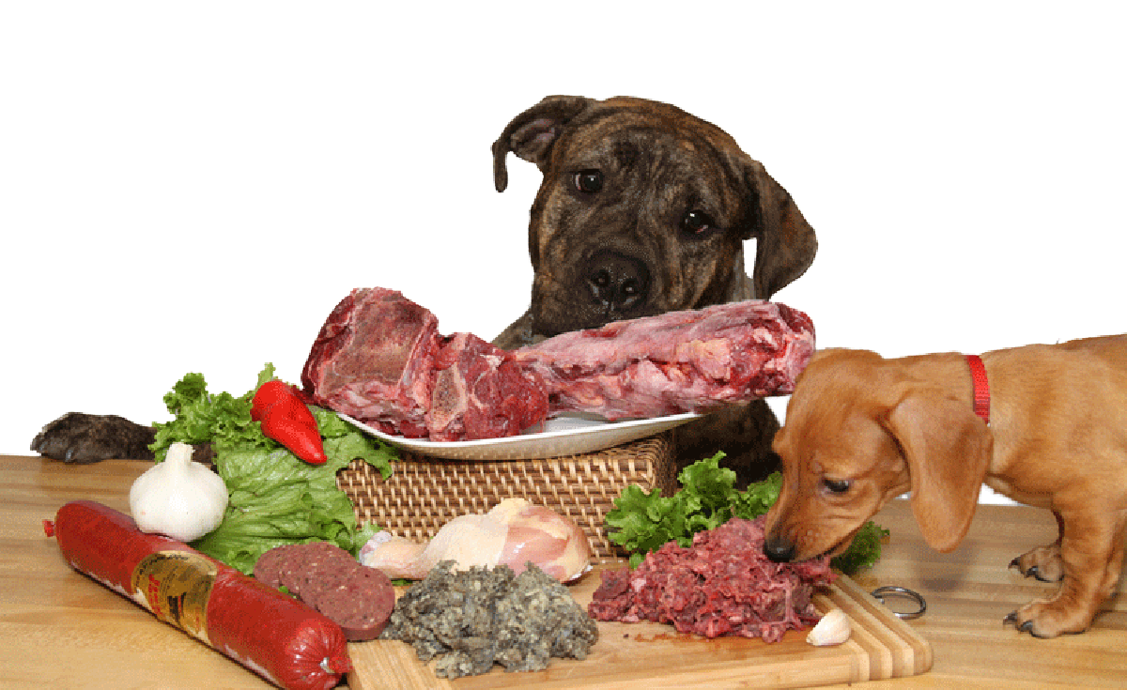
无预备的应用
如同生吃食材
PREPARATION FOR APPLICATION

Slide 22
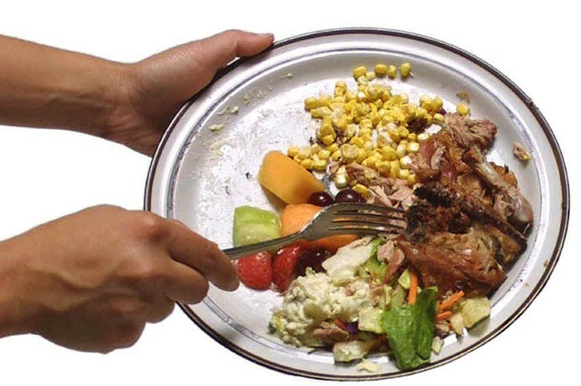
应用的重要性：
光有预备而不应用就如同将烹好的美食直接倒掉。
THE IMPORTANCE OF APPLICATION

Slide 23
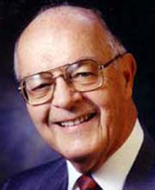
“圣经不是写来满足你的好奇心,而是有助于使你与基督的形象相符;不是使你成为一个更聪明的罪人,而是使你更像救主;不是在你的头脑中灌输一大堆圣经事实,而是要改变你的生命.
—达拉斯神学院教授霍华德·亨德里克斯”
“The Bible was not written to satisfy your curiosity, but to help you conform to Christ’s image. Not to make you a smarter sinner, but to make you like the Savior. Not to fill your head with a collection of Biblical facts, but to transform your life.” -Howard Hendricks- Dallas Theological Seminary Professor

Slide 24
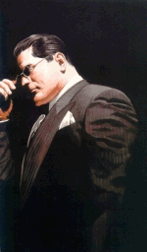
真正学会是 生命有改变 真正学会是 生命有改变 真正学会是 生命有改变
Learning does not occur unless life change results.

Slide 25
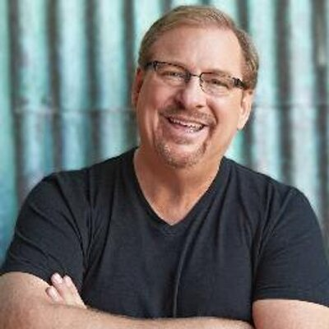
“讲道和教导中缺乏应用，我认为是美国讲道人中存在的最大问题。太多的讲章无非是长篇大论地讲述圣经背景或晦涩难懂的希腊或希伯来文词汇。结果，尽管人们在教会进进出出，生命却毫无改变。”——华理克
“The lack of application in preaching and teaching is, I believe, the number one problem with preaching in America. Too many sermons are nothing more than lectures on biblical backgrounds or obscure Greek and Hebrew words. As a result, people walk into a church and walk out, but their lives remain unchanged.” –Rick Warren

Slide 26
“研经尚未结束，直到我们问自己: ‘对我到底意味着什么？我如何应用？ ’ 我们要做的是在阅读和解释圣经中所获得的知识中提炼出实践性的原则，应用到我们个人的生命中去。如果有命令要遵守，我们就遵守；如果有应许给我们，我们就接受；如果有警告要遵行，我们就留心。终极步骤是：我们服从圣经，让它转变我们的生命。如果忽略这个步骤，你就不可能喜爱研究圣经，同时圣经也就不可能改变你的生命。” —约翰麦克阿瑟
"Bible study is not complete until we ask ourselves, ‘What does this mean for my life and how can I practically apply it?’ We must take the knowledge we have gained from our reading and interpretation and draw out the practical principles that apply to our personal lives. If there is a command to be obeyed, we obey it. If there is a promise to be embraced, we claim it. If there is a warning to be followed, we heed it. This is the ultimate step: we submit to Scripture and let it transform our lives. If you skip this step, you will never enjoy your Bible study and the Bible will never change your life.“John MacArthur

Slide 27
《圣经》是如何说到应用的？
(What does the Bible say about Application?)

Slide 28
“这律法书 不可离开你的口,总要昼夜思想,好使你谨守遵行这书 上所写的一切话.如此,你的道路就可以亨通,凡事顺利."
约书亚记1:8
“This Book of the Law shall not depart from your mouth, but you shall meditate on it day and night, so that you may be careful to do according to all that is written in it. For then you will make your way prosperous, and then you will have good success“ -Joshua 1:8

Slide 29
“撒母耳说:耶和华喜悦燔祭和平安祭,岂如喜悦人听从他的话呢?听命胜于献祭; 顺从胜于公羊的脂油.”
—撒上15:22
““Has the Lord as great
delight in burnt offerings and sacrifices, as in obeying
the voice of the Lord?
Behold,
to obey is better than sacrifice, and to listen
than the fat of rams“
-1 Sam 15:22

Slide 30
“不从恶人的计谋,不站罪人的道路,不坐好讥笑的人的座位,惟喜爱耶和华的律法,昼夜思想,这人便为有福! 他要像一棵树栽在溪水旁,按时候结果子,叶子也不枯干.凡他所作的尽都顺利.”
—诗篇1:1-3
“Blessed is the man who walks not in the
counsel of the wicked, nor stands in the way of sinners, nor sits in the seat of scoffers; but his delight
is in the law of the Lord, and on his law
he meditates day and night.“ –Psalm 1:1-3

Slide 31
“所以,你们要去,使万民作我的门徒,奉父,子,圣灵的名给他们施洗(或作:给他们施洗，归于父,子,圣灵的名).凡我所吩咐你们的,都教训他们遵守,我就常与你们同在,直到世界的末了.”
—太28:19-20
“Go therefore and make disciples of all nations, baptizing them in the name of the Father and of the Son and of the Holy Spirit, teaching them to observe all that I have commanded you. And behold, I am with you always, to the end of the age.” –Matthew 28:19-20

Slide 32
“我给你们作了榜样,叫你们照着我向你们所作的去做…你们既知道这事,若是去行就有福了.”
—约13:15&17
“For I have given you an example, that you also
should do just as I have
done to you. …
If you know these things, blessed are you
if you do them“
–John 13:15&17

Slide 33
“你们在我身上所学习的,所领受的,所听见的,所看见的,这些事你们都要去行,赐平安的神就必与你们同在.”
—腓4:9
“What you have learned
and received and heard
and seen in me—
practice these things,
and the God of peace
will be with you“
–Phil 4:9

Slide 34
“只是你们要行道,不要单单听道,自己欺哄自己.”
—雅1:22
“But be doers of the word,
and not hearers only,
deceiving yourselves“
–James 1:22

Slide 35
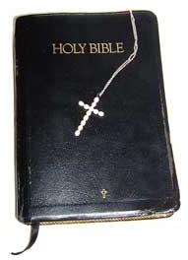
“圣经都是神所默示的,于教训,督责, 使人归正,教导人学义都是以有益的.”
教训
teaching
公义的训练
training
矫正
correction
责备
reproof
“All Scripture is inspired by God and is profitable for teaching, for reproof, for correction, and for training in righteousness.” 2 Timothy 3:16-17

Slide 36
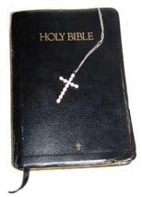
教导教义和例律
teaching doctrines and precepts
使我们知罪
convicting us of sin
教导 teaching
责备reproof
矫正correction
公义训练training
Didaskalia
Elegchos
让我们回到正确之地；矫正和改善我们的行为
restoring us to a right place; to correct or improve our actions.
加增生命中的美
德和纯洁；归正我们思想、感情和行为中的错误
increasing virtue and purity of life; correcting mistakes in our thinking, feeling and actions;
Paideia
Dikaiosynē
Epanorthōsis

Slide 37
(10 KEYS TO APPLYING SCRIPTURE)
应用圣经的十把钥匙

Slide 38
1. The Application MUST be Kept in Context
1. 应用必须保持上下文一致

Slide 39
2. The Application must match the AUTHOR’S INTENT
2. 应用必须与作者的原意吻合

Slide 40
3. The Application must match the intended RECIPIENT
3. 应用必须与预定的接收者相吻合

Slide 41
4. The Application MUST be based on VALID INTERPRETATION
4. 应用必须建立在有效的释经之上

Slide 42
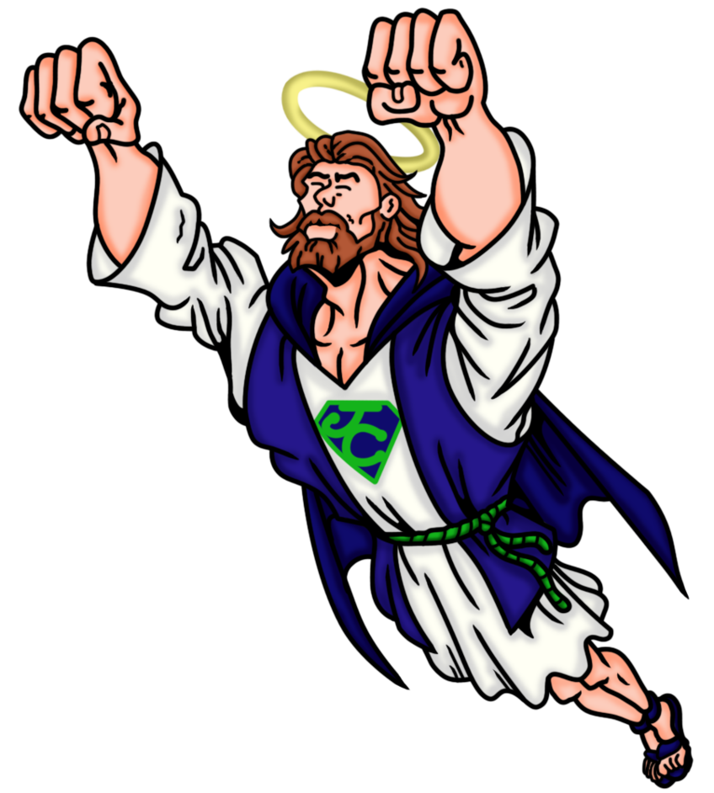
5. The Application MUST be Doctrinally True
5. 应用必须教义上纯正

Slide 43
6. The Application MUST be Stated Clearly
6. 应用必须说明清楚

Slide 44
7. The Application MUST be Measurable
7. 应用必须可测度

Slide 45
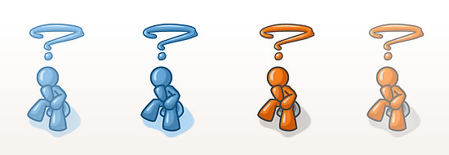
人们是否知道应该做什么?
Do people know what they are supposed to do?
人们能分辨自己是否顺服神吗？
Can people even tell if they are obedient or not?

Slide 46
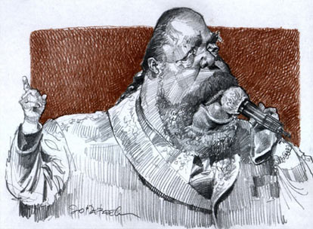
“要有信心!”
“爱他人!”
“成为一个好基督徒!”
“要忠心!”
“Have more faith” “Love others” “Be a better Christian” “Be faithful”

Slide 47
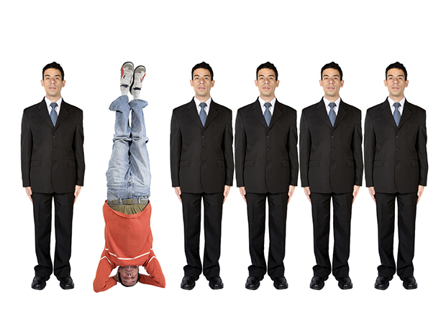
8. The Application MUST be Interesting & Memorable
8. 应用必须有趣并容易记忆

Slide 48
9. The Application MUST be Exampled by the Teacher
9. 应用必须由教师身体力行

Slide 49
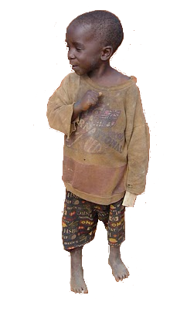
10. The Application MUST be Applicable to the HEARER
10. 应用必须适用于听者

Slide 50
基本应用&间接应用
PRIMARY vs INDIRECT APPLICATION

Slide 51
不是所有的经文都是写给你的，但是所有的经文都为你而写的。——拉里
“Not all Bible verses are written TO you, but they are all written FOR you.”
一旦你确定了主要接收者，目的和应用后,你还可以寻找次要（间接）应用
Once you determine the primary recipient, purpose and application, you can also search for secondary (INDIRECT) applications.
谨慎区分两者的差异。
Be careful to distinguish the difference
知道要寻找什么。
Know what to look for

Slide 52
要寻找的东西
THINGS TO LOOK FOR

Slide 53
查找这些内容 (LOOK FOR THESE THINGS)
对基督徒的应许 (Promises Christians can claim)
我应该改变的态度 (Attitudes I should change)
要基督徒遵守的命令 (Commands for Christians to obey)
可追随的榜样 (Examples to follow)
应改变的习惯 (Habits to change)
我应避免的罪 (Sins I should avoid)
可赞美的事/可感恩的事 (Things to praise/thank God for)
我需要降服于神的领域 (Areas I need to surrender to God)

Slide 54
宝剑法 “神的道是活泼的，是有功效的，比一切两刃的剑更快，甚至魂与灵、骨节与骨髓，都能刺入、剖开，连心中的思念和主意都能辨明。(来4:12) ”
“For the word of God is alive and active. Sharper than any double-edged sword, it penetrates even to dividing soul and spirit, joints and marrow; it judges the thoughts and attitudes of the heart..” Hebrews4:12

Slide 55
宝剑图分为四部分: 宝剑顶端指向上帝。这提醒我们问这个问题：从这段经文里我们要学习有关上帝的什么？ 宝剑剑柄指向人类。这提醒我们问这个问题：从这段经文里我们要学习有关人类什么？ 宝剑的双刃从不同的方向刺入我们的生命，从而改变我们： 第一刃提醒我们问：这里有无可供效仿的榜样？ 第二刃提醒我们问：这里有无诫命让我们遵守？
“For the word of God is alive and active. Sharper than any double-edged sword, it penetrates even to dividing soul and spirit, joints and marrow; it judges the thoughts and attitudes of the heart..” Hebrews4:12

Slide 56
诗篇1:1-6 (Psalm 1:1-6)
1
1. 对基督徒的应许
2. 我应改变的态度
1. Promises to Christians
2. Attitudes I should change
1. 基督徒应遵守的命令
2. 可效仿的榜样
1. Commands for Christians to Obey
2. Example to Follow
1. 我应改变的习惯
2. 我应远离的罪
1. Habits I should change
2. Sins I Should Avoid
1. 可赞美和感恩的事物
2. 要降服于神的领域
1. Things to praise/thank God for.
2. Areas to surrender to God

Slide 57
约翰三书 (3 John)
2
我们从约翰的话中知道该犹的什么？
What can we learn from John’s words about Gaius?
我们从约翰的话中知道丢特腓什么？
What can we learn from John’s words about Diotrephes?
我们能从约翰的话中知道低米丢的什么？
What can we learn from John’s words about Demetrius?
我们能从在13-14节约翰的话中知道什么？
What can we learn from John’s words in v.13-14?

Slide 58
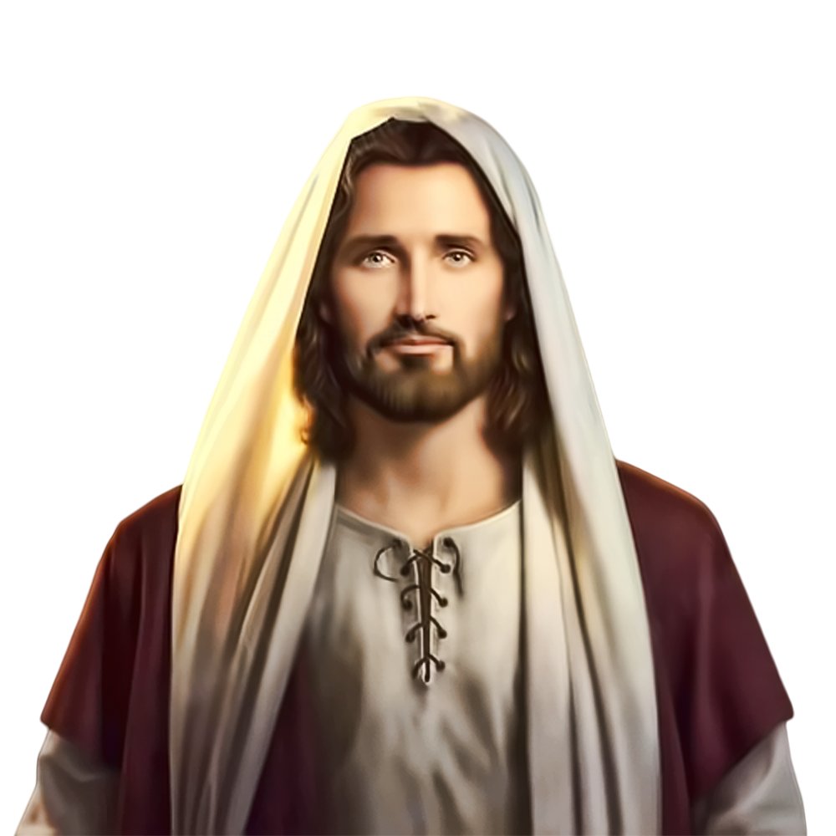
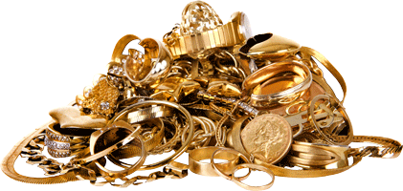
错误应用
FALSE APPLICATION

Slide 59
要避免的危险: Dangers to avoid
属灵化: Spiritualizing
忽视其他的段落: Ignoring other passages
仅聚焦于新约: Becoming NT focused
预想的观点: Preconceived opinions
断章取义: Taking verses out of context
律法主义: Legalism
骄傲: Pride

Slide 60
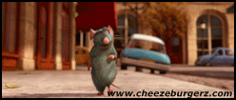
结束
THE END

