Slide 1
天使ANGELS

Slide 2

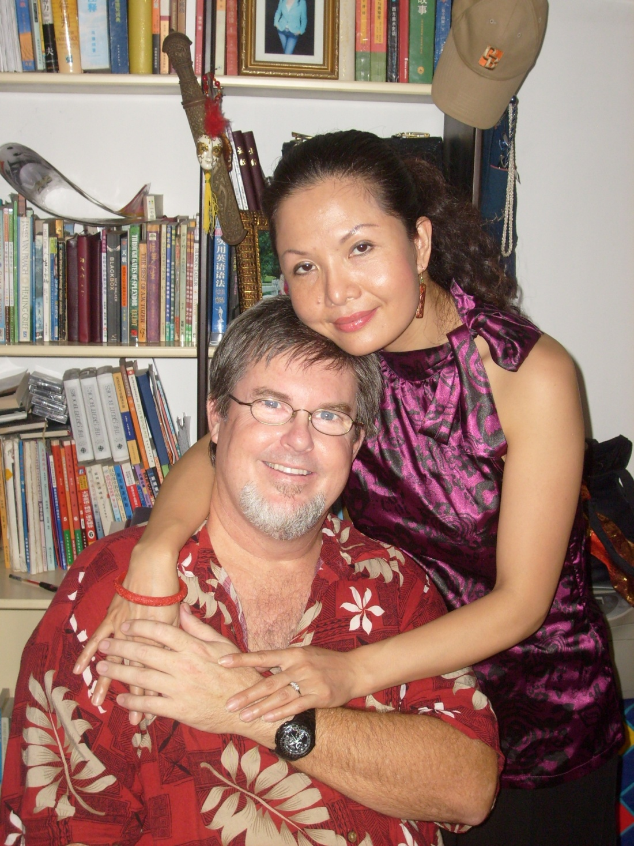
Teachers:
Dr. Johnnie Achord
&
Shulan
Achord

Slide 3
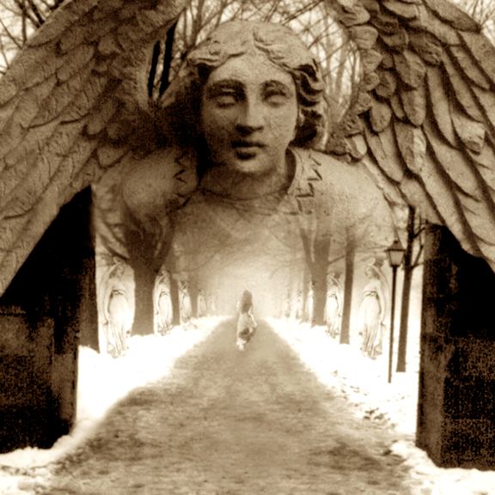
天 使
ANGELS

Slide 4
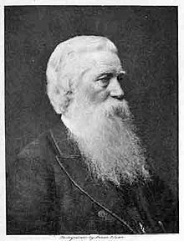
  John Payton, a missionary to the New Hebrides.
  one night wild natives surrounded his house, frantically dancing and jumping up and down in the jungle, desiring to kill John and his wife.
  Well, they got on their knees realizing there was no way they could protect themselves against these wild cannibals and they prayed.
  Soon after that the attackers all vanished into the jungle, they were gone.
  a year later the chief of the tribe became a Christian,
  John asked him at that time, "What happened that night about a year ago when your natives surrounded our little lean-to there on the sand and near the beach and all of a sudden they left?"
  And this is what the chief said, "Well, because of all those men you had with you, we left." John said, "There were no men, just myself and my wife." The chief said that they had seen men standing guard, hundreds of big men in shining clothes, with swords in their hands, totally circling his home.
  ALSO: SAMOANS IN CAR
约翰·佩顿
(John Payton: Missionary)

Slide 5
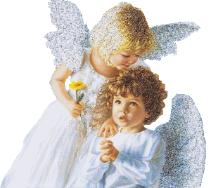
关于天使有哪些误区?
What are some common misconceptions about ANGELS?

Slide 6
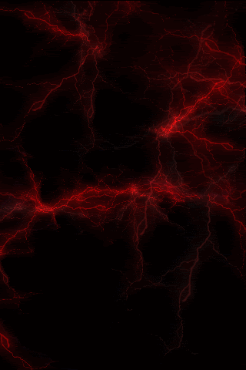
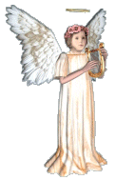
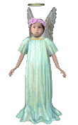
关于天使的误区
“天使是肥嘟嘟的小孩子” “Angels are chubby children”
“天使有男有女” “Angels are both male and female”
“天使无性别” “Angels are sexless”
“我们死后会变成天使” “We become angels when we die”
Misconceptions about angels

Slide 7
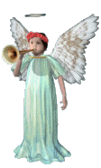
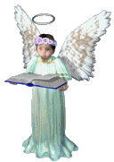
关于天使的误区
“天使是得救的存在体”
“Angels are saved beings”
“天使都是懦弱无用的人” “Angels are effeminate wimps”
“天使有翅膀” “Angels have wings”
“耶稣只是另一个天使” “Jesus was just another angel”
Misconceptions about angels

Slide 8
关于天使的误区
“天使向牧羊人唱歌”
“Angels sang to the shepherds”
“天使同时无所不在”
“Angels are omnipresent”
“天使是死去后看顾着我们的亲人.” “Angels are dead relatives who watch over us”
Misconceptions about angels

Slide 9
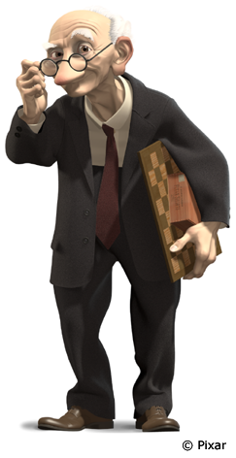
真相 到底 是什么
?
BUT WHAT IS THE TRUTH?

Slide 10

《圣经》是怎么说的？
BUT WHAT DOES THE BIBLE SAY?

Slide 11
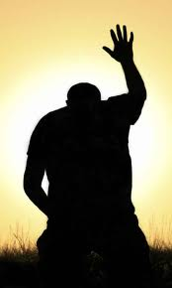
天使是什么?
神创造的不可见的灵性存在,执行神的旨意,顺服神,敬拜神并服事神的儿女。
  Invisible spirit beings created by God to do His will through obedience, worship and ministering to His children.
天使在圣经中的出现超过200次.
  ANGEL appears over 200 times in the Bible
What are angels?

Slide 12

“天使”这个词是什么意思?
希伯来词 “malach”和希腊词 “angelos”都是指“使者” 的意思。
  The Hebrew word "malach" and the Greek word ‘angelos’ both mean messenger
What does the word “angel” mean?

Slide 13
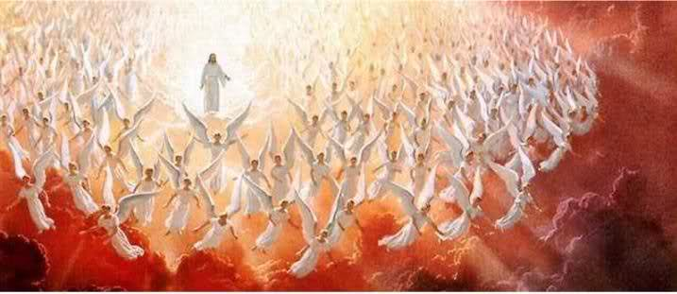
到底有多少天使?
不计其数。
  INNUMERABLE
但7:10: “…在他面前侍立的有万万。”
  Dan. 7:10 “a thousand thousands ministered unto him, and 10,000 x 10,000”
来12:22: “那里有千万的天使。”
  Heb. 12:22 “an innumerable company of angels”
How many angels are there?

Slide 14
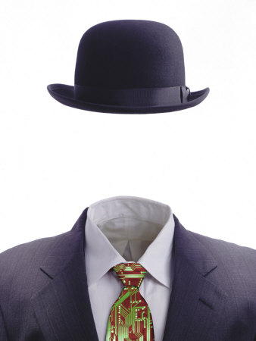
天使有身体吗?
看不见的存在,但可以肉身显现。
  Invisible beings that can be embodied
以利沙的仆人看到了天使天军。（王下6）
  Elisha’s servant was allowed to see the warrior angels (2 Kings 6)
声音和风看不见, 但却是一种实质。
  i.e. Sound & wind are invisible but have substance
Do angels have bodies?

Slide 15
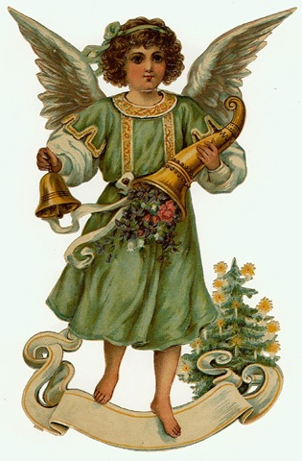
天使到底是什么样子?
天使不是…
  ANGELS ARE NOT…
* 不是女人, 婴儿, 孩童, 动 物等。
  Not women, babies, children, animals, etc.
* 不是女里女气, 带翅膀, 穿裙子的男人。
  Not feminine men with wings and dresses
* 也不是死去的基督徒。
  Not dead Christians
What do angels look like?

Slide 16
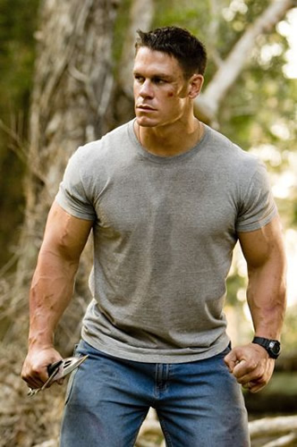
天使到底是什么样子?
天使是
  ANGELS ARE
成年的
  Adult
男性
  Male
勇士
  Warriors
跟男人没什么太大区别
  Indistinguishable from men
What do angels look like?

Slide 17
天使是做什么的?
遵从神
  OBEY GOD
敬拜神
  WORSHIP GOD
帮助我们
  HELP US
传递信息
  DELIVER MESSAGES
争战打仗
  FIGHT BATTLES
引导我们
  GUIDE US
供应我们
  PROVIDE FOR US
保护我们
  PROTECT US
鼓励我们
  ENCOURAGE US
将我们护送至神
  CARRY US TO GOD
What do angels do?

Slide 18
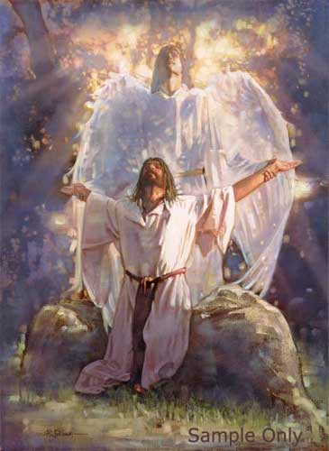
举例
天使毫不犹豫地遵从神的命令。
“愿你的旨意行在地上如同行在天上.”（太6:10）
  They obey without hesitation. “Thy will be done on earth as it is in heaven” (Mt 6:10)
EXAMPLE

Slide 19
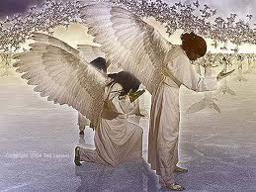
举例
天使敬拜神: “我又看见…有许多天使的声音；他们的数目有千千万万， 大声说：“曾被杀的羔羊是配得权柄、丰富、智慧、能力、尊贵、荣耀、颂赞的！”(启5:11-14)
  They WORSHIP GOD: “…I heard a voice of many angels around the throne …saying with a loud voice: “The Lamb that was slaughtered is worthy to receive the power and riches and wisdom and strength and honor and glory and blessing.” (Rev 5:11-14)
EXAMPLE

Slide 20
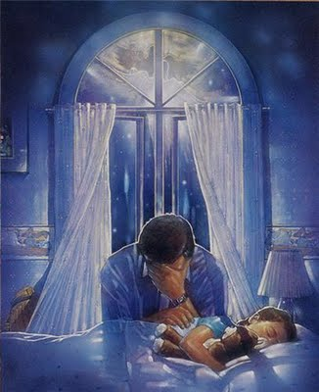
举例
天使帮助信徒: “天使岂不都是服役的灵、奉差遣为那将要承受救恩的人效力吗？” (来1:14)
  THEY HELP CHRISTIANS: “Are not all angels ministering spirits sent to serve those who will inherit salvation?” (Heb. 1:14)
EXAMPLE

Slide 21
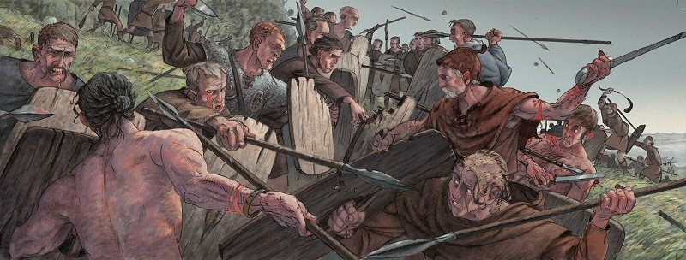
举例
天使争战打仗: 以利沙的仆人很恐惧，神允许他开眼看到成千上万的天军已预备战斗。
  THEY FIGHT BATTLES: i.e. Elisha’s servant was afraid so God allowed him to see the numerous angels prepared to do battle.
EXAMPLE

Slide 22
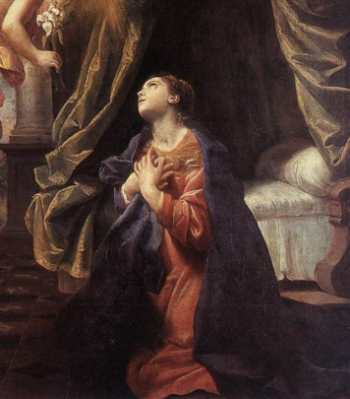
举例
天使透露信息:将神的旨意传达给人. 他们也帮助将律法启示给摩西( 徒7)，将神的信息传给马利亚和约瑟。
  THEY REVEAL MESSAGES to communicate God's will to men. They helped reveal the law to Moses (Acts 7), and delivered God’s message to Mary and Joseph
EXAMPLE

Slide 23
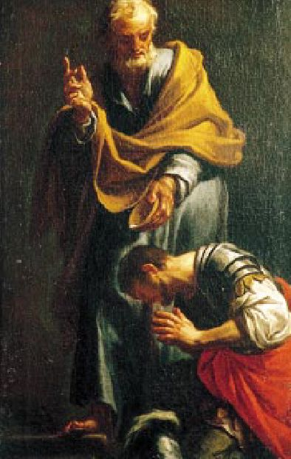
举例
天使引领我们:
天使指引坟墓旁的妇女,也指引腓力(徒8:26)和哥尼流(徒10:1-8)
  THEY GUIDE US: Angels gave instructions to the women at the tomb, to Philip (Acts 8:26), and to Cornelius (Acts 10:1-8).
EXAMPLE

Slide 24
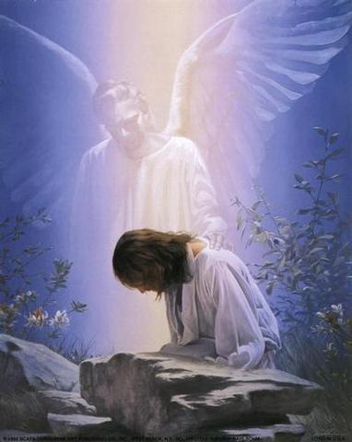
举例
天使递送神的供应：神使用天使给夏甲(创21),以利亚(王上19)和受试探后的基督自己(太4:11)供应食物等物质需求 .
  THEY DELIVER GOD’S PROVISION: God used angels to provide physical needs such as food for Hagar (Gen. 21), Elijah (1 Ki. 19), and Christ after His temptation (Matt. 4:11).
EXAMPLE

Slide 25
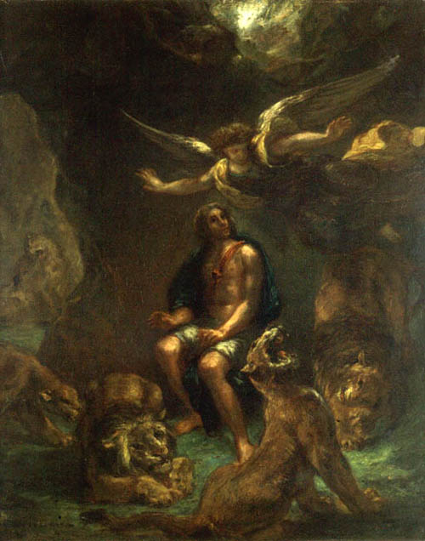
举例
天使保护我们:天使确保神的子民远离身体的危险。可在狮子坑里的但以理以及他火窑里的三个朋友的经历中看到。(但3-6)
  THEY PROTECT US: Angels keep God's people out of physical danger, as in the cases of Daniel and the lions, and his three friends in the fiery furnace (Daniel 3 -6).
EXAMPLE

Slide 26
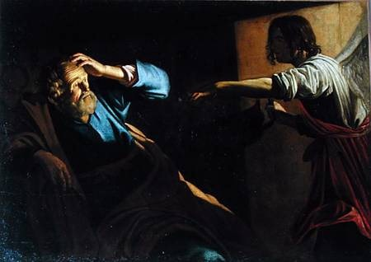
举例
天使解救我们：他们将神那些处于危险中的人解救出来. 天使将狱中的保罗和彼得救出来. (徒5+12)
THEY DELIVER US: Angels get God's people out of danger once they're in it. Angels released the apostles and Peter from prison (Acts 5+12)
EXAMPLE

Slide 27
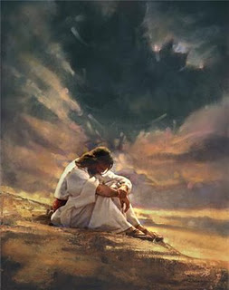
举例
天使坚固和勉励我们: 他们在耶稣受试探后坚固祂 (太4), 鼓励遭囚禁的使徒继续传道(徒5)并告诉保罗他将在船难后生存下来 (徒27)。
  THEY STRENGTHEN AND ENCOURAGE US: Angels strengthened Jesus after His temptation (Matt 4), encouraged the apostles to keep preaching after prison (Acts 5) and told Paul that everyone on his ship would survive the impending shipwreck (Acts 27).
EXAMPLE

Slide 28
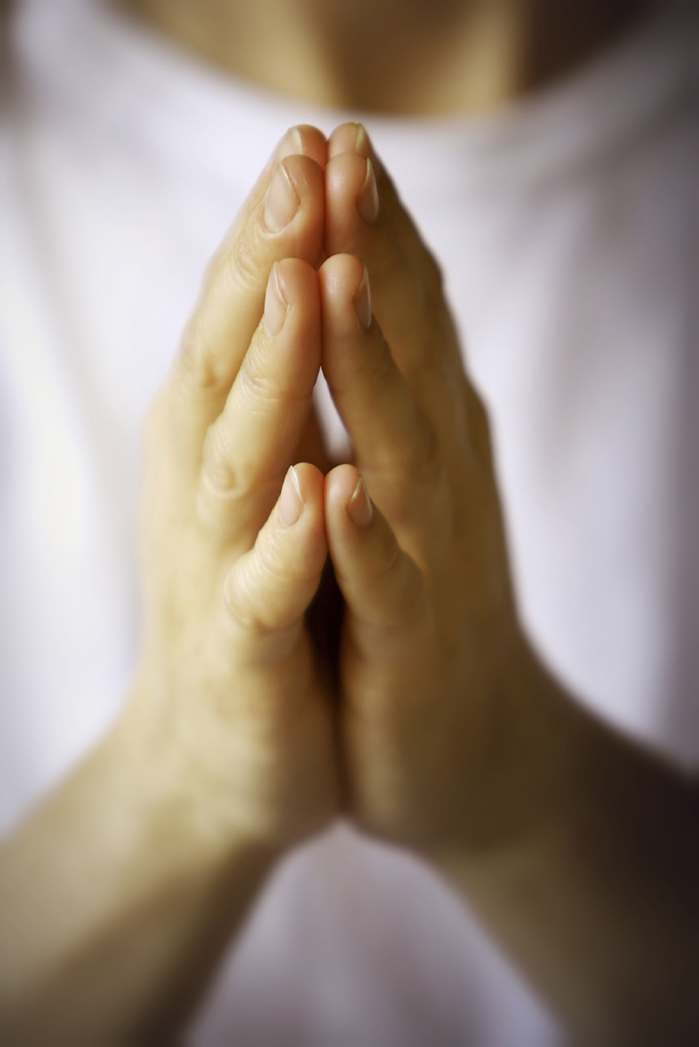
举例
回应祷告:神常使用天使作为回应祂子民祷告的手段. (但9&10;徒12)
  ANSWERED PRAYER: God often uses angels as His means of answering the prayers of His people (Daniel 9&10; Acts 12).
EXAMPLE

Slide 29
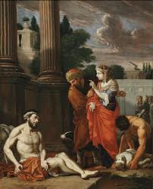
举例
天使将我们护送至耶稣:天使将死后的拉撒路的灵魂送到“亚伯拉罕的怀抱.” (路16:22)
  THEY CARRY US TO JESUS: angels carried the spirit of Lazarus to “Abraham's bosom” when he died (Luke 16:22).
EXAMPLE

Slide 30
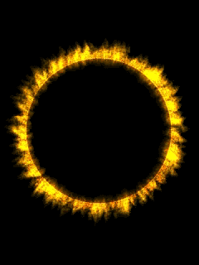

天使什么时候被造的?
在地球被造以先。
  Before the earth was created
约伯记38:4-7告诉我们神在创造地球时，在一旁观看的天使大声欢呼。
  Job 38:4-7 tells us that the angels shouted for joy as they watched God create the earth
When were angels created?

Slide 31
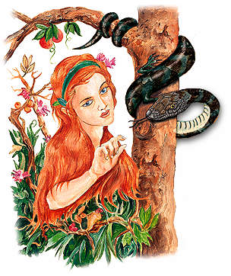
部分天使是什么时候堕落的?
六天创造后，神说一切甚 好（创1:31）
  After Day 6…God said ALL He made was very good (Gen. 1:31)
在创3前…撒旦在伊甸园试 探夏娃。
  Before Gen 3… Satan tempts Eve in the garden
在创世记1和3之间有很多 年的间隔。
  There are many years between Gen. 1 and Gen. 3
When did some angels fall?

Slide 32
我们能看见天使吗?
天使是看不见的(比如以利沙的仆人).
  They are invisible (i.e.: Elisha’s servant)
他们若愿意可以显现(比如,向约伯, 亚伯拉罕,巴兰以及众多其他人.)
  They can appear when they want (i.e.: to Job, Abraham, Balaam, many more)
你即使看见他们也未必认得出(“不可忘记用爱心接待客旅,因为曾有接待客旅的，不知不觉就接待了天使. ”来13:2)
  You may see them and not know it (“Do not forget to entertain strangers, for by so doing some people have entertained angels without knowing it.” Heb. 13:2)
Can we see angels?

Slide 33
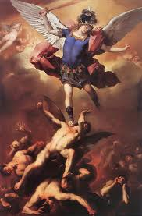
鬼魔就是堕落后的天使吗?
是的。它们选择跟随撒旦而非神。
  Yes. They chose to follow Satan over God.
下一节我们将要回答有关鬼魔的问题。
  We will answer questions about demons next session.
Are demons just fallen angels?

Slide 34
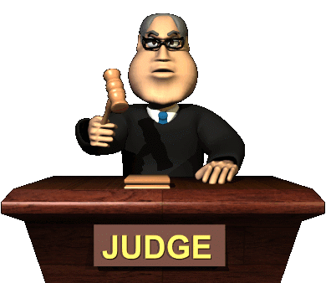
天使有一天会遭受审判吗?
是的…而且是由我们来审判！
  Yes… by US!
“岂不知我们要审判天使吗？”
  “Do you not know that we will judge angels?” (1 Cor. 6:3)
我们还不知道如何以及为何。
  We do not know how or why.
Will angels be judged someday?

Slide 35
耶稣如何比天使微小一点?
来2:7-9告诉我们…
  Heb. 2:7-9 tells us…
人比天使小（你叫他比天使微小一点（注：或作“你叫他暂时比天使小”)
  Men are lower than angels (“You made them (mankind) a little lower than the angels…”)
耶稣作为人比天使小(“惟独见那成为比天使小一点的耶稣 “)
  Jesus as a man was lower than angels (“But we do see Jesus, who was made lower than the angels for a little while…”)
耶稣现在超越天使 (“..现在他以荣耀,尊贵为冠冕”)
  Jesus is now above the angels again (“…now crowned with glory and honor”)
How was Jesus made lower than the angels?

Slide 36
我们具备哪些天使没有的优势?
天使不明白得蒙饶恕成为神儿女的意义。
  Angels cannot understand what it means to be a forgiven son or daughter of the Almighty God.
彼前1:12 “他们(先知们)得了启示，知道他们所传讲的一切事不是为自己，乃是为你们（基督徒）。那靠著从天上差来的圣灵传福音给你们的人，现在将这些事报给你们。天使也愿意详细察看这些事。 ”
  1 Peter 1:12 “It was revealed to them (the prophets) that they were not serving themselves but YOU (Christians) when they spoke of the things that have now been told YOU by those who have preached the gospel to YOU by the Holy Spirit sent from heaven. EVEN ANGELS LONG TO LOOK INTO THESE THINGS.”
What advantages do we have over angels?

Slide 37
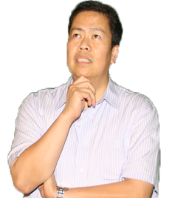
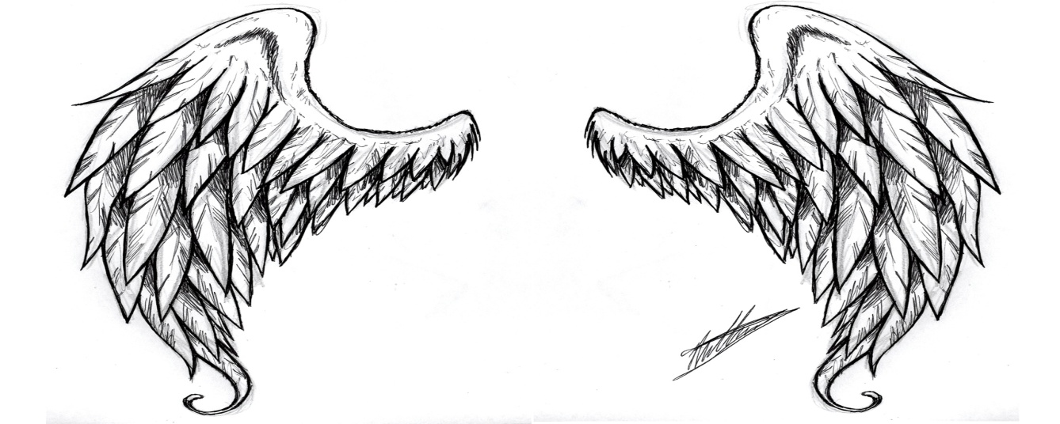
我们死后会变成天使吗?
不会。天使受造后的数目是固定的，且与人类迥然相异。
  No. Angels are a set number of created beings separate from humans.
这个观念就是产生妇女和婴儿天使的土壤。
  This idea is where women and baby angels came from.
Will we become angels when we die?

Slide 38
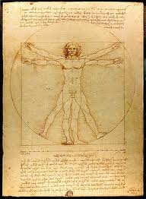
天使是男性,女性还是无性别?
根据圣经，他们都以男性面目出现。
  All Biblical references and appearances are MALE
圣经并没有说他们是无性别的。
  The Bible never says they are without gender
Are angels male or female or neither?

Slide 39
天使能繁殖吗?
天上的天使不嫁不娶不繁殖。
  The angels in Heaven do not marry or reproduce
“当复活的时候，人也不娶，也不嫁，乃像天上的使者一样。 ”(太22:30)
  “At the resurrection people will neither marry nor be given in marriage; they will be like the angels in heaven (unmarried)” (Matt 22:30).
堕落天使不但与地上的女人成婚, 且繁殖后代。
  The fallen angels both married earthly women and produced offspring.
这件事促使神给人类120多年时间悔改，然后以大洪水灭世.(创6:1-8) 详见下一堂课。
  That prompted God to give men 120 more years and then destroy the earth in a great flood. (Gen. 6:1-8) More about this next session.
Do angels reproduce?

Slide 40
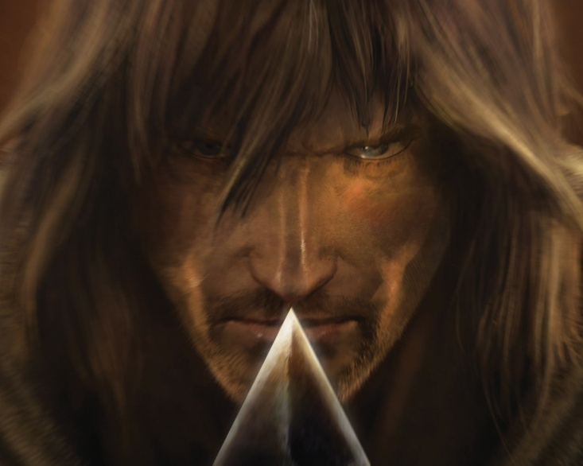
天使无所不知吗?
天使并非无所不知。他们只知道他们应该知道的。
  Angels are not Omniscient. They only know what they are told.
天使并非无所不能。他们只拥有神给他们的力量。
  Angels are not Omnipotent. They have only the power God gives them.
天使并非无所不在。他们一时只能在一地。
  Angels are not Omnipresent. They can be only one place at a time.
天使并非永恒。
他们在某个时刻受造。
  Angels are not Eternal.
  They were created at a point in time.
天使并非众神，乃是仆人。
  Angels are not gods, but servants.
Do angels know everything?

Slide 41
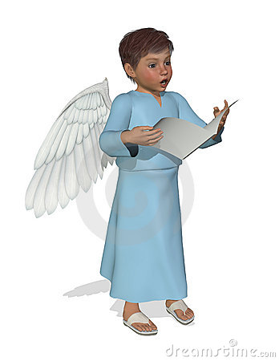
天使会唱歌吗?
约伯38章:天使在神创造天地时大声歌唱欢呼。
  Job 38: The angels sing for joy at creation
启5: 他们高唱: “曾被杀的羔羊是配得…”
  Rev. 5: They sing “Worthy is the Lamb that was slain…”
路2: 他们唱给牧羊人: “至高之处荣耀归于神”
  Luke 2: They sing “Glory to God in the highest” to the shepherds
但是”唱”这个词的希伯来词(ruwa)和希腊词(lego)字面意思都是指“在得胜, 欢乐和悲痛时大声喊叫”的意思。天使可能唱歌。圣经并没有告诉我们。
  BUT both the Heb word (ruwa) and the Greek word (lego) for sing literally mean “to shout for triumph, joy or distress”
  Angels might sing. The Bible just does not tell us.
Do angels sing?

Slide 42
天使分等级吗?
伊斯兰的可兰经提到天使分为14个等级。
  In Islam, the Koran mentions 14 levels or ranks of angels
犹太教将天使分成10个等级。
In Judaism, they list 10 ranks of angels
天主教列出9 ( 3大界,每界3个等级)
  In Catholicism, they list 9 (3 realms of angels with 3 ranks in each)
我们所知道的就是天使有等级(由基路伯, 撒拉弗,天使长, 天使,权天使, 能天使等.)
  All we know for sure is that there are ranks (consisting of Cherubim, Seraphim, archangels, angels, principalities, powers, authorities, etc.)
Are their ranks of angels?

Slide 43
传统的等级体系
第一等级
(level 1)
第二等级
(level 2)
第三等级
(level 3)
撒拉弗
  SERAPHIM
基路伯
  CHERUBIM
座天使
  Ophanim (Thrones)
主天使
  DOMINIONS
德天使
  VIRTUES
能天使
  POWERS/Authorities
权天使
  PRINCIPALITIES
天使长
  ARCHANGELS
天使
  ANGELS
Traditional Ranking System

Slide 44
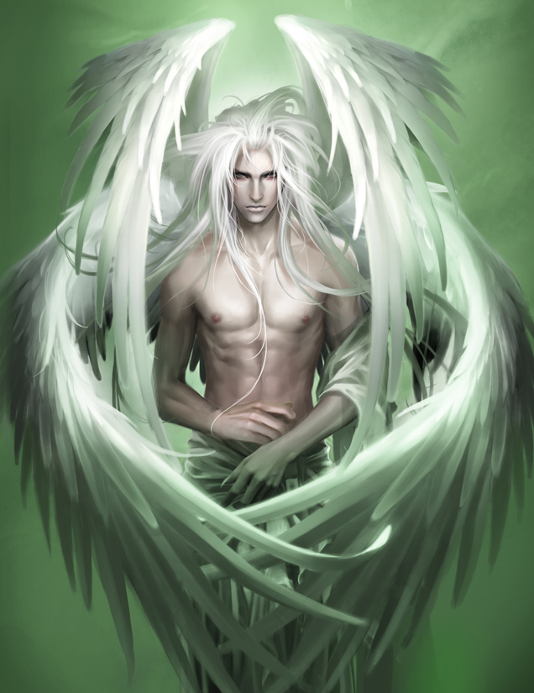
基路伯是什么?
基路伯是参与敬拜和颂赞神的天使。
  Cherubim are angelic beings involved in the worship and praise of God
我们看见其中一个守护伊甸园(创3)
  We see one guarding Eden (Gen 3)
四个翅膀(两个飞; 两个在神面前遮盖自己)
  4 wings (2 for flying; 2 cover them in God’s presence)
What are Cherubim?

Slide 45
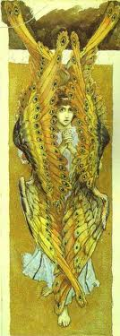
撒拉弗是什么?
撒拉弗(炽天使) 是持续敬拜神的天使。
  The seraphim (fiery ones) are angelic beings who worship God continually.
赛6:2-3: “其上有撒拉弗侍立，各有六个翅膀：用两个翅膀遮脸，两个翅膀遮脚，两个翅膀飞翔。彼此呼喊说：“圣哉！圣哉！圣哉！万军之耶和华，他的荣光充满全地！” 因呼喊者的声音，门槛的根基震动，殿充满了烟云。”
  Is. 6:2-4 “Above Him were seraphs, each with 6 wings: With 2 wings they covered their faces, with 2 they covered their feet, and with 2they were flying. And they called to one another: ‘Holy, holy, holy is the Lord Almighty.”
What are Seraphim?

Slide 46
《圣经》中提到哪些天使名字?
加百列: 报信的天使( 向但以理, 撒加利亚,马利亚和约瑟显现.)
  GABRIEL: The Messenger angel . (Appears to Daniel, Zechariah, Mary & Joseph)
米迦勒: 争战天使 (犹大书九节提到与撒旦争战; 但以理书10章中作为大君米迦勒:帖前4:16提到将会由他宣布耶稣的再临.)
  MICHAEL: The warrior archangel. (Fought with Satan in Jude 9; is listed as a Chief Prince in Dan. 10; and will announce the 2nd coming of Jesus in 1 Thess. 4:16)
Are any angels named in the Bible?

Slide 47
我们能敬拜天使吗?
西2:18-19说: “不可让人因著故意谦虚和敬拜天使，就夺去你们的奖赏.这等人窥察所没有见过的”, 随著自己的欲心,无故地自高自大,不持定元首.”
  Col. 2:18-19 says, “Don’t let anyone condemn you by…the worship of angels, saying they have had visions about these things. Their sinful minds have made them proud and they are not connected to Christ”
启19:10 : “我就俯伏在他脚前要拜他.他说: “千万不可！我和你,并你那些为耶稣作见证的弟兄同是作仆人的. 你要敬拜神. 因为预言中的灵意乃是为耶稣作见证.”
Rev. 19:10 “Then I fell down at his feet to worship him (the messenger angel), but he said, “No, don’t worship me. I am a servant of God, just like you and your brothers and sisters who testify about their faith in Jesus. Worship only God.”
Can we worship angels?

Slide 48
天使也是神的儿女么?
鬼魔曾被称为神的众子(创6) 以区别于人类的众子。
  Demons are once called the sons of God (Gen. 6) to distinguish them from sons of mankind.
  天使，鬼魔和所有人类有时被称为神的孩子，是就创造而言，而非关系而言。(Angels, demons & ALL people = Children in CREATION, NOT RELATION)
天使和鬼魔都不是神的孩子，也不像我们那样与耶稣同为神的后嗣。
  Neither demons or angels are God’s adopted children or joint heirs with Jesus as we are.
耶稣是神唯一的爱子（约翰3:16）
  Jesus is the ONLY Begotten Son of God (John 3:16)
Are angels also children of God?

Slide 49
堕落天使能得救吗?
不能。神在创世之前就选择了祂的儿女(弗1:4-5). 祂也管那些未堕落的天使为 “蒙拣选的天使”(提前5:21). 神在造他们之前就拣选了他们。
  No. Just as God chose His children before He created them (Eph. 1:4-5), He also calls the current unfallen angels “elect angels” (1 Tim. 5:21) chosen before He created them.
堕落天使已经被定罪, 将会在白色大宝座的审判后，判在火湖里遭受刑罚。
  Fallen angels have already been condemned and will suffer their punishment in the Lake of Fire following the Great White Throne Judgment.
Can fallen angels be saved?

Slide 50

有没有人被称作天使?
记住: 天使这个词的意思就是“使者”的意思。
  Remember…The word angel simply means messenger. ..NOT ALWAYS HEAVENLY
该词也用来称呼《启示录》中七封信的收信人(也许是牧师)。
  The word is used of the recipients of the 7 letters in Rev. (May be pastors)
该词也多次用来称呼施洗约翰.
  The word is used of John the Baptist several times
该词也用来称呼被摩西派遣的十二探子.
  The word is used of the 12 spies sent out by Moses
也被用来称呼撒旦差去伤害保罗的差役
(林后12)
  Is used of the messenger sent by Satan to Paul (2 Cor. 12)
Are men ever called angels?

Slide 51
谁是 “那主的使者”?
《圣经》常称呼耶稣为 “主的使者”.
  The Bible often refers to Jesus as the Angel (messenger) of the Lord.
耶稣以肉身形式显现给亚当,夏娃, 雅各,亚伯拉罕, 巴兰, 约书亚, 沙得拉,米煞, 亚伯尼歌(还有许多)作为神接受敬拜。
  Jesus appeared in human form (called by this title) to Adam, Eve, Jacob, Abraham, Balaam, Joshua, Daniel, Shadrach, Meshach, Abednego, (and many more) receiving worship as God.
这些 “基督显现”(伯利恒道成肉身前的耶稣) 在旧约中出现了百次以上。
  These CHRISTOPHANIES (pre-Bethlehem appearances of Jesus) occur over 100 times in the Old Testament.
Who is the Angel of the Lord?

Slide 52
我们有守护天使吗?
天使有时受差遣保护个人，但是圣经中并未提到每人有一个固定的守护天使。
  Angels were sometimes sent to individuals, but there is no mention in the Bible of permanent assignment to one person.
古犹太人教导: 每人都分配了一天使和一鬼魔。
  Ancient Jewish teaching: Everyone is assigned an angel and a demon
太18:10: “你们要小心,不可轻看这小子里的一个。我告诉你们:他们的使者在天上,常见我天父的面.”
  Matt. 18:10 “See that you do not look down on one of these little ones. For I tell you that their angels in heaven always see the face of my Father in heaven.”
“小子们”可以指孩子或信徒. 此外“使者”用了复数。
  “Little ones” can be kids or believers. Also…angels is plural.
Do we have guardian angels?

Slide 53
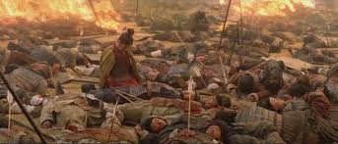
天使比鬼魔强大吗?
一个天使一晚上击杀了185000名亚述士兵。(赛37)
  ONE angel killed 185,000 Assyrians in a one night battle. (Is 37)
一个天使将捆绑撒旦一千年。(启20)
  ONE angel will bind Satan for 1,000 years (Rev 20).
都很强大,但神最强大。天使靠着神的力量争战，我们也是如此。
  BOTH are strong but God is strongest. Angels fight in HIS strength; as do we.
Are angels stronger than demons?

Slide 54
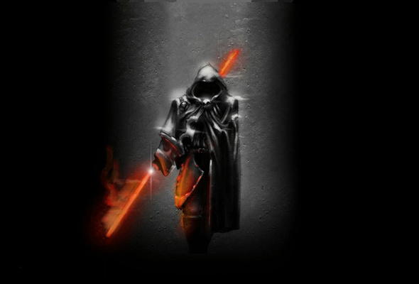
为什么认识天使很重要?
他们毫不犹豫地服事神作了我们出色的榜样.
  They are an excellent example of serving God without hesitation
他们与我们的生活密切相关。
  They are deeply involved with your life
有一天你将审判他们。
  You will judge them someday
有一天我们将一起敬拜。
  We will worship together someday
我们都服事同一伟大的神， 同一救主和同一圣灵。
  We all serve the same great God, Savior and Holy Spirit
Why is it important to know about angels?

Slide 55
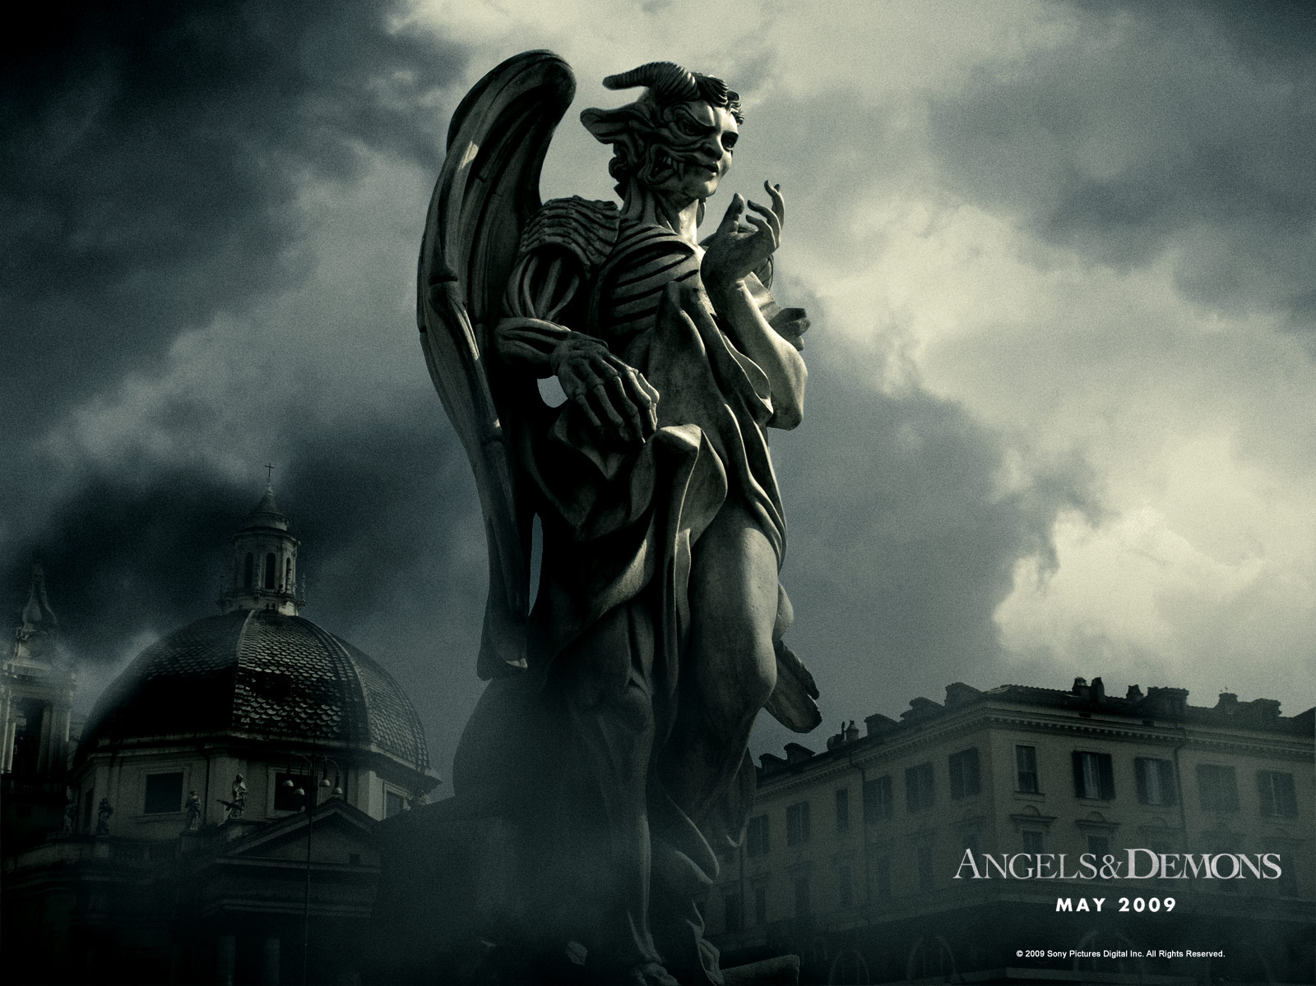
下一部分:
鬼魔
Next Session: DEMONS

