Slide 1
天堂和地狱 （二）

Slide 2
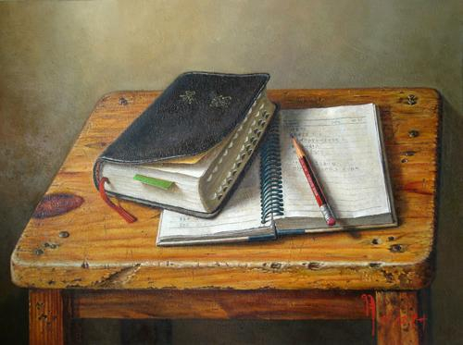
“慕心小组”主题圣经课程
INTENSIVE BIBLE TRAINING PROGRAM

Slide 3
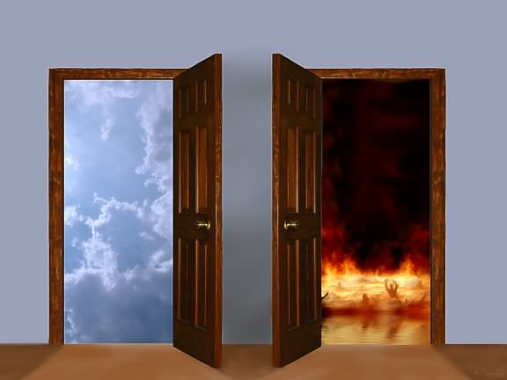
天堂和地狱是什么样子?
WHAT ARE HEAVEN & HELL LIKE?

Slide 4
地狱 (HELL)
天堂 (Heaven)
折磨 (TORMENTS)
乐园 (PARADISE)
火湖 (LAKE OF FIRE)
天堂 (HEAVEN)
千禧年 (MILLINEUM)
新地 (NEW EARTH)
新耶路撒冷 (NEW JER)

Slide 5
地狱 (HELL)
折磨 (TORMENT)
路加福音十六章描述了 “痛苦”, “折磨”和 “火焰” 。
Luke 16 uses the descriptions ‘ANGUISH’, ‘TORMENT’ and ‘FLAME”
可以看见乐园的人,但中间有鸿沟阻隔。
Can see those in paradise; a gulf fixed between them
乞求人去警告他们的家人。
Begging for someone to warn their families
又叫 “阴间或冥府” ：死人呆的地方.
Called SHEOL & HADES: the place of the dead

Slide 6
地狱 (HELL)
火湖 (LAKE OF FIRE)
但12:2 使用了 ‘永远受蔑视’和 ‘羞辱’.
Dan. 12:2 uses the words ‘everlasting contempt’ and ‘shame’
在马可福音九章, 耶稣引用了以赛亚66章 “虫是不死的,火是不灭的.凡有血气的都必憎恶他们.”
In Mark 9, Jesus quotes Is. 66 “the worms that eat them will not die, the fire that burns them will not be quenched, and they will be loathsome to all mankind.”
启20:10 “他们必昼夜受痛苦，直到永永远远.”
Rev. 20:10 “They will be tormented day and night for ever and ever.”
耶稣将之与欣嫩子谷相比(垃圾场;火不灭;向 “摩洛”献祭婴孩.)
Jesus compares it to Gehenna (Dump; continuous fire; babies sacrificed to Molech)
太25 “黑暗”- “痛哭”- “咬牙切齿”- “永火”
Matt. 25 “Darkness” – “Weeping” – “Grinding Teeth” – “Eternal Fire”
启19 “硫磺燃烧”- “燃烧的湖”
Rev. 19 “Burns with sulfur” – “fiery lake” -

Slide 7
天堂 (Heaven)
乐园 (PARADISE)
“天堂”这词在新约中出现了276次。
The word “heaven” is found 276 times in the New Testament
希伯来语 “天堂”意为伊甸园般的 “园子”或 “花园”。
The Hebrew word for paradise means a “park” or “garden” like Eden
旧约中的圣徒死后等在此处, 等候耶稣的死亡赎他们的罪。
O.T. saints awaited Jesus’ death to atone for their sins
可看见并与那些受折磨的人交谈。
Can see and talk to those in torments
如今不再是一个等候之所。
No longer in the waiting place

Slide 8
天堂 (Heaven)
天堂 (HEAVEN)
林前2:9: “神为爱他的人所预备的,是眼睛未曾看见,耳朵未曾听见,人心也未曾想到的. ”
1 Cor. 2:9 “no human mind has conceived - the things God has prepared for those who love him—”
太5:12 说天堂是一个接受赏赐的地方。
Matt. 5:12 says Heaven is a place of rewards
启4章说天堂是一个神永远接受敬拜的地方。
Rev. 4 says Heaven is a place where God is eternally worshipped
不尽的喜乐 ( 犹大书1)
Exceeding Joy (Jude 1)
路加福音10章说我们的名字已经写在那儿了。
Luke 10 says our names are ALREADY written there

Slide 9
天堂 (Heaven)
千禧年 (MILLINEUM)
耶稣将在地上的耶路撒冷作王. (耶3; 撒14)
Jesus will reign on earth from Jerusalem (Jer. 3; Zech 14)
这将是丰盛的世代. （拉34;赛35）
It will be a time of abundance (Ez 34; Is 35)
撒旦将会被绑在无底坑里.（启20）
Satan will be bound in a bottomless pit (Rev 20)
所有的动物都驯服并吃草. (赛11)
All animals will be tamed and vegetarian (Is 11)
地上将充满了耶和华的知识. (赛11)
The earth will be filled with the knowledge of the Lord ((s 11)
基督的跟随者将与祂一同做王. (启20)
Christ’s followers will reign with Him (Rev 20)

Slide 10
天堂 (Heaven)
新地 (NEW EARTH)
(启21和22) “没有海洋”— “新耶路撒冷从天上降下来.” (Rev 21 & 22) “No sea” – “New Jerusalem comes down from heaven”
“天使又指示我在城内街道当中一道生命水的河，明亮如水晶,从神和羔羊的宝座流出来.在河这边与那边有生命树,结十二样果子每月都结果子,树上的叶子乃为医治万民。 以后再没有咒诅. 在城里有神和羔羊的宝座,他的仆人都要事奉他,也要见他的面. 他的名字必写在他们的额上. 不再有黑夜,他们也不用灯光,日光,因为主神要光照他们. 他们要作王,直到永永远远.”
”Then the angel showed me the river of the water of life, as clear as crystal, flowing from the throne of God and of the Lamb down the middle of the great street of the city. On each side of the river stood the tree of life, bearing twelve crops of fruit, yielding its fruit every month. And the leaves of the tree are for the healing of the nations. No longer will there be any curse. The throne of God and of the Lamb will be in the city, and his servants will serve him. They will see his face, and his name will be on their foreheads. There will be no more night. They will not need the light of a lamp or the light of the sun, for the Lord God will give them light. And they will reign for ever and ever.”

Slide 11
天堂 (Heaven)
新耶路撒冷 (NEW JER)
John 14:2 “Many rooms”; prepared just for us
Rev. 21:10-27 “我被圣灵感动，天使就带我到一座高大的山，将那由 神那里从天而降的圣城耶路撒冷指示我。 城中有 神的荣耀，城的光辉如同极贵的宝石，好像碧玉，明如水晶。 有高大的墙，有十二个门，门上有十二位天使，门上又写著以色列十二个支派的名字。 东边有三门，北边有三门，南边有三门，西边有三门。 城墙有十二根基，根基上有羔羊十二使徒的名字。 对我说话的，拿著金苇子当尺，要量那城和城门、城墙。 城是四方的，长宽一样。天使用苇子量那城，共有四千里，长、宽、高都是一样； 又量了城墙，按著人的尺寸，就是天使的尺寸，共有一百四十四肘。 墙是碧玉造的，城是精金的，如同明净的玻璃。 城墙的根基是用各样宝石修饰的：第一根基是碧玉，第二是蓝宝石，第三是绿玛瑙，第四是绿宝石， 第五是红玛瑙，第六是红宝石，第七是黄璧玺，第八是水苍玉，第九是红璧玺，第十是翡翠，第十一是紫玛瑙，第十二是紫晶。 十二个门是十二颗珍珠，每门是一颗珍珠。城内的街道是精金，好像明透的玻璃。 我未见城内有殿，因主 神全能者和羔羊为城的殿。 那城内又不用日月光照，因有 神的荣耀光照，又有羔羊为城的灯。 列国要在城的光里行走，地上的君王必将自己的荣耀归与那城。 城门白昼总不关闭，在那里原没有黑夜。 人必将列国的荣耀、尊贵归与那城。 凡不洁净的，并那行可憎与虚谎之事的，总不得进那城；只有名字写在羔羊生命册上的才得进去。”

Slide 12
谁去天堂,谁去地狱？
WHO GOES TO HEAVEN & HELL?

Slide 13
地狱 (HELL)
约3:36节说信子的人有永生;不信子的人得不著永生,神的震怒常在他身上.
John 3:36 Whoever believes in the Son has eternal life, but whoever rejects the Son will not see life, for God’s wrath remains on them
敌基督和假先知和及追随他们的.(启14:11;20:10)
Anti-Christ & False Prophet & all who follow them (Rev. 14:11; 20:10)
撒旦和其党羽. (太25:41;彼后2:4)
Satan and his angels (Matt. 25:41; 2 Peter 2:4)
不信耶稣的宗教分子(太23:15)
Religious People who do not believe Jesus (Matt:23:15)
所有名字没有记在《生命册》上的. (启20:15)
EVERYONE whose name is not written in the Book of Life (Rev. 20:15)

Slide 14
关于天堂和地狱的常见问题
COMMON QUESTIONS ABOUT HEAVEN & HELL?

Slide 15
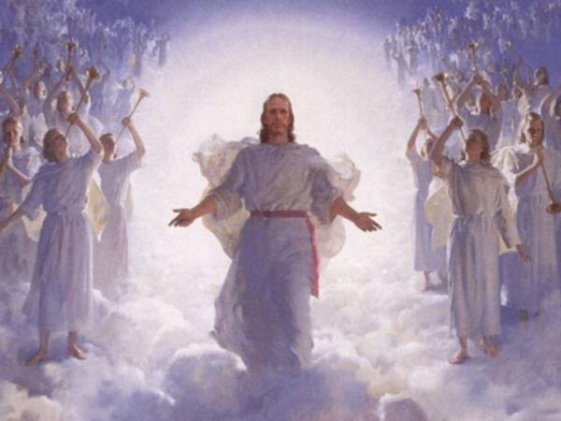
十二个关于天堂的问题
12 Common Questions about Heaven

Slide 16
在天堂能看到并认出我们朋友家人吗？
使徒在 “登山变像”中认出了摩西和以利亚.(太17)
The apostles recognized Moses & Elijah on the Mt. of Transfiguration (Mt 17)
亚伯拉罕, 拉撒路和财主都能认出彼此.
Abraham, Lazarus & the rich man recognized each other
第一位你想见的一定是耶稣。
The first person you will want to see is Jesus.
Will we see and know friends or family in Heaven?

Slide 17
天堂有赏赐吗？
“不要为自己积攒财宝在地上… 只要积攒财宝在天上…你的财宝在哪里,心就在哪里.” (太6:19-20)
“Do not store up for yourselves treasures on earth…But store up for yourselves treasures in heaven…For where your treasure is, there your heart will be also. (Matt. 6:19-20)
你还可能失去(约二1:8) “你们要小心, 不要失去你们所作的工,乃要得着满足的赏赐.”
You can also lose them (2 John 1:8) “Watch out that you do not lose what we have worked for, but that you may be rewarded fully.”
恒久忠心会赢得天上的赏赐— “可以得著不能朽坏,不能玷污,不能衰残,为你们存留在天上的基业.” (彼前1:3-5)
Faithful endurance wins a heavenly reward which is “an inheritance incorruptible and undefiled and that does not fade away, reserved in heaven for you” (1 Pet.er 1:3-5).
Are there rewards in Heaven?

Slide 18
冠冕: 体育赛事中赢得的花环
是的. 你现在就可以将冠冕积存起来。
Yes. You can even store crowns up now.
不朽坏的冠冕 (林前9:24-25)
IMPERISHABLE CROWN (1 Cor. 9:24-25)
喜乐的冠冕 (帖前2:19)
CROWN of REJOICING (1 Thes. 2:19)
公义的冠冕 (提后4:8)
CROWN OF RIGHTEOUSNESS (2 Tim. 4:8)
荣耀的冠冕 (彼前5:4)
CROWN OF GLORY (1 PETER 5:4)
生命的冠冕 (启2:10)
CROWN OF LIFE (Rev. 2:10)
CROWN (stephanos) wreath won in an athletic event

Slide 19
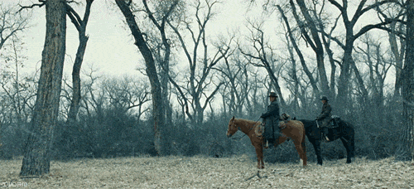
在永恒的天堂里我会做什么？
敬拜和服事上帝. (启22:3)
WORSHIP & SERVE GOD (Rev. 22:3)
天上的事情超出我们的理解和想象.(林前2:9)
Things beyond our understanding and imagination (1 Cor. 2:9)
What will I do in Heaven forever?

Slide 20
在天堂我们嫁娶吗?
不嫁娶他人.我们将与耶稣成婚.
Not to other people; We will be married to Jesus
“当复活的时候，人也不娶，也不嫁，乃像天上的使者一样. ” (太22:30)
“At the resurrection people will neither marry nor be given in marriage; they will be like the angels in heaven” (Matt 22:30).
“我们要欢喜快乐,将荣耀归给他! 因为羔羊婚娶的时候到了,新妇也自己预备好了. ”(启19:7)
“Let us rejoice and be glad and give Him glory! For the wedding of the Lamb has come, and His bride has made herself ready.” (Rev. 19:7)
Will we be married in Heaven?

Slide 21
在天上我们还能记得地上的生活吗?
赛65:16-17 “因为从前的患难已经忘记,也从我眼前隐藏了.看哪,我造新天新地;从前的事不再被记念,也不再追想.”
Isaiah 65:16-17 “For the past troubles will be forgotten and hidden from my eyes. For, behold, I create new heavens and a new earth: and the former shall not be remembered, nor come into mind.”
启21:4 “神要擦去他们一切的眼泪. 不再有死亡,也不再有悲哀、哭号、疼痛，因为以前的事都过去了。”
Rev. 21:4 “He will wipe every tear from their eyes. There will be no more death or mourning or crying or pain, for the old order of things has passed away.”
Will we remember our earthly lives in Heaven?

Slide 22
我们的亲人在天上观察我们吗？
不太可能.
Probably not.
在天上不再有痛苦,忧伤和眼泪. (启21:4)
There is no pain tears or grief in heaven (Rev. 21:4).
观察我们的生活会带来很多忧伤和痛苦.
Watching our lives would cause MUCH grief and pain.
他们忙着敬拜神呢。
They are preoccupied with worshipping God
Are our relatives watching us from Heaven?

Slide 23
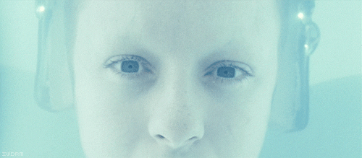
我们在天堂会变成天使吗?
不会. 天使在人类之前就受造了。
No. Angels were created before men were created.
天使的数目是固定的,这数目不改变。
There is an uncountable set number that will not change
Do we become angels in Heaven?

Slide 24
在天堂撒旦既犯罪, 我们可能犯罪吗？
不会. 蒙拣选的天使一直在天堂里. (提前5:21)
No. The elect angels remained in Heaven (1 Tim. 5:21).
神蒙拣选的孩子将有一个新身体和新性情.
The elect children of God will have a new body and a new nature
在圣经里所有关于天堂的描述中, 无一处提到任何人在那儿犯罪。
Of all the descriptions of Heaven given in the Bible, NONE mention anyone sinning.
我们同时也被圣灵封上了印章。
We are also sealed by the Holy Spirit
If Satan sinned in Heaven, is it possible for us?

Slide 25
我们在天堂都有一栋豪宅吗？
在新耶路撒冷,也就是耶稣的家里有一间房,我们与主同住。
A room in Jesus’ home, the New Jerusalem.
“在我父的家里有许多住处(房间);若是没有,我就早已告诉你们了;我去原是为你们预备地方去. 我若去为你们预备了地方,就必再来接你们到我那里去;我在哪里,叫你们也在那里.” (约14:2-3)
In my Father’s house are many rooms. If it were not so, would I have told you that I go to prepare a place for you? And if I go and prepare a place for you, I will come again and will take you to myself, that where I am you may be also.” (Jn. 14:2-3)
Will we have a mansion in Heaven?

Slide 26
婴孩死后去天堂吗？
我不知道. 圣经对此是沉默的。
I don’t know. The Bible is silent.
我个人的观点: 神是慈爱的, 必会行祂眼中看为正确的事.
My opinion: God is loving. He will do what is right in His eyes.
“审判全地的主岂不行公义吗?”(创18:25)
“Shall not the Judge of all the earth do right?” (Gen. 18:25)
“耶和华在他一切所行的,无不公义;在他一切所做的都有慈爱.” (诗145:17)
“The LORD is righteous in all His ways, Gracious in all His works.” (Ps. 145:17)
Do babies go to Heaven if they die?

Slide 27
我们在天堂能见到 “三位一体”的神吗？
圣父: “就是那独一不死,住在人不能靠近的光里,是人未曾看见,也是不能看见的,要将他显明出来.但愿尊贵和永远的权能都归给他。阿们!” (提前6:16)
The FATHER: “who alone has immortality, who dwells in unapproachable light, whom no one has ever seen or can see. To him be honor and eternal dominion. Amen.” (1 Tim. 6:16)
圣子 : 启示录第五章描述了我们将看到的祂的样子。
The SON: Rev. 5 describes what He will look like when we see Him.
圣灵: 只能看到祂以鸽子, 火焰等形显现的样子。
The SPIRIT: Can only be seen when He manifests Himself as a dove, a flame, etc.
Will we see the Trinity in Heaven?

Slide 28
在天堂我们的身体是什么样子?
我们将有一个耶稣复活后那样的身体. (约一3:2)
We will have a body like Jesus’ resurrected body (1 John 3:2)
他能吃, 能走, 可以触摸到, 能穿墙过壁(约20:19), 有肉有骨. (路24:37-43)
He could eat, talk, be touched, walk through walls (Jn. 20:19) and had skin and bones (Lk. 24:37-43)
他保留那些伤痕以提醒我们他的牺牲.
He kept His scars to remind us of His sacrifice.
我们旧的身体将会变成不朽坏的身体. (林前15)
Our old bodies will be changed into an incorruptible body (1 Cor. 15)
What will our bodies look like in Heaven?

