Slide 1
天堂和地狱 （三）

Slide 2
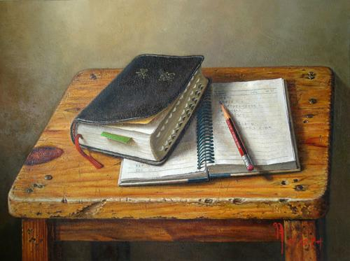
“慕心小组”主题圣经课程
INTENSIVE BIBLE TRAINING PROGRAM

Slide 3
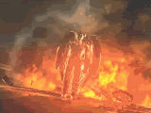
十二个关于地狱的问题
12 Common Questions about Hell

Slide 4
慈爱的神怎能让人下地狱?
人下地狱是因为他们拒绝耶稣.
People go to hell because they reject Jesus.
我们该问的是: “神怎会允许任何人上天堂?”
We should be asking, “Why would God allow ANYONE into Heaven?”
不要按你堕落的标准论断神！
DO NOTJUDGE GOD BY YOUR FALLEN STANDARDS
当我们看到圣洁, 伟大, 慈爱, 全权的神时, 就会明白他所有的决定无不慈爱,正确和公义。
When we see the Holy, Awesome, Almighty, Loving, Sovereign God, we will know that ALL of His decisions were loving, right, and just.
Why would a loving God send anyone to Hell?

Slide 5
在地狱里我能认出他人吗?
不能. 这是一个完全黑暗的地方.
No. It is a place of total darkness. (in the eternal Lake of Fire)
你会被永恒的痛苦搞得抓狂.
You will be distracted by an eternity of pain
你也不想看到他人受苦。
You will not want to see others suffer
Will I know people in Hell?

Slide 6
我的亲人能否寄些钱物给我？
不能.圣经说得很清楚无人能带来宽慰.
No. The Bible makes it clear that no one can offer relief.
财主求亚伯拉罕给点水喝;并差拉撒路去警告他的兄弟.
The rich man begged Abraham to put a drop of water on his tongue; and to send Lazarus to warn his brothers.
撒旦希望我们相信这是一个享乐的地方,一个令人羡慕的去处。
Satan wants us to think it is a place of enjoyment. A place to desire.
Can my relatives send money (and other things) to me there?

Slide 7
地狱的神是谁？
“那杀身体不能杀灵魂的，不要怕他们；惟有能把身体和灵魂都灭在地狱里的，正要怕他。” (太10:28)
“ Do not be afraid of those who kill the body but cannot kill the soul. Rather, be afraid of the One who can destroy both soul and body in hell.” (Matt. 10:28)
撒旦还未曾去过地狱!
Satan has never been to Hell…YET!
Who is the God of Hell?

Slide 8
地狱里的人能得救吗？
来9:27 “按著定命,人人都有一死, 死后且有审判.”
Hebrews 9:27, “It is appointed once to die, and then judgment.”
圣经无一处教导有二次机会.
NOWHERE does the Bible teach a second chance.
天主教发明了 “炼狱”给教会敛财.
人们花钱将死去的亲人赎到天堂.
Catholicism invented Purgatory to raise money for the church.
People could pay money to get dead relatives into Heaven.
Can a person get saved in Hell?

Slide 9
为何人们拒绝有关地狱的教义?
痛苦: 想到所爱的亲人在那里让人痛苦.
PAIN: It hurts to think of lost loved ones there.
骄傲: 他们的观点比耶稣还高明.
PRIDE: Their opinion is higher than that of Jesus
无知: 他们没有阅读耶稣所说的话.
IGNORANCE: They do not read what Jesus said
愚忠: 忠于某一宗派而非圣经。
FALSE LOYALTY: Devoted to a denomination over the Bible
受骗: 相信撒旦而非基督。
DECEIVED: Believing Satan over Christ
Why do people reject the idea of Hell?

Slide 10
认为地狱的审判分层次的看法最初来自但丁1321年的著作《神曲》.在此书里,罗马诗人维吉尔带领但丁寻找他那被撒旦掳去的,失落的爱人.他们穿越九层地狱,根据邪恶程度不断加深,直到撒旦被捆绑的地球中心.在这里,每个罪人因着他所犯的主要罪孽而永受折磨.根据但丁的描写,地狱层次从第一层开始,这里住着一些未受洗却德行高尚的异教徒,直到地狱的中心,专为那些犯了致命大罪——背叛离弃神的人而存留。 The idea of levels of punishment in hell derives primarily from the DIVINE COMEDY written by DANTE Alighieri in 1321. In it, the Roman poet Virgil guides Dante to find his lost love, kidnapped by Satan, through the 9 CIRCLES OF HELL which increase in wickedness, and culminate at the center of the earth, where Satan is bound. Each sinner is afflicted for all of eternity by the chief sin he committed. According to Dante, the circles range from the first circle, where dwell the unbaptized yet virtuous pagans, to the very center of hell reserved for those who have committed the ultimate sin—treachery against God.
地狱的惩罚分层次吗？
Are there levels of punishment in Hell?

Slide 11
但是圣经可能在以下地方暗示了审判的层次… But Scripture might possibly also allude to degrees of punishment in…
启20:12-13,我又看见死了的人,无论大小,都站在宝座前.案卷. 展开了,并且另有一卷展开,就是生命册. 死了的人都凭着这些. 案卷所记载的,照他们所行的受审判.于是海交出其中的死人;死亡和阴间也交出其中的死人;他们都照各人所行的受审判。
Rev. 20:12-13, “And I saw the dead, great and small, standing before the throne, and books were opened. Another book was opened, which is the book of life. The dead were judged according to what they had done as recorded in the books. The sea gave up the dead that were in it, and death and Hades gave up the dead that were in them, and each person was judged according to what he had done. “
“但我告诉你们,审判的日子,所多玛所受的,比你还容易受呢!” 太11:24, Matt11:24, “But I tell you that it will be more bearable for Sodom on the day of judgment than for you."
“你们这假冒为善的文士和法利赛人有祸了! 因为你们侵吞寡妇的家产,假意作很长的祷告,所以要受更重的刑罚.” 太23: 14 Matt. 23:14, "Woe unto you, scribes and Pharisees, hypocrites! for ye devour widows' houses, and for a pretence make long prayer: therefore ye shall receive the greater damnation,"

Slide 12
你相信那些声称看见过地狱的人吗？
首先, 意识到神能给人一个天堂或地狱的异象很重要。
First, it is important to note that of course God COULD give a person a vision of heaven or hell.
使徒保罗(林后12: 1-6)和以赛亚(赛6) 就有这些异象.
Apostle Paul (2 Cor. 12:1-6) and Isaiah (Is. 6) had these visions.
只有神知道这些声明是属实,还是源于误区, 夸大其词或谎言.
Only God knows if these claims are true, the result of misperception, exaggeration or lies.
将这些异象或经历与神的道相比较.
Compare the visions and experiences with the Word of God.
若与圣经相冲突, 就是从那模仿神的恶者而来.
If they contradict the Bible, they are from the evil one who imitates God.
Do you believe those who say they have seen Hell?

Slide 13
那些从未听到耶稣的人会去地狱吗？
是的. (不要相信那些告诉你其它意见的牧师.)
YES. (Don’t listen to pastors who tell you otherwise)
耶稣在约14:6 中说: “我就是道路、真理、生命；若不藉著我，没有人能到父那里去. ” 没人,没人.
Jesus says. John 14:6, “I am the way, the truth, the life; No one comes to the Father but by me,” NO ONE, NO ONE.
3. 佛教, 印度教,新纪元教, 魔门教, 耶和华见证人, 好人, 善人, 慷慨的人, 宗教分子都不能去天堂。无人！无例外。
NOT Buddhism, Hinduism, New Age-ism, Mormonism, Jehovah’s Witness, Nice people, Good people, Generous people, Religious people, No one! No exception.
4. “除他以外，别无拯救；因为在天下人间，没有赐下别的名，我们可以靠著得救。” (徒4:12)
“Salvation is found in no one else, for there is no other name under heaven given to mankind by which we must be saved.” (Acts 4:12)
Will people who have never heard of Jesus go to Hell?

Slide 14
一个真基督徒可以不相信地狱吗？
不相信地狱并不会让地狱的温度减少一度。
NOT believing wont’ make it go away.
所有基督徒均处于探询和学习的过程.
ALL Christians are in a questioning and learning process.
“这书上的预言，若有人删去什么，神必从这书上所写的生命树和圣城，删去他的份。”
You cannot call Jesus a liar without suffering the consequences
Can a true Christian NOT believe in Hell?

Slide 15
在传福音时应提到地狱吗？
既然耶稣公开地教导过这点, 你为何要藏着掖着呢？
Why would you hide it when Jesus taught it so openly?
好消息(福音)之所以是好的 是因为我们先明白坏消息。
Good News (Gospel) is only good when we understand the Bad News
让我跟你分享一个方法:
Let me share a way you can do that…
Should we mention Hell when we share the Gospel?

Slide 16
活水机构提供
你是好 人吗？
主角:好好先生
“Are you a good person?” Featuring: Mr. Nice Guy

Slide 17
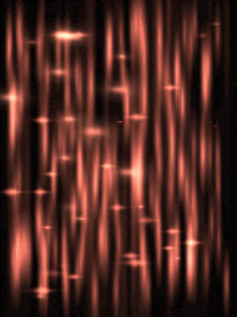
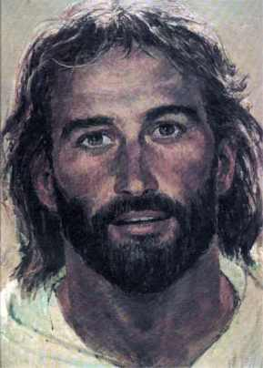
最重要的问题
THE MOST IMPORTANT QUESTION

Slide 18
如果今天你死了…
天堂 (Heaven)
地狱 (Hell)
IFYOU DIE TODAY…

