Slide 1
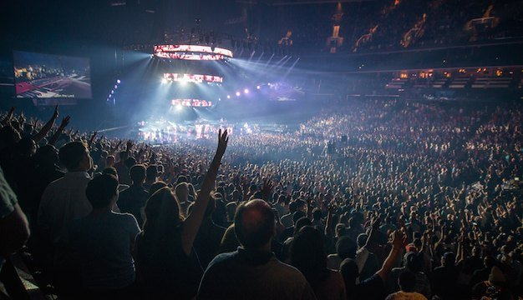
敬拜

Slide 2
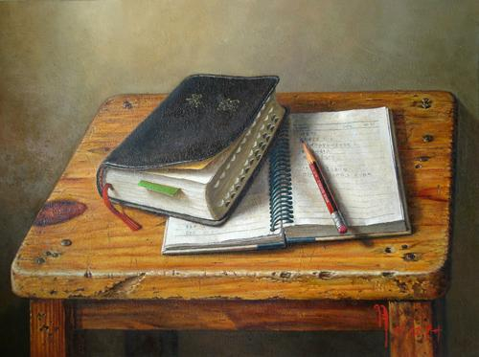
圣经主题培训课程
INTENSIVE BIBLE TRAINING PROGRAM

Slide 3
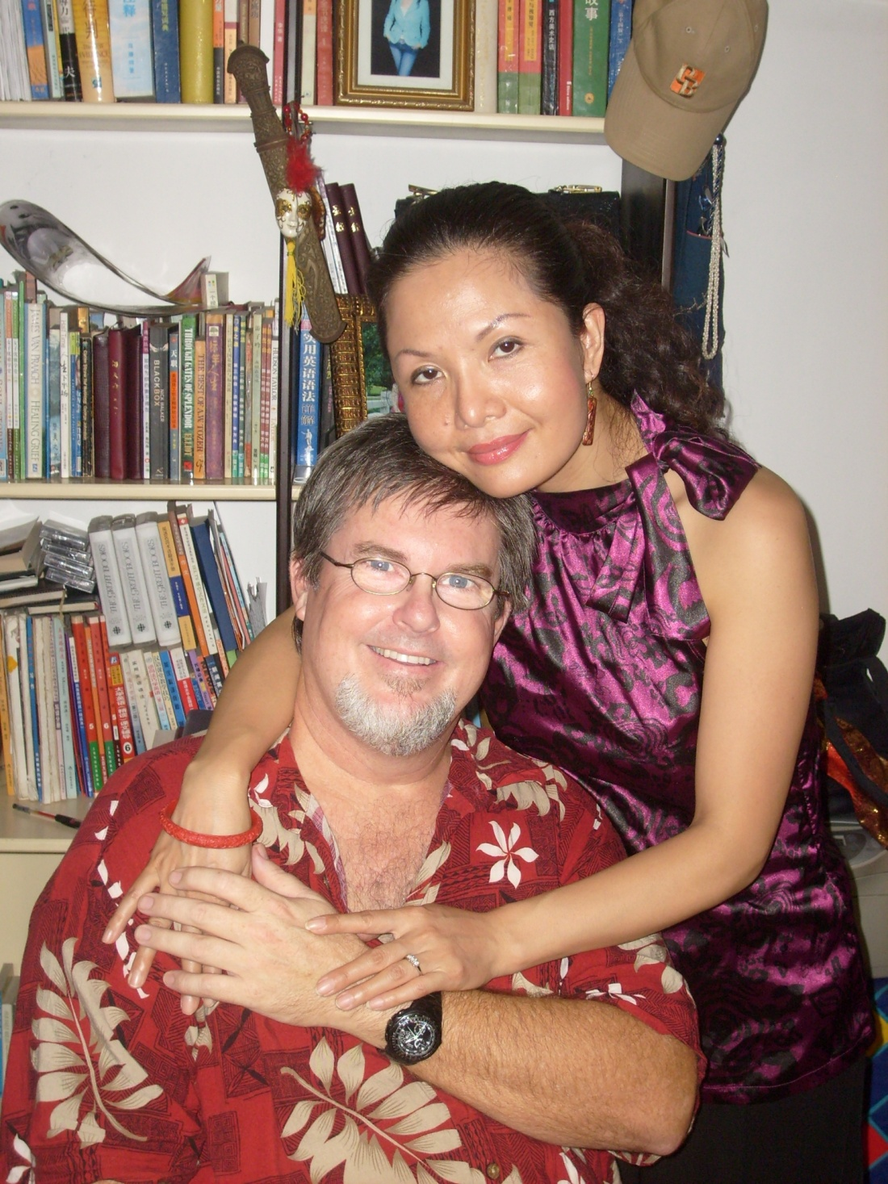
Teachers:
Dr. Jay
Barleon
&
Suran

Slide 4
今天….《敬拜》
.
广义上的敬拜
.
个人敬拜操练
.
团体敬拜聚会
什么是真正的敬拜？
Today…WORSHIP

Slide 5
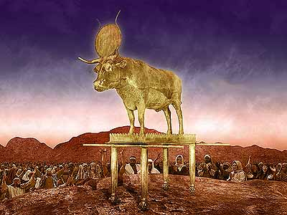

Slide 6
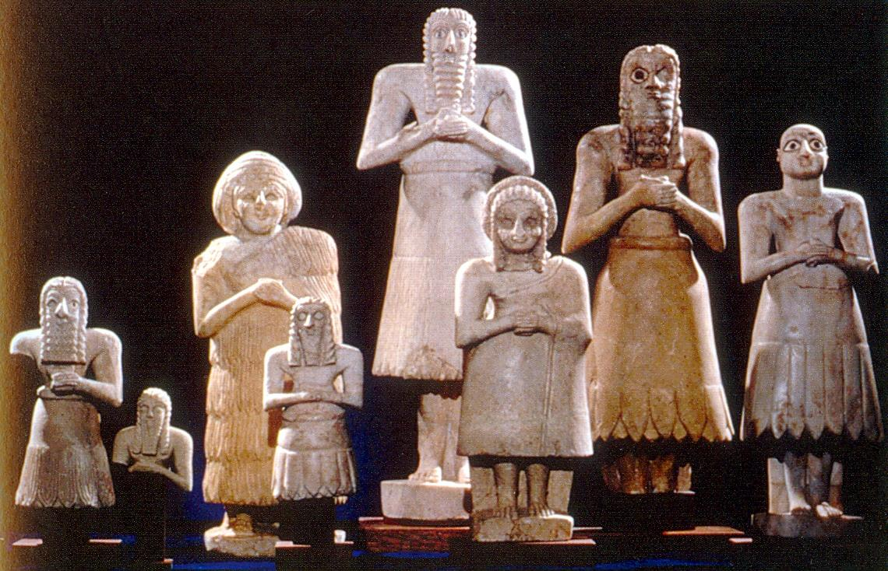

Slide 7
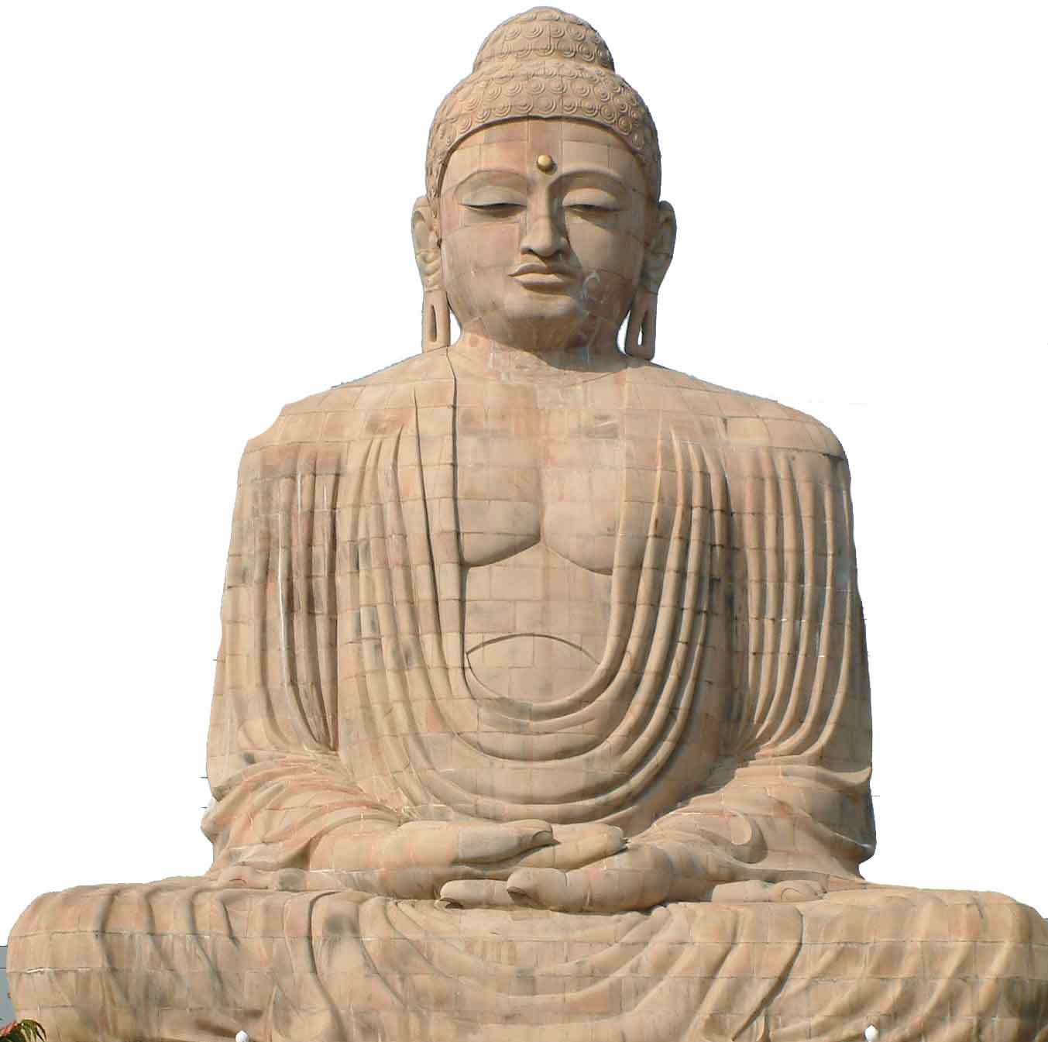

Slide 8
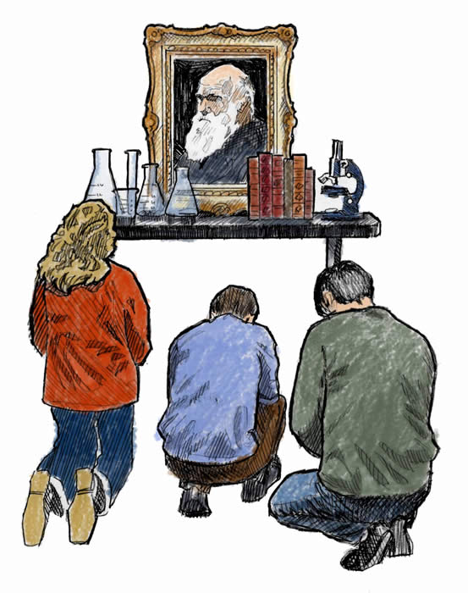

Slide 11
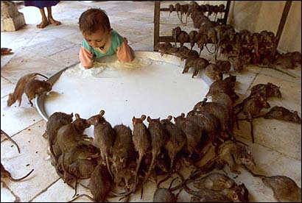

Slide 12
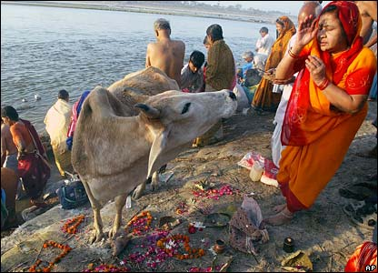

Slide 13
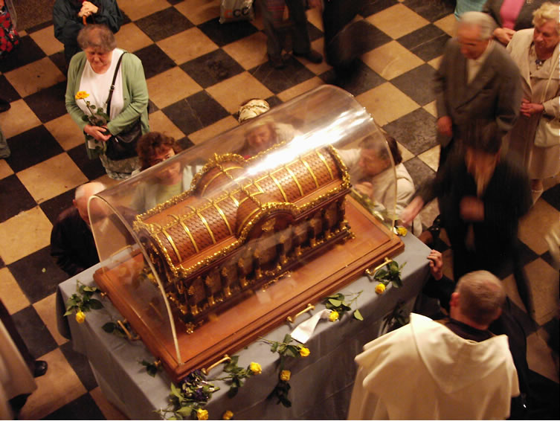

Slide 15
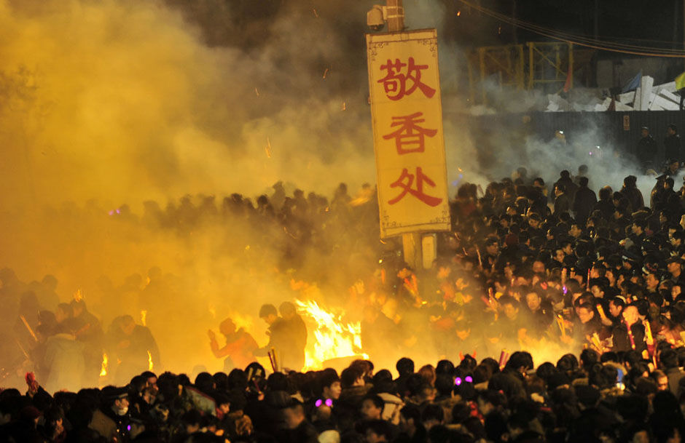

Slide 16
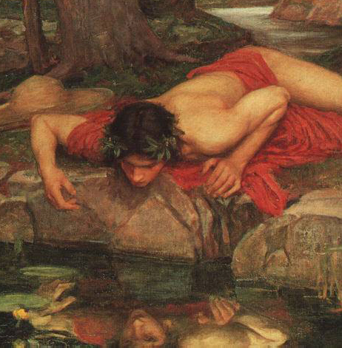

Slide 17
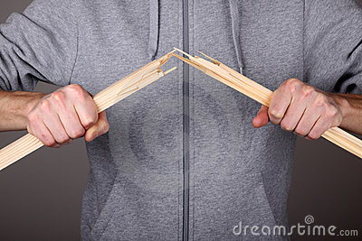
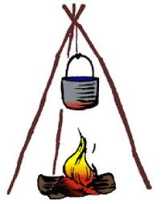
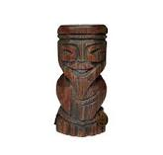
Isaiah 44:15-17

Slide 18
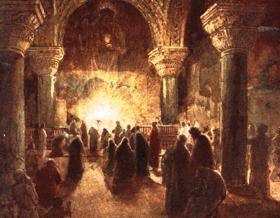
什么是敬拜？
WHAT IS WORSHIP?

Slide 19
敬拜不是
敬拜不是执行一系列的规矩和仪式
Worship is NOT following a list of rules and rituals
敬拜不是你以此获得神青睐的途径
Worship is NOT something you do to gain God’s favor
敬拜不是礼拜天上午的时间档
Worship is NOT a time slot on Sunday morning
敬拜不是某种特定的音乐风格
Worship is NOT a particular style of music
敬拜不是你身体姿势与心灵姿势的冲突。
Worship is NOT a body position that contradicts the heart position
What Worship is NOT

Slide 20
什么是真正的敬拜？
旧约希伯来语: 弯腰鞠躬;四体投地地赞美和膜拜
O.T. Hebrew: to bow down; fall prostrate in praise and adoration
新约希腊语: 崇敬地亲吻那手; 出于极深的敬意而跪下或磕头。
N.T. Greek: to kiss the hand in reverence; kneeling or touching the forehead to the ground out of profound reverence.
我们的定义: 出于心,魂,意,体或言语的任何足以展示对神尊荣,敬重或感激的行为。
My Definition: Any act of the heart, soul, mind, words or body that shows honor, respect or appreciation to God for all He has done.
WHAT IS TRUE WORSHIP?

Slide 21
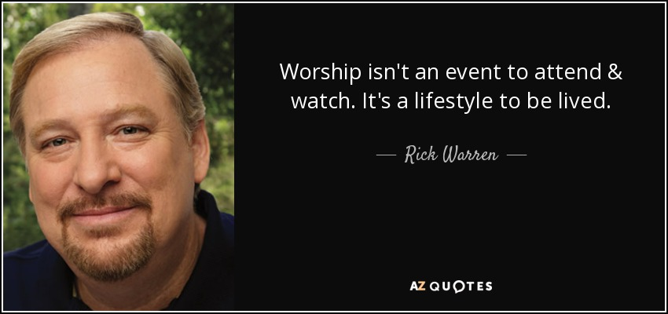
广义敬拜:基督徒的生活方式
“敬拜不是你出席或观看的活动，而是你要活出来的生活方式”
-华理克
WHAT IS TRUE WORSHIP?

Slide 22
敬拜是基督徒的生活方式
弟兄们,我凭着神的仁慈劝你们,要把身体献上,作圣洁而蒙神悦纳的活祭;这是你们理所当然的事奉。
—罗12:1
WHAT IS TRUE WORSHIP?

Slide 23
敬拜是基督徒的生活方式
工作也是敬拜——
保罗说：“作仆人的，要凡事听从你们肉身的主人，不要只在眼前事奉，像是讨人喜欢的，总要存心诚实敬畏主。无论做什么，都要从心里做，像是给主做的，不是给人做的，因你们知道从主那里必得着基业为赏赐；你们所事奉的乃是主基督。”（《西》22-23）。
WHAT IS TRUE WORSHIP?

Slide 24
敬拜是基督徒的生活方式
所以, 你们或吃喝, 或作什么,一切都要为神的荣耀而行。
—林前10:31
WHAT IS TRUE WORSHIP?

Slide 25
敬拜是基督徒的生活方式
“ 最深刻的敬拜是能在痛苦中赞美，试炼中感恩、试探时信靠、受苦时降服，在神看似遥不可及时仍然爱祂。”——华理克
WHAT IS TRUE WORSHIP?

Slide 26
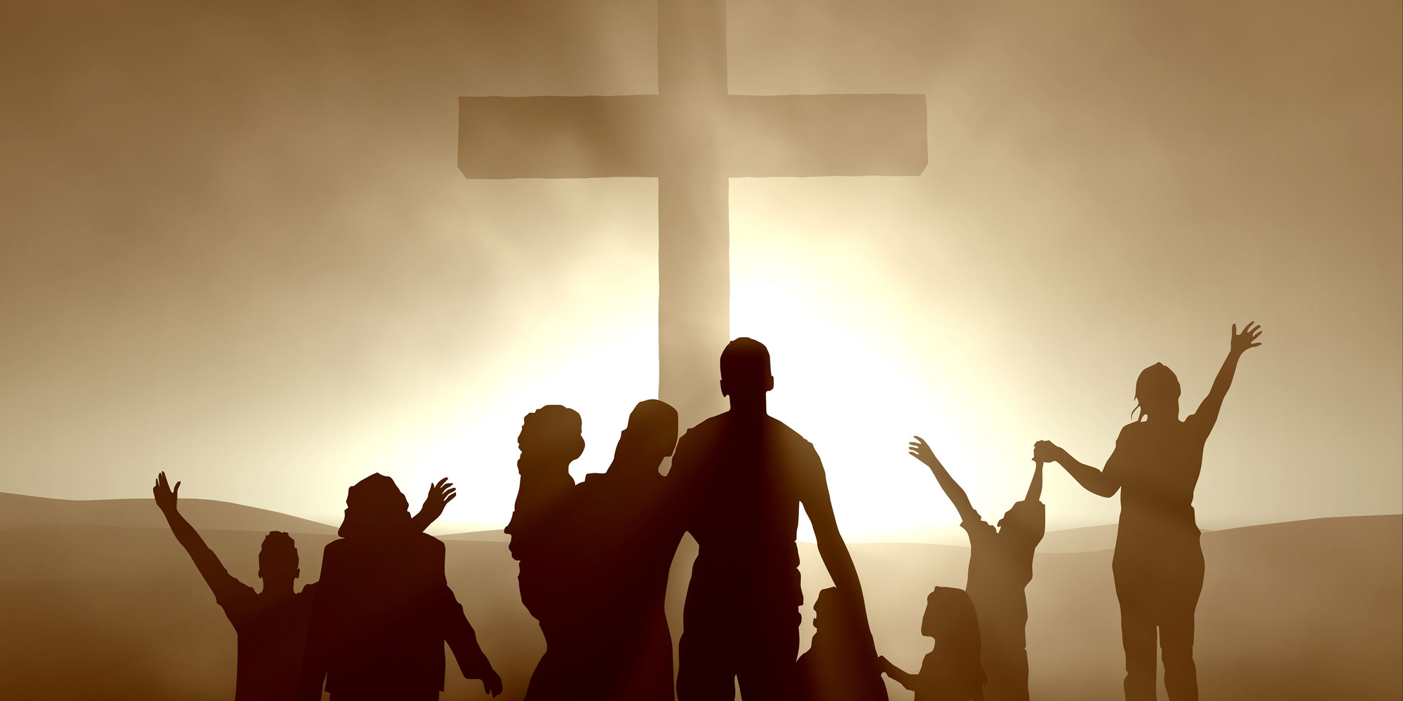
我如何敬拜神？
HOW CAN I WORSHIP GOD?

Slide 27
透过每天的顺服
罗12:1 “所以弟兄们，我以神的慈悲劝你们，将身体献上,当作活祭,是圣洁的,是神所喜悦的。你们如此事奉,乃是理所当然的.”
Romans 12:1 “Therefore, I urge you, brothers, in view of God’s mercy, to offer your bodies as living sacrifices, holy and pleasing to God— this is your spiritual act of worship.”
约一5:3 “我们遵守神的诫命,这就是爱他了.”
1 John 5:3 “This is love for God: to obey His commands…”
THROUGH DAILY OBEDIENCE

Slide 28
透过集中祷告
弗6:18 “靠着圣灵，随时多方祷告祈求，并要在此儆醒不倦，为众圣徒祈求.”
Eph 6:18 "And pray in the Spirit on all occasions with all kinds of prayers and requests. With this in mind, be alert and always keep on praying for all the saints"
腓4:6 “应当一无挂虑,只要凡事藉着祷告,祈求, 和感谢,将你们所要的告诉神.”
Phil. 4:6 "Do not be anxious about anything, but in everything, by prayer and petition, with thanksgiving, present your requests to God.”
THROUGH FOCUSED PRAYER

Slide 29
透过对祂感恩
来12:28 “所以我们既得了不能震动的国， 就当感恩，照神所喜悦的，用虔诚敬畏的心侍奉神。 ”
Heb. 12:28 “Therefore, since we are receiving a kingdom that cannot be shaken, let us be thankful, and so worship God acceptably with reverence and awe…”
帖前5:16-18 “要常常喜乐. 不住的祷告. 凡事谢恩. 因为这是神在基督耶稣里向你们所定的旨意. ”
1 Thess. 5:16-18 "Be joyful always; pray continually; give thanks in all circumstances, for this is God's will for you in Christ Jesus“
THROUGH GIVING OF THANKS TO HIM

Slide 30
透过给他人传福音
可16:15 “他又对他们说，你们往普天下去，传福音给万民听。”
Mark 16:15 :And he said to them, “Go into all the world and proclaim the gospel to the whole creation. “
赛52:7 “那报佳音，传平安，报好信， 传救恩的，对锡安说，你的神作王了。 这人的脚登山何等佳美.”
Isaiah 52:7 “How beautiful on the mountains are the feet of those who bring good news, who proclaim peace, who bring good tidings, who proclaim salvation, who say to Zion, "Your God reigns!"
THROUGH SHARING HIM WITH OTHERS

Slide 31
透过学习祂的道
提后2:15 “你当竭力，在神面前得蒙喜悦， 作无愧的工人，按着正意分解真理的道。”
2 Tim. 2:15 “Study to show thyself approved unto God, a workman that needs not to be ashamed, rightly dividing the word of truth.”
诗119:9-12 “少年人用什么洁净他的行为呢? 是要遵行你的话。我一心寻求了你。求你不要叫我偏离你的命令。我将你的话藏在心里，免得我得罪你。耶和华阿，你是应当称颂的。求你将你的律例教训我.”
Psalm 119:9-12 “How can a young person stay on the path of purity? By living according to your word. I seek you with all my heart; do not let me stray from your commands. I have hidden your word in my heart that I might not sin against you. Praise be to You, LORD; teach me your decrees.”
THROUGH THE STUDY OF HIS WORD

Slide 32
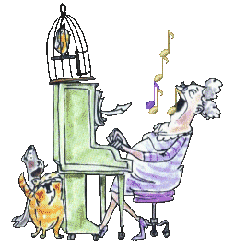
透过歌唱
诗30:4 “耶和华的圣民哪， 你们要歌颂他， 称赞他可记念的圣名。”
Psalm 30:4 “Sing praise to the LORD, you His godly ones, And give thanks to His holy name.”
诗9:2 “我要因你欢喜快乐。 至高者阿，我要歌颂你的名。”
Psalm 9:2 “I will be glad and rejoice in You: I will sing praise to Your name, O Thou most High.”
THROUGH SINGING

Slide 33
透过默想神和祂的道
腓4:8 “弟兄们，我还有未尽的话。凡是真实的，可敬的，公义的，清洁的，可爱的，有美名的。若有什么德行，若有什么称赞，这些事你们都要思念。”
Phil. 4:8 “Finally, brothers and sisters, whatever is true, whatever is noble, whatever is right, whatever is pure, whatever is lovely, whatever is admirable—if anything is excellent or praiseworthy—think about such things.”
希腊语的意思是深思冥想,让你的心思停留一会儿。
The Greek word means to meditate or let your mind dwell for a while
THROUGH MEDITATION ON GOD AND HIS WORD

Slide 34
透过对神和他人的给予
太6:3,4,19,20 “你施舍的时候，不要叫左手知道右手所作的。要叫你施舍的事行在暗中，你父在暗中察看，必报答你。不要为自己积攒财宝在地上，地上有虫子咬，能锈坏，也有贼挖窟窿来偷。只要积攒财宝在天上，天上没有虫子咬，不能锈坏，也没有贼挖窟窿来偷。”
Matt. 6:3,4, 19,20 “But when you give to the needy, do not let your left hand know what your right hand is doing, so that your giving may be in secret. Then your Father, who sees what is done in secret, will reward you… Do not store up for yourselves treasures on earth, where moths and vermin destroy, and where thieves break in and steal. But store up for yourselves treasures in heaven, where moths and vermin do not destroy, and where thieves do not break in and steal. For where your treasure is, there your heart will be also. “
THROUGH GIVING TO GOD AND OTHERS

Slide 35
透过集体的敬拜聚会
来10:24-25 “又要彼此相顾,激发爱心, 勉励行善。你们不可停止聚会,好像那些停止惯了的人,倒要彼此劝勉. 既知道那日子临近,就更当如此.”
Heb. 10:24-25 “And let us consider how we may spur one another on toward love and good deeds, not giving up meeting together, as some are in the habit of doing, but encouraging one another—and all the more as you see the Day approaching. “
THROUGH CORPORATE WORSHIP SERVICES

Slide 36
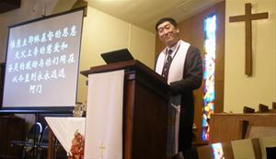
集体敬拜服事
THE CORPORATE WORSHIP SERVICE

Slide 37
为何我要参加敬拜聚会
来10:24-25 “又要彼此相顾，激发爱心，勉励行善。你们不可停止聚会，好像那些停止惯了的人，倒要彼此劝勉。既知道（原文作看见）那日子临近，就更当如此。”
Heb. 10:24-25 “And let us consider how we may spur one another on toward love and good deeds, not giving up meeting together, as some are in the habit of doing, but encouraging one another—and all the more as you see the Day approaching.”
神的命令
God commands it
神配得
God deserves it
挑战他人
To challenge others
激励他人
To encourage others
耶稣很快再来
Jesus is coming soon
WHY SHOULD I GO TO A WORSHIP SERVICE?

