Slide 1
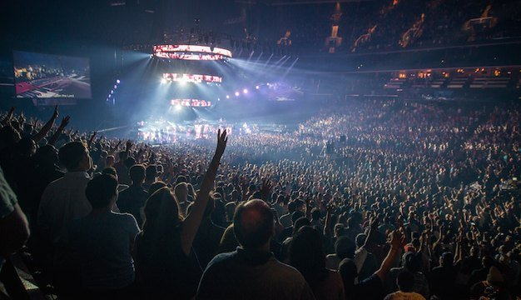
敬拜

Slide 2
圣经主题培训课程
INTENSIVE BIBLE TRAINING PROGRAM

Slide 3
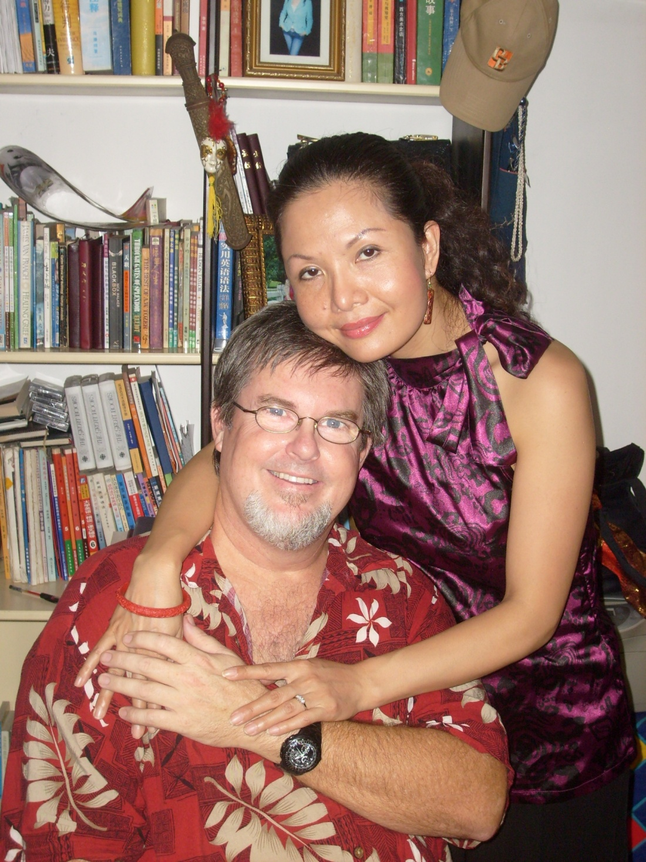
Teachers:
Dr. Jay
Barleon
&
Suran

Slide 4
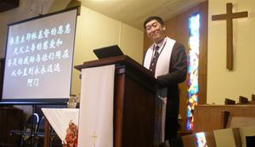
集体敬拜服事
THE CORPORATE WORSHIP SERVICE

Slide 5
为何我要参加敬拜聚会
来10:24-25 “又要彼此相顾，激发爱心，勉励行善。你们不可停止聚会，好像那些停止惯了的人，倒要彼此劝勉。既知道（原文作看见）那日子临近，就更当如此。”
Heb. 10:24-25 “And let us consider how we may spur one another on toward love and good deeds, not giving up meeting together, as some are in the habit of doing, but encouraging one another—and all the more as you see the Day approaching.”
神的命令
God commands it
神配得
God deserves it
挑战他人
To challenge others
激励他人
To encourage others
耶稣很快再来
Jesus is coming soon
WHY SHOULD I GO TO A WORSHIP SERVICE?

Slide 6
敬拜聚会的要素
讲道
圣餐
祷告
奉献
歌唱
诵读经文
ELEMENTS of a WORSHIP SERVICE

Slide 7
1.讲道
提后4:2: “务要传道。无论得时不得时， 总要专心，并用百般的忍耐，各样的教训，责备人，警戒人， 劝勉人。”
2 Tim. 4:2 : Preach the word; be prepared in season and out of season; correct, rebuke and encourage—with great patience and careful instruction.”
1. PREACHING THE WORD

Slide 8
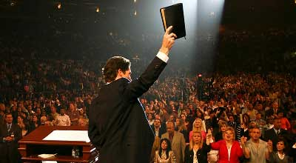
1.讲道
1. PREACHING THE WORD

Slide 9
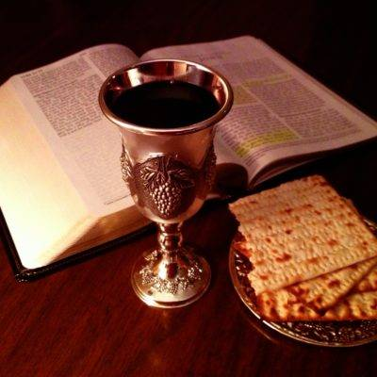
2.定期领圣餐
徒2:42 “都恒心遵守使徒的教训,彼此交接, 擘饼,祈祷.”
Act 2:42 “They were continually devoting themselves to the apostles' teaching and to fellowship, to the breaking of bread and to prayer.”
2. Periodic Communion

Slide 10
3.祷告
提前2:1 “我劝你第一要为万人恳求祷告， 代求,祝谢.”
1 Tim. 2:1 “I urge, then, first of all, that petitions, prayers, intercession and thanksgiving be made for all people…”
3. PRAYER

Slide 11
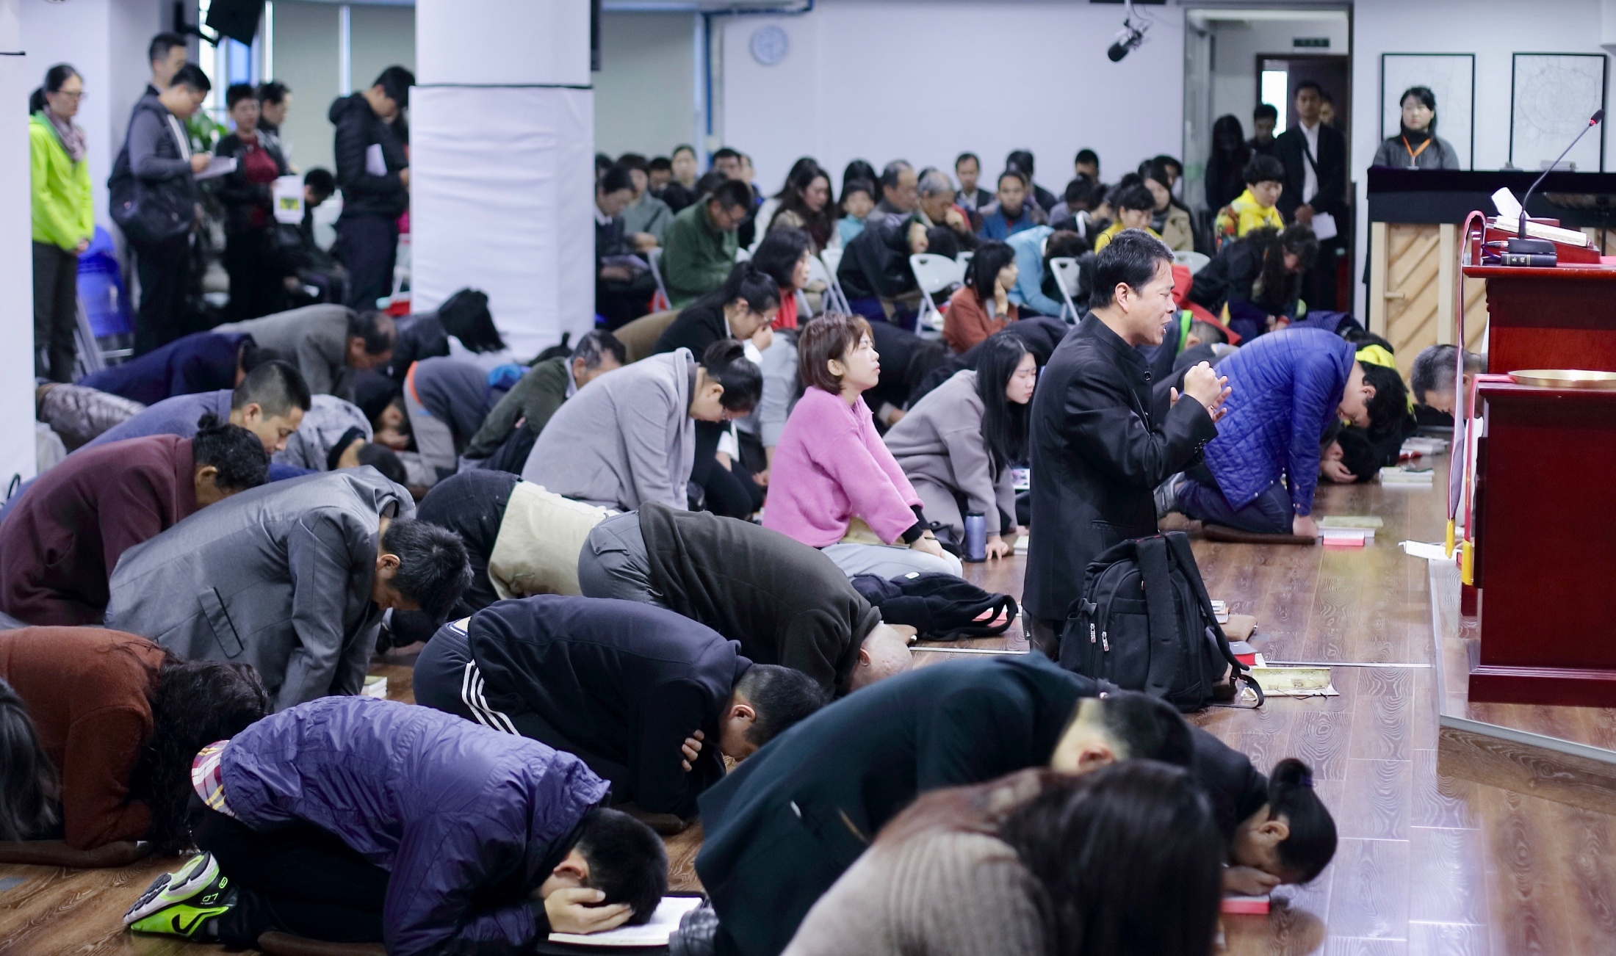
3.祷告
3. PRAYER

Slide 12
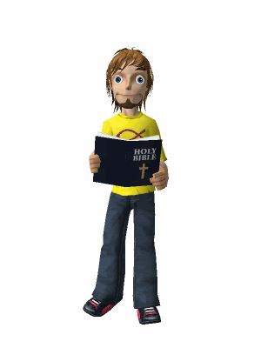
4. 公开宣读经文
提前4:13 “你要以宣读,劝勉，教导为念,直等到我来.”
1 Tim. 4:13 “Until I come, devote yourself to the public reading of Scripture, to preaching and to teaching.”
4. PUBLIC READING OF SCRIPTURE

Slide 13
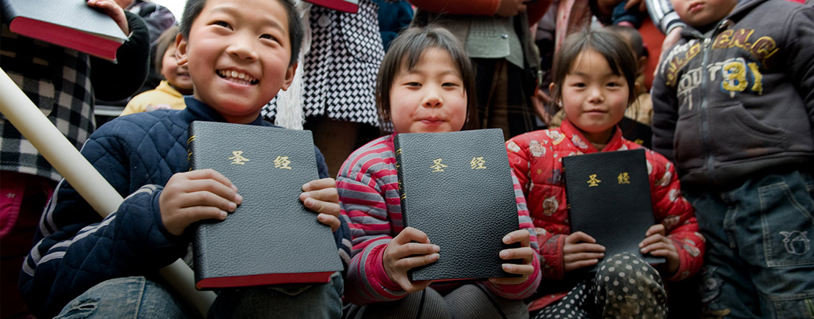
4. 公开宣读经文
4. PUBLIC READING OF SCRIPTURE

Slide 14
5.奉献
林后9: 6-8 “少种的少收，多种的多收。这话是真的。各人要随本心所酌定的。不要作难，不要勉强，因为捐得乐意的人，是神所喜爱的。神能将各样的恩惠，多多的加给你们。使你们凡事常常充足，能行各样的善事。”
2 Cor. 9:6-8 “Remember this: Whoever sows sparingly will also reap sparingly, and whoever sows generously will also reap generously. Each of you should give what you have decided in your heart to give, not reluctantly or under compulsion, for God loves a cheerful giver. And God is able to bless you abundantly, so that in all things at all times, having all that you need, you will abound in every good work.”
5. GIVING

Slide 15
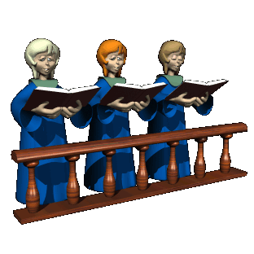
6. 歌唱
西3:16 “当用各样的智慧，把基督的道理，丰丰富富的存在心里，用诗章，颂词，灵歌，彼此教导，互相劝戒，心被恩感歌颂神。”
Col. 3:16 “Let the message of Christ dwell among you richly as you teach and admonish one another with all wisdom through psalms, hymns, and songs from the Spirit, singing to God with gratitude in your hearts.”
6. SINGING

Slide 16
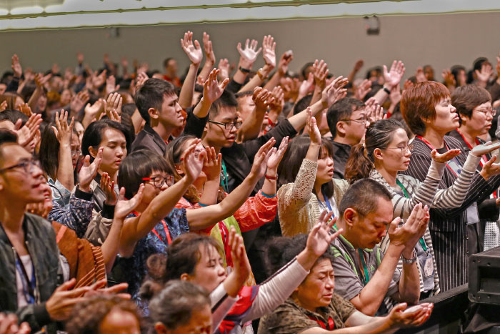
6. 歌唱
6. SINGING

Slide 17
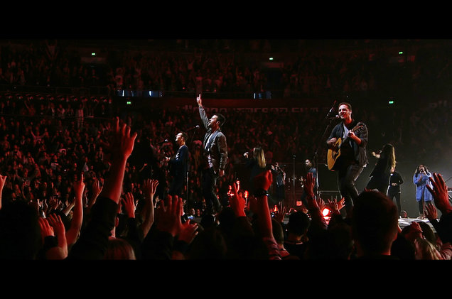
6. 歌唱
6. SINGING

Slide 18
是否可以加入其它要素呢？
讲道
圣餐
祷告
诵读经文
奉献
歌唱
IS IT OK TO ADD OTHER ELEMENTS?

Slide 19
两种观点
排他观点:
“我们只做圣经中有的敬拜。”
EXCLUSIVE VIEW: “We only do worship elements in the Bible”
2. 包容观点:
“我们在敬拜中加入文化元素。”
INCLUSIVE VIEW: “We add cultural elements of worship also”
2 VIEWS

Slide 20
排他观点: 只实践圣经
长处
STRENGTHS
聚焦于早期教会的实践
Focuses on the practices of the early church
排除了假宗教的实践
Keeps out practices of false religions
高度注重圣经
Highly regards the Bible
短处
WEAKNESSES
律法主义/注重规则
Legalistic / Rule focused
排除了新技术和文化需求
Leaves out new technology and cultural necessities
礼拜天比其它时间更神圣吗？
Sunday holier that other days?
EXCLUSIVE VIEW: Bible practices ONLY

Slide 21
包容观点: 加入文化因素
长处
STRENGTHS
原则永不改变,
但方法可以变化
PRINCIPLES never change but METHODS do change
允许文化差异性
Allows for cultural differences
允许创新的敬拜(诗班, 戏剧等)
Allows for creative worship (choirs, drama, etc.)
短处
WEAKNESSES
警惕假宗教的实践混进来。
BEWARE incorporating methods of false religions
可能聚焦在取悦观众而不是神
Can focus on pleasing people instead of God
必要内容因非必要内容而被牺牲掉
Essentials are sacrificed for non-essentials
INCLUSIVE VIEW: Cultural Practices Also

Slide 22
要点
聚焦于敬拜神，而非娱乐人。
Stay focused on worshipping God, not entertaining people
保留敬拜聚会中的圣经要素。
Maintain the Biblical elements of a Worship Service
方法应该带来合一而非分裂。
Methods should bring unity, not division
整个敬拜是会众中每人因神恩典和爱而感恩的行动。
The entire service is an act of gratefulness to God for the grace and love He has shown to everyone in the congregation
THE KEY

Slide 23
有无错误的敬拜方式？
该隐: 以我的方式, 而非神要的方式敬拜。
Cain & Abel: Worshipping God how WE want, not how HE wants
扫罗: 不合格的领导(听命胜于献祭)
Saul: Unqualified leadership (To obey is better than sacrifice)
法利赛人: 敬拜偶像(约柜/圣殿)而非神
Pharisees: Worship the icons (ark/temple) rather than God
拿答和亚比户: 怪火(掺入异教方法)
Nadab & Abihu: Strange fire (incorporating cultic methods)
玛拉基书1: 给神残羹剩汤而非初熟之果。
Malachi 1: Giving God the leftover sacrifices instead of first fruit
IS THERE A WRONG WAY TO WORSHIP?

Slide 24
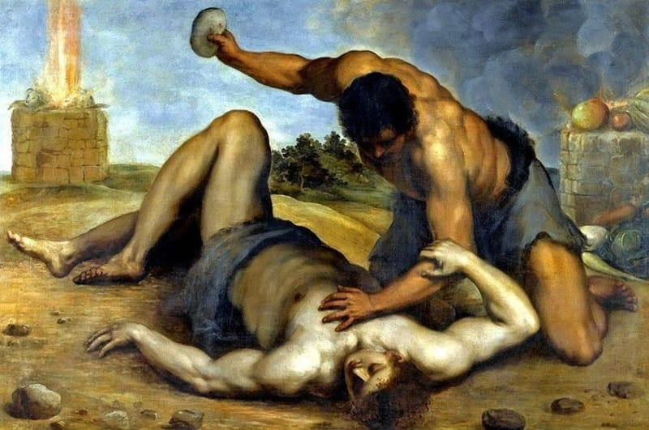
该隐的敬拜——
以我的方式而非神的方式
IS THERE A WRONG WAY TO WORSHIP?

Slide 25
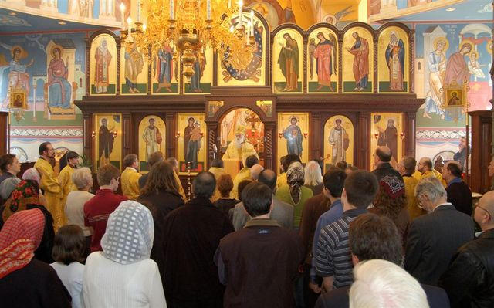
敬拜偶像
IS THERE A WRONG WAY TO WORSHIP?

Slide 26
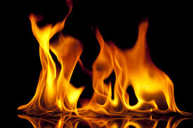
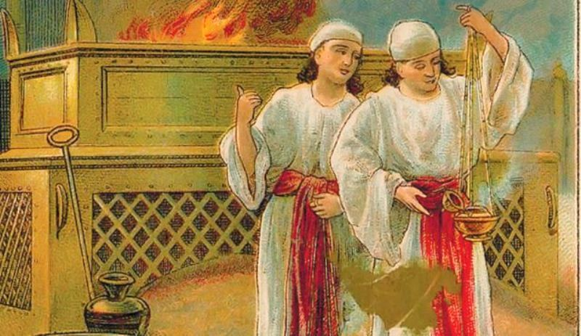
拿答和亚比户——
掺入凡火
IS THERE A WRONG WAY TO WORSHIP?

Slide 27
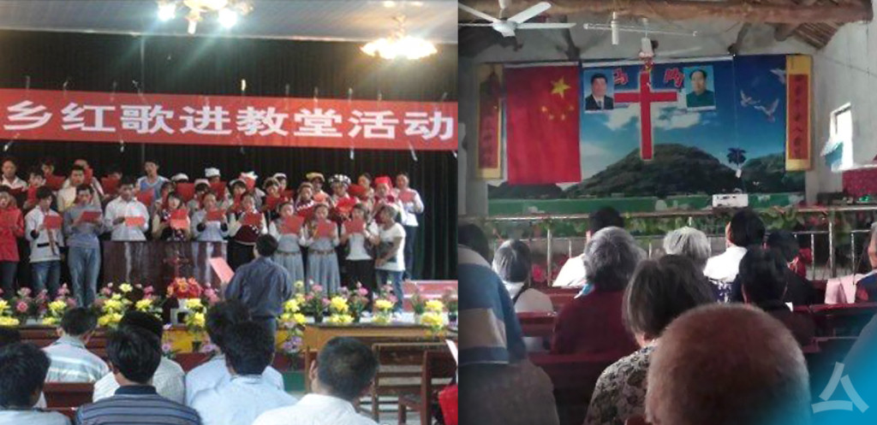
今天的凡火
IS THERE A WRONG WAY TO WORSHIP?

Slide 28
误解和错误观念
“聚会越长敬拜越诚恳.”
“Longer services are more worshipful”
“只有特定的音乐风格和衣服才有敬拜性”
“Only certain music styles or clothes are worshipful”
“聚会应让非基督徒感到自在.”
“The service should be comfortable for non-Christians”
“聚会不应有组织性. 让圣灵流动就好了.”
“A service should not be very organized. Let the Spirit flow”
“每堂聚会必须传讲福音.”
“The Gospel must be given at every service”
“教堂比我的家更神圣.”
“The church is a holier place than my home”
误解
MISCONCEPTIONS & WRONG IDEAS

Slide 29
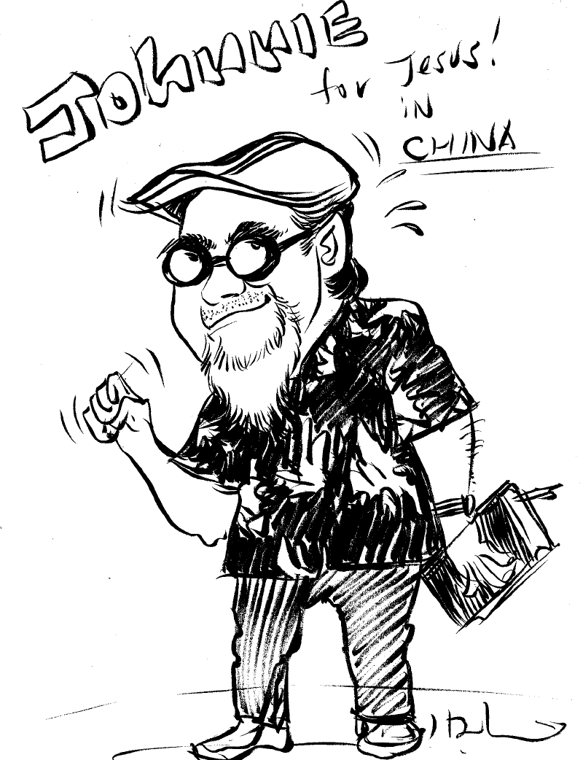
结论
CONCLUSION

Slide 30
我们只敬拜上帝
A TRUE WORSHIP SERVICE

Slide 31
真正的敬拜聚会
“基督徒的整个生活都是对圣父神不间断的敬拜. 这敬拜透过对圣子神的默想, 以及靠着圣灵神内住的能力去行神在圣经中所命令之事, 不行神所禁止之事。敬拜也包括当聚在一起崇敬神时,以适合本文化的方式促进福音广传或分散的时候, 个人对神荣耀的恩典做出喜乐的回应.”
“All of Christian life is ceaseless worship of God the Father through the mediation of God the Son by the indwelling power of God the Spirit doing what God commands in Scripture, not doing what God forbids in Scripture, in culturally appropriate ways for the furtherance of the Gospel when both gathered for adoration and scattered for action in joyous response to God’s glorious grace.” MD
A TRUE WORSHIP SERVICE

Slide 32
真正的敬拜
“整个基督徒的生活都是对父神不间断敬拜. 这敬拜透过对圣子神的默想, 以及靠着圣灵神内住的能力去行神在圣经中所命令之事, 不行神所禁止之事。敬拜也包括当聚在一起崇敬神时,以适合本文化的方式促进福音广传或分散的时候, 个人对神荣耀的恩典做出喜乐的回应.”
“All of Christian life is ceaseless worship of God the Father through the mediation of God the Son by the indwelling power of God the Spirit doing what God commands in Scripture, not doing what God forbids in Scripture, in culturally appropriate ways for the furtherance of the Gospel when both gathered for adoration and scattered for action in joyous response to God’s glorious grace.” MD
A TRUE WORSHIP SERVICE

Slide 33
真正的敬拜
“基督徒的整个生活都是对圣父神不间断的敬拜. 这敬拜透过对圣子神的默想, 以及靠着圣灵神内住的能力去行神在圣经中所命令之事, 不行神所禁止之事。敬拜也包括当聚在一起崇敬神时,以适合本文化的方式促进福音广传或分散的时候, 个人对神荣耀的恩典做出喜乐的回应。”
“All of Christian life is ceaseless worship of God the Father through the mediation of God the Son by the indwelling power of God the Spirit doing what God commands in Scripture, not doing what God forbids in Scripture, in culturally appropriate ways for the furtherance of the Gospel when both gathered for adoration and scattered for action in joyous response to God’s glorious grace.” MD
A TRUE WORSHIP SERVICE

Slide 34
真正的敬拜
“基督徒的整个生活都是对圣父神不间断的敬拜. 这敬拜透过对圣子神的默想, 以及靠着圣灵神内住的能力去行神在圣经中所命令之事, 不行神所禁止之事。敬拜也包括当聚在一起崇敬神时,以适合本文化的方式促进福音广传或分散的时候, 个人对神荣耀的恩典做出喜乐的回应。”
“All of Christian life is ceaseless worship of God the Father through the mediation of God the Son by the indwelling power of God the Spirit doing what God commands in Scripture, not doing what God forbids in Scripture, in culturally appropriate ways for the furtherance of the Gospel when both gathered for adoration and scattered for action in joyous response to God’s glorious grace.” MD
A TRUE WORSHIP SERVICE

Slide 35
真正的敬拜
“基督徒的整个生活都是对圣父神不间断的敬拜. 这敬拜透过对圣子神的默想, 以及靠着圣灵神内住的能力去行神在圣经中所命令之事, 不行神所禁止之事。敬拜也包括当聚在一起崇敬神时,以适合本文化的方式促进福音广传或分散的时候, 个人对神荣耀的恩典做出喜乐的回应。”
“All of Christian life is ceaseless worship of God the Father through the mediation of God the Son by the indwelling power of God the Spirit doing what God commands in Scripture, not doing what God forbids in Scripture, in culturally appropriate ways for the furtherance of the Gospel when both gathered for adoration and scattered for action in joyous response to God’s glorious grace.” MD
A TRUE WORSHIP SERVICE

Slide 36
真正的敬拜
“基督徒的整个生活都是对圣父神不间断的敬拜. 这敬拜透过对圣子神的默想, 以及靠着圣灵神内住的能力去行神在圣经中所命令之事, 不行神所禁止之事。敬拜也包括当聚在一起崇敬神时,以适合本文化的方式促进福音广传或分散的时候, 个人对神荣耀的恩典做出喜乐的回应。”
“All of Christian life is ceaseless worship of God the Father through the mediation of God the Son by the indwelling power of God the Spirit doing what God commands in Scripture, not doing what God forbids in Scripture, in culturally appropriate ways for the furtherance of the Gospel when both gathered for adoration and scattered for action in joyous response to God’s glorious grace.” MD
A TRUE WORSHIP SERVICE

Slide 37
真正的敬拜
“基督徒的整个生活都是对圣父神不间断的敬拜. 这敬拜透过对圣子神的默想, 以及靠着圣灵神内住的能力去行神在圣经中所命令之事, 不行神所禁止之事。敬拜也包括当聚在一起崇敬神时,以适合本文化的方式促进福音广传或分散的时候, 个人对神荣耀的恩典做出喜乐的回应。”
“All of Christian life is ceaseless worship of God the Father through the mediation of God the Son by the indwelling power of God the Spirit doing what God commands in Scripture, not doing what God forbids in Scripture, in culturally appropriate ways for the furtherance of the Gospel when both gathered for adoration and scattered for action in joyous response to God’s glorious grace.” MD
A TRUE WORSHIP SERVICE

Slide 38
真正的敬拜
“基督徒的整个生活都是对圣父神不间断的敬拜. 这敬拜透过对圣子神的默想, 以及靠着圣灵神内住的能力,去行神在圣经中所命令之事, 不行神所禁止之事。敬拜也包括聚在一起崇敬神时,以适合本文化的方式促进福音广传或分散的时候, 个人对神荣耀的恩典做出喜乐的回应。”
“All of Christian life is ceaseless worship of God the Father through the mediation of God the Son by the indwelling power of God the Spirit doing what God commands in Scripture, not doing what God forbids in Scripture, in culturally appropriate ways for the furtherance of the Gospel when both gathered for adoration and scattered for action in joyous response to God’s glorious grace.” MD
A TRUE WORSHIP SERVICE

