Slide 1
TIME
时间管理

Slide 2
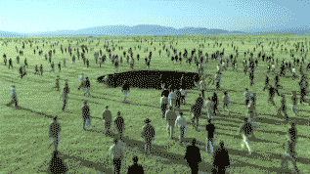
今天: 时间管理
Today: TIME MANAGEMENT

Slide 3
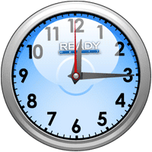
一周168小时，一年8736小时。
  There are 168 hours in a week and 8,736 hours in a year.
不管年轻还是年老，富有亦或贫穷，忙碌或者闲懒，我们都拥有相同的时间。不同的是我们如何使用时间。
  We all get the same number whether we are young or old, rich or poor, busy or bored. The difference is in what we do with our time.

Slide 4
今天：时间
问题 Problems
经文Passages
优先顺序 Prioritizing
计划 Planning
目的 Purpose
TODAY: TIME

Slide 5
问题
总是不够时间来完成任务
  Not enough time to finish our tasks
工作过度导致疾病和疲倦
  Physically sick and exhausted from overwork
花在社交媒体上的时间多于家庭
  More time with friends than family
为了完成其它事情而放弃聚会
  Skipping church to finish other things
工作太累而无法享受家庭生活
  Too tired from work to enjoy family
PROBLEMS

Slide 6
问问你自己…
在好配偶和好员工之间，神对哪个更满意？
  Is God more pleased if I am a good parent or a good worker?
圣经要我与老板成为一体, 还是配偶？
  Does the Bible say I become ONE with my boss or my spouse?
没有我, 谁最遭罪, 我的孩子还是我的工作？
  Who will suffer most without me; my kids or my job?
我该首先顺服神还是顺服公司或国家？
  Do I obey God or country first?
我要留给我子孙的产业是什么？
  What legacy do I want to leave for my grandchildren?
Ask Yourself…

Slide 7
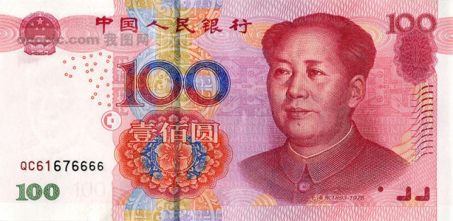
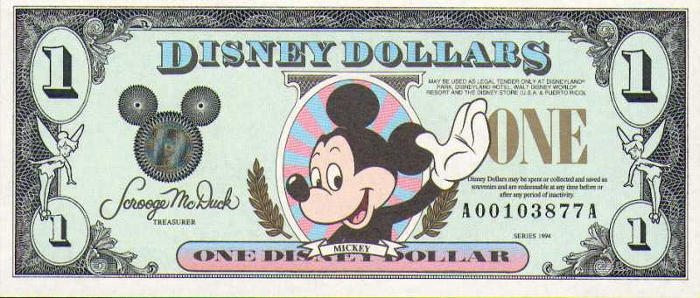
ie: Have you ever seen a counterfeit $20 bill that was pink and had Mickey Mouse’s picture on it? Of course not. Counterfeiters want to make their product look as much like the real thing as possible. Their intent is to deceive you into thinking their fake money is the real thing. That’s the same principle Satan uses to deceive Christians into accepting his counterfeit plans for using time. He understands that subtlety is a much more effective tactic than obvious error. Many people miss God’s best in their use of time because they are busy doing something good and respectable. Most of aren’t going to spend time today planning a bank robbery or convenience store hold up. But, we might light let Satan rob us of time by sitting too long in front of a TV, aimless telephone conversations which border on gossip, or mindless web surfing. Ask God today to reveal to you any subtle counterfeits that might hinder you from redeeming the time.

Slide 8
引述
“撒旦若不能让你犯罪, 就会让你忙碌.”
  “If Satan cannot make you sin, he will make you too busy”
“很多人都有一个二奶. 她的名字是工作.”
  “Too many men have a concubine. Her name is WORK”
“如果你以牺牲孩子获得成功, 你便是个最大的失败者.”
  “If you have sacrificed your children to become successful, you are the greatest failure.”
“很多基督徒寻求的是建造他们自己的国度, 而非神的国度. ”
  “Many Christians seek to build their own kingdoms instead of God’s Kingdom”
“神绝不会让你去做任何事,却不给你时间和金钱完成它。”
  “God will never ask you to do anything unless He is going to give you the time and $$$ to complete it.”
QUOTES

Slide 9

神的教导
最大化地利用你的时间.
MAKE THE BEST USE OF YOUR TIME
弗5:15-16: “ 你们要谨慎行事,不要像愚昧人,当像智慧人. 要爱惜光阴,因为现今的世代邪恶.”
  Ephesians 5:15-16 Look carefully then how you walk, not as unwise but as wise, making the best use of the time, because the days are evil.
PASSAGES

Slide 10
神的教导
要明白你在世上的日子何等有限.
UNDERSTAND HOW SHORT YOUR TIME ON EARTH IS
诗39:4-5 “耶和华阿，求你叫我晓得我身之终,我的寿数几何，叫我知道我的生命不长. 你使我的年日窄如手掌。我一生的年数,在你面前如同无有。各人最稳妥的时候,真是全然虚幻.”
  Psalm 39:4-5 “O Lord, make me know my end and what is the measure of my days; let me know how fleeting I am! Behold, you have made my days a few hand breadths, and my lifetime is as nothing before you. Surely all mankind stands as a mere breath! Selah
诗90:10 “我们一生的年日是七十岁。若是强壮可到八十岁；但其中所矜夸的不过是劳苦愁烦，转眼成空，我们便如飞而去。”
  Psalm 90:10 The years of our life are seventy, or even by reason of strength eighty; yet their span is but toil and trouble; they are soon gone, and we fly away.
PASSAGES

Slide 11
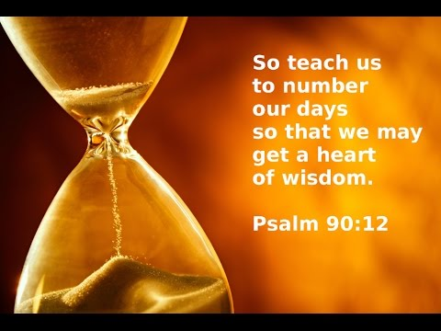
神的教导
明白你时间的有限性，要智慧地决策.
UNDERSTANDING YOUR TIME LIMITS LEADS TO WISE DECISIONS
诗90:12 “求你指教我们怎样数算自己的日子，好叫我们得着智慧的心。”
  Psalm 90:12 “So teach us to number our days that we may get a heart of wisdom.”
PASSAGES

Slide 12
神的教导
神会改变你的计划. GOD CAN CHANGE YOUR PLANS
雅4:13-17 “你们有话说,今天明天我们要往某城里去，在那里住一年,作买卖得利。其实明天如何,你们还不知道. 你们的生命是什么呢?你们原来是一片云雾,出现少时就不见了. 你们只当说,主若愿意,我们就可以活着,也可以作这事，或作那事。现今你们竟以张狂夸口. 凡这样夸口都是恶的。人若知道行善,却不去行,这就是他的罪了.”
  James 4:13-17 “Come now, you who say, “Today or tomorrow we will go into such and such a town and spend a year there and trade and make a profit”— yet you do not know what tomorrow will bring. What is your life? For you are a mist that appears for a little time and then vanishes. Instead you ought to say, “If the Lord wills, we will live and do this or that.” As it is, you boast in your arrogance. All such boasting is evil. So whoever knows the right thing to do and fails to do it, for him it is sin.
PASSAGES

Slide 13
神的教导
万事都有定时. THERE IS A TIME FOR EVERYTHING
传3:1-8 “凡事都有定期，天下万务都有定时。生有时，死有时；栽种有时，拔出所栽种的，也有；杀戮有时，医治有时；拆毁有时，建造有时；哭有时，笑有时；哀恸有时，跳舞有时； 抛掷石头有时，堆聚石头有时；怀抱有时，不怀抱有时；寻找有时，失落有时；保守有时，舍弃有时；撕裂有时，缝补有时；静默有时，言语有时；喜爱有时，恨恶有时；争战有时，和好有时。”
  Eccl. 3:1-8 “There is a time for everything, and a season for every activity under the heavens: a time to be born and a time to die, a time to plant and a time to uproot, a time to kill and a time to heal, a time to tear down and a time to build, a time to weep and a time to laugh, a time to mourn and a time to dance, a time to scatter stones and a time to gather them, a time to embrace and a time to refrain from embracing, a time to search and a time to give up, a time to keep and a time to throw away, a time to tear and a time to mend, a time to be silent and a time to speak, a time to love and a time to hate, a time for war and a time for peace.”

Slide 14
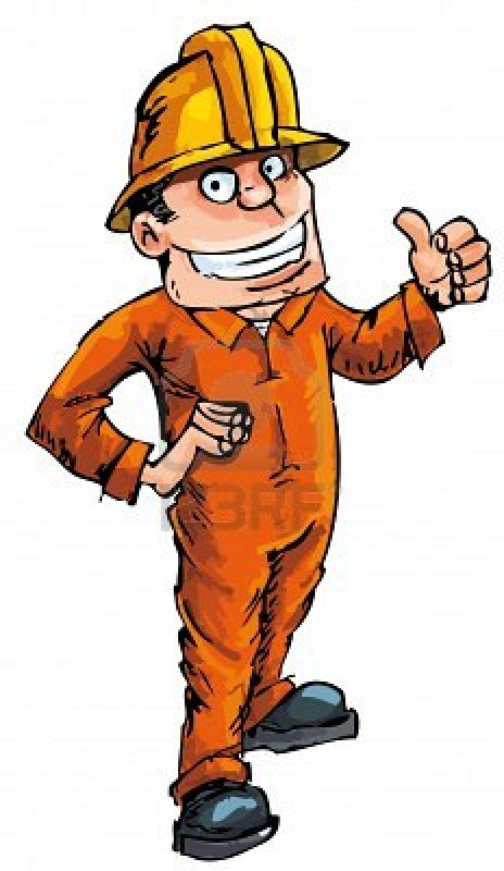

懒汉和勤劳者
THE SLUGGARD & THE GOOD WORKER

Slide 15
《箴言》中的勤劳者
有足够的食物
  Has enough food (12:11)
勤劳得酬报
  Is rewarded for hard work (12:14)
积蓄必见加增
  Gathers a little at a time (13:11)
甘心工作
  Wants to work (31:13)
并不闲懒和无所事事
  Is not lazy and inactive (31:27)
他办事殷勤得称赞
  Is praised for his hard work (31:31)
赢得去见重要人物的权利
  Earns the right to meet important people (22:29)
善于从他人的错误中吸取教训
  Learns from other’s mistakes (24:30)
THE GOOD WORKER in PROVERBS

Slide 16
《箴言》中的懒汉
会挨饿
  Will suffer hunger (19:15)
生活贫穷
  Lives in poverty (10:4)
强迫工作
  Is forced to work (21:25)
不成功
  Is unsuccessful (12:27)
拒绝做工
  Refuses to work (21:25)
懒惰
  Is lazy (26:15)
该干活时睡大觉
  Sleeps during work hours (10:5)
陷入 “快速致富”的陷阱
  Gets involved with “Get-Rich-Quickly” schemes (12:11)
爱找借口
  Makes excuses (22:13)
让家人蒙羞
  Shames their families (10:5)
自以为聪明
  See themselves as wise (26:16)
结交同类朋友
  His friends are the same way (18:9)
THE SLUGGARD in PROVERBS

Slide 17
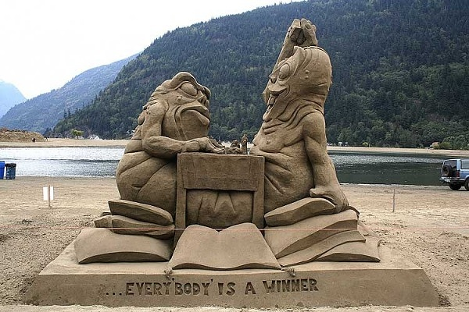
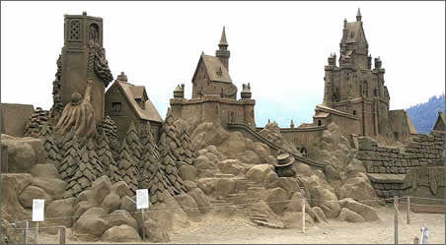

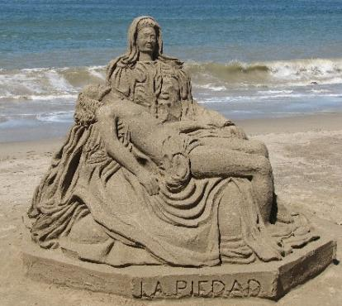
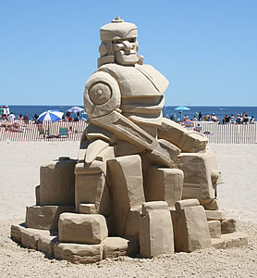
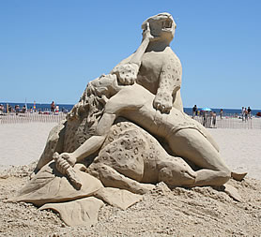
优先顺序 PRIORTIZING

Slide 18
优先顺序
“想要成就很多事会妨碍我们成就大事”
  “Trying to complete too many good things can keep us from accomplishing great things.”
“我们认为重要的事, 神可能并不这么认为。”
  “What we see as the priority may not be what God has set as our priority”
“如果把优先顺序弄错了,你虽然爬梯的速度很快,但是到了顶上, 才发现梯子放错了墙。”
  “If you have your priorities wrong, you may climb the ladder very fast but when you get to the top, you will find you ladder on the wrong wall.”
PRIORTIZING

Slide 19



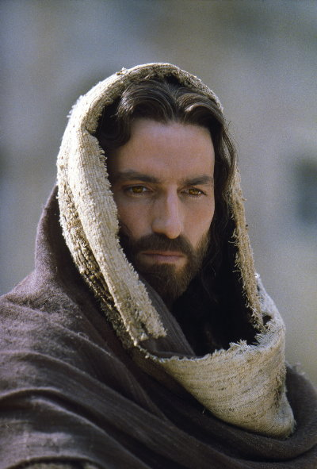
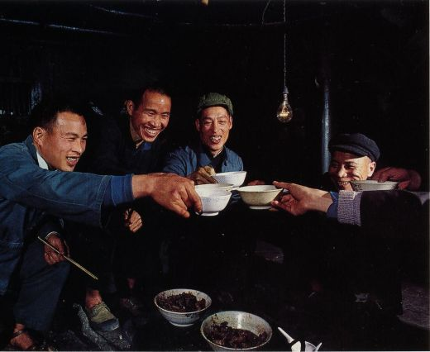

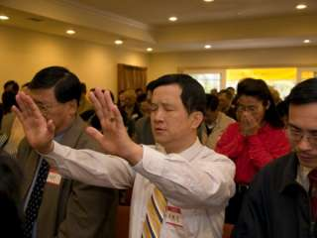

Slide 20
上帝 (GOD)
家庭 (FAMILY)
工作 (WORK)
教会 (CHURCH)
国家(COUNTRY)
其余 (The Rest)

Slide 21

计划
一旦我们将生活优先顺序化后，我们需要一个切实可行的方法排除一切干扰和浪费我们时间的事。以下是一些日常生活中可以使用的建议。
  Once we prioritize our life, we need some practical ways to eliminate those things which distract us or waste our time. Here are some helpful hints that you can use in your daily life.
PLANNING

Slide 22
紧急
URGENT
不紧急
NOT URGENT
紧急而重要
URGENT & IMPORTANT
重要但不紧急
IMPORTANT / NOT URGENT
重要
IMPORTANT
紧急而不重要
URGENT / NOT IMPORTANT
不重要亦不紧急
NOT IMPORTANT / NOT URGENT
不重要
NOT IMPORTANT

Slide 23
谨慎西西弗斯效应
Beware the SISYPHUS EFFECT

Slide 24
西西弗斯效应
“传说古希腊的 西西弗斯因为触犯了所谓的众神而被囚禁在阴间. 折磨西西佛斯的是一项永无完结的任务:他必须将一块巨石推到山顶上, 再看着这块石头滚下山, 然后重新开始。周而复始, 没完没了. 听上去很熟悉？”
* In the ancient Greek legend, Sisyphus was imprisoned in the underworld as punishment for his earthly crimes. Sisyphus was tortured by a never-ending task. He was condemned to roll a huge rock up a hill – only to watch it roll back down and have to start all over again. He was to do this for eternity. Sound familiar?
我们经常日复一日地重复很多无意义的事。
清除, 简化和授权一些你必须日复一日做的事情.
* Sometimes we have far too many insignificant tasks that we repeat daily.
* Eliminate, streamline or delegate things you must do over and over.
The SISYPHUS EFFECT

Slide 25


“毁掉我们的不是我们憎恨的，而恰恰是我们热爱的”——《娱乐至死》
玩游戏、看视频，浏览朋友圈，微信聊天。时间很快就在不断刷屏中逝去。
逝去的不只是时间，还有你的意志，行动力和思考能力。
人开始不思进取，沉溺于快感，不做长期投入。对任何稍有深度的文字都不愿阅读，对任何需要持之以恒才能成功的事物，你都无力坚持，最终被娱乐废掉。

Slide 26

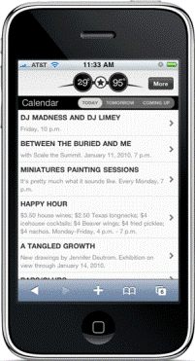
你拥有电话.不是电话拥有你.
You own the phone. It doesn’t own you.

Slide 27
会议
会议多不意味着成功多.
* More meetings does not mean more success.
定好开始和结束的时间. 这样便强迫你紧扣主题而不花时间在一些不重要的细节上.
* Set a start and ending time. End on time. It will force you to stay on topic and not spend time on insignificant details that one person can decide.
信任你授权的人. 让他们按自己的方式做分内之事。
* Trust the people you delegate to. Let them do their part their way.
如果你有很多会议, 尽量把它们安排在一起开, 这样便强迫你按时开完, 紧扣主题并且有更大块的工作时间。
* If you must have many meetings, put them closer together. This forces you to finish on time, stay on topic and have bigger work times.
MEETINGS

Slide 28
将会议安排在一起可以给你更多工作时间
8 | 会议 (meeting)
9 | 工作(work)
10 | 会议(meeting)
11 | 工作(work)
12 | 会议(meeting)
1 | 工作(work)
2 | 工作(work)
3 | 会议(meeting)
8 | 会议 (meeting)
9 | 会议(meeting)
10 | 会议(meeting)
11 | 会议(meeting)
12 | 工作(work)
1 | 工作(work)
2 | 工作(work)
3 | 工作(work)
Put meetings back to back to allow bigger work times

Slide 29
准时开始和结束会议
推迟开始或迟到给其他人带来不便.
* Starting or coming late inconveniences others
要做一个说话算话,值得信任的人. 这不是一个文化问题, 而是一个诚信问题.
* Be a person that can be trusted to do what you say when you say.
It is not a cultural issue, it is an honesty issue.
聚会迟到会打扰他人敬拜, 同时也是对带领人所付出劳动的不尊重.
* Coming into church late distracts others in their worship and shows a lack of respect for the work that the leaders invested.
影响下一组人使用场地.
* The next group must wait for you to leave.
START & FINISH MEETINGS ON TIME!!

Slide 30

家庭时间
你将对你在家庭上的影响力向神交账。
* You will be held accountable for your influence on your family
花在孩子身上的时间质量和数量都很必要.
* Both quality time AND quantity time are necessary for kids
你的配偶比你的老板和朋友更重要。
* Your spouse is more important than your boss or friends
FAMILY TIME

Slide 31
目的
你在世上的目的便是凡事按照神话语指示的方式去侍奉祂。
  YOUR PURPOSE ON EARTH IS TO SERVE GODWITH EVERYTHING HE HAS GIVEN YOUIN THE WAY HE DICTATES IN HIS WORD.
PURPOSE

Slide 32
目的
太6:33 “你们要先求他的国和他的义。 这些东西都要加给你们了。”
  Matthew 6:33 “But seek first his kingdom and his righteousness, and all these things will be given to you as well.”
林前10:31 “所以你们或吃或喝， 无论作什么，都要荣耀神而行。”
  1 Corinthians 10:31 “So, whether you eat or drink, or whatever you do, do all to the glory of God.”
箴19:21 “人心多有计谋， 惟有耶和华的筹算，才能立定。”
  Proverbs 19:21 “Many are the plans in the mind of a man, but it is the purpose of the Lord that will stand.”
PURPOSE

Slide 33

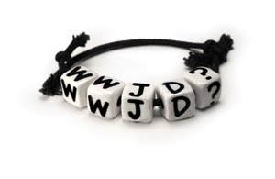
耶稣会首先要我做什么？
What would Jesus have me do 1st?

Slide 34

今天的决定能否体现敬虔的优先顺序？
Did today’s decisions reflect godly priorities?

Slide 35
智慧地使用你的时间
USE YOUR TIME WISELY

