Slide 1
爱是什么？

Slide 2
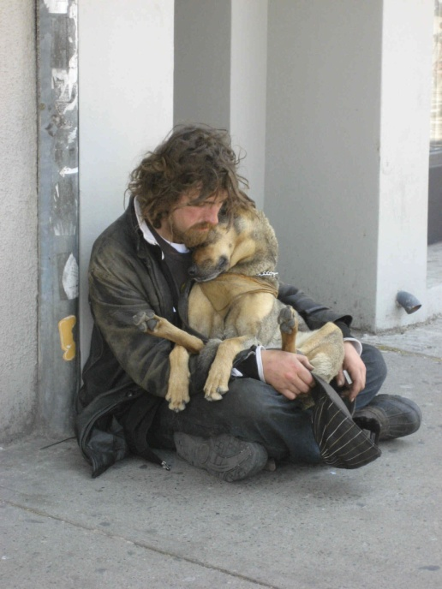
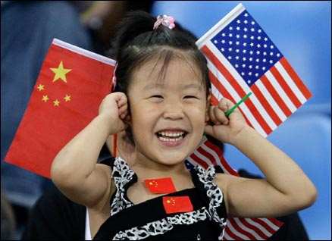
爱是什么？
What is love?

Slide 3
圣经给出了三种爱
性之爱
Eros
友之爱
Phileo
神之爱
Agape
The Bible shows 3 Types of Love

Slide 4
圣经命令我们爱
The Bible Commands Us to Love

Slide 5
圣经命令我们爱
“你们要彼此相爱，像我爱你们一样；这就是我的命令”
约15:12
“My command is this:
Love each other
as I have loved you.
–John 15:12
The Bible Commands Us to Love

Slide 6
圣经告诉我们爱谁
The Bible Tells Us Who to Love

Slide 7
我们要爱家人
We are to Love our Families

Slide 8
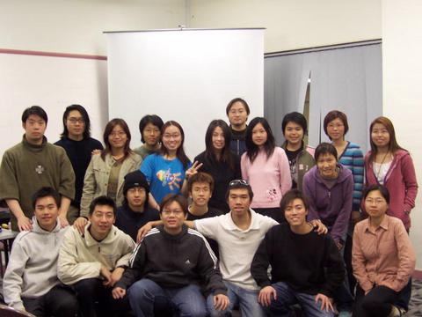
我们要爱其他基督徒
We are to LOVE other Christians

Slide 9
我们要爱其他基督徒
“不是我们爱神，乃是神爱我们，差他的儿子为我们的罪作了挽回祭，这就是爱了。亲爱的弟兄阿，神既是这样爱我们，我们也当彼此相爱”
约一4:10-11
This is love:
not that we loved God, but that He loved us and sent His Son as an atoning sacrifice for our sins. Dear friends,
since God so loved us,
we also ought to
love one another.
– 1 John 4:10-11
We are to LOVE other Christians

Slide 10
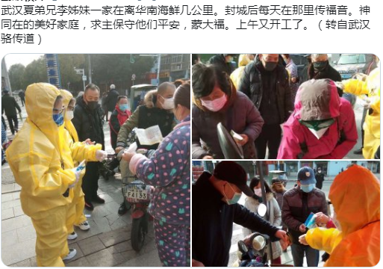
我们要爱邻人
We are to LOVE our Neighbors

Slide 11
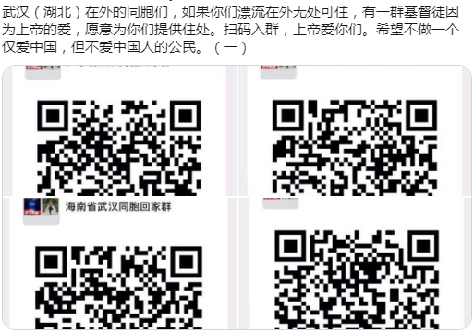
我们要爱邻人
“…要爱人如己。 我是耶和华。”
—利未记19:18
We are to LOVE our Neighbors

Slide 12
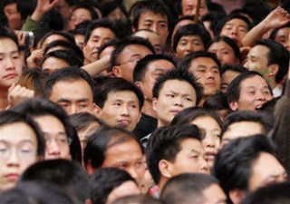
我们要爱失丧的人
We are to LOVE the Lost

Slide 13
我们要爱失丧的人
“我已将你的名指示他们，还要指示他们，使你所爱我的爱在他们里面， 我也在他们里面”
—约17:26
“I have made you
known to them,
and will continue
to make you known
in order that the love
you have for me
may be in them
and that I myself
may be in them.“
-John 17:26
We are to LOVE the Lost

Slide 14
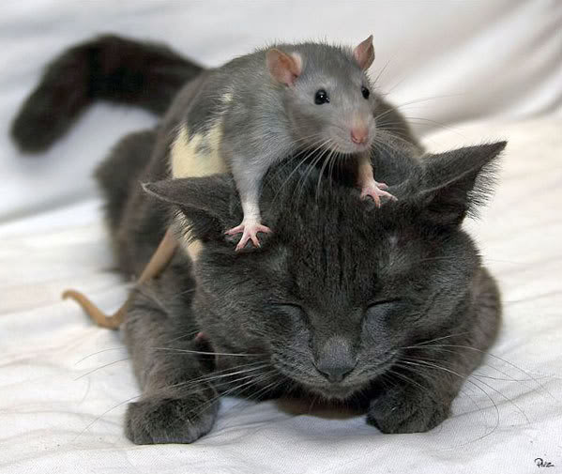
我们要爱仇敌
We are to LOVE our Enemies

Slide 15
我们要爱仇敌
“只是我告诉你们， 要爱你们的仇敌， 为那逼迫你们的祷告。这样就可以作你们天父的儿子..你们若单爱那爱你们的人， 有什么赏赐呢﹖” 太5:43-48
“But I say,
love your enemies!
Pray for those who persecute you!
In that way, you will be acting as true children of your Father in heaven…
If you love only
those who love you,
what good is that?”
-Matthew 5:43-48
We are to LOVE our Enemies

Slide 16
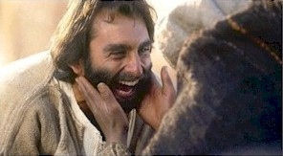
最重要…爱神！
Most Importantly… LOVE GOD!

Slide 17
最重要…爱神！
“耶稣对他说： 你要尽心、尽性、尽意爱主─你的神。这是诫命中的第一，且是最大的。” -太22:37-38
Jesus replied:
" 'Love the Lord your God with all your heart and with all your soul and with all your mind.' This is the first and greatest commandment.
–Matthew 22:37-38
Most Importantly… LOVE GOD!

Slide 18
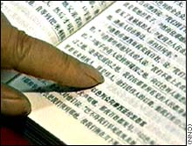
圣经告诉我们何为爱 林前13
The Bible tells us what love is
(1 Co 13:4-7)

Slide 19
爱是恒久忍耐
Love is PATIENT

Slide 20
爱是恩慈
Love is KIND

Slide 21
爱是不嫉妒
Love Does Not ENVY

Slide 22
爱是不自夸
Love Does NOT BOAST

Slide 23
爱是不骄傲
Love is NOT PROUD

Slide 24
爱是不粗鲁
Love is NOT RUDE

Slide 25
爱是不求自己的益处
Love is NOT SELF-SEEKING

Slide 26
爱是不轻易发怒
Love is NOT EASILY ANGERED

Slide 27
爱是不计算人的恶
Love Keeps NO RECORD of Wrongs

Slide 28
爱是不喜欢不义
Love DOES NOT DELIGHT in EVIL

Slide 29
爱是喜欢真理
Love REJOICES in TRUTH

Slide 30
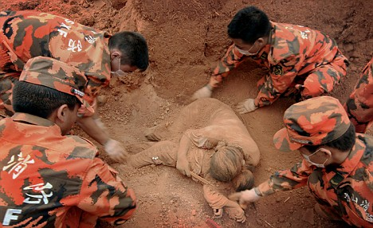
爱总是保护
Love Always PROTECTS

Slide 31
爱总是相信
Love Always TRUSTS

Slide 32
爱总是盼望
Love Always HOPES

Slide 33
爱总是坚忍
Love Always PERSEVERES

Slide 34
爱永不止息
LOVE NEVER FAILS

Slide 35
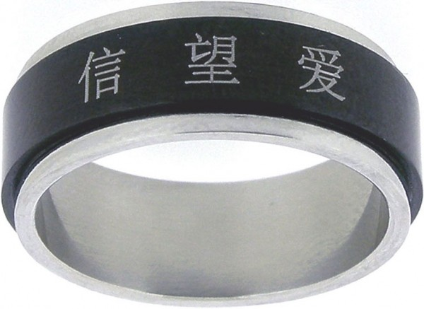
爱比”信”和”望”都大
Love is Greater than FAITH & HOPE

Slide 36
圣经为我们提供了爱的榜样
The BIBLE Goves us Examples of Love

Slide 37
耶稣爱你！
JESUS LOVES YOU

Slide 38
耶稣爱你！
神爱世人，甚至将他的独生子赐给他们，叫一切信他的，不至灭亡， 反得永生。
—约3:16
For God so loved the world that He gave His one and only Son, that whoever believes in Him shall not perish but have eternal life. - John 3:16
JESUS LOVES YOU

Slide 39
耶稣爱你！
爱我的，
我也爱他；
恳切寻求我的，
必寻得见。
—箴:8:17
I love those
who love me,
and those who seek
me find me.
- Proverbs 8:17
JESUS LOVES YOU

Slide 40
耶稣爱你！
神差他独生子到世间来，使我们借着他得生，神爱我们的心在此就显明了。
——约一4:9
This is how God showed
His love among us:
He sent His one and only Son into the world that we might live through him.
– 1 John 4:9
JESUS LOVES YOU

Slide 41
耶稣爱你！
“惟有基督在我们还作罪人的时候为我们死，神的爱就在此向我们显了”
— 罗5:8
“This is how God showed
His love toward us,
while we were
still sinners,
Christ died for us.“
- Romans 5:8,
JESUS LOVES YOU

Slide 42
耶稣爱你！
“人为朋友舍命， 人的爱心没有比这个大的。”
—约15:13
“Greater love has
no one than this,
that he lay down his life
for his friends.”
–John 15:13
JESUS LOVES YOU

Slide 43
圣经里充满爱之故事
The Bible is Filled with LOVE STORIES

Slide 44
爱不是一种感觉…
Love is NOT a FEELING

Slide 45
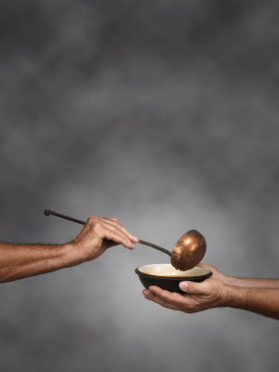
爱是一种行动
LOVE is an ACTION

Slide 46
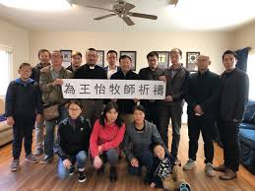
爱是一种行动
“小子们哪，我们相爱，不要只在言语和舌头上，总要在行为和诚实上。”
—约一3:18
LOVE is an ACTION

Slide 47
问题是…
The QUESTION is…

Slide 48
如何向神表达爱？
HOW can You ShowLove to God

Slide 49
如何向家人表达爱？
HOW can you show LOVE to your FAMILY?

Slide 50
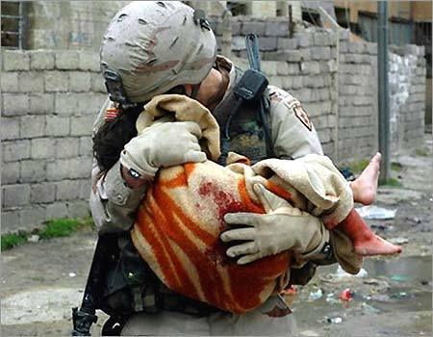
如何向敌人表达爱？
How can you show love to your ENEMIES?

Slide 51
如何向失丧者表达爱？
How can you show love to the LOST?

Slide 52
爱是什么？
“我们若照他的命令行，这就是爱。 你们从起初所听见当行的， 就是这命令。”
—约二1:6
“And this is love:
that we walk in obedience to His commands.
As you have heard
from the beginning,
His command
is that you walk in love.
-2 John 1:6
WHAT IS LOVE?

Slide 53
finis

