Slide 1
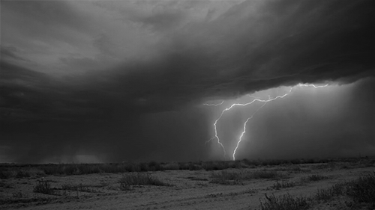
祷告
Today: PRAYER

Slide 2
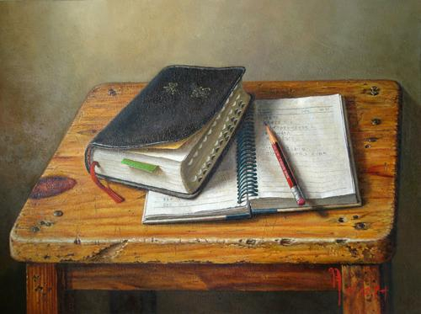
圣经强化培训课程
INTENSIVE BIBLE TRAINING PROGRAM

Slide 3
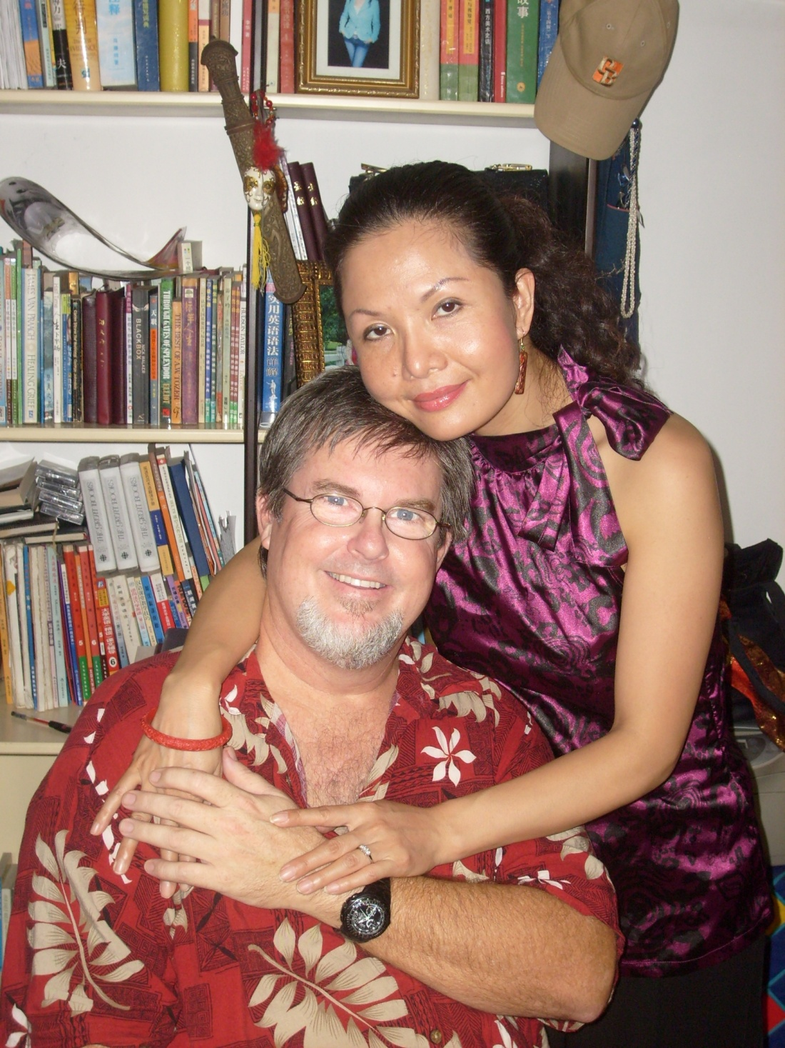
Dr. Jay Barleon
&
SURAN

Slide 4
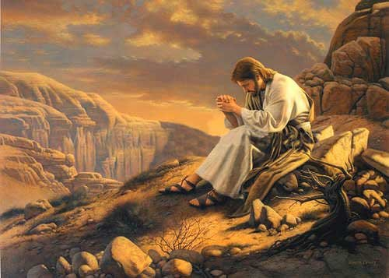
主 祷文 THE LORD’S PRAYER
有关 祷告 THOUGHTS ON PRAYER
祷告时间 PRAYER TIME
第一课
第二课

Slide 5
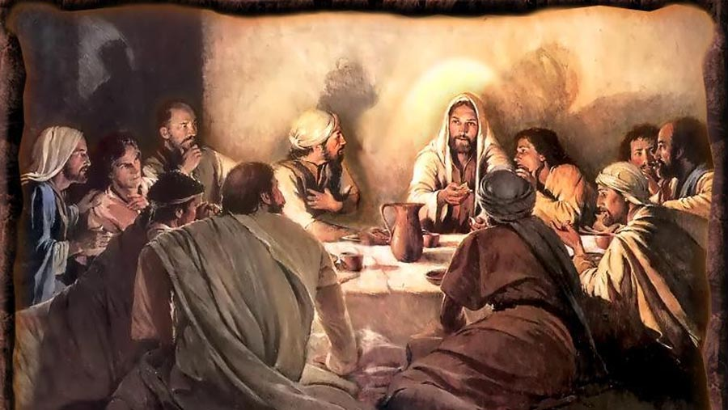
主祷文
The Lord’s Prayer

Slide 6
马太福音6:9-13
“所以你们祷告,要这样说: ‘我们在天上的父，愿人都尊你的名为圣。愿你的国降临，愿你的旨意行在地上，如同行在天上。我们日用的饮食，今日赐给我们。免我们的债，如同我们免了人的债。不叫我们遇见试探，救我们脱离凶恶。因为国度，权柄，荣耀，全是你的，直到永远，阿们。 ’
“After this manner therefore pray ye: Our Father which art in heaven, Hallowed be Thy Name. Thy kingdom come, Thy will be done in earth, as it is in heaven. Give us this day our daily bread. And forgive us our debts, as we forgive our debtors. And lead us not into temptation, but deliver us from evil: For Thine is the kingdom, and the power, and the glory, for ever. Amen. “
Matthew 6:9-13

Slide 7
路加福音11:1-4
耶稣在一个地方祷告。祷告完了,有个门徒对他说，求主教导我们祷告，像约翰教导他的门徒。耶稣说，你们祷告的时候，要说: ‘我们在天上的父，愿人都尊你的名为圣。愿你的国降临。愿你的旨意行在地上，如同行在天上。我们日用的饮食，天天赐给我们。赦免我们的罪，因为我们也赦免凡亏欠我们的人。不叫我们遇见试探。救我们脱离凶恶。’
“And it came to pass, that, as he was praying in a certain place, when he ceased, one of his disciples said unto him, Lord, teach us to pray, as John also taught his disciples. And he said unto them, When ye pray, say, Our Father which art in heaven, Hallowed be thy name. Thy kingdom come. Thy will be done, as in heaven, so in earth. Give us day by day our daily bread. And forgive us our sins; for we also forgive every one that is indebted to us. And lead us not into temptation; but deliver us from evil. “
Luke 11:1-4

Slide 8
你有无留意到…
最后一行并不在古卷里(取自历上29:11)
The last line is not in older manuscripts (Taken from 1 Chron. 29:11)
三一神: 耶稣, 被圣灵充满, 向父神祷告。
The Trinity: Jesus, filled with the Spirit, prays to the Father
祷告并非不断重复就有果效。
The prayer is not to be repeated for effectiveness
祷告也包括他人: 我们, 我们的…并非我, 我的。
Prayer includes others: We, Our, and Us… not Me, My, and I
Did you notice…

Slide 9
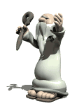
祷告不是什么？
祷告不是试图让神按你的意志行, 乃是你按祂的旨意行。
Prayer is not trying to get God to do your will, but you to do His.
祷告不是义务而是与神交谈的特权。
Prayer is not a duty but it is a privilege to speak to God.
祷告不是获得你所要的东西的魔方。
Prayer is not a magic formula for getting whatever you want.
祷告不能以长度和口才来判断。
Prayer is not judged by length or eloquence.
祷告并非一日就学会。
Prayer is not learned in a day
What Prayer is NOT

Slide 10
如何做到不这么祷告？
太6:5-8: “你们祷告的时候，不可像那假冒为善的人，爱站在会堂里，和十字路口上祷告，故意叫人看见。我实在告诉你们，他们已经得了他们的赏赐。你祷告的时候，要进你的内屋，关上门，祷告你在暗中的父，你父在暗中察看，必然报答你。你们祷告，不可像外邦人，用许多重复话。他们以为话多了必蒙垂听。”
Matthew 6:5-8 “ “And when you pray, do not be like the hypocrites, for they love to pray standing in the synagogues and on the street corners to be seen by others. Truly I tell you, they have received their reward in full. But when you pray, go into your room, close the door and pray to your Father, who is unseen. Then your Father, who sees what is done in secret, will reward you. And when you pray, do not keep on babbling like pagans, for they think they will be heard because of their many words. Do not be like them, for your Father knows what you need before you ask him.”
How NOT to Pray

Slide 11
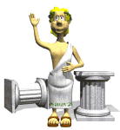
如何做到不这么祷告？
不要效仿宗教人士,而是孩子跟慈父交谈。
Do not imitate religious people, but kids with a good dad
不要将注意力引向你自己。
Do not draw attention to yourself
不要使用重复的祷告。
Do not use repetitious prayers
不要以时间来衡量你的祷告。
Do not measure your prayer by time
不要以为你是在通知神祂不知道的事。
Don’t think you are informing God of something He doesn’t know
不要与撒旦的儿女一起祷告（不同的父）。
Don’t pray with children of Satan (Different father)
How NOT to Pray

Slide 12
祷告是什么？
祷告是与神对话(说和听).
祷告是受造之灵对灵魂创造者的回应。
Prayer is CONVERSATION WITH GOD (TALK & LISTEN)
祷告是以圣灵的能力, 借着耶稣, 达到父神.
Prayer is TO THE FATHER, THROUGH THE SON, BY THE SPIRIT’S POWER
祷告是神给祂儿女的恩赐。
Prayer is GOD’S GIFT TO HIS CHILDREN
祷告是神对每个基督徒的旨意(帖前5:17)。
Prayer is GOD’S WILL FOR EVERY CHRISTIAN (1 Thess. 5:17)
祷告是神对回应的选择(好, 不好, 迟点)。
祷告是天堂的钥匙
What Prayer IS

Slide 13
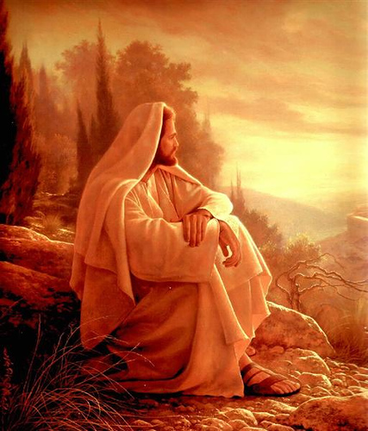
祷告的焦点在神,而非我们
神，那父
God the Father
神，那圣者
God the Holy One
神，那王者
God the King
神 ，那全权者
God the Sovereign
神，那供应者
God the Provider
神，那赦罪者
God the Forgiver
神，那拯救者
God the Deliverer
Prayer focuses on God, not us.

Slide 14
神，那父
神和撒旦都被称为父。神是基督徒的父。
God and Satan are both called Fathers. God is the Father of Christians.
旧约中, 神被称为父，只针对以色列民（18次）
In the O.T., God is called Father ONLY as the Father of the nation Israel (18x)
当耶稣说要向 “父”祷告, 这是革命性的. 他因为称神为他的父而被杀。
When Jesus said to pray to God as ‘Father’, it was revolutionary. He was killed because He called God His Father.
许多人对父神有错误的观念，这是因为他们的父亲很不敬虔. 你的儿女将透过你为父的行为看神。你作为父亲代表神。
Many have wrong ideas of God as Father because their father was ungodly.
Your children will see God through your actions as father. You represent God as Father.
God the FATHER (Our Father in Heaven)

Slide 15
神,那父 (续)
5. 孩子若感到安全和被爱，便会自然带着需要，愿望, 帮助和感谢来到爸爸跟前。
Children naturally go to a daddy for needs, desires, help, thanks, if they feel safe & loved
6. 孩子喜欢花时间与一个慈爱的父亲相处。
Children like to spend time with their dad if he is loving.
7. 神永远有时间给祂的孩子。
God is always available to His children
8. 神不是一股毫无感情的力, 一个愤怒的老板或一个不相干的陌生人. 他乃是慈爱的爸爸。
God is not an impersonal force, angry boss or uncaring stranger. He is a loving daddy
God the FATHER (cont)

Slide 16
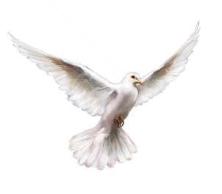
神,那圣者
神被称为“圣洁”超过任何其他属性。
God is called HOLY more than any other attribute
神的名(祂所是)都被看为圣洁。
God’s Name (ALL HE IS) is to be regarded as holy
当我们向祂陈述祂的属性时, 神接受敬拜。
God accepts worship as we mention His attributes to Him
圣洁是神众多属性中唯一三 次连续重复的。
Holiness is God’s only attribute that is said 3 times in a row
God the HOLY ONE (Hallowed be Thy Name)

Slide 17
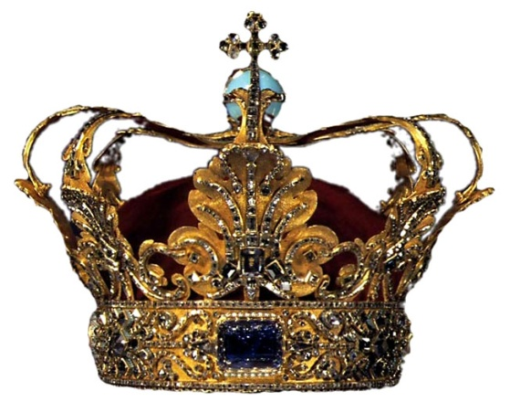
神,那王者
每个王国都有一个国王掌权。
Every Kingdom has a King who is in charge
地上有两个王国在争战。
2 Kingdoms are at war on earth
神的国最终将取胜并统治全地。
God’s Kingdom will win and eventually rule on earth
神将做我们的王直到永远。
God will be our King throughout eternity
God the KING (Thy Kingdom Come)

Slide 18
神,那全权者
神的旨意将成就在地上如同在成就天上.在天上, 神一说话,天使便遵行. 这就是我们的目标。
God’s will be done on earth as it is in heaven. In heaven, God speaks, angels obey. This is our goal.
异教的祷告都是寻求自己的意志; 属神的祷告寻求的是神的旨意。
Pagan prayer seeks its own will; godly prayer seeks God’s will now.
举例:耶稣在客西马尼园的祷告 便将父的旨意置放于他的意志之上。
i.e. Jesus in Gethsemane prayed God’s will above his own
既然你无意遵行神的旨意，何必祷告呢？
Why pray if you have no intention of doing God’s will?
God the SOVEREIGN (Thy will be done)

Slide 19
神,那供应者
今日…今日的饮食（物质, 智慧,能力, 忍耐,情感）
THIS DAY… DAILY BREAD (physical needs)
若你已有足够的饮食，感谢祂吧。
Thank Him if you have enough already.
允许神按祂的意思回应 (好, 不好, 迟点)。
Allow God to answer as He wants (Yes, No, Later)
有时候没有得到是因为我们不求。
Sometimes we have not because we ask not.
为他人的需求祷告. 记住, 祷告是团体的(我们，我们的)。
Pray for other’s needs. Remember, prayer is corporate (We, us, our)
God the PROVIDER (Give us this day)

Slide 20
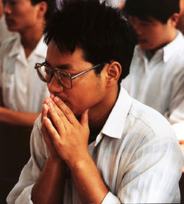
神, 那赦罪者
认罪并悔改. 神已经知道这些罪了.
Confess & Repent of sins. God knows them already.
“罪”这个词此处的意思是 “欠神的债”.
The word ‘sin’ here means a ‘debt owed to God’
过犯之罪(不该做的做了) 和疏忽之罪 (该做的没做)
Sins of Commission (bad things we do) and Omission (good things we don’t do)
债务必须有人偿还…耶稣已经偿还我们的债
Debts MUST be paid for by someone…JESUS PAID OUR DEBT
对于所犯之罪，认罪时要具体.
Be specific regarding sins you have committed
God the FORGIVER (Forgive us our debts)

Slide 21
神,那赦罪者(续)
6. 我们若不赦免他人, 神亦不赦免我们。
If we won’t forgive others, God won’t forgive us.
7. 赦免他人不意味着忘记, 和解, 或情感否认。
Forgiving others does not mean forgetting, reconciling, or emotional denial.
8. 即使罪已得赦免也要承受后果。
Even forgiven sin can have to suffer consequences.
God the FORGIVER (cont.)

Slide 22
神, 那拯救者
叫我们不要遇见试探; 救我们脱离恶者.
Leads us not into temptation; deliver us from evil (Lit: THE EVIL ONE)
这个世界充满罪恶, 鬼魔和试探你的人.
This world is filled with evil, demons and people who tempt you.
神不试探任何人犯罪. 神拯救我们出魔鬼的试探.
God does not tempt anyone to sin. God delivers us from demonic temptation.
太多人只在犯罪后求饶恕而非犯罪之前祷告.
Too many pray ONLY for forgiveness AFTER they sin and not BEFORE they sin.
也为其他人的解救而祷告.
Pray for deliverance for others also.
God the DELIVERER (Deliver us from evil)

Slide 23
有哪些东西拦阻祷告
我们的罪
Our sins.
我们心里对他人的不饶恕
Our unforgiving heart towards others .
我们的忙碌
Our busyness
我们对神的失望.
Our disappointment in God.
心怀二意和疑惑
Doubt like a wave of the sea.
丈夫不善待妻子
（彼前3:7）
The things hinder our Prayers

Slide 24
祷告吧！
只有在失去正直时，正直人才会停止祈祷。
—— 克里梭顿(Chrysostom)
爱少的人祈祷就少，爱多的人祈祷必多。
——奥古斯丁(Augustine)
祷告是一个公义生命
第一件也是最后一件要做之事。
——理查．虎克(R.Hooker)
若你不是祈祷的人，你必不是一位基督徒。
——约翰班扬(John Bunyan)
祈祷是“新造人的呼吸”——巴斯特(R.Baxter)
祈祷是“灵魂的血液”——乔治．贺伯特(G.Herbert)
The things hinder our Prayer

